Slide 1


Slide 2
Today’s Mission
By the end of this class, you will be able to:
open a dataset in Kaggle
understand rows and columns
use simple Python commands
calculate averages
filter and sort data
create a chart
explain your findings in English
The objective is not only to write code. The objective is to explain what the code does in English.

Slide 3
Warm-Up Question
What Can Data Tell Us?
Discuss with a partner:
What information can we find in exam results?
Why do schools collect student data?
Can data help students improve?
Speaking sentence starters:
Data can show…
Exam results can help us understand…
Schools collect data because…
Student task: Students discuss in pairs for 3 minutes.

Slide 4
Key Vocabulary: Data
data
information
dataset
A collection of data
table
data organised in rows and columns
row
One record
column
one category
score
Exam result
Typical value
average
finding
Something we discover
These words are very important. You will use them in your spoken report at the end.

Slide 5
What Is Python?
Python is a programming language.
It is used for:
data science
artificial intelligence
websites
automation
cybersecurity
scientific research
Speaking practice: Complete the sentence:
Python is used for ___.
Python is one of the most important languages in data science and AI.

Slide 6
What Is Kaggle?
Kaggle is an online platform for:
datasets
notebooks
Python practice
data science projects
machine learning competitions
Class instruction: Open Kaggle and create/open a notebook.
Today Kaggle is our online coding laboratory. We do not need to install Python.

Slide 7
Dataset: Students Performance in Exams
We will analyse student exam results.
The dataset includes:
student background information
test preparation information
maths score
reading score
writing score
Speaking practice: Complete:
This dataset contains information about ___.

Slide 8
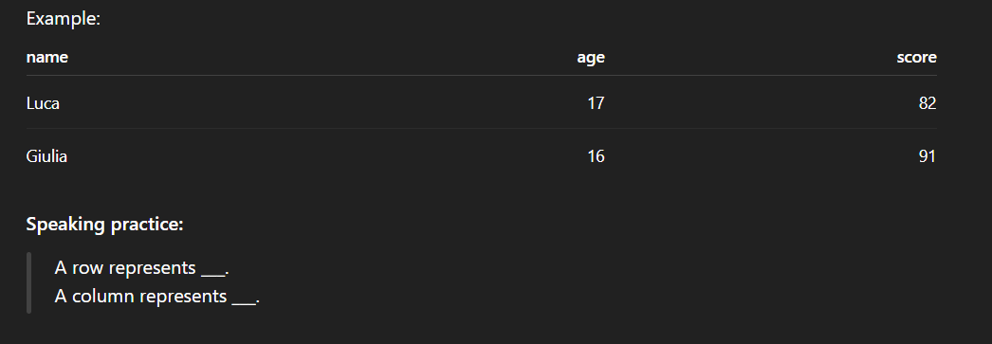
Data Tables: Rows and Columns
A dataset table has:
rows = individual records
columns = types of information

Slide 9

First Command: Import pandas
Meaning: This command loads the pandas library.
English explanation: Pandas helps us work with data tables.
Student task: Type and run the command in Kaggle.
Speaking practice: Complete:
This dataset contains information about ___.

Slide 10

Load the Dataset
Meaning: This command reads the CSV file and stores it in a variable called df.
Vocabulary:
read
CSV file (Comma-Separated values)
store
variable
dataframe
A DataFrame is like a table in Python.

Slide 11

Show the First Rows
Meaning: This shows the first five rows of the dataset.
Speaking practice:
The command head() shows ___.
Student task: Run the command and look at the table.

Slide 12
Look at the Dataset
Answer with a partner:
How many score columns can you see?
What subjects are included?
What information is not about exam scores?
Useful phrases:
I can see…
The dataset includes…
One column is called…
Student task: Students speak in pairs for 4 minutes.

Slide 13

Command 4: Show the Columns
Meaning: This command shows all column names.
Speaking practice:
The dataset has columns such as ___, ___ and ___.
Student task: Run the command and read the column names aloud.

Slide 14

Dataset Size
Meaning: This command shows the number of rows and columns.
English structure:
The dataset has ___ rows and ___ columns.
Student task: Run the command and complete the sentence.

Slide 15
Understanding the Columns
gender
student gender
parental level of education
parents’ education level
lunch
lunch category
test preparation course
completed or none
math score
maths exam result
reading score
reading exam result
writing exam result
writing score
Some columns are categories. Some columns are numerical scores.

Slide 16
Numerical vs Categorical Data
Numerical data: numbers Examples:
math score
reading score
writing score
Categorical data: groups or labels Examples:
gender
lunch
test preparation course
Speaking practice:
Math score is numerical data. Test preparation course is categorical data.

Slide 17

Command 6: Describe the Data. Stats
Meaning:
This gives a statistical summary of the numerical columns.
Vocabulary:
count
mean
standard deviation
minimum
maximum
What you say: Do not worry about understanding everything. Focus on mean, min and max.

Slide 18
Speaking About Statistics
Use these sentences:
The average maths score is ___. The minimum reading score is ___. The maximum writing score is ___. The average means ___.
Student task: Students complete the sentences using their Kaggle output.

Slide 19

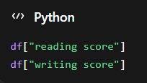
Command 7: Select a Column
Meaning: This selects only the maths score column
Speaking practice:
This command selects the ___ column.

Slide 20
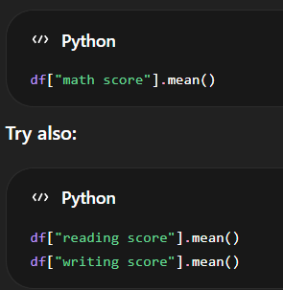
Command 8: Calculate the Average
Meaning: The mean() function calculates the average.
Speaking practice:
The average ___ score is ___.

Slide 21

Command 9: Compare Subject Averages
Meaning: This calculates the average for the three subjects.
Speaking practice:
The highest average score is in ___. The lowest average score is in ___.

Slide 22

Command 10: Create a Chart
Meaning: This creates a bar chart comparing the average scores.
Vocabulary:
chart
bar chart
compare
higher
lower
Speaking practice:
The chart shows ___. The highest bar is ___.

Slide 23

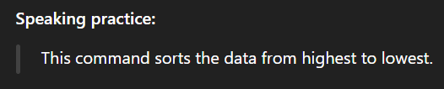
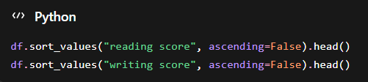
Command 11: Sort Scores
Meaning: This shows the top five maths scores.

Slide 24
Explain the Top Scores
Complete:
The top maths score is ___. The top reading score is ___. The top writing score is ___. Sorting helps us find ___.
Student task: Students compare answers with a partner.

Slide 25

Command 12: Filter High Scores
Meaning: This shows only students with a maths score of 80 or more.
Vocabulary:
filter
condition
greater than
equal to
at least
Speaking practice:
This filter shows students with ___.

Slide 26
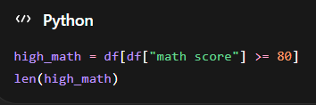
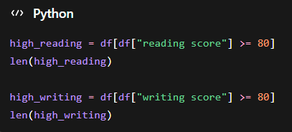
Command 13: Count High Scores
Meaning: This counts how many students scored 80 or more in maths.
Speaking practice:
There are ___ students with high maths scores.

Slide 27
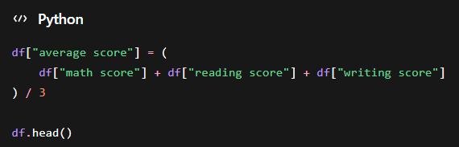
Command 14: Create Average Score
Meaning: This creates a new column with each student’s average score.
Speaking practice:
We created a new column called ___.

Slide 28
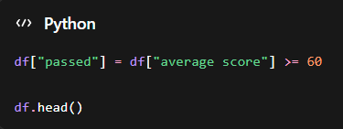
Command 15: Create Pass/Fail Result
Meaning: This creates a True or False result.
English explanation:
True means the student passed. False means the student did not pass.
Speaking practice:
A student passes if the average score is ___ or more.

Slide 29

Command 16: Group by Test Preparation
Meaning: This compares average scores for students who completed or did not complete the preparation course.
Vocabulary:
group
category
completed
none
compare

Slide 30
Does Preparation Help?
Discuss:
Do students who completed preparation have higher scores?
In which subject is the difference biggest?
Is the result surprising?
Useful phrases:
Students who completed preparation…
The difference is bigger in…
I think this is surprising because…
Student task: Pair discussion, then 2–3 students share answers.

Slide 31
Data Detective Mission
Work in pairs. Answer these questions using Python:
What is the average maths score?
What is the average reading score?
What is the average writing score?
Which subject has the highest average?
How many students scored 80 or more in maths?
Did test preparation help?
Create one chart.
Output: Write your answers in English.

Slide 32
How to Present a Finding
Use these sentence frames:
We found that ___. The data shows that ___. The average score is ___. The highest average is in ___. Our chart shows ___. This is interesting because ___.
Student task: Students prepare 3 findings.

Slide 33
Final Spoken Report
Hello, we are Group ___. We analysed the Students Performance dataset. The average maths score is ___. The average reading score is ___. The average writing score is ___. Our most interesting finding is ___. Our chart shows ___. Thank you for listening.
Student task: Prepare a 1–2 minute group report.

Slide 34
Present Your Findings
When another group presents, listen for:
one average
one comparison
one chart explanation
one interesting finding
Audience sentence:
I liked your finding about ___.
The audience must listen actively and give one positive comment.

Slide 35
What Did You Learn Today?
Complete three sentences:
Today I learned how to ___.
One new English word I learned is ___.
One Python command I can explain is ___.
Speaking task: Students share with a partner.

Slide 36
Exit Ticket
Before leaving, answer:
What does df.head() do?
What does mean() calculate?
What does filtering do?
Say one sentence about the dataset in English.
Final sentence: You are now a Student Data Detective.
This exit ticket checks both technical understanding and English speaking.

