Slide 2
The Internet of Things (IoT)
How Smart Devices Are Changing the World
Subtitle: From Smart Fridges to Self-Driving Cars
Teacher notes: Ask:
“How many smart devices do you think you used before coming to class today?”

Slide 3
What Smart Devices Do You Use?
Examples:
Smartphone
Smartwatch
Smart TV
Alexa / Google Home
Smart lights
AirPods
Gaming console
Activity:
Raise your hand if you use:
Bluetooth headphones
Smartwatch
Voice assistant
Online gaming

Slide 4
What Does IoT Mean?
IoT = Internet of Things
Simple Definition:
Devices connected to the internet that can:
collect data
communicate
make decisions
help humans

Slide 5
IoT = Thing + Computer + Internet
Example:
Smart Fridge
Part | Example
Thing | Refrigerator
Computer | Sensors + processor
Internet | Wi-Fi

Slide 6
IoT Devices Around You
Examples:
Smart TVs
Smartwatches
Ring Doorbells
Smart speakers
Smart cars
Fitness trackers
Speaking:
“Which IoT device do you think is most useful?”

Slide 7
Smart Refrigerator Example
Normal Fridge vs Smart Fridge
Normal Fridge | Smart Fridge
Keeps food cold | Detects food
No internet | Connected online
No sensors | Cameras & sensors
Manual shopping | Can suggest shopping

Slide 8
Would You Want a Smart Fridge?
Possible Features:
Orders milk automatically
Suggests recipes
Warns about expired food
Tracks calories
Discussion:
“Would this help your family or become annoying?”

Slide 9
Cars Are IoT Devices
Modern cars have:
GPS
Sensors
Cameras
Bluetooth
Internet
AI systems
Example:
Tesla autopilot

Slide 10
Why Cars Became Smarter
Computers Inside Cars
Modern cars use processors for:
braking
parking
navigation
fuel efficiency
safety systems
Key idea:
The car still looks simple to drive.

Slide 11
IoT in Healthcare
Smart Health Devices
Examples:
Smartwatch heart tracking
Pacemakers
Insulin pumps
Fitness trackers
Discussion:
“Would you trust a device to monitor your health?”

Slide 12
IoT at Home : Smart Homes
Examples:
Smart lights
Smart locks
Smart thermostats
Smart cameras
Example:
Turn your lights on using your phone.

Slide 13
IoT in Schools
Examples:
Attendance systems
RFID cards
Smart projectors
Security cameras
Motion sensors

Slide 14
IoT and Gaming
Gaming Uses IoT Too
Examples:
Online multiplayer
VR headsets
Cloud gaming
Motion controllers
Ask:
“What gaming technology do you think will exist in 10 years?”

Slide 15
What Is Embedded Computing?
Tiny Computers Inside Devices
Examples:
Microwave
Washing machine
Car
Drone
Smart speaker
Key idea:
Most devices today secretly contain computers.

Slide 16
Main IoT Components
Inside an IoT Device
Core Parts:
Sensors
Processor
Memory
Power supply
Internet connection

Slide 17
Sensors = Device Senses
Examples:
Sensor | Detects
Temperature | Heat
Camera | Images
GPS | Location
Motion sensor | Movement

Slide 18
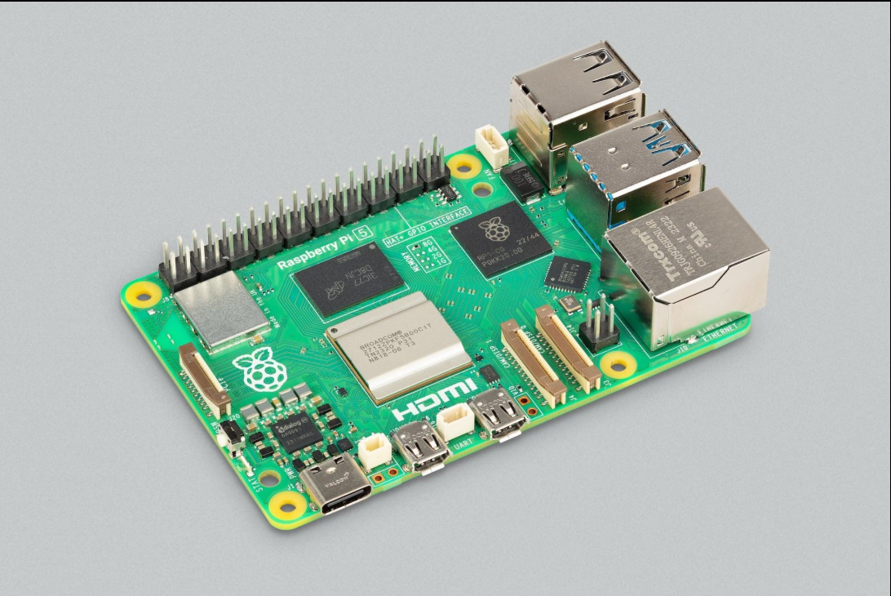
Raspberry Pi
Raspberry Pi
Tiny Computer for IoT
Uses:
Robots
Smart mirrors
Servers
Cameras
AI projects

Slide 19
Arduino
Tiny Controller for Hardware
Great for:
LEDs
Sensors
Robots
Electronics
Difference:
Raspberry Pi | Arduino
Full computer | Simple controller
Runs Linux | Runs one program

Slide 20
Raspberry Pi vs Arduino
Which One Would You Choose?
Activity:
Choose the best tool for:
Traffic light
Robot
Smart mirror
Weather station

Slide 21
Why IoT Became Popular
Technology Trends
IoT became possible because:
computers became cheaper
internet became faster
Wi-Fi became common
devices became smaller

Slide 22
ENIAC vs Modern Devices
Computers Became Tiny
ENIAC (1945) | Modern Laptop
27 tons | 1–2 kg
Huge room | Backpack
Very expensive | Affordable

Slide 23
Cloud Computing
IoT + Cloud
Example:
Siri / Alexa
Your device:
records your voice
Cloud:
processes the answer

Slide 24
How IoT Connects
Networking Basics
Devices use:
Wi-Fi
Bluetooth
Ethernet
4G / 5G

Slide 25
What Is a Network Protocol?
Devices Need Rules
Protocol = communication rules
Examples:
HTTP
HTTPS
Bluetooth
TCP/IP

Slide 26
IoT Security Risks
Problems With IoT
Risks:
hacking
spying
stolen passwords
cameras being accessed
tracking your location

Slide 27
Privacy Discussion
Are Smart Devices Always Listening?
Discussion:
Alexa
Siri
TikTok
Smart TVs
Ask:
“How much privacy are people willing to trade for convenience?”

Slide 28
Social Effects of IoT
IoT Changes Society
Benefits:
easier life
automation
healthcare help
Risks:
less human interaction
screen addiction
overdependence on technology

