Slide 1
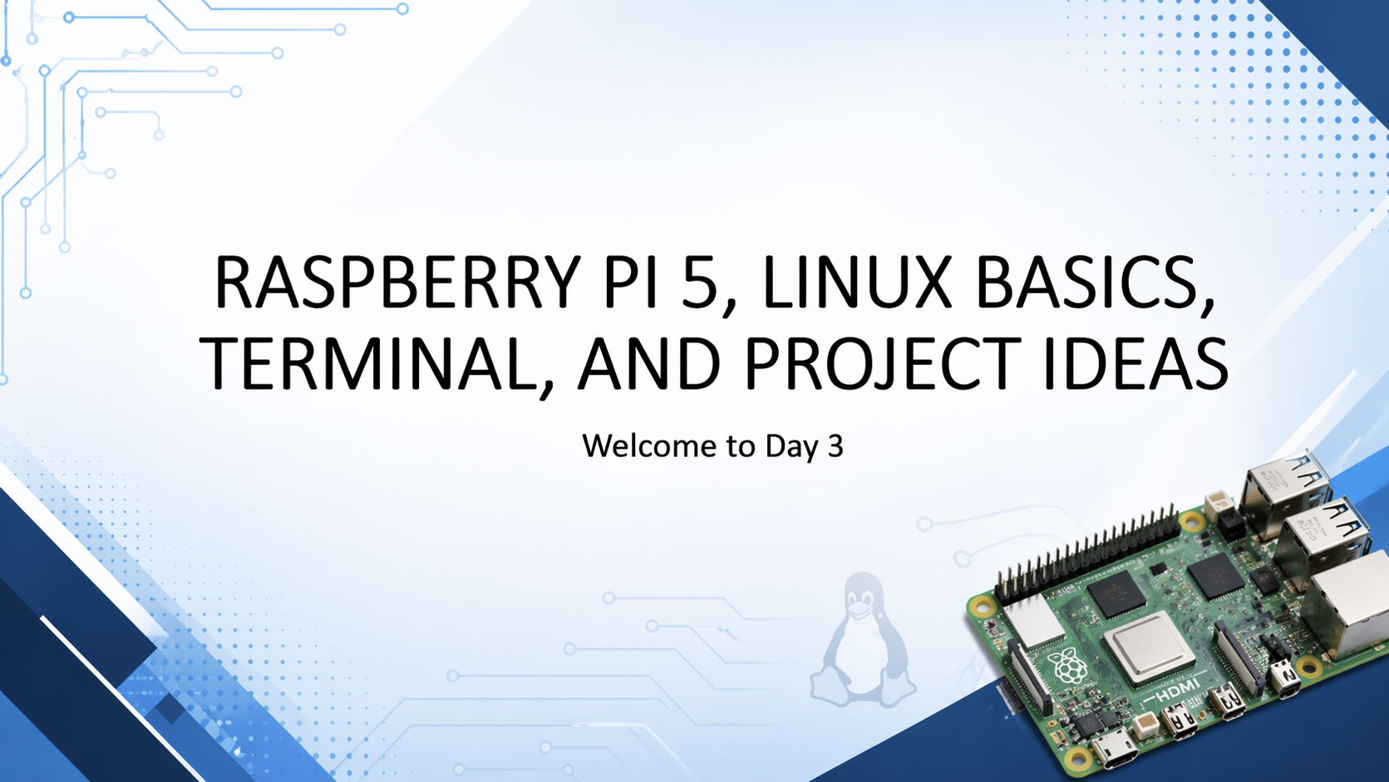
RASPBERRY PI 5, LINUX BASICS, TERMINAL, AND PROJECT IDEAS
Welcome to Day 3

Slide 2
Welcome to Day 3
Day 3: Raspberry Pi 5
Today’s goal: understand and use a mini-computer
Topics:
What Raspberry Pi 5 is
How it differs from Arduino
Linux basics
Files, folders, and terminal
Raspberry Pi project ideas

Slide 3
What we have done so far
Day 1: Scratch
Day 2: Arduino
Day 3: Raspberry Pi 5

Slide 4
What you will learn today
What Raspberry Pi 5 is
Why it is useful
Raspberry Pi vs Arduino
Raspberry Pi vs laptop
What Linux is
How to use files, folders, and terminal
What projects Raspberry Pi can power

Slide 5
Quick starter question
Have you ever:
seen a Raspberry Pi?
used Linux?
used a terminal?
created folders with commands?

Slide 6
What is Raspberry Pi?
Raspberry Pi is a small, affordable computer
It can run an operating system
It can connect to:
Screen
Keyboard
Mouse
Internet
USB devices
electronic components

Slide 7
What makes Raspberry Pi special?
very small
low power consumption
Flexible
useful for learning, coding, electronics, and projects

Slide 8
Raspberry Pi 5 in simple words
a mini-computer
can run Linux
can open apps
can browse the web
can run Python
can control GPIO pins
can be used for many project types

Slide 9
Raspberry Pi is not the same as Arduino
Raspberry Pi
- full computer
- runs an operating system
- can do many tasks at once
Arduino
Microcontroller
runs one simple program repeatedly
great for sensors and simple control

Slide 10
Arduino vs Raspberry Pi
Raspberry Pi:
more powerful
more flexible
runs applications
works like a computer
Arduino:
simple
fast startup
hardware control
limited

Slide 11
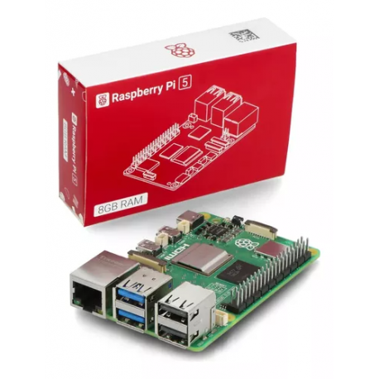
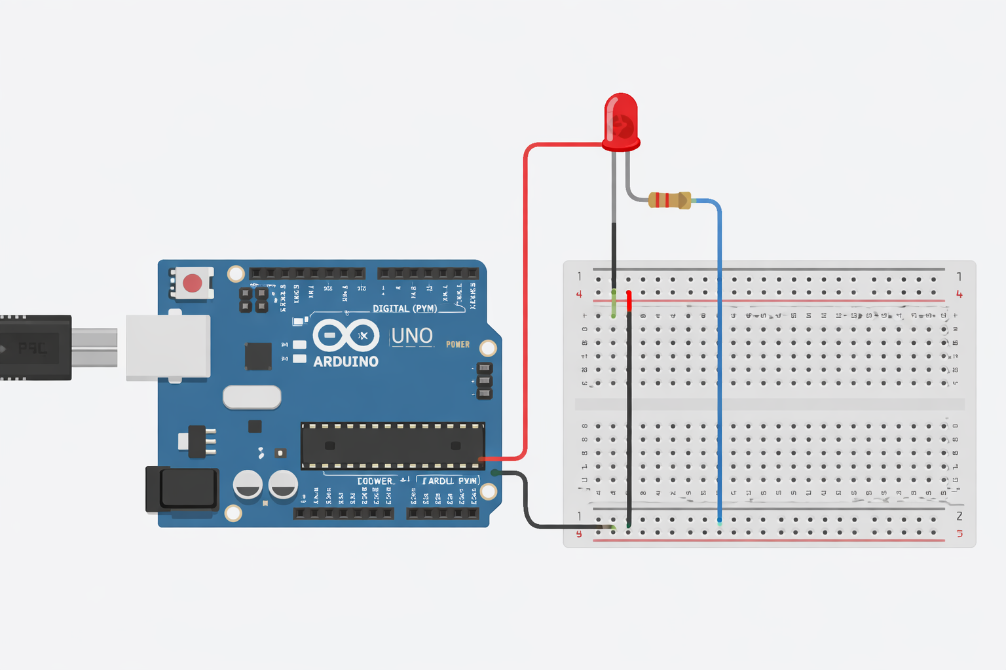
Scenario Best tool
Traffic light Arduino
Web server Raspberry Pi
Smart mirror Raspberry Pi
Simple buzzer alarm Arduino
Weather station Both
Robot brain Raspberry Pi + Arduino

Slide 12
Raspberry Pi vs a normal laptop
Laptop:
larger
more powerful in general
built for everyday computing
Raspberry Pi:
smaller
cheaper
lower power
often used for learning and projects

Slide 13
Examples of Raspberry Pi uses
coding and education
home server
media centre
smart home controller
weather station
retro gaming
Robotics
digital signage

Slide 14
Why people love Raspberry Pi
Affordable
Practical
good for experimentation
teaches computing and hardware together
large community and lots of project ideas

Slide 15
What is a single-board computer?
A complete computer built on one boardincludes processor, memory, ports, and connections

Slide 16
Main hardware parts on Raspberry Pi 5
Label image or list:
USB ports
HDMI ports
power input
GPIO pins
microSD or storage
Processor
network connection

Slide 17
What do you need to use Raspberry Pi?
Raspberry Pi board
power supply
storage with operating system
Screen
Keyboard
Mouse
optional internet

Slide 18
What is an operating system?
Software that manages the computer
lets you run programs
manages files, devices, and the interface
Examples
Windows
macOS
Linux

Slide 19
Raspberry Pi usually runs Linux
Raspberry Pi often uses a Linux-based operating system
Linux is widely used in:
Servers
Programming
Cybersecurity
embedded systems
cloud systems

Slide 20
What is Linux?
An operating system family
known for flexibility and control
common in technical and educational environments

Slide 21
Why learn a bit of Linux?
useful for developers
useful for system administrators
useful for makers and robotics
useful in cybersecurity
useful for Raspberry Pi projects

Slide 22
Raspberry Pi desktop
Menu
Desktop
Icons
Taskbar
file manager
Terminal
browser

Slide 23
Teacher demo: boot the Raspberry Pi
Watch for:
boot process
login or desktop
mouse and keyboard
menu and taskbar

Slide 24
What is the desktop environment?
The visual interface of the operating system
includes windows, icons, menus, and apps

Slide 25
File manager basics
open folders
move through directories
create files
delete files
organise work

Slide 26
What is a file?
A file stores information
examples:
Image
text
Document
Program
video

Slide 27
What is a folder?
A folder contains files and sometimes other folders
used for organisation

Slide 28
Why file organisation matters
easier to find things
easier to understand projects
easier to share work
easier to avoid mistakes

Slide 29
Example project folder
my_project/
images/
code/
notes.txt

Slide 30
What is the terminal?
A text-based way to interact with the computer
instead of clicking, you type commands

Slide 31
Why use the terminal?
Fast
Precise
Powerful
useful for coding and system tasks
common in Linux environments

Slide 32
Terminal is just another interface
GUI = graphical user interface
Terminal = command-line interface

Slide 33
First terminal command: pwd
pwd
means: print working directory
shows where you are

Slide 34
Second command: ls
ls
lists files and folders

Slide 35
Third command: cd
cd foldername
changes directory

Slide 36
Fourth command: mkdir
mkdir newfolder
makes a new folder

Slide 37
Fifth command: nano or text editor
open or create a text file
write text
save

Slide 38
Teacher demo: basic terminal flow
Example:
pwd
Ls
mkdir projects
cd projects
pwd

Slide 39
Student task: terminal practice
Task:
open terminal
run pwd
run ls
create a folder called day3
enter it using cd day3
run pwd again

Slide 40
Common terminal mistakes
spelling errors
wrong folder name
using spaces incorrectly
being in the wrong directory

Slide 41
Why the terminal matters in real life
Development
Linux servers
cloud systems
Cybersecurity
Raspberry Pi projects

Slide 42
Raspberry Pi and Python
Raspberry Pi is great for Python
Python is beginner-friendly and powerful
useful for automation, projects, and hardware control

Slide 43
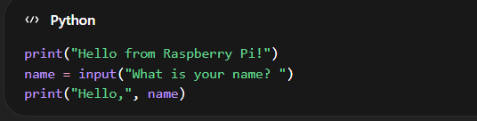
Tiny Python example

Slide 44
Teacher demo: run a small Python file
Steps:
open editor
write simple Python code
save file
run it

Slide 45
What GPIO means
GPIO = General Purpose Input/Output
pins that allow Raspberry Pi to interact with hardware

Slide 46
Raspberry Pi can also do electronics
read buttons
control LEDs
use sensors
connect to other devices

Slide 47
Then why not always use Raspberry Pi instead of Arduino?
Arduino:
simpler
better for basic control
starts quickly
Raspberry Pi:
more powerful
more complex
better for full systems

Slide 48
Choosing the right tool
Use Arduino for:
simple sensor project
traffic light
reaction game
buzzer and LEDs
Use Raspberry Pi for:
media centre
server
smart home hub
coding platform
more advanced integrated projects

Slide 49
Raspberry Pi project ideas
mini web server
weather station
smart mirror
retro gaming system
home automation hub
digital photo frame
classroom notice board

Slide 50
Raspberry Pi in education
Coding
Linux basics
hardware interaction
networking ideas
problem-solving
project building

Slide 51
Raspberry Pi in real industries
Prototyping
Automation
monitoring systems
IoT
embedded projects
digital displays

Slide 52
Activity: Arduino or Raspberry Pi?
Which would you choose for:
traffic light controller
home media centre
web server
plant watering system
smart classroom dashboard
simple alarm

Slide 53
Activity answers discussion
Possible answers:traffic light controller → Arduino
media centre → Raspberry Pi
web server → Raspberry Pi
plant watering system → Arduino or both
dashboard → Raspberry Pi
simple alarm → Arduino

Slide 54
Raspberry Pi and the internet
connect to Wi-Fi or Ethernet
browse the web
download software
run network-based projects

Slide 55
Raspberry Pi can be a server
can host files or services
can run apps for other devices
can act as a simple web server

Slide 56
Raspberry Pi and cybersecurity
Linux practice
networking practice
Scripting
basic server ideas

Slide 57
Raspberry Pi and robotics
combine code, sensors, motors, and logic
can act as the ‘brain’ of more complex projects

Slide 58
Raspberry Pi and AI projects
simple local AI demos
computer vision experiments
data collection
automation scripts

Slide 59
What we learned today
Today we explored:
Raspberry Pi as a mini-computer
Linux basics
files and folders
terminal basics
Raspberry Pi vs Arduino
Raspberry Pi project ideas

Slide 60
Key vocabulary
Raspberry Pi
single-board computer
operating system
Linux
Terminal
Directory
File
Folder
GPIO

Slide 61
Quick recap questions
What is Raspberry Pi?
What is the difference between Raspberry Pi and Arduino?
What is an operating system?
What does pwd do?
What does ls do?
What does cd do?
What does GPIO mean?

Slide 62
Tomorrow’s connection
Tomorrow: GitHub and project planning
saving and sharing work
repositories
README files
preparing final projects

Slide 63
BONUS SLIDES — Why small computers matter
Cheaper
lower energy use
easier to dedicate to one project
useful for experimentation

Slide 64
Graphical interface vs terminal
Graphical:
easy to click
more visual
Terminal:
fast
powerful
common in technical work

Slide 65
Example of a project folder structure
raspberry_pi_project/
code/
images/
notes/
README.txt

Slide 66
Common student fears
“Linux looks hard”
“Terminal looks scary”
“I’ll break something”

Slide 67
What makes Raspberry Pi fun?
small but powerful
can behave like a desktop
can connect to hardware
supports creative projects

Slide 68
End of Day 4
Well done.
Today you explored a real mini-computer.

Slide 69
