Slide 1
01
資料蒐集
Sample size
蒐集方法
硬體安全導論
Final Project
02
參數設定
參數設定
第二組
03
結果與分析
Pass rate
分析
106000147 沈永聖 106061247 林均容 106061252劉育瑋 106061255 陳孟泰
04
Quality of TRNG
Quality of TRNG

Slide 2
大綱
01
資料蒐集
Sample size
蒐集方法
02
參數設定
參數設定
03
結果與分析
Pass rate
分析
04
Quality of TRNG
Quality of TRNG

Slide 3
01
資料蒐集
Sample size
蒐集方法
02
參數設定
參數設定
03
結果與分析
Pass rate
分析
04
Quality of TRNG
Quality of TRNG

Slide 4
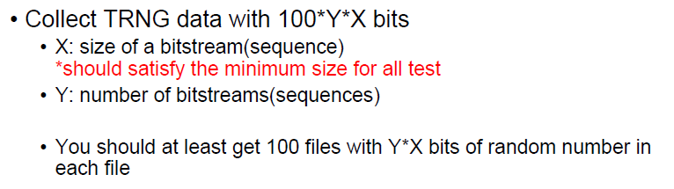
如何選擇X與Y?
01
資料蒐集
Sample size
蒐集方法
02
參數設定
參數設定
03
結果與分析
Pass rate
分析
04
Quality of TRNG
Quality of TRNG

Slide 5
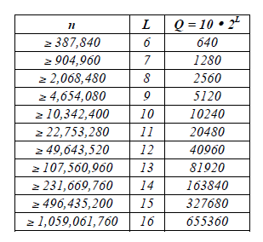
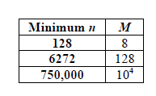
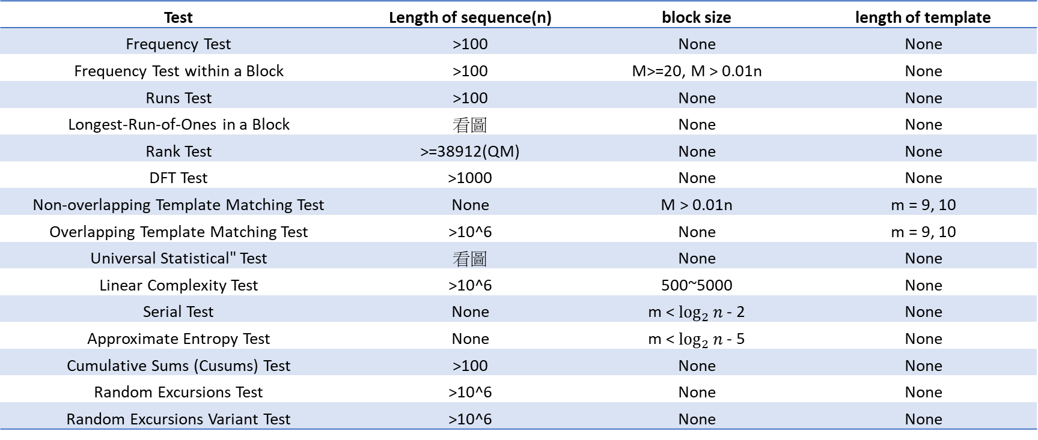
Sample size -如何選擇X?
01
Test | Length of sequence(n) | block size | length of template
Frequency Test | >100 | None | None
Frequency Test within a Block | >100 | M>=20, M > 0.01n | None
Runs Test | >100 | None | None
Longest-Run-of-Ones in a Block | 看圖 | None | None
Rank Test | >=38912(QM) | None | None
DFT Test | >1000 | None | None
Non-overlapping Template Matching Test | None | M > 0.01n | m = 9, 10
Overlapping Template Matching Test | >10^6 | None | m = 9, 10
Universal Statistical" Test | 看圖 | None | None
Linear Complexity Test | >10^6 | 500~5000 | None
Serial Test | None | m < $\log_{2}{n}$ - 2 | None
Approximate Entropy Test | None | m < $\log_{2}{n}$ - 5 | None
Cumulative Sums (Cusums) Test | >100 | None | None
Random Excursions Test | >10^6 | None | None
Random Excursions Variant Test | >10^6 | None | None
Longest Run-of-Ones in a Block
Universal Statistical Test

Slide 6
Sample size -如何選擇X?
01
Test | Length of sequence(n) | block size | length of template
Frequency Test | >100 | None | None
Frequency Test within a Block | >100 | M>=20, M > 0.01n | None
Runs Test | >100 | None | None
Longest-Run-of-Ones in a Block | 看圖 | None | None
Rank Test | >=38912(QM) | None | None
DFT Test | >1000 | None | None
Non-overlapping Template Matching Test | None | M > 0.01n | m = 9, 10
Overlapping Template Matching Test | >10^6 | None | m = 9, 10
Universal Statistical" Test | 看圖 | None | None
Linear Complexity Test | >10^6 | 500~5000 | None
Serial Test | None | m < log_2(n) - 2 | None
Approximate Entropy Test | None | m < log_2(n) - 5 | None
Cumulative Sums (Cusums) Test | >100 | None | None
Random Excursions Test | >10^6 | None | None
Random Excursions Variant Test | >10^6 | None | None
Universal Statistical Test
Longest Run-of-Ones in a Block
Notes:
Title switch

Slide 7

Sample size -如何選擇X?
01
$$X≥{10}^{6}$$
Longest Run-of-Ones in a Block
Universal Statistical Test

Slide 8
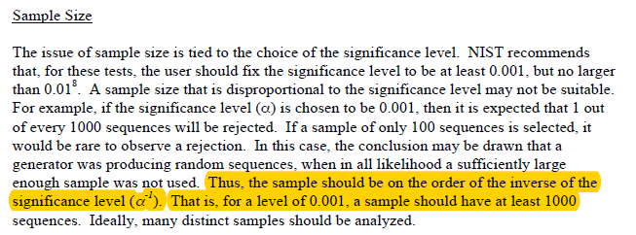
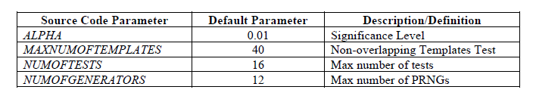

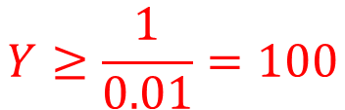
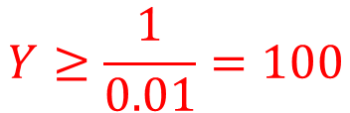
Sample size -如何選擇Y?
01
$$X≥{10}^{6}≈2^{20}$$
$$Y≥\frac{1}{0.01}=100$$
100 files
Baud rate = 115200 bits/s
$$Y≥\frac{1}{0.01}=100$$

Slide 9




如何選擇X與Y?
01
資料蒐集
Sample size
蒐集方法
$$X≥{10}^{6}≈2^{20}$$
參數設定
參數設定
$$Y≥\frac{1}{0.01}=100$$
$$\frac{{(2}^{20}×100×100)}{115200}≈91022s≈1.05天$$
結果與分析
Pass rate
分析
100 files
$$X=2^{20}$$
Quality of TRNG
Quality of TRNG
Baud rate = 115200 bits/s
$$Y=100$$
Size for each file $=12.5MB$
Notes:
I’m not sure what’s sample sie

Slide 10
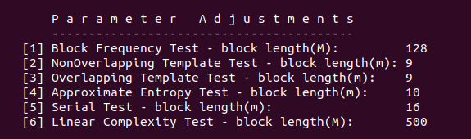
01
資料蒐集
Sample size
蒐集方法
02
參數設定
參數設定
03
結果與分析
Pass rate
分析
04
Quality of TRNG
Quality of TRNG

Slide 11
參數設定
02
01
資料蒐集
Sample size
蒐集方法
參數設定
參數設定
03
結果與分析
Pass rate
分析
04
Quality of TRNG
Quality of TRNG

Slide 12
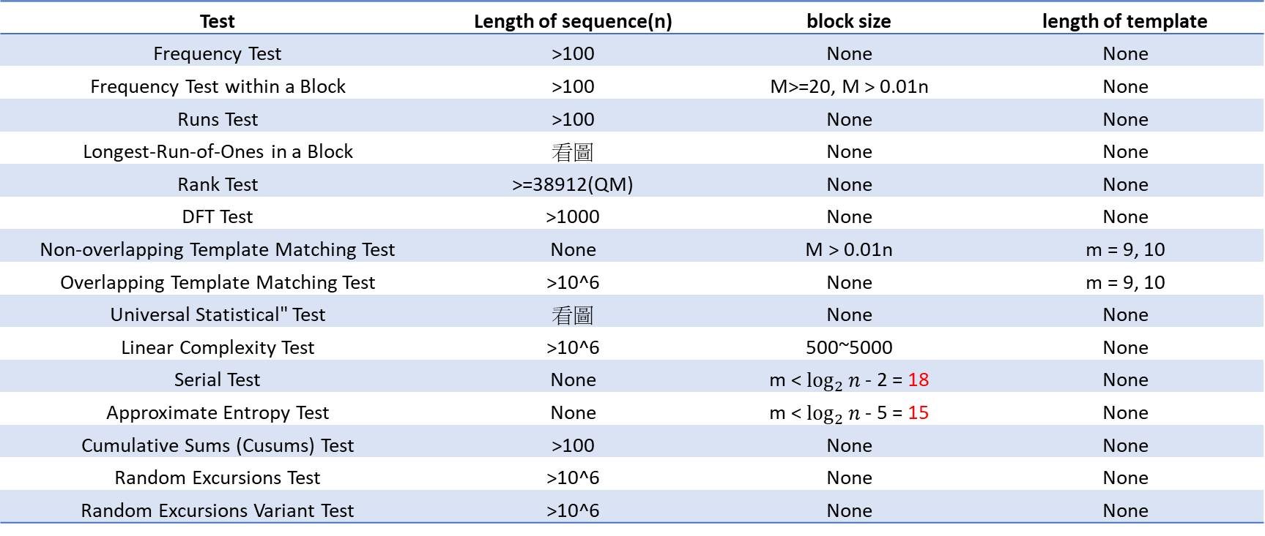
參數設定
02
Test | Length of sequence(n) | block size | length of template
Frequency Test | >100 | None | None
Frequency Test within a Block | >100 | M>=20, M > 0.01n | None
Runs Test | >100 | None | None
Longest-Run-of-Ones in a Block | 看圖 | None | None
Rank Test | >=38912(QM) | None | None
DFT Test | >1000 | None | None
Non-overlapping Template Matching Test | None | M > 0.01n | m = 9, 10
Overlapping Template Matching Test | >10^6 | None | m = 9, 10
Universal Statistical" Test | 看圖 | None | None
Linear Complexity Test | >10^6 | 500~5000 | None
Serial Test | None | m < $\log_{2}{n}$ - 2 = 18 | None
Approximate Entropy Test | None | m < $\log_{2}{n}$ - 5 = 15 | None
Cumulative Sums (Cusums) Test | >100 | None | None
Random Excursions Test | >10^6 | None | None
Random Excursions Variant Test | >10^6 | None | None

Slide 13
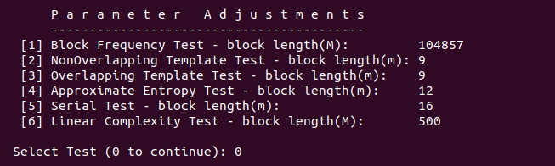
參數設定
02

Slide 14
01
資料蒐集
Sample size
蒐集方法
02
參數設定
參數設定
03
結果與分析
Pass rate
分析
04
Quality of TRNG
Quality of TRNG

Slide 15

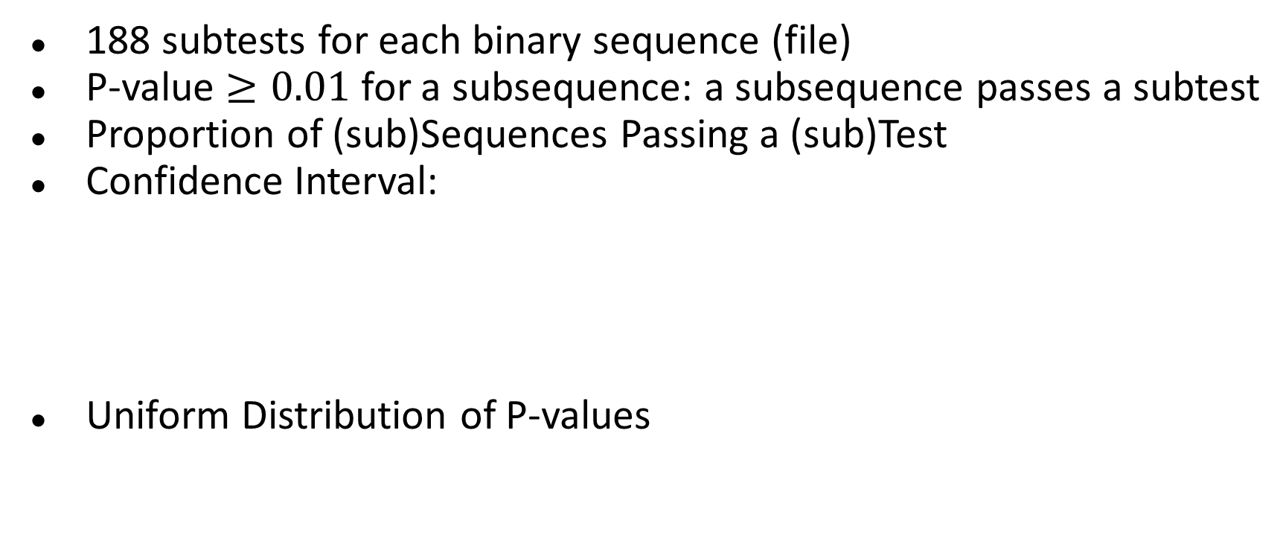


Pass? Fail? For a Specific subtest
03
01
資料蒐集
Sample size
蒐集方法
188 subtests for each binary sequence (file)
P-value $≥0.01$for a subsequence: a subsequence passes a subtest
Proportion of (sub)Sequences Passing a (sub)Test
Confidence Interval:
Uniform Distribution of P-values
02
參數設定
參數設定
$$\hat{p}±3\sqrt{\frac{\hat{p}\left(1−\hat{p}\right)}{Y}}$$
結果與分析
Pass rate
分析
$$where \hat{p}=1−α ,Y is the sample size$$
04
Quality of TRNG
Quality of TRNG

Slide 16
Pass Rate
03
Rate of sufficiently random sequence generated from an RNG
Sufficiently random: Pass all subtests in NIST SP900-22
Pass Rate for the collected random number sequences: 50%

Slide 17
Possible Reasons for Failure
03

Slide 18
Insufficient Length of Sequence
03
Test | Length of sequence(n) | # of Fails | # of Subtests
Frequency Test | >100 | 0 | 1
Frequency Test within a Block | >100 | 0 | 1
Runs Test | >100 | 0 | 1
Longest-Run-of-Ones in a Block | >=750,000 (in our case) | 2 | 1
Rank Test | >=38912(QM) | 0 | 1
DFT Test | >1000 | 0 | 1
Non-overlapping Template Matching Test | None | 39 | 148
Overlapping Template Matching Test | >10^6 | 0 | 1
Universal Statistical" Test | 904,960 ~ 2,068,480 (in our case) | 1 | 1
Linear Complexity Test | >10^6 | 1 | 1
Serial Test | None | 2 | 2
Approximate Entropy Test | None | 1 | 1
Cumulative Sums (Cusums) Test | >100 | 0 | 1
Random Excursions Test | >10^6 | 6 | 8
Random Excursions Variant Test | >10^6 | 2 | 18

Slide 19
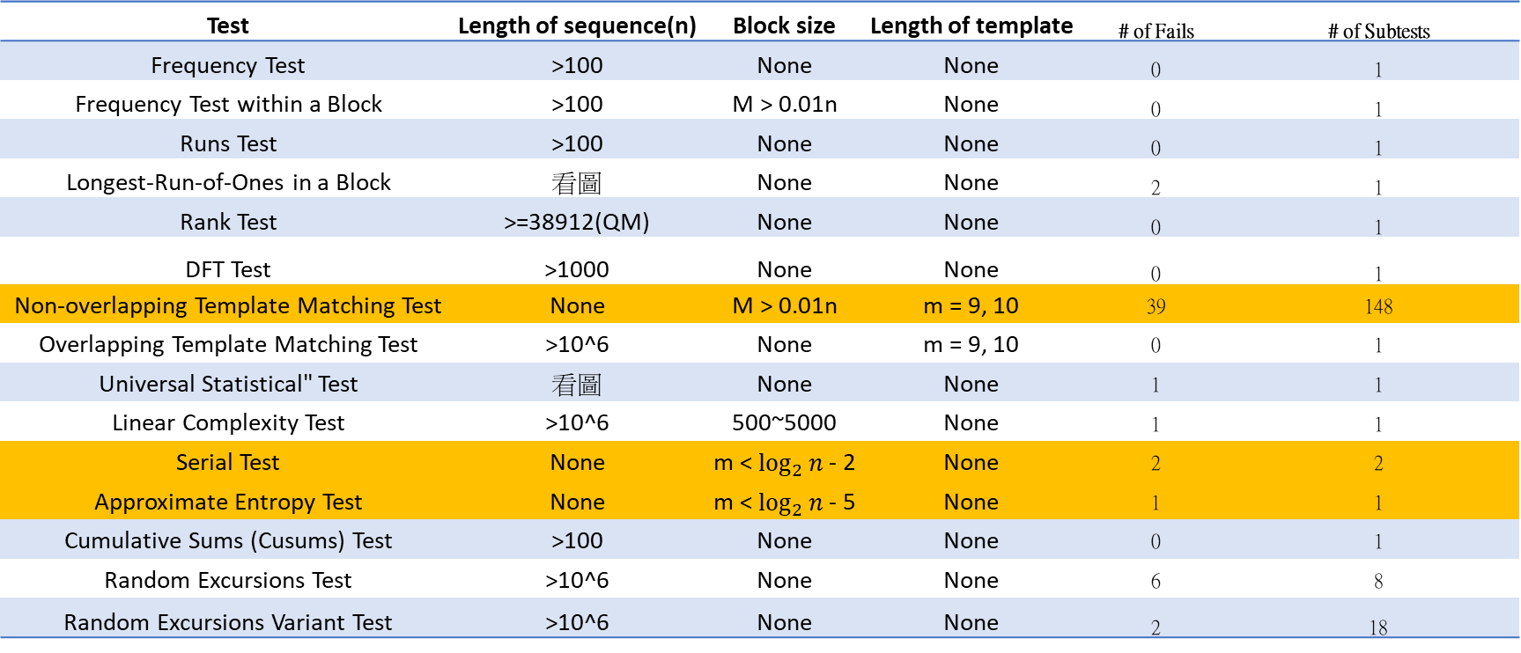
Parameter-Dependent Tests
03
Test | Length of sequence(n) | Block size | Length of template | # of Fails | # of Subtests
Frequency Test | >100 | None | None | 0 | 1
Frequency Test within a Block | >100 | M > 0.01n | None | 0 | 1
Runs Test | >100 | None | None | 0 | 1
Longest-Run-of-Ones in a Block | 看圖 | None | None | 2 | 1
Rank Test | >=38912(QM) | None | None | 0 | 1
DFT Test | >1000 | None | None | 0 | 1
Non-overlapping Template Matching Test | None | M > 0.01n | m = 9, 10 | 39 | 148
Overlapping Template Matching Test | >10^6 | None | m = 9, 10 | 0 | 1
Universal Statistical" Test | 看圖 | None | None | 1 | 1
Linear Complexity Test | >10^6 | 500~5000 | None | 1 | 1
Serial Test | None | m < $\log_{2}{n}$ - 2 | None | 2 | 2
Approximate Entropy Test | None | m < $\log_{2}{n}$ - 5 | None | 1 | 1
Cumulative Sums (Cusums) Test | >100 | None | None | 0 | 1
Random Excursions Test | >10^6 | None | None | 6 | 8
Random Excursions Variant Test | >10^6 | None | None | 2 | 18

Slide 20
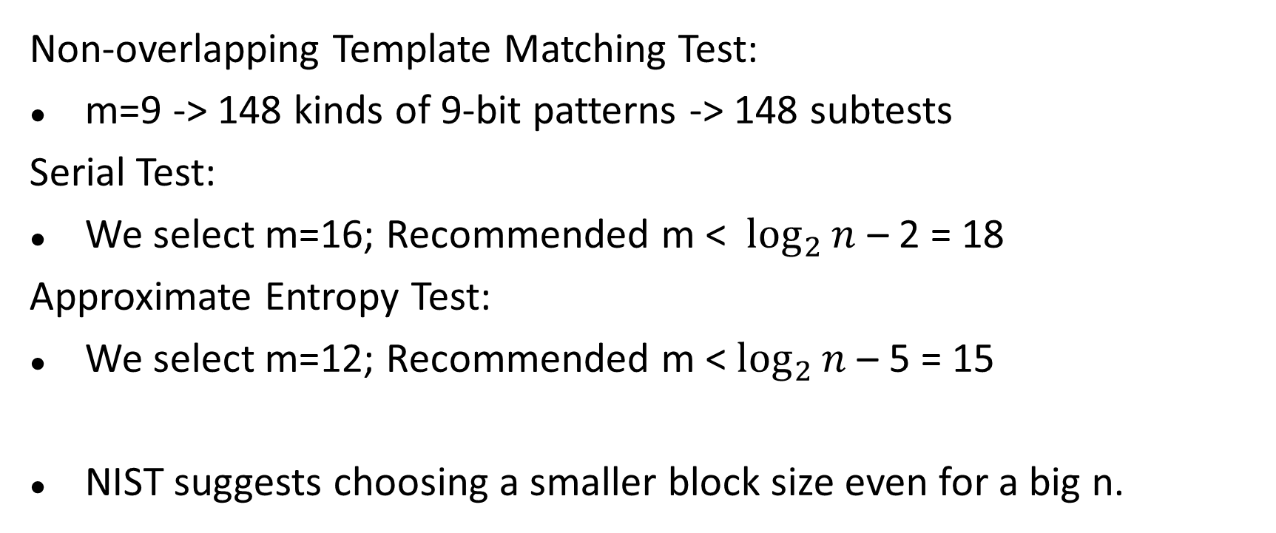
Parameter-Dependant Tests
03
Non-overlapping Template Matching Test:
m=9 -> 148 kinds of 9-bit patterns -> 148 subtests
Serial Test:
We select m=16; Recommended m < $\log_{2}{n}$ – 2 = 18
Approximate Entropy Test:
We select m=12; Recommended m < $\log_{2}{n}$ – 5 = 15
NIST suggests choosing a smaller block size even for a big n.

Slide 21
Selection of Sample Size (Y)
03
100 files * 100 * 2^20 bits
50 files * 200 * 2^20 bits

Slide 22

Selection of Sample Size (Y)
03
Sample size should be on the order of the inverse of the significance level (α) -> α = 0.01 -> Y >=100
Larger Y seems to provide larger tolerance on # of low-quality RN subsequences since few fails have larger impact under a smaller Y
Calculate accepted lower bound of the confidence interval:
Y=100: 100*(0.99-0.0298)=96.0=96(in NIST test)
Y=200: 200*(0.99-0.0211)=193.8=193(in NIST test)
*Y=1073: 1073*0.9809=1052
$$\hat{p}±3\sqrt{\frac{\hat{p}\left(1−\hat{p}\right)}{Y}}$$

Slide 23
Tests Often Fail
03

Slide 24
Non-overlapping Template Matching Test
03
39 fails in 100 files (39%)
54 fails in (148 subtests (m=9) * 100 files) (0.36%)
A common reason for a sequence to be rejected as a random one, but not common for failing a subtest.

Slide 25
Purpose and Test Description
03
Detect generators that produce too many occurrences of a given non-periodic pattern.
An m-bit window is used to search for a specific m-bit pattern. If matches, counter +1.
A measure of how well the observed number of template “hits” matches the expected number of template “hits” (under an assumption of randomness) -> Consequent P-value

Slide 26
Why Fail and How to Improve
03
Reason
A small sample size (Y=100)
Too many (148) subtests under recommended m=9 (9-bit pattern)
Solution (in statistical ways)
Larger Y (39% to 10% as Y=100 to Y = 200)
m=8, 7, 6…
Ask NIST to replace the results of these 148 subtests with fewer outcomes, or say, do some further statistical calculation among the 148 results

Slide 27
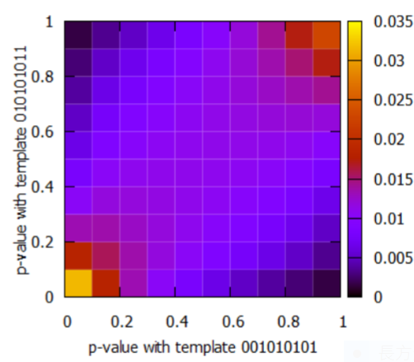
Why Argue that an Advanced Non-overlapping Template Matching Test is needed ?
03
High correlation between the tests with some tested patterns
-> non-necessary for so many tests
The correlation coefficients can be computed as ρ(001010101, 010101011) = 0.652525 and ρ(001010101, 101010100) = 0.3212—from Atsushi Iwasaki, “Independent Randomness Tests based on the Orthogonalized Non-overlapping Template Matching Test”, 2019
Joint distribution of p-values with templates 001010101 and 010101011

Slide 28
Tests for the
Longest-Run-of-Ones in a Block
03

Slide 29
Example
03
Number of X-bit sequences (Y) |  | 100 | 200
Pass Rate |  | 50% | 80%
Test | Subtest # | Fail #
Frequency Test | 1 | 0 | 0
Frequency Test within a Block | 1 | 0 | 0
Runs Test | 1 | 0 | 0
Longest-Run-of-Ones in a Block | 1 | 2 | 0
Rank Test | 1 | 0 | 0
DFT Test | 1 | 0 | 0
Non-overlapping Template Matching Test | 148 | 39 | 5
Overlapping Template Matching Test | 1 | 0 | 0
Universal Statistical Test | 1 | 1 | 1
Linear Complexity Test | 1 | 1 | 0
Serial Test | 2 | 2 | 1
Approximate Entropy Test | 1 | 1 | 0
Cumulative Sums (Cusums) Test | 2 | 0 | 0
Random Excursions Test | 8 | 6 | 5
Random Excursions Variant Test | 18 | 2 | 0
Notes:
Change first 2 titles

Slide 30
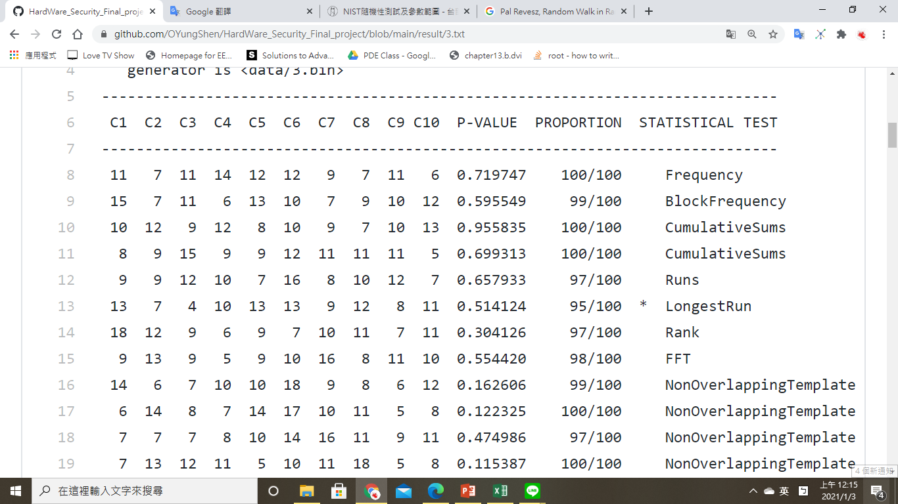
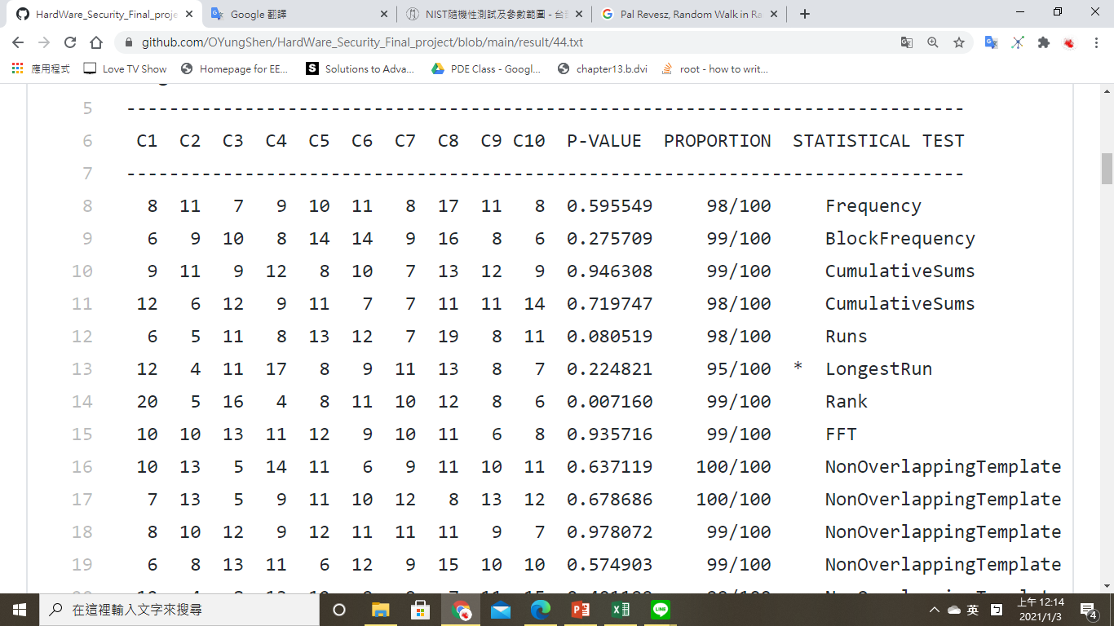
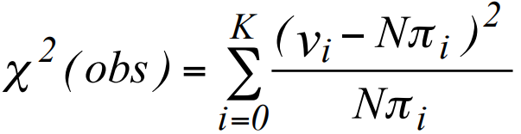
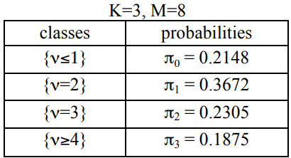
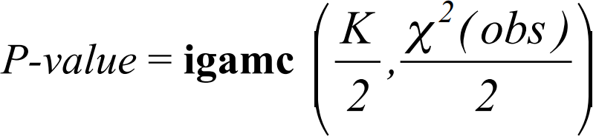
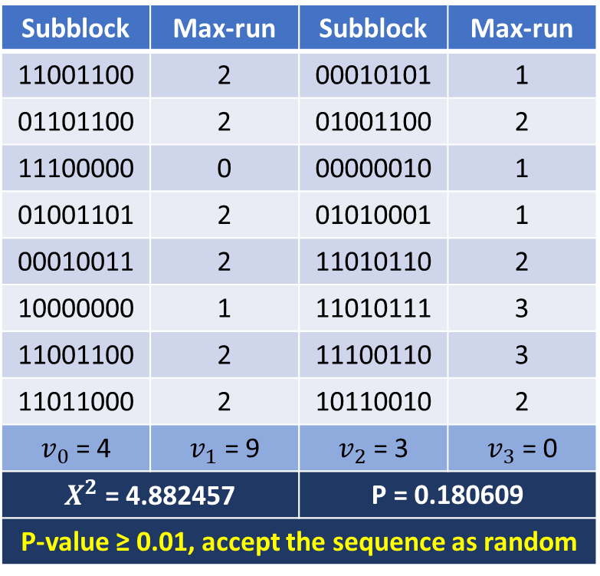
Example
03
n : The length of the bit string. (128)
M : The length of each block. (8)
N : The number of blocks. (16)
input = 11001100000101010110110001001100111000000000001001001101010100010001001111010110100000001101011111001100111001101101100010110010
Subblock | Max-run | Subblock | Max-run
11001100 | 2 | 00010101 | 1
01101100 | 2 | 01001100 | 2
11100000 | 0 | 00000010 | 1
01001101 | 2 | 01010001 | 1
00010011 | 2 | 11010110 | 2
10000000 | 1 | 11010111 | 3
11001100 | 2 | 11100110 | 3
11011000 | 2 | 10110010 | 2
$v_{0}$ = 4 | $v_{1}$ = 9 | $v_{2}$ = 3 | $v_{3}$ = 0
$X^{2}$ = 4.882457 |  | P = 0.180609
P-value ≥ 0.01, accept the sequence as random

Slide 31
Random Excursions Test
03

Slide 32
Test Purpose
03
The number of cycles having exactly K visits in a cumulative sum random walk
Cumulative sum random walk
A cycle of a random walk
To determine if the number of visits to a particular state within a cycle deviates from what one would expect for a random sequence. This test is actually a series of eight tests (and conclusions), one test and conclusion for each of the states: -4, -3, -2, -1 and +1, +2, +3, +4.
Notes:
這個 test focus 在累積總和 random walk 中恰好有K次訪問的週期數。累積總和 random walk 是從(0,1) sequence 轉成(-1, +1) sequence 後的 partial sums 衍生而來。
一個random walk 的週期是由從原點開始並返回原點，隨機採取的單位長度的一連串步驟組成。

Slide 33
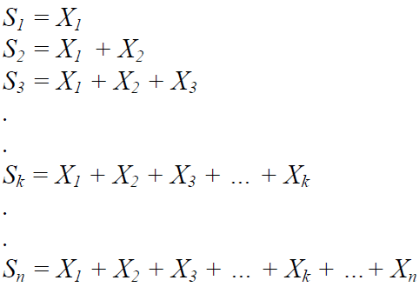
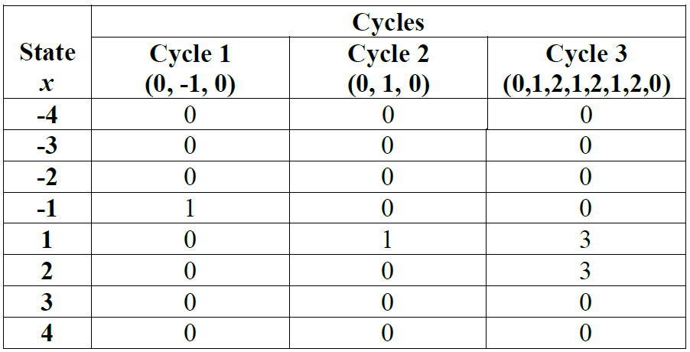
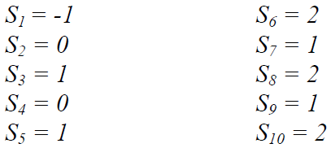
Example
03

Slide 34
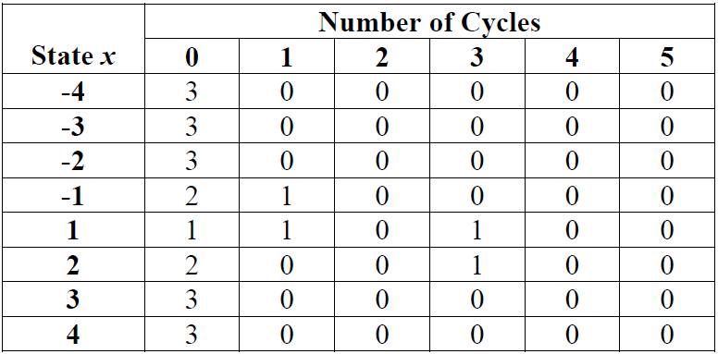



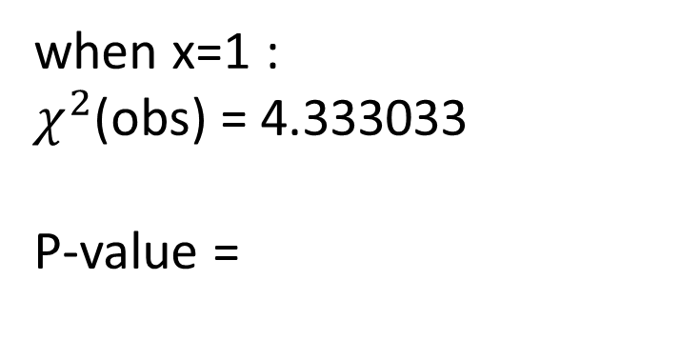
Example
03
when x=1 :
$χ^{2}$(obs) = 4.333033
P-value =
0.502529 ≧ 0.01
→ the sequence is random

Slide 35
Why Fail and How to Improve
03
If the computed P-value is < 0.01, then conclude that the sequence is non-random. Otherwise, conclude that the sequence is random.
Reason :
It is recommended that each subsequence consists of a minimum of 10^6 bits.
The length of a subsequence is not large enough.
Increase the size of the sequence.
Notes:
Change Some inaccurate words

Slide 36
01
資料蒐集
Sample size
蒐集方法
02
參數設定
參數設定
03
結果與分析
Pass rate
分析
04
Quality of TRNG
Quality of TRNG

Slide 37
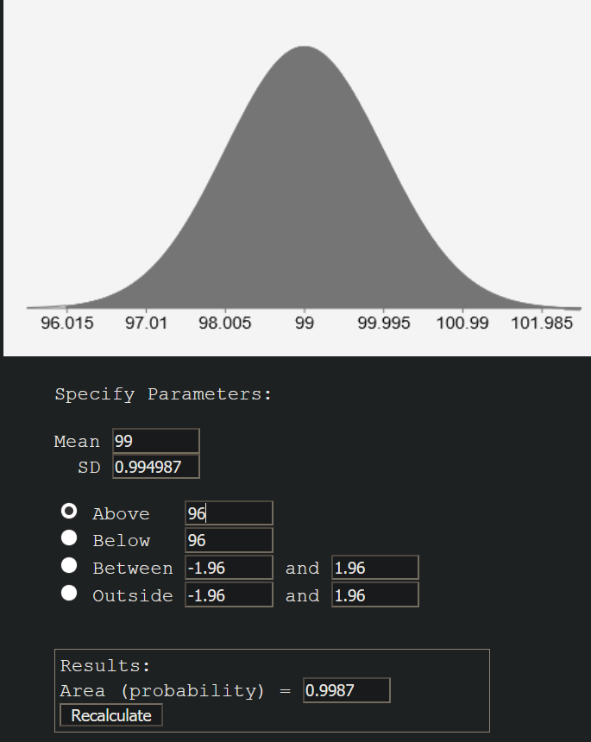
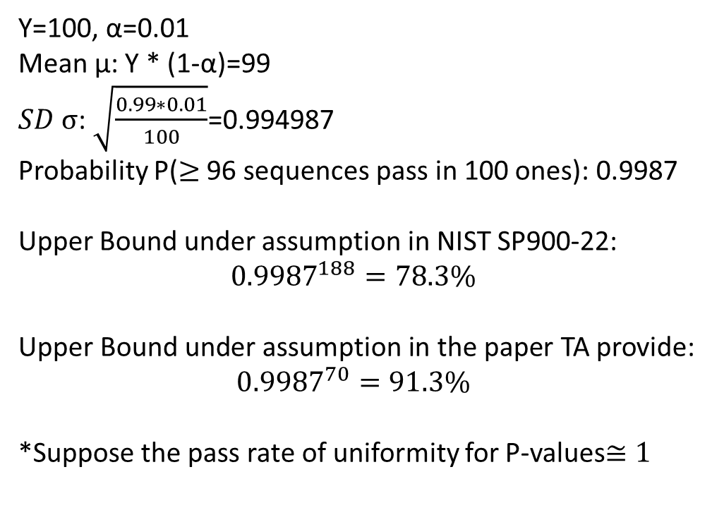
Upper Bound in our case
04
01
資料蒐集
Sample size
蒐集方法
Y=100, α=0.01
Mean μ: Y * (1-α)=99
$SD σ$: $\sqrt{\frac{0.99∗0.01}{100}}$=0.994987
Probability P($≥$ 96 sequences pass in 100 ones): 0.9987
Upper Bound under assumption in NIST SP900-22:
$${0.9987}^{188}=78.3\%$$
Upper Bound under assumption in the paper TA provide:
$${0.9987}^{70}=91.3\%$$
*Suppose the pass rate of uniformity for P-values$≅1$
02
參數設定
參數設定
03
結果與分析
Pass rate
分析
Quality of TRNG
Quality of TRNG

Slide 38
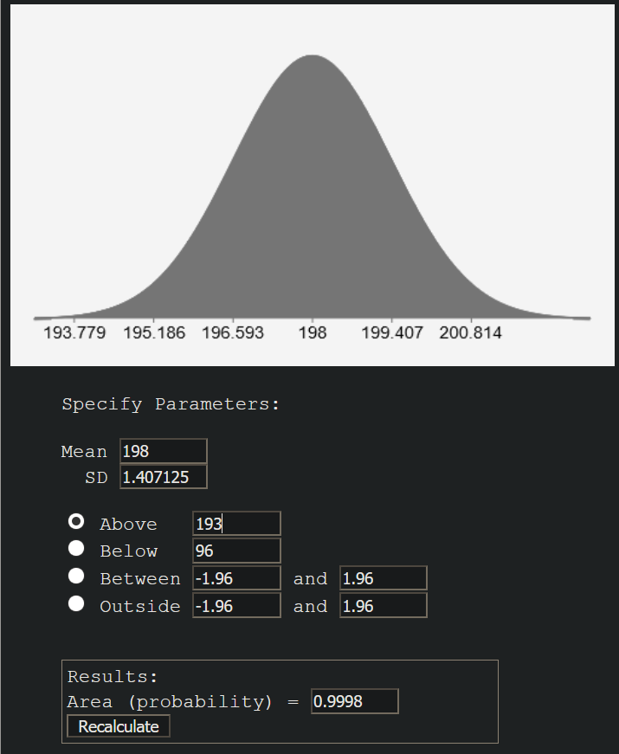
Upper Bound in our case
04
Y=100
Pass Rate: 50%
Upper Bound(NIST): 78.3%
Upper Bound(Paper): 91.3%
Y=200
Pass Rate: 80%
Upper Bound(NIST): 96.3%
Upper Bound(Paper): 98.6%

Slide 39
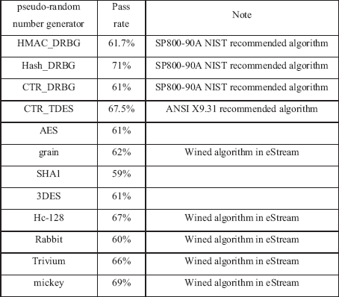
Quality of our TRNG
04
For Known PRNGs:
Pass Rate: 60~70%
Upper Bound(NIST): 56.8%
Upper Bound(Paper): 81%
->The pass rate is closer to upper bound than ours obviously
It seems that the RNG doesn’t perform as well as the proposed known PRNGs. However, those PRNGs are designed for the purpose of being statistically random, while the RNG we use is a truly one whose performance of statistical randomness is also reliable to some extent.
Better way of using the TRNG: take it as the seed generator of a PRNG
Known PRNGs

Slide 40
Thank You for Listening
04

Slide 41
Q&A

