Slide 1
01
資料蒐集
Sample size
蒐集方法
硬體安全導論
Final Project
02
參數設定
參數設定
第二組
03
結果與分析
Pass rate
分析
106000147 沈永聖 106061247 林均容 106061252劉育瑋 106061255 陳孟泰
04
Quality of TRNG
Quality of TRNG

Slide 2
大綱
01
資料蒐集
Sample size
蒐集方法
02
參數設定
參數設定
03
結果與分析
Pass rate
分析
04
Quality of TRNG
Quality of TRNG

Slide 3
01
資料蒐集
Sample size
蒐集方法
02
參數設定
參數設定
03
結果與分析
Pass rate
分析
04
Quality of TRNG
Quality of TRNG

Slide 4
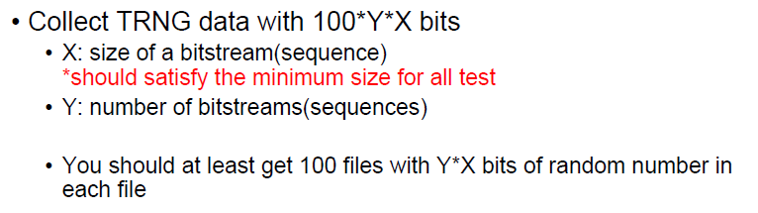
如何選擇X與Y?
01
資料蒐集
Sample size
蒐集方法
02
參數設定
參數設定
03
結果與分析
Pass rate
分析
04
Quality of TRNG
Quality of TRNG

Slide 5
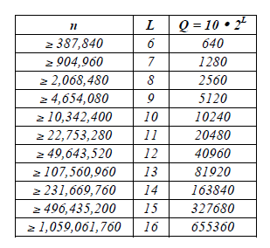
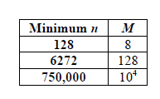
Sample size -如何選擇X?
01
Test | Length of sequence(n) | block size | length of template
Frequency Test | >100 | None | None
Frequency Test within a Block | >100 | M>=20, M > 0.01n | None
Runs Test | >100 | None | None
Longest-Run-of-Ones in a Block | 看圖 | None | None
Rank Test | >=38912(QM) | None | None
DFT Test | >1000 | None | None
Non-overlapping Template Matching Test | None | M > 0.01n | m = 9, 10
Overlapping Template Matching Test | >10^6 | None | m = 9, 10
Universal Statistical" Test | 看圖 | None | None
Linear Complexity Test | >10^6 | 500~5000 | None
Serial Test | None | m < log_2(n) - 2 | None
Approximate Entropy Test | None | m < log_2(n) - 5 | None
Cumulative Sums (Cusums) Test | >100 | None | None
Random Excursions Test | >10^6 | None | None
Random Excursions Variant Test | >10^6 | None | None
Longest Run-of-Ones in a Block
Universal Statistical Test

Slide 6
Sample size -如何選擇X?
01
Test | Length of sequence(n) | block size | length of template
Frequency Test | >100 | None | None
Frequency Test within a Block | >100 | M>=20, M > 0.01n | None
Runs Test | >100 | None | None
Longest-Run-of-Ones in a Block | 看圖 | None | None
Rank Test | >=38912(QM) | None | None
DFT Test | >1000 | None | None
Non-overlapping Template Matching Test | None | M > 0.01n | m = 9, 10
Overlapping Template Matching Test | >10^6 | None | m = 9, 10
Universal Statistical" Test | 看圖 | None | None
Linear Complexity Test | >10^6 | 500~5000 | None
Serial Test | None | m < log_2(n) - 2 | None
Approximate Entropy Test | None | m < log_2(n) - 5 | None
Cumulative Sums (Cusums) Test | >100 | None | None
Random Excursions Test | >10^6 | None | None
Random Excursions Variant Test | >10^6 | None | None
Longest Run-of-Ones in a Block
Universal Statistical Test

Slide 7

Sample size -如何選擇X?
01
$$X≥{10}^{6}$$
Longest Run-of-Ones in a Block
Universal Statistical Test

Slide 8
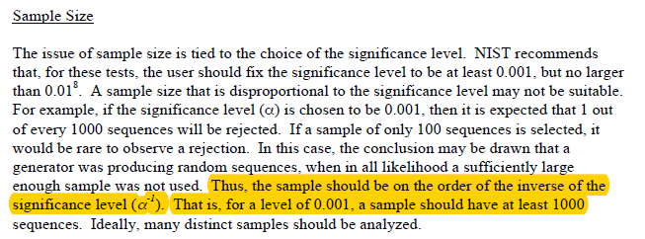
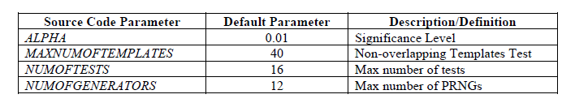

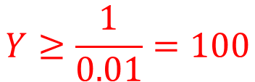
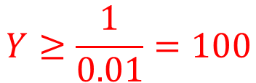
Sample size -如何選擇Y?
01
$$X≥{10}^{6}≈2^{20}$$
$$Y≥\frac{1}{0.01}=100$$
100 files
Baud rate = 115200 bits/s
$$Y≥\frac{1}{0.01}=100$$

Slide 9




如何選擇X與Y?
01
資料蒐集
Sample size
蒐集方法
$$X≥{10}^{6}≈2^{20}$$
參數設定
參數設定
$$Y≥\frac{1}{0.01}=100$$
$$\frac{{(2}^{20}×100×100)}{115200}≈91022s≈1.05天$$
結果與分析
Pass rate
分析
100 files
$$X=2^{20}$$
Quality of TRNG
Quality of TRNG
Baud rate = 115200 bits/s
$$Y=100$$
$$Sample sie=12.5MB$$

Slide 10
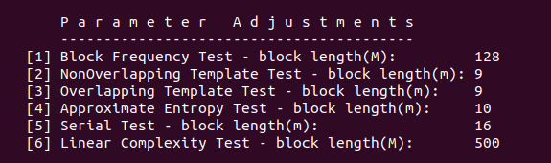
01
資料蒐集
Sample size
蒐集方法
02
參數設定
參數設定
03
結果與分析
Pass rate
分析
04
Quality of TRNG
Quality of TRNG

Slide 11
參數設定
02
01
資料蒐集
Sample size
蒐集方法
參數設定
參數設定
03
結果與分析
Pass rate
分析
04
Quality of TRNG
Quality of TRNG

Slide 12
參數設定
02
Test | Length of sequence(n) | block size | length of template
Frequency Test | >100 | None | None
Frequency Test within a Block | >100 | M>=20, M > 0.01n | None
Runs Test | >100 | None | None
Longest-Run-of-Ones in a Block | 看圖 | None | None
Rank Test | >=38912(QM) | None | None
DFT Test | >1000 | None | None
Non-overlapping Template Matching Test | None | M > 0.01n | m = 9, 10
Overlapping Template Matching Test | >10^6 | None | m = 9, 10
Universal Statistical" Test | 看圖 | None | None
Linear Complexity Test | >10^6 | 500~5000 | None
Serial Test | None | m < log_2(n) - 2 | None
Approximate Entropy Test | None | m < log_2(n) - 5 | None
Cumulative Sums (Cusums) Test | >100 | None | None
Random Excursions Test | >10^6 | None | None
Random Excursions Variant Test | >10^6 | None | None

Slide 13
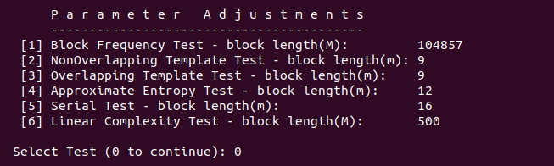
參數設定
02

Slide 14
01
資料蒐集
Sample size
蒐集方法
02
參數設定
參數設定
03
結果與分析
Pass rate
分析
04
Quality of TRNG
Quality of TRNG

Slide 15


Pass? Fail? For a Specific subtest
03
01
資料蒐集
Sample size
蒐集方法
188 subtests for each binary sequence (file)
Proportion of (sub)Sequences Passing a Test
Confidence Interval:
Uniform Distribution of P-values
02
參數設定
參數設定
結果與分析
Pass rate
分析
04
Quality of TRNG
Quality of TRNG

Slide 16
Pass Rate
03
Rate of sufficiently random sequence generated from an RNG
Sufficiently random: Pass all subtests in NIST SP900-22
Pass Rate for the collected random number sequences: 50%

Slide 17
Possible Reasons for Failure
03

Slide 18
Insufficient Length of Sequence
03
Test | Length of sequence(n) | # of Fails | # of Subtests
Frequency Test | >100 | 0 | 1
Frequency Test within a Block | >100 | 0 | 1
Runs Test | >100 | 0 | 1
Longest-Run-of-Ones in a Block | 904,960 ~ 2,068,480 (in our case) | 2 | 1
Rank Test | >=38912(QM) | 0 | 1
DFT Test | >1000 | 0 | 1
Non-overlapping Template Matching Test | None | 39 | 148
Overlapping Template Matching Test | >10^6 | 0 | 1
Universal Statistical" Test | >=750,000 (in our case) | 1 | 1
Linear Complexity Test | >10^6 | 1 | 1
Serial Test | None | 2 | 2
Approximate Entropy Test | None | 1 | 1
Cumulative Sums (Cusums) Test | >100 | 0 | 1
Random Excursions Test | >10^6 | 6 | 8
Random Excursions Variant Test | >10^6 | 2 | 18

Slide 19
Parameter-Dependant Tests
03
Test | Length of sequence(n) | Block size | Length of template | # of Fails | # of Subtests
Frequency Test | >100 | None | None | 0 | 1
Frequency Test within a Block | >100 | M > 0.01n | None | 0 | 1
Runs Test | >100 | None | None | 0 | 1
Longest-Run-of-Ones in a Block | 看圖 | None | None | 2 | 1
Rank Test | >=38912(QM) | None | None | 0 | 1
DFT Test | >1000 | None | None | 0 | 1
Non-overlapping Template Matching Test | None | M > 0.01n | m = 9, 10 | 39 | 148
Overlapping Template Matching Test | >10^6 | None | m = 9, 10 | 0 | 1
Universal Statistical" Test | 看圖 | None | None | 1 | 1
Linear Complexity Test | >10^6 | 500~5000 | None | 1 | 1
Serial Test | None | m < log_2(n) - 2 | None | 2 | 2
Approximate Entropy Test | None | m < log_2(n) - 5 | None | 1 | 1
Cumulative Sums (Cusums) Test | >100 | None | None | 0 | 1
Random Excursions Test | >10^6 | None | None | 6 | 8
Random Excursions Variant Test | >10^6 | None | None | 2 | 18

Slide 20
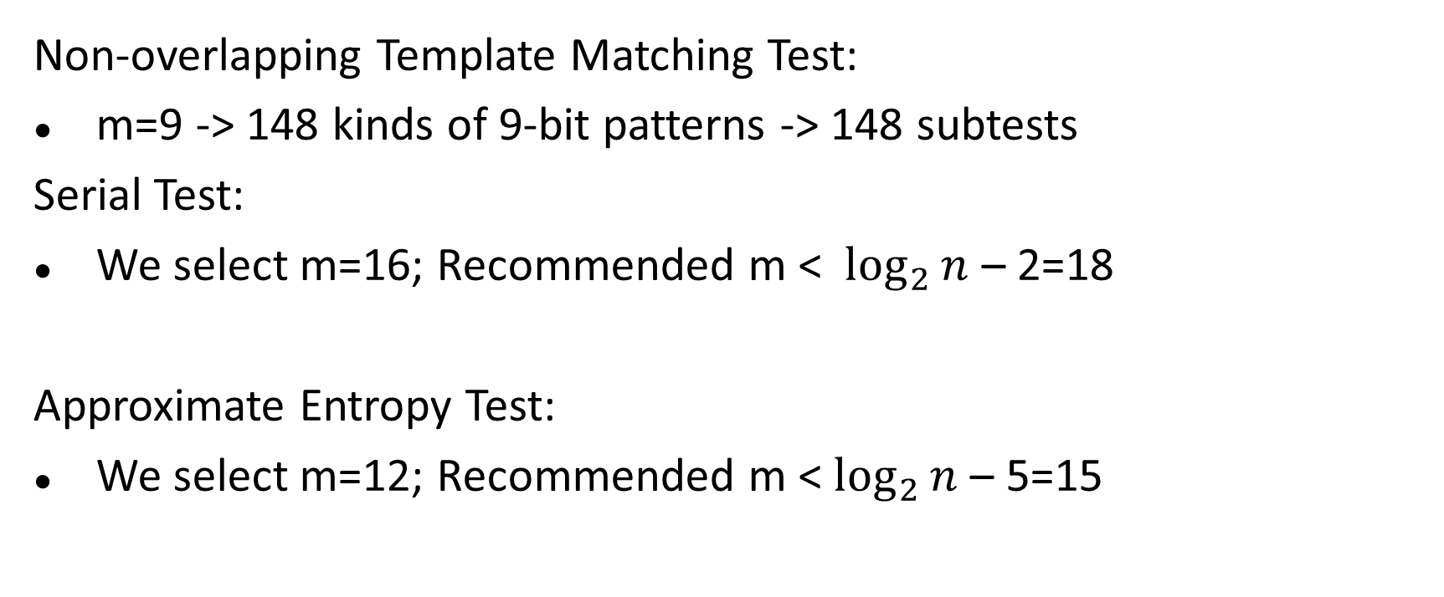
Parameter-Dependant Tests
03
Non-overlapping Template Matching Test:
m=9 -> 148 kinds of 9-bit patterns -> 148 subtests
Serial Test:
We select m=16; Recommended m < $\log_{2}{n}$ – 2=18
Approximate Entropy Test:
We select m=12; Recommended m < $\log_{2}{n}$ – 5=15

Slide 21
Selection of Sample Size (Y)
03
100 files * 100 * 2^20 bits
50 files * 200 * 2^20 bits

Slide 22
Selection of Sample Size (Y)
03
Sample size should be on the order of the inverse of the significance level (α) -> α = 0.01 -> Y >=100
The larger Y we use, the larger the tolerance of the # of low-quality RN subsequences
Calculate accepted lower bound of the confidence interval:
Y=100: 100*(0.99-0.0298)=96.0=96(in NIST test)
Y=200: 200*(0.99-0.0211)=193.8=193(in NIST test)
*Y=1000: 1000*0.9805=980

Slide 23
Tests Often Fail
03

Slide 24
Non-overlapping Template Matching Test
03
39 fails in 100 files (39%)
54 fails in (148 subtests (m=9) * 100 files) (0.36%)
A common reason for a sequence to be rejected as a random one, but not common for failing a subtest.

Slide 25
Purpose and Test Description
03
Detect generators that produce too many occurrences of a given non-periodic pattern.
An m-bit window is used to search for a specific m-bit pattern. If matches, counter +1.
A measure of how well the observed number of template “hits” matches the expected number of template “hits” (under an assumption of randomness) -> consequent P-value

Slide 26
Why Fail and How to Improve
03
Reason
A small sample size (Y=100)
Too many (148) subtests under recommended m=9 (9-bit pattern)
Solution (in statistical way)
Larger Y
m=8, 7, 6…
Ask NIST to replace the results of these 148 subtests with fewer outcomes, or say, do some further statistical calculation among the 148 results instead of directly 148 P-values for a subsequence.

Slide 27
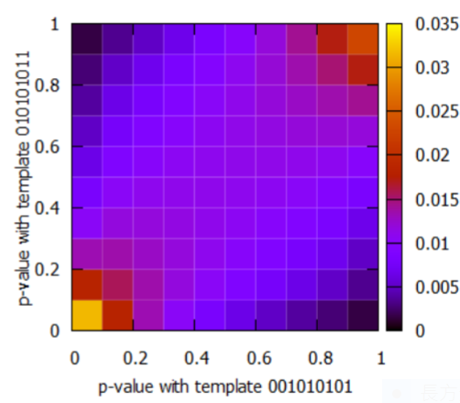
Why Argue an Advanced Non-overlapping Template Matching Test is needed ?
03
High correlation between the tests with some tested patterns
The correlation coefficients can be computed as ρ(001010101, 010101011) = 0.652525 and ρ(001010101, 101010100) = 0.3212—from Atsushi Iwasaki, “Independent Randomness Tests based on the Orthogonalized Non-overlapping Template Matching Test”, 2019

Slide 28
Tests for the
Longest-Run-of-Ones in a Block
03

Slide 29
Example
03
Number of sequences |  | 100 | 200
Total Fails |  | 50% | 20%
Test | Subtest # | Fail #
Frequency Test | 1 | 0 | 0
Frequency Test within a Block | 1 | 0 | 0
Runs Test | 1 | 0 | 0
Longest-Run-of-Ones in a Block | 1 | 2 | 0
Rank Test | 1 | 0 | 0
DFT Test | 1 | 0 | 0
Non-overlapping Template Matching Test | 148 | 39 | 5
Overlapping Template Matching Test | 1 | 0 | 0
Universal Statistical Test | 1 | 1 | 1
Linear Complexity Test | 1 | 1 | 0
Serial Test | 2 | 2 | 1
Approximate Entropy Test | 1 | 1 | 0
Cumulative Sums (Cusums) Test | 2 | 0 | 0
Random Excursions Test | 8 | 6 | 5
Random Excursions Variant Test | 18 | 2 | 0

Slide 30
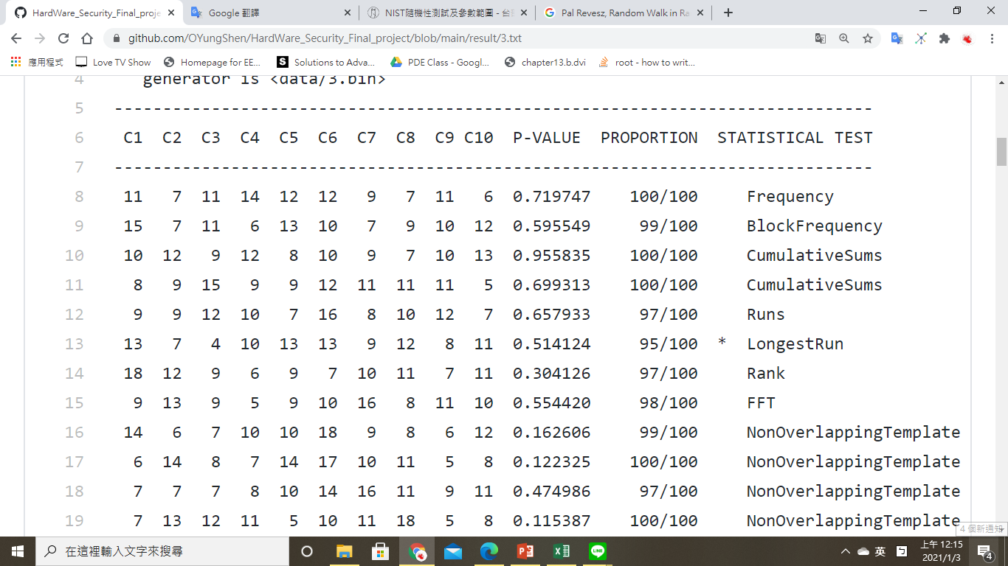
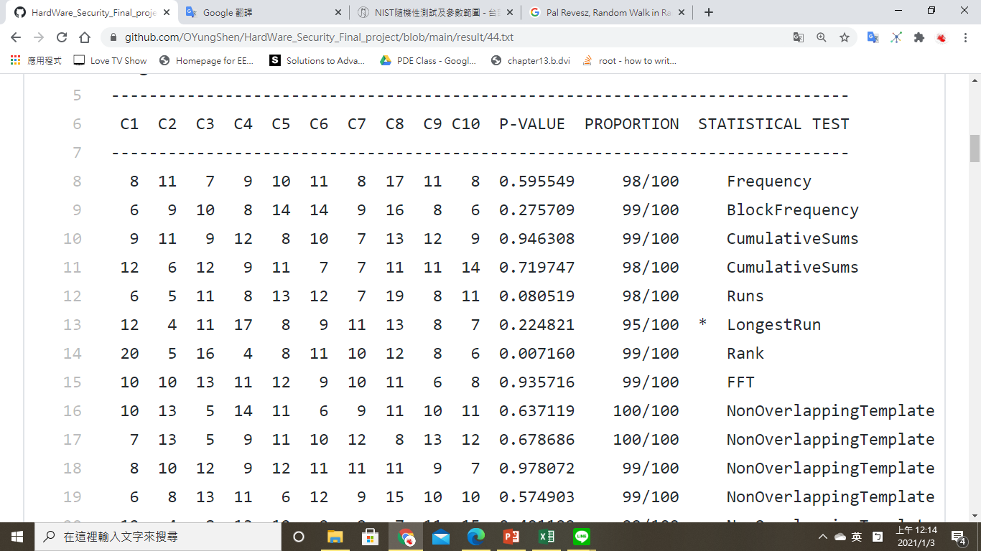
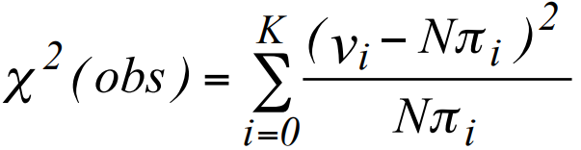
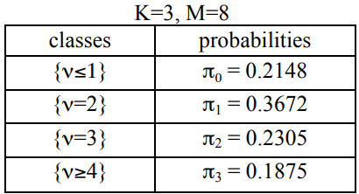
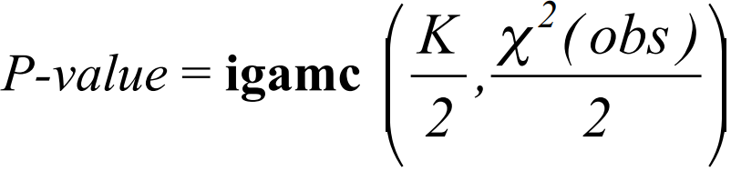
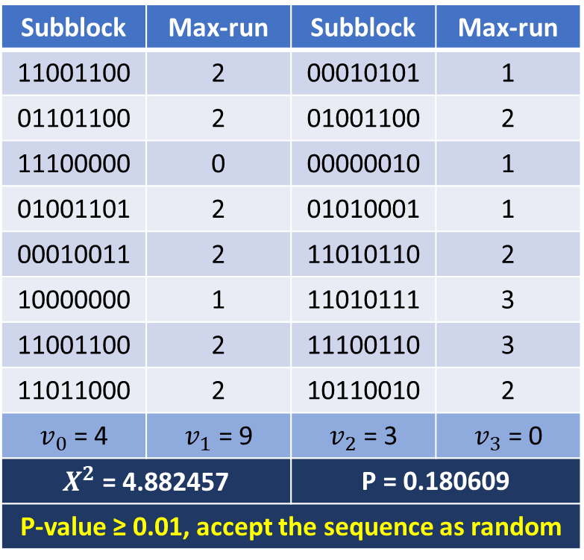
Example
03
n : The length of the bit string. (128)
M : The length of each block. (8)
N : The number of blocks. (16)
input = 11001100000101010110110001001100111000000000001001001101010100010001001111010110100000001101011111001100111001101101100010110010
Subblock | Max-run | Subblock | Max-run
11001100 | 2 | 00010101 | 1
01101100 | 2 | 01001100 | 2
11100000 | 0 | 00000010 | 1
01001101 | 2 | 01010001 | 1
00010011 | 2 | 11010110 | 2
10000000 | 1 | 11010111 | 3
11001100 | 2 | 11100110 | 3
11011000 | 2 | 10110010 | 2
$v_{0}$ = 4 | $v_{1}$ = 9 | $v_{2}$ = 3 | $v_{3}$ = 0
$X^{2}$ = 4.882457 |  | P = 0.180609
P-value ≥ 0.01, accept the sequence as random

Slide 31
Random Excursions Test
03

Slide 32
Test Purpose
03
The number of cycles having exactly K visits in a cumulative sum random walk
Cumulative sum random walk
A cycle of a random walk
To determine if the number of visits to a particular state within a cycle deviates from what one would expect for a random sequence. This test is actually a series of eight tests (and conclusions), one test and conclusion for each of the states: -4, -3, -2, -1 and +1, +2, +3, +4.

Slide 33
Test Description
03
Form a normalized (-1, +1) sequence X: The zeros and ones of the input sequence (ε) are changed to values of –1 and +1 via Xi = 2εi – 1.
Compute the partial sums Si of successively larger subsequences, each starting with X1. Form the set S ={Si}.
Form a new sequence S' by attaching zeros before and after the set S. That is, S' = 0, s1, s2, … , sn,0.
Let J = the total number of zero crossings in S‘, where a zero crossing is a value of zero in S ’ that occurs after the starting zero. J is also the number of cycles in S′

Slide 34
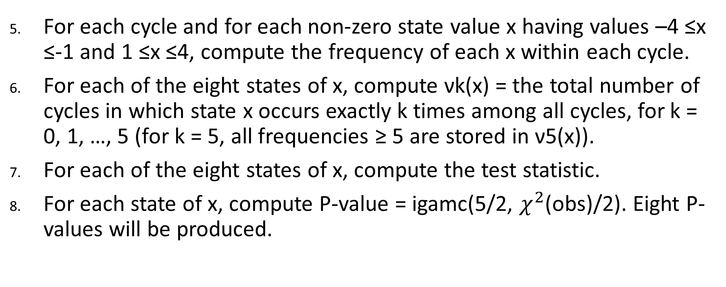
Test Description
03
For each cycle and for each non-zero state value x having values –4 ≤x ≤-1 and 1 ≤x ≤4, compute the frequency of each x within each cycle.
For each of the eight states of x, compute νk(x) = the total number of cycles in which state x occurs exactly k times among all cycles, for k = 0, 1, …, 5 (for k = 5, all frequencies ≥ 5 are stored in ν5(x)).
For each of the eight states of x, compute the test statistic.
For each state of x, compute P-value = igamc(5/2, $χ^{2}$(obs)/2). Eight P-values will be produced.

Slide 35
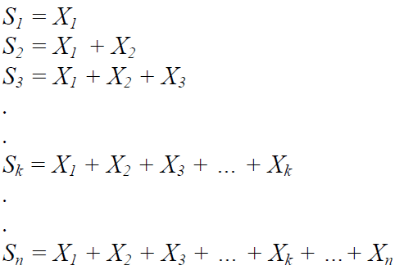
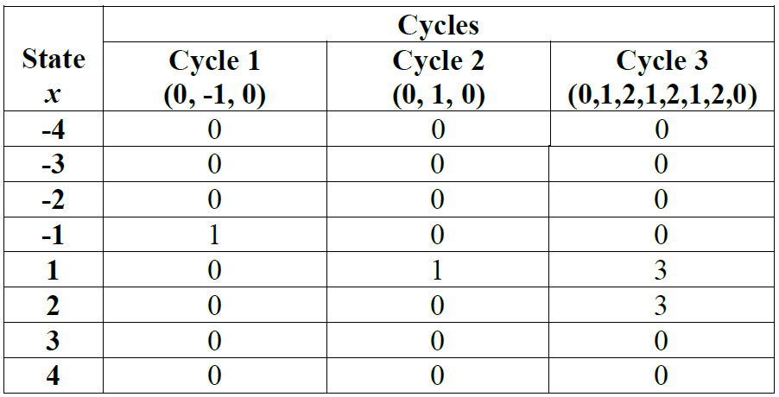
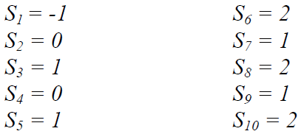
Example
03

Slide 36
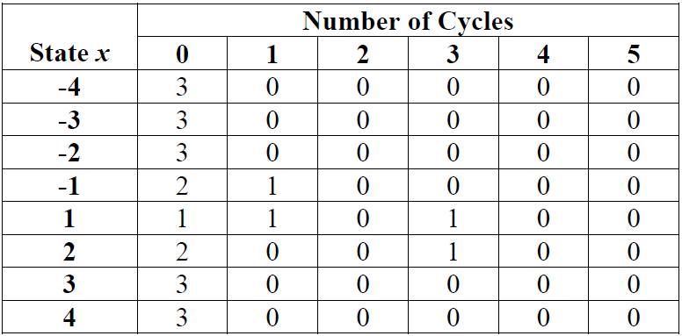



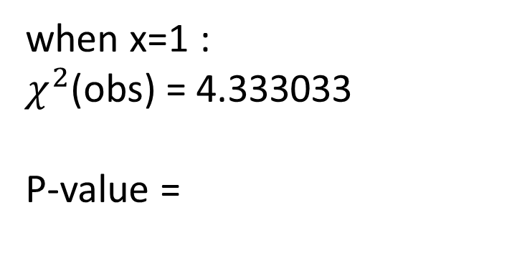
Example
03
when x=1 :
$χ^{2}$(obs) = 4.333033
P-value =
0.502529 ≧ 0.01
→ the sequence is random

Slide 37
Why Fail and How to Improve
03
If the computed P-value is < 0.01, then conclude that the sequence is non-random. Otherwise, conclude that the sequence is random.
Reason :
P-value formulas may result in bogus values due to difficulties arising from numerical approximations.
Improve the P-value formulas may improve the results.

Slide 38
01
資料蒐集
Sample size
蒐集方法
02
參數設定
參數設定
03
結果與分析
Pass rate
分析
04
Quality of TRNG
Quality of TRNG

Slide 39
Quality of TRNG
04

Slide 40
Thank You for Listening
04

Slide 41
Q&A

