Slide 1


Pass? Fail? For a Specific subtest
188 subtests for each binary sequence (file)
Proportion of (sub)Sequences Passing a Test
Confidence Interval:
Uniform Distribution of P-values

Slide 2
Pass Rate
Rate of sufficiently random sequence generated from an RNG
Sufficiently random: Pass all subtests in NIST SP900-22
Pass Rate for the collected random number sequences: 50%

Slide 3
Possible Reasons for Failure

Slide 4
Insufficient Length of Sequence
Test | Length of sequence(n) | # of Fails | # of Subtests
Frequency Test | >100 | 0 | 1
Frequency Test within a Block | >100 | 0 | 1
Runs Test | >100 | 0 | 1
Longest-Run-of-Ones in a Block | 904,960 ~ 2,068,480 (in our case) | 2 | 1
Rank Test | >=38912(QM) | 0 | 1
DFT Test | >1000 | 0 | 1
Non-overlapping Template Matching Test | None | 39 | 148
Overlapping Template Matching Test | >10^6 | 0 | 1
Universal Statistical" Test | >=750,000 (in our case) | 1 | 1
Linear Complexity Test | >10^6 | 1 | 1
Serial Test | None | 2 | 2
Approximate Entropy Test | None | 1 | 1
Cumulative Sums (Cusums) Test | >100 | 0 | 1
Random Excursions Test | >10^6 | 6 | 8
Random Excursions Variant Test | >10^6 | 2 | 18

Slide 5
Parameter-Dependant Tests
Test | Length of sequence(n) | Block size | Length of template | # of Fails | # of Subtests
Frequency Test | >100 | None | None | 0 | 1
Frequency Test within a Block | >100 | M > 0.01n | None | 0 | 1
Runs Test | >100 | None | None | 0 | 1
Longest-Run-of-Ones in a Block | 看圖 | None | None | 2 | 1
Rank Test | >=38912(QM) | None | None | 0 | 1
DFT Test | >1000 | None | None | 0 | 1
Non-overlapping Template Matching Test | None | M > 0.01n | m = 9, 10 | 39 | 148
Overlapping Template Matching Test | >10^6 | None | m = 9, 10 | 0 | 1
Universal Statistical" Test | 看圖 | None | None | 1 | 1
Linear Complexity Test | >10^6 | 500~5000 | None | 1 | 1
Serial Test | None | m < log_2(n) - 2 | None | 2 | 2
Approximate Entropy Test | None | m < log_2(n) - 5 | None | 1 | 1
Cumulative Sums (Cusums) Test | >100 | None | None | 0 | 1
Random Excursions Test | >10^6 | None | None | 6 | 8
Random Excursions Variant Test | >10^6 | None | None | 2 | 18

Slide 6
Parameter-Dependant Tests (cont’d)
Non-overlapping Template Matching Test:
m=9 -> 148 kinds of 9-bit patterns -> 148 subtests
Serial Test:
We select m=16; Recommended m < log_2(n) – 2=18
Approximate Entropy Test:
We select m=12; Recommended m < log_2(n) – 5=15

Slide 7
Selection of Sample Size (Y)
100 files * 100 * 2^20 bits
50 files * 200 * 2^20 bits

Slide 8
Selection of Sample Size (Y) (cont’d)
Sample size should be on the order of the inverse of the significance level (α) -> α = 0.01 -> Y >=100
The larger Y we use, the larger the tolerance of the # of low-quality RN subsequences
Calculate accepted lower bound of the confidence interval:
Y=100: 100*(0.99-0.0298)=96.0=96(in NIST test)
Y=200: 200*(0.99-0.0211)=193.8=193(in NIST test)
*Y=1000: 1000*0.9805=980

Slide 9
Tests Often Fail

Slide 10
Non-overlapping Template Matching Test
36 fails in 100 files (36%)
39 fails in (148 subtests (m=9) * 100 files) (0.26%)
-> A common reason for a sequence to be rejected as a random one, but not common for failing a subtest.

Slide 11
Purpose and Test Description
Detect generators that produce too many occurrences of a given non-periodic pattern.
An m-bit window is used to search for a specific m-bit pattern. If matches, counter +1.
A measure of how well the observed number of template “hits” matches the expected number of template “hits” (under an assumption of randomness) -> consequent P-value

Slide 12
Why Fail and How to Improve
Reason
A small sample size (Y=100)
Too many (148) subtests under recommended m=9 (9-bit pattern)
Solution (in statistical way)
Larger Y
m=8, 7, 6…
Ask NIST to replace the results of these 148 subtests with fewer outcomes, or say, do some further statistical calculation among the 148 results instead of directly 148 P-values for a subsequence.

Slide 13
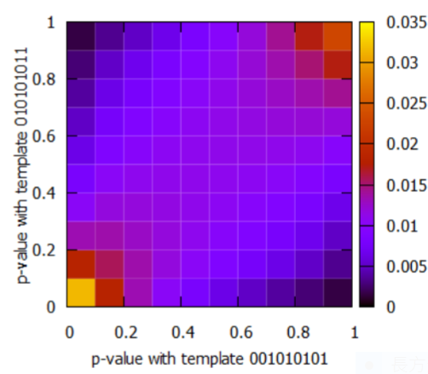
Why Argue an Advanced Non-overlapping Template Matching Test is needed
High correlation between the tests with some tested patterns
The correlation coefficients can be computed as ρ(001010101, 010101011) = 0.652525 and ρ(001010101, 101010100) = 0.3212—from Atsushi Iwasaki, “Independent Randomness Tests based on the Orthogonalized Non-overlapping Template Matching Test”, 2019

Slide 14
Quanlity of the TRNG

Slide 15
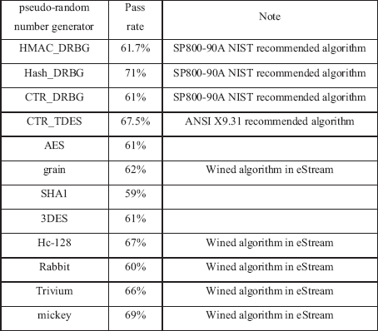
Pass Rate: 50%
Known PRNGs
It seems that the RNG doesn’t perform as well as the proposed known PRNGs.
However, those PRNGs are designed for the purpose of being statistically random, while the RNG we use is a truly one whose performance of statistical randomness is also reliable to some extent.

