Slide 1
Random Excursions Test

Slide 2
Test Purpose
The number of cycles having exactly K visits in a cumulative sum random walk
Cumulative sum random walk
A cycle of a random walk
To determine if the number of visits to a particular state within a cycle deviates from what one would expect for a random sequence. This test is actually a series of eight tests (and conclusions), one test and conclusion for each of the states: -4, -3, -2, -1 and +1, +2, +3, +4.
Notes:
這個 test focus 在累積總和 random walk 中恰好有K次訪問的週期數。累積總和 random walk 是從(0,1) sequence 轉成(-1, +1) sequence 後的 partial sums 衍生而來。
一個random walk 的週期是由從原點開始並返回原點，隨機採取的單位長度的一連串步驟組成。

Slide 3
Test Description
Form a normalized (-1, +1) sequence X: The zeros and ones of the input sequence (ε) are changed to values of –1 and +1 via Xi = 2εi – 1.
Compute the partial sums Si of successively larger subsequences, each starting with X1. Form the set S ={Si}.
Form a new sequence S' by attaching zeros before and after the set S. That is, S' = 0, s1, s2, … , sn,0.
Let J = the total number of zero crossings in S‘, where a zero crossing is a value of zero in S ’ that occurs after the starting zero. J is also the number of cycles in S′

Slide 4
Test Description
For each cycle and for each non-zero state value x having values –4 ≤x ≤-1 and 1 ≤x ≤4, compute the frequency of each x within each cycle.
For each of the eight states of x, compute νk(x) = the total number of cycles in which state x occurs exactly k times among all cycles, for k = 0, 1, …, 5 (for k = 5, all frequencies ≥ 5 are stored in ν5(x)).
For each of the eight states of x, compute the test statistic.
For each state of x, compute P-value = igamc(5/2, χ^2(obs)/2). Eight P-values will be produced.

Slide 5
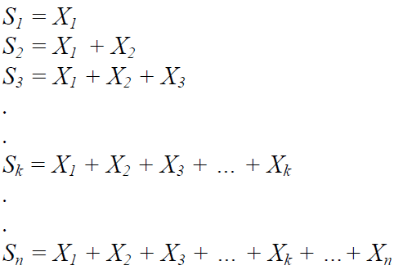
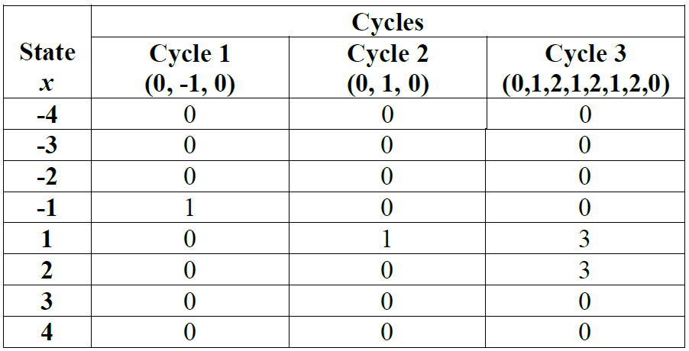
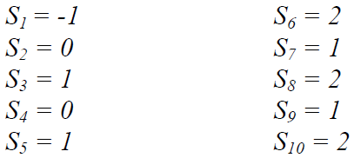
Example

Slide 6
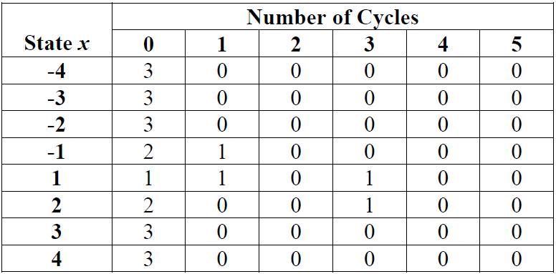



Example
when x=1 :
χ^2(obs) = 4.333033
P-value =
0.502529 ≧ 0.01
→ the sequence is random

Slide 7
Why Fail and How to Improve
If the computed P-value is < 0.01, then conclude that the sequence is non-random. Otherwise, conclude that the sequence is random.
Reason :
P-value formulas may result in bogus values due to difficulties arising from numerical approximations.
Improve the P-value formulas may improve the results.

