Slide 1
Number of sequences |  | 100 | 200
Total Fails |  | 50% | 20%
Test | Subtest # | Fail #
Frequency Test | 1 | 0 | 0
Frequency Test within a Block | 1 | 0 | 0
Runs Test | 1 | 0 | 0
Longest-Run-of-Ones in a Block | 1 | 2 | 0
Rank Test | 1 | 0 | 0
DFT Test | 1 | 0 | 0
Non-overlapping Template Matching Test | 148 | 39 | 5
Overlapping Template Matching Test | 1 | 0 | 0
Universal Statistical Test | 1 | 1 | 1
Linear Complexity Test | 1 | 1 | 0
Serial Test | 2 | 2 | 1
Approximate Entropy Test | 1 | 1 | 0
Cumulative Sums (Cusums) Test | 2 | 0 | 0
Random Excursions Test | 8 | 6 | 5
Random Excursions Variant Test | 18 | 2 | 0

Slide 2
Tests for the Longest-Run-of-Ones in a Block

Slide 3
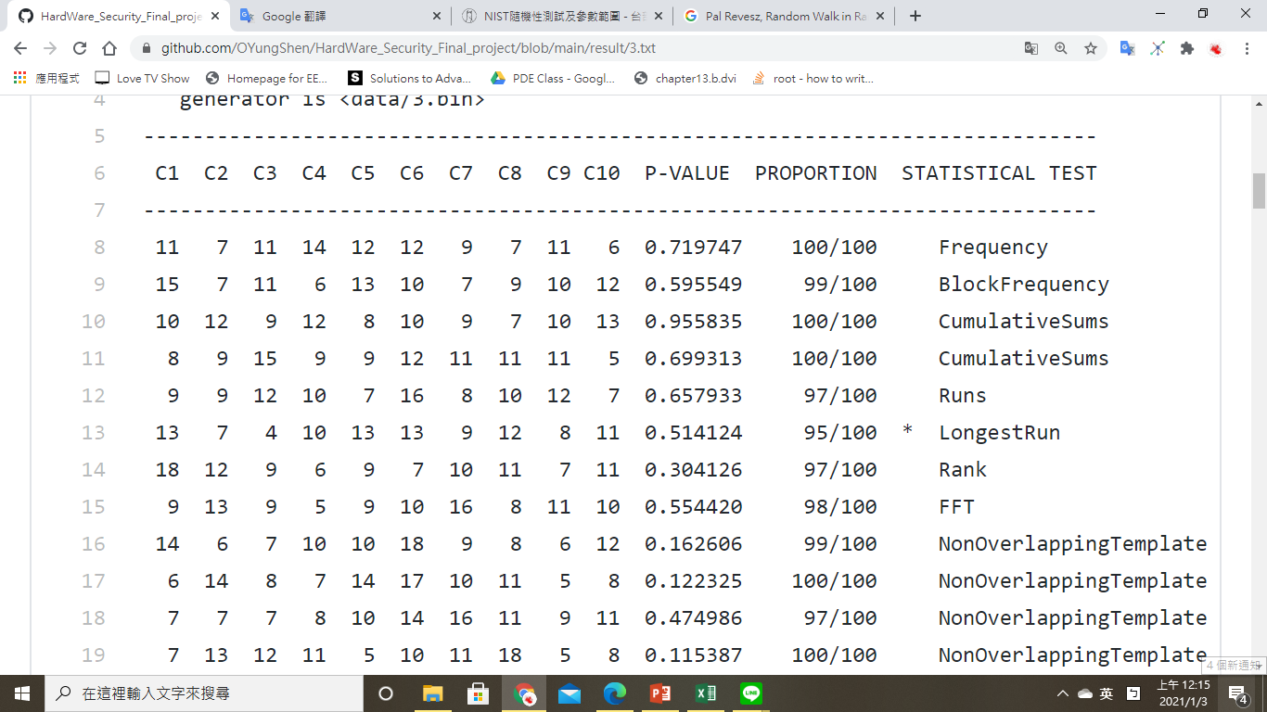
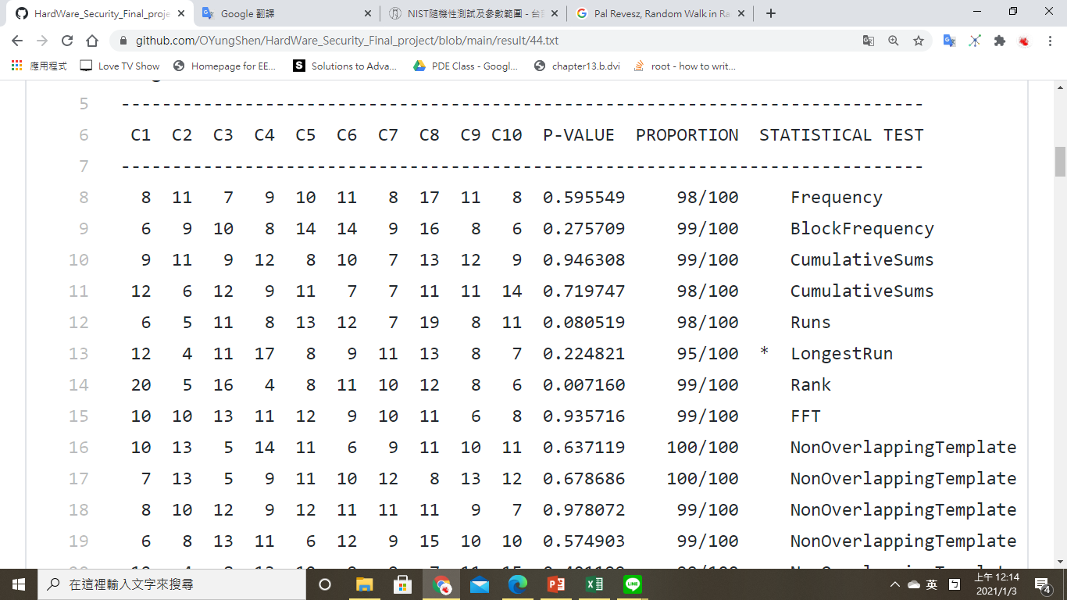
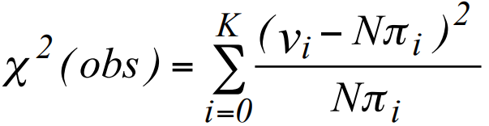
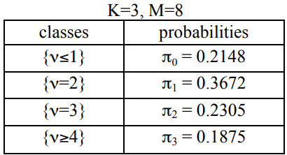
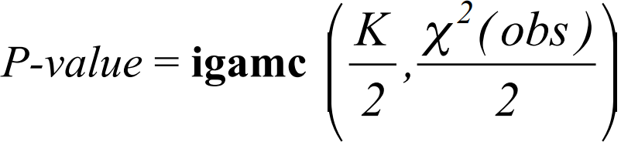
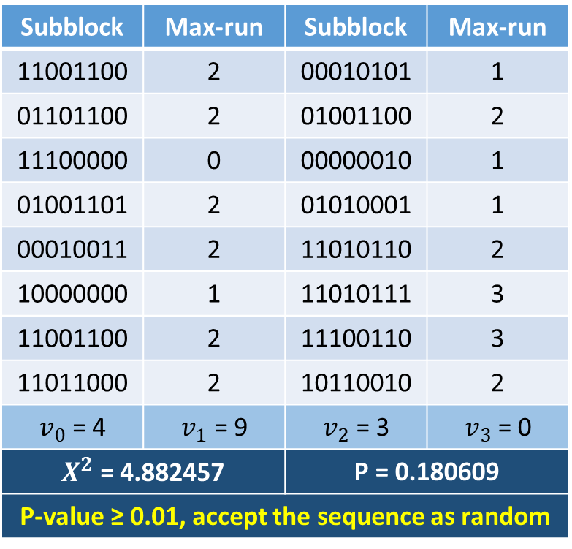
Example
n : The length of the bit string. (128)
M : The length of each block. (8)
N : The number of blocks. (16)
input = 11001100000101010110110001001100111000000000001001001101010100010001001111010110100000001101011111001100111001101101100010110010
Subblock | Max-run | Subblock | Max-run
11001100 | 2 | 00010101 | 1
01101100 | 2 | 01001100 | 2
11100000 | 0 | 00000010 | 1
01001101 | 2 | 01010001 | 1
00010011 | 2 | 11010110 | 2
10000000 | 1 | 11010111 | 3
11001100 | 2 | 11100110 | 3
11011000 | 2 | 10110010 | 2
$v_{0}$ = 4 | $v_{1}$ = 9 | $v_{2}$ = 3 | $v_{3}$ = 0
$X^{2}$ = 4.882457 |  | P = 0.180609
P-value ≥ 0.01, accept the sequence as random

