Slide 1
Motivation
Method
Research
To-dos
硬體安全導論
Final Project
第二組
姓名
．Introduction
．Problem
．Objective
．Window
．Uniform region
．Side view
．Color
．Light test
．Other factor
．Curvature
．Gloss
．Different camera

Slide 2

大綱
資料收集
參數設定
實驗與分析
比較
Sample size
蒐集方法
Pass rate
分析

Slide 3
01
資料蒐集
Sample size
蒐集方法
02
參數設定
參數設定
03
實驗與分析
Pass rate
分析
04
比較

Slide 4
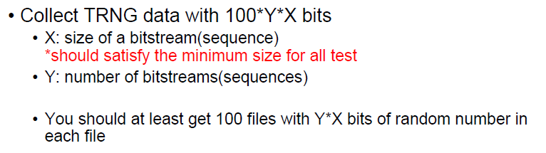
如何選擇X與Y?
01
資料蒐集
Sample size
蒐集方法
02
參數設定
參數設定
03
實驗與分析
Pass rate
分析
04
比較

Slide 5
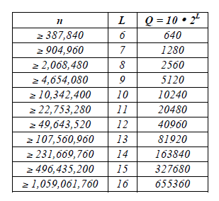
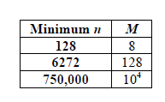
Sample size -如何選擇X?
01
Test | Length of sequence(n) | block size | length of template
Frequency Test | >100 | None | None
Frequency Test within a Block | >100 | M>=20, M > 0.01n | None
Runs Test | >100 | None | None
Longest-Run-of-Ones in a Block | 看圖 | None | None
Rank Test | >=38912(QM) | None | None
DFT Test | >1000 | None | None
Non-overlapping Template Matching Test | None | M > 0.01n | m = 9, 10
Overlapping Template Matching Test | >10^6 | None | m = 9, 10
Universal Statistical" Test | 看圖 | None | None
Linear Complexity Test | >10^6 | 500~5000 | None
Serial Test | None | m < log_2(n) - 2 | None
Approximate Entropy Test | None | m < log_2(n) - 5 | None
Cumulative Sums (Cusums) Test | >100 | None | None
Random Excursions Test | >10^6 | None | None
Random Excursions Variant Test | >10^6 | None | None
Longest Run-of-Ones in a Block
Universal Statistical Test

Slide 6
Sample size -如何選擇X?
01
Test | Length of sequence(n) | block size | length of template
Frequency Test | >100 | None | None
Frequency Test within a Block | >100 | M>=20, M > 0.01n | None
Runs Test | >100 | None | None
Longest-Run-of-Ones in a Block | 看圖 | None | None
Rank Test | >=38912(QM) | None | None
DFT Test | >1000 | None | None
Non-overlapping Template Matching Test | None | M > 0.01n | m = 9, 10
Overlapping Template Matching Test | >10^6 | None | m = 9, 10
Universal Statistical" Test | 看圖 | None | None
Linear Complexity Test | >10^6 | 500~5000 | None
Serial Test | None | m < log_2(n) - 2 | None
Approximate Entropy Test | None | m < log_2(n) - 5 | None
Cumulative Sums (Cusums) Test | >100 | None | None
Random Excursions Test | >10^6 | None | None
Random Excursions Variant Test | >10^6 | None | None
Longest Run-of-Ones in a Block
Universal Statistical Test

Slide 7
Sample size -如何選擇X?
01
Test | Length of sequence(n) | block size | length of template
Frequency Test | >100 | None | None
Frequency Test within a Block | >100 | M>=20, M > 0.01n | None
Runs Test | >100 | None | None
Longest-Run-of-Ones in a Block | 看圖 | None | None
Rank Test | >=38912(QM) | None | None
DFT Test | >1000 | None | None
Non-overlapping Template Matching Test | None | M > 0.01n | m = 9, 10
Overlapping Template Matching Test | >10^6 | None | m = 9, 10
Universal Statistical" Test | 看圖 | None | None
Linear Complexity Test | >10^6 | 500~5000 | None
Serial Test | None | m < log_2(n) - 2 | None
Approximate Entropy Test | None | m < log_2(n) - 5 | None
Cumulative Sums (Cusums) Test | >100 | None | None
Random Excursions Test | >10^6 | None | None
Random Excursions Variant Test | >10^6 | None | None
Longest Run-of-Ones in a Block
Universal Statistical Test

Slide 8

Sample size -如何選擇X?
01
$$X≥{10}^{6}$$
Longest Run-of-Ones in a Block
Universal Statistical Test

Slide 9
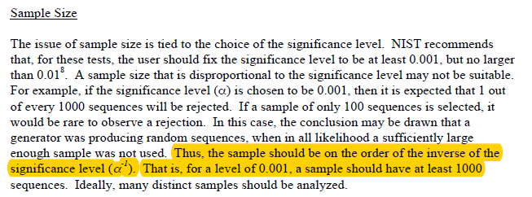
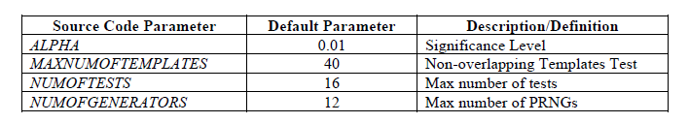
Sample size -如何選擇Y?
01
Longest Run-of-Ones in a Block
Universal Statistical Test

Slide 10

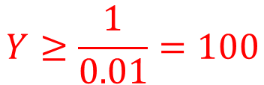
Sample size -如何選擇Y?
01
$$X≥{10}^{6}≈2^{20}$$
100 files
Baud rate = 115200 bits/s
$$Y≥\frac{1}{0.01}=100$$

Slide 11
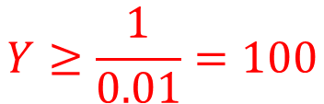

如何選擇X與Y?
01
$$X≥{10}^{6}≈2^{20}$$
$$Y≥\frac{1}{0.01}=100$$
100 files
Baud rate = 115200 bits/s

Slide 12

如何選擇X與Y?
01
$$X≥{10}^{6}≈2^{20}$$
$$Y≥\frac{1}{0.01}=100$$
$$\frac{{(2}^{20}×100×100)}{115200}≈91022s≈1.05天$$
100 files
Baud rate = 115200 bits/s

Slide 13



如何選擇X與Y?
01
資料蒐集
Sample size
蒐集方法
$$X≥{10}^{6}≈2^{20}$$
參數設定
參數設定
$$Y≥\frac{1}{0.01}=100$$
$$\frac{{(2}^{20}×100×100)}{115200}≈91022s≈1.05天$$
實驗與分析
Pass rate
分析
100 files
$$X=2^{20}$$
比較
Baud rate = 115200 bits/s
$$Y=100$$
$$Sample sie=12.5MB$$

Slide 14
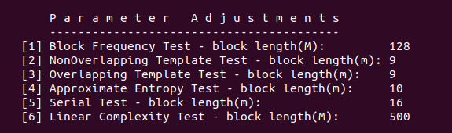
01
資料蒐集
Sample size
蒐集方法
$$X≥{10}^{6}≈2^{20}$$
02
參數設定
參數設定
$$Y≥\frac{1}{0.01}=100$$
$$\frac{{(2}^{20}×100×100)}{115200}≈91022s≈1.05天$$
03
實驗與分析
Pass rate
分析
100 files
$$X=2^{20}$$
04
比較
Baud rate = 115200 bits/s
$$Y=100$$
$$Sample sie=12.5MB$$

Slide 15
參數設定
02
01
資料蒐集
Sample size
蒐集方法
參數設定
參數設定
03
實驗與分析
Pass rate
分析
04
比較

Slide 16
參數設定
02
Test | Length of sequence(n) | block size | length of template
Frequency Test | >100 | None | None
Frequency Test within a Block | >100 | M>=20, M > 0.01n | None
Runs Test | >100 | None | None
Longest-Run-of-Ones in a Block | 看圖 | None | None
Rank Test | >=38912(QM) | None | None
DFT Test | >1000 | None | None
Non-overlapping Template Matching Test | None | M > 0.01n | m = 9, 10
Overlapping Template Matching Test | >10^6 | None | m = 9, 10
Universal Statistical" Test | 看圖 | None | None
Linear Complexity Test | >10^6 | 500~5000 | None
Serial Test | None | m < log_2(n) - 2 | None
Approximate Entropy Test | None | m < log_2(n) - 5 | None
Cumulative Sums (Cusums) Test | >100 | None | None
Random Excursions Test | >10^6 | None | None
Random Excursions Variant Test | >10^6 | None | None

Slide 17
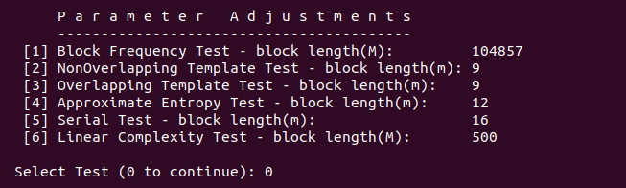
參數設定
02

