Slide 1
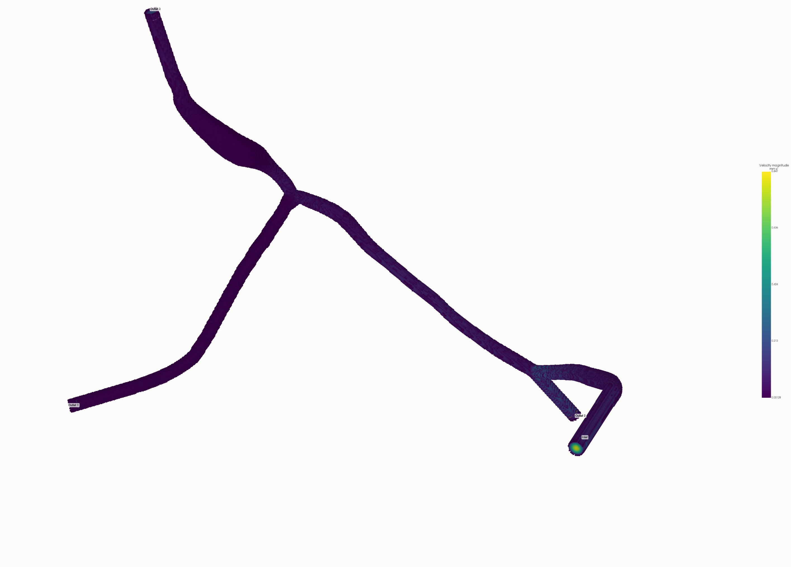
COMPUTATIONAL METHODS · MOUSE MICROVASCULAR ROI
From 1D Vascular Data to Validated 3D CFD
A three-stage workflow for constructing, preparing and solving flow in a mouse microvascular ROI
1D boundary data → prepared lumen → steady 3D field
Accepted Base · physical velocity magnitude (mm s⁻¹)
Notes:
[Sources]
- https://github.com/OZAKI39/ulm-3d-vascular-model-generation/blob/codex/cfd-wall-force-numerics-validated-sync-20260830/outputs/cfd_flow/production_tau1_base_promotion_anchor003274_20260902_013637/flow/production_steady_flow_field_manifest.json
- https://github.com/OZAKI39/ulm-3d-vascular-model-generation/blob/codex/cfd-wall-force-numerics-validated-sync-20260830/outputs/cfd_flow/production_tau1_base_promotion_anchor003274_20260902_013637/visualization/interactive_v3_redesign/01_after_velocity_overview.json
[/Sources]

Slide 2
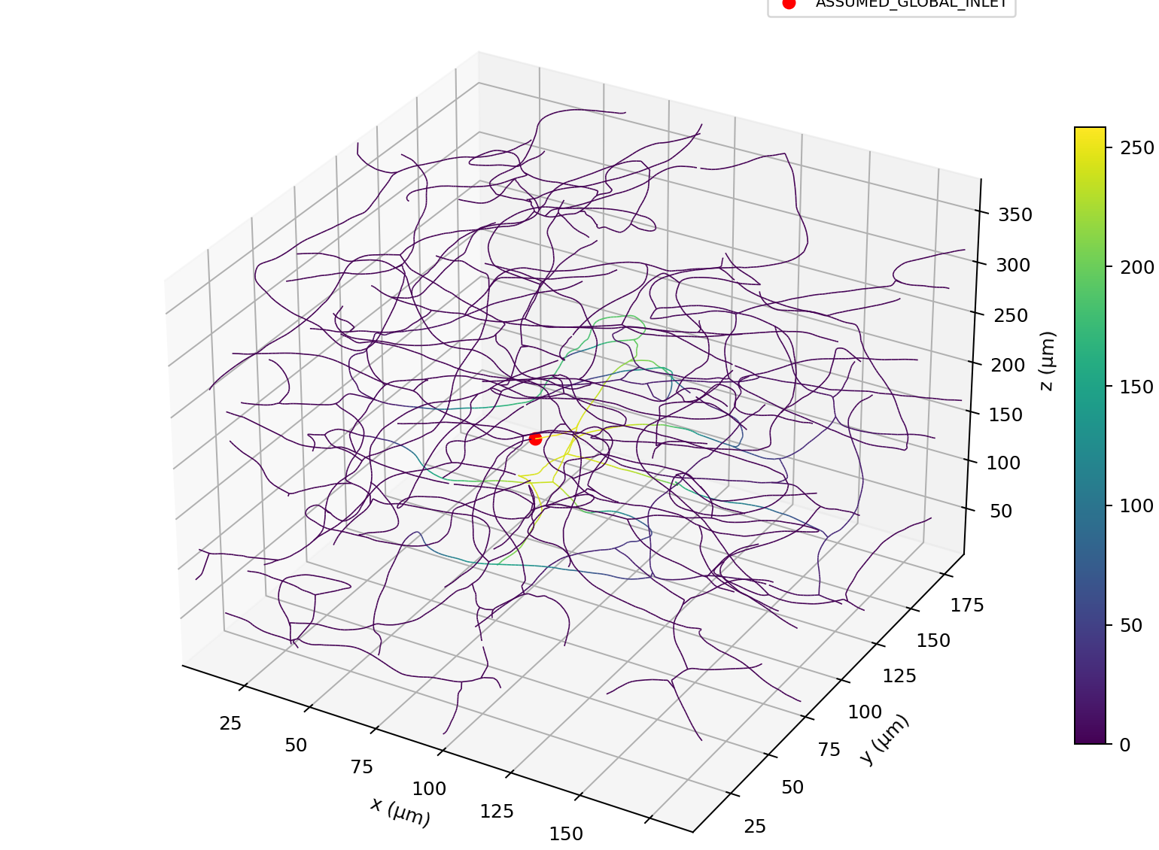
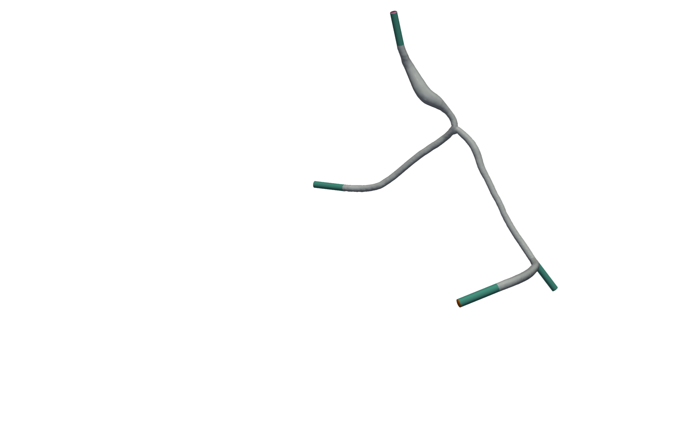
Three stages turn vascular data into a validated 3D flow field
WORKFLOW
01
02
03
1D boundary data
CFD-ready surface
3D flow solution
A reduced network supplies flow and pressure at the local ports.
Extensions and caps create clean regions for boundary conditions.
A validated lattice model resolves steady velocity and gauge pressure.
Scientific hand-off at each stage: boundary values → geometry → validated field
02
Notes:
[Sources]
- https://github.com/OZAKI39/ulm-3d-vascular-model-generation/blob/codex/cfd-wall-force-numerics-validated-sync-20260830/outputs/cfd_preprocess/global_to_roi_anchor003274_20260825_183628/qc/run_summary.json
- https://github.com/OZAKI39/ulm-3d-vascular-model-generation/blob/codex/cfd-wall-force-numerics-validated-sync-20260830/outputs/cfd_surface_prepare/vmtk_tps_boundarynormal_crossseam_finalized_recovery_anchor003274_20260826_221611/qc/final_surface_qc.json
- https://github.com/OZAKI39/ulm-3d-vascular-model-generation/blob/codex/cfd-wall-force-numerics-validated-sync-20260830/outputs/cfd_flow/production_tau1_base_promotion_anchor003274_20260902_013637/qc/run_summary.json
[/Sources]

Slide 3
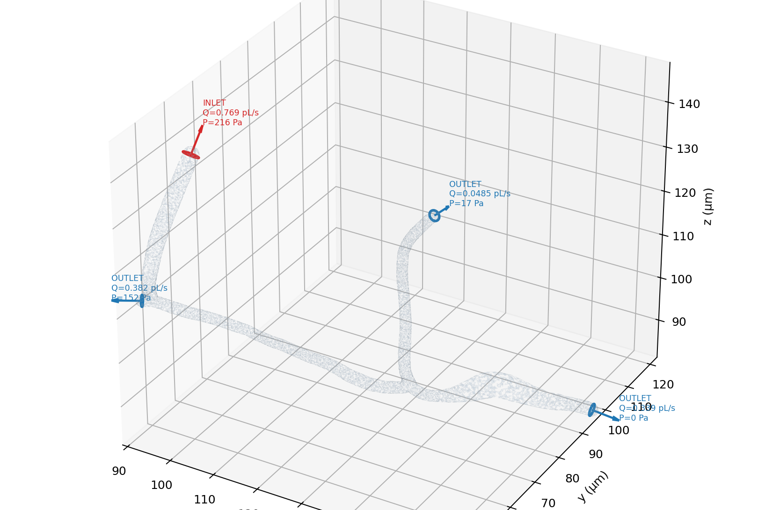
The 1D model supplies consistent 3D boundary conditions
STAGE 1
Global network · color bar: pressure, p (Pa)
How the 3D boundary conditions are constructed
1 · Solve the 1D hydraulic network
Q = Δp / R
R = (8μ/π) ∫₀ᴸ ds / r(s)⁴
Pressure drop, viscosity and vessel radius determine segment flow.
2 · Map 1D pressure onto the prepared ports
p_cut = p_parent − Q R(0→cut)
Local ROI ports
Q [pL/s] · p [Pa]
IN 0.769 · 216
O1 0.0485 · 17
O2 0.382 · 152
O3 0.339 · 0
p_out,i^3D = p_cut,i − Q_i^1D R_i,extension
The second term removes the artificial extension pressure loss.
3 · Apply the final solver boundaries
INLET
Q_target = u_mean,healthy A_inlet = ∫_A u·n dA
adaptive_flux_pressure adjusts inlet pressure to match Q_target
OUTLETS
pressure_eq: p_gauge,i = p_out,i^3D
WALL
wall_libb: u_wall = 0
03
Notes:
[Sources]
- https://github.com/OZAKI39/ulm-3d-vascular-model-generation/blob/codex/cfd-wall-force-numerics-validated-sync-20260830/outputs/cfd_preprocess/global_to_roi_anchor003274_20260825_183628/qc/run_summary.json
- https://github.com/OZAKI39/ulm-3d-vascular-model-generation/blob/codex/cfd-wall-force-numerics-validated-sync-20260830/outputs/cfd_preprocess/global_to_roi_anchor003274_20260825_183628/qc/port_transfer_qc.json
- https://github.com/OZAKI39/ulm-3d-vascular-model-generation/blob/codex/cfd-wall-force-numerics-validated-sync-20260830/outputs/cfd_surface_prepare/vmtk_tps_boundarynormal_crossseam_finalized_recovery_anchor003274_20260826_221611/bc/boundary_conditions_vmtk_boundarynormal_crossseam.json
- https://github.com/OZAKI39/ulm-3d-vascular-model-generation/blob/codex/cfd-wall-force-numerics-validated-sync-20260830/utils/cfd_preprocess/one_d_flow.py
- https://github.com/OZAKI39/ulm-3d-vascular-model-generation/blob/codex/cfd-wall-force-numerics-validated-sync-20260830/utils/cfd_preprocess/port_transfer.py
- https://github.com/OZAKI39/ulm-3d-vascular-model-generation/blob/codex/cfd-wall-force-numerics-validated-sync-20260830/utils/cfd_surface_prepare/vmtk_qc.py
- https://github.com/OZAKI39/ulm-3d-vascular-model-generation/blob/codex/cfd-wall-force-numerics-validated-sync-20260830/outputs/cfd_flow/healthy_mouse_capillary_calibration_anchor003274_20260829_180310/qc/healthy_flow_target_calculation.json
- https://github.com/OZAKI39/ulm-3d-vascular-model-generation/blob/codex/cfd-wall-force-numerics-validated-sync-20260830/outputs/cfd_flow/production_tau1_base_promotion_anchor003274_20260902_013637/input/production_numerical_contract.json
[/Sources]

Slide 4
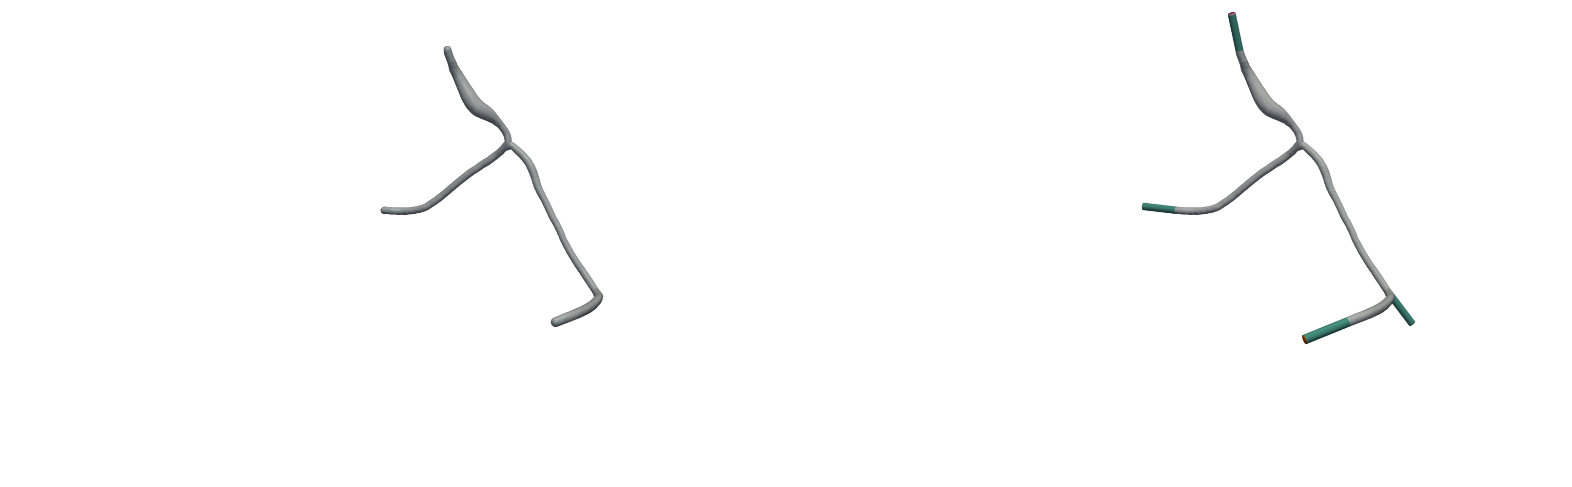
Surface preparation creates a clean solver-ready vascular domain
STAGE 2
BEFORE · open cut surface
AFTER · extended and capped
Core preserved
Boundary-ready
Geometry QC
Inlet
Outlet 1
0 μm max far-core motion
4 capped ports · 1 component
Watertight · 0 intersections
Outlet 2
Outlet 3
04
Notes:
[Sources]
- https://github.com/OZAKI39/ulm-3d-vascular-model-generation/blob/codex/cfd-wall-force-numerics-validated-sync-20260830/outputs/model_generate/ultraliser_anchor003274_20260825_133350/geometry/lumen_surface_um.vtp
- https://github.com/OZAKI39/ulm-3d-vascular-model-generation/blob/codex/cfd-wall-force-numerics-validated-sync-20260830/outputs/cfd_surface_prepare/vmtk_tps_boundarynormal_crossseam_finalized_recovery_anchor003274_20260826_221611/geometry/cfd_surface_vmtk_tps_boundarynormal_crossseam_um.vtp
- https://github.com/OZAKI39/ulm-3d-vascular-model-generation/blob/codex/cfd-wall-force-numerics-validated-sync-20260830/outputs/cfd_surface_prepare/vmtk_tps_boundarynormal_crossseam_finalized_recovery_anchor003274_20260826_221611/qc/final_surface_qc.json
[/Sources]

Slide 5
The 3D solver uses a validated lattice-Boltzmann configuration
STAGE 3
A uniform lattice advances local particle populations until the physical flow field becomes steady.
Uniform 3D lattice
Stream & collide
Steady physical field
DRIVING
Adaptive
inlet flow
The lumen is represented by 182,320 fluid cells.
D3Q19 populations exchange information locally.
Velocity and gauge pressure are recovered in SI units.
3 outlet
gauge pressures
Validated Base configuration
dx
dt
τ
Target Q
0.20 μm
2.039 ns
1.0
0.164 nL/min
Diffusive scaling: dt = dx² / (6ν)
05
Notes:
[Sources]
- https://github.com/OZAKI39/ulm-3d-vascular-model-generation/blob/codex/cfd-wall-force-numerics-validated-sync-20260830/outputs/cfd_flow/production_tau1_base_promotion_anchor003274_20260902_013637/input/production_numerical_contract.json
- https://github.com/OZAKI39/ulm-3d-vascular-model-generation/blob/codex/cfd-wall-force-numerics-validated-sync-20260830/outputs/cfd_flow/production_tau1_base_promotion_anchor003274_20260902_013637/flow/production_steady_flow_field_manifest.json
[/Sources]

Slide 6
Steady CFD resolves velocity across vascular branches
RESULT
PHYSICAL VELOCITY · mm s⁻¹
0.177 mm s⁻¹
mean speed across the accepted Base field
598,755
accepted steady-state iteration
Interpretation
Higher-speed colors are localized around the inlet and selected branch segments.
06
Notes:
[Sources]
- https://github.com/OZAKI39/ulm-3d-vascular-model-generation/blob/codex/cfd-wall-force-numerics-validated-sync-20260830/outputs/cfd_flow/production_tau1_base_promotion_anchor003274_20260902_013637/qc/production_primary_metrics.json
- https://github.com/OZAKI39/ulm-3d-vascular-model-generation/blob/codex/cfd-wall-force-numerics-validated-sync-20260830/outputs/cfd_flow/production_tau1_base_promotion_anchor003274_20260902_013637/visualization/interactive_v3_redesign/01_after_velocity_overview.json
[/Sources]

Slide 7
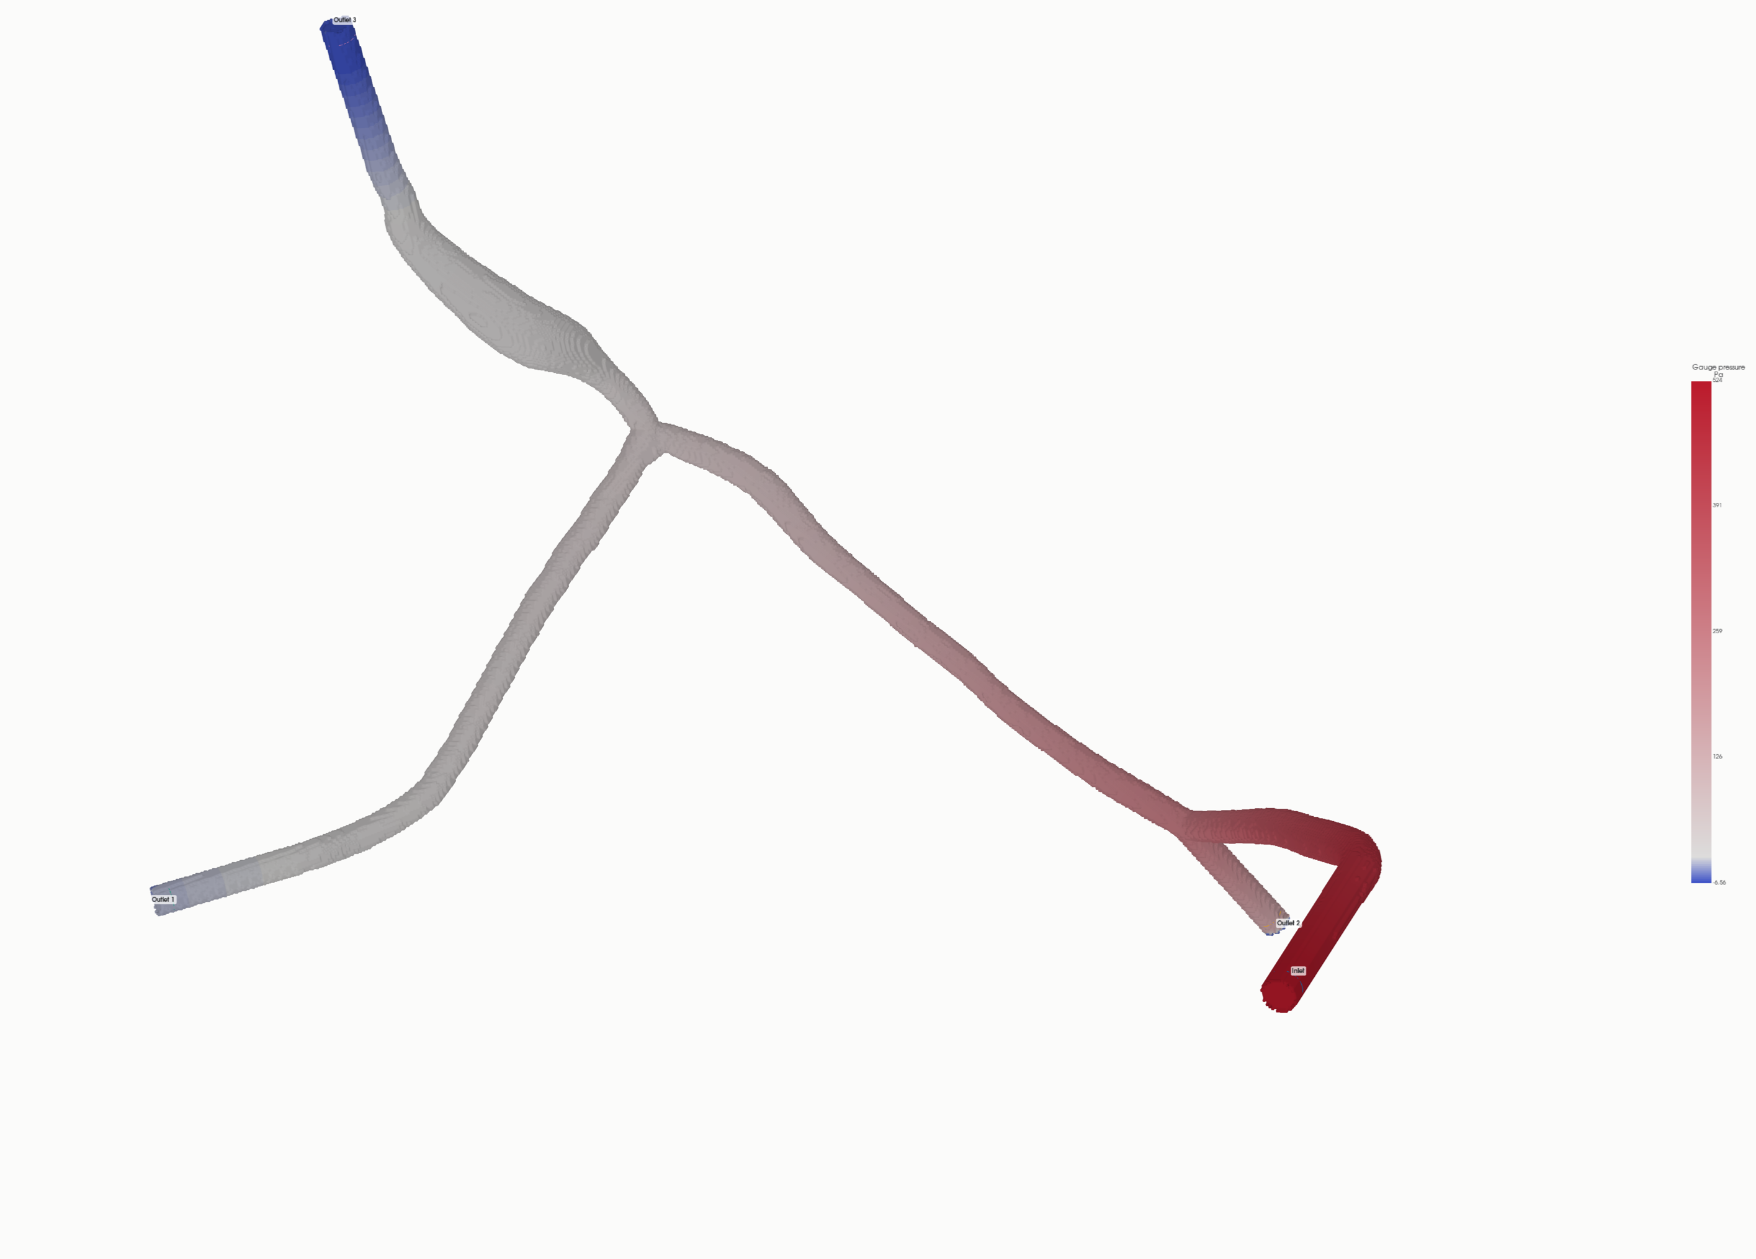
Flow and gauge pressure remain consistent across three outlets
QUANTITATIVE RESULT
GAUGE PRESSURE · Pa
Outlet flow split
0.164 → 0.163
0.154%
inlet → outlet (nL/min)
physical flow closure
531 Pa inlet gauge pressure
07
Notes:
[Sources]
- https://github.com/OZAKI39/ulm-3d-vascular-model-generation/blob/codex/cfd-wall-force-numerics-validated-sync-20260830/outputs/cfd_flow/production_tau1_base_promotion_anchor003274_20260902_013637/qc/production_primary_metrics.json
- https://github.com/OZAKI39/ulm-3d-vascular-model-generation/blob/codex/cfd-wall-force-numerics-validated-sync-20260830/outputs/cfd_flow/production_tau1_base_promotion_anchor003274_20260902_013637/visualization/interactive_v3_redesign/02_after_pressure_overview.json
[/Sources]

Slide 8
The validated Base solution is production-ready within the current study scope
VALIDATION & SCOPE
VALIDATED
CURRENT SCOPE LIMITS
Steady Base solution
Accepted at 598,755 iterations
Three-grid convergence
Richardson/GCI not completed under the compute budget.
Physical flow closure
0.154% (< 1%)
Fine grid
Mesh, controller and 5,000-step safety passed; steady state not completed.
Full-timestep mass identity
7.91e-10 (< 1 × 10⁻⁸)
Numerical safety
Positive populations; low lattice speed
Wall shear stress
Validation is deferred to a later production phase.
Resolution sensitivity
Coarse → Base max difference 1.45%
The validated Base field is the production flow solution used for downstream analysis.
08
Notes:
[Sources]
- https://github.com/OZAKI39/ulm-3d-vascular-model-generation/blob/codex/cfd-wall-force-numerics-validated-sync-20260830/outputs/cfd_flow/production_tau1_base_promotion_anchor003274_20260902_013637/qc/production_steady_qc.json
- https://github.com/OZAKI39/ulm-3d-vascular-model-generation/blob/codex/cfd-wall-force-numerics-validated-sync-20260830/outputs/cfd_flow/production_tau1_base_promotion_anchor003274_20260902_013637/qc/production_full_timestep_v2.json
- https://github.com/OZAKI39/ulm-3d-vascular-model-generation/blob/codex/cfd-wall-force-numerics-validated-sync-20260830/outputs/cfd_flow/production_tau1_base_promotion_anchor003274_20260902_013637/qc/two_grid_resolution_sensitivity.json
- https://github.com/OZAKI39/ulm-3d-vascular-model-generation/blob/codex/cfd-wall-force-numerics-validated-sync-20260830/outputs/cfd_flow/production_tau1_base_promotion_anchor003274_20260902_013637/qc/run_summary.json
[/Sources]

