Slide 1
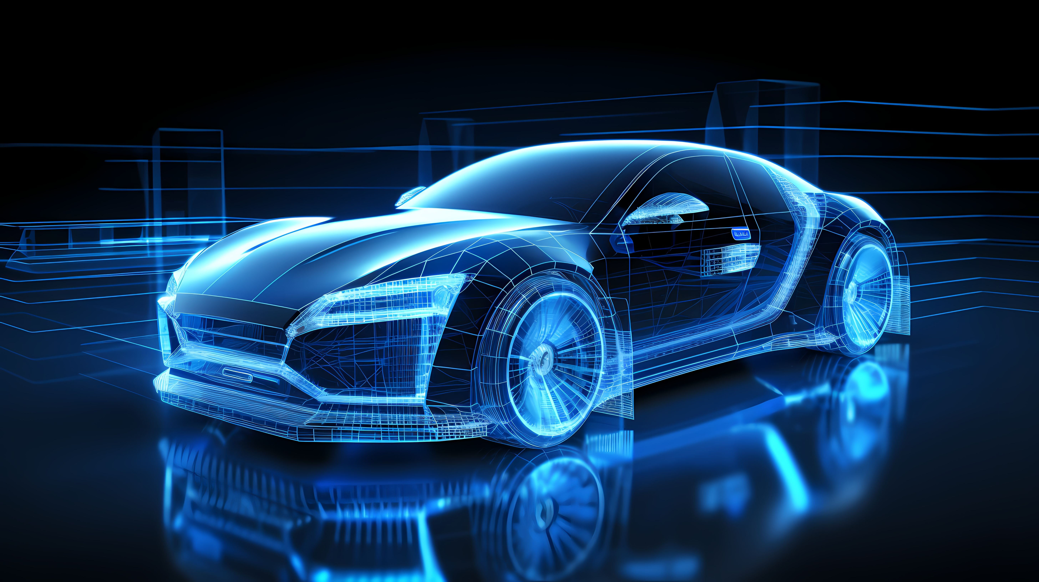
AUTOSYNC Infotainment System
Olamide Aderogba
G00401971

Slide 2
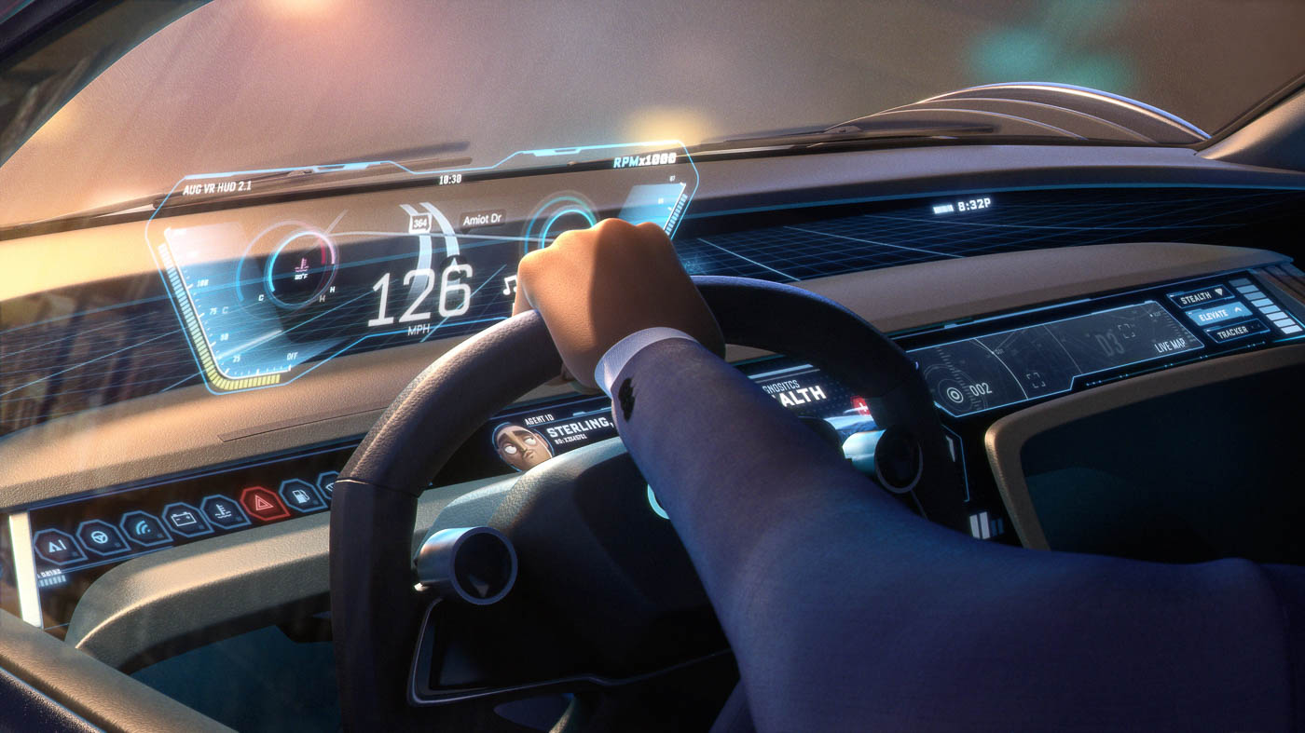
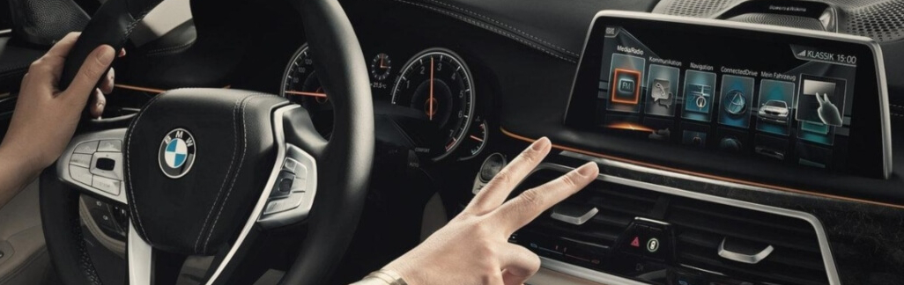
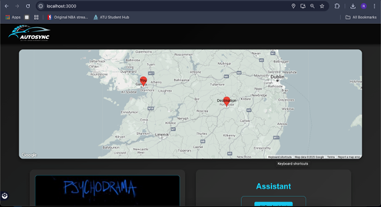
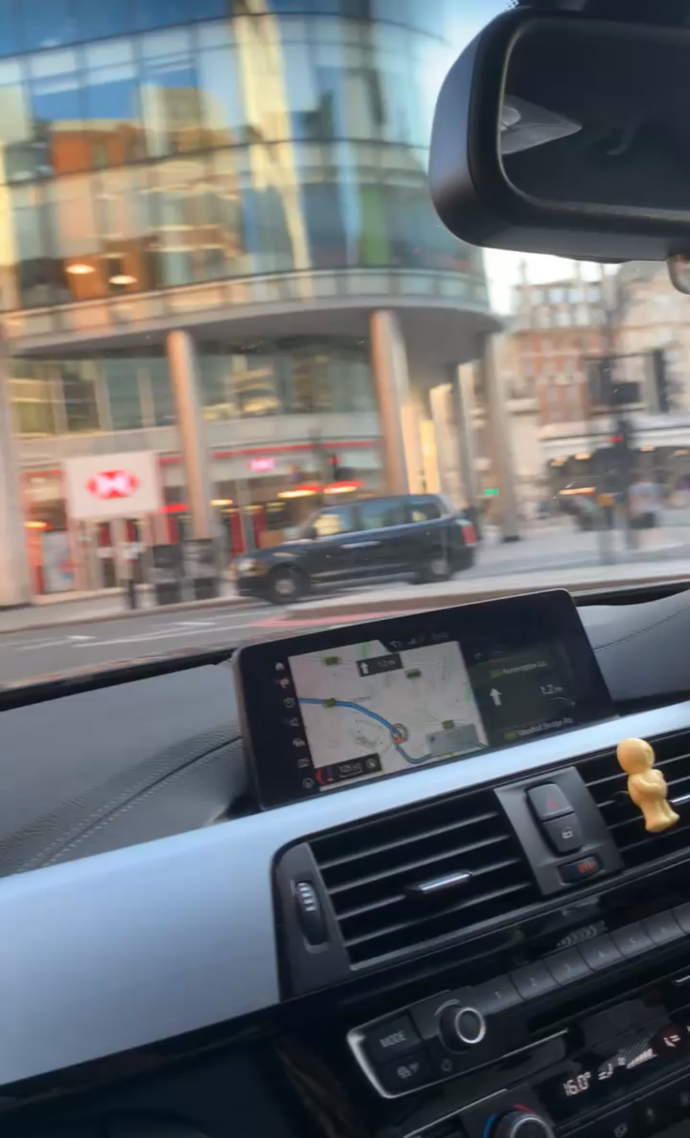
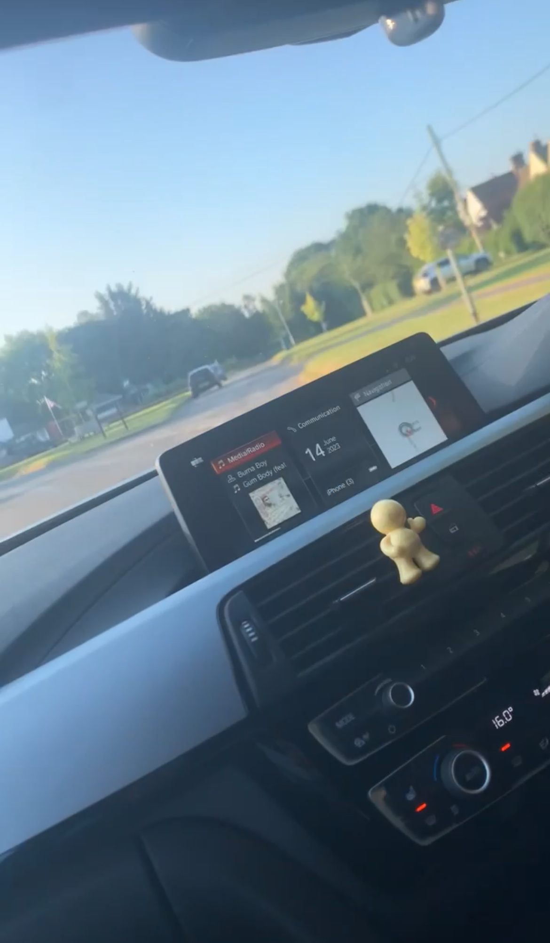
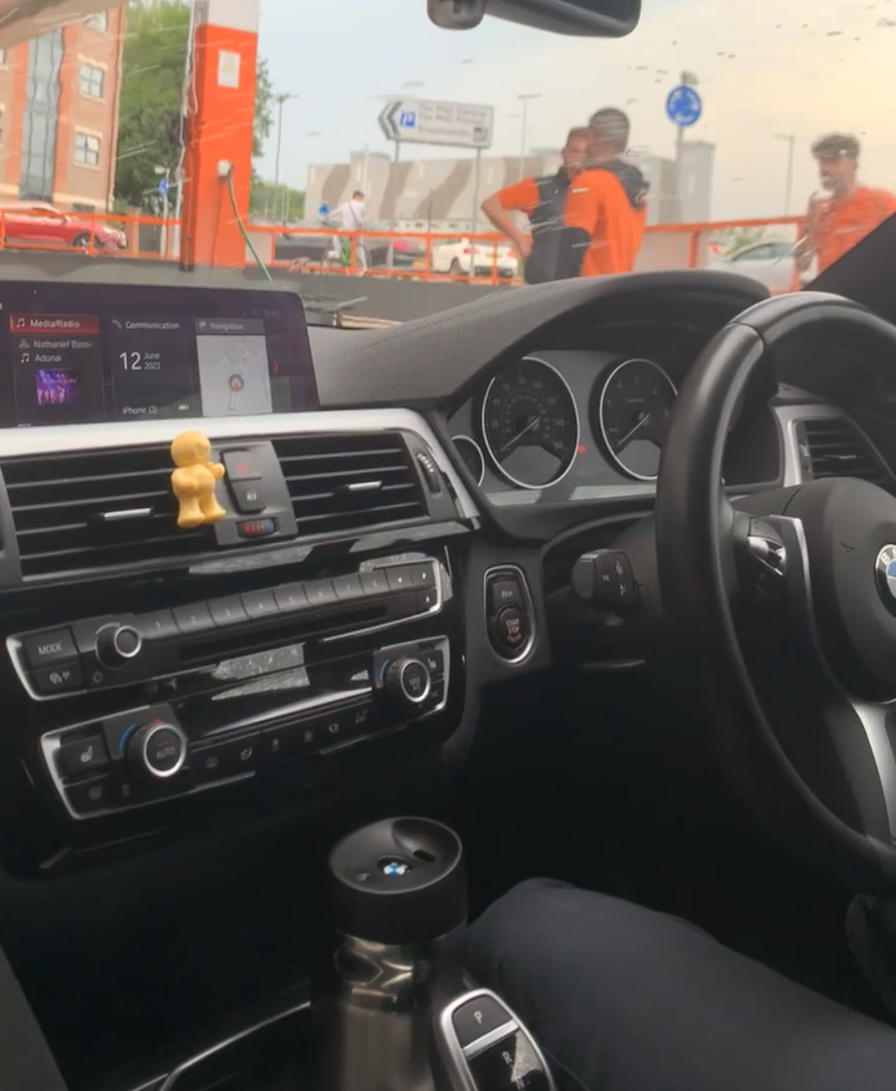
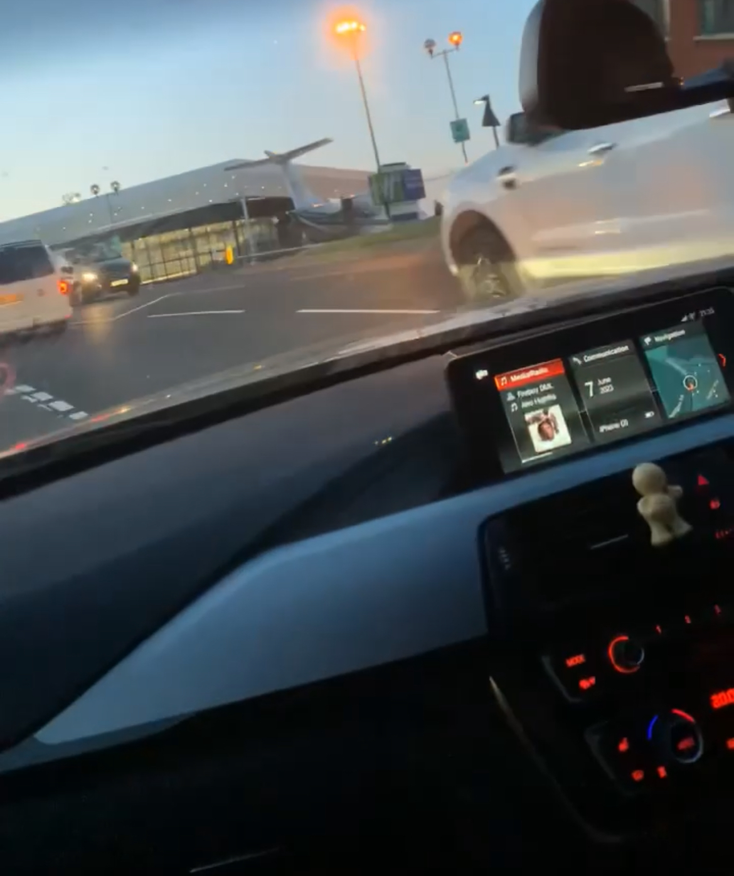
Research
Research
Idea Development
Idea generated based off the BMW (Idrive)
Began as Spotify web page (Presented in proposal)
Pivoted to car infotainment system
Discovering key implementations into project
Components/Tools
HW: Laptop (Mac), webcam,
SW: React, Node.js, Python, MediaPipe, Google Maps API, OpenAI API
Shifted from Spotify API, ESP32-S3 Skainet to local music, OpenAI
Research & Synthesis
Analysis within car – Unique idea & approach
NHTSA/RSA stats for hands-free focus
APIs (Spotify, Google Maps, OpenAI), gesture methods (TensorFlow, MediaPipe)
Sources: API docs, papers [5], [6]
BMV Gesture Control within cars
Challenges
Spotify URI delays (Sprints 1–2); OAuth fix
ESP32-S3 setup delays (Sprint 3); dropped
TensorFlow Object detection issues (Sprint 7); used MediaPipe
References
[1] Google Mediapipe 2025
[5] Kim & Park, 2023
[3] SockeT.IO, 2025

Slide 3

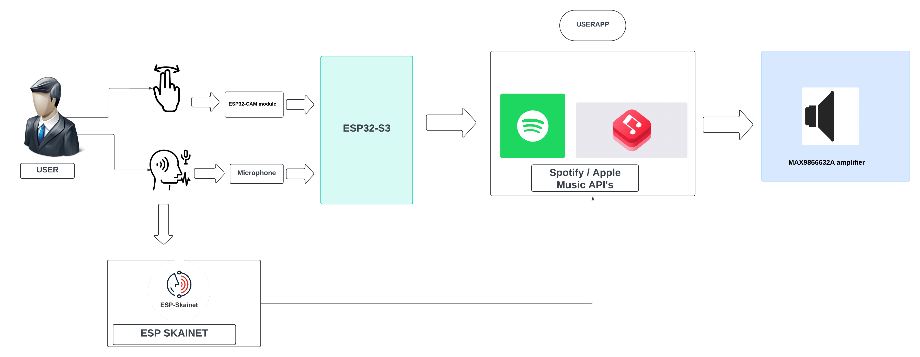
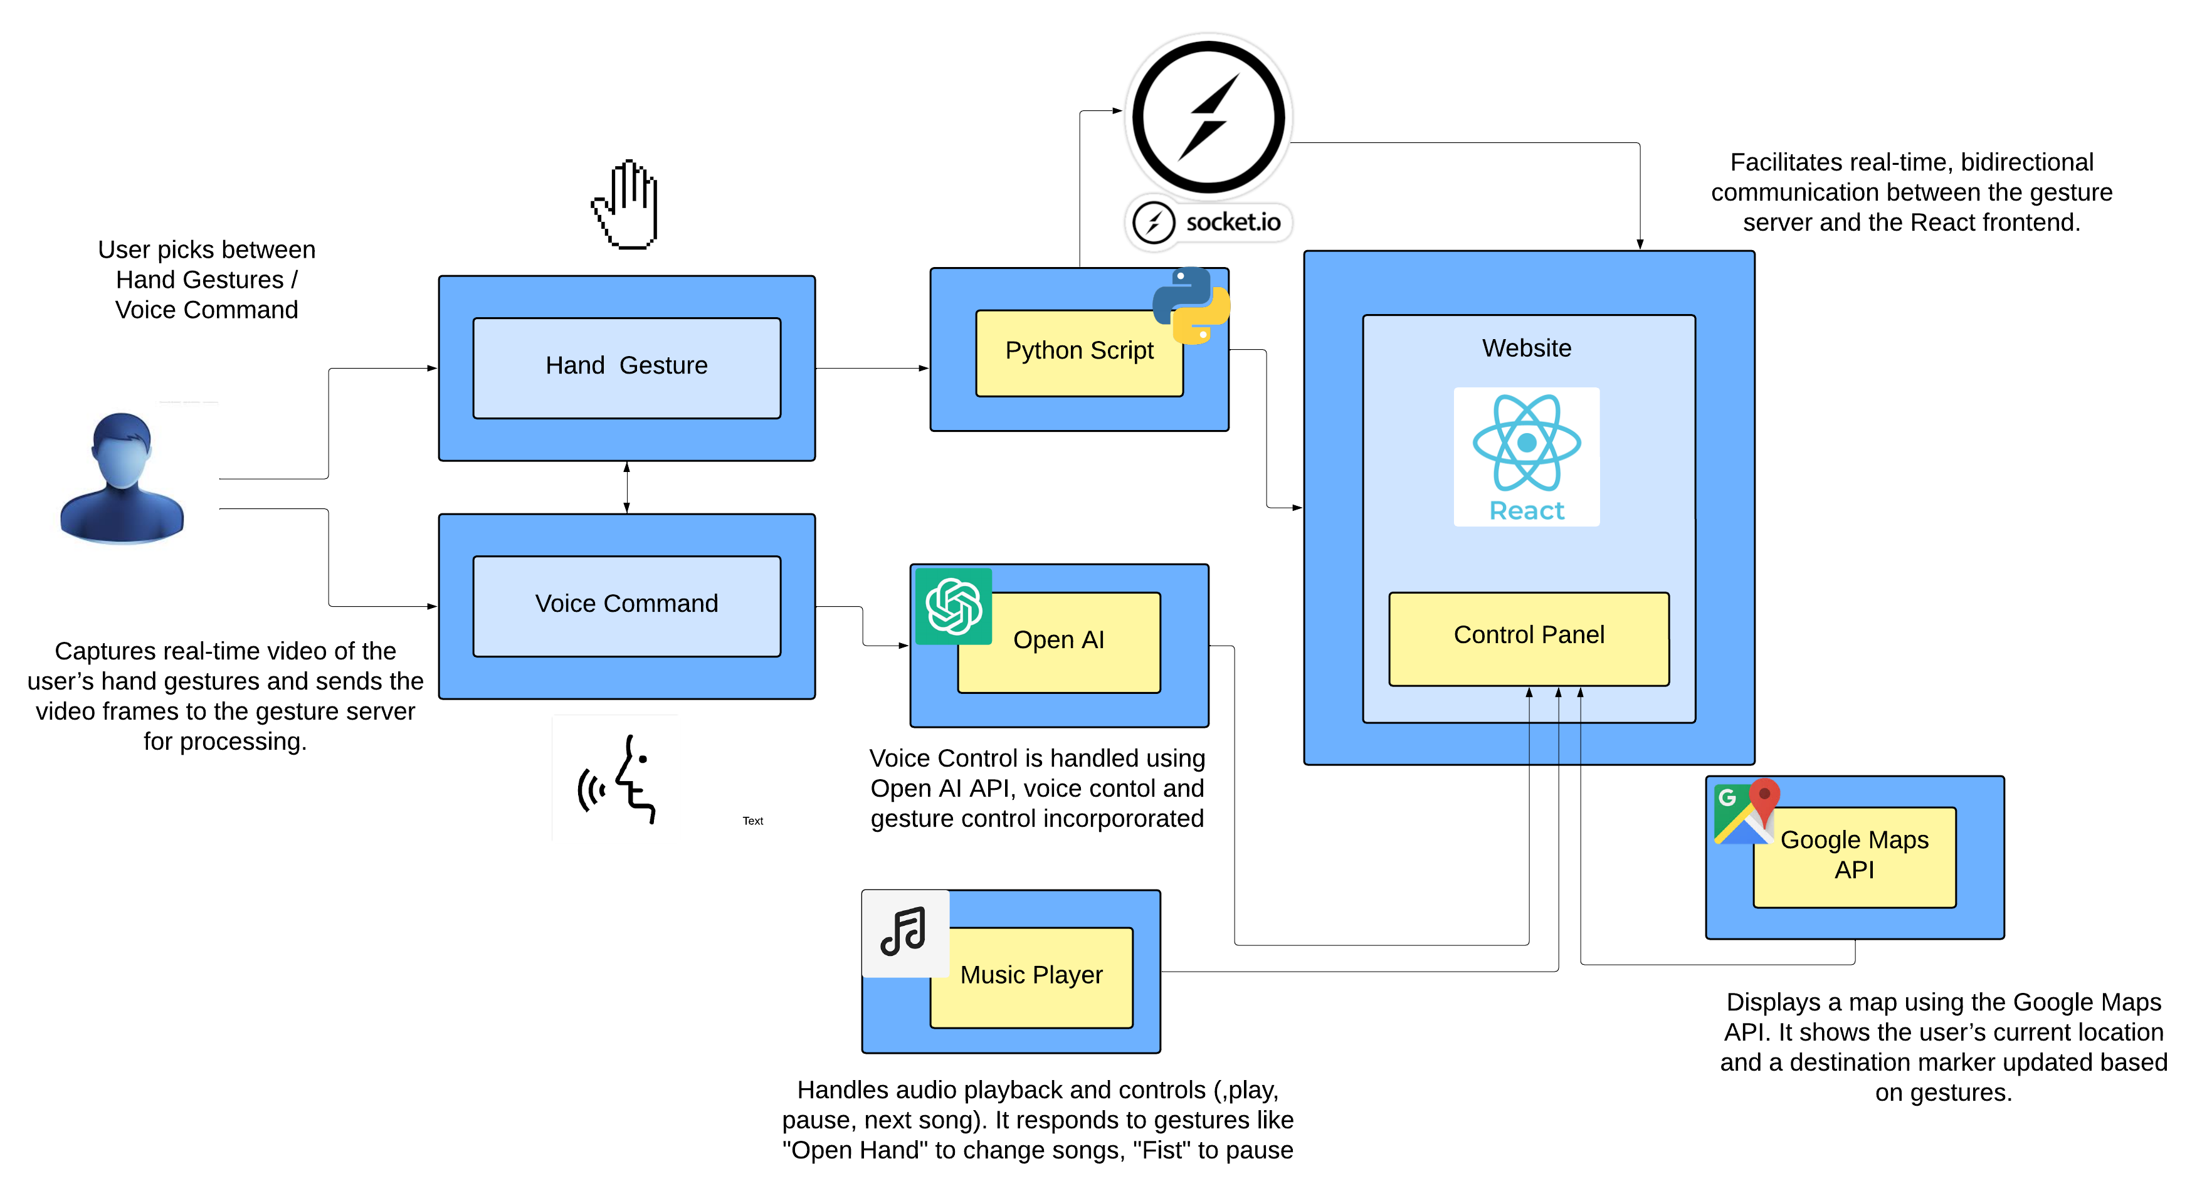

Slide 4
Academic/ Technical Content
Complex Technical Development
Built hands-free car infotainment system using gesture/voice control
Integrated React frontend, Node.js backend, Python gesture recognition
Problem-Solving & Independence
Resolved Spotify API ban by pivoting to local music
Fixed TensorFlow issue by switching to MediaPipe
Worked independently, with guidance from supervisor and advice from peers.
Unique Code & Algorithms
Developed custom gesture recognition algorithm with MediaPipe
Created AIInterface for voice command processing with OpenAI API
Implemented real-time Socket.IO integration for gesture updates
Software Design & Analysis
Designed React components (GoogleMapComponent, MusicPlayer)
Analysed RSA/NHTSA stats to prioritise hands-free safety features
Evaluated gesture accuracy (custom dataset vs. MediaPipe)
External Technologies & Third-Party Use
Used Web Speech API for voice input
Integrated Google Maps API, OpenAI API with proper refs [2], [3]
Avoided overusing tutorials, built unique logic for gesture detection
Plagiarism Awareness
Properly cited and referenced third-party APIs/ libraries and information within reports

Slide 5
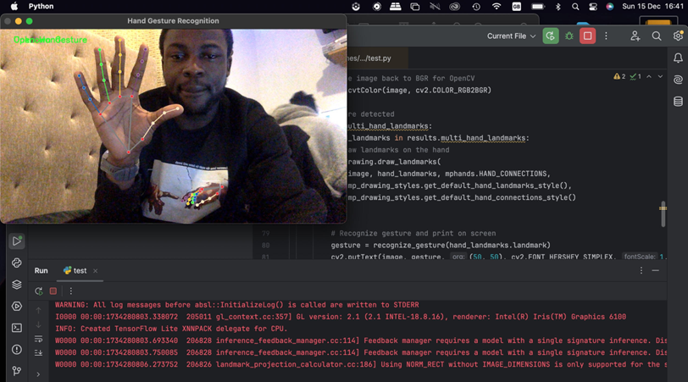
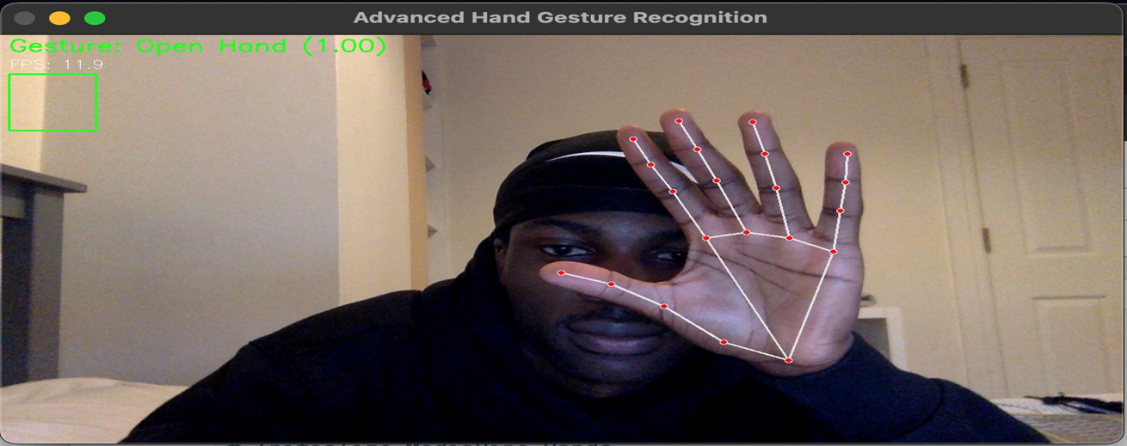
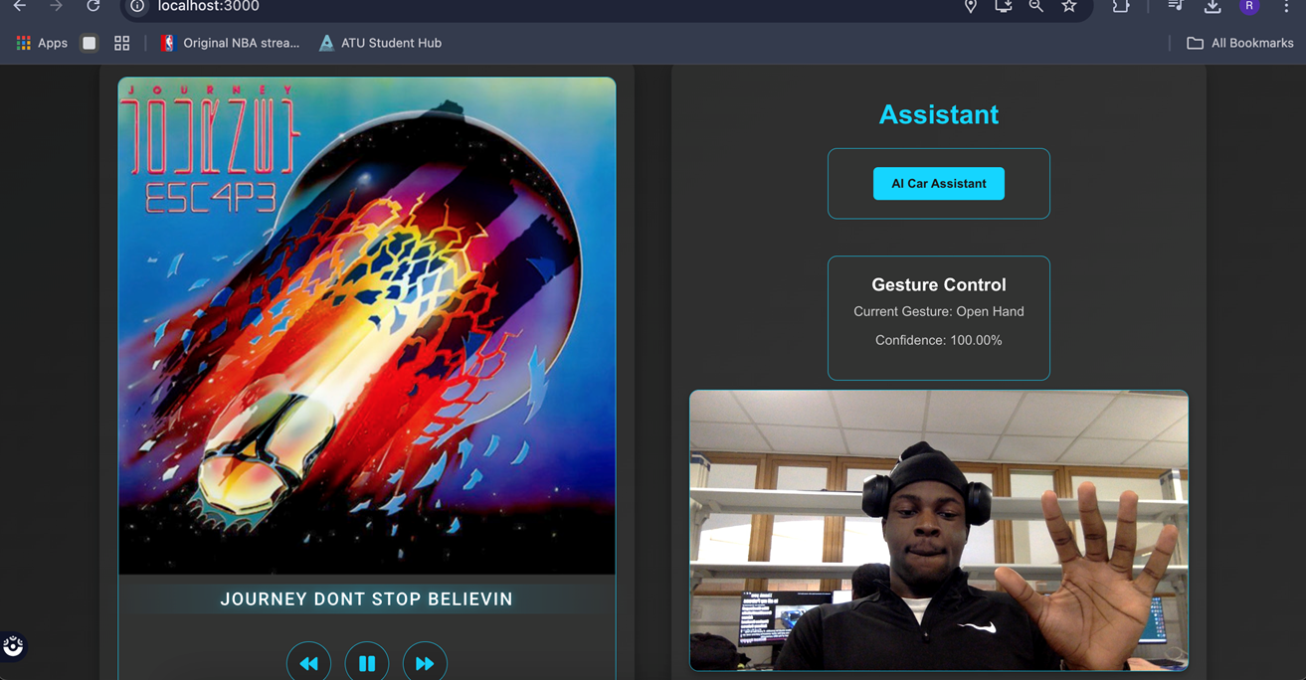
Demonstration of Understanding
Overall Project Idea & Purpose
Hands-free car infotainment to reduce driver distraction
Integrated gesture/voice control for navigation, music
Implementation Overview
React frontend for UI, Node.js backend for voice processing
Python script for gesture recognition, linked via Socket.IO
Field Insights
In-vehicle tech: Hands-free aligns with safety trends
Gesture/voice control: MediaPipe, OpenAI API benefits
Deep Learning
Mastered MediaPipe for precise gesture detection
Learned Web Speech API for robust voice input
Understood Socket.IO for real-time system sync
Code Reuse & Acknowledgment
Reused Socket.IO [2], MediaPipe examples [3], cited properly

Slide 6
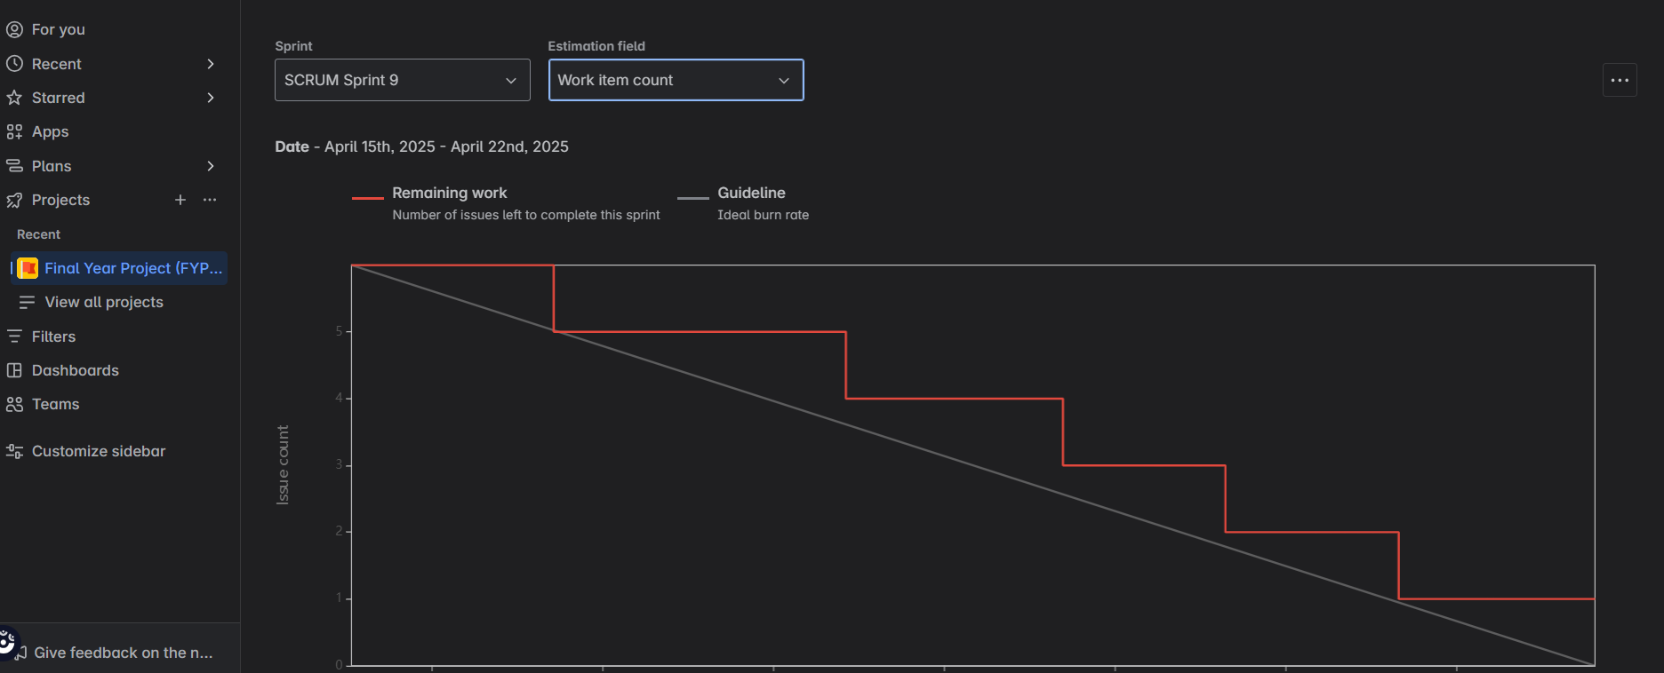
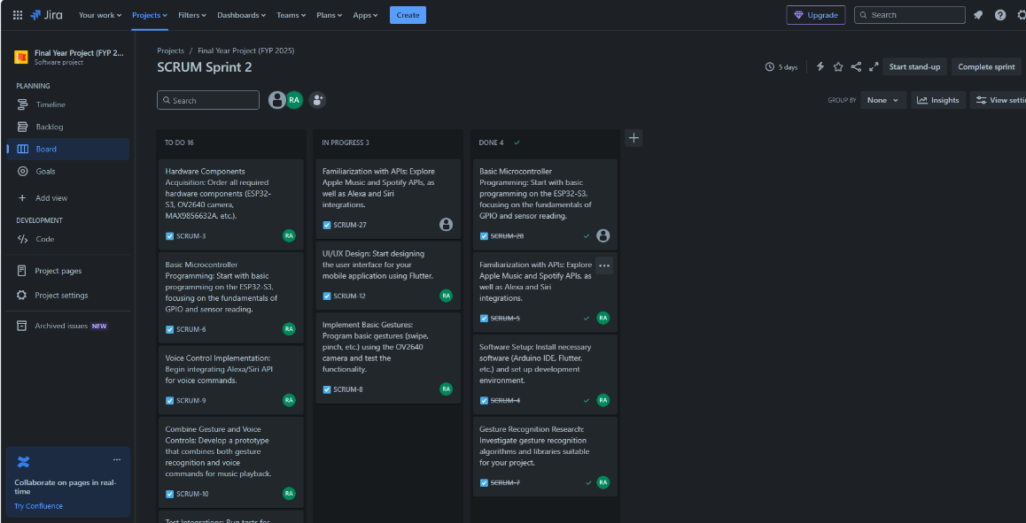
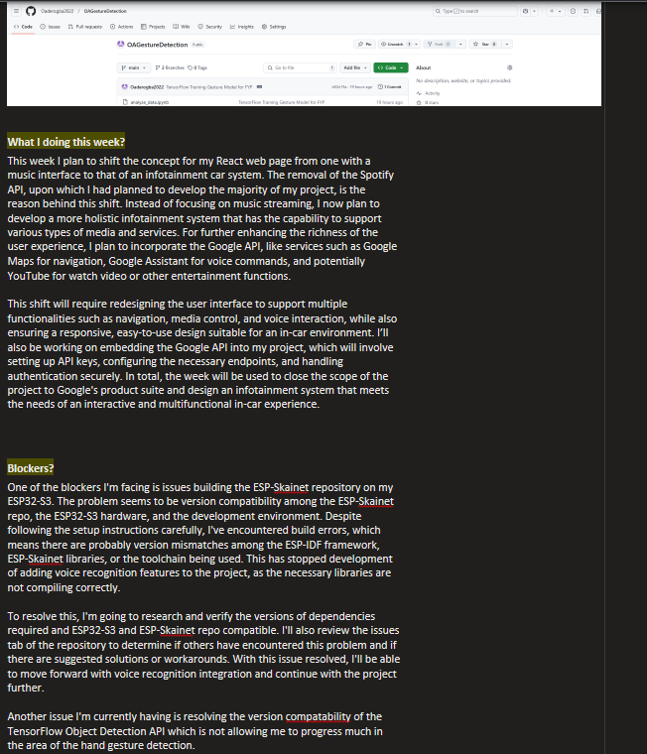
Organisation
Project Organisation Skills
Structured 24 weeks into Jira sprints
Managed solo: Planned, coded, tested, documented
Attended Stand up meetings, updated OneNote log weekly
Task Planning & Reflection
Prioritise major tasks then pivot tasks
Weekly reflections: Adjusted plans post-API ban
Plan Documentation
Updated Jira: Added pivot tasks
Documented timeline
Commits to Github
Committed code to GitHub repository
Demo Preparation
Prepared demo: Tested gestures, voice commands

Slide 7
Initiative And Engagement
Proactive Approach
Self initiated pivot after Spotify API ban
Explored TensorFlow for gestures before MediaPipe switch
Approached my project to be unique as possible – proactively looking for areas to improve
Self-Motivation
Solo project: Managed 24 weeks, Jira sprints
Consistently met deadlines despite challenges and other module deadlines
Seeking Feedback
Consulted supervisor on pivot strategy
Incorporated peer feedback on different aspect of project and also on report review
Engagement
Presented progress at review sessions
Engaged users during Apr. 2025 demo for feedback
Stand up Meetings
General checkup with peers during project class

Slide 8

References
[1] Google, "Google Maps Platform Documentation," Google Cloud, 2025. [Online]. Available: https://developers.google.com/maps/documentation. [Accessed: Apr. 12, 2025].
[2] OpenAI, "OpenAI API Documentation," OpenAI, 2025. [Online]. Available: https://platform.openai.com/docs/api-reference. [Accessed: Apr. 12, 2025].
[3] Google, "MediaPipe Hands Documentation," MediaPipe, 2025. [Online]. Available: https://developers.google.com/mediapipe/solutions/vision/hand_landmarker. [Accessed: Apr. 12, 2025].
[4] React, "React Documentation," React, 2025. [Online]. Available: https://react.dev/reference. [Accessed: Apr. 14, 2025].
[5] Socket.IO, "Socket.IO Documentation," Socket.IO, 2025. [Online]. Available: https://socket.io/docs/v4/. [Accessed: Apr. 15, 2025].
[6] OpenCV Team, "OpenCV: Real-Time Computer Vision with OpenCV," OpenCV Documentation, 2025. [Online]. Available: https://docs.opencv.org/4.x/. [Accessed: Apr. 25, 2025].

