Slide 1
STM32F103C8T8 (Bluepill)

Slide 2
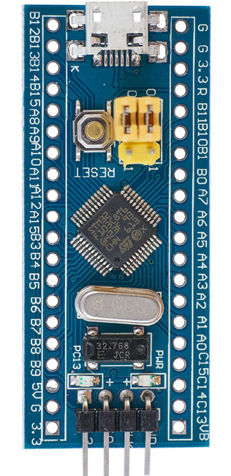
GRBL Pin Diagram
Z Limit
PB12
Spindle Enable
PB13
Spindle Direction
PB14
Spindle PWM
PA8
PB11
Y Limit
PB10
X Limit
PA6
Disable
Coolant Flood
PB3
PA5
Z Direction
Coolant Mist
PB4
PA4
Y Direction
Reset
PB5
PA3
X Direction
Feed Hold
PB6
PA2
Z Step
Cycle Start
PB7
PA1
Y Step
Safety Door
PB8
PA0
X Step
GND
3v3

Slide 3
