Slide 1
Lead Contamination in Drinking Water
Northeastern New Jersey
Jesse Fried
GIS Programming Project Presentation

Slide 2
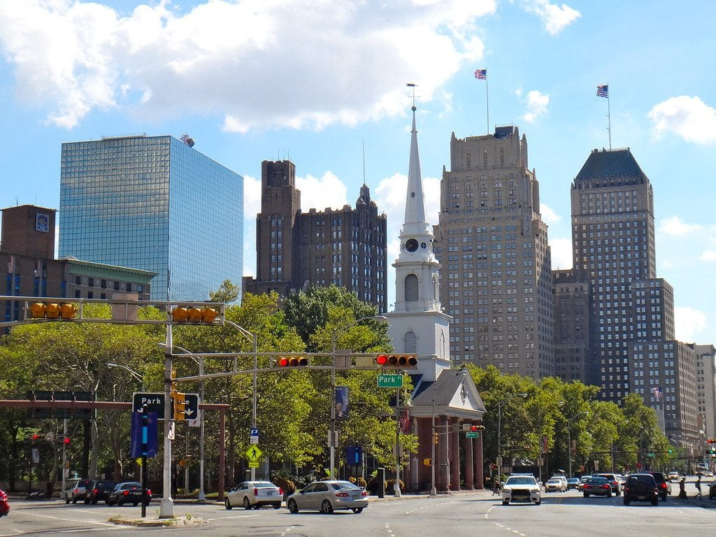
Background: Newark Lead Crisis
The New York Times called the recent lead crisis in Newark, NJ’s drinking water supply “one of the worst environmental disasters to strike a U.S. city in decades.”
It has been resolved but at great expense after years of health risk.

Slide 3
Lead Contamination in Drinking Water
Lead service lines connecting homes/buildings to water mains
Old construction
Water treatment plants can prevent contamination with corrosion control, etc.
Urban decline: Cash-strapped cities struggle with water treatment.

Slide 4
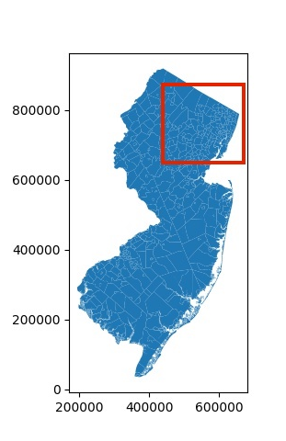
How widespread is this problem in the region?
Look at the urban and suburban municipalities of Northeastern NJ
Five counties: Essex, Hudson, Bergen, Passaic and Morris...roughly, the Passaic River watershed
Data on lead concentrations in drinking water samples available from the NJDEP from 2002 to present.

Slide 5
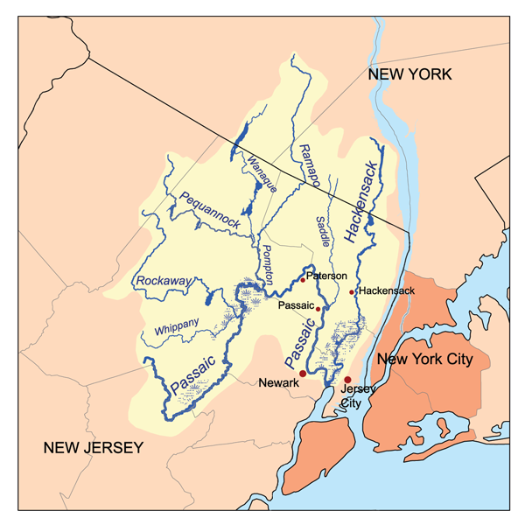
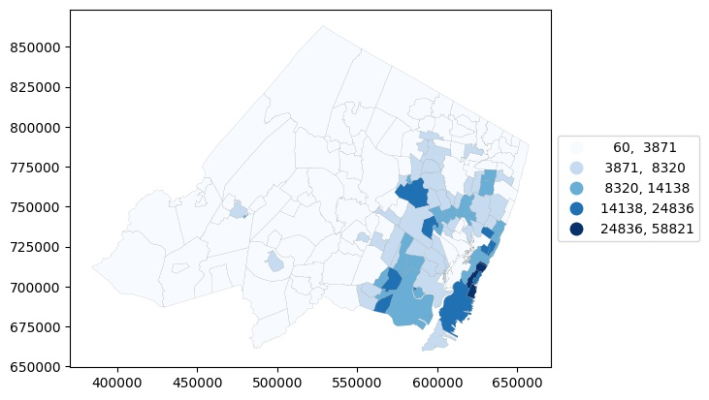
Population density by municipality
Passaic River Watershed (credit: Wikipedia)

Slide 6
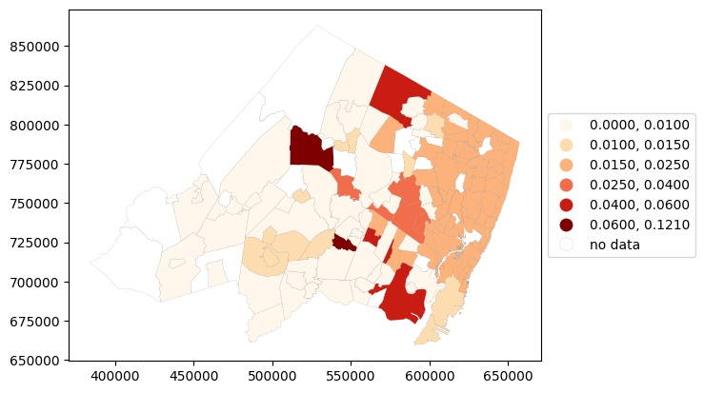
Maximum recorded lead level, 2002 – 2021

Slide 7
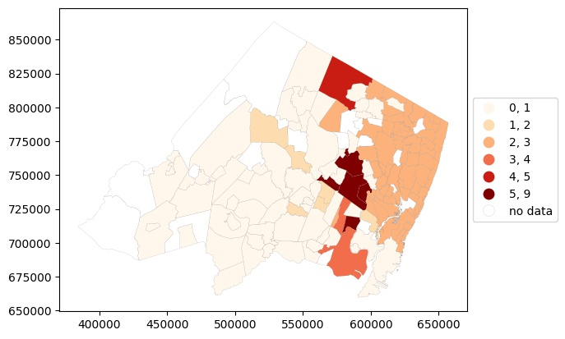
Number of years during which a MCL violation occurred (2002-2021)
EPA sets 0.015 mg/L as the maximum contaminant level (MCL)

Slide 8
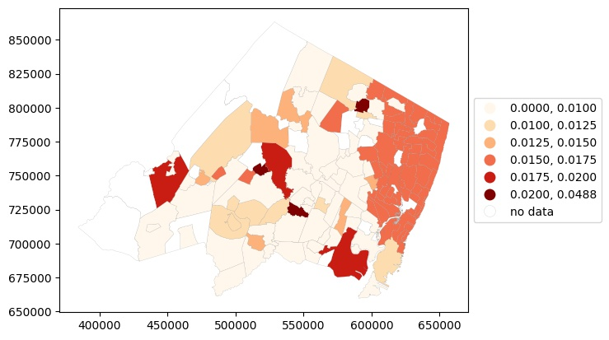
Mean lead concentration 2002-2021

Slide 9
Discussion
Newark didn't have the highest level of lead, the longest-lasting problem, or the greatest exposure over the whole time period, but ranks fairly highly for all three.
It is among the region's most serious lead problems because of its high population.
However, lead contamination problems in Northeastern NJ is both urban and suburban.

Slide 10
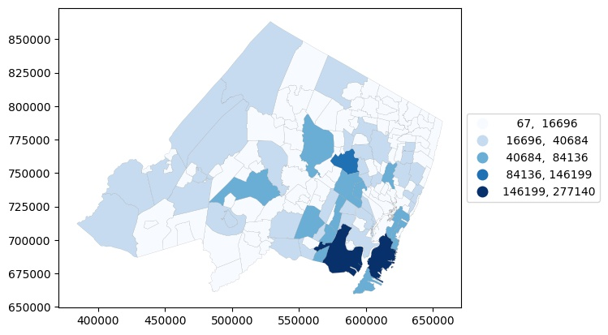
Total population by municipality

