Slide 1
Spotless Cinema
Web application project
Group 5
Niko Lindqvist, Milja Tissari, Ville Korkeaniemi, Tomi Koskinen, Toni Palmén

Slide 2
Our team and roles
Team member | Main work | Hours
Niko Lindqvist | Search, accounts, review and UI | 70
Milja Tissari | Reviews, general coding | 58
Ville Korkeaniemi | Groups, scrum, testing, general coding | 65
Tomi Koskinen | Deployment, stressing about Github, bug hunting | 68
Toni Palmén | UI improvements, TMDB movie routing, Favorites sharing | 60

Slide 3
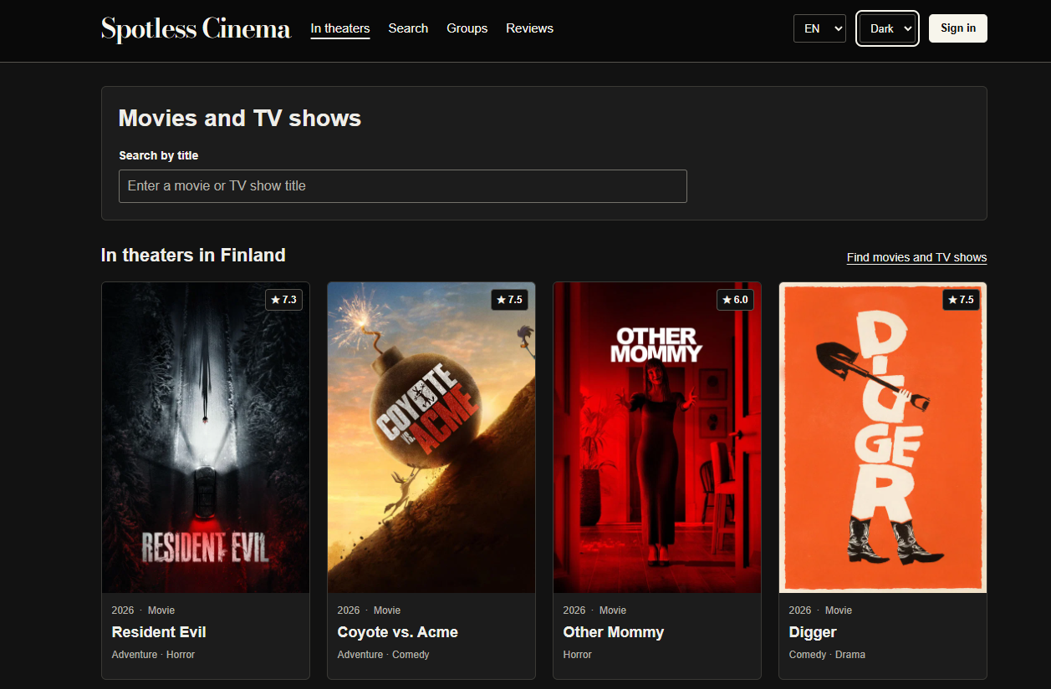
Our app and how it works
React builds the pages and forms.
Node.js and Express handle API requests.
PostgreSQL stores our application data.
TMDB provides movie information and posters.

Slide 4
All 15 requirements
What we implemented
ID | Requirement | What we implemented
1 | Responsive layout | Desktop and phone layouts
2 | Registration | Email, password: 8+ chars, uppercase, number
3 | Login and logout | Login and logout functions
4 | Account and data deletion | Account deletion
5 | Movie and series search | Title, year and genre search
6 | In cinemas in Finland | TMDB cinema list for Finland
7 | Groups | create, list, access and delete
8 | Join requests and approval | request, accept and reject
9 | Remove members / leave | remove a member and leave
10 | Add a movie to a group | add a searched movie
11 | Write a movie review | text, 1-5 stars, author and date
12 | Public review browsing | reviews visible to everyone
13 | Public favourite lists | own list with a public page
14 | Share favourites by URL | share link and public access
15 | Extra feature | Language options and colour themes

Slide 5
Live website demo
Website: http://86.50.21.8/
Step | What we show
1 | Guest: Finland list, title/year/genre search, phone view and themes/languages
2 | Sign-up, password checks, login and logout
3 | Groups: create/delete, join, approve/reject, remove/leave and add movies
4 | Review: save stars and text, show author/date and public view
5 | Favourites: public list and shared URL
6 | Delete a demo account and check its related data

Slide 6
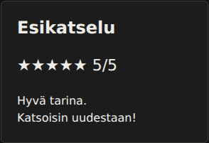
Niko's contribution
Movie search and the Finland cinema list
Registration, login and account deletion
Reviews.jsx: the form and preview
Language options, themes and CSS
My estimated workload was around 70 hours, including development, troubleshooting, the database diagram and presentation preparation

Slide 7
Ville´s contribution
I worked mainly on group-section.
Organizing our roadmap and informing other team members about our next steps.
General coding and testing.
Bug fixing.

Slide 8
Toni´s contribution
Worked on the moviedetails page
  Used TMDB movie IDs to open movies on our own page
Added the Favourites sharing function
Worked on the user interface
  Improved buttons and mobile scaling
  Simplified movie information shown on the front page

Slide 9

Tomi's contribution
Duck pics
Deployment
Merging branches :D
Bug hunting
Live testing
Going rogue

Slide 10
Milja's contribution
Worked mainly on the movie review feature
  Database and backend functionality for saving, editing, deleting and displaying reviews
  Integrated reviews into the movie details page
Helped with general frontend and backend development

Slide 11
Personal reflection
Each person shares one challenge, lesson or change for next time.
Team member | My reflection
Niko Lindqvist | I learned a valuable lesson about project- and teamwork
Tomi Koskinen | Tracking down tricky bugs and handling GitHub workflows taught me patience and how to use developer tools more effectively.
Ville Korkeaniemi | I learned that roles are more important than I previously thought. Also, how complicated simple-looking website could be.
Milja Tissari | This project helped me understand how much planning and cooperation are needed to build a working web application.
Toni Palmén | I learned about how important it is to plan, divide work and keep a clear structure in these kinds of projects.

Slide 12
Next time: clearer responsibilities
We would decide who focuses on the frontend and who handles the backend.
Frontend | Backend
React pages Forms, CSS and the user experience | API routes Database and input validation
Agree on API requests and responses before coding
Merge and test smaller changes regularly

Slide 13
Conclusion
We built on the existing React and Node project.
Each member contributed to the application.
Thank you.

