Slide 1
Challenges of Concurrency Control in Object Oriented Distributed Database

Slide 2
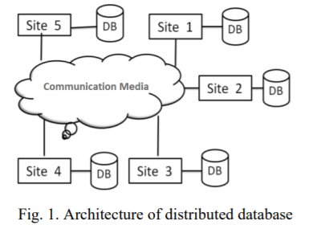
Introduction
ACID (atomicity, consistency, isolation, durability) - properties of database transactions
more than one transaction tries to read or write same data cluster => concurrency control needed
Distributed database
Distributed database = regular centralized database + physically spread across multiple geographical sites and is connected through wired or wireless network

Slide 3
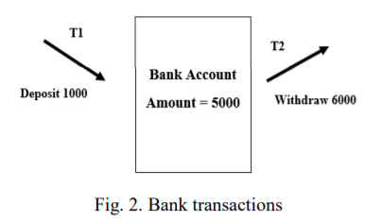
Concurrency
one of the main properties of relational database system that allows multiple users to affect multiple transactions at a time
distributed transactions = transactions in distributed environment
local transaction manager
Serializability theory = transactions are prioritized based upon their importance and effect on the system to retain data integrity in the system.
Serializability = technique to stop a transaction temporarily while other transaction is accessing some data item.
Notes:
This is done using serialization in concurrency control.

Slide 4
Techniques of Concurrency Control
I. Distributed Two-Phase Locking Protocol
II. Timestamp-Based Protocols
III. Validation-Based Protocols

Slide 5
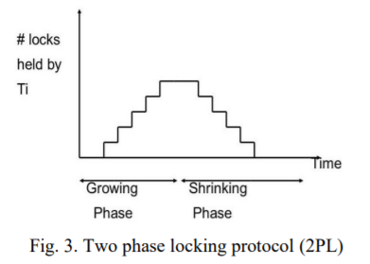
I. Distributed Two-Phase Locking Protocol
most common protocol in relational databases
Two phase locking (overwrite old values)
or
Multi version two-phase locking (new version after every commit)

Slide 6
II. Timestamp-Based Protocols
Transaction T1 starts P(A) operation.
If (Write_TimeStamp > TimeStamp (T1))
Then rollback T1
Else
Execute P(A)
and
set P_ TimeStamp(A) = MAX {
P_ TimeStamp (A),
TimeStamp (T1)
}
additional „timestamp‟ parameter which is associated to every transaction
two timestamps:
read timestamp
write timestamp
Multi version Timestamp Ordering (FCFS)

Slide 7
Wait-Die & Wound-Wait Algorithms
Wait-Die
a transaction T1 requests a data held by T2
If TimeStamp(T1) < TimeStamp (T2)
T1 is allowed to wait until the data is available.
If TimeStamp (T1) > TimeStamp (T2)
T1 is restarted later with some delay but with the same timestamp
Wound-Wait
a transaction T1 requests a data held by T2
If TimeStamp (T1) < TimeStamp (T2)
T1 makes T2 to be rolled back
If TimeStamp (T1) > TimeStamp (T2)
T1 is forced to wait until the required data is available.

Slide 8
III. Validation-Based Protocols
3 phases: read, write and validation
Validation is achieved by giving each transaction a timestamp at the end of the read phase and synchronizing using timestamp ordering

Slide 9
Issues
Two phase locking:
- deadlock occurrence (solved by using backup)
- cannot work well with query intensive applications
Timestamp ordering: chances of starvation of lengthy transactions
Multi version concurrency control: increases the cost of storing multiple versions in storage media

