Slide 1

Project 3 Group 3 Data Visualisation Track- Steam Games Data Visualisation
Ziyue Zhou (Jacky)
Hung Lim (Hansen)
Rakhi Singh
Jordan Chia

Slide 2
Introduction
Why Chose this topic?
We want to present users with insights of the world’s most popular digital games distribution platform (Steam!)
Through this project, we would like to show users our findings of games data in a visual perspective, such as → in various plots.
Hence, our project offers users to view in both static & dynamic charts ways, with certain extent of user interactivity included to enable users view the data in their interests.

Slide 3
Data Sources
Kaggle.com, Martin Bustos, Steam Games Dataset url: https://www.kaggle.com/datasets/fronkongames/steam-games-dataset Licence: MIT (url: https://www.mit.edu/~amini/LICENSE.md)
- Author Declaration: All data has been collected thanks to the Web API provided by Steam (Steam Spy). Only games (no DLCs, episodes, music, videos, etc) currently released have been added.
Kaggle.com, Nik Davis, Steam Store Games (Clean dataset) url: https://www.kaggle.com/datasets/nikdavis/steam-store-games Licence: Attribution 4.0 International (CC BY 4.0) (url: https://creativecommons.org/licenses/by/4.0/)
- Author Declaration: Hereby according to the author said: data gathered via using Steam Store and SteamSpy API.

Slide 4

Guiding Questions
Q1: What are the most popular 10 games from 2014 to 2024?
Q2: Is there any relationship between users' review and games price?
Q3: Which publishers have the highest positive ratings?
Q4: Do games with certain genre or descriptors tend to be more popular?

Slide 5
Libraries Used for this project
Data Cleansing:
Pandas, Numpy (standard python library for data processing & analysis, also helpful for transforming & exporting data in CSV & JSON format)
Database & CRUD:
MongoDB + Pymongo
(Even after initial cleaning, Steam games data still contains columns with nested strings which hard to load directly into relational DB like SQLite/Postegre. So MongoDB is better choice as storing JSON-like data)
Back-end server:
Flask (Light-weight back end serve written in python suitable for quick & easy hosting for small-scale project)
Plotting:
- Matplotlib, Seaborn, D3.js, Plotly.js (First 2 library is popular for plotting static chart in py, D3 and Plotly useful for providing interactive plots for users)

Slide 6
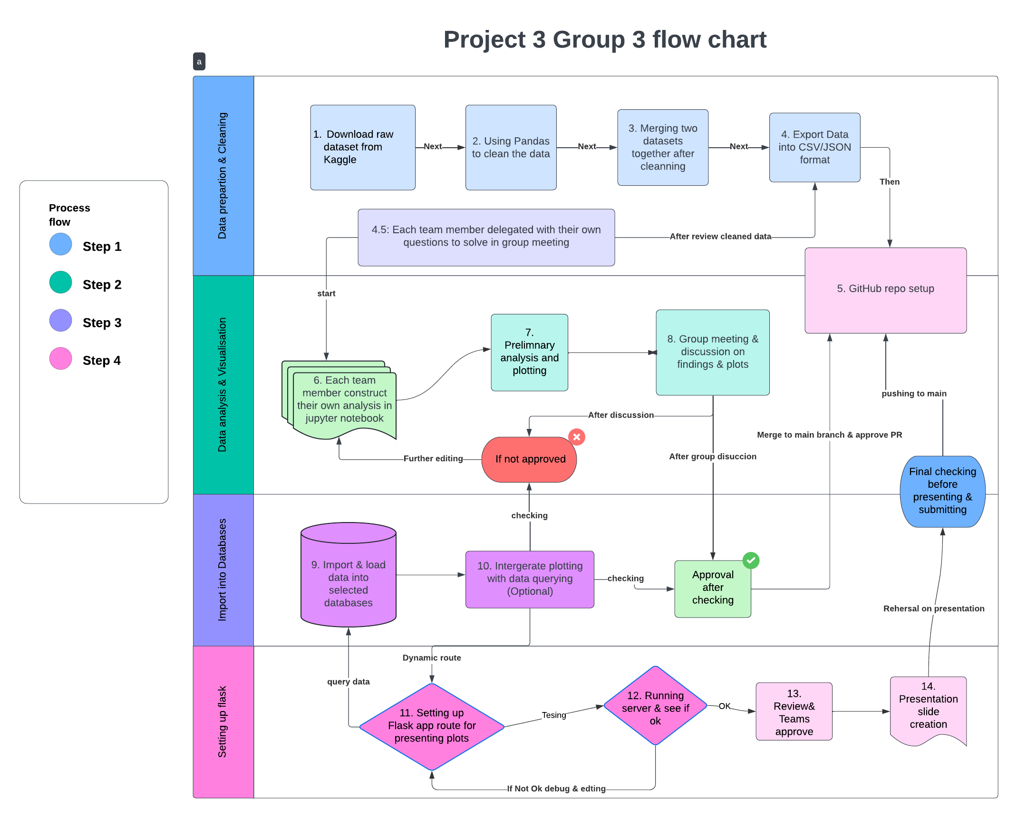

Slide 7
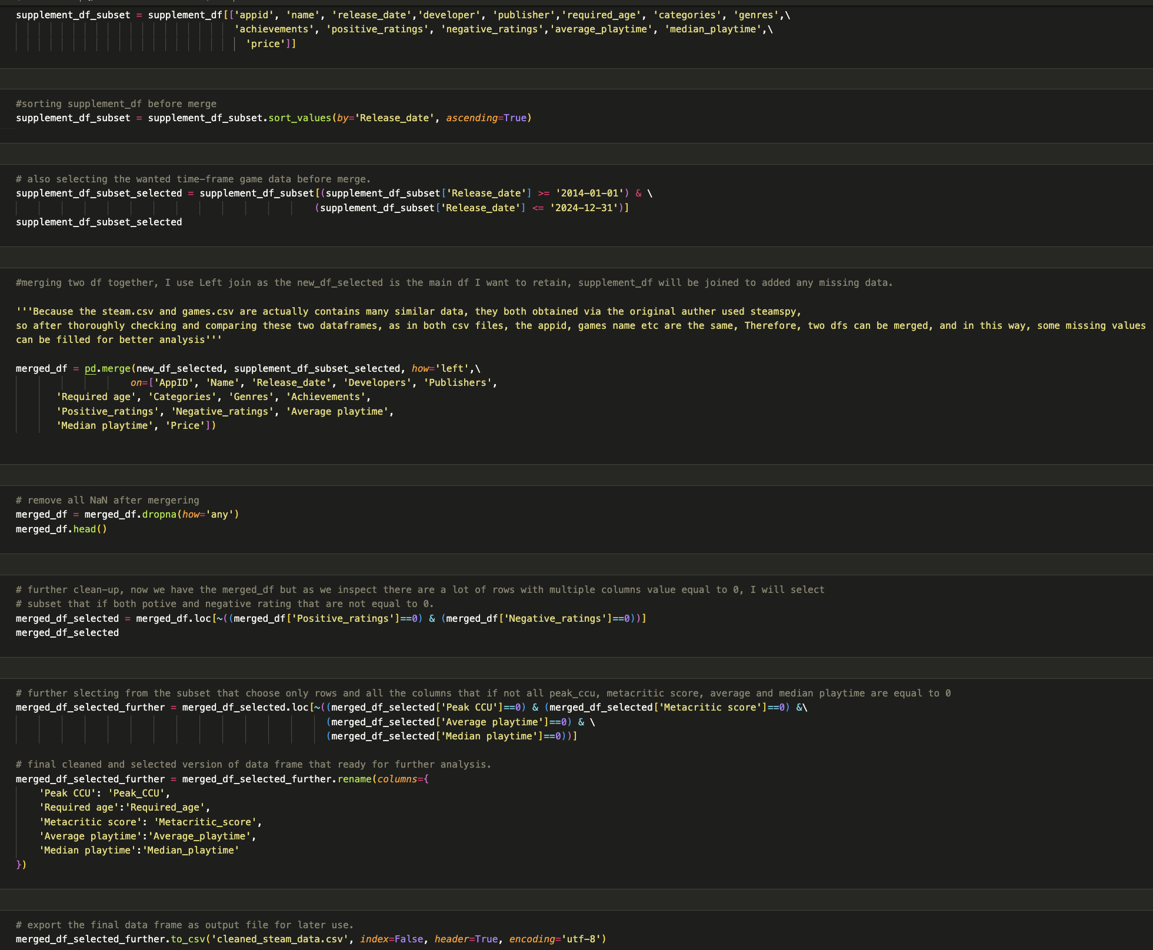
Data Wrangling
Using pandas & Numpy to convert csv into data frames
Then apply data conversion & subsetting, remove the NaN.
Examine the pre-processed data
Merge two data frames together by using Left merge and on common columns.
Export cleaned data into csv and JSON format for next step usage.
For detailed steps please visit the GitHub repository ‘Project_3’

Slide 8
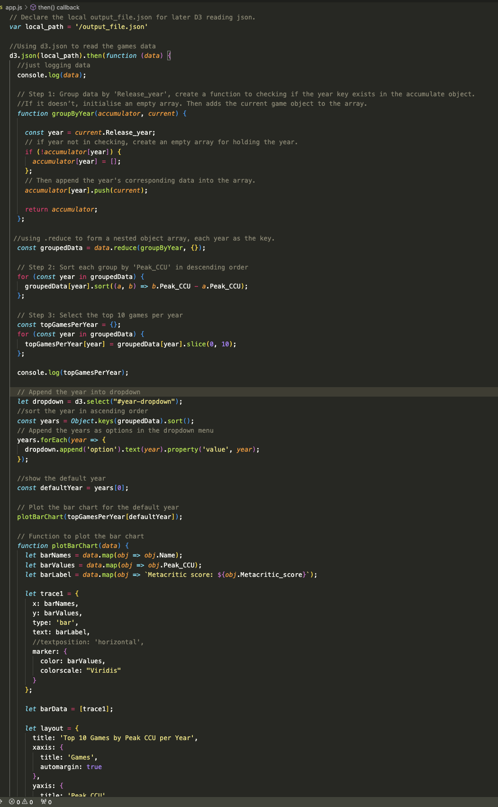
D3.js + Plotly.js interactive plotting
After initial data cleansing and exporting. I decide to build an interactive webpage and present plots using JavaScript.
Use the locally saved JSON steam data file, passing it in D3.js to load the data.
Inside D3.json.then(), groups the required data then using plotBarChart() and plotScatterPlot() function to process the charts
For details, please view the repo thanks.

Slide 9
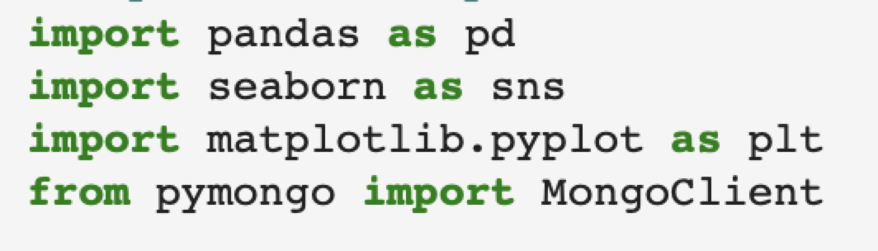
Seaborn
What is Seaborn?
Powerful and versatile Python library built on top of Matplotlib, designed specifically for creating statistical graphics and visualizations with ease. It simplifies the process of making plots by providing a high-level interface and integrating well with Pandas Data Frames.

Slide 10
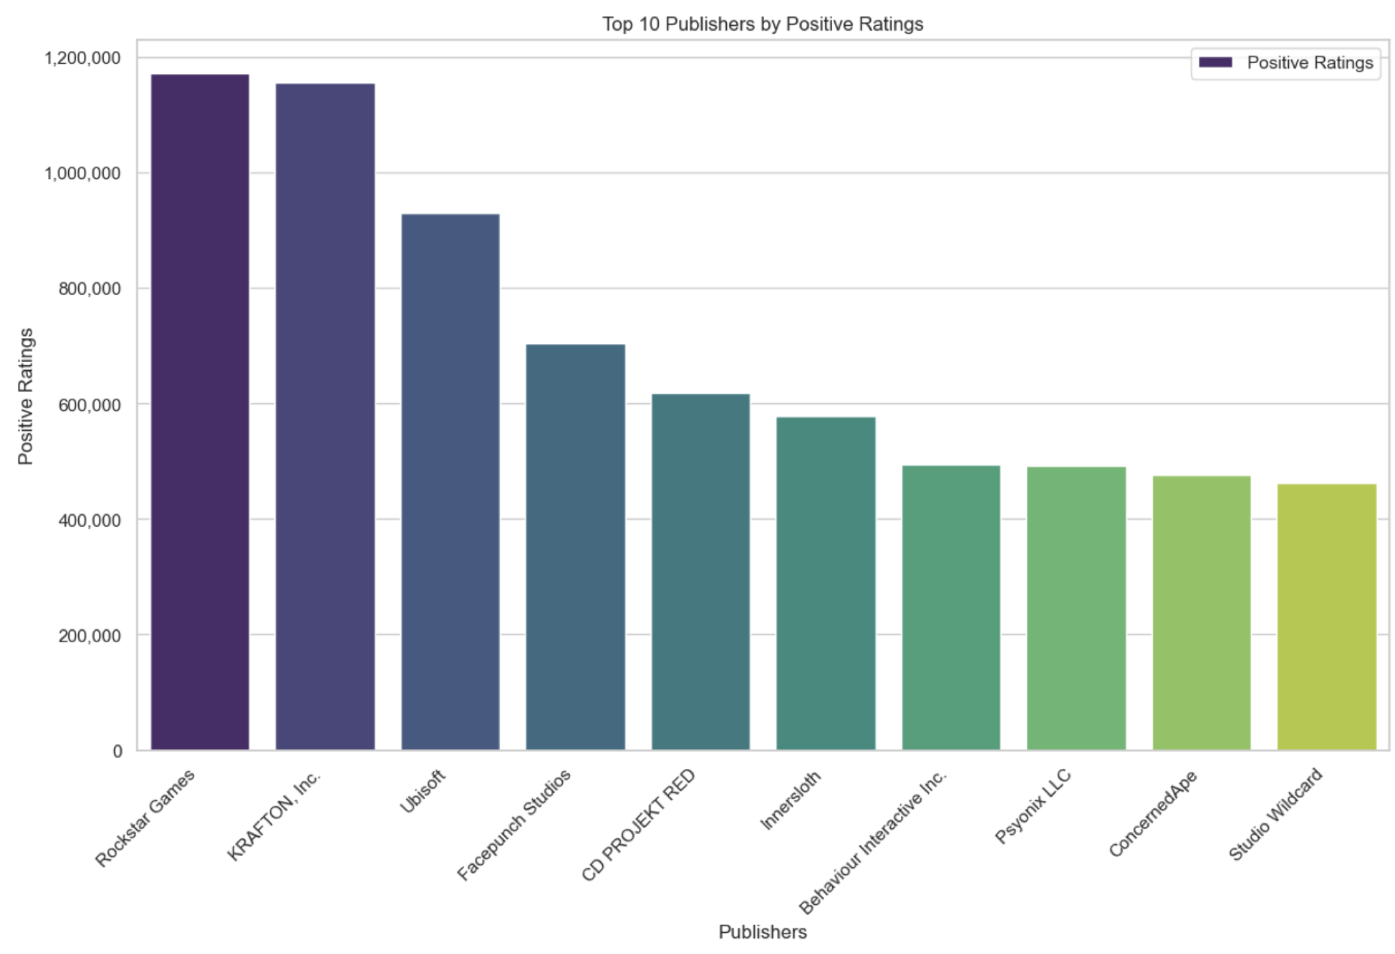
Seaborn
Key Features of Seaborn:
Beautiful Default Styles: Seaborn comes with aesthetic themes and colour palettes, which makes the plots visually appealing out-of-the-box.
Integration with Pandas: Works seamlessly with Pandas Data Frames, making it easy to handle datasets, and allows plotting directly from Data Frames without having to convert data to arrays.
Statistical Plotting: Provides functions to visualize complex datasets and automatically fits statistical models to the data (like regression lines).
Variety of Plot Types: Seaborn supports many different plot types, from simple histograms and bar plots to more advanced visualizations like violin plots and pair plots.

Slide 11
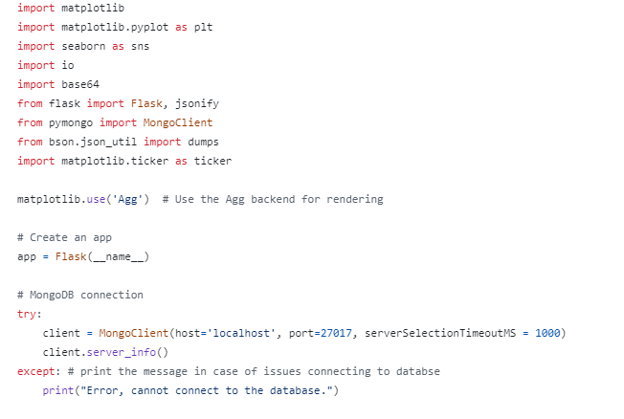
MongoDB + Pymongo
MongoDB is a NoSQL database that stores data in a flexible, document-oriented format (BSON).
For using NoSQL db of MongoDB. As the cleaned data contains some nested columns which are hard to seperate and store in relational DB, so NoSQL is more suitable for storing the data for this project.
The `pymongo` library is used to interact with MongoDB from Python. It provides a straightforward API for connecting to the database, querying data, and performing operations such as aggregation and updates.
In summary, MongoDB with `pymongo` offers flexibility and ease of use for applications dealing with dynamic or semi-structured data, while SQL databases provide structured data management and strong transactional guarantees. The choice between MongoDB and SQL databases depends on the specific requirements of your application, including data structure, query complexity, and scalability needs.

Slide 12

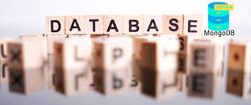
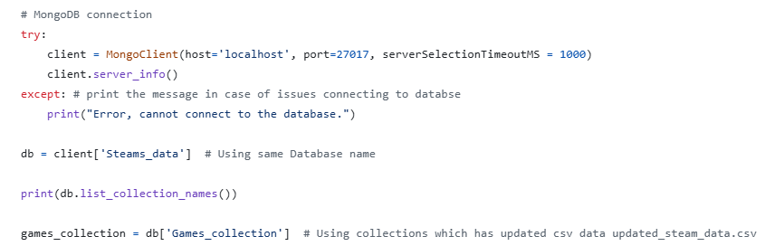
How to use Mongo DB -> Example usage in the project
Why Mongo DB
Flexible schema
Easy data retrieval
Easy Integration with Flask
NoSQL database
Start the MongoDB
Imported the data in MongoDB using mongoimport command
Establishes connection to MongoDB instance on localhost:27017
Retrieves server information to verify connection
Error Handling:
Catches any exceptions that occur during connection
Prints error message if connection fails
Database Selection:
Selects "Steams_data" database
Prints list of collection names in the database
Selects "Games_collection" collection for further operations

Slide 13

Steam Games Data Analysis Using Flask
Why we’ve used Flask API app
API Flexibility: Easily build API endpoints to expose analysis results.
Database Integration: Connects smoothly with databases like MongoDB to handle large datasets.
Visualization: Generate and serve charts and graphs dynamically.
Rapid Development: Ideal for quickly building and scaling a data analysis application.
Python-based: Leverage Python’s rich ecosystem for data analysis.

Slide 14

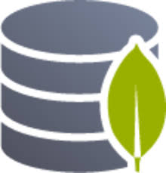

Tools and Technologies used
API Flask
Mongo DB
Matplotlib
Flask: for building web applications and APIs
MongoDB: for storing and querying Steam games data
Python Libraries: for data visualization

Slide 15

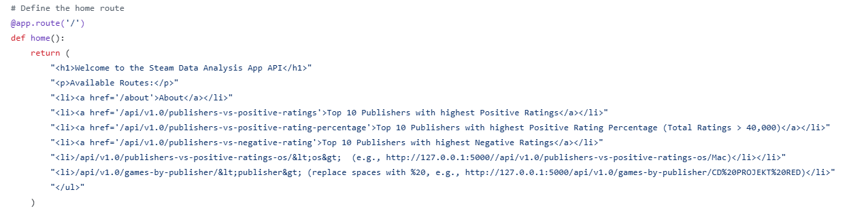
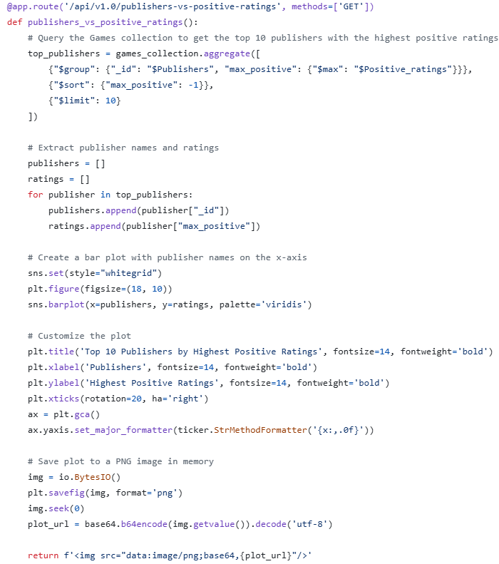
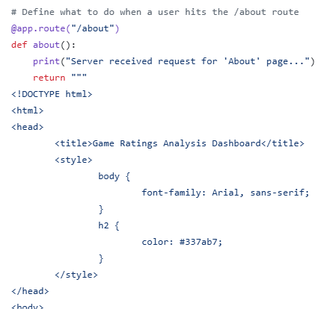
Flask Application Structure
Home Route
API Endpoints
About Route

Slide 16
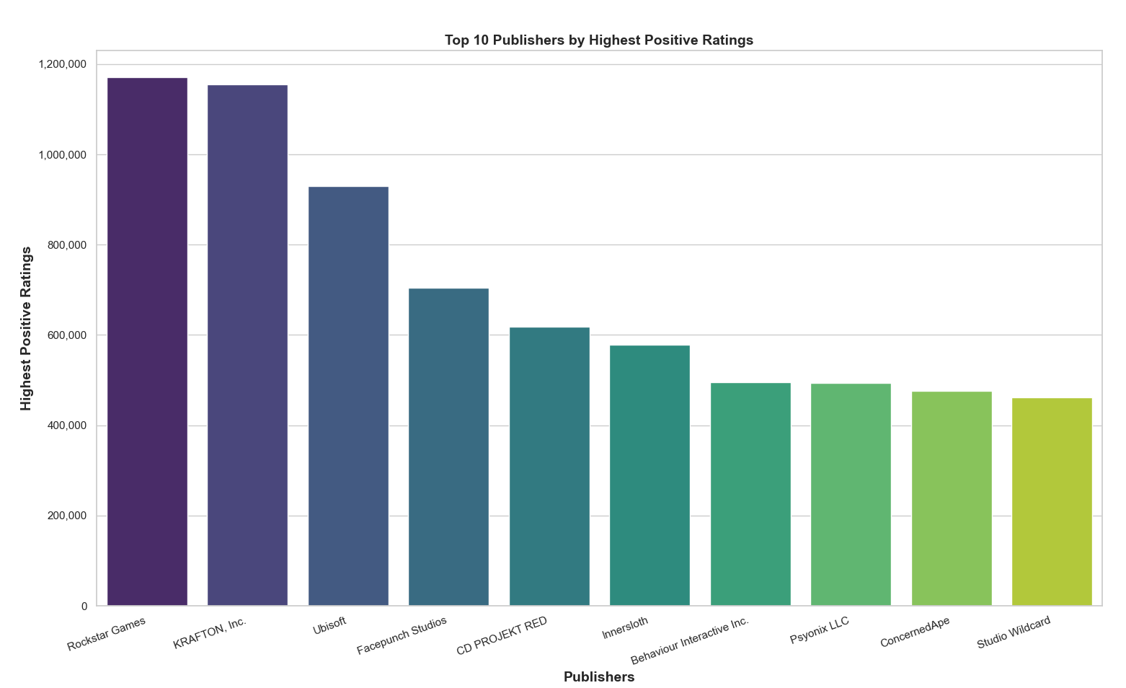

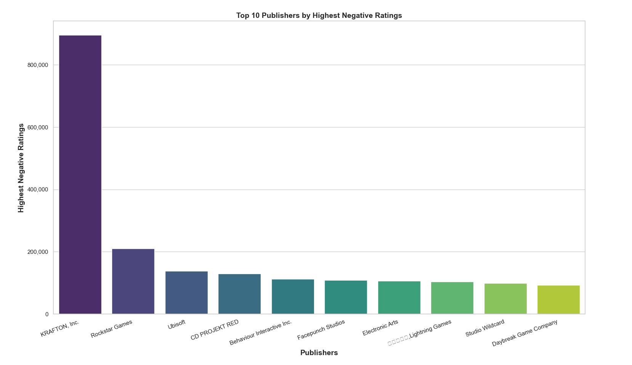
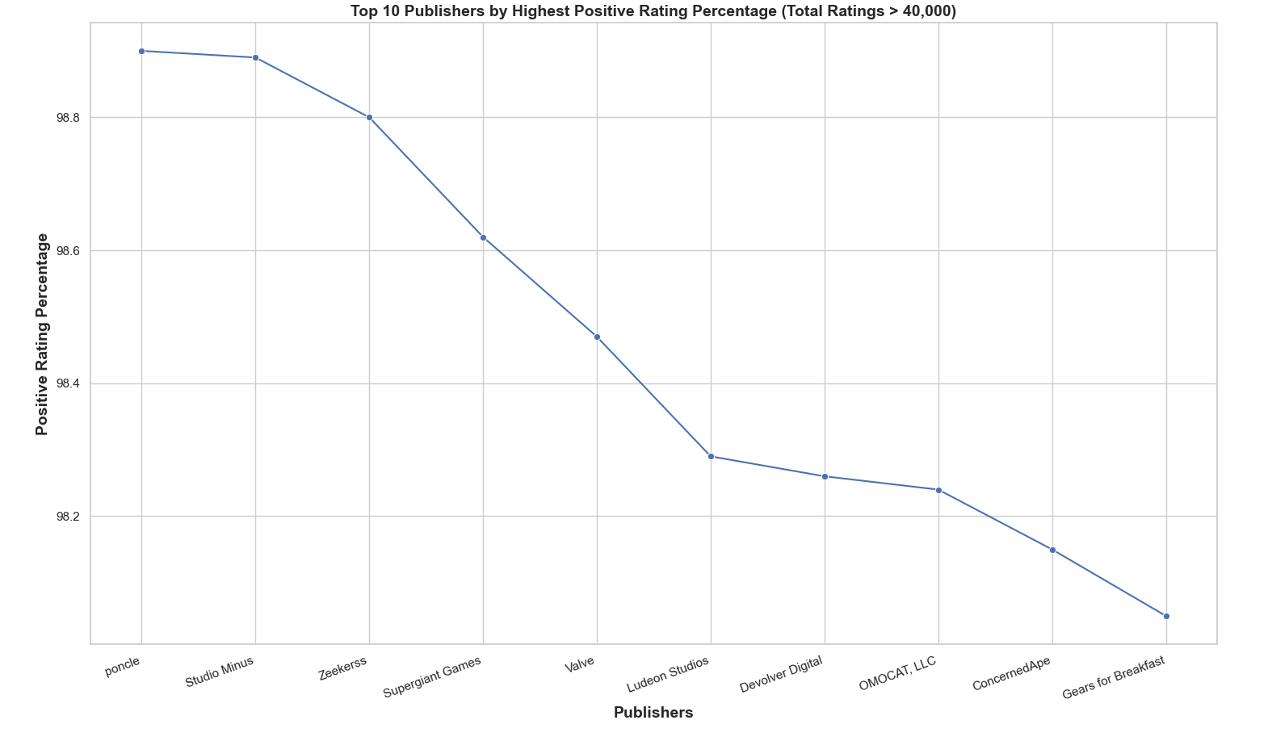
Data visualizations

Slide 17
Conclusion
For this project, we present to users about the Steam games data visualisation using the techniques introduced in above sides.
The project adopted a comprehensive approach, incorporating data pre-processing, cleansing, exporting, loading to databases, querying & aggregating, plotting, finally with back-end serving & interactive dashboarding.
Some limitations for the project:
The source data sets contains many missing data, even after manipulation some columns need to be removed due to low quality.

Slide 18
Demonstration

