Slide 1
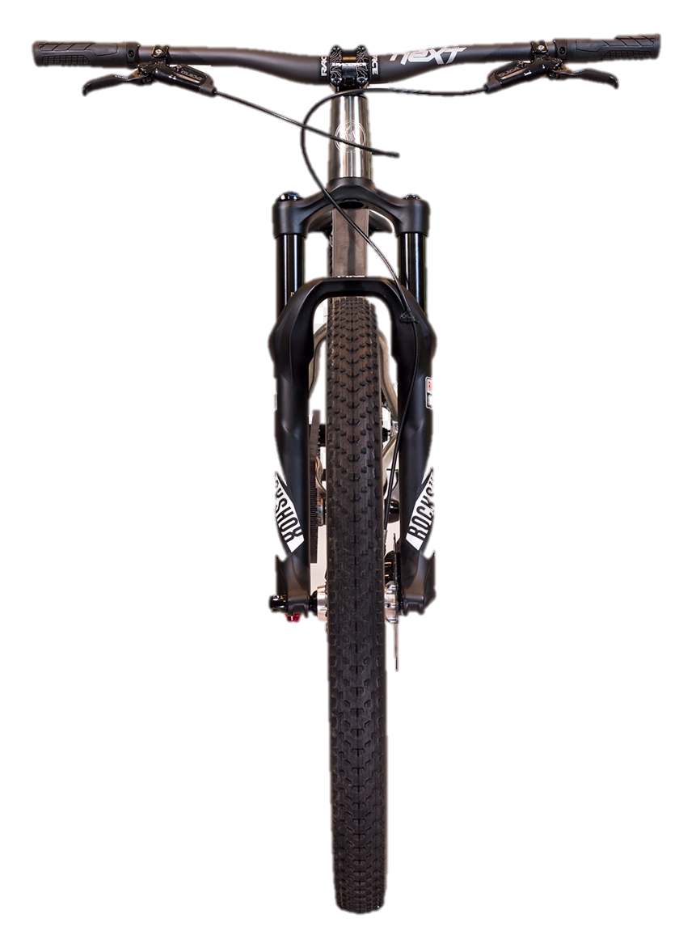
90°

Slide 2
50°

Slide 3



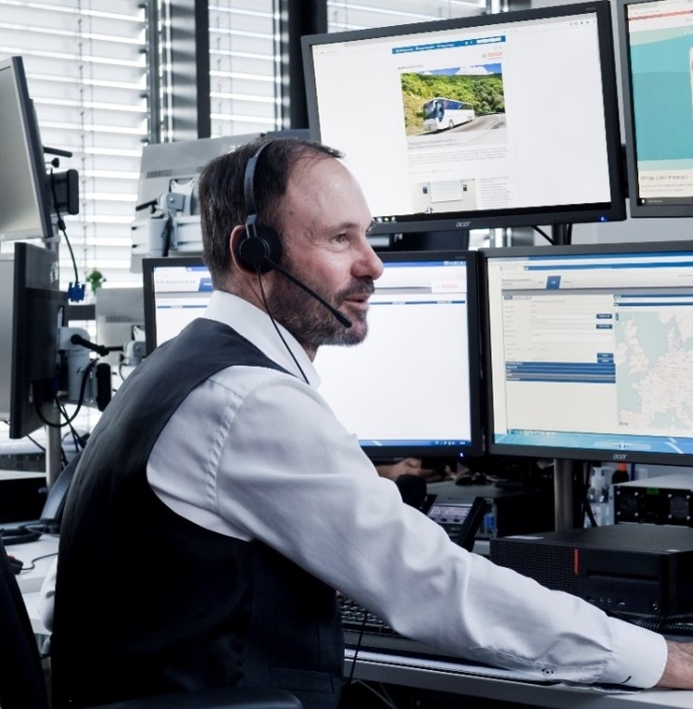

4
Local help
1
Crash detection
3
Public rescue services
Crash
3
Emergency call processing and assistance
2
Emergency contact, communities

