Slide 1
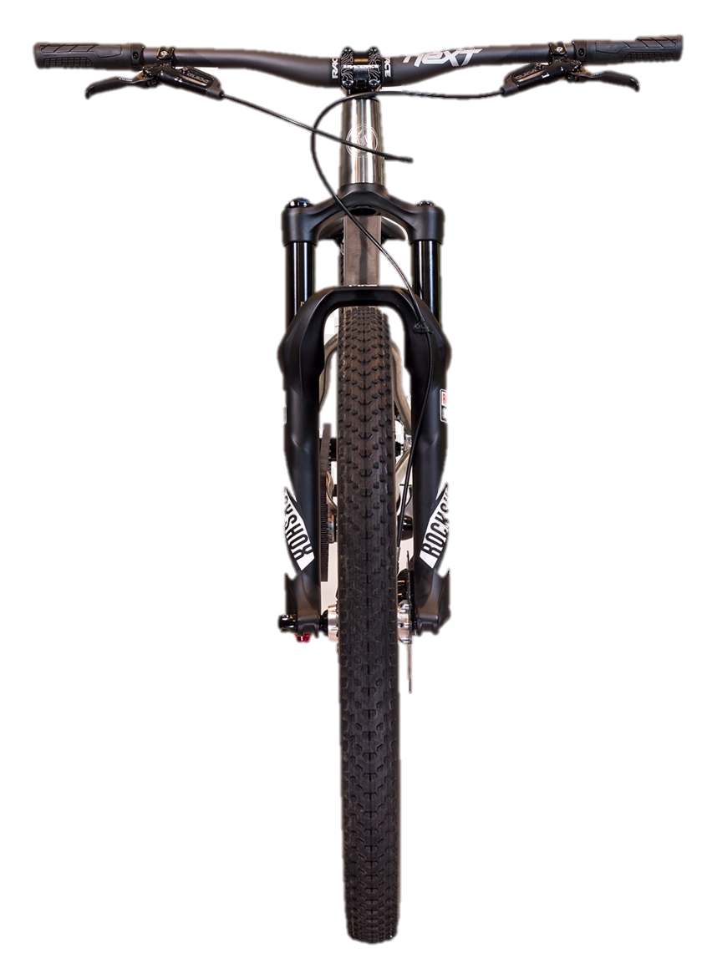
90°

Slide 2
50°

Slide 3



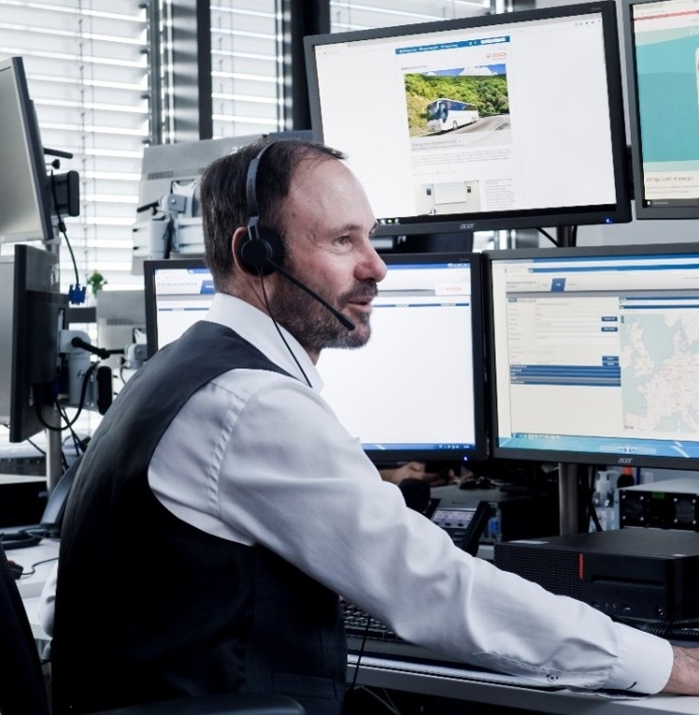

4
Local help
1
Crash detection
3
Public rescue services
Crash
3
Emergency call processing and assistance
2
Emergency contact, communities

Slide 4






$$z_{BF}$$
$$y_{SF}$$
Samrtphone
$$z_{SF}$$
$$x_{BF}$$
$$y_{BF}$$
$$x_{SF}$$

Slide 5






$$z_{BF}$$
$$y_{SF}$$
Samrtphone
$$z_{SF}$$
$$x_{BF}$$
$$y_{BF}$$
$$x_{SF}$$

Slide 6






$$z_{BF}$$
$$y_{SF}$$
Samrtphone
$$z_{SF}$$
$$x_{BF}$$
$$y_{BF}$$
$$x_{SF}$$

