Slide 1

Agricultural Robotics
Crop Monitoring
A PDDL & PDDL+ planning project
Assignment D5-V1 Artificial Intelligence for Robotics II
Notes:
Open with the one-sentence intuition: a single robot drives around a field of crop plots, looks at each plot, and reports its condition. Then say we modelled it at two levels - classical PDDL for routing, and PDDL+ where the crops degrade over time on their own. Keep it conversational, don't read.

Slide 2
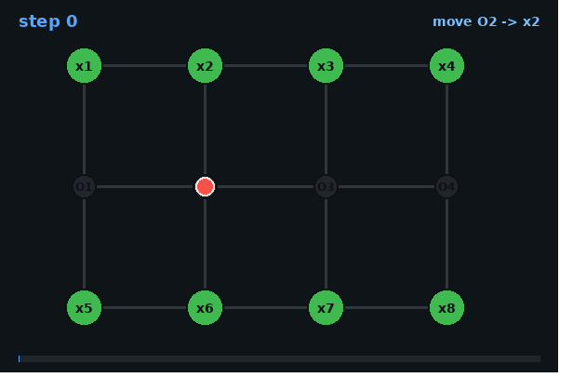



PROBLEM & DOMAIN
What we are modelling
A single mobile robot patrols a field divided into plots. For every plot it must:
Navigate drive edge-by-edge across the field graph
Inspect read the crop's condition (must be at the plot)
Report log the observation once the plot is inspected
Key twist: crop conditions change over time even with no intervention.
Field graph - plots x1-x8 joined by routing junctions O1-O4; robot starts at O2.
2
Notes:
Give the intuition, don't list. Plots are where crops grow; junctions are just road intersections the robot passes through. Inspect needs the robot physically there; report can be logged afterwards. End on the key twist: crops degrade on their own - that's what makes the PDDL+ version interesting.

Slide 3

PROBLEM & DOMAIN
One scenario, two levels
Q1
Q2
Classical PDDL
PDDL+ (processes + events)
No time.
The world only changes when the robot acts.
Challenge: visit and report every plot with the fewest moves - a routing problem.
Continuous time.
Crops degrade autonomously - doing nothing has a cost.
Challenge: inspect every plot before its crop crosses the failure threshold.
The jump from Q1 to Q2 is time: in Q1 the field is static; in Q2 it evolves while the robot works.
3
Notes:
This is the spine of the whole talk. Q1 = a map problem, find the shortest tour. Q2 = a race, because crops are dying on a clock. Everything technical I show next maps back to these two columns.

Slide 4
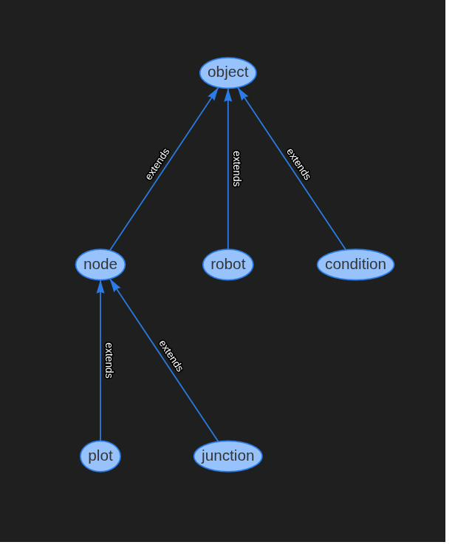
DESIGN CHOICES -
Shared structure: types, predicates, actions
Core predicates
robot-at position connected edges crop-condition state
inspected observed reported logged
Three Q1 actions
move
traverse an edge - the only thing that costs (+1)
inspect
read the crop - passive, never changes it
report
log a reading - needs inspected, not co-location
Why split plot vs. junction? move works on any node, but only plots can be inspected - no duplicated actions.
4
Type hierarchy
Notes:
Walk the hierarchy: node splits into plot and junction so one move action covers all travel. Predicates are deliberately simple. Stress two modelling choices: inspect is passive (monitoring observes, never intervenes), and report is decoupled from position - it only needs the plot inspected, and the robot not moving. Cost lives only on move, which turns Q1 into routing.

Slide 5




DESIGN CHOICES - PDDL+
Q2: numeric fluents, a process, an event
Numeric fluents
The degrade process
The crop-fails event
condition-level
runs while
fires when
crop health, falling over time
condition-level > 0
level <= 20 & not reported
degrade-rate
effect
effect
how fast each plot declines
decrease level by ( * #t rate )
plot marked failed - permanent
move-timer / report-timer
meaning
meaning
drive action durations
crops lose health on their own
goal becomes unreachable
How they interact: the process drains every crop continuously; the moment a level hits 20 on an unreported plot, the event fires and locks it as failed. So the robot's actions are racing a clock the environment controls.
5
Notes:
This is the technical heart. Numeric fluents hold continuous quantities classical predicates can't. The single degrade process is the autonomous dynamics - * #t means change per unit time. The crop-fails event is the threshold reaction. Emphasise the interaction box: process = slow continuous drain, event = instant reaction at the threshold, robot must beat it.

Slide 6

DESIGN CHOICES - KEY INSIGHT
No durative actions in ENHSP
A timed action is emulated by a start action + a timer process + a completion event.
>
>
start-move
moving (process)
move-complete (event)
instant action.
robot begins moving;
sets is-moving = true
runs while moving.
advances move-timer
continuously with #t
fires at timer >= 1.
teleports robot to dest;
resets the timer
Same pattern gives report its 0.2s duration. One durative action = 1 action + 1 process + 1 event.
6
Notes:
This is the slide to slow down on - it's the most novel modelling decision and examiners love it. ENHSP rejects :durative-action, so I rebuilt duration from primitives: a start action flips a flag, a process counts time with #t, and an event fires at the threshold to finish the action. Report uses the exact same three-part pattern at 0.2 seconds.

Slide 7




LIVE DEMO / PLAN OUTPUT
Watching the plans run
I'll run ENHSP live in VS Code and play the four animations. Here's how to read them:
Red dot the robot, moving along edges
Four plans
Q1-P1 stable crops
Blue inner ring plot has been inspected
Q1-P2 fewest-moves tour
Purple outer ring plot has been reported (rep)
Q2-P1 timing irrelevant
Q2-P2 timing critical *
Pink ring (Q2) condition-level - shrinks as crop degrades; red = near failure
* the highlight
7
Notes:
Set up the demo here. Tell them the planner only prints a list of timed actions, which is hard to read, so the GIFs visualise it. Walk the legend once. Flag Q2-P2 as the one to watch. Then switch to VS Code, run a problem live, and play the animations on the next slides.

Slide 8
PLAN OUTPUT - Q1 (CLASSICAL)
Q1 - P1
Q1 - Problem 1: stable crops
8
Notes:
Play this first. Point out the move-inspect-report rhythm and the rings filling in. No urgency here - it just proves the model works. The route isn't minimal because no metric is set; that's what Problem 2 fixes.

Slide 9
PLAN OUTPUT - Q1 (CLASSICAL)
Q1 - P2
Q1 - Problem 2: cost-optimised
8
Notes:
Play this first. Point out the move-inspect-report rhythm and the rings filling in. No urgency here - it just proves the model works. The route isn't minimal because no metric is set; that's what Problem 2 fixes.

Slide 10
PLAN OUTPUT - Q2 (PDDL+)
Q2 - P1
Q2 - Problem 1: timing irrelevant
8
Notes:
Play this first. Point out the move-inspect-report rhythm and the rings filling in. No urgency here - it just proves the model works. The route isn't minimal because no metric is set; that's what Problem 2 fixes.

Slide 11
PLAN OUTPUT - Q2 (PDDL+) - THE HIGHLIGHT
Q2 - P2
Q2 - Problem 2: timing critical
8
Notes:
Play this first. Point out the move-inspect-report rhythm and the rings filling in. No urgency here - it just proves the model works. The route isn't minimal because no metric is set; that's what Problem 2 fixes.

Slide 12


Challenges & limitations
What was hard
Limits & what I'd change
No durative actions in ENHSP
rebuilt duration from start + process + event
Discrete Q1 labels hide how close a crop is to failing - Q2's numeric level fixes this.
State-dependent cost failed
ENHSP optimises only unit costs -> kept flat +1/move
Single robot, fixed graph - no multi-robot coordination or repeated monitoring cycles.
Time-step (delta) tuning
too coarse misses events; too fine is slow
Failure is binary and permanent - no partial quality or recovery model.
Next: add intervention (irrigation) -> resource limits, deadlines, re-degradation.
Thank you - questions welcome
12
Notes:
Close honestly. The two genuine engineering hurdles were the missing durative actions and ENHSP ignoring state-dependent cost. Biggest conceptual limit: discrete labels lose the trajectory, which is exactly why Q2 goes numeric. The most interesting extension is letting the robot intervene, which turns monitoring into a resource-and-deadline scheduling problem. Then invite questions.

