Slide 1
Cybersecurity: Protecting Our Digital World
Understanding Threats and Defense Mechanisms
MUHAMMAD OBAID ULLAH

Slide 2
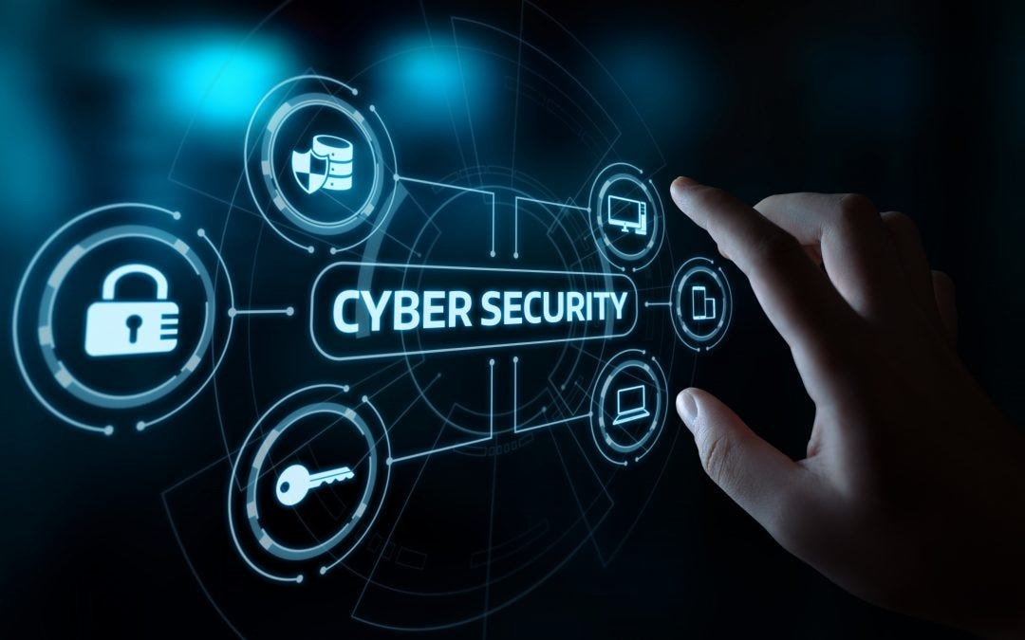
Introduction to Cybersecurity
Cybersecurity Defined:
Importance:
Increasing Threats:
Protects digital systems and data from unauthorized access, attacks, or damage.
Safeguard personal, financial, and business information from being stolen or compromised
Rising cyber attacks demand stronger security measures.

Slide 3

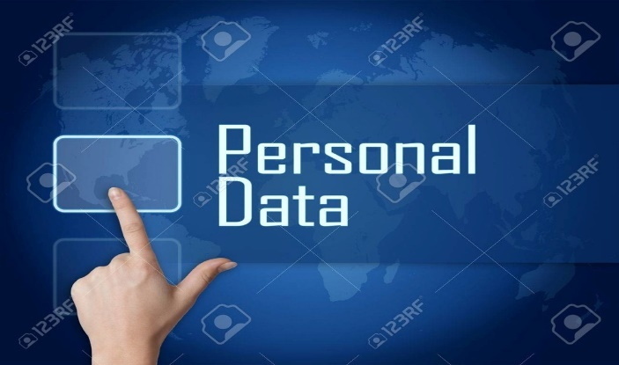

Key Points in Cybersecurity
Common Cyber Threats:
Malware: Malicious software like viruses and ransomware.
Phishing: Fraudulent attempts to steal sensitive information.
Importance of Personal Data Security:
Privacy: Protects against identity theft and data breaches.
Trust: Maintains confidence in digital interactions.
Strategies for Cyber Defense:
Strong Passwords: Unique and complex passwords.
Two-Factor Authentication: Adds an extra security layer.
Security Awareness: Educates users on safe practices.

Slide 4
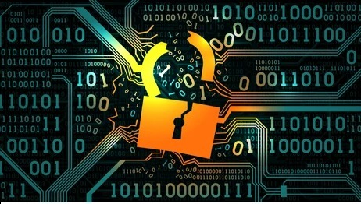
Case Study: The 2017 Equifax Data Breach
Overview:
Incident: In 2017, Equifax, a major credit reporting agency, experienced a massive data breach.
Impact: Personal data of over 147 million people, including Social Security numbers and financial information, was compromised.
Key Details:
Cause: The breach occurred due to a vulnerability in Equifax's web application framework that was not patched in time.
Consequences: Significant financial and reputational damage to Equifax, along with legal repercussions and loss of consumer trust.
Lessons Learned:
Importance of Regular Software Updates: Highlighted the need for timely patching of vulnerabilities.
Data Protection: Emphasized the necessity for strong data protection measures and robust security protocols.

Slide 5

Conclusion
Main Takeaways:
Importance of Cybersecurity: Essential for protecting sensitive information and maintaining trust in digital systems.
Proactive Measures: Regular updates, strong passwords, and security training are key strategies for preventing cyber attacks.
Call to Action:
Stay Vigilant: Encourage everyone to regularly update security practices and remain aware of new threats.
Adopt Best Practices: Urge the use of strong, unique passwords, two-factor authentication, and ongoing education about cybersecurity.

