Slide 1
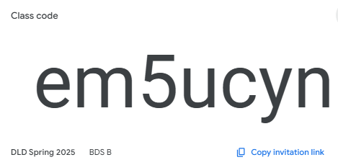
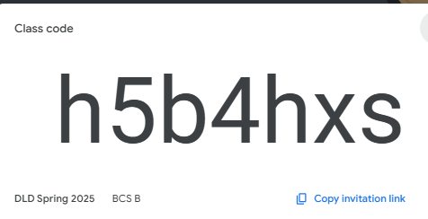
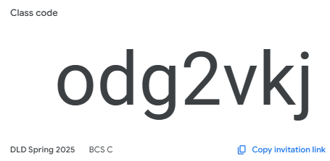
Digital Logic Design
EE(1005)

Slide 2
Introduction to Digital Logic Design

Slide 3
What is this course all about?
The fundamental of Digital Logic
  Binary numbers and relate number systems
  Digital circuit building block (Logic Gates)
  Boolean Algebra and Logic simplification
How to design
  Combinational logic circuits
  Sequential logic circuits

Slide 4
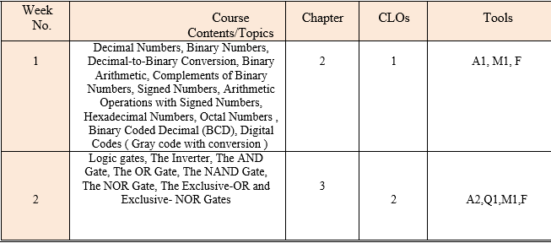
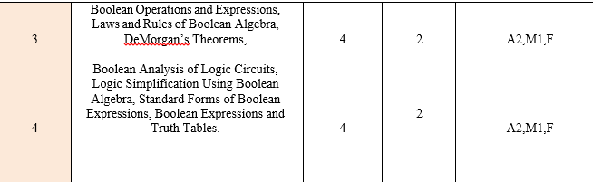

Slide 5
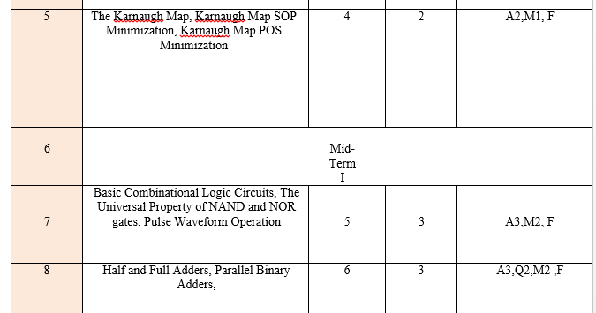

Slide 6
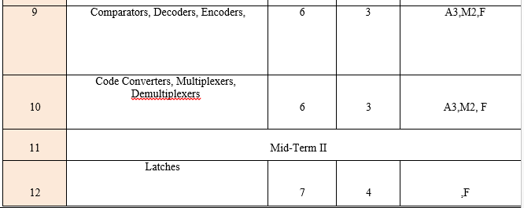
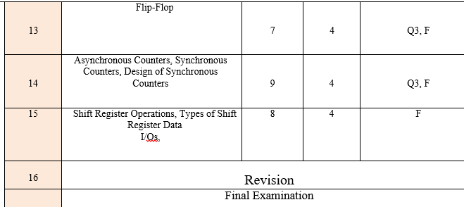

Slide 7
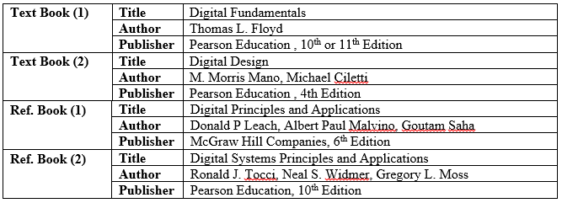
BOOKS

Slide 8
Assessment Tools & Criteria
AT | Description | Weight
1 | Mid Term I and II | 30
2 | Assignments | 10
3 | Quizzes | 10
4 | Final Examination | 50

