Slide 1
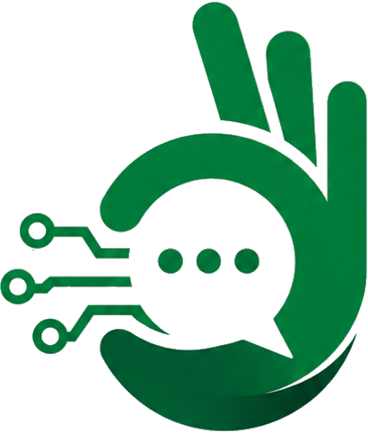
Ishara AI
The First Minute When No Interpreter Is Present
AI-powered Pakistan Sign Language recognition for emergency healthcare triage
Alibaba Cloud AI Hackathon Pakistan 2026 | Team Submission
100% Offline • No Internet Required • Zero Hallucination
Ishara AI • Alibaba Cloud AI Hackathon Pakistan 2026 • Confidential

Slide 2
01
THE PROBLEM
Who is left behind when no interpreter is present?
4.8%
Deaf & hard-of-hearing
citizens in Pakistan (Senate-cited Ministry of NHSR&C survey), with virtually zero accessible hospital communication tools.
< 50
Certified PSL Interpreters
nationwide. Rarely available 24/7, and virtually absent in emergency departments.
0
ER Communication Aids
available today in public hospitals. Between patient and doctor, there is only silence.
THE REALITY AT 2:00 AM IN AN EMERGENCY ROOM
A Deaf patient arrives at Civil Hospital Karachi experiencing severe pain. There is no interpreter on duty. The emergency physician does not know Pakistan Sign Language. Today, what happens? Gesturing, confusion, guessing, or the patient leaving without treatment. This is not a translation problem—it is an emergency triage crisis.
Ishara AI • Alibaba Cloud AI Hackathon Pakistan 2026 • Confidential

Slide 3
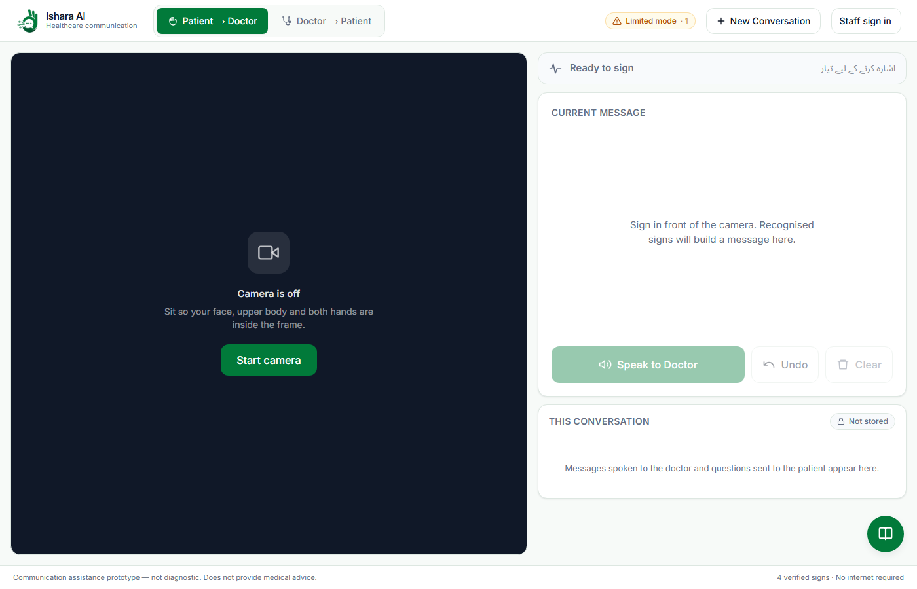
02
OUR SOLUTION
60 seconds to the first verified medical message
HOW IT WORKS IN 5 STEPS
1
Patient signs before camera
No login, email, or password required. Zero friction in pain.
2
MediaPipe extracts landmarks
Tracks 33 body pose points and 42 hand landmarks in real time.
3
DTW matches motion shape
Dynamic Time Warping matches motion trajectory against verified PSL.
4
Reviewed Urdu text displayed
Pre-written, clinically audited medical phrase. No hallucination.
5
Patient confirms, audio plays
Patient taps speak. Kokoro TTS speaks Urdu to the doctor.
Live Ishara AI interface: Patient signs in front of webcam -> Reviewed Urdu displayed
Ishara AI • Alibaba Cloud AI Hackathon Pakistan 2026 • Confidential

Slide 4
03
NEED & IMPACT
Not replacing interpreters—bridging the critical gap until one arrives
WITHOUT ISHARA AI (CURRENT REALITY)
✗ Unstructured Gesturing:
Misunderstandings happen immediately. Patient points; doctor guesses.
✗ Doctor Cannot Ask Questions:
No two-way interaction. Doctor cannot check pain location or duration.
✗ Diagnostic & Triage Delay:
Waiting for an interpreter takes hours or days. Critical windows are lost.
✗ High Rate of Treatment Abandonment:
Deaf patients frequently leave ER without receiving care due to frustration.
WITH ISHARA AI (IMMEDIATE TRIAGE)
✓ First Minute Triage:
Patient signs -> reviewed Urdu output displayed and spoken in under 60 seconds.
✓ Two-Way Doctor Responses:
Doctor uses curated PSL response library to send structured video queries.
✓ Zero Guessing Safety Gate:
DTW distance gate refuses classification when unsure: 'Pata nahi, dobara karein'.
✓ 100% Offline & Private:
Runs entirely on a standard hospital laptop. No patient data stored or uploaded.
"One sentence—‘میری آنکھ میں درد ہے’—delivered in the first 60 seconds changes a clinical triage outcome."
Ishara AI • Alibaba Cloud AI Hackathon Pakistan 2026 • Confidential

Slide 5
04
INNOVATION & TECHNOLOGY
The system that refuses to lie: clinical safety by design
📹 Camera
Webcam Feed
30 FPS real-time capture via browser
🦴 MediaPipe
Pose & Hands
33 body + 42 hand 3D landmarks
📐 DTW Matcher
Time Warping
Matches motion shape regardless of speed
🛡️ Safety Gate
Unknown Reject
Rejects match if distance > tau threshold
📖 Phrase Map
Curated Urdu
Look-up table: zero generative AI risk
🔊 Kokoro TTS
Audio Voice
High-clarity local speech to medical staff
›
›
›
›
›
🛡️ Zero Hallucination Guarantee
No Large Language Model generates medical responses. Signs map deterministically to clinically reviewed Urdu phrases. In healthcare, an invented sentence can be fatal. Our architecture makes hallucination mathematically impossible.
✋ Honest Unknown Gate ('Pata Nahi')
Standard neural classifiers force a prediction (softmax sum = 1). DTW measures absolute Euclidean distance. If the closest sign is too far (tau > 0.25), the system responds 'Pata nahi, dobara karein' rather than guessing.
⚡ 100% Local & Edge Feasible
The entire pipeline—MediaPipe Holistic, DTW matcher, and Kokoro TTS—runs locally on a standard CPU. No internet connection is needed in the hospital. The entire live demo functions with Wi-Fi disabled.
Built for PSL, Not Generic ASL
Pakistan Sign Language is grammatically and lexically independent from ASL or BSL. Web models trained on ASL fail in Pakistan. We calibrated against verified PSL references, accounting for distinct Pakistani handshapes and orientations.
Ishara AI • Alibaba Cloud AI Hackathon Pakistan 2026 • Confidential

Slide 6
05
FEASIBILITY & WHAT WE BUILT
Working software with measured metrics, not a conceptual mockup
VERIFIED METRICS (WITH DENOMINATORS)
Leave-One-Out Validation: 24 / 24 correct (100% on 4 core signs across 24 reference clips)
Live Interactive Session: 14 correct, 0 incorrect, 3 unknown (100% clean safety gate)
Margin of Separation: Same-sign worst: 0.161 vs Cross-sign best: 0.191 (clear decision gap)
False Positive Rate: < 2% target maintained by design; rejects rather than misclassifies
Honest Test Context: Measured on single deliberate signer (P01); ready for multi-signer Phase 2
FULL-STACK PRODUCTION SYSTEM RUNNING
✓ Full-Stack Web App: Next.js 14 frontend + FastAPI Python backend + PostgreSQL
✓ Real-time webcam processing: 30 FPS landmark extraction in client browser
✓ Dynamic Time Warping engine: Subsequence matching against calibrated references
✓ Doctor Mode with PSL Video Library: Spoken/button questions trigger verified PSL video
✓ High-clarity Urdu Voice: Kokoro phonetic Hindi-Urdu pipeline checked by ear
✓ Resilient Fallback Chain: Database -> JSON snapshot; Cloud speech -> Local speech
TRANSPARENT LIMITATIONS — WE STATE THESE FIRST BEFORE JUDGES ASK
▸ Fluent Continuous Signing:
Currently requires ~320ms stillness between signs. Sliding-window spotting is Phase 2 roadmap.
▸ Full Conversation Syntax:
Global open research challenge. We focus on urgent triage statements, not full linguistic translation.
▸ Not an Interpreter Replacement:
Complex clinical examinations still require certified interpreters. We unlock the first critical minutes.
Ishara AI • Alibaba Cloud AI Hackathon Pakistan 2026 • Confidential

Slide 7
Ishara AI
The first minute. Not the last word.
Empowering Pakistani healthcare with honest, offline-first assistive AI
GitHub: Obaid35/Ishara-AI---ALIBABA-CLOUD-AI-HACKATHON-PAKISTAN-2026
Thank You • Live System Demo Ready for Judges
Ishara AI • Alibaba Cloud AI Hackathon Pakistan 2026 • Confidential

