Slide 1
Visitor Gate Pass System
Prepared By : 1) Shadab Ali Shaikh
2) Obaid Kazi
3) Mohd Adnan Ansari
4) Mudassar Pawaskar

Slide 2
What Is The Need Of Our Software ??
As compare to previous way in-charge or a gate keeper have to enter all the details of the visitor in register. They have to maintain that register and may be that register is not present throughout the year the time. In case an organization needs data of visitor that who is visited in an organization, then that register should be present in an organization Manual systems are boring and time consuming. Our Visitor Gate Pass System records all-relevant information about the visitor, which is automatically captured in a database. Then ID scanning is done, and a professional quality visitor pass is printed. The pass printing software is integrated into the module for convenient operation.

Slide 3
What we have developed ??
We have developed a software on PHP and MySQL which is platform independent and name as Visitor Gate Pass System. This system provide providing the functionality of entering the visitor records (DATA) into the database. Visitor Gate Pass System provides a way to effectively control, records and find the organization’s visitors. It helps to reduce the waiting time of visitor in premise.

Slide 4
Platform We Used
The platform we used is PHP. PHP is a server-side scripting language designed primarily for web development but also used as a general-purposed programming language. Originally created by Rasmus Lerdorf in 1994, the PHP reference implementation is now produced by The PHP Development Team. PHP originally stood for Personal Home Page, but it now stands for the recursive acronym PHP: Hypertext Preprocessor.
PHP code may be embedded into HTML or HTML5 code, or it can be used in combination with various web template systems, web content management systems and web frameworks. PHP code is usually processed by a PHP interpreter implemented as a module in the web server or as a Common Gateway Interface (CGI) executable. The web server combines the results of the interpreted and executed PHP code, which may be any type of data, including images, with the generated web page. PHP code may also be executed with a command-line interface (CLI) and can be used to implement standalone graphical applications

Slide 5
Data Base Used In our Software
MySQL (officially pronounced as is an open-source relational database management system (RDBMS). Its name is a combination of "My", the name of co-founder Michael Widenius' daughter, and "SQL", the abbreviation for Structured Query Language. The MySQL development project has made its source code available under the terms of the GNU General Public License, as well as under a variety of proprietary agreements. MySQL was owned and sponsored by a single for-profit firm, the Swedish company MySQL AB, now owned by Oracle Corporation. For proprietary use, several paid editions are available, and offer additional functionality.
MySQL is a central component of the LAMP open-source web application software stack (and other "AMP" stacks). LAMP is an acronym for "Linux, Apache, MySQL, Perl/PHP/Python". Applications that use the MySQL database include: TYPO3, MODx, Joomla, WordPress, phpBB, MyBB, and Drupal. MySQL is also used in many high-profile, large-scale websites, including Google (though not for searches), Facebook, Twitter, Flickr, and YouTube

Slide 6
Features Of Our Project
Visitor Gate Pass System
Keeps Visitor Records who has visited.
Get visitors details any time when we want.
All visitors information via SMS.
Protect your Organization and Institute from unwanted people.
Bulk data of all visitors are manage easily.
Visitor history & statistics.
User and Role definition.

Slide 7
System requirements
Hardware Configuration
Processor ------------------------- Pentium Series
Hard Disk Capacity ------------- 20 GB
Ram ------------------------------- 512 MB
Keyboard & Mouse-------------- Normal
Software Configuration
Operating System ------------- Windows XP,7,8,,10
Font End ------------------------ PHP,HTML
Back End ----------------------- JS, AJAX, MySQL
Browser ------------------------- Microsoft Edge, Chrome, etc

Slide 8
Let’s Visit To Our Project Flow

Slide 9
Home Page
Home Page
Features
About Us
Contact Us
Home
Login
Global Access on Visitor
Details
Designing Construction
Address
Contact
Details
Admin / In-charge Loging
Visitor Login
Visitor Pictures
Security Of Organization
Event Notification

Slide 10
Login Form
User Credentials
Admin
In-charge
Username & Password Validation
Username & Password Validation
Username
If
Username
Password
Password
return to
else
If login as Admin
If as login as In-charge
Admin Dashboard
In-charge Dashboard
(In-charge 1/2)

Slide 11
Admin Dashboard
Admin Dashboard
Create
In-charge
Update In-charge
Remove In-charge
View Visitor Report
View In-charge Details
Logout
Entering valid details of In-charge
Update necessary flied of
(In-charge 1/2)
Remove In-charge
Home Page
Shift
Wise
In-charge
Wise
Date Wise
Shift Wise
In-charge
All can selected

Slide 12
In-charge Dashboard (1/2)
In-charge Dashboard
Create Visitor
Existing Visitor
View Report
Logout
Personal Detail
Legal ID proof
View Report can date wise / day wise
Home Page
Details about the visitors
Take Photo
SMS Notification
Print Hardcopy

Slide 13
Screen-Shots Of Our Project
(Visitor Gate Pass System)

Slide 14
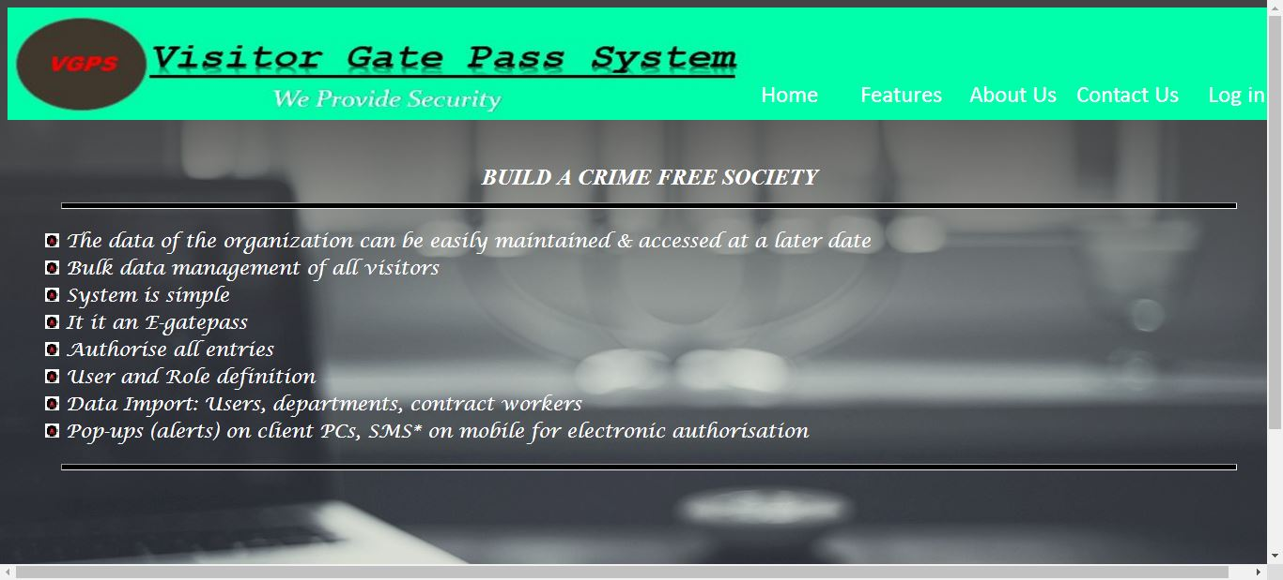
Screen-shot Of Home Page

Slide 15
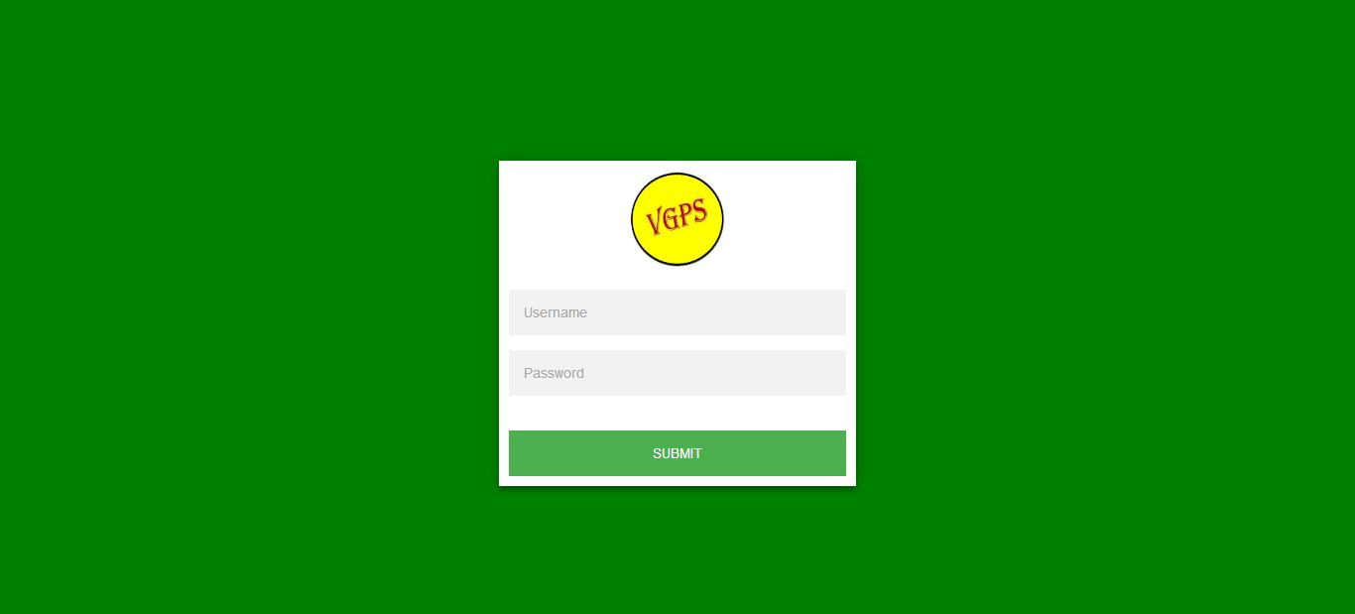
Screen-shot Of Login Form

Slide 16
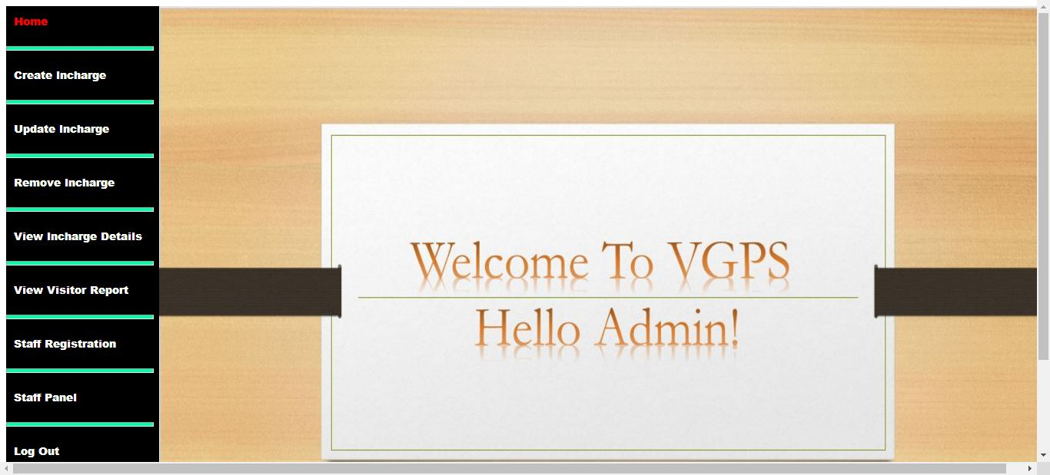
Screen-shot Of Admin Dashboard

Slide 17
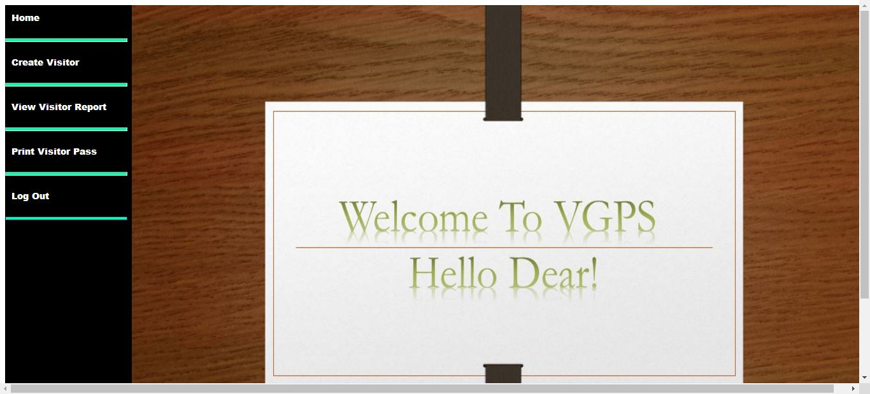
Screen-shot Of In-charge (1/2) Dashboard

Slide 18
Advantages Of Our Project
Visitor Gate Pass System
Easy to use interface.
Role-based user login.
Gate Pass is provided to Visitors.
Manage multiple host employee data.
Integrated with various hard-wares like web-cam, printers.

Slide 19
.
Feature Enhancement Of Our Project
Visitor Gate Pass System
Reports can be exported in various formats like Word/ Excel /Pdf etc.
Finger Print security.
Email notification.
Bar-code generator.
An application can be developed on “Visitor Gate Pass System”

Slide 20
Thank You

