Slide 1


FLIGHT RESERVATION SYSTEM
GROUP MEMBERS
AHSAN OMERJEE(CT-091)
OBAID UR REHMAN(CT-048)
MUHAMMAD DANIYAL SALEEM(CT-063)

Slide 2
OVERVIEW OF THE PROJECT
The main objective of the project is to design,
code and test flight reservation system.
It contains details about flight schedules its fair, passenger reservation and their ticket through online booking and it contains information about available seats and also about flight and captains.
The system is implement in C++ and file handling on csv will act as database.

Slide 3
OBAID UR REHMAN
CLASS PILOT
By the Execution of this Class:
In this Class, we have two Pilots (Captain and Vice Captain) Info. of Airlines i.e. Emirates, PIA, Airblue.
We have Saved Pilot Personal Information in different variables.
In this Class A User can see Pilot's Name, Age, Experience etc.
CLASS PLANE
By the Execution of this Class:
In this Class we have three Plane Info. i.e. Emirates, PIA, Airblue.
We have Saved Plane Information in different variables.
In this Class A User can see Plane Model, Plane Name, Total Seats, Total Plane Staff etc.

Slide 4
AHSAN OMERJEE
CLASS FLIGHT
By the Execution of this Class:
In this Class,We have stored Flight Schedule Which can be viewable by the user.
From this Class,A user can select his/her light type i.e:Domestic and International and he/she can also tell the destination and origin from different cities in Domestic flight and from different countries in International flight which will be stored in different variables.

Slide 5
CLASS TICKET
In this Class, We have inherited class Flight and class Passenger publically.
In this Class, We have done file handling
By the Execution of this Class:
Through file handling the data entered by the user in class Passenger and class Flight will be stored such as:destination,origin,name,age etc.
All these Ticket information will be saved in .csv file.
User can also search for his/her Ticket by just entering the seat number which he/she entered in passenger data.

Slide 6
MUHAMMAD DANIYAL SALEEM
CLASS PASSENGER
In this class which has different data members with protected and public datatypes and also member function which are used to get input and view passenger data.
Class Passenger is the base class which has inherited with class Ticket.
By the Execution of this Class:
User can add passenger data
User can view input passenger data
Passenger data will be saved in .csv file
User can search and view passenger data by entering its seat number,Just to check if it exist or not.
User can also delete and cancel reservation of flight

Slide 7
CLASS PAYMENT
In this class which has different data members with private and public datatypes and also member function which are used to payment to get ticket.
By the Execution of this Class :
Users can select the bank which have an user’s account
Users can also choice a type of payment which they want like:
Debit Card Method
Credit Card Method
Net Banking
After successfully transaction, they get ticket.

Slide 8
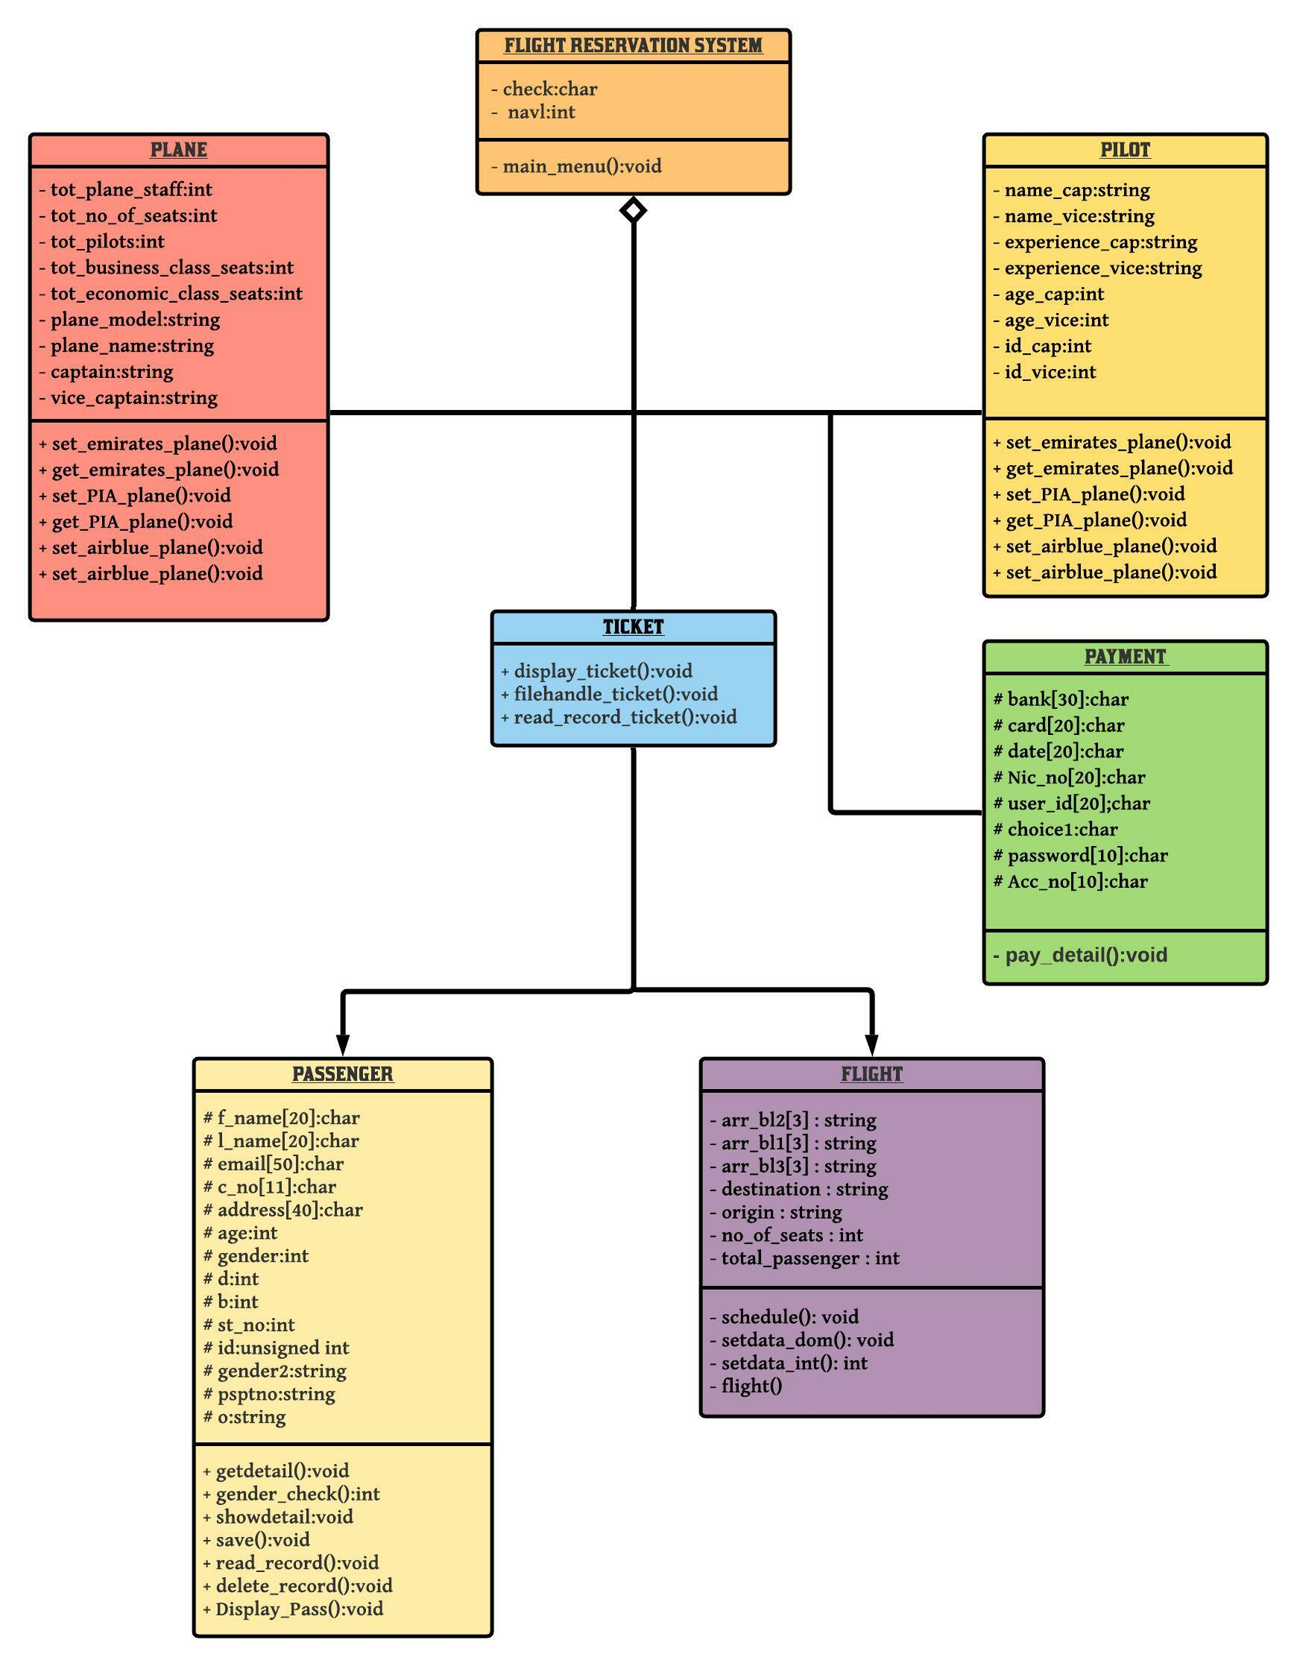

Slide 9
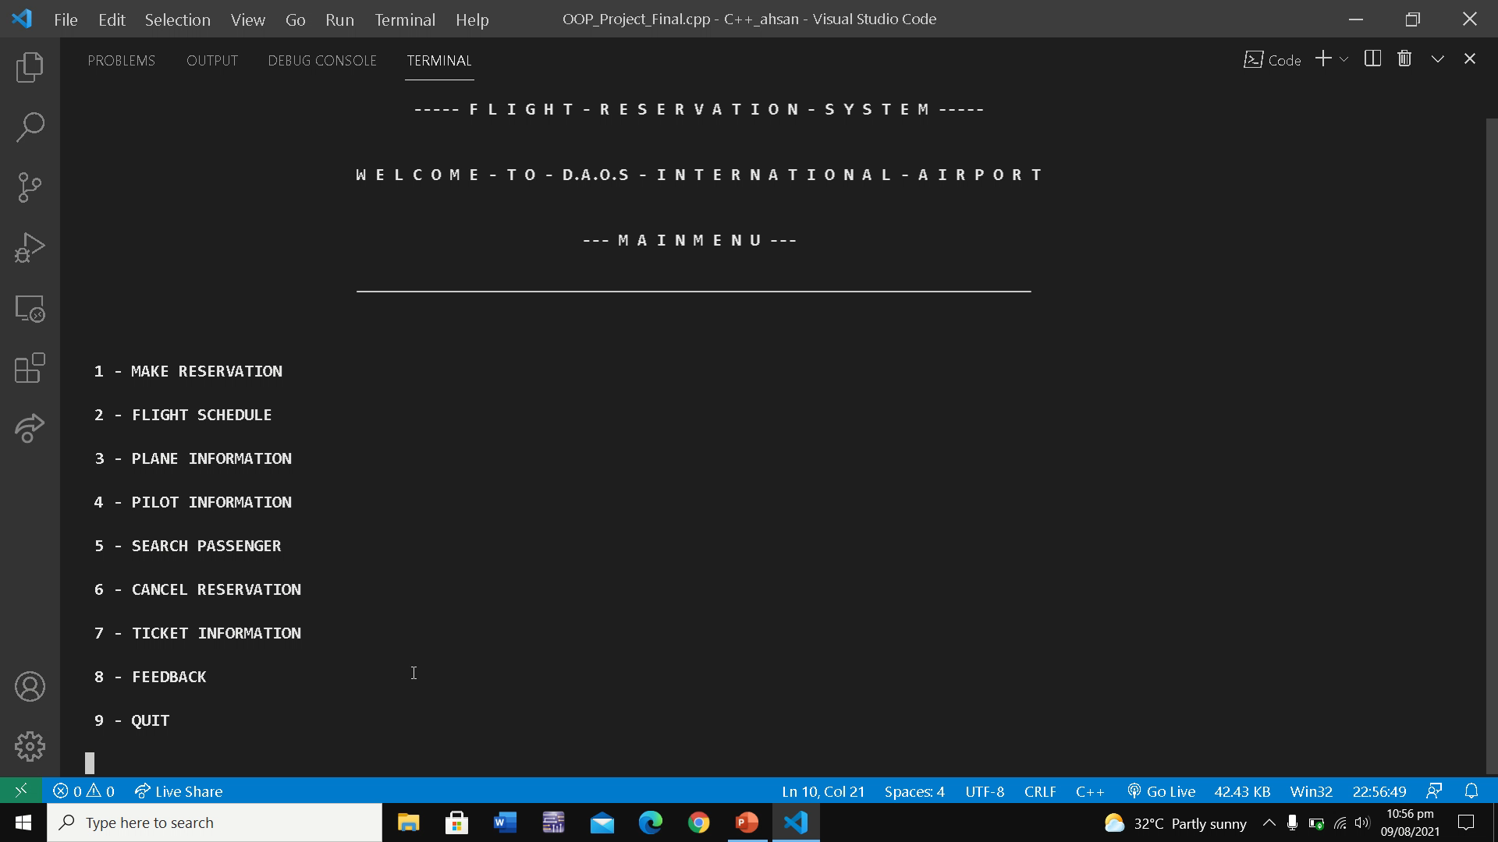

Slide 10
REMAINING WORK
Our Project is almost done except some formatting in Schedule and Ticket and there is reusability of code so we will Dry-run and if we think that more Modification will be done then,we will do it!

Slide 11
THANK YOU!

