Slide 1



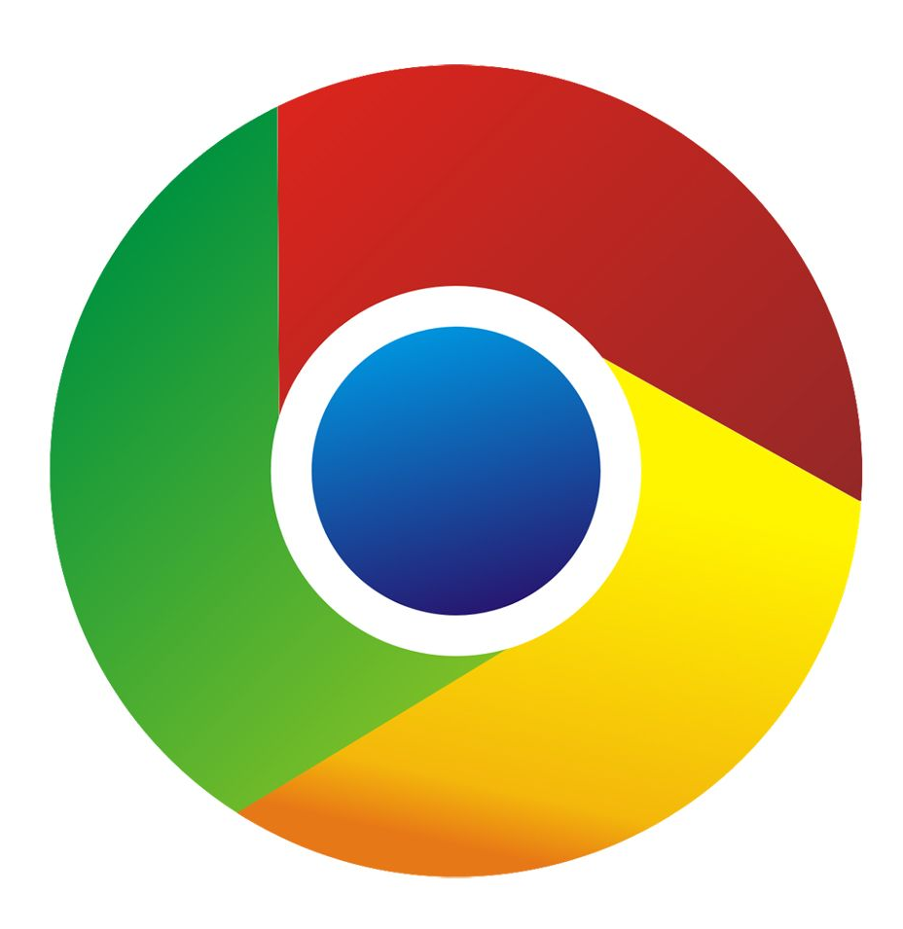
Brackets (IDE)
JavaScript (Language)
p5 (Library)
Chrome (GUI)

