Slide 1
FORESHORE HOLDINGS
Product walkthrough for investors
Agent collection app · admin dashboard · from business model to build
Prepared by Olumide Michael Obaniwa (Bossman) · 18 September 2026

Slide 2
The business today
A daily field-collection savings and loan model — run on cards, cash, and trust.
1
2
3
Daily collection
Manual reconciliation
Withdrawals & loans
Field agents visit customers every day, collect savings in cash, and record it on a customer-exclusive card.
At day's end, agent and admin jointly total collections and post them to a paper ledger.
Customers withdraw monthly savings less a service charge, or take short-term loans at 20% flat interest.
The risk: every step above is manual, so mismatches, disputes, and lost cards are only ever caught after the fact. The screens on the following pages digitize each step — without changing how the business actually runs.

Slide 3
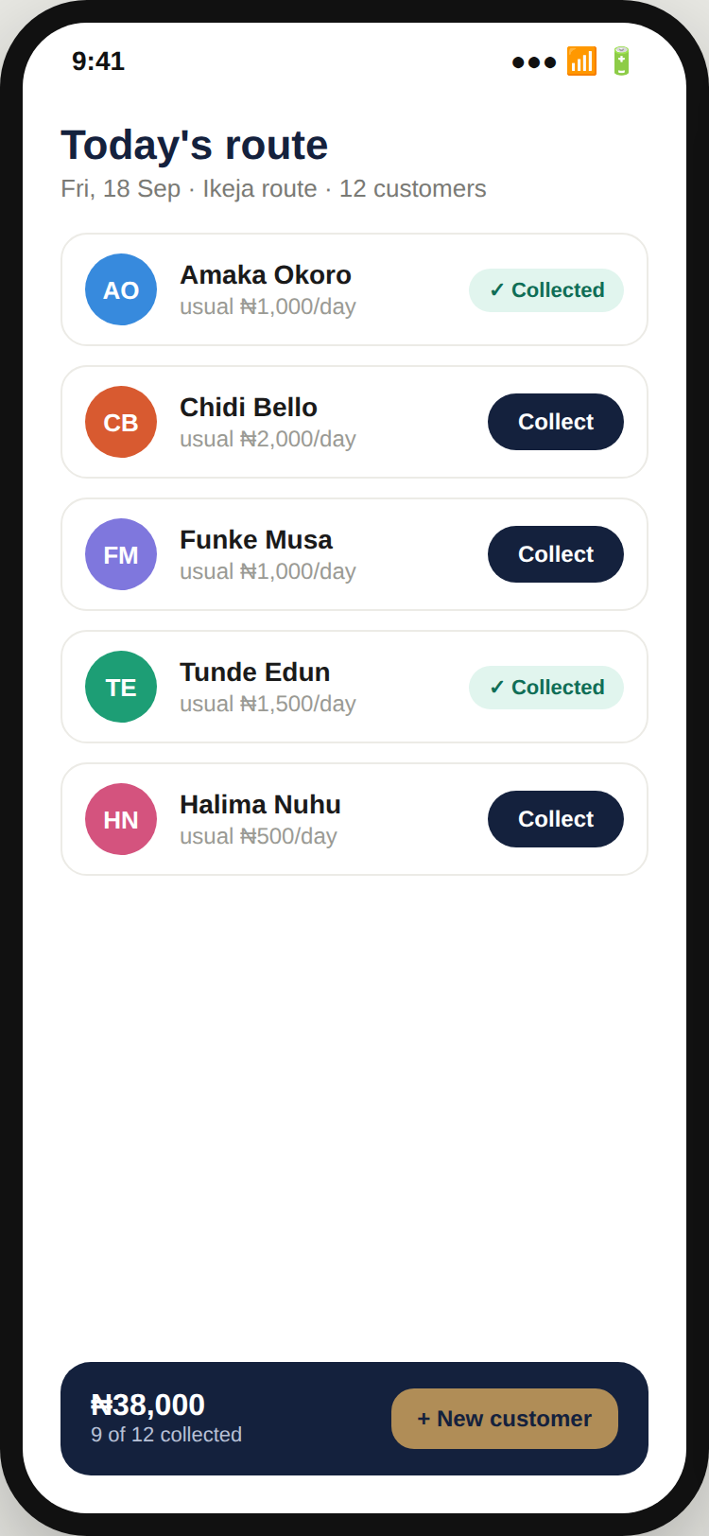
01
Agent app — today's route
Every agent opens the day already knowing who to see and their usual saving amount — no memory or paper card needed to start the round.
One tap logs a collection at the customer's usual amount, so a routine stop takes seconds.
The running total at the bottom is the exact figure that gets reconciled with admin that evening.
Maps to BRD requirements FR-4, FR-6

Slide 4
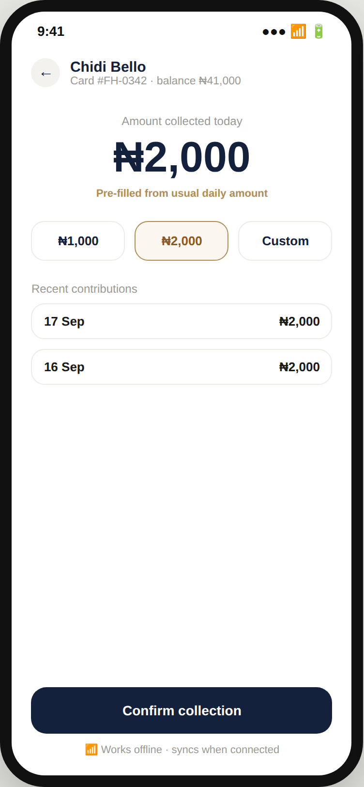
02
Agent app — collect payment
Amount pre-fills to the customer's usual daily saving and is editable in one tap for a top-up or a smaller amount.
Recent contribution history is visible on the spot, which builds trust with the customer during collection.
Designed to work fully offline in the field, syncing automatically once the agent has signal again.
Maps to BRD requirements FR-4, FR-5

Slide 5
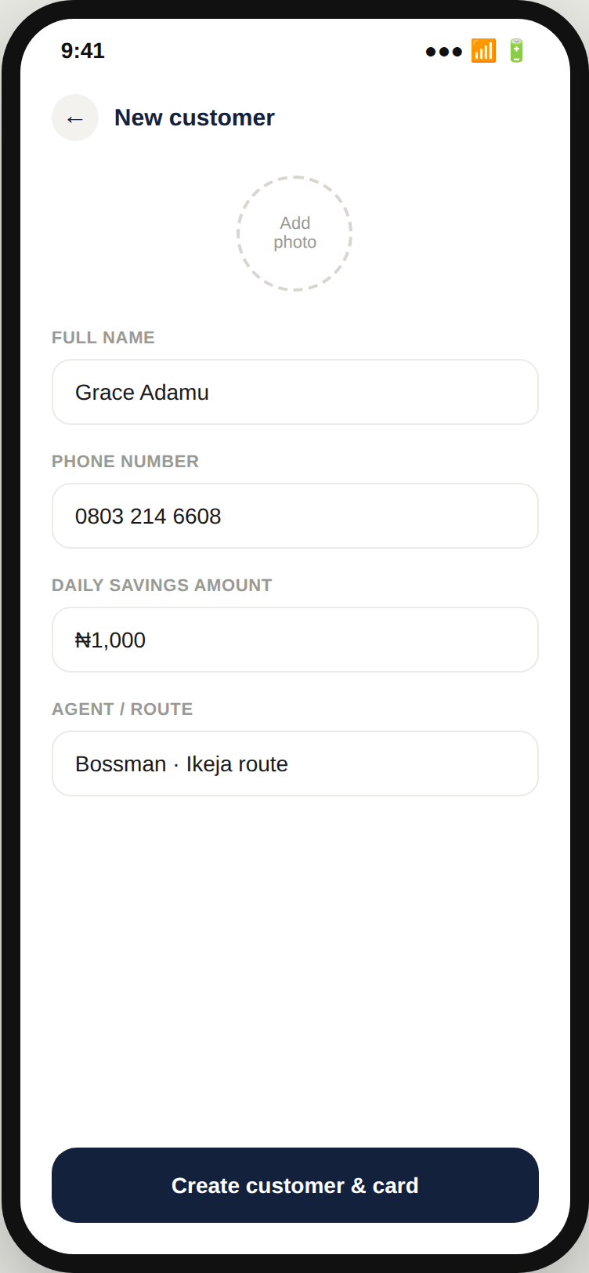
03
Agent app — new customer
Agents can onboard a new saver mid-route, without sending them into an office first.
Creates the digital equivalent of the paper card instantly — name, phone, and daily amount, ready to collect against tomorrow.
Growth from door-to-door prospecting compounds without waiting on office hours.
Maps to BRD requirements FR-1, FR-2, FR-3

Slide 6
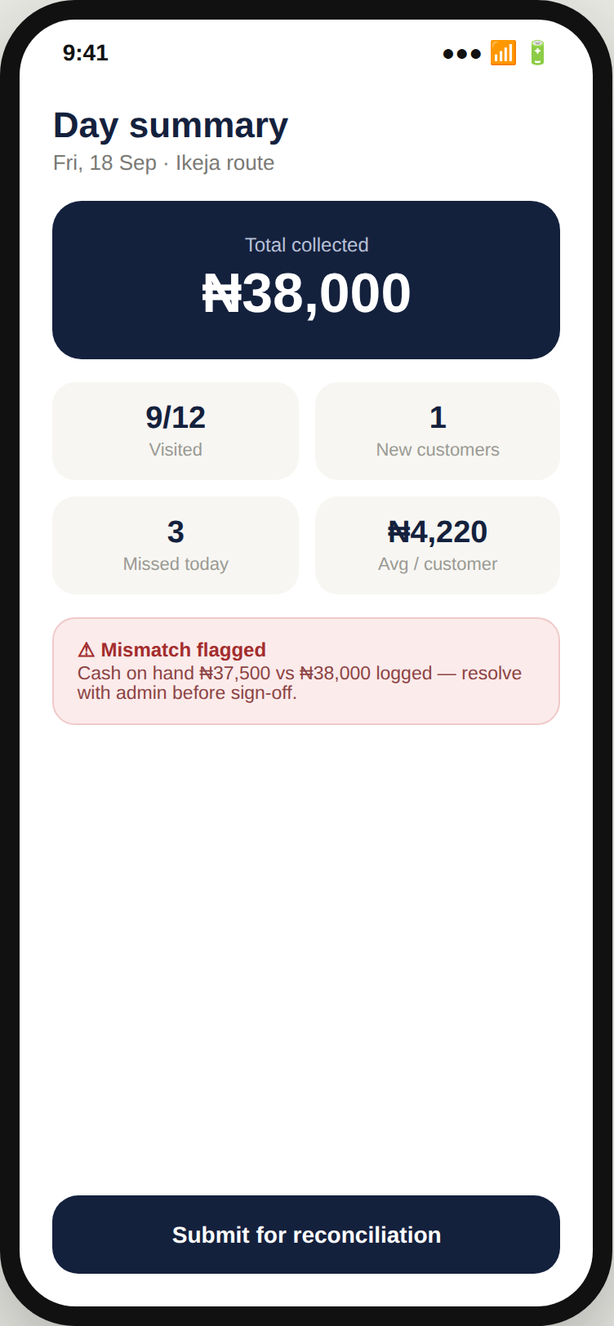
04
Agent app — day summary
The agent sees the full day's numbers before ever walking into the office — no mental math on the way back.
Any mismatch between cash on hand and logged collections is flagged immediately, not discovered during reconciliation.
This is the exact figure admin reconciles against — not a verbal report.
Maps to BRD requirements FR-6, FR-7, FR-8

Slide 7
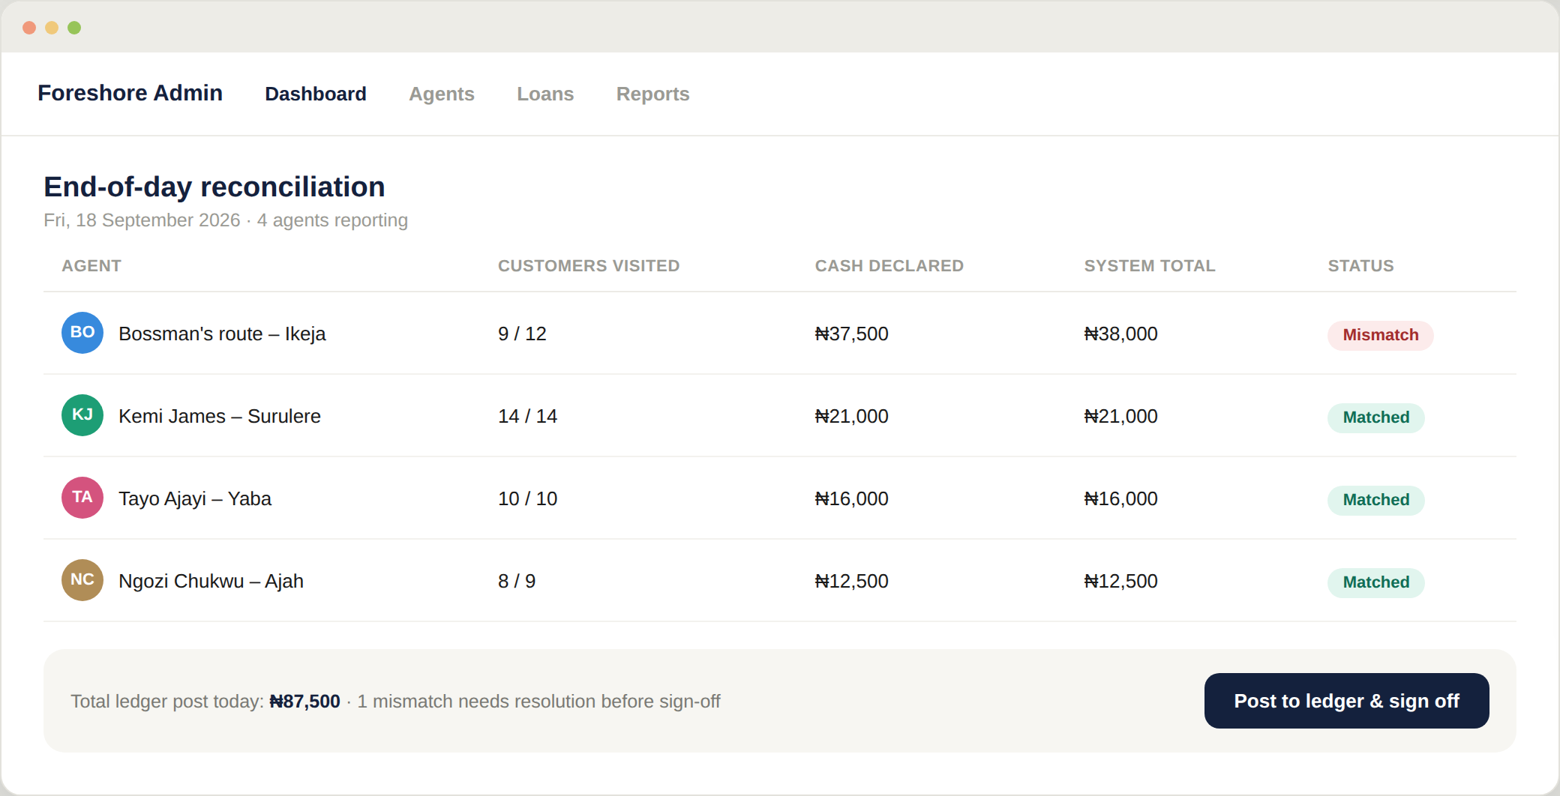
05
Admin — end-of-day reconciliation
Every agent's declared cash sits next to the system's logged total, for every route, on one screen.
A mismatch is flagged in red before anything is posted — admin resolves it with the agent on the spot, same day.
Sign-off happens digitally: once posted, the day's ledger entries are locked from further editing.
Maps to BRD requirements FR-7, FR-8, FR-9, FR-10

Slide 8
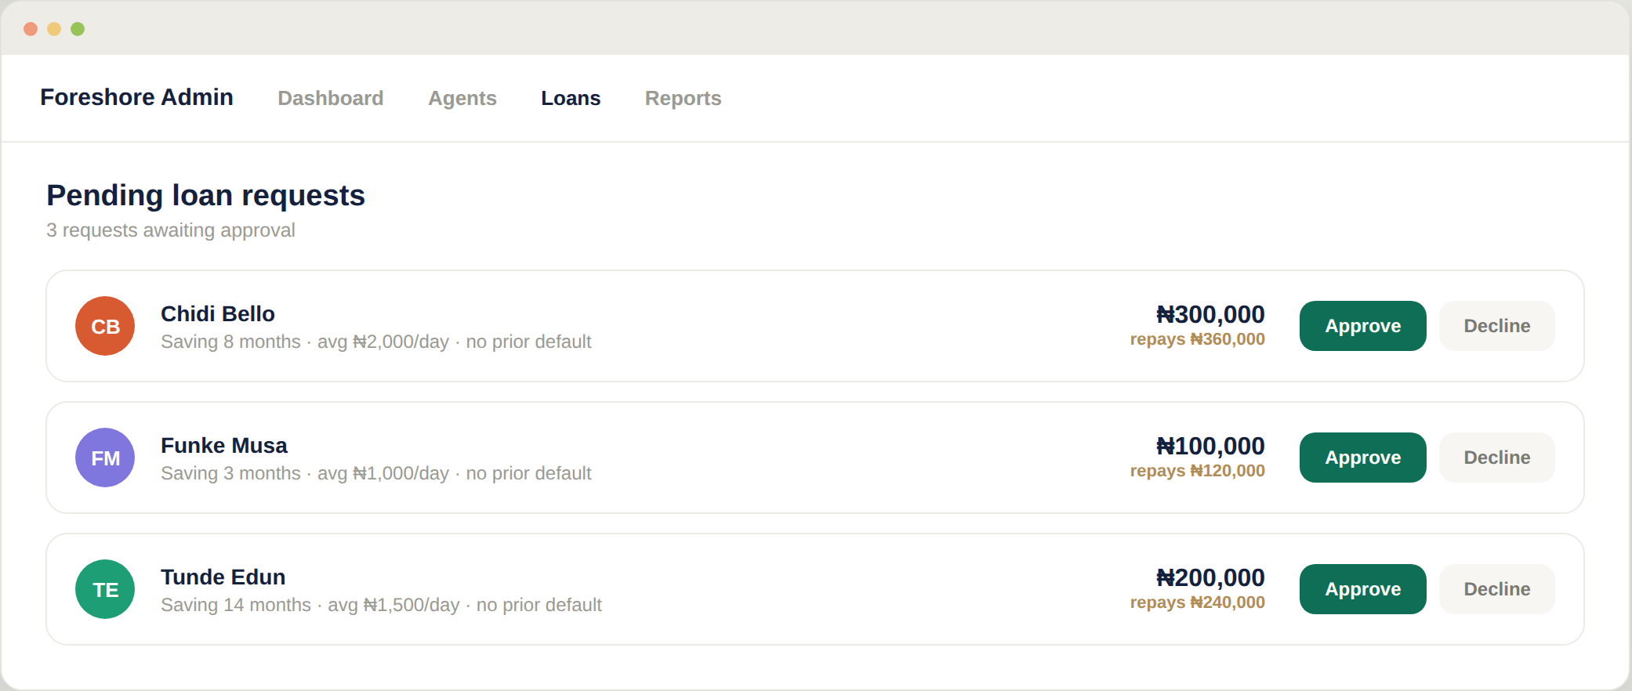
06
Admin — loan approval
Each request shows savings tenure and daily average — the track record admin actually needs to decide, at a glance.
Repayment (principal plus the flat 20% charge) is calculated automatically — no manual math, no spreadsheet.
Approve or decline from the same screen the request arrived on.
Maps to BRD requirements FR-14, FR-15

Slide 9
What's next
A phased path from these screens to a live system.
Phase 1
Phase 2
Phase 3
Phase 4
Build
Pilot
Roll out
Extend
Develop the agent app and admin dashboard against the BRD requirements (FR-1 to FR-20), including offline sync and the audit trail.
Run one route end-to-end on the system alongside the existing paper process, to validate reconciliation accuracy before switching over fully.
Onboard all agents and routes onto the system; retire paper cards and manual ledger entry.
Add customer-facing statements (via WhatsApp or SMS), automated loan risk scoring, and management reporting.

Slide 10
What we're asking for
[Placeholder — replace with your specific funding ask before sending]
Engineering — build and QA the agent app and admin dashboard
Pilot operations — devices, agent training, and one route's running costs
Loan book working capital — principal to disburse while the pilot proves out
Contact: Olumide Michael Obaniwa · Foreshore Holdings

