Slide 1
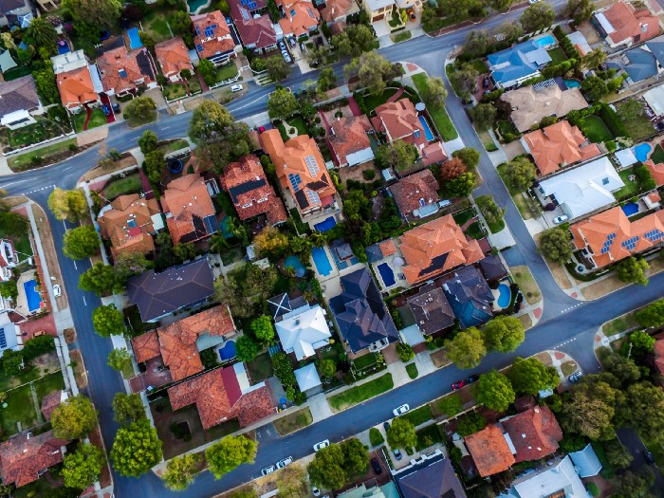
KINGS COUNTY PROJECT

Slide 2
Objective
I have to build a simple linear regression that can help to predict the value of the house King county, WA houses

Slide 3
Benefits
Being able to predict the fluctuation of home prices. Future homeowners; renters, investors, and businesses will all benefit from the outcome of this project. They will be able to appropriately plan and make informed decisions about purchases in regards to real estate.

Slide 4
Methodology
We first needed to clean the provided data sets for accurate analysis.
We leveraged the strength of the pandas library in order to ease ourselves the burden of cleaning the data sets using complex methods.

Slide 5
The kings county dataset contains a wealth of information about the price, size, location, condition and various other features of houses in Washington’s King County. In this presentation, I’ll present how I built a multiple linear regression model in Python to predict house prices

Slide 6
Column Names and descriptions for Kings County Data Set
id - unique identified for a house
dateDate - house was sold
pricePrice - is prediction target
bedroomsNumber - of Bedrooms/House
bathroomsNumber - of bathrooms/bedrooms
sqft_livingsquare - footage of the home
sqft_lotsquare - footage of the lot
floorsTotal - floors (levels) in house
waterfront - House which has a view to a waterfront
view - Has been viewed
condition - How good the condition is ( Overall )
grade - overall grade given to the housing unit, based on King County grading system
sqft_above - square footage of house apart from basement
sqft_basement - square footage of the basement
yr_built - Built Year
yr_renovated - Year when house was renovated
zipcode - zip
lat - Latitude coordinate
long - Longitude coordinate
sqft_living15 - The square footage of interior housing living space for the nearest 15 neighbors
sqft_lot15 - The square footage of the land lots of the nearest 15 neighbors

Slide 7
EDA
Majority of the columns were deemed acceptable for analysis and some were transformed for analysis. Especially categorical columns.

Slide 8
Patterns
Sqft_living
It was discovered that this variable had an additive relationship with two other plots ie. sqft above and sqft_basement.

Slide 9
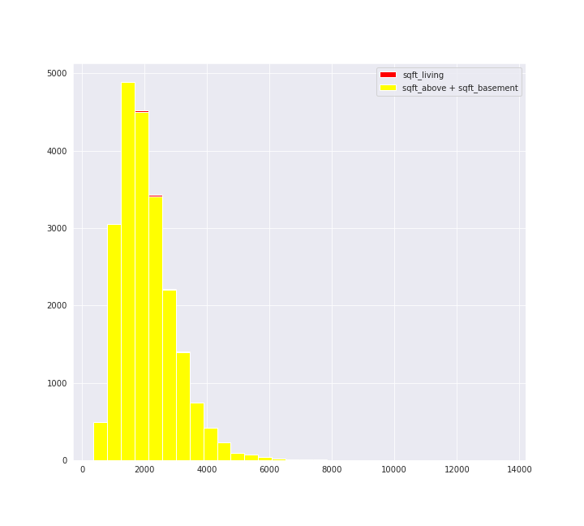

Slide 10
The variable also appeared to have a linear relationship with the price.

Slide 11
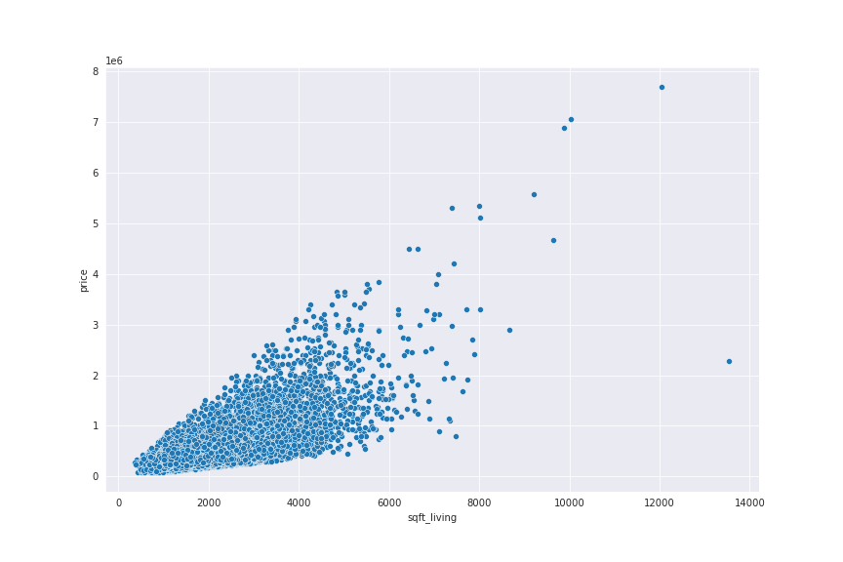

Slide 12
Bedrooms
It was noted that 5 bedroomed homes sold at higher prices.

Slide 13
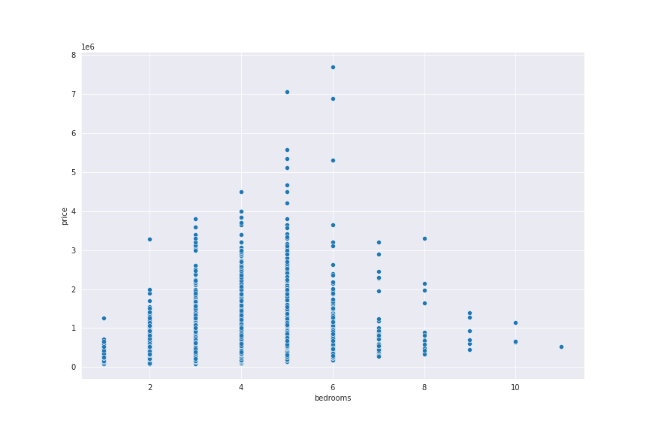

Slide 14
Bathrooms
It was observed that prices of homes kept increasing as the number of bathrooms increased.

Slide 15
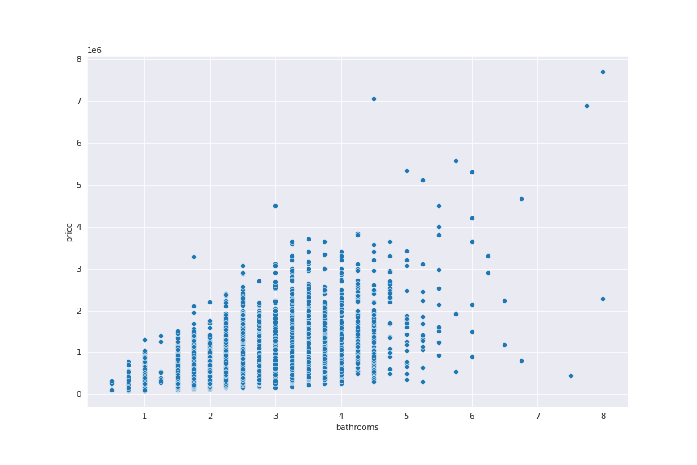

Slide 16
Houses built
It a appears there is an increasing in house constructions since 1900. This could be an indicator of increasing demand.

Slide 17
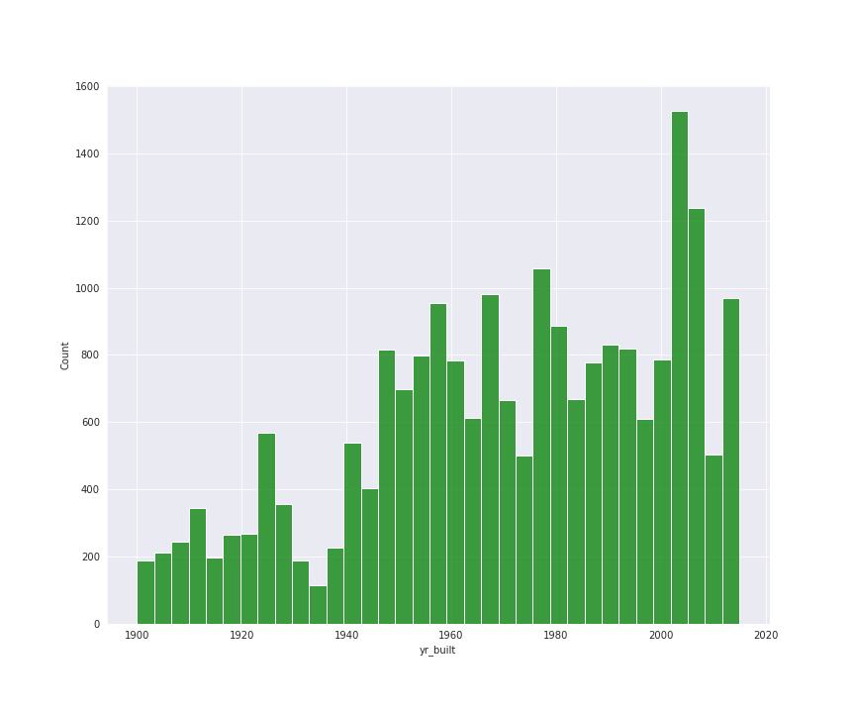

Slide 18
Grades
There also appeared to be some evidence that the prices of homes increased as the grade ratings were higher.

Slide 19
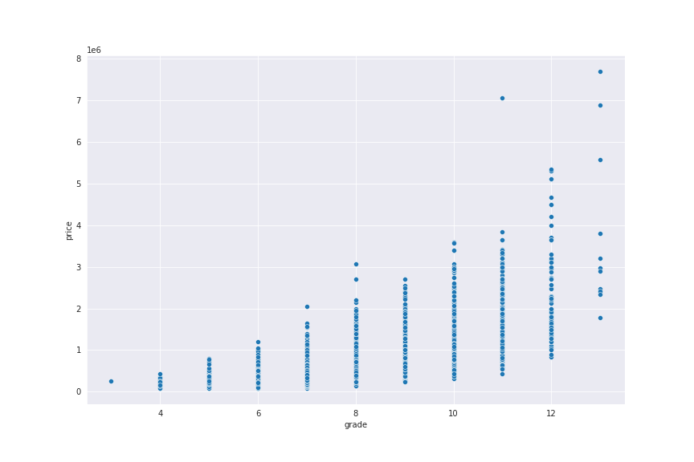

Slide 20
Condition
There was evidence that average condition homes sold at higher prices compared to good condition homes, which would go against the believed norms.

Slide 21
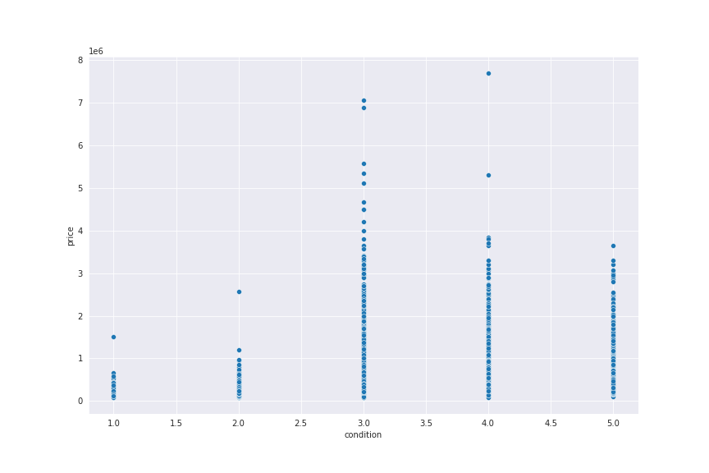

Slide 22
House age
Newer homes have higher sale count compared to old homes with low sales count.

Slide 23
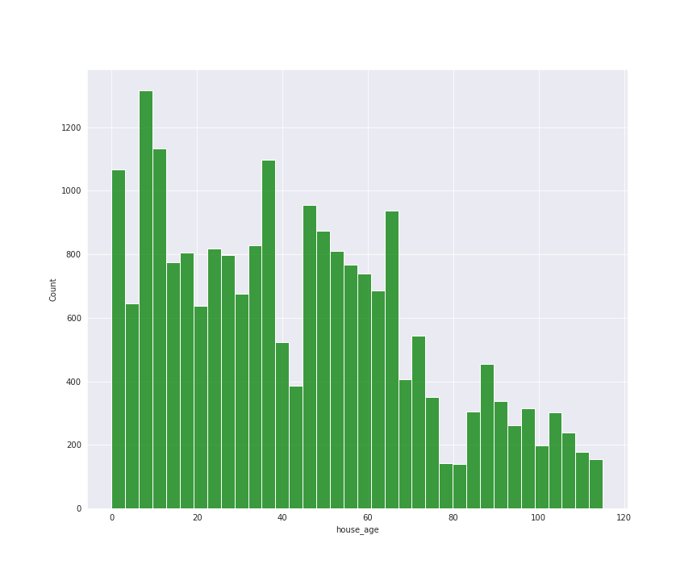

Slide 24
Modeling
Model 1
I fitted a model of price ~ sqft_living^5
It appeared that the relationship between price and sqft_living could be described by a polynomial relationship of order 5.

Slide 25
