Slide 1

Algorithm Analysis
Michael Hahsler
This work is licensed under a Creative Commons Attribution-ShareAlike 4.0 International License.

Slide 2

What is an Algorithm?
Definition
“A clearly specified set of simple instructions to be followed to solve a problem.”
Important properties
Correctness
Run time - time complexity
Memory requirement - space complexity

Slide 3

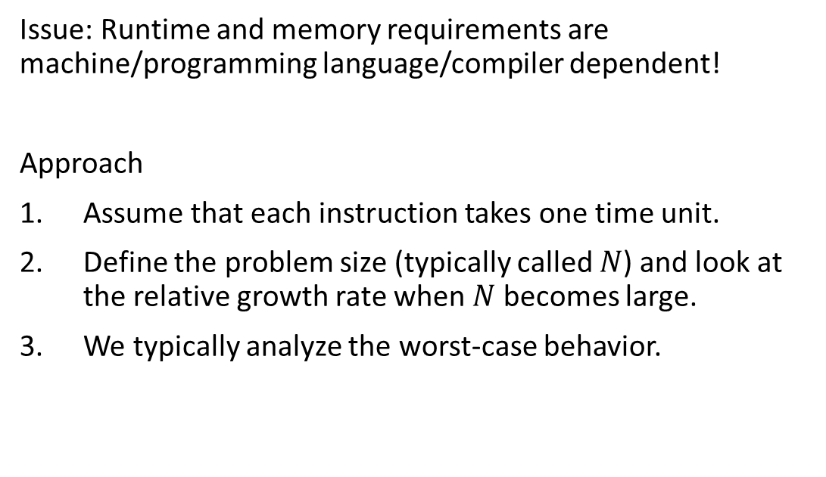
How do we assess/compare time complexity?
Issue: Runtime and memory requirements are machine/programming language/compiler dependent!
Approach
Assume that each instruction takes one time unit.
Define the problem size (typically called $N$) and look at the relative growth rate when $N$ becomes large.
We typically analyze the worst-case behavior.

Slide 4
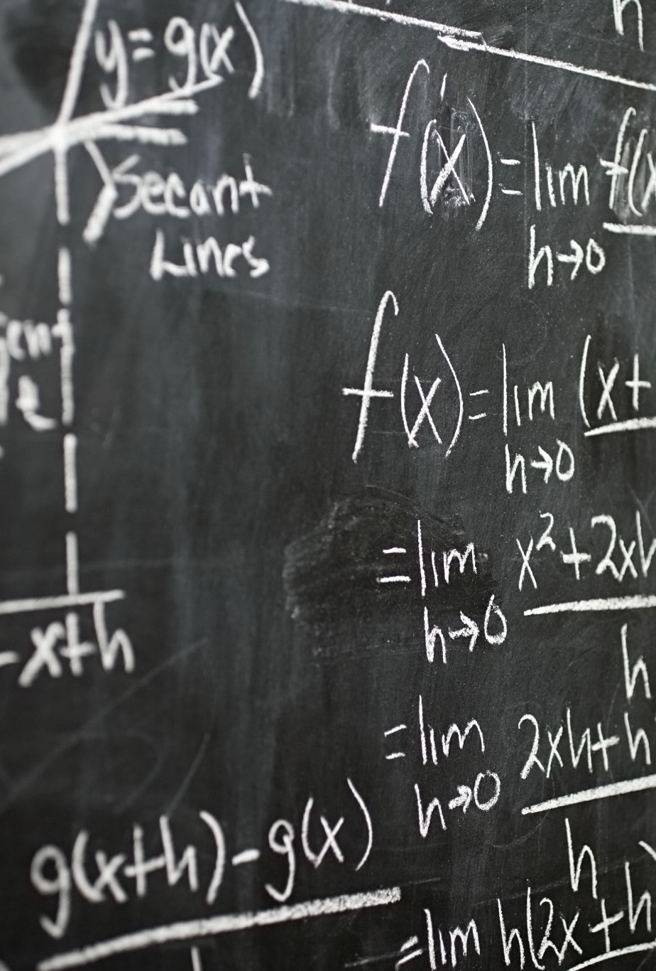
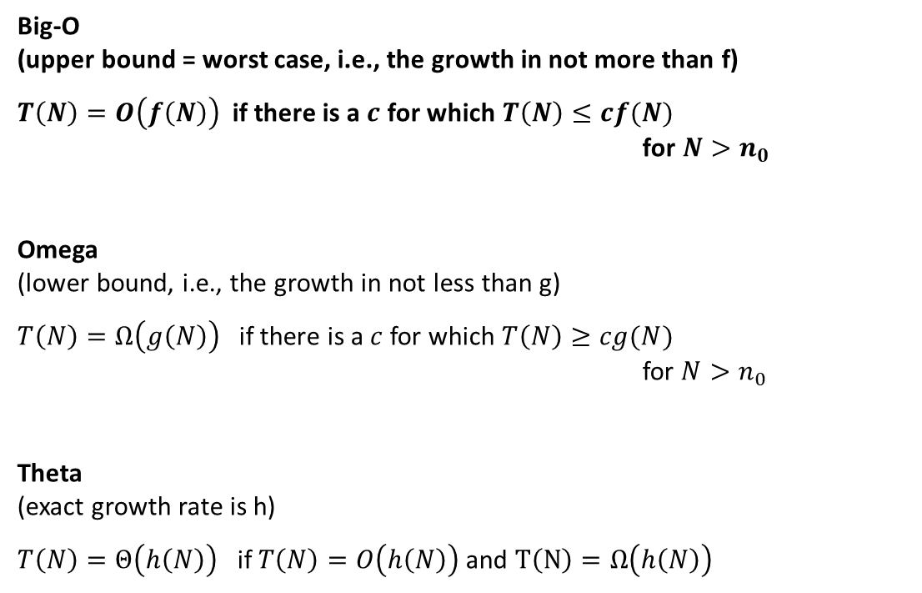
Mathematical Definitions
Big-O (upper bound = worst case, i.e., the growth in not more than f)
$T\left(N\right)=O\left(f\left(N\right)\right)$ if there is a $c$ for which $T\left(N\right)≤cf(N)$ for $N>n_{0}$
Omega (lower bound, i.e., the growth in not less than g)
$T\left(N\right)=Ω\left(g\left(N\right)\right)$ if there is a $c$ for which $T\left(N\right)≥cg(N)$ for $N>n_{0}$
Theta (exact growth rate is h)
$T\left(N\right)=Θ\left(h\left(N\right)\right)$ if $T\left(N\right)=O\left(h\left(N\right)\right)$ and $T\left(N\right)=Ω\left(h\left(N\right)\right)$
Most commonly used

Slide 5

Comparison of different complexity functions $f$
Bad!
Great!

Slide 6
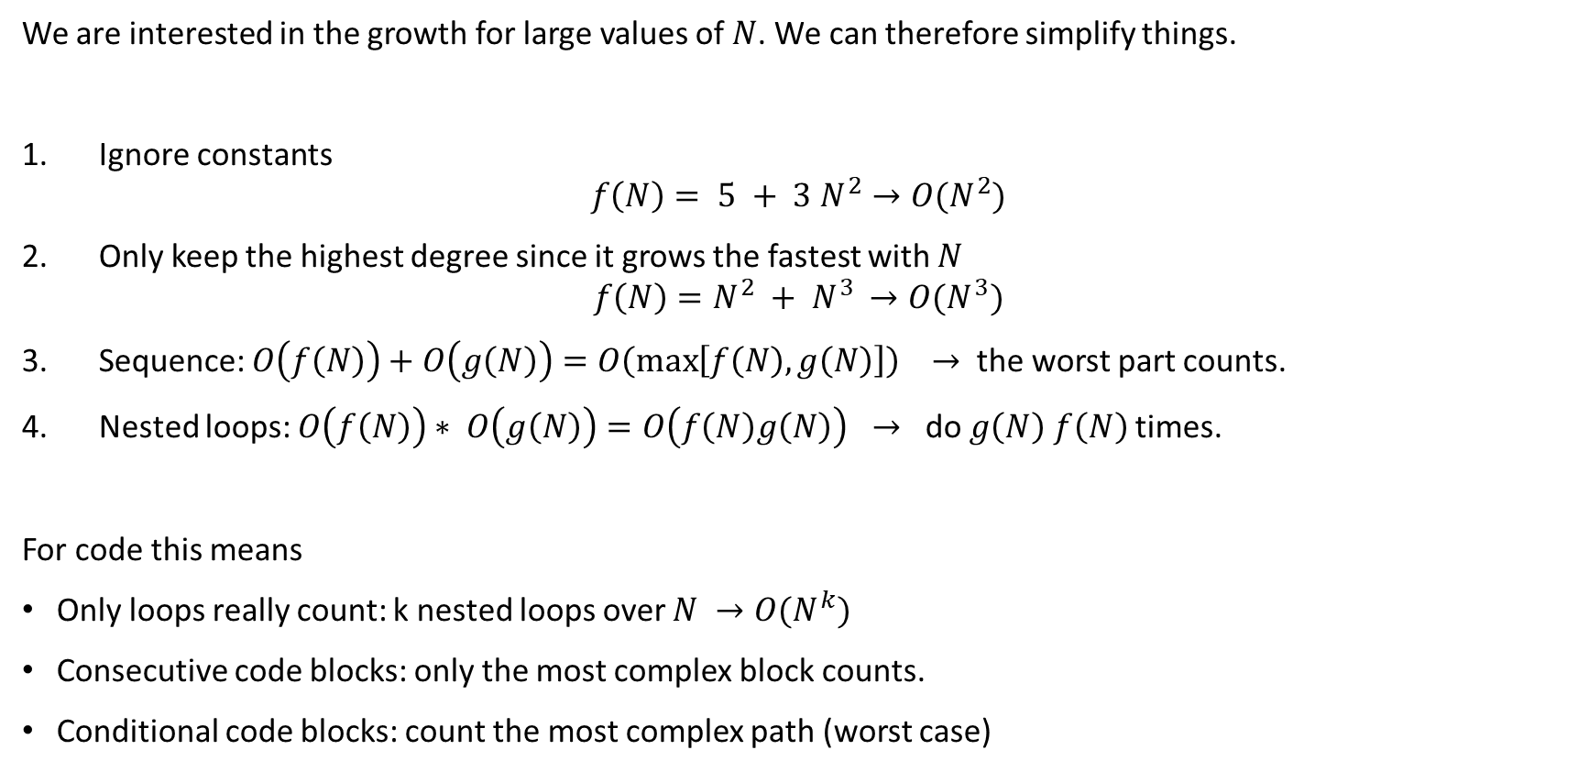
Some Rules
We are interested in the growth for large values of $N$. We can therefore simplify things.
Ignore constants $f\left(N\right)= 5 + 3 N^{2}→O(N^{2})$
Only keep the highest degree since it grows the fastest with $N$ $f\left(N\right)=N^{2} + N^{3 }→O(N^{3})$
Sequence: $O\left(f\left(N\right)\right)+O\left(g\left(N\right)\right)=O\left(\max\left[f\left(N\right),g\left(N\right)\right]\right) →$ the worst part counts.
Nested loops: $O\left(f\left(N\right)\right)∗ O\left(g\left(N\right)\right)=O\left(f\left(N\right)g\left(N\right)\right) →$ do $g\left(N\right)$ $f\left(N\right)$ times.
For code this means
Only loops really count: k nested loops over $N →O(N^{k})$
Consecutive code blocks: only the most complex block counts.
Conditional code blocks: count the most complex path (worst case)

Slide 7


Some Useful Series
$$\sum_{i=0}^{N}{2^{i}=2^{N+1}−1}$$
$$\sum_{i=1}^{N}{i^{k}≈\frac{N^{k+1} }{|k+1|}} for k≠−1$$
$$\sum_{i=1}^{N}{i=\frac{N(N+1)}{2}≈\frac{N^{2}}{2}}$$
$$\sum_{i=1}^{N}{\frac{1}{i}≈\log_{e}{N}}$$

Slide 8
Example: Bubble Sort
// n is the length of the arr
void bubbleSort(int arr[], int n)
{
int i, j;
for (i = 0; i < n - 1; ++i)
// Last i elements are already
// in place
for (j = 0; j < n - i - 1; ++j)
if (arr[j] > arr[j + 1])
swap(arr[j], arr[j + 1]);
}
Worst-case time complexity?
Worst-case space complexity?

Slide 9
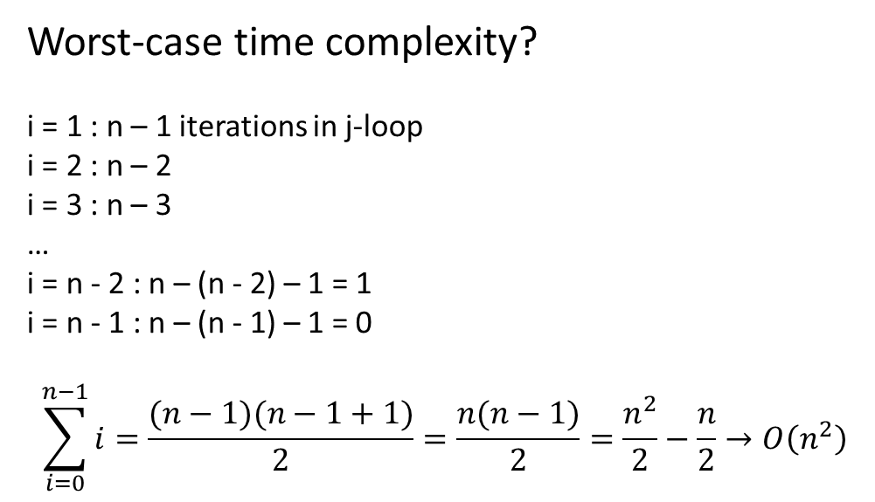

Example: Bubble Sort
// n is the length of the arr
void bubbleSort(int arr[], int n)
{
int i, j;
for (i = 0; i < n - 1; ++i)
// Last i elements are already
// in place
for (j = 0; j < n - i - 1; ++j)
if (arr[j] > arr[j + 1])
swap(arr[j], arr[j + 1]);
}
Worst-case time complexity?
i = 1 : n – 1 iterations in j-loop
i = 2 : n – 2
i = 3 : n – 3
…
i = n - 2 : n – (n - 2) – 1 = 1
i = n - 1 : n – (n - 1) – 1 = 0
$$\sum_{i=0}^{n−1}{i}=\frac{(n−1)(n−1+1)}{2}=\frac{n(n−1)}{2}=\frac{n^{2}}{2}−\frac{n}{2}→O\left(n^{2}\right)$$
Worst-case space complexity? Only memory for i and j is needed $→O(1)$

Slide 10
Example: Linear Search
template <typename Comparable>
int linearSearch(
const vector<Comparable> & a, const Comparable & x )
{
for(int i = 0; i < a.size(); ++i)
{
if( a[ i ] == x )
return i;
}
return -1
}
Find the index of a value in an array/vector.
Time complexity?

Slide 11
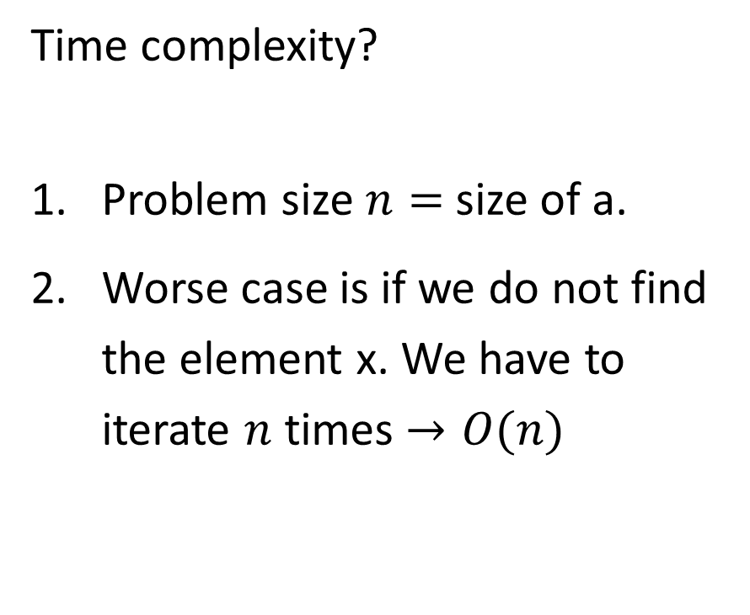
Example: Linear Search
template <typename Comparable>
int linearSearch(
const vector<Comparable> & a, const Comparable & x )
{
for(int i = 0; i < a.size(); ++i)
{
if( a[ i ] == x )
return i;
}
return -1
}
Time complexity?
Problem size $n=$ size of a.
Worse case is if we do not find the element x. We have to iterate $n$ times $→O(n)$

Slide 12
Example: Binary Search
template <typename Comparable>
int binarySearch(
const vector<Comparable> & a, const Comparable & x )
{
int low = 0, high = a.size( ) - 1;
while( low <= high )
{
int mid = ( low + high ) / 2;
if( a[ mid ] < x )
low = mid + 1;
else if( a[ mid ] > x )
high = mid - 1;
else
return mid; // Found
}
return -1
}
Find the index of a value in a presorted array/vector.
Time complexity?

Slide 13
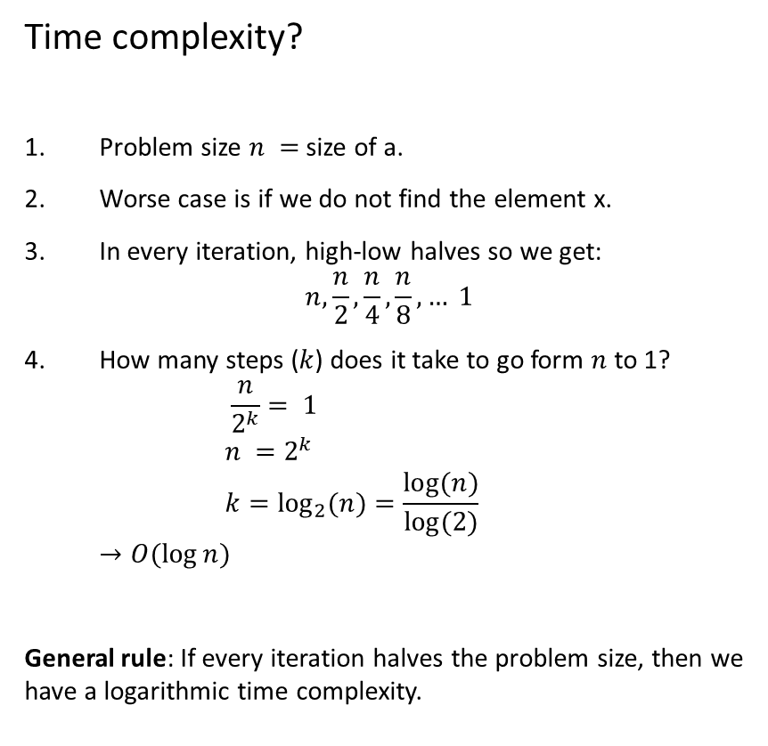
Example: Binary Search
template <typename Comparable>
int binarySearch( const vector<Comparable> & a, const Comparable & x )
{
int low = 0, high = a.size( ) - 1;
while( low <= high )
{
int mid = ( low + high ) / 2;
if( a[ mid ] < x )
low = mid + 1;
else if( a[ mid ] > x )
high = mid - 1;
else
return mid; // Found
}
return -1
}
Time complexity?
Problem size $n =$size of a.
Worse case is if we do not find the element x.
In every iteration, high-low halves so we get: $n, \frac{n}{2}, \frac{n}{4},\frac{n}{8}, … 1$
How many steps ($k$) does it take to go form $n$ to 1? $\frac{n}{2^{k}}= 1$ $n =2^{k}$ $k=\log_{2}{(n)}=\frac{\log{(n)}}{\log{(2)}}$ $→O(\log{n})$
General rule: If every iteration halves the problem size, then we have a logarithmic time complexity.

Slide 14
Example With More Complicated Problem Size
O(?)
Given is a list of numbers: 6, 88, 12, 5, 6 ,7, 93, 8
Check which of another set of numbers is in the list. E.g., 7, 0, 12

Slide 15


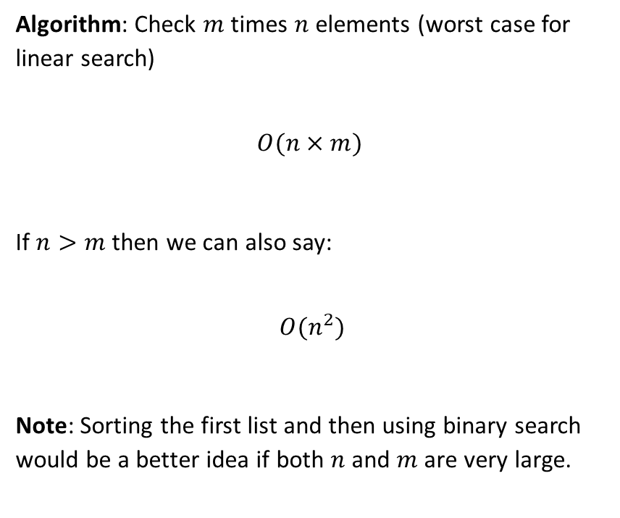
Example With More Complicated Problem Size
Given is a list of numbers: 6, 88, 12, 5, 6 ,7, 93, 8
Check which of another set of numbers is in the list. E.g., 7, 0, 12
Algorithm: Check $m$ times $n$ elements (worst case for linear search)
$$O(n×m)$$
If $n>m$ then we can also say:
$$O(n^{2})$$
Note: Sorting the first list and then using binary search would be a better idea if both $n$ and $m$ are very large.
$$n = 8$$
$$m = 3$$

Slide 16


Some Final Words on Complexity
Complexity analysis points to the part of the code (algorithms and data structures) that would benefit from algorithmic optimization the most.
Space complexity analysis looks at how the memory need grows with $n$.
Note:
Better complexity does not mean faster! Complexity analysis ignores potentially large constants and factors in the runtime.
Big-O looks at the worst case. Average case analysis is typically much harder to do.
Assumption that each operation takes the same amount of time is very strong. Memory access is different for cash memory vs hard drive.
Complexity analysis looks at the algorithm and bad implementations (e.g., copying arrays unnecessarily) may lead to worse run time.

