Slide 1

Balanced Binary Search Trees: AVL Trees
Michael Hahsler
With figures from: M.A. Weiss, Data Structures and Algorithm Analysis,4th edition

Slide 2
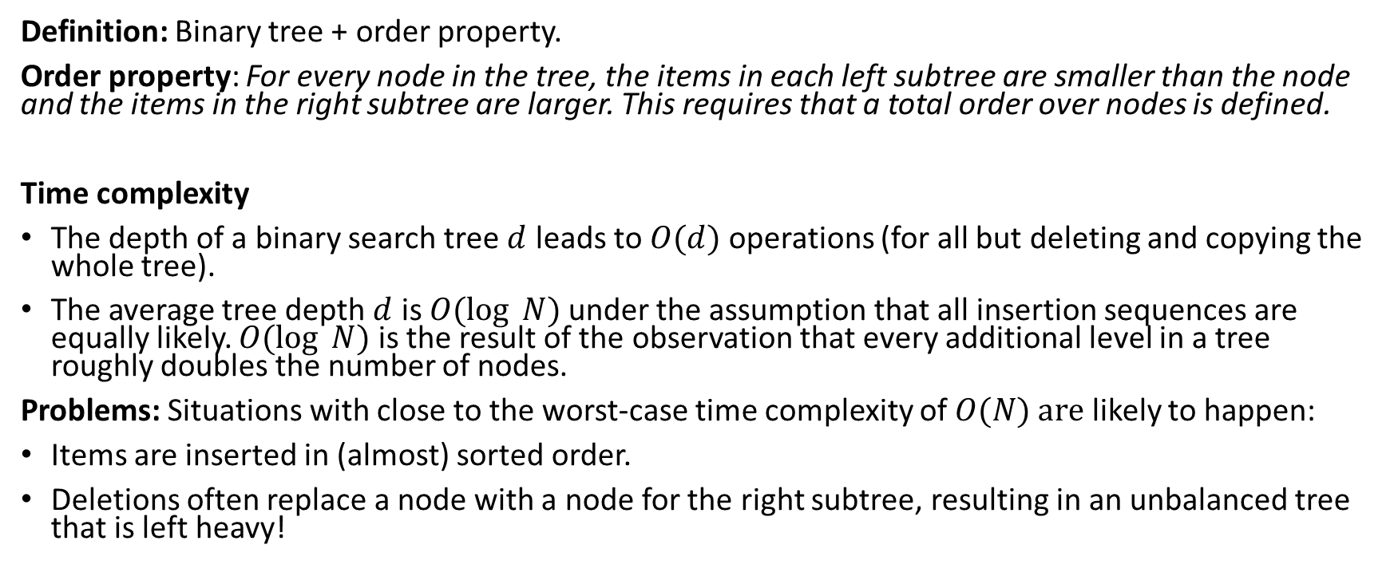
Binary Search Trees
Definition: Binary tree + order property.
Order property: For every node in the tree, the items in each left subtree are smaller than the node and the items in the right subtree are larger. This requires that a total order over nodes is defined.
Time complexity
The depth of a binary search tree $d$ leads to $O(d)$ operations (for all but deleting and copying the whole tree).
The average tree depth $d$ is $O(log⁡ N)$under the assumption that all insertion sequences are equally likely. $O(log⁡ N)$ is the result of the observation that every additional level in a tree roughly doubles the number of nodes.
Problems: Situations with close to the worst-case time complexity of $O(N) are$ likely to happen:
Items are inserted in (almost) sorted order.
Deletions often replace a node with a node for the right subtree, resulting in an unbalanced tree that is left heavy!

Slide 3
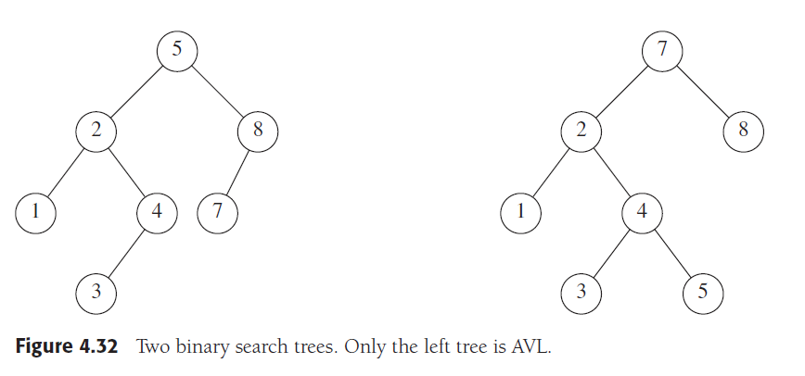
AVL Trees
An AVL (Adelson-Velskii and Landis) tree is an autobalancing binary search tree with the following balance condition:
For every node in the tree, the height of the left and the right subtree can differ by at most 1.
Missing nodes have height = -1
Balance condition is violated!
Diff(2, 0) > 1
height = 2
height = 1
height = 2
height = 0
height = -1
height = 0
height = 1
height = 0
height = -1
height = 0

Slide 4
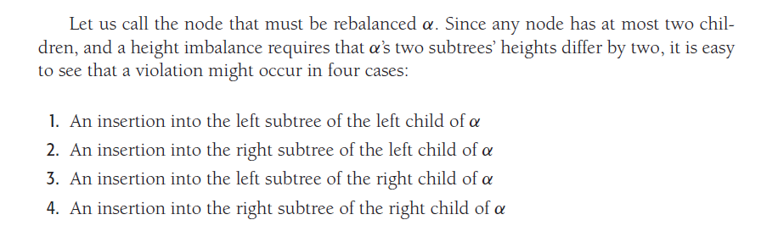

Rebalancing
Only necessary locally (in the subtree) where the tree gets changed by an insertion (or deletion). If we store and update height information in the nodes, then detection is easy!
Cases:
$$α$$
Child
L
R
L
R
L
R
Subtree
Case
1
2
3
4
Inside insertion
Outside insertion

Slide 5
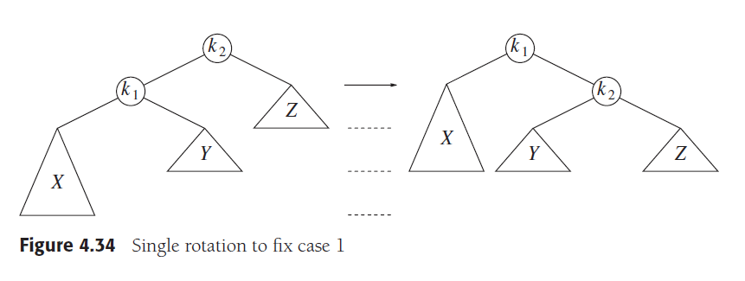
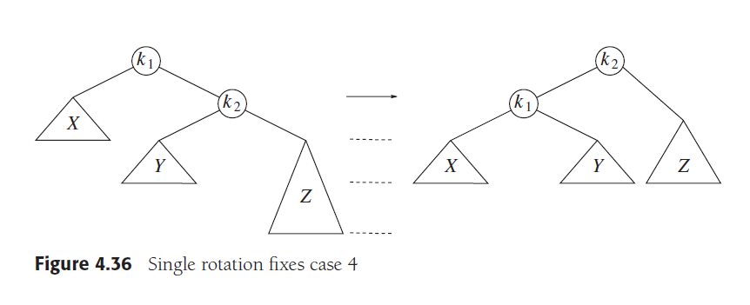

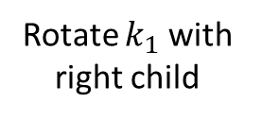
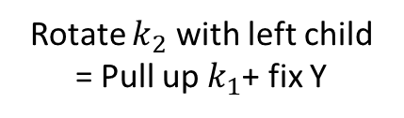
Single Rotation
Balance condition is violated!
Pull up k1
Rotate $k_{2}$ with left child
= Pull up $k_{1}$+ fix Y
height = 2
height = 2
Insertion in X
Note: Y is smaller than $k_{2}$
: lifts up X by one level.
Outside Insertion
These cases are perfectly symmetric!
Balance condition is violated!
Rotate $k_{1}$ with right child
height = 1
height = 3
Insertion in Z
: lifts up Z by one level.

Slide 6
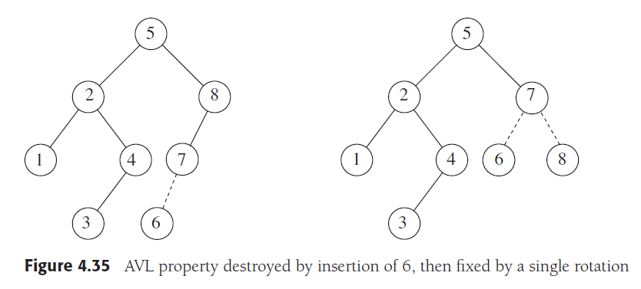
Example:
Balance condition is violated!
Diff(1, -1) > 1
Rotate 8 with
left child
(= pull up 7)
Note: There is no right subtree of 7 (Y) to fix since 7 has only a single child.

Slide 7
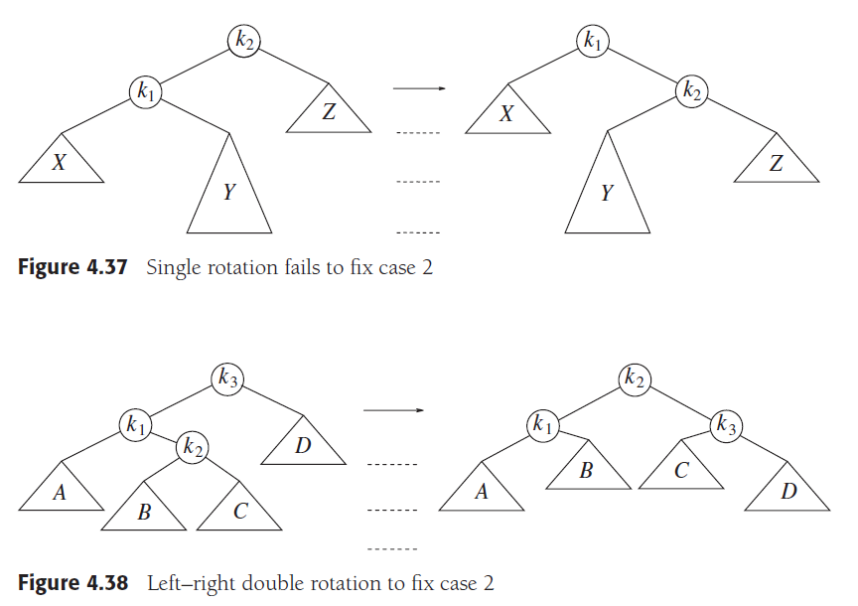

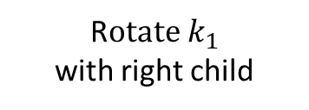

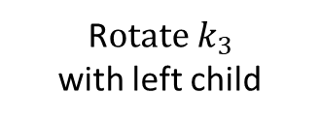




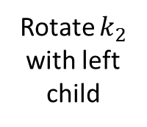

Single Rotation Fails
Balance condition is violated!
Pull up k1
Balance condition is still violated!
Rotate $k_{2}$ with left child
height = 1
height = 1
height = 3
height = 3
Insertion in Y makes it too deep
: does not lift up Y!
We need a double rotation
Pull up k2
Balance condition is violated!
R$otate k_{1}$ with right child
Pull up k2
R$otate k_{3}$ with left child
$${ k}_{3}$$
Y
$${ k}_{2}$$
$$D$$
$${ k}_{1}$$
$$C$$
$$A$$
$$B$$

Slide 8
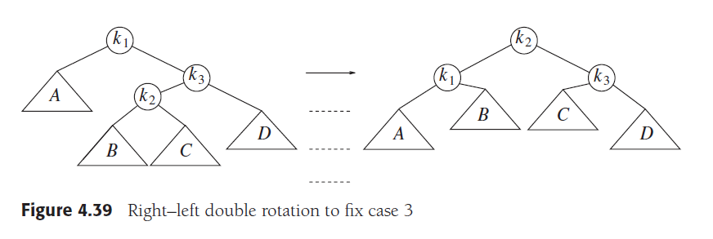


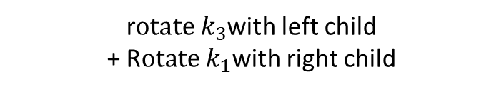

Double Rotation
“pull $k_{2}$ up twice”
r$otate k_{1}$with right child
+ R$otate k_{3}$with left child
Inside Insertion
These cases are perfectly symmetric!
“pull $k_{2}$ up twice”
r$otate k_{3}$with left child
+ R$otate k_{1}$with right child

Slide 9
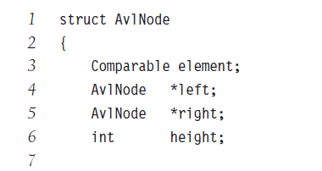
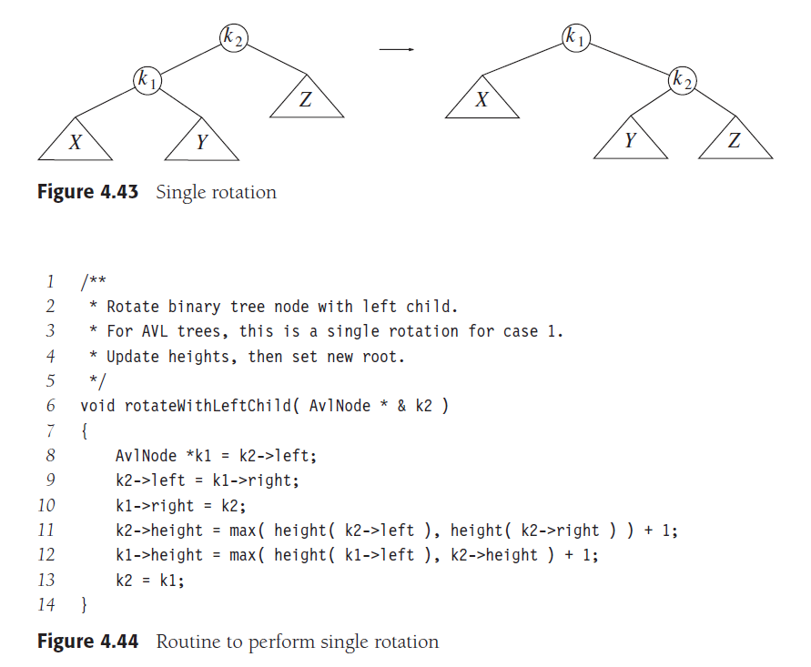
Implementation
3.
2.
1.
}
rotateWithRightChild() is similar with right and left switched.
// find k1
// 1. move Y to k2
// 2. add k2 to k1
// update height
// 3. replace the subtree with k1 (note the reference passed on)

Slide 10
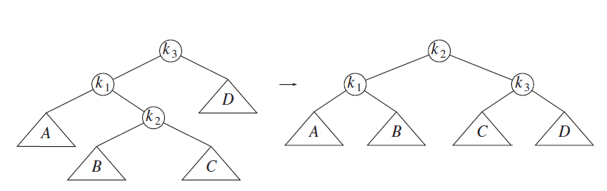
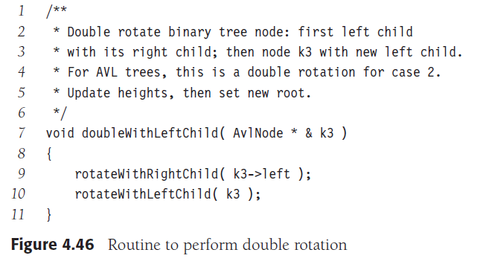
Implementation
2.
1.
}
doubleWithRightChild() is similar with right and left switched.
// 1. swap k1 (which is k3->left) and k2
// 2. swap k2 and k3

