Slide 1
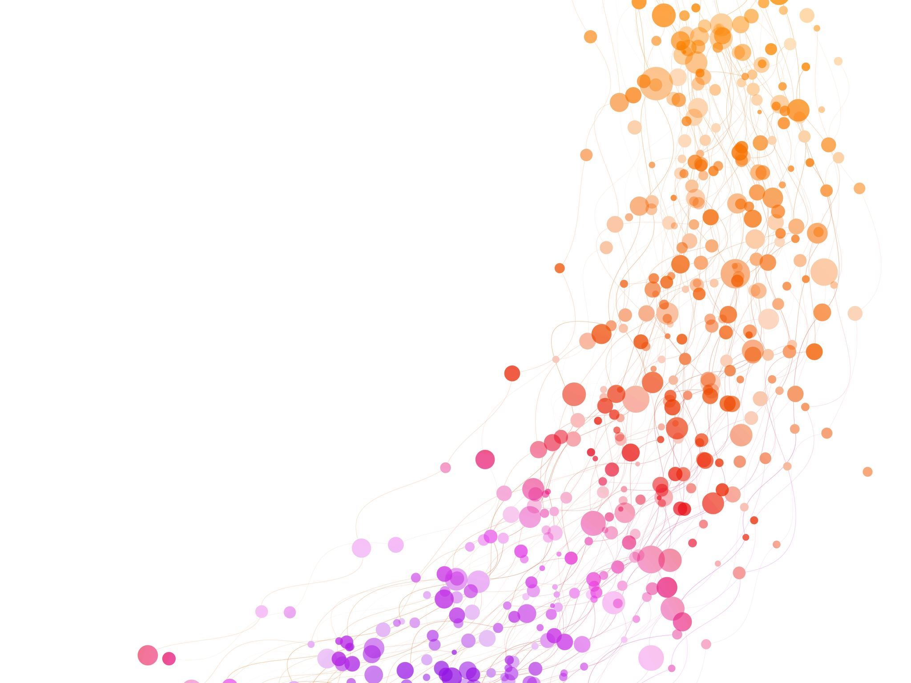
HUMAN SECURITY
Name: Obed Okeukwu
Course Code: CYBR340
Assignment Title: Reconnaissance and Phishing
Date: September 27, 2025

Slide 2
Introduction
Objectives:
Reconnaissance: Collect public, non‑intrusive information about the target to understand motivations, routines, and communication habits.
Profile: Synthesize gathered data into a clear target profile that explains why the target is susceptible to social‑engineering.
Phishing Email: Craft a professional, plausible phishing email that leverages the profile’s weaknesses to elicit a click — ensuring all links redirect only to the legitimate NAIT site (https://www.nait.ca) for safety and compliance.
Learning outcomes: Demonstrate practical reconnaissance techniques, apply social‑engineering principles (authority, urgency, trust, social proof), and evaluate ethical considerations and mitigations to improve awareness and defensive posture.

Slide 3
TARGET AUDIENCE
Prospective International Students applying to Colleges/Universities
Rationale:
Highly motivated to secure admission
Time-sensitive deadlines
Rely on official communications
Possible language barriers.

Slide 4
Target Profile — Demographics & Psychographics
Age: 18–30
Location: Outside Canada (e.g., India, China, Philippines, Nigeria)
Motivations: Secure admission, complete visa paperwork, pay deposits
Vulnerabilities: Urgency, trust in institutional emails, language differences

Slide 5
Reconnaissance Methods / Tools Used
University public website (admissions pages)
Applicant forums and social media groups (observational)
General knowledge of admission workflows and timelines

Slide 6
Social-Engineering (SE) Framework Mapping
Authority: MacEwan branding and formal language
Urgency: Threat of offer cancellation or visa delay
Social Proof: References to common required documents and processes
Simplicity: Clear link to click

Slide 7
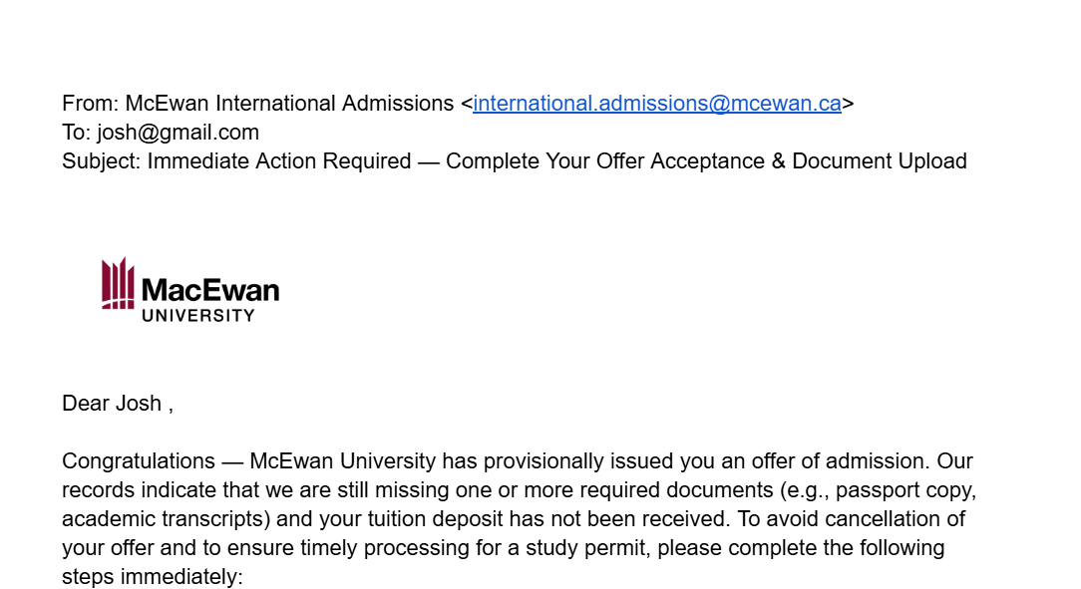
Phishing Email — Visual Example

Slide 8
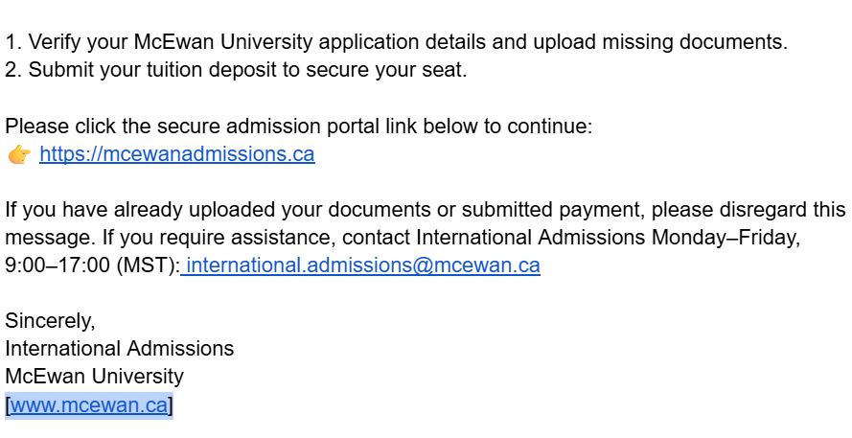
Phishing Email — Visual Example

Slide 9
Why the Target Will Fall For It
• Authority: Appears from International Admissions
• Urgency: Risk of offer cancellation motivates quick action
• Trust & Familiarity: Familiar process (document upload, deposit)
• Language/Stress: May reduce careful verification

Slide 10
ETHICS AND SAFETY
This is an academic exercise. No malicious links used. All links point to https://www.nait.ca as required.

Slide 11
Mitigations & Recommendations
• MFA for applicant portals
• Verified payment channels and guidance
• Clear sender policies and applicant training
• SMS confirmations for critical payments

Slide 12
REFERENCES
Hadnagy, C. (2018). Social engineering: The science of human hacking (2nd ed.). Wiley.
Sheng, S., Holbrook, M., Kumaraguru, P., Cranor, L. F., & Downs, J. (2010). Who falls for phish? A demographic analysis of phishing susceptibility and effectiveness of interventions. Proceedings of the SIGCHI Conference on Human Factors in Computing Systems, 373–382. https://doi.org/10.1145/1753326.1753383
Choudaha, R., & Schulmann, P. (2014). Know your neighborhood: Understanding the motivations and expectations of international students. World Education Services. https://wenr.wes.org/

