Slide 1

University of Buea: Mobile App for User Experience Data
This presentation outlines the design and implementation of a mobile app. The app will collect user experience data from mobile network subscribers. It aims to improve network performance and user satisfaction.
AN
by Ayuk Nestor

Slide 2
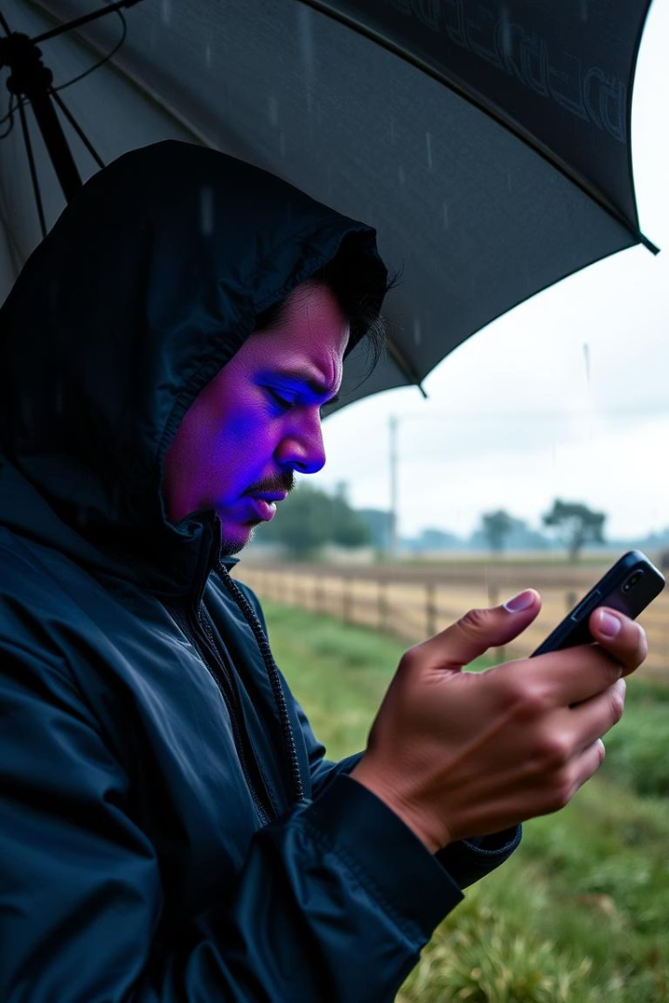
Background and Context
Mobile network expansion in Cameroon faces challenges. Subscribers experience inconsistent signal strength and service delays. Traditional KPIs don't reflect the user's true experience.
Quality of Experience (QoE) requires subjective feedback and contextual factors.
1
Inconsistent Signals
2
Service Delays
Sudden drops in 4G coverage.
High latency during peak hours.
3
Unexpected Outages
Voice call failures in rural areas.

Slide 3
Current Limitations in Network Monitoring
Existing measurements have critical shortcomings. There is not enough real-time user feedback. There is too much emphasis on infrastructure measures. There is no common platform for subjective and objective data.
Limited Feedback
Infrastructure Focus
Reliance on infrequent surveys.
Network logs fail to capture usability.

Slide 4

Project Aim and Objectives
The project aims to design and implement a mobile application. The app will enable real-time collection of user experience data. It will support QoE analytics and network performance evaluation.
Real-Time Collection
QoE Analytics
Performance Evaluation
Gather user experience data instantly.
Support analysis of user experience quality.
Evaluate network performance effectively.

Slide 5




Stakeholder Identification
Stakeholder identification ensures the project meets the needs of all relevant parties. This includes end-users, MNOs, regulators, and developers.
End-Users
MNOs
Developers

Slide 6
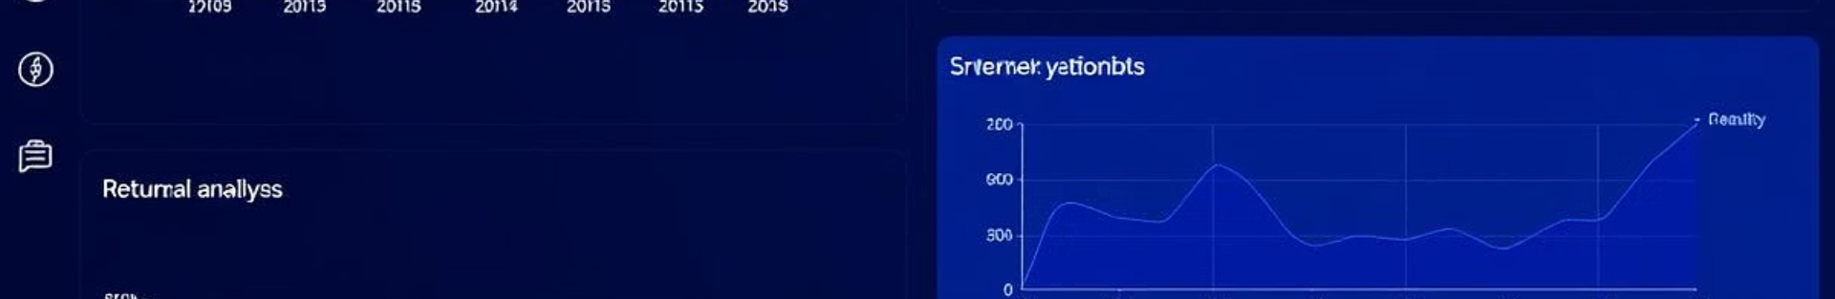



Requirements Engineering
We employed surveys, interviews, and QoS measurements. These methods elicit user perception and technical network performance.
Surveys
Gather quantitative opinions.
Interviews
Explore unmet needs.
QoS Measurement
Validate network performance.

Slide 7



Data Gathering: Survey Insights
Surveys revealed key demographics and network issues. Most users are young students in urban areas. Common problems include slow internet and call drops.
1
Urban Users
2
Slow Internet
3
Call Drops

Slide 8
Data Gathering: Interview Insights
Interviews uncovered context-dependent issues. Rural users reported no signal in their homes. Urban users experienced slow video downloads.
1
Rural: No Signal
2
Urban: Slow Downloads

Slide 9



Data Gathering: Application Data
Application data showed network performance variations. Orange had the strongest performance. Blue underperformed, especially in Mutengene.
2
MTN: Variable
1
Orange: Strong
Blue: Underperforming
3

Slide 10

User Reluctance Assessment
Users demand rewards and easy reporting methods. Addressing these concerns is crucial for app adoption. AI-triggered prompts and public proof can bridge the trust gap.
83%
Reward Demand
62%
Easy Reporting

