Slide 1


Regional Sales Analysis

Slide 2
Problem Statement
Sales teams often lack a clear, data-driven understanding of regional performance.
This makes it difficult to identify growth opportunities and optimize resources.
Goal: Analyze and visualize regional sales data to uncover trends, evaluate profitability, and support strategic decision-making.

Slide 3
Approach
Collected and processed 5 years of sales data.
Conducted Exploratory Data Analysis (EDA) using Python (pandas, matplotlib, seaborn).
Created visualizations to identify trends, regional performance, and channel profitability.
Generated KPIs and actionable insights to guide strategy.

Slide 4
Data Overview
64,104 transactions spanning years 2014-2018.
Key fields: Order Date, State, Region, Revenue, Cost, Profit, Margin %, Channel, Product.
Geographic coverage: All U.S. regions and states.
Rich detail across customers, products, and sales channels.

Slide 5
Project Workflow
1. Data Collection & Cleaning
2. Exploratory Data Analysis (EDA)
3. Visualization of Key Metrics
4. KPI Dashboard Creation
5. Strategic Insight Development
6. Recommendations

Slide 6
Exploratory Data Analysis (EDA)
Regional revenue & profit trends highlight West as top-performing region.
Seasonality observed: peaks in May, Aug, Nov, Dec; dips in Feb and Apr.
Top products (26 & 25) dominate sales, showing concentration risk.
Wholesale channel is largest contributor; Export has highest margin.
California leads state-level orders, followed by Illinois, Florida, and Texas.

Slide 7
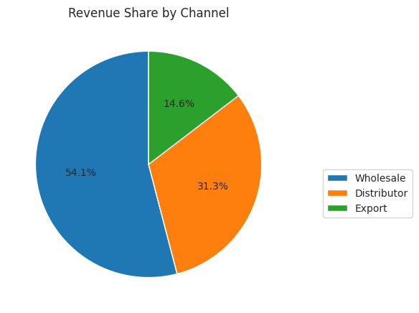
Revenue Share by Channel
Key Insights
The pie chart shows that Wholesale is the biggest contributor with revenue of $668 million.
Second biggest contributor is Distributor with $387 million in revenue.
Exports can provide growth opportunities in international markets this can diversify the company and reduce ri

Slide 8
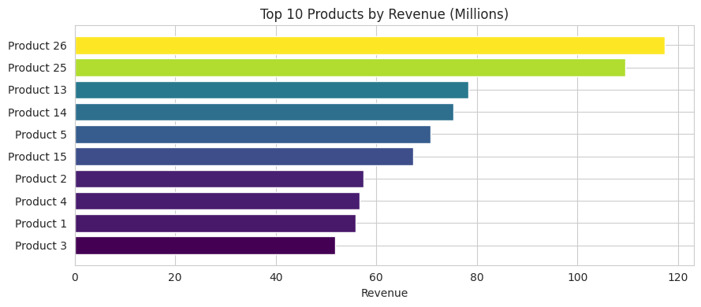
Top 10 Products by Revenue
Key Insights
Product 26 and 25 are strong leaders with revenue for Product 26 being $117 million and for product 25 being $109 million. This makes up 18% of total company revenue.
If any demand of the top 5 products fall it can significantly impact revenue.
Product 1-4 grouped together are showing revenue but looking at individually they do not rival the top 2 products.

Slide 9
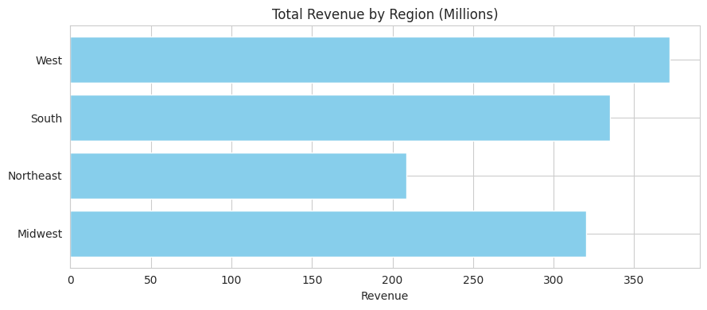
Top Revenue By Region
Key Insights
Based on both charts the West region leasds in both revenue $372 million and profit of $139 million.
The South and Midwest regions demonstrates in being strong contributors.
The Northeast region demonstrates weak contribution and can be a region to focus on to increase business profit and revenue.

Slide 10
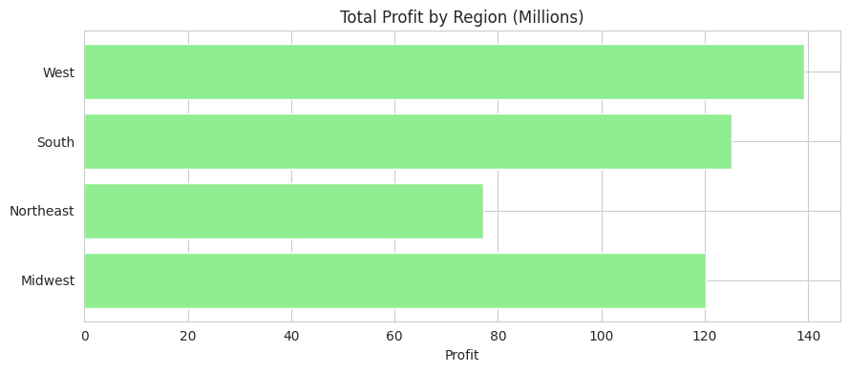
Top Profit By Region
Key Insights
Based on both charts the West region leasds in both revenue $372 million and profit of $139 million.
The South and Midwest regions demonstrates in being strong contributors.
The Northeast region demonstrates weak contribution and can be a region to focus on to increase business profit and revenue.

Slide 11
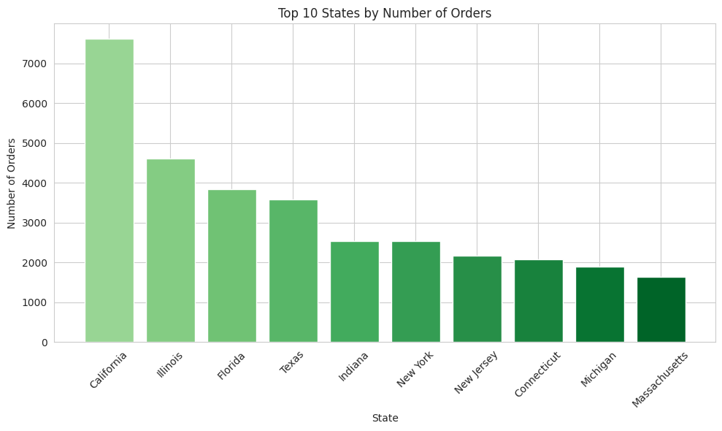
Top 10 States by # of Orders
Key Insights
California has the highest number of orders with orders of 7,613, California is critical to maintain service levels and competitive positioning
States like Illinois, Florida, and Texas are also strong markets

Slide 12
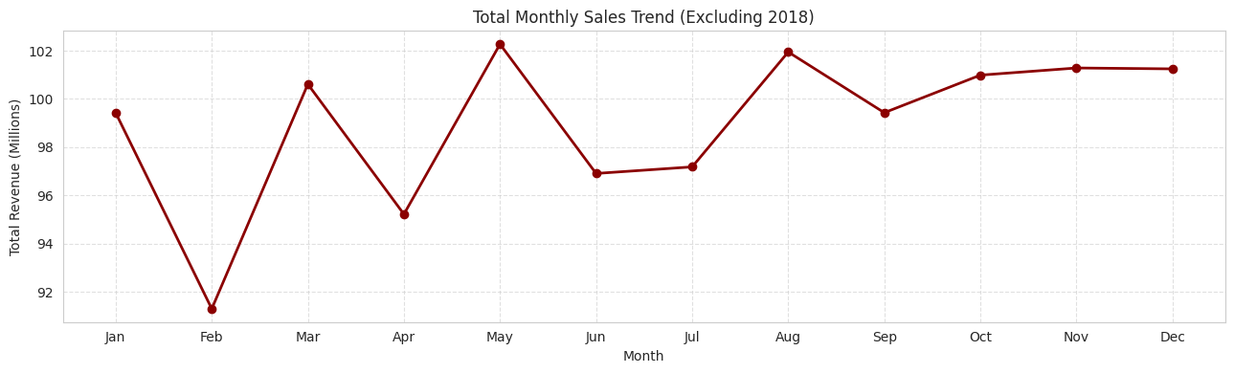
Total Monthly Sales Trend
Key Insights
The strongest month is May with $102.3 million
The weakest month is February with $91.3 million, which shows a demand dip and can be caused by post-holiday slowdowns.
The months of November and December remain strong, which marketing, promotions, and inventory stocking should be prioritized in these months.
For weak periods like in February and April, special promotions or targets campaigns to increase demand.

Slide 13
Key Insights
Total Revenue: $1.24B | Profit: $462M | Avg Margin: 37%.
West region leads; Northeast underperforms.
Seasonal peaks in May and Nov-Dec; demand dips in Feb-Apr.
Heavy reliance on top 5 products (~37% of revenue).
Wholesale channel dominates; Export offers growth potential.
California is the single largest state market.

Slide 14
Recommendations
Strengthen core presence in West & South; unlock value in Northeast.
Diversify product portfolio beyond top SKUs to reduce risk.
Optimize Wholesale channel and scale Export strategically.
Leverage seasonality: promotions in low-demand months; maximize holiday surges.
Expand market share in key states like California, Illinois, Florida, Texas.
Continue leveraging data-driven insights for strategic decisions.

