Slide 1
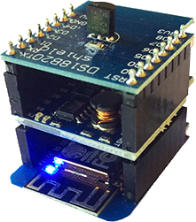
SIMPLE IOT WORKSHOP https://www.pocketmagic.net/simple-iot/
Internet connected temperature sensor

Slide 2
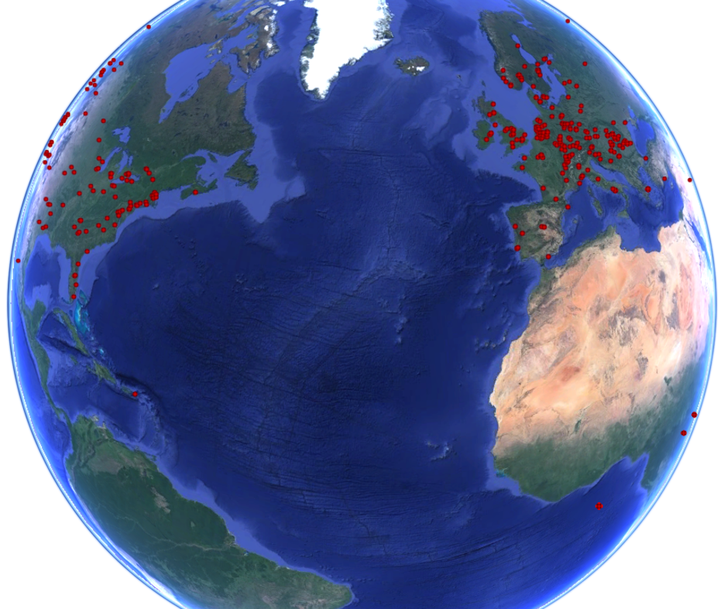
About me
Radu Motisan
uRADMonitor Founder
uRADMonitor is a global network of IOT devices used for environmental monitoring. There are close to 800 units worldwide.
radhoo.tech@gmail.com
uRADMonitor units on the globe

Slide 3
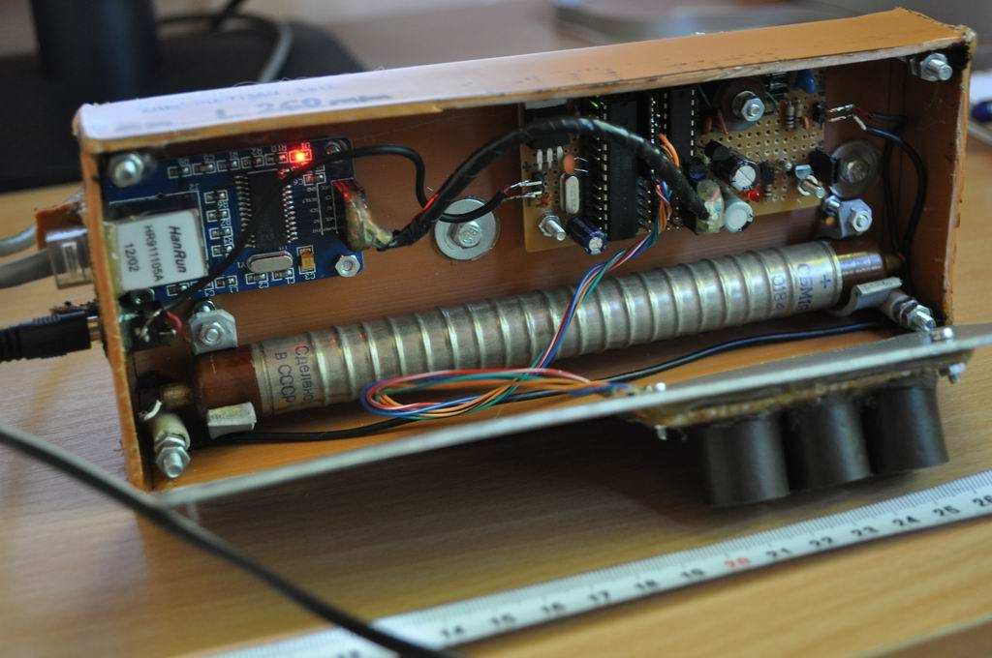
Introduction
IOT stands for Internet of Things and refers to small devices equipped with direct internet connectivity, without needing an external computer.
They are cheap and low power.
Early IOT Device based on en28j60

Slide 4
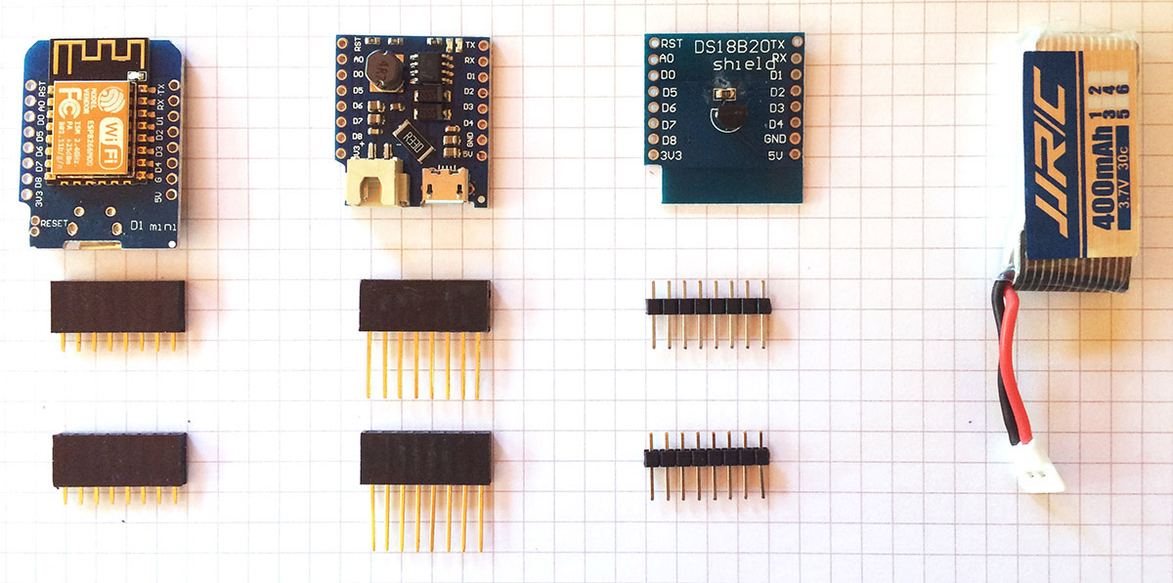
Hands on IOT Workshop
Today we build an IOT device!
Requirements:
Simple IOT Kit
Soldering station
Computer
MicroUSB cable

Slide 5
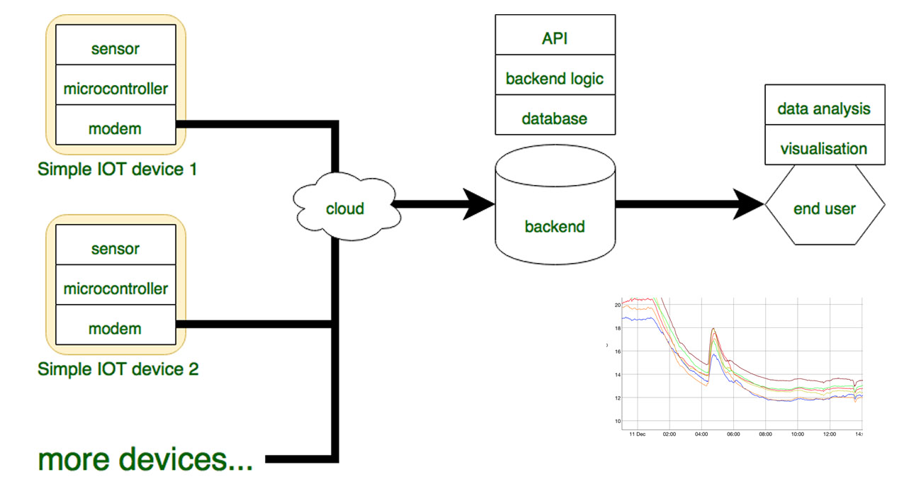
Simple IOT Architecture
IOT Device
Server

Slide 6
Software requirements
Please install the following:
Arduino IDE
CH340 driver
Configure Arduino IDE for ESP8266.
https://www.arduino.cc/en/Main/Software
http://www.wch.cn/download/CH341SER_ZIP.html
Additional boards Manager: http://arduino.esp8266.com/stable/package_esp8266com_index.json

Slide 7
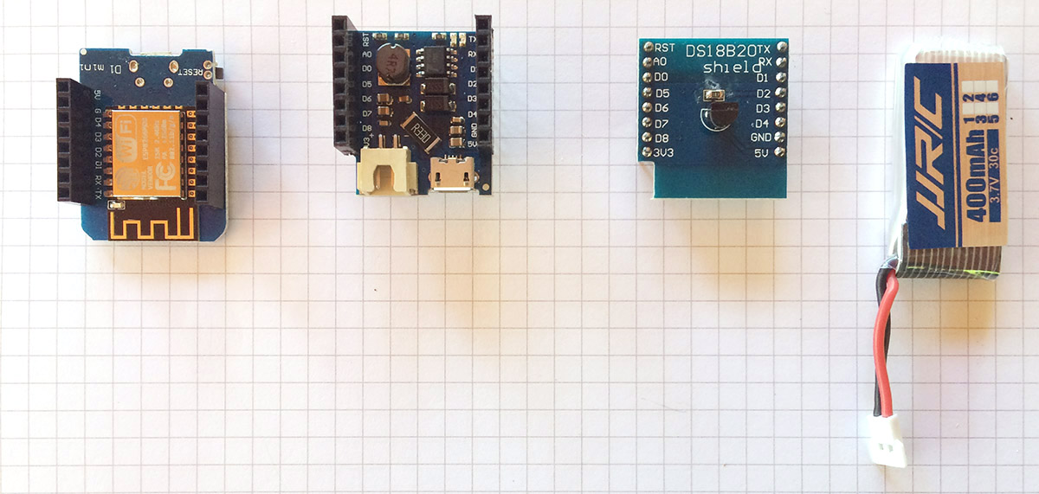
Assembling the hardware
Solder the headers so the modules can stack together with the battery shield at the middle and the temperature sensor at the top.

Slide 8
Downloading the firmware
Download the firmware from Github.
Add your Wifi Router settings to the code (SSID + Key).
Add the user ID and the user Key.
Download code:https://github.com/radhoo/SimpleIOT
Create a user account on: https://www.uradmonitor.com/dashboard/

Slide 9
Improvements
Know the code and try to improve it:
More sensors
Power saving
The EXP Protocol is presented here: https://www.pocketmagic.net/simple-iot/
ESP8266 deep sleep: ESP.deepSleep(50e6); // 50e6 is 50 seconds

Slide 10
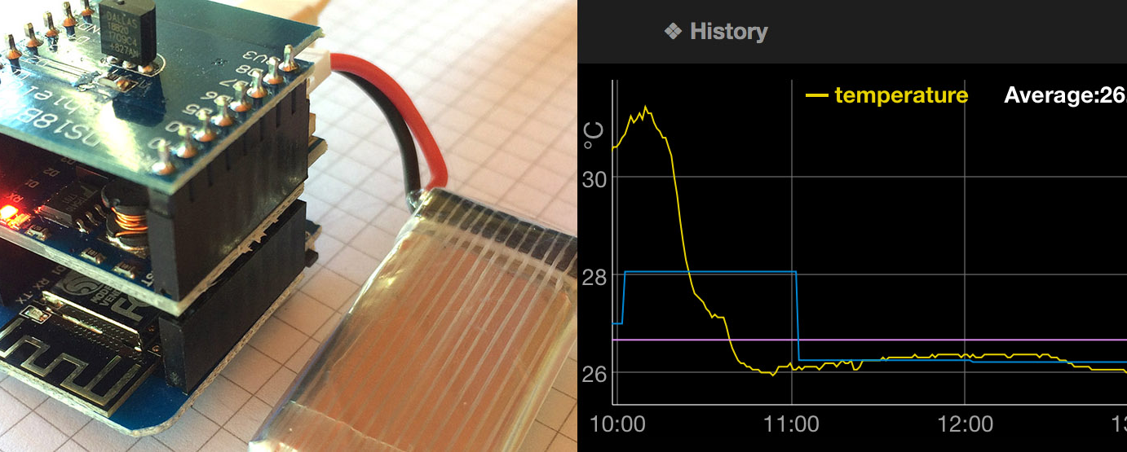
The results and data access
https://www.uradmonitor.com/?open=13XXXXXX

Slide 11
Thanks for your time!
Radu Motisan
radhoo.tech@gmail.com
The Simple IOT Device stack

