Slide 1
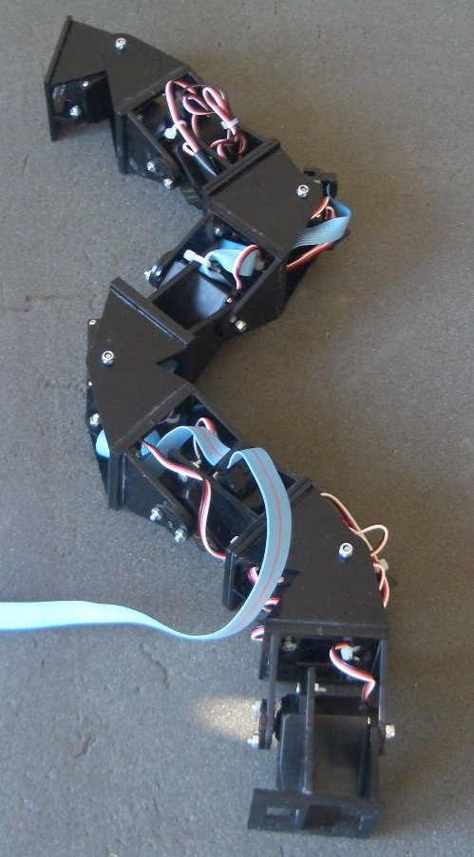

Locomotion Capabilities of a Modular Robot with Eight Pitch-Yaw-Connecting Modules
J. Gonzalez-Gomez, E. Boemo
DSLab, School of Engineering,
Universidad Autonoma de Madrid, Spain
H. Zhang, J. Zhang
TAMS, Department of Informatics,
University of Hamburg, Germany
Clawar 2006
9th International Conference on Climbing and Walking Robots.
12-14 September. Brussels, Belgium

Slide 2
Outline
Modular robotics
Previous work
Overview of the pitch-yaw-connecting robot
Control approach
Locomotion capabilities
Videos
Conclusion
Future work

Slide 3


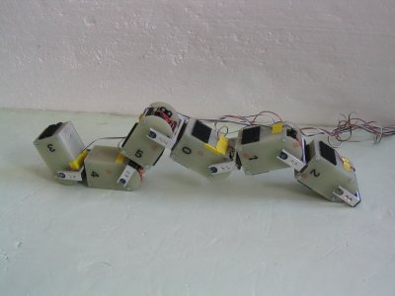

Modular Robotics (I)
Main idea: Building robots composed of modules
The design is focused in the module, not in a particular robot
The different combinations of modules are called configurations
Some Advantages:
  Versatility
  Fast prototyping
  Testing new ideas
Very good platforms for researching in locomotion

Slide 4
Modular Robotics (II)
The idea of modular robotics was introduced by Mark Yim, in 1994
There are many groups working on this topic in the world.
The most avanced robots are:
  POLYBOT (USA). Palo Alto Research Center (PARC)
  M-TRAN (JAPAN). Advance Industrial Science Technology (AIST)
  YAMOR (Swiss). Ecole Polytechnique Federale de Lausanne (EPFL)

Slide 5



Modular Robotics:
Topologies
There are an infinite number of configurations that can be built
A general clasification is needed to study the properties of the subgroups
We have proposed a classification based on the topology
1D Topologies: one chain of modules
(Worms, snakes, arms, legs...)
2D Topologies. Two or more chains connected along different axes
3D Topologies. Three or more chains connected along different axes

Slide 6



Previous work:
Y1 Module
DOF: 1
Material: 3mm Plastic
Servo: Futaba 3003
Dimension: 52x52x72mm
Range: 180 degrees
Cheap and easy to build
Two types of connection:

Slide 7




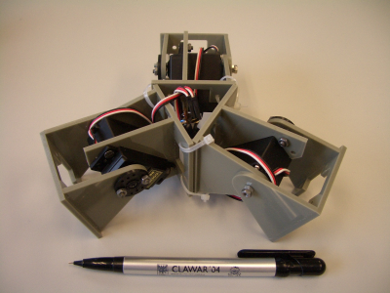
Previous work:
Configurations
1D Topology:
Locomotion in 1D:
Locomotion in 2D:
Pitch-Pitch
8 pitch-connecting modules
Pitch-Yaw-Pitch
8 pitch-yaw-connecting modules
2D Topology:
Star of 3 modules
Locomotion in 2D:

Slide 8


Overview of the robot: Mechanics
1D Topology
8 Pitch-yaw connecting modules
4 rotates around the pitch axes
4 rotates around the yaw axes
Based on the Y1 modules

Slide 9


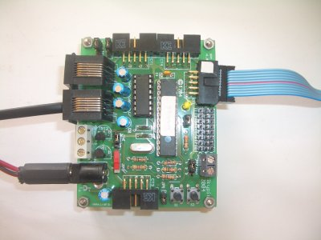
Overview of the robot: Control Hardware
A small board based on the PIC16F876 (Skypic)
Power supply and controller located off-board
The locomotion algorithms are executed on a PC
The PC is connected to the controller by RS-232
PC
RS-232
PWM
Power supply

Slide 10
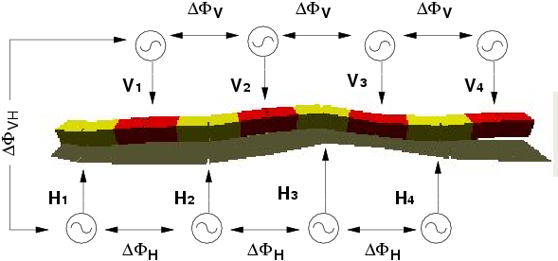
Control approach
It is based on Central Pattern Generators (CPGs) to produce rhythmic motions.
Our model of CPG is a generator of sinusoidal signals
4 CPGs controls the pitch modules and another 4 for the yaw ones.
The parameters are:
Amplitude:
A
,
A
H
V
Offset:
O
,
O
H
V
Phase differences:
Df
,
Df
,
Df
H
V
VH
Period: T

Slide 11
Locomotion capabilities
Using this control approach, 5 gaits have been achieved:
1D sinusoidal gait
Forward and backward movement
Turning gait
The robot move along an arc
Rolling gait
The robot rolls arount its body axis
Rotating gait
The robot rotates parallel to the ground
Lateral shift
The robot moves parallel to its body axis
All these gaits have been simulated using the Open Dynamics Engine (ODE)
They all have been implemented sucessfully on the robot

Slide 12
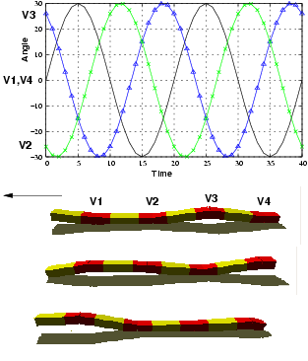
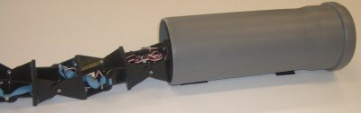
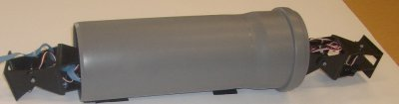
Locomotion capabilities:
1D sinusoidal gait
Only the vertical joints are moving
Parameters:
A
=
0
A
= 0
V
H
O
= 0
O
= 0
V
H
Df
= 120
V

Slide 13
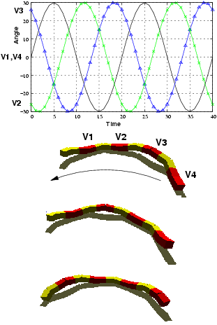
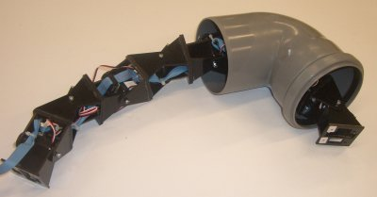
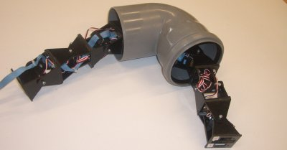
Locomotion capabilities:
Turning gait
Only the vertical joints are moving
Parameters:
A
=
0
A
= 0
V
H
O
= 0
O
=
0
V
H
Df
= 120
V

Slide 14
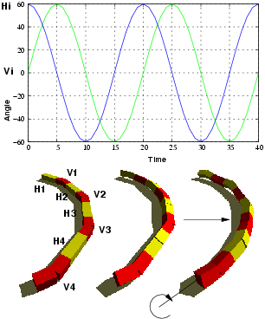
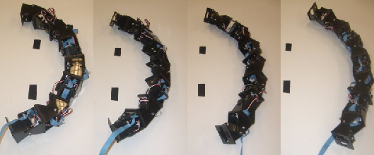
Locomotion capabilities:
Rolling gait
Parameters:
A
>60
A
>60
V
H
O
= 0
O
= 0
V
H
Df
= 0
Df
= 0
Df
= 90
V
H
VH

Slide 15
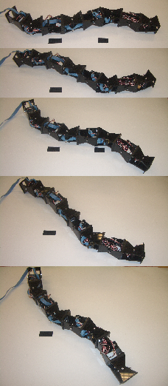
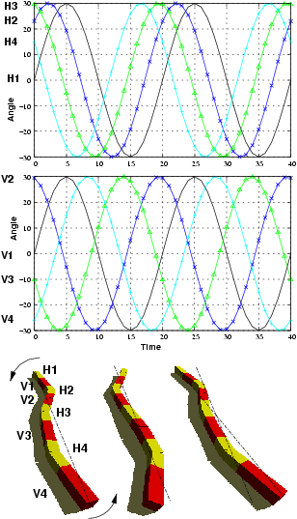
Locomotion capabilities:
Rotating gait
This is a new gait not previously mentioned by other researchers
Parameters:
A
=
0
A
=
0
V
H
O
= 0
O
= 0
V
H
Df
= 120
Df
= 50
V
H
Df
= 0
VH

Slide 16
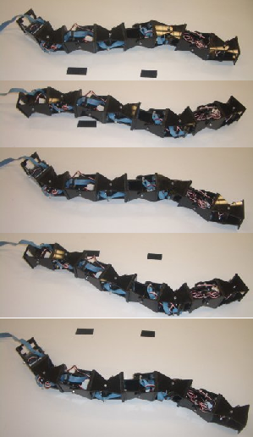
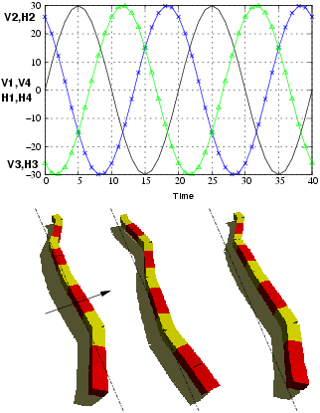
Locomotion capabilities:
Lateral shift
Parameters:
A
=
0
A
=
0
V
H
O
= 0
O
= 0
V
H
Df
= 100
V
Df
= 100
H
Df
= 0
VH

Slide 17
Let's see some videos...

Slide 18
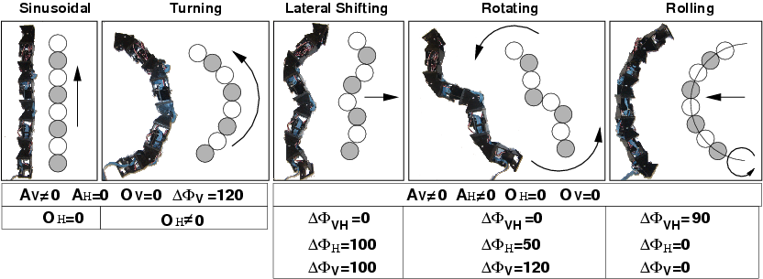
Conclusions
All the gais have been implemented using a sinusoidal CPG approach
The parameters for achieving the gaits are summarized below:
The experiments confirm the principles of CPGs and the locomotion capabilities of the pitch-yaw connecting modular robots .

Slide 19
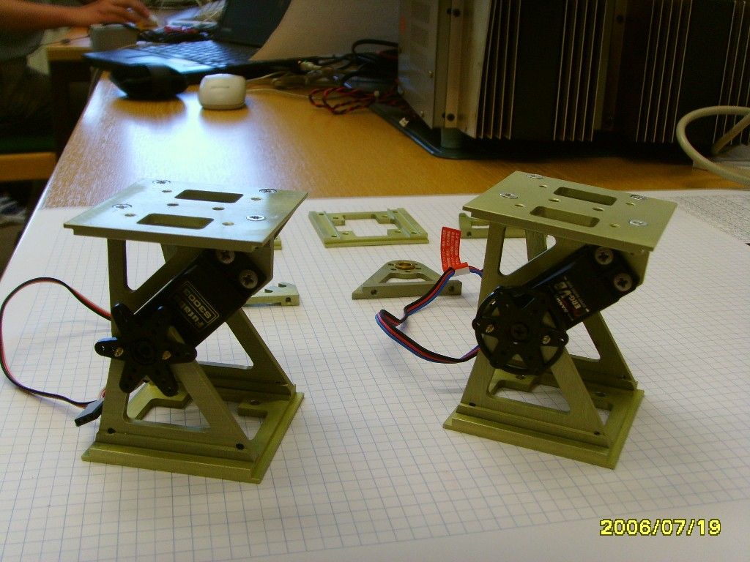
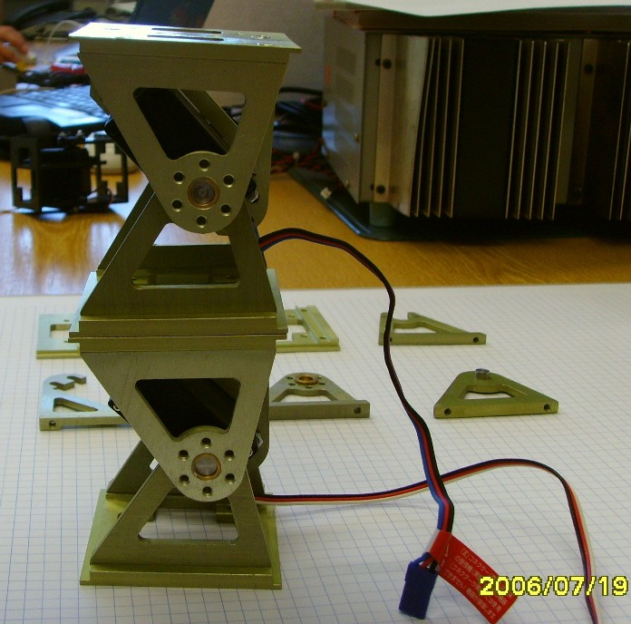
Future work
A new generation of modules have been designed:
Now it is possible to build more complex configurations like a 4 legged or a humanoid robot:
We are studying the climbing properties to develop a climbing caterpillar

Slide 20
Thank you very much for your attention

Slide 21
Locomotion Capabilities of a Modular Robot with Eight Pitch-Yaw-Connecting Modules
J. Gonzalez-Gomez, E. Boemo
DSLab, School of Engineering,
Universidad Autonoma de Madrid, Spain
H. Zhang, J. Zhang
TAMS, Department of Informatics,
University of Hamburg, Germany
Clawar 2006
9th International Conference on Climbing and Walking Robots.
12-14 September. Brussels, Belgium

