Slide 1




Modular robotics and locomotion
Juan Gonzalez Gomez
  School of Engineering
  Universidad Autonoma de Madrid (Spain)
Uni Hamburg. FB Informatik. AB TAMS. May 2006

Slide 2
Contents
Introduction to robotics
Introduction to modular robotics
Starting platform: Y1 Modules
Locomotion of minimal configurations
Locomotion of 1D worm-like robot
Locomotion of 2D snake-like robots
Future work

Slide 3
Introduction to robotics

Slide 4

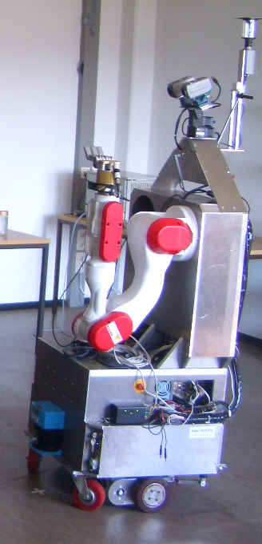
Main areas of robotics
Manipulation: Robots that are able to grasp and manipulate objects
Locomotion: Capability of the robots to move from one point to another
Industrial robots
Service Robots
Mobile robots

Slide 5
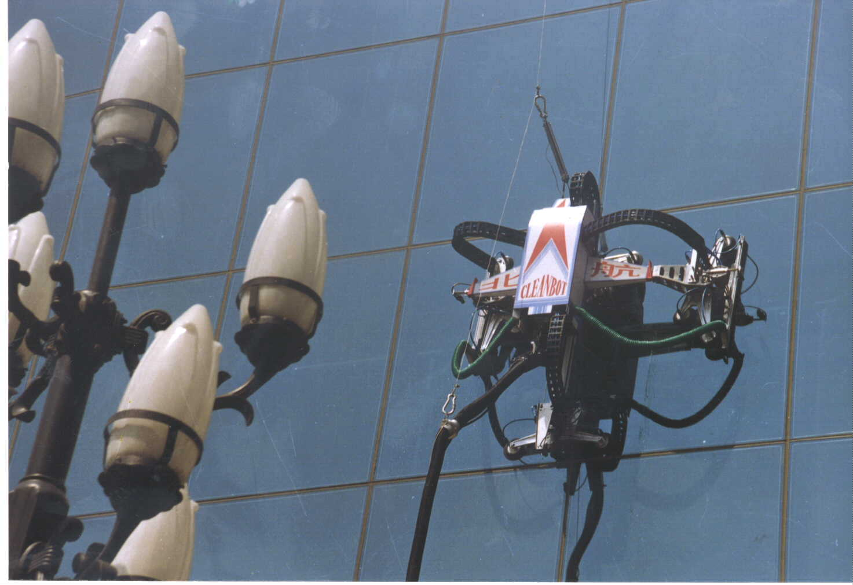

Locomotion: Classification of mobile robots (I)
Mobile robots can be classified according to environment in which they move:
Air. Flying robots: robotics planes, helicopters, insects...
Water. Swimming robots: fish, snakes
Earth. Terrestrial robots: Move on a surface
  Horizontal surface: Locomotion on the ground
  Vertical surface: Climbing robots.

Slide 6
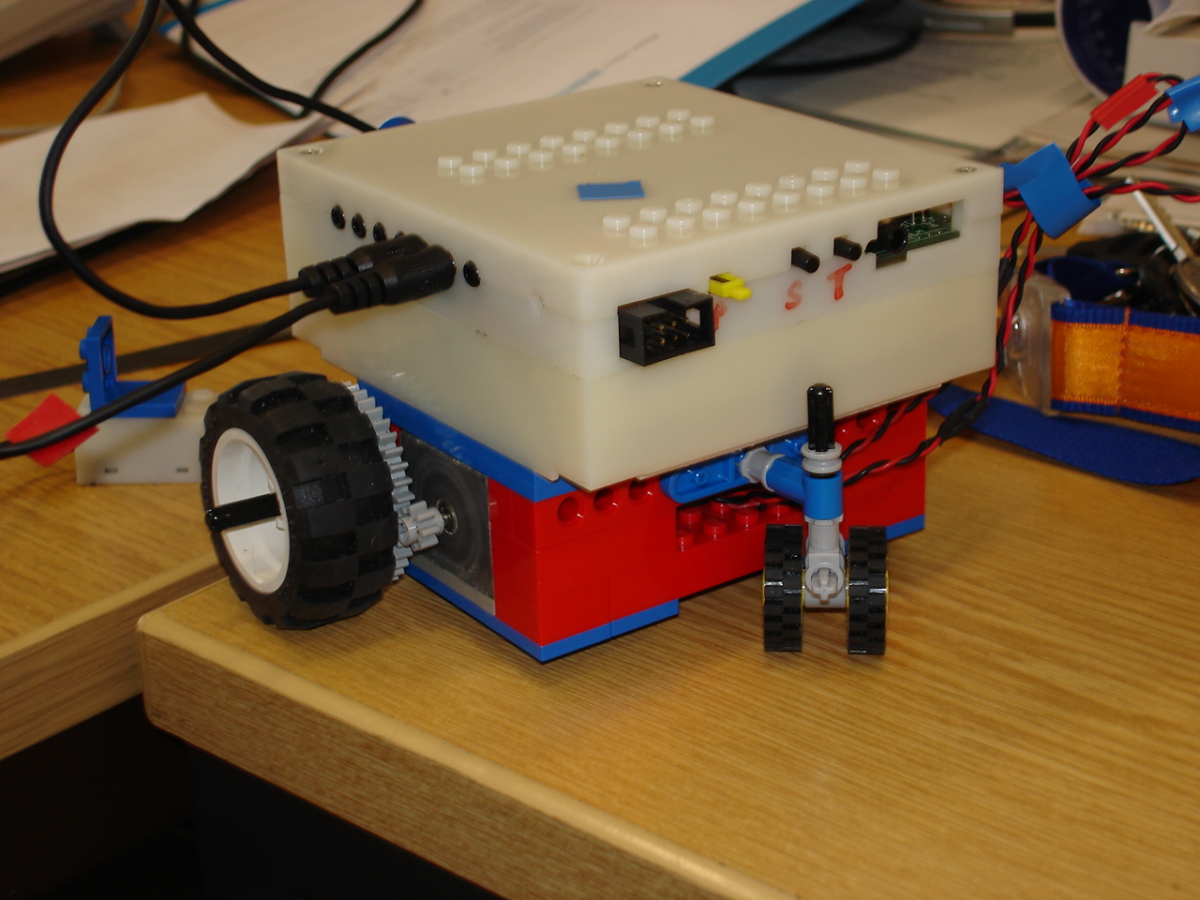
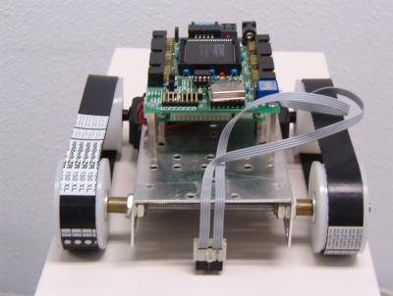
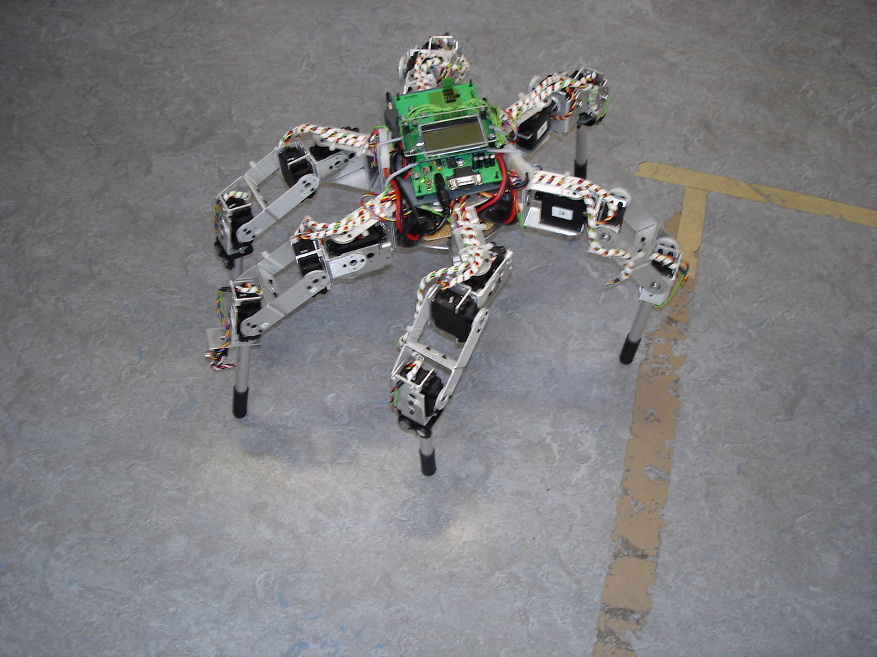
Locomotion: Classification of mobile robots (II)
Mobile robots can be classified according to the elements used to perform the locomotion:
Wheeled robots
tracked robots
Legged robots
Body-motion robots

Slide 7
Wheeled robots
Locomotion is easy to achieve
They are very efficient
Mechanics is very well known
DISADVANTAGE:
They can only move on special surfaces

Slide 8
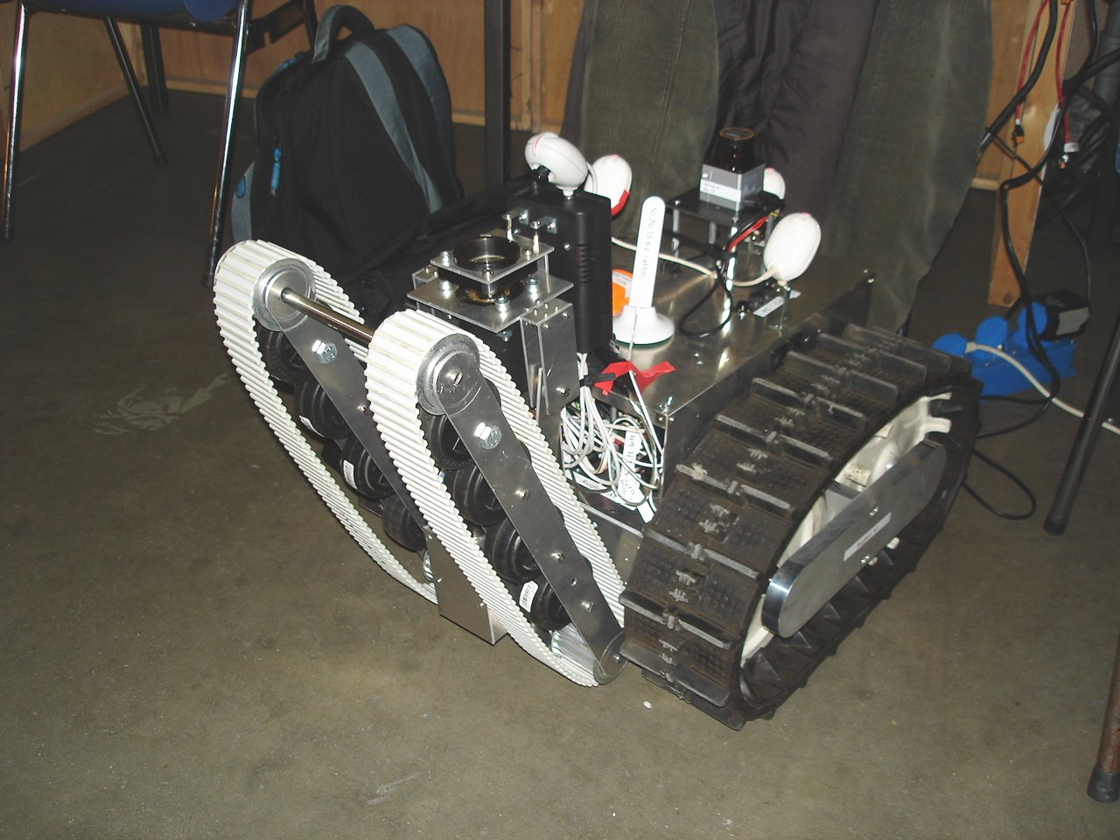
Tracked robots
Very similar to wheeled robot
They can move better in a rough terrain

Slide 9
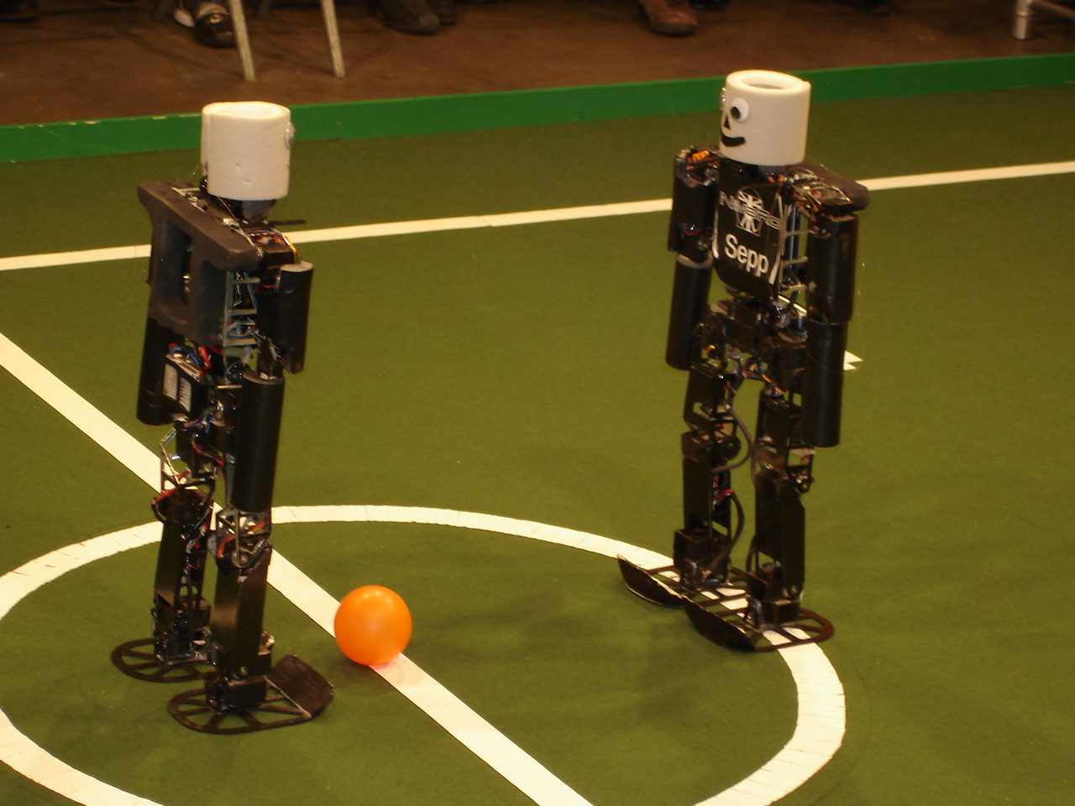
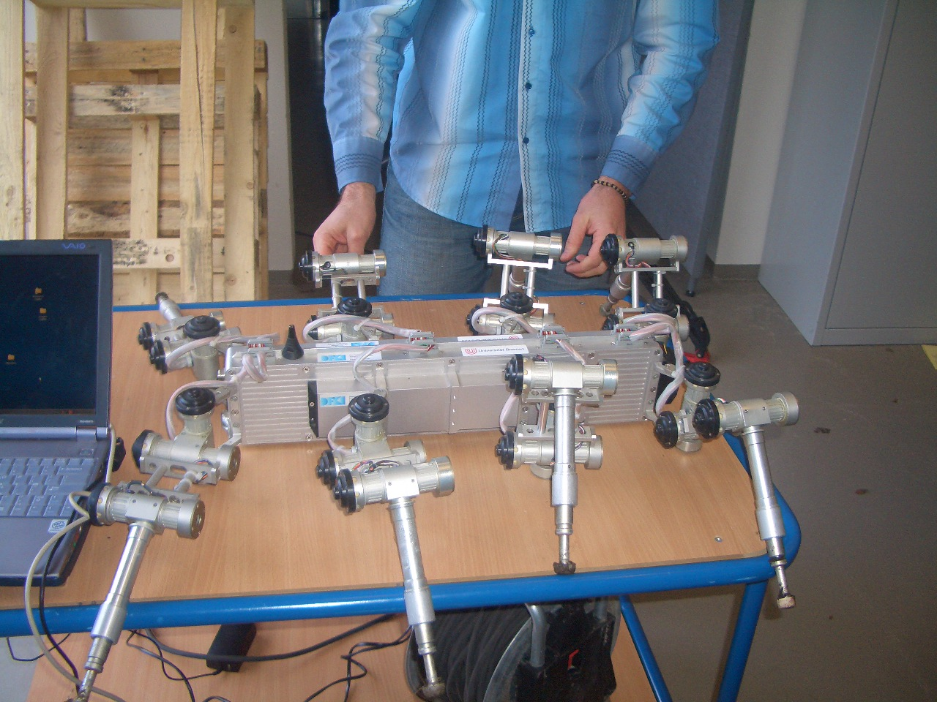
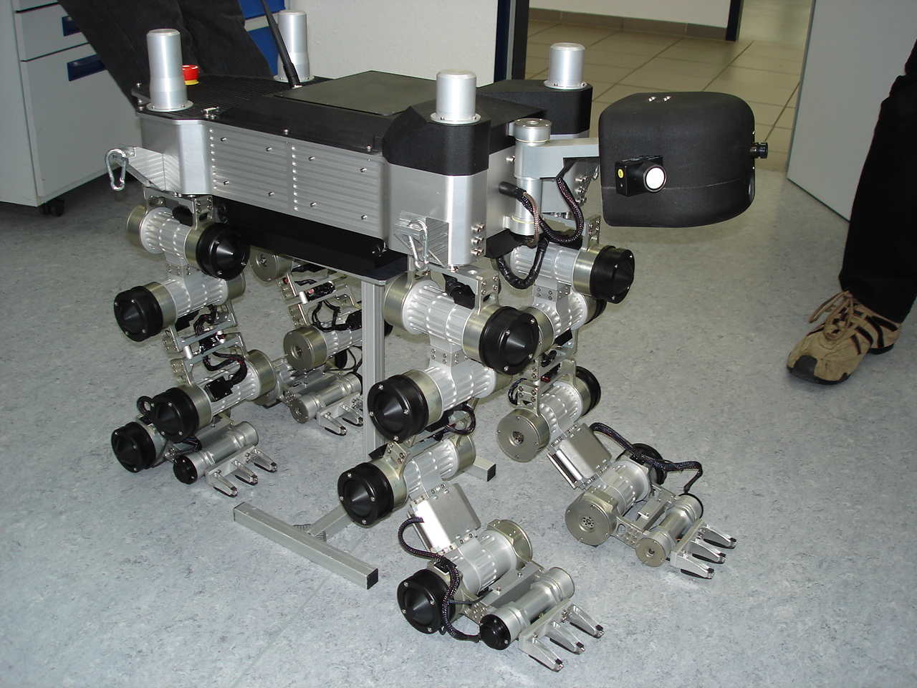
Legged robots
Higher power consumption
More complex
Coordination problem
2 legs
Why there are so many legged animals in the nature?
8 legs
6 legs
4 legs

Slide 10
Body-motion robots
The locomotion is based on the movements of the body
Examples: snakes, worms...

Slide 11



Classification according the structure
Specific design
Modular design
Video
Specific design of an Humanoid
Modular approach

Slide 12
Modular robotics

Slide 13
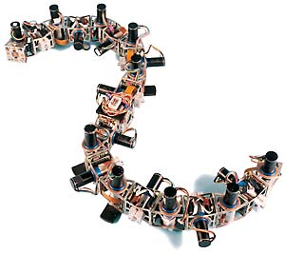

Introduction to
Modular Robotics (I)
Main idea: Building robots composed of modules
The design is focused in the module, not in a particular robot
The different combinations of modules are called configurations
There are two kinds of modular robots:
  Manually reconfigurable robots
  Self-reconfigurable robots

Slide 14

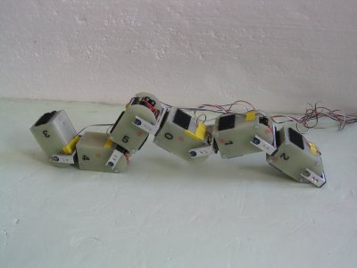
Introduction to
Modular Robotics (II)
The idea of modular robotics was introduced by Mark Yim, in 1994
There are many groups working on this topic in the world.
The most avanced robots are:
  POLYBOT (USA). Palo Alto Research Center (PARC)
  M-TRAN (JAPAN). Advance Industrial Science Technology (AIST)
  YAMOR (Swiss). Ecole Polytechnique Federale de Lausanne (EPFL)

Slide 15
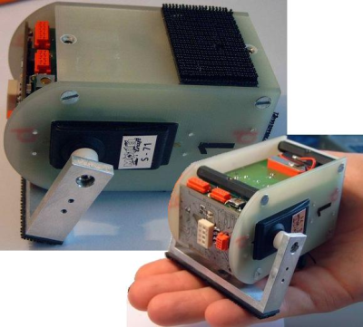
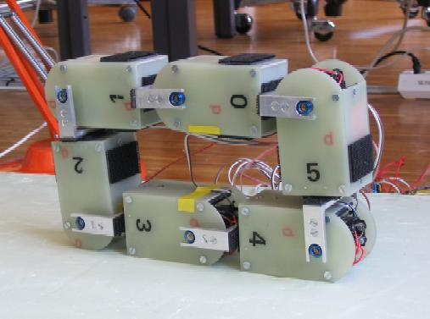
Introduction to
Modular Robotics (V)
YAMOR
The modules have 1 DOF
Manually reconfigurable
Control: ARM and FPGA
Communication via bluetooth
Connection using velcro

Slide 16
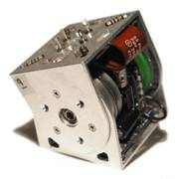
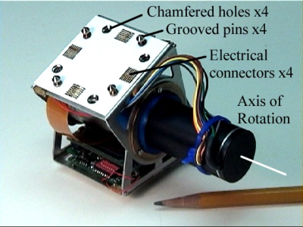
Introduction to
Modular Robotics (III)
Generation 1
POLYBOT
Manually reconfigurable
Many versions
All the modules have 1 DOF
3 generations of modules
Generation 2
Generation 3
11x7x6 cm
Power PC 555
1MB Ram
Can Bus
Infrared emitters and detectors
5x5x5cm
Maxon motor
Similar electronics than G2

Slide 17
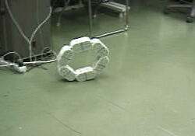
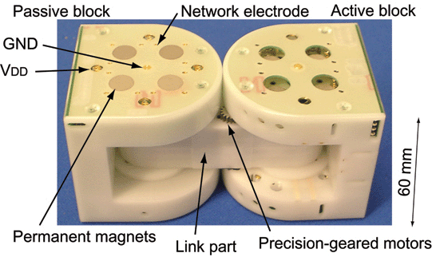
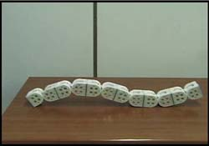
Introduction to
Modular Robotics (IV)
M-TRAN
4 Legged
All the modules have 2 DOF
6x12x6 cm
CPU: 1 Neuron Chip and 3 PICs
Acceleration sensor
Wheel
Snake
Video

Slide 18

Starting platform:
Y1 Modules

Slide 19

Y1 Modules:
Introduction
We needed a cheap and easy-to-build platform to research on modular robotics
It was not possible to buy the modules developed by the other groups
Y1 Modules is the first generation
  Fast prototyping
  Manually reconfigurable robots
  Students can build them very easily

Slide 20



Y1 module:
Characteristics
Material: 3mm Plastic
Servo: Futaba 3003
Dimension: 52x52x72mm
Range: 180 degrees
Two types of connection:
Same orientation
90 degrees rotation
Video

Slide 21







Y1 modules:
Building in 6 steps

Slide 22

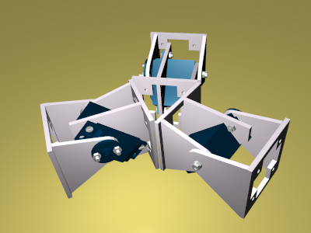
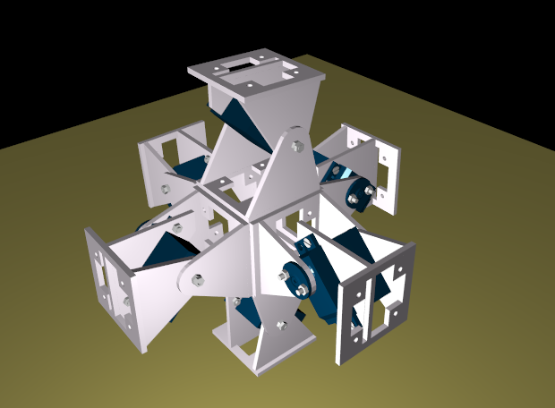
Y1 modules:
Topology
1D: Chain robots
(Worms, snakes)
2D structures
3D structures

Slide 23

Y1 Modules:
1D Structures (Chain robots)
Two different type of robots:
Same orientation
90 degrees rotation

Slide 24
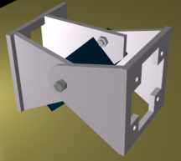

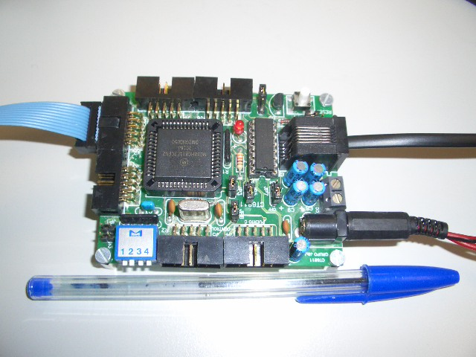

Y1 modules:
Electronics
The electronic and power supply are located outside the module
An 8 bits micro-controller is used for the generation of the PWM signal that position the servos
The software running in the PC send the position to the servos by serial communication
Y1 Modules
RS-232
PWM
PC
Power supply

Slide 25
Y1 modules:
Software
The modules are controlled by the PC
The software can set the position of every module
There is an simple API
Application
Position each module
Enable/disable each module
API
Modules
controller
Demo
Let's see some code...
Let's move one module...

Slide 26
Locomotion of minimal configurations

Slide 27
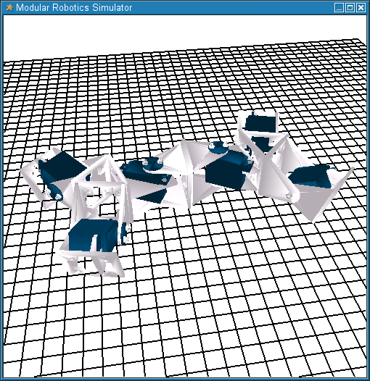
Introduction
Complex robots can be constructed by attaching these modules
But, what we wonder is:
What is the minimum number of modules needed to achieve locomotion in 1D and 2D?
How do these modules have to be coordinated to achieve the locomotion?

Slide 28
Configuration with one module (II)
Can one module move from one point to another??
How can we test it?
????
Test
Let's move one module...

Slide 29
Configuration with one module
Answer: no locomotion
Let's try with two modules...

Slide 30


Configuration with two modules:
Pitch-Pitch
Pitch axis
Can this robot move from one point to another?
if so ... How do we have to coordinate the articulations?
????
Test
Let's move two modules...

Slide 31
Configuration with two modules:
Pitch-Pitch
Pitch axis
Answer: yes!!
only two modules is enough for locomotion in 1D
The robot can move forward and backward
Let's try to study what happened...

Slide 32
Configuration Pitch-Pitch:
Coordination
1
2
2
π
ϕ
=
Asin(
t)
1
T
2
π
Δφ
ϕ
=
Asin(
t+
)
2
T
Two sinusoidal waves are applied to each articulation
These waves only differ on the phase ( )
determines the coordination of the movement
Δφ
Δφ

Slide 33
Configuration I (Pitch-Pitch)
Results
5,5
5
Δφ
When is in the range [100, 130] degrees, the speed is maximum and the coordination is the best.
4,5
4
3,5
3
ΔS (cm/cycle)
2,5
2
1,5
Demo
1
0,5
0
0
25
50
75
100
125
150
175
200
Δφ

Slide 34
Locomotion in 2D
Now we want to build the minimal configuration capable of moving in 2D
How many modules are necessary?
What is the coordination?
One module is not enough...
Two modules?
Three modules?
????

Slide 35
Locomotion in 2D
Let's try this configuration...
Can this robot move from one point to another?
Test
Let's move two modules...

Slide 36
Locomotion in 2D
ANSWER: NO
Let's try with three modules...
How can we connect the modules?
Are three modules enough for moving in 2D?
How are the modules coordinates?
Test
Let's move three modules...

Slide 37


Configuration II (Pitch-Yaw-Pitch)
Description
Yaw Axis
1
2
3
Pitch axis
Pitch axis
Three modules: two rotating in the pitch axis and one in the yaw
We call it Pitch-Yaw-Pitch configuration (PYP)
1D and 2D sinusoidal gait
Lateral shift gait
Lateral rolling gait

Slide 38
Configuration II (Pitch-Yaw-Pitch)
1D sinusoidal gait
1
2
2
π
3
ϕ
=
Asin(
t)
1
T
ϕ
=
0
2
2
π
Δφ
ϕ
=
Asin(
t +
)
3
T
The angle of articulation 2 fixed to 0 degrees
Articulations 1 and 3 coordinated in the same way that in the PP configuration
Sames results as in configuration PP

Slide 39
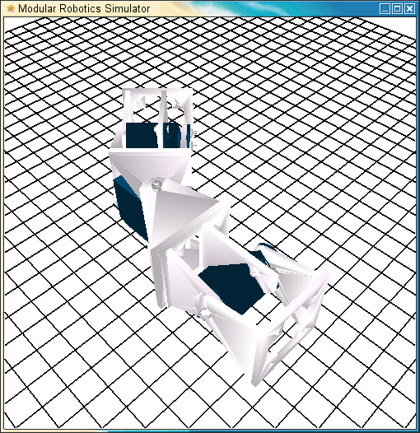
Configuration II (Pitch-Yaw-Pitch)
2D sinusoidal gait
1
2
2
π
3
ϕ
=
Asin(
t)
1
T
ϕ
=
0
2
2
π
Δφ
ϕ
=
Asin(
t +
)
3
T
The same as in 1D sinusoidal gait, but the angle of articulation 2 different from 0 degrees
The trajectory of the robot is an arc

Slide 40
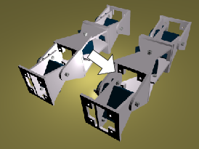
Configuration II (Pitch-Yaw-Pitch)
Lateral shift gait
1
2
2
π
3
ϕ
=
Asin(
t)
1
T
2
π
π
ϕ
=
Asin(
t +
)
2
T
2
ϕ
=
ϕ
3
1
A<=40
Module 1 and 3 are in phase
Module 2 is 90 degrees out of phase
The robot moves parallel to its body axis

Slide 41
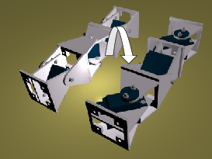
Configuration II (Pitch-Yaw-Pitch)
Lateral rolling gait
The same coordination as in the lateral shift gait, but using and amplitude A>60 degrees.
The sense of rolling can also be controlled by changing the sign of the difference of phase
The robot rolls about its body axis

Slide 42
Minimal configuration in 2D
Which is the minimal configuration in 2D that can move from one point to another?
How do we have to coordinate the modules?
At least, we need three modules...
????
Test

Slide 43
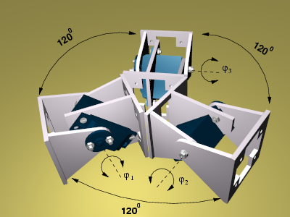
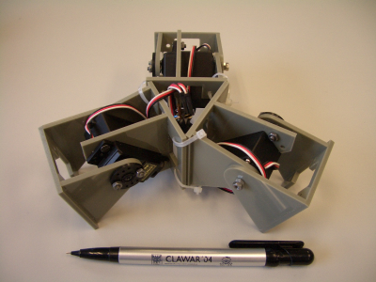
Configuration III: three-modules star
Description
1
2
3
Three modules in the same plane, moving about its pitch axis
The angle between the modules is 120 degrees (connected in a three-points-star form)
1D sinusoidal gait along six different directions
Rotation about the robot's yaw axis

Slide 44
Configuration III: three-modules star
1D sinusoidal gait
1
2
3
The robot can move along six different directions
Three sinusoidal waves are applied
Example: In order to move along the red direction:
π
π
ϕ
ϕ
2
2
π
ϕ
2
Δφ
=
=
Δφ
)
Asin(
)
Asin(
+
)
2
3
1
=
Asin(
+
100<
Δφ
<130
T
T
T

Slide 45
Configuration III: three-modules star
Rotation about its yaw axis
1
2
3
Rotation about the robot yaw axis
Three sinusoidal waves are applied
π
π
π
π
π
π
π
π
π
2
π
4
2
2
2
2
2
ϕ
Asin(
)
ϕ
2
+
)
ϕ
2
+
)
Asin(
Asin(
Asin(
1
=
2
=
Asin(
3
=
Asin(
T
3
3
T
T
T
Video

Slide 46
Conclusions...
We have found three minimal configurations:
1D Structure
1D Structure
2D Structure
Locomotion in 1D
Locomotion in 2D
Locomotion in 2D
Rolling
Rotating
All of these robots are controlled using sinusoidal signals
The phase difference determines the coordination between the modules
A: Amplitude
2
π
T: Period
ϕ
=
Asin(
t+
φ
)
T
φ
: Phase

Slide 47
Conclusions...
We have discover the basic coordination method that is found in nature.
All the vertebrates have central pattern generators (CPGs) in the Cord.
CPG are oscillators that generate periodic signals that are applied to the muscles, making the animal move.
CPGs
Cord

Slide 48
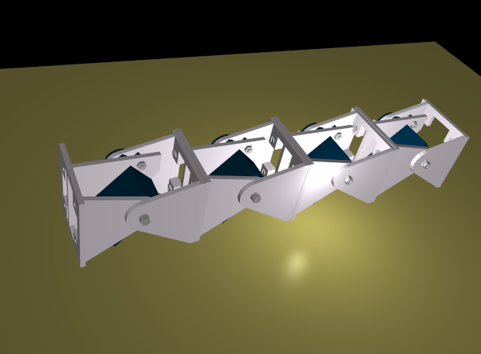
Conclusions...
We are applying the same model that in nature, but a little simplied
π
ϕ
2
φ
CPG
=
Asin(
t+
)
T
There are one CPG per module:
Module 1
Module 2
Module 3
Module 4
CPG
CPG
CPG
CPG

Slide 49
Conclusions...
We have found a general control method valid for all the configurations!!!
We only have to find the different parameters of the CPG: Phase difference, Amplitude and period.

Slide 50

Locomotion of 1D worm-like robot

Slide 51
1D chain robot:
Introduction
Configuration: 8 Y1 modules in the same orientation
Dimensions: 52x52x576mm:

Slide 52
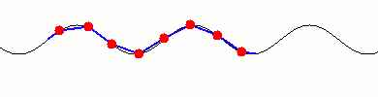
1D Chain robot:
Locomotion approaches
Two approaches can be used for the locomotion:
  Using 8 CPGs
  Using a global wave that travel through the robot, from the tail to the head
For the second approach only 4 parameters have to be specified:
  Waveform
  Wavelength
  Amplitude
  Period

Slide 53






1D chain robots:
Global waves
The locomotion characteristics depend on the global wave used:
High amplitude: Crossing over obstacles
Low amplitude: Going inside a tube
Semi-sine wave: Caterpillar locomotion

Slide 54




1D chain robots:
Locomotion capabilities
One feature of these robots is that they can change their shape:
Video

Slide 55
Locomotion of 2D snake-robot

Slide 56
Chain robot 2D:
Introduction
Robot composed of 8 Y1 modules
Two adjacent modules are 90 degrees rotated
90 degrees rotation
This robot have the following locomotion capabilities:
  1D locomotion
  1D locomotion in an arc
  Lateral shift
  Rotating parallel to the ground
  Lateral rolling

Slide 57

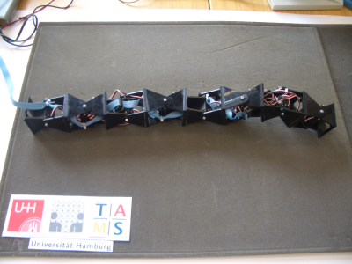

Chain robot 2D:
Control approaches
Using 8 CPGs
Using two global waves. One for the vertical modules and the other for the horizontal:
Some gaits are easier to implement with the first approach and others with the second

Slide 58
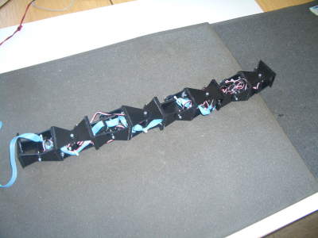
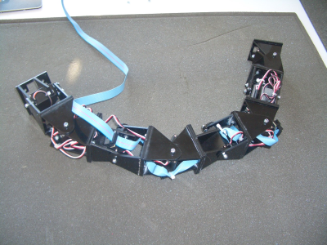
Chain robot 2D:
1D locomotion
Locomotion in 1D: straight and arc trajectories
CPG
CPG
CPG
CPG
Δφ=120
CPG
CPG
CPG
CPG
Fixed: 0 degrees
Fixed: 30 degrees

Slide 59

Chain robot 2D:
2D locomotion
Locomotion in 2D: Lateral shift and rotating
Horizontal wave
Δφ=90
Shift right
Δφ=−90
Shift left
Δφ=0
Anti-clockwise
rotation
Vertical wave
Δφ=180
Clockwise
rotation

Slide 60
Chain robot 2D:
Lateral rolling
Two CPGs are used for vertical and horizontal modules
The phase difference between them is 90 degrees
The robot rotates about its body axis
CPG
Δφ=90
CPG
Demo

Slide 61
Future work (I)
We are designing a new module (GZ2)
The servo is more powerful
It is stronger: made of aluminium
It has four connection plates

Slide 62
Future work (II)
Caterpillar configuration:
Snake configuration:

Slide 63
Future work
4 Leg configuration

Slide 64
Future work
Humanoid configuration

Slide 65
Modular robotics and locomotion
Juan Gonzalez Gomez
  School of Engineering
  Universidad Autonoma de Madrid (Spain)
Uni Hamburg. FB Informatik. AB TAMS. April 2006

