Slide 1




Modular robotics and locomotion
Juan Gonzalez Gomez
  School of Engineering
  Universidad Autonoma de Madrid (Spain)
Uni Hamburg. FB Informatik. AB TAMS. April 2006

Slide 2
Index
Introduction to Modular robotics
Starting platform: Y1 Modules
Locomotion of minimal configurations
Locomotion of 1D worm-like robot
Locomotion of 2D snake-like robots
Future work

Slide 3
Introduction to
Modular robotics

Slide 4
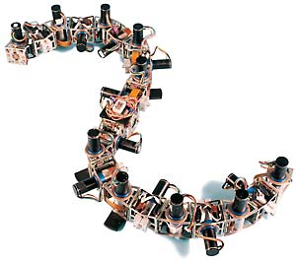

Introduction to
Modular Robotics (I)
Main idea: Building robots composed of modules
The design is focused in the module, not in a particular robot
The different combinations of modules are called configurations
There are two kinds of modular robots:
  Manually reconfigurable robots
  Self-reconfigurable robots

Slide 5


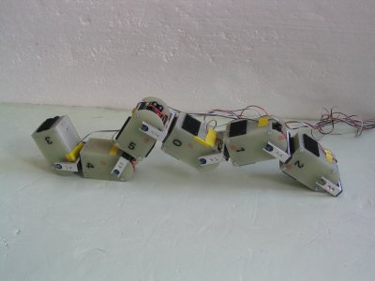
Introduction to
Modular Robotics (II)
The idea of modular robotics was introduced by Mark Yim, in 1994
There are many groups working on this topic in the world.
The most avanced robots are:
  POLYBOT (USA). Palo Alto Research Center (PARC)
  M-TRAN (JAPAN). Advance Industrial Science Technology (AIST)
  YAMOR (Swiss). Ecole Polytechnique Federale de Lausanne (EPFL)

Slide 6
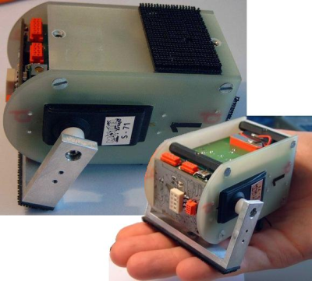
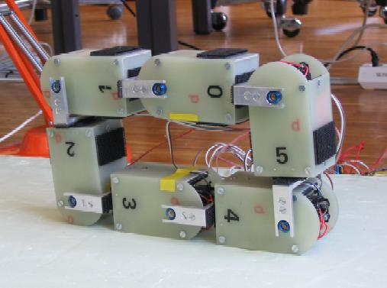
Introduction to
Modular Robotics (V)
YAMOR
The modules have 1 DOF
Manually reconfigurable
Control: ARM and FPGA
Communication via bluetooth
Connection using velcro

Slide 7

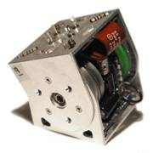
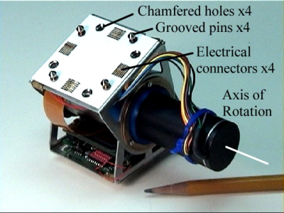
Introduction to
Modular Robotics (III)
Generation 1
POLYBOT
Manually reconfigurable
Many versions
All the modules have 1 DOF
3 generations of modules
Generation 2
Generation 3
11x7x6 cm
Power PC 555
1MB Ram
Can Bus
Infrared emitters and detectors
5x5x5cm
Maxon motor
Similar electronics than G2

Slide 8
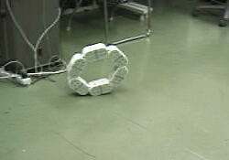
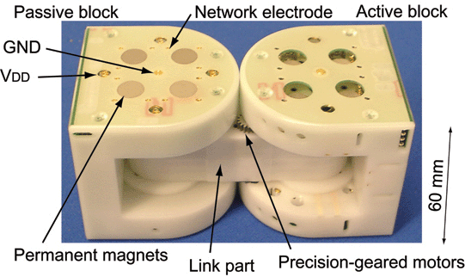
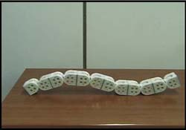
Introduction to
Modular Robotics (IV)
M-TRAN
4 Legged
All the modules have 2 DOF
6x12x6 cm
CPU: 1 Neuron Chip and 3 PICs
Acceleration sensor
Wheel
Snake
Video

Slide 9

Starting platform:
Y1 Modules

Slide 10

Y1 Modules:
Introduction
We needed a cheap and easy-to-build platform to research on modular robotics
It was not possible to buy the modules developed by the other groups
Y1 Modules is the first generation
  Fast prototyping
  Manually reconfigurable robots
  Students can build them very easily

Slide 11



Y1 module:
Characteristics
Material: 3mm Plastic
Servo: Futaba 3003
Dimension: 52x52x72mm
Range: 180 degrees
Two types of connection:
Same orientation
90 degrees rotation
Video

Slide 12







Y1 modules:
Building in 6 steps

Slide 13

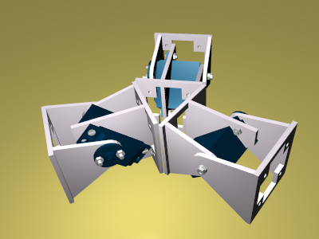
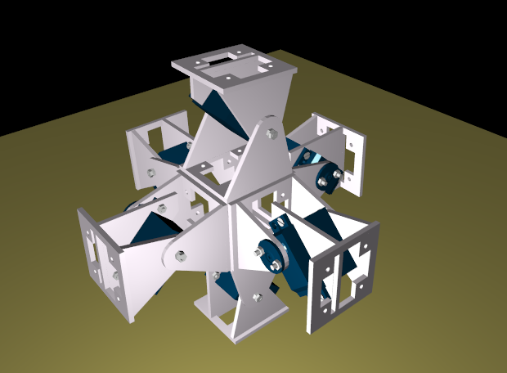
Y1 modules:
Topology
1D: Chain robots
(Worms, snakes)
2D structures
3D structures

Slide 14

Y1 Modules:
1D Topology (Chain robots)
Two different type of robots:
Same orientation
90 degrees rotation

Slide 15
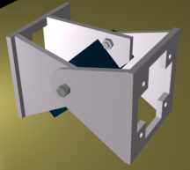

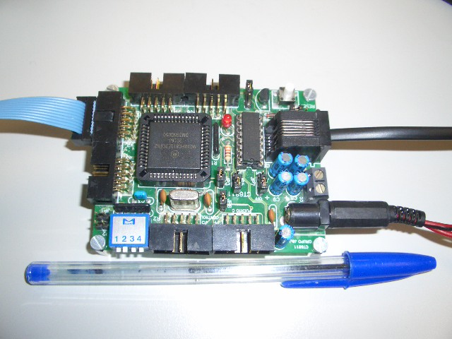

Y1 modules:
Electronics
The electronic and power supply are located outside the module
An 8 bits microcontroller is used for the generation of the PWM signal that position the servos
The software running in the PC send the position to the servos by serial communication
Y1 Modules
RS-232
PWM
PC
Power supply

Slide 16
Locomotion of minimal configurations

Slide 17
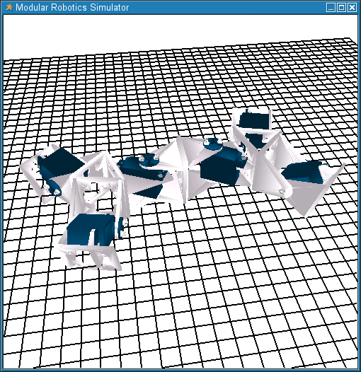
Introduction
Complex robots can be constructed by attaching these modules
But, what we wonder is:
What is the minimum number of modules needed to achieve locomotion in 1D and 2D?
How do these modules have to be coordinated to achieve the locomotion?
In order to answer these questions, we have constructed three prototypes

Slide 18
Locomotion using CPGs
There are two main approaches for implementing the locomotion of an articulated robot
  The classic way is based on inverse kinematics and the position of the centre of gravity
  There is a new bio-inspired approach, based on the central patter generator (CPG) of the vertebrates
CPG are oscillators that generate periodic signals
CPGs

Slide 19
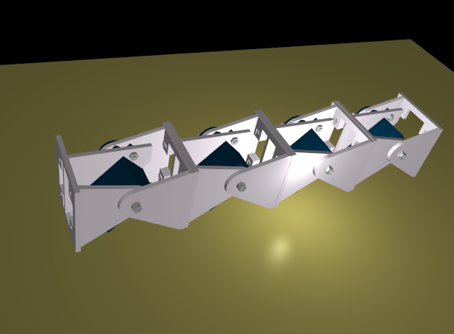
Locomotion using CPGs (II)
We use a simplified CPG model, based on a sine function
2
π
ϕ
=
Asin(
t+
φ
CPG
)
T
There are one CPG per module:
Module 1
Module 2
Module 3
Module 4
CPG
CPG
CPG
CPG

Slide 20


Configuration I (Pitch-Pitch)
Description
Pitch axis
We call it Pitch-Pitch configuration (PP)
Two modules connected in the same orientation
They both move about the pitch axis
1D sinusoidal gait

Slide 21
Configuration I (Pitch-Pitch)
Coordination
1
2
2
π
ϕ
=
Asin(
t)
1
T
2
π
Δφ
ϕ
=
Asin(
t+
)
2
T
Two sinusoidal waves are applied to each articulation
These waves only differ on the phase ( )
determines the coordination of the movement
Δφ
Δφ

Slide 22
Configuration I (Pitch-Pitch)
Results
5,5
5
Δφ
When is in the range [100, 130] degrees, the speed is maximum and the coordination is the best.
4,5
4
3,5
3
ΔS (cm/cycle)
2,5
2
1,5
Video
1
0,5
0
0
25
50
75
100
125
150
175
200
Δφ

Slide 23


Configuration II (Pitch-Yaw-Pitch)
Description
Yaw Axis
1
2
3
Pitch axis
Pitch axis
Three modules: two rotating in the pitch axis and one in the yaw
We call it Pitch-Yaw-Pitch configuration (PYP)
1D and 2D sinusoidal gait
Lateral shift gait
Lateral rolling gait

Slide 24
Configuration II (Pitch-Yaw-Pitch)
1D sinusoidal gait
1
2
2
π
3
ϕ
=
Asin(
t)
1
T
ϕ
=
0
2
2
π
Δφ
ϕ
=
Asin(
t +
)
3
T
The angle of articulation 2 fixed to 0 degrees
Articulations 1 and 3 coordinated in the same way that in the PP configuration
Sames results as in configuration PP

Slide 25
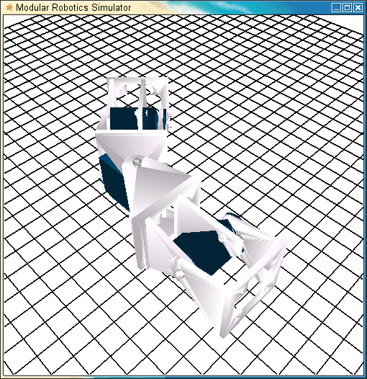
Configuration II (Pitch-Yaw-Pitch)
2D sinusoidal gait
1
2
2
π
3
ϕ
=
Asin(
t)
1
T
ϕ
=
0
2
2
π
Δφ
ϕ
=
Asin(
t +
)
3
T
The same as in 1D sinusoidal gait, but the angle of articulation 2 different from 0 degrees
The trajectory of the robot is an arc

Slide 26
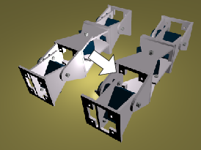
Configuration II (Pitch-Yaw-Pitch)
Lateral shift gait
1
2
2
π
3
ϕ
=
Asin(
t)
1
T
2
π
π
ϕ
=
Asin(
t +
)
2
T
2
ϕ
=
ϕ
3
1
A<=40
Module 1 and 3 are in phase
Module 2 is 90 degrees out of phase
The robot moves parallel to its body axis

Slide 27
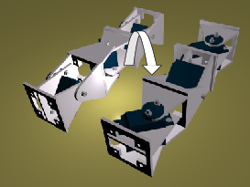
Configuration II (Pitch-Yaw-Pitch)
Lateral rolling gait
The same coordination as in the lateral shift gait, but using and amplitude A>60 degrees.
The sense of rolling can also be controlled by changing the sign of the difference of phase
The robot rolls about its body axis
Video

Slide 28
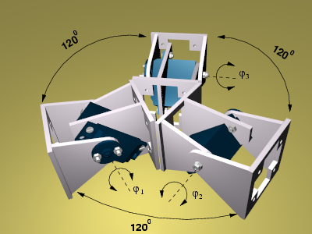
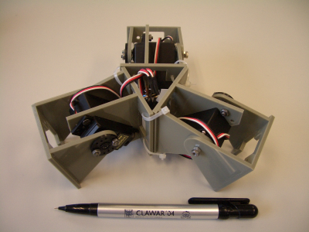
Configuration III: three-modules star
Description
1
2
3
Three modules in the same plane, moving about its pitch axis
The angle between the modules is 120 degrees (connected in a three-points-star form)
1D sinusoidal gait along six different directions
Rotation about the robot's yaw axis

Slide 29
Configuration III: three-modules star
1D sinusoidal gait
1
2
3
The robot can move along six different directions
Three sinusoidal waves are applied
Example: In order to move along the red direction:
π
π
ϕ
ϕ
2
2
π
ϕ
2
Δφ
=
=
Δφ
)
Asin(
)
Asin(
+
)
2
3
1
=
Asin(
+
100<
Δφ
<130
T
T
T

Slide 30
Configuration III: three-modules star
Rotation about its yaw axis
1
2
3
Rotation about the robot yaw axis
Three sinusoidal waves are applied
π
π
π
π
π
π
π
π
π
2
π
4
2
2
2
2
2
ϕ
Asin(
)
ϕ
2
+
)
ϕ
2
+
)
Asin(
Asin(
Asin(
1
=
2
=
Asin(
3
=
Asin(
T
3
3
T
T
T
Video

Slide 31

Locomotion of 1D worm-like robot

Slide 32
1D chain robot:
Introduction
Configuration: 8 Y1 modules in the same orientation
Dimensions: 52x52x576mm:

Slide 33
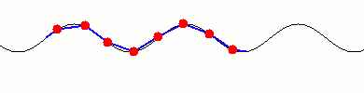
1D Chain robot:
Locomotion approaches
Two approaches can be used for the locomotion:
  Using 8 CPGs
  Using a global wave that travel through the robot, from the tail to the head
For the second approach only 4 parameters have to be specified:
  Waveform
  Wavelength
  Amplitude
  Period

Slide 34






1D chain robots:
Global waves
The locomotion characteristics depend on the global wave used:
High amplitude: Crossing over obstacles
Low amplitude: Going inside a tube
Semi-sine wave: Caterpillar locomotion

Slide 35




1D chain robots:
Locomotion capabilities
One feature of these robots is that they can change their shape:
Video

Slide 36
Locomotion of 2D chain robot

Slide 37
Chain robot 2D:
Introduction
Robot composed of 8 Y1 modules
Two adjacent modules are 90 degrees rotated
90 degrees rotation
This robot have the following locomotion capabilities:
  1D locomotion
  1D locomotion in an arc
  Lateral shift
  Rotating parallel to the ground
  Lateral rolling

Slide 38

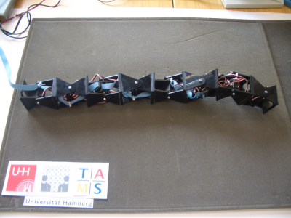

Chain robot 2D:
Control approaches
Using 8 CPGs
Using two global waves. One for the vertical modules and the other for the horizontal:
Some gaits are easier to implement with the first approach and others with the second

Slide 39
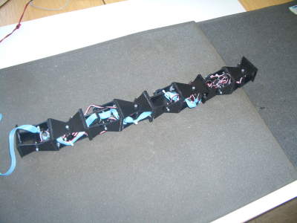
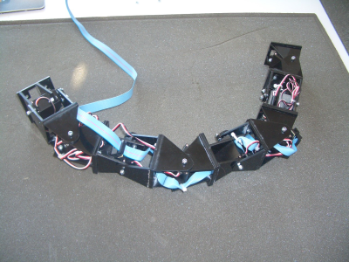
Chain robot 2D:
1D locomotion
Locomotion in 1D: straight and arc trajectories
CPG
CPG
CPG
CPG
Δφ=120
CPG
CPG
CPG
CPG
Fixed: 0 degrees
Fixed: 30 degrees

Slide 40

Chain robot 2D:
2D locomotion
Locomotion in 2D: Lateral shift and rotating
Horizontal wave
Δφ=90
Shift right
Δφ=−90
Shift left
Δφ=0
Anti-clockwise
rotation
Vertical wave
Δφ=180
Clockwise
rotation

Slide 41
Chain robot 2D:
Lateral rolling
Two CPGs are used for vertical and horizontal modules
The phase difference between them is 90 degrees
The robot rotates about its body axis
CPG
Δφ=90
Demo
CPG

Slide 42
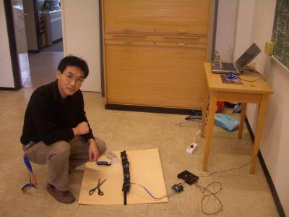
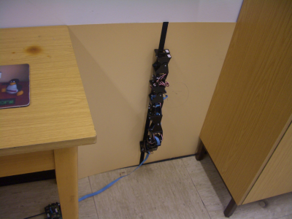
Future work
Minimal configurations:
  What is the 3D minimal configuration?
Climbing tests:
  What is the minimal configuration for climbing?
  What are the parameters of the CPGs or global waves to make the robot climb?

Slide 43
Modular robotics and locomotion
Juan Gonzalez Gomez
  School of Engineering
  Universidad Autonoma de Madrid (Spain)
Uni Hamburg. FB Informatik. AB TAMS. April 2006

