Slide 1
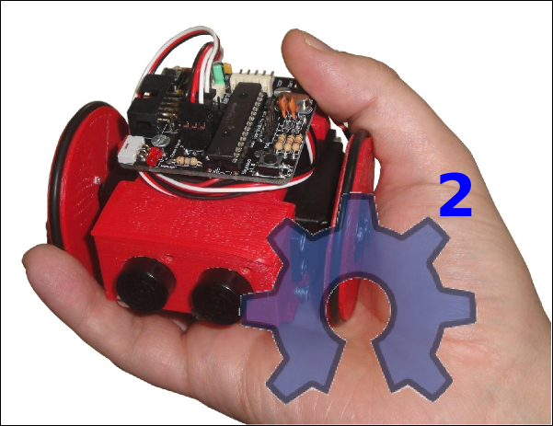

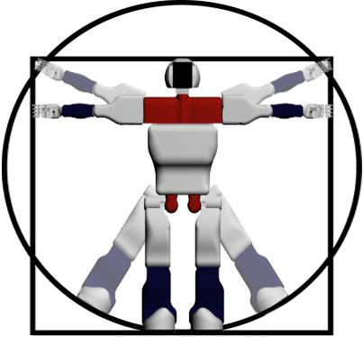
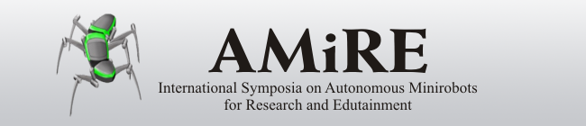
A New Open Source 3D-printable Mobile
Robotic Platform for Education
Juan Gonzalez-Gomez, Alberto Valero Gomez,
Andres Prieto-Moreno, Mohamed Abderrahim
Robotics Lab
Carlos III University of Madrid
6th International Symposium on Autonomous Minirobots for research and Edutainment
Centre for Interdisciplinary Research, University of Bielefeld, Germany
2011/May/23
Notes:
Thanks Prof. Matellan. I am going to start the presentation of my Dissertation which is about the Locomotion of Limbless Modular robots

Slide 2
A New Open Source 3D-printable Mobile Robotic Platform for Education
Outline
Motivation
Miniskybot Robot
Derivative Robots
Conclusions and future work
6th International Symposium on Autonomous Minirobots for research and Edutainment
Notes:
This presentation is divided into 7 parts. First I will introduce the Locomotion problem and the objectives of the dissertation. Second, I will explain the general classification for all the modular robots. Then I will present the central ideas of the dissertation: Locomotion of limbless robots in 1D, 2D and the locomotion of the minimal configurations. Then I will describe some experiments and we will see some videos and simulations. Finally, the conclusions and future work are summarized.

Slide 3





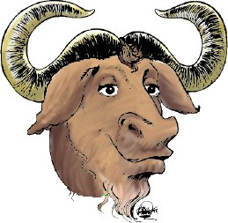



Open source model
The open source model works
Distributed around the world
Thousand of people cooperating
The concept of communities
Tools: repositories, wikis...
Belong to all: World heritage
Notes:
A big challenge in robotics is the development of a very versatile mobile robot capable of moving on different terrains.
As a first approach, the study of locomotion of the mobile robots can be divided into two big leves.
The higher level involves the perception of the environment, planning trajectories, navigation and making decisions.
The lower level is in charge of the control and coordination of the joints in order to move the robot a step in any direction. This Locomotion lower level is the scope of the dissertation

Slide 4
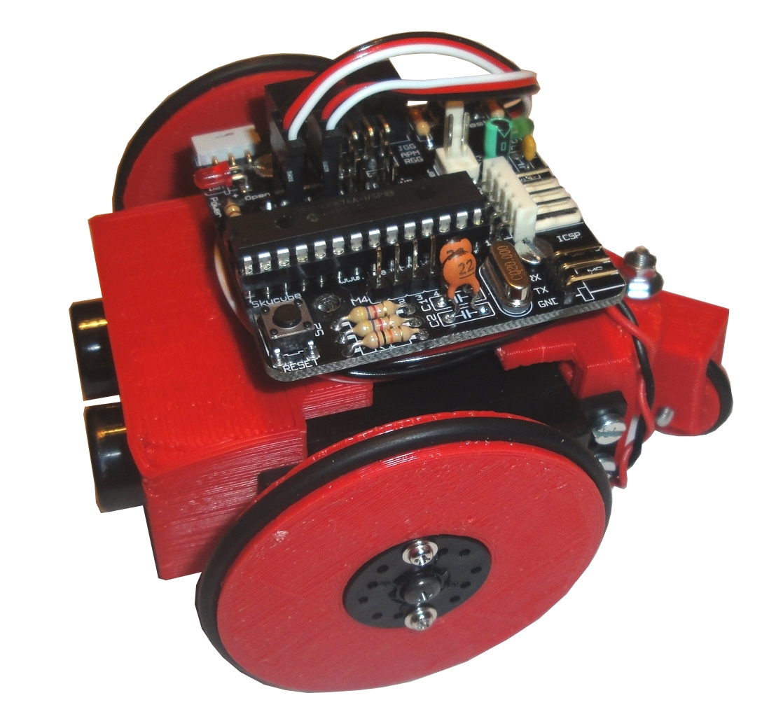
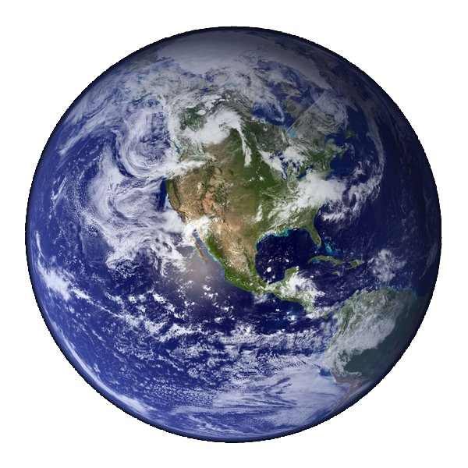
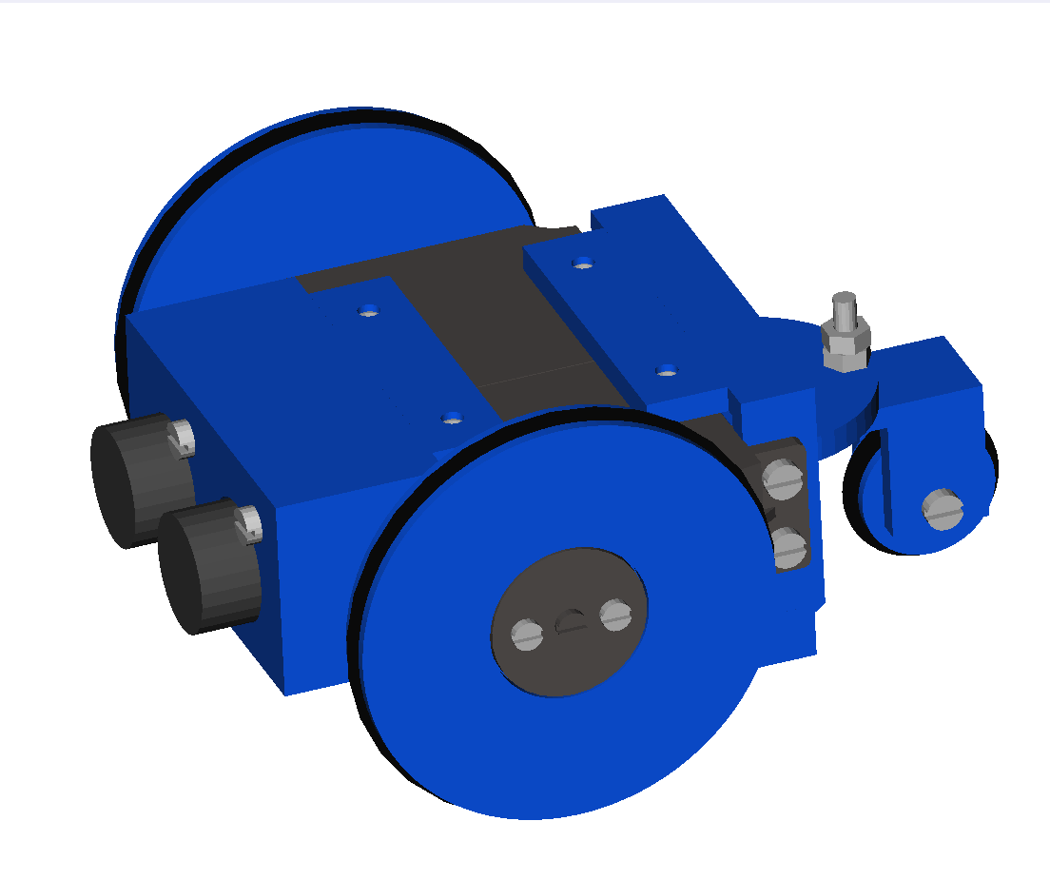
Open Source Robotics (I)
Why not applying this model to robotics?
Advantages:
Robots developed by the community
Shared across the internet
Evolutionary robots
Amazing designs!!
Notes:
A big challenge in robotics is the development of a very versatile mobile robot capable of moving on different terrains.
As a first approach, the study of locomotion of the mobile robots can be divided into two big leves.
The higher level involves the perception of the environment, planning trajectories, navigation and making decisions.
The lower level is in charge of the control and coordination of the joints in order to move the robot a step in any direction. This Locomotion lower level is the scope of the dissertation

Slide 5
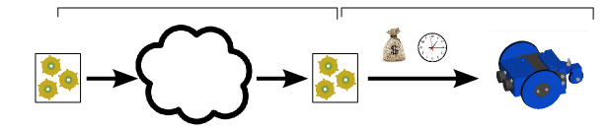
Open Source Robotics (II)
How can it be applied?
Problems:
Robots are physical objects, not bits like the software
The duplication requires time and money
Approach:
Sharing
Manufacture
Physical
object
Bits
Internet
Part drawings
Part drawings
The drawings and schematics are bits. They can be shared easily
The challenge is to manufacture the robot from the drawings easily and cheap
Notes:
A big challenge in robotics is the development of a very versatile mobile robot capable of moving on different terrains.
As a first approach, the study of locomotion of the mobile robots can be divided into two big leves.
The higher level involves the perception of the environment, planning trajectories, navigation and making decisions.
The lower level is in charge of the control and coordination of the joints in order to move the robot a step in any direction. This Locomotion lower level is the scope of the dissertation

Slide 6
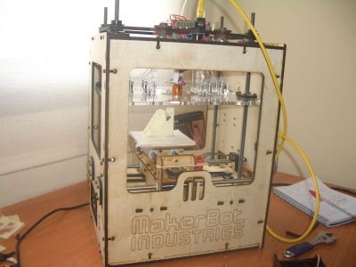
Manufacturing with Open source 3D printers
3D printers: Devices that build real objects from files (bits)
Cost:
  Comercial 3D printers: 13.000€ - 60.000€
  Open source 3D printers: 300€ - 2.000€
(very Affordable)
Build material: Plastic (ABS, PLA)
Cost of build material:
  PLA: 20€/Kg
  ABS: 10€/Kg
Notes:
A big challenge in robotics is the development of a very versatile mobile robot capable of moving on different terrains.
As a first approach, the study of locomotion of the mobile robots can be divided into two big leves.
The higher level involves the perception of the environment, planning trajectories, navigation and making decisions.
The lower level is in charge of the control and coordination of the joints in order to move the robot a step in any direction. This Locomotion lower level is the scope of the dissertation

Slide 7

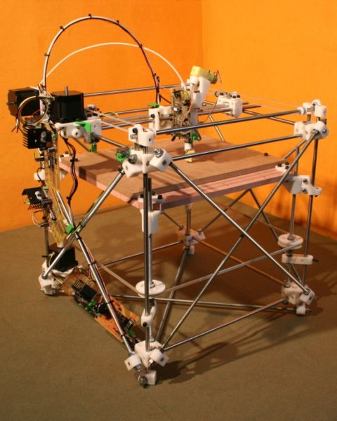
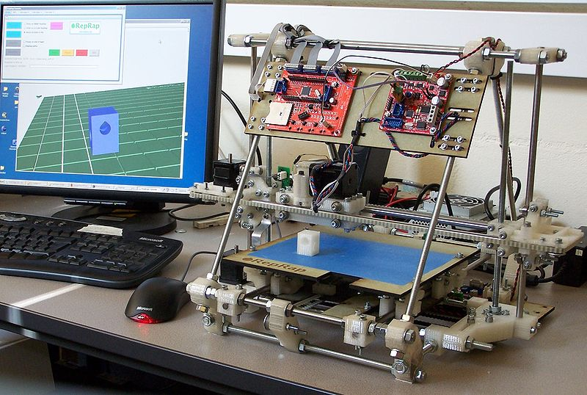
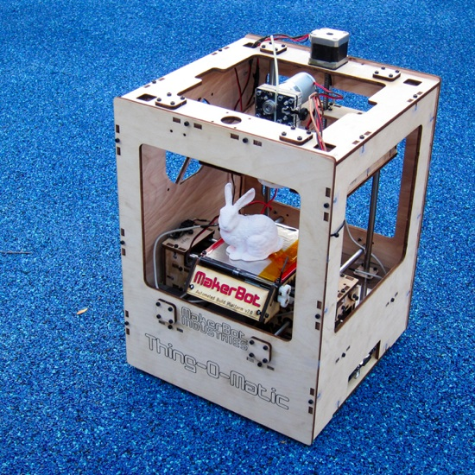


Open source 3D printers
Reprap project: A self-replicant machine (2005)
Makerbot: Start shelling Open Source 3D printer in 2009
Thingiverse: Site for sharing printable objects (2009)
Notes:
A big challenge in robotics is the development of a very versatile mobile robot capable of moving on different terrains.
As a first approach, the study of locomotion of the mobile robots can be divided into two big leves.
The higher level involves the perception of the environment, planning trajectories, navigation and making decisions.
The lower level is in charge of the control and coordination of the joints in order to move the robot a step in any direction. This Locomotion lower level is the scope of the dissertation

Slide 8
Robots for educational purposes
We propose to design robots with the following features:
We propose to design robots with the following features:
We propose to design robots with the following features:
Open source
The design is made publicly available so that anyone can study, modify, distribute, make, and sell the design or hardware based on that design
3D printable
The robot parts can be manufactured by means of an open-source 3D printer
Open source tools
2
The design is created exclusively using open-source tools. This guarantees that there will be no constraints for modifying, sharing or manufacturing
Notes:
A big challenge in robotics is the development of a very versatile mobile robot capable of moving on different terrains.
As a first approach, the study of locomotion of the mobile robots can be divided into two big leves.
The higher level involves the perception of the environment, planning trajectories, navigation and making decisions.
The lower level is in charge of the control and coordination of the joints in order to move the robot a step in any direction. This Locomotion lower level is the scope of the dissertation

Slide 9
A New Open Source 3D-printable Mobile Robotic Platform for Education
Outline
Motivation
Miniskybot Robot
Derivative Robots
Conclusions and future work
6th International Symposium on Autonomous Minirobots for research and Edutainment
Notes:
This presentation is divided into 7 parts. First I will introduce the Locomotion problem and the objectives of the dissertation. Second, I will explain the general classification for all the modular robots. Then I will present the central ideas of the dissertation: Locomotion of limbless robots in 1D, 2D and the locomotion of the minimal configurations. Then I will describe some experiments and we will see some videos and simulations. Finally, the conclusions and future work are summarized.

Slide 10
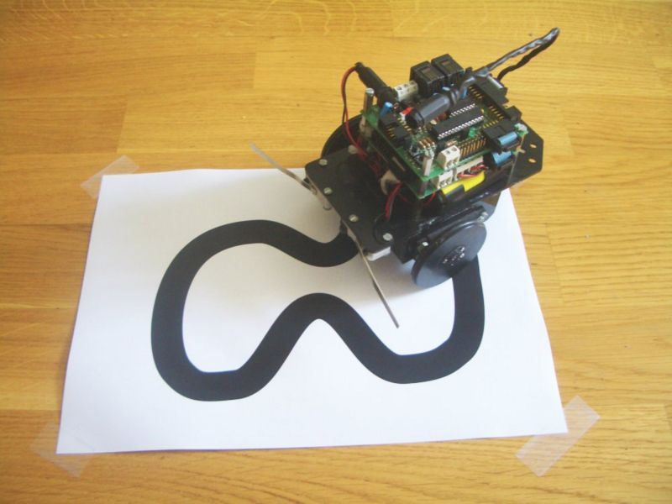
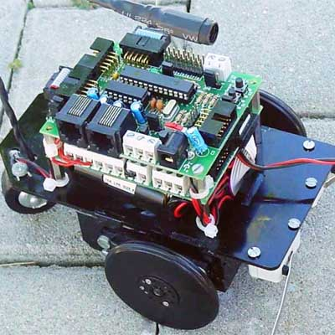
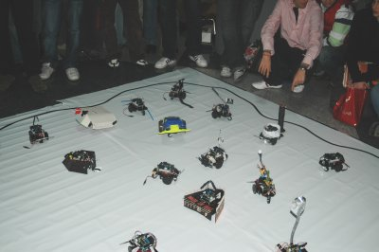
Previous robot: Skybot
Open source robot
Since 2005
Laser cut parts
Microcontroller: PIC16F876A
Chassis not evolved by the students
Notes:
A big challenge in robotics is the development of a very versatile mobile robot capable of moving on different terrains.
As a first approach, the study of locomotion of the mobile robots can be divided into two big leves.
The higher level involves the perception of the environment, planning trajectories, navigation and making decisions.
The lower level is in charge of the control and coordination of the joints in order to move the robot a step in any direction. This Locomotion lower level is the scope of the dissertation

Slide 11
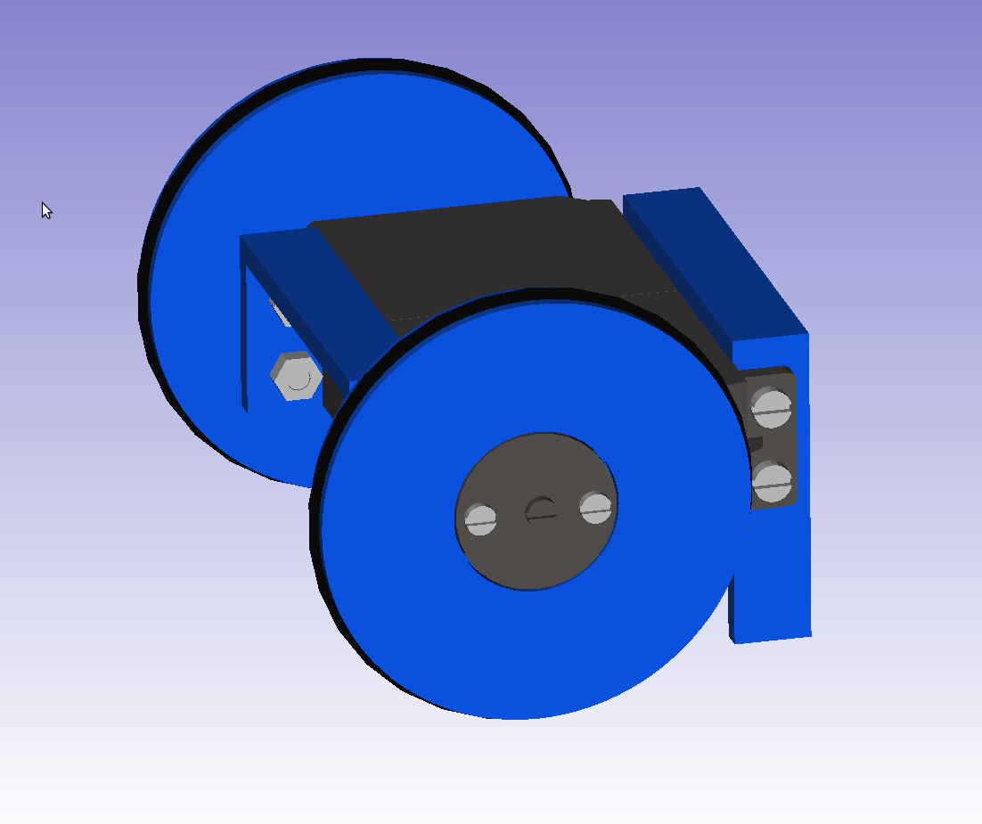
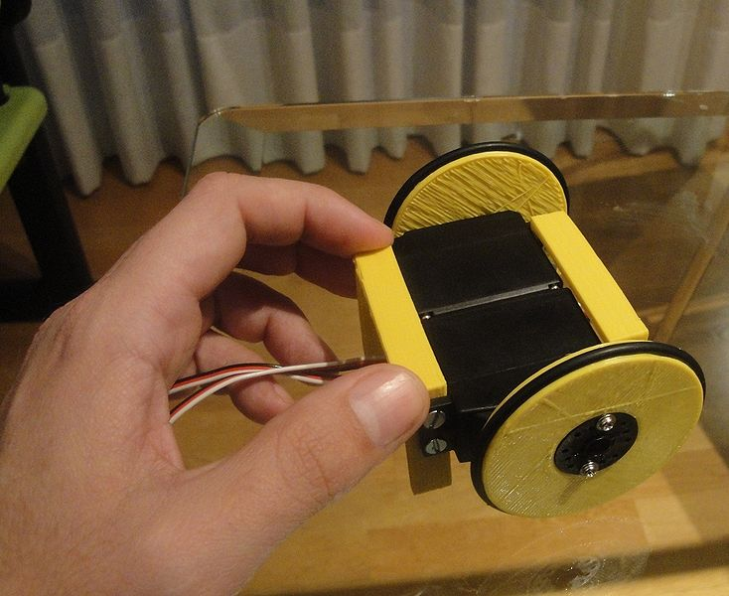
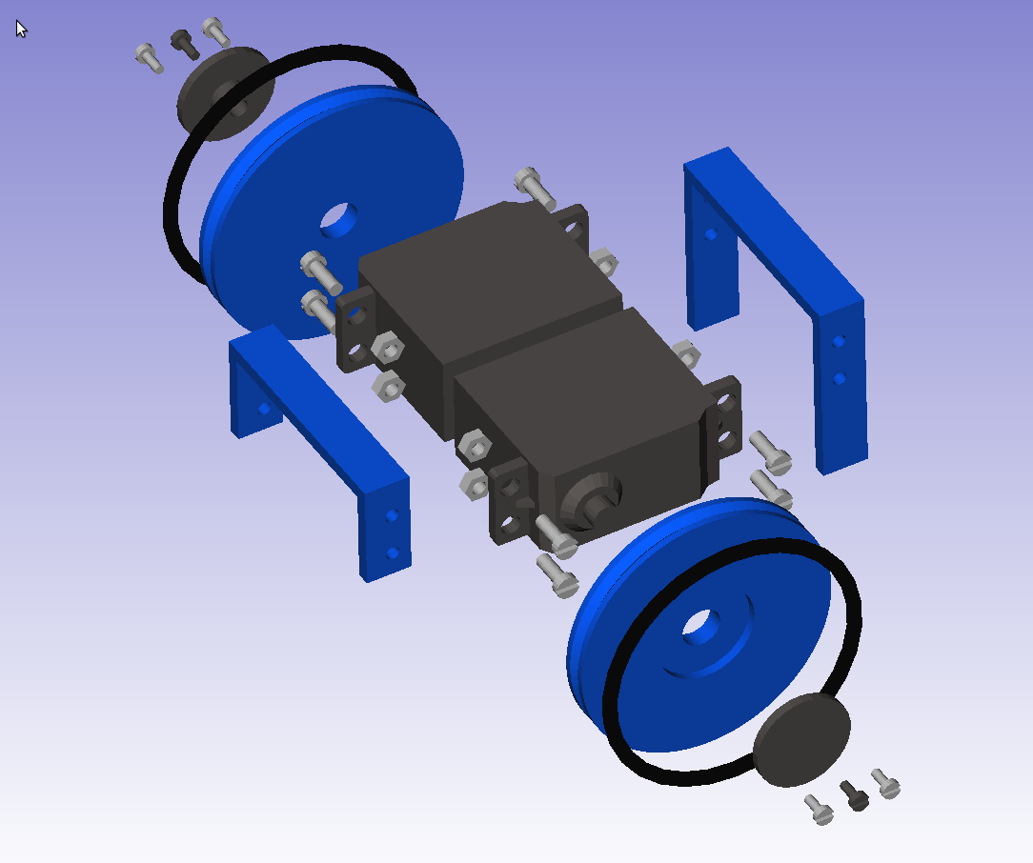
Miniskybot 0.1: Minimal chassis
Learning 3D printing
Viability of printable robots
Minimal chassis for stimulating the students
The evolution starts!
http://www.thingiverse.com/thing:4954
Notes:
A big challenge in robotics is the development of a very versatile mobile robot capable of moving on different terrains.
As a first approach, the study of locomotion of the mobile robots can be divided into two big leves.
The higher level involves the perception of the environment, planning trajectories, navigation and making decisions.
The lower level is in charge of the control and coordination of the joints in order to move the robot a step in any direction. This Locomotion lower level is the scope of the dissertation

Slide 12
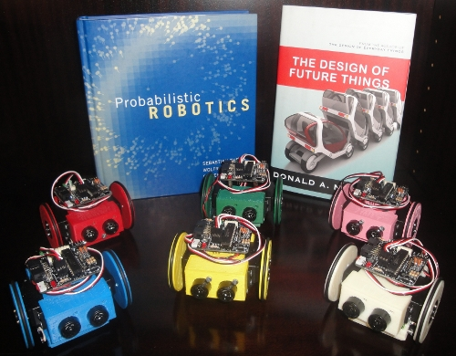
Miniskybot 1.0
Differential robot with castor wheel
Complete robot: chassis + electronics + batteries + sensor
The students can easily modify it
http://www.thingiverse.com/thing:7989
Notes:
A big challenge in robotics is the development of a very versatile mobile robot capable of moving on different terrains.
As a first approach, the study of locomotion of the mobile robots can be divided into two big leves.
The higher level involves the perception of the environment, planning trajectories, navigation and making decisions.
The lower level is in charge of the control and coordination of the joints in order to move the robot a step in any direction. This Locomotion lower level is the scope of the dissertation

Slide 13
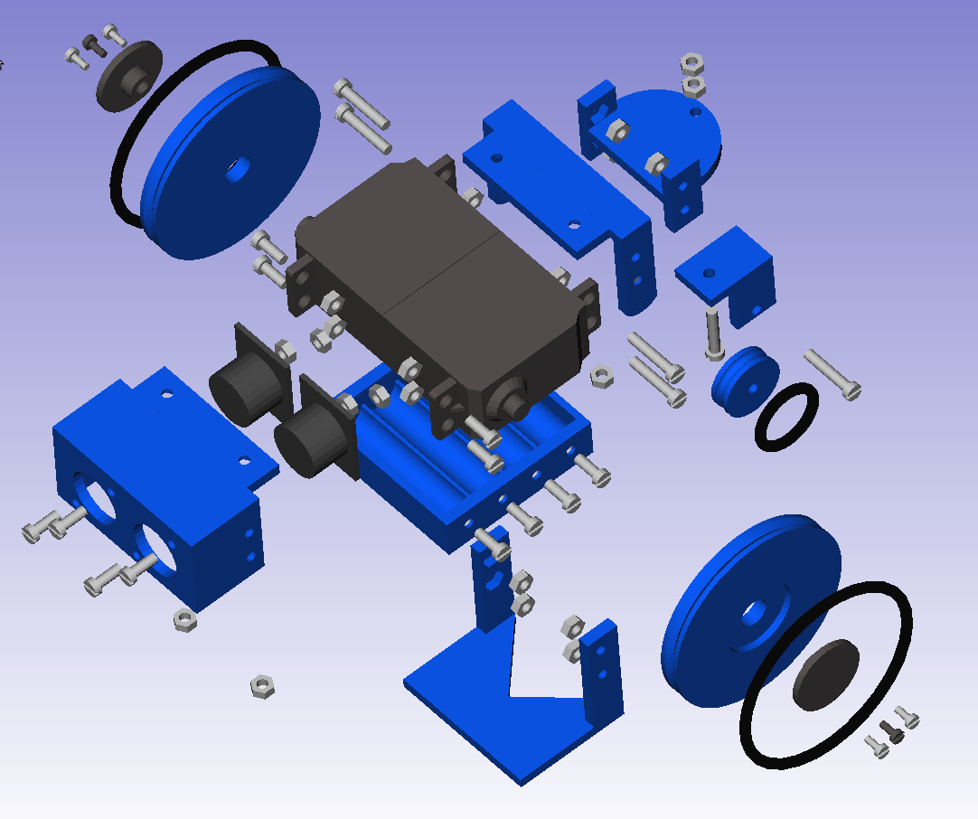
Mechanics
9 printable parts
M3 screws and nuts
O-rings as tyres
Notes:
A big challenge in robotics is the development of a very versatile mobile robot capable of moving on different terrains.
As a first approach, the study of locomotion of the mobile robots can be divided into two big leves.
The higher level involves the perception of the environment, planning trajectories, navigation and making decisions.
The lower level is in charge of the control and coordination of the joints in order to move the robot a step in any direction. This Locomotion lower level is the scope of the dissertation

Slide 14
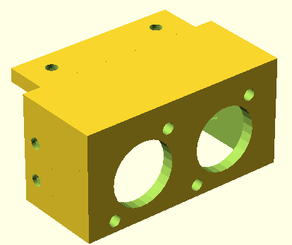
Mechanics: Design tools
The following open-source tools are chosen:
OpenScad
Parts are described by scripts that produce graphical meshes when compiled
module U_front_skycube() {
difference() {
union() {
//-- Main part: U-piece
Futaba_U_union2(bottom_thick=bottom_thick,h=h);
//-- Ear 1
translate([d1_x,0,0])
cube(size=[ear_x-0.01,ear_y,bottom_thick], center=true);
//-- Ear 2
Specially easy and useful for computer science students!
FreeCad
Used for visualizing the robot with all the part
Notes:
A big challenge in robotics is the development of a very versatile mobile robot capable of moving on different terrains.
As a first approach, the study of locomotion of the mobile robots can be divided into two big leves.
The higher level involves the perception of the environment, planning trajectories, navigation and making decisions.
The lower level is in charge of the control and coordination of the joints in order to move the robot a step in any direction. This Locomotion lower level is the scope of the dissertation

Slide 15
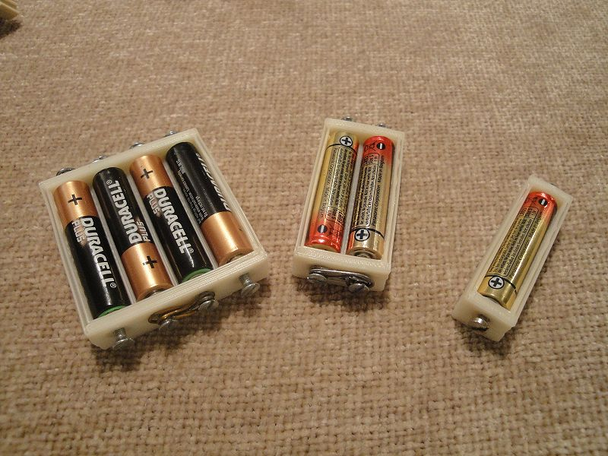

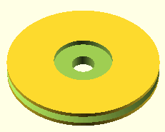
Parametric design
The parts are parametric. New parts can be obtained just changing some parameters in the source code
Examples:
Battery pack:
Type of batteries
Number
Wheels:
Diameter
Height
...
Notes:
A big challenge in robotics is the development of a very versatile mobile robot capable of moving on different terrains.
As a first approach, the study of locomotion of the mobile robots can be divided into two big leves.
The higher level involves the perception of the environment, planning trajectories, navigation and making decisions.
The lower level is in charge of the control and coordination of the joints in order to move the robot a step in any direction. This Locomotion lower level is the scope of the dissertation

Slide 16
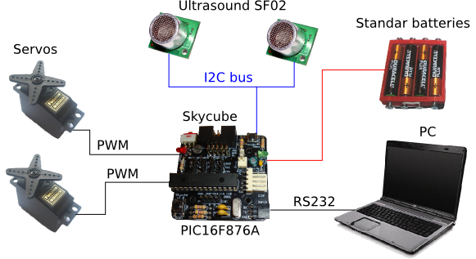
Electronics (I)
Notes:
A big challenge in robotics is the development of a very versatile mobile robot capable of moving on different terrains.
As a first approach, the study of locomotion of the mobile robots can be divided into two big leves.
The higher level involves the perception of the environment, planning trajectories, navigation and making decisions.
The lower level is in charge of the control and coordination of the joints in order to move the robot a step in any direction. This Locomotion lower level is the scope of the dissertation

Slide 17
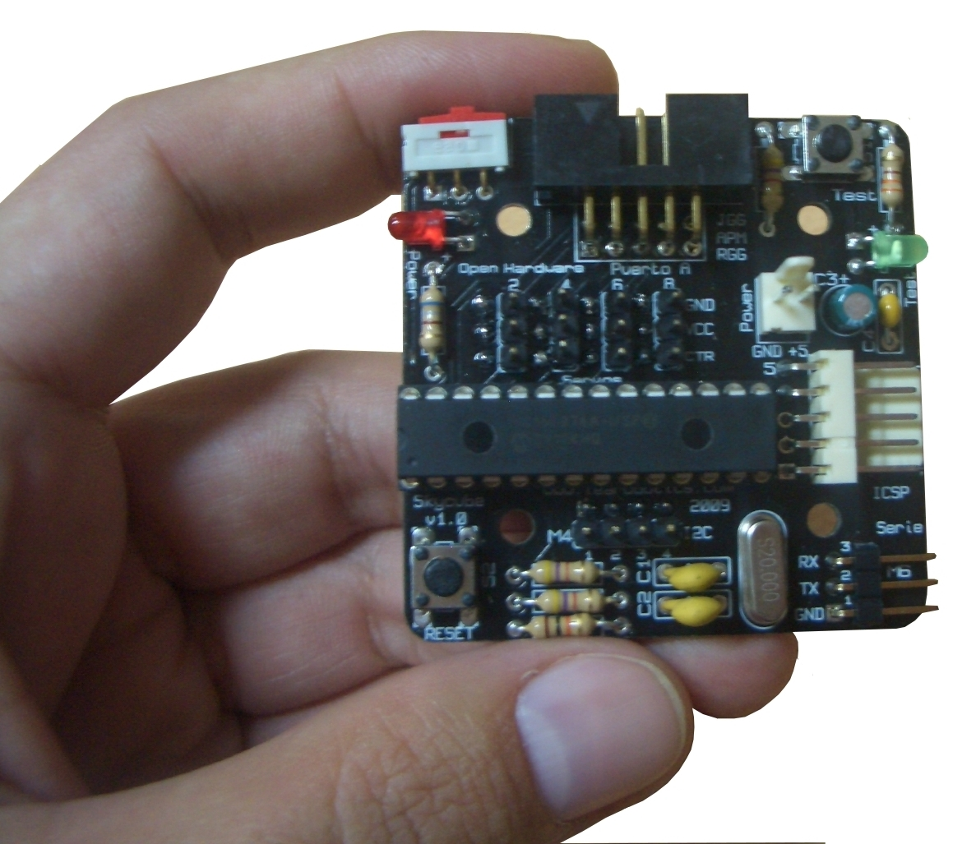
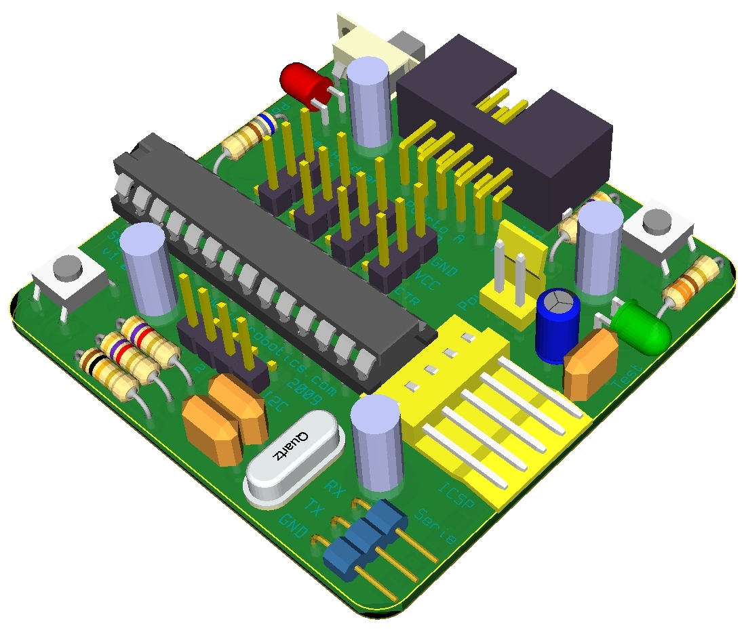
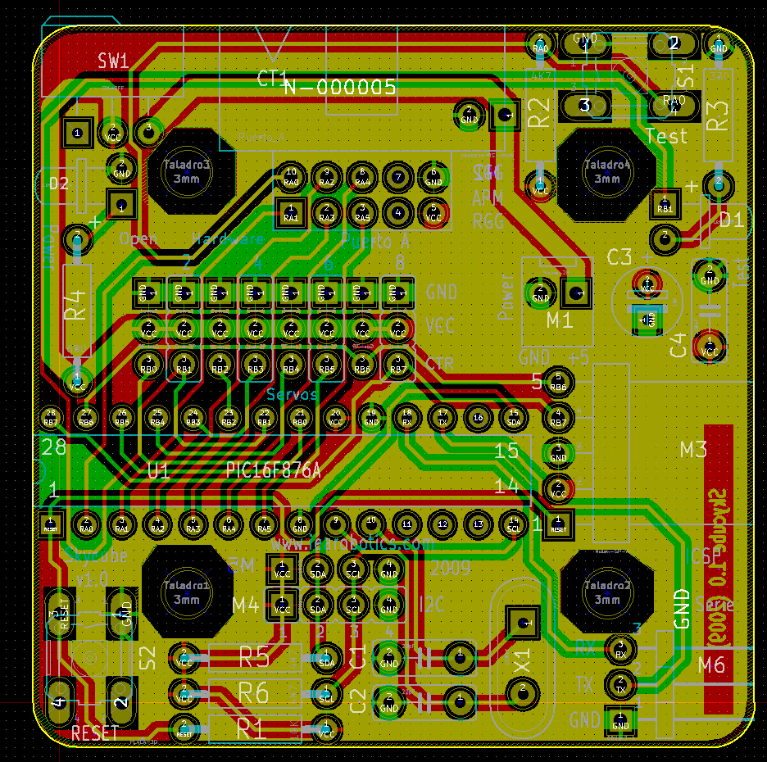
Electronics (II)
Designed with: KICAD
Open source software
Notes:
A big challenge in robotics is the development of a very versatile mobile robot capable of moving on different terrains.
As a first approach, the study of locomotion of the mobile robots can be divided into two big leves.
The higher level involves the perception of the environment, planning trajectories, navigation and making decisions.
The lower level is in charge of the control and coordination of the joints in order to move the robot a step in any direction. This Locomotion lower level is the scope of the dissertation

Slide 18

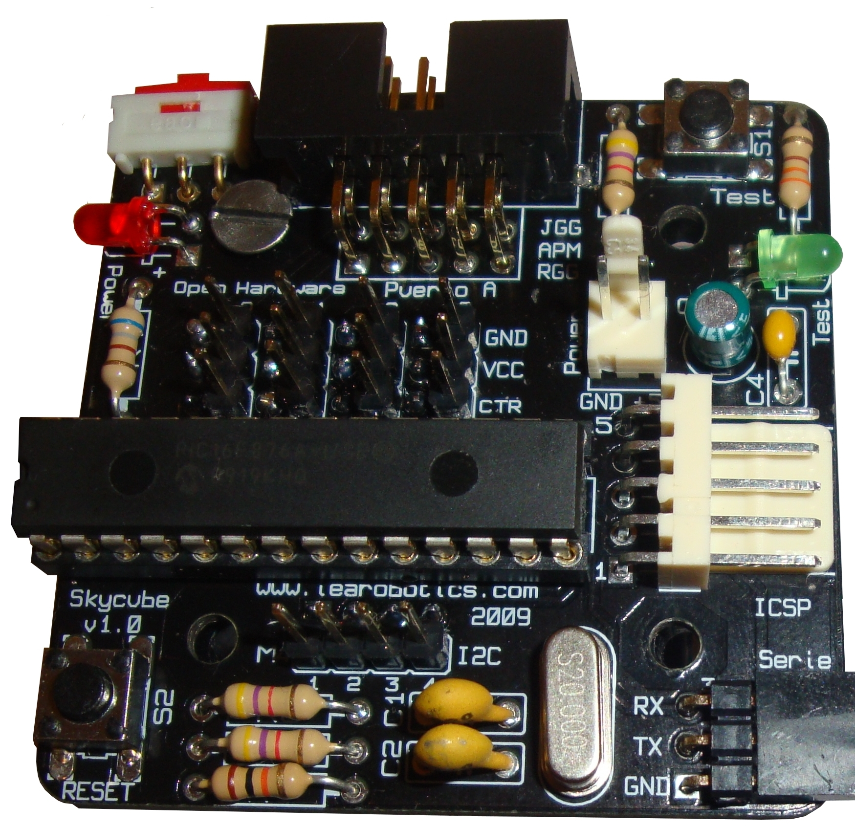
Programming
Robot programmed in C language
Compiler: SDCC (Open source)
Pydownloader: our own downloading application (Open source)
RS-232 cable
Notes:
A big challenge in robotics is the development of a very versatile mobile robot capable of moving on different terrains.
As a first approach, the study of locomotion of the mobile robots can be divided into two big leves.
The higher level involves the perception of the environment, planning trajectories, navigation and making decisions.
The lower level is in charge of the control and coordination of the joints in order to move the robot a step in any direction. This Locomotion lower level is the scope of the dissertation

Slide 19
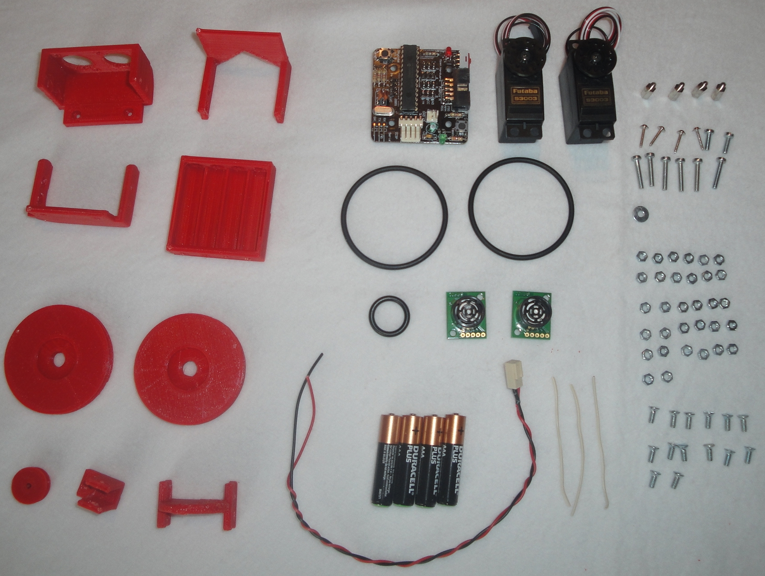
Building the robot
Printable parts
Non Printable parts
Printing time: 3h
Notes:
A big challenge in robotics is the development of a very versatile mobile robot capable of moving on different terrains.
As a first approach, the study of locomotion of the mobile robots can be divided into two big leves.
The higher level involves the perception of the environment, planning trajectories, navigation and making decisions.
The lower level is in charge of the control and coordination of the joints in order to move the robot a step in any direction. This Locomotion lower level is the scope of the dissertation

Slide 20
Cost
Total:
Around 60€
<1€
18€
20€
2.5€
1.5€
2.5€
12€
Notes:
A big challenge in robotics is the development of a very versatile mobile robot capable of moving on different terrains.
As a first approach, the study of locomotion of the mobile robots can be divided into two big leves.
The higher level involves the perception of the environment, planning trajectories, navigation and making decisions.
The lower level is in charge of the control and coordination of the joints in order to move the robot a step in any direction. This Locomotion lower level is the scope of the dissertation

Slide 21
A New Open Source 3D-printable Mobile Robotic Platform for Education
Outline
Motivation
Miniskybot Robot
Derivative robots
Conclusions
6th International Symposium on Autonomous Minirobots for research and Edutainment
Notes:
This presentation is divided into 7 parts. First I will introduce the Locomotion problem and the objectives of the dissertation. Second, I will explain the general classification for all the modular robots. Then I will present the central ideas of the dissertation: Locomotion of limbless robots in 1D, 2D and the locomotion of the minimal configurations. Then I will describe some experiments and we will see some videos and simulations. Finally, the conclusions and future work are summarized.

Slide 22
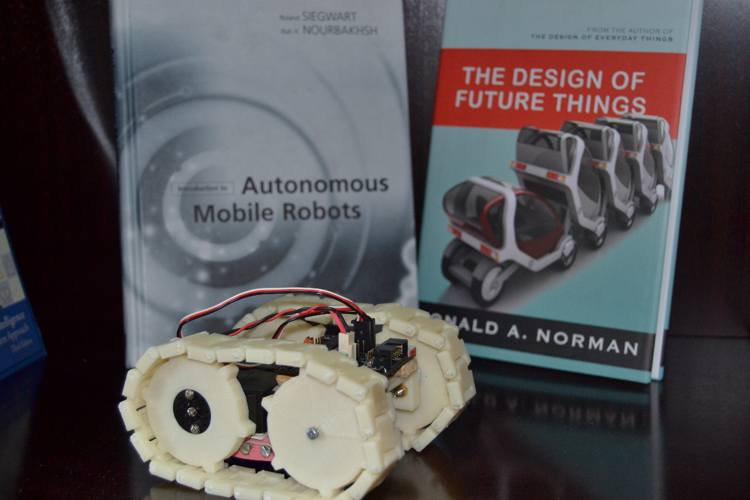
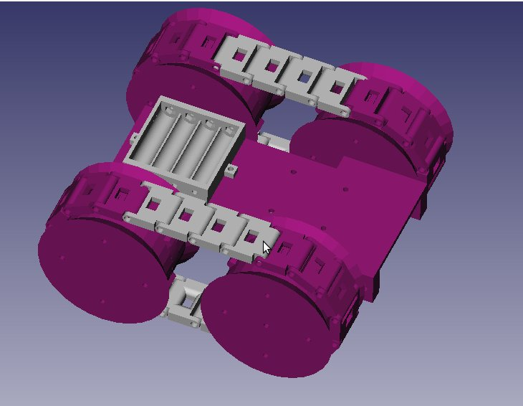
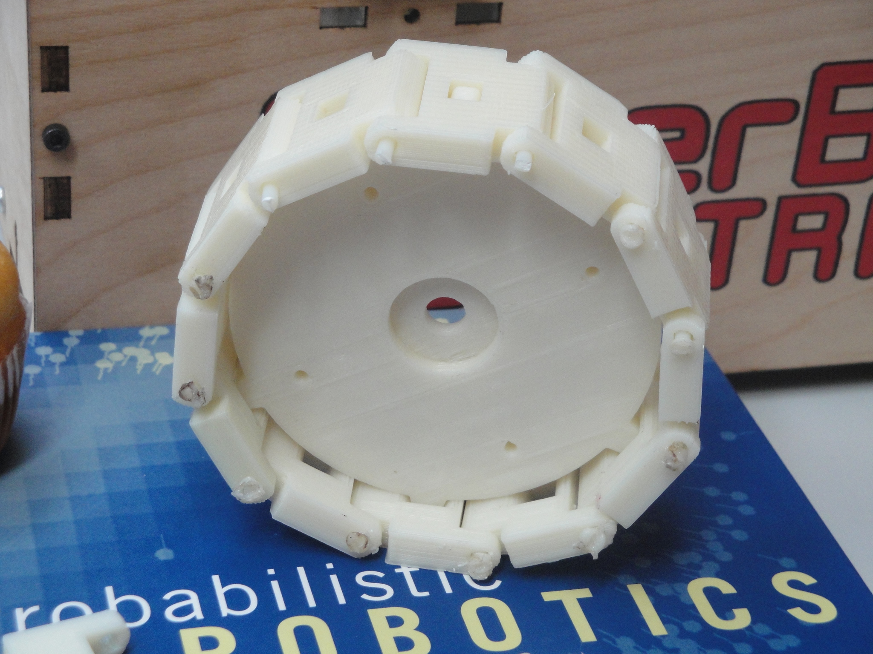
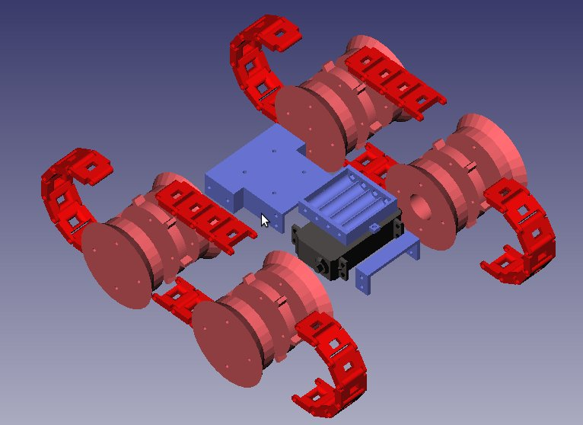
Tracked robot
http://www.thingiverse.com/thing:8559
Notes:
A big challenge in robotics is the development of a very versatile mobile robot capable of moving on different terrains.
As a first approach, the study of locomotion of the mobile robots can be divided into two big leves.
The higher level involves the perception of the environment, planning trajectories, navigation and making decisions.
The lower level is in charge of the control and coordination of the joints in order to move the robot a step in any direction. This Locomotion lower level is the scope of the dissertation

Slide 23
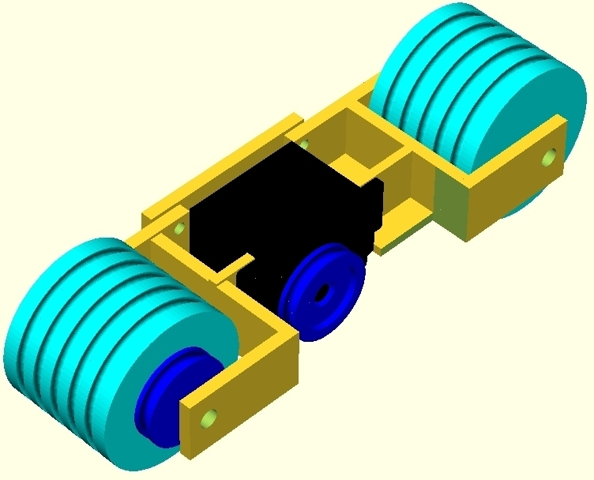
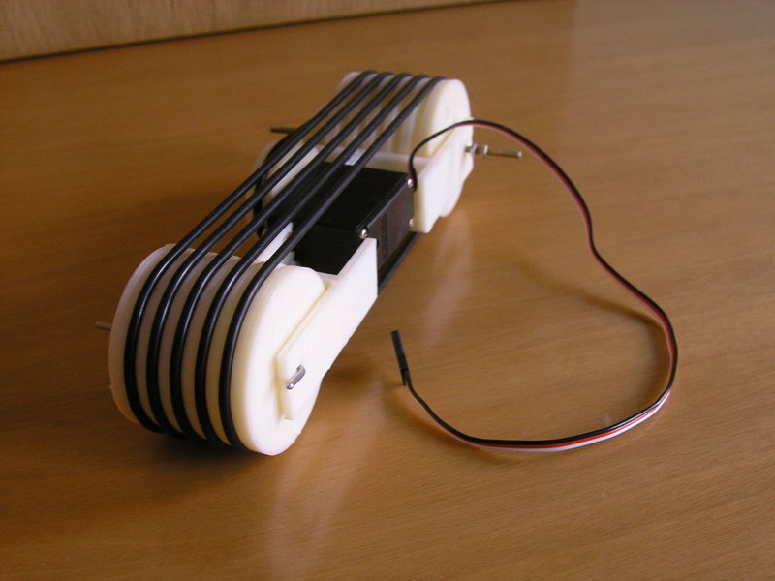
Unitrack
http://www.thingiverse.com/thing:7640
Notes:
A big challenge in robotics is the development of a very versatile mobile robot capable of moving on different terrains.
As a first approach, the study of locomotion of the mobile robots can be divided into two big leves.
The higher level involves the perception of the environment, planning trajectories, navigation and making decisions.
The lower level is in charge of the control and coordination of the joints in order to move the robot a step in any direction. This Locomotion lower level is the scope of the dissertation

Slide 24
A New Open Source 3D-printable Mobile Robotic Platform for Education
Outline
Motivation
Miniskybot Robot
Derivative robots
Conclusions and future work
6th International Symposium on Autonomous Minirobots for research and Edutainment
Notes:
This presentation is divided into 7 parts. First I will introduce the Locomotion problem and the objectives of the dissertation. Second, I will explain the general classification for all the modular robots. Then I will present the central ideas of the dissertation: Locomotion of limbless robots in 1D, 2D and the locomotion of the minimal configurations. Then I will describe some experiments and we will see some videos and simulations. Finally, the conclusions and future work are summarized.

Slide 25
Conclusions
3 requirements: Open source, 3D-printable, Open source tools
Very low cost
Very easy to modify
Evolutionary robot
A good candidate for educational porpouses
Future work
Creation of comunities around it
Continue evolving the robot
Electronic compatible with Arduino (ATMEGA microcontroller)
Building Repraps 3D printers for the students
Notes:
A big challenge in robotics is the development of a very versatile mobile robot capable of moving on different terrains.
As a first approach, the study of locomotion of the mobile robots can be divided into two big leves.
The higher level involves the perception of the environment, planning trajectories, navigation and making decisions.
The lower level is in charge of the control and coordination of the joints in order to move the robot a step in any direction. This Locomotion lower level is the scope of the dissertation

Slide 26
A New Open Source 3D-printable Mobile
Robotic Platform for Education
Juan Gonzalez-Gomez, Alberto Valero Gomez,
Andres Prieto-Moreno, Mohamed Abderrahim
Robotics Lab
Carlos III University of Madrid
6th International Symposium on Autonomous Minirobots for research and Edutainment
Centre for Interdisciplinary Research, University of Bielefeld, Germany
2011/May/23
Notes:
Thanks Prof. Matellan. I am going to start the presentation of my Dissertation which is about the Locomotion of Limbless Modular robots

