Slide 1
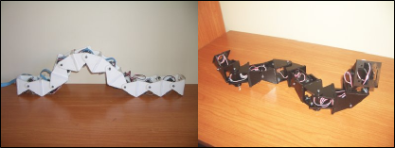
Modular Robotics and Locomotion:
Application to Limbless Robots
Juan González Gómez
Ph.D. Thesis
Supervisor: Dr. Eduardo Boemo Scalvinoni
Notes:
Thanks Prof. Matellan. I am going to start the presentation of my Dissertation which is about the Locomotion of Limbless Modular robots

Slide 2
Outline
Outline
Introduction and Objectives
Classification
Locomotion in 1D
Locomotion in 2D
Minimal configurations
Experiments
Conclusions and future work
Modular Robotics and Locomotion: Application to Limbless Robots
Notes:
This presentation is divided into 7 parts. First I will introduce the Locomotion problem and the objectives of the dissertation. Second, I will explain the general classification for all the modular robots. Then I will present the central ideas of the dissertation: Locomotion of limbless robots in 1D, 2D and the locomotion of the minimal configurations. Then I will describe some experiments and we will see some videos and simulations. Finally, the conclusions and future work are summarized.

Slide 3
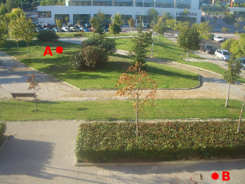
1.- Introduction
The Locomotion Problem
Development of a very versatile robot with the full capability of moving on different terrains.
Higher Level:
  Perception of the environment
  Planning trajectories
  Navigation
  Making decisions
Lower Level:
  Coordination of the articulations
  Robot morphology (Limbs, wheels,...)
  Gaits
Scope of this thesis
Modular Robotics and Locomotion: Application to Limbless Robots
Notes:
A big challenge in robotics is the development of a very versatile mobile robot capable of moving on different terrains.
As a first approach, the study of locomotion of the mobile robots can be divided into two big leves.
The higher level involves the perception of the environment, planning trajectories, navigation and making decisions.
The lower level is in charge of the control and coordination of the joints in order to move the robot a step in any direction. This Locomotion lower level is the scope of the dissertation

Slide 4
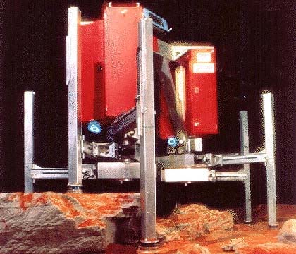

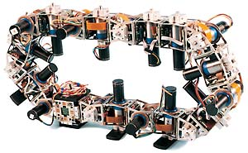
1.- Introduction
The locomotion problem (II)
Classic approach:
New approach: (Yim, 1995)
Self-reconfigurable Modular Robots
Study the terrain
Design the robot's structure
Gait realization
Consist of equal modules
Their shape is adapted to the terrain
Polybot experiment
four legs
Wheel
(CMU Ambler, Krotkov et al,1995)
(Polybot, Yim et al, 2000)
Modular Robotics and Locomotion: Application to Limbless Robots
Notes:
The classic approach for designing mobile robots is first study the terrain in which the robot will be deploy. Then designing an adequate robot structure, using wheels, tracks or limbs and Finally implementing the gaits. An example was the design of the CMU ambler for the mar's surface exploration. It was funded by the NASA.
In 1995, Mark Yim proposed in this dissertation a new approach: the self-reconfigurable modular robots. These are robots composed of equals modules. They have the ability of changing their shape so that it can be adapted to the terrain. The first prototype was polybot. In one of the experiments the robot moves like a wheel on a flat surface and then it is transformed into a four leg robot. It is the same robot but with a different morphology.

Slide 5
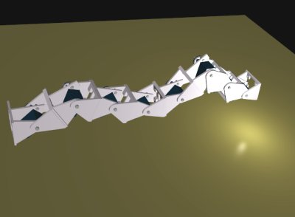


1.- Introduction
Morphology
Each morphology has its own locomotion capabilities that should be studied
The number of configurations growth exponentially with the number of modules
Solution: A Classification should be established
This dissertation is focused on the 1D topology modular robot group
Modular Robotics and Locomotion: Application to Limbless Robots
Notes:
One important aspect is the morphology. Each morphology has its own locomotion capabilities that should be studied. The problem is that the number of configurations growth exponentially with the modules. The solution is to established a classification and to study the locomotion capabilities of the different groups. In this dissertation the group of the 1D topology modular robots is studied.

Slide 6
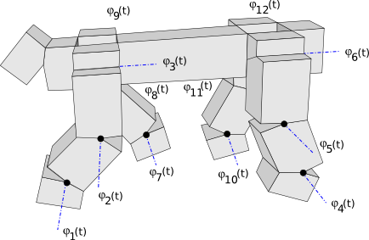
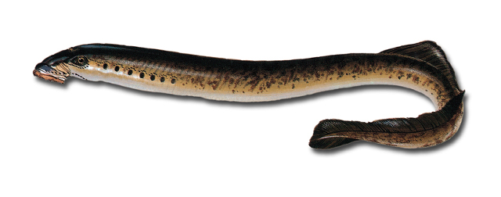
1.- Introduction
Controller
Coordination problem:
Calculation of the joint's angles to realize a gait:
Classic approach: Mathematical modelling
  Calculation by inverse kinematics
  Disadvantages: The equations are only valid for an specific morphology
CPG
CPG
CPG
Bio-inspired controllers: CPGs
  Central Pattern Generators
  CPGs control the rhythmic activities
  Ej. The locomotion of the lamprey
Modular Robotics and Locomotion: Application to Limbless Robots
Notes:
Another important aspect is the controller. It is in charge of calculating the joint's angles to make the robot move.
The classic approach is the mathematical modelling of the robot and the calculation of the angles by inverse kinematics. The disadvantage is that it is only valid for an specific morphology and a lot of computations should be done, so it requires more resources than other approaches for its implementation
Another approach is the use of bio-inspired controllers. In the 60ths....

Slide 7
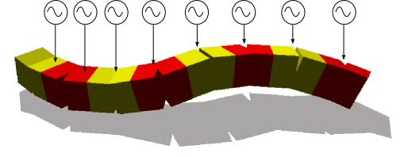
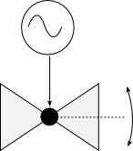
1.- Introduction
Hypothesis: Sinusoidal oscillators
CPGs are replaced by a Simplified model
CPG
CPG
CPG
Sinusoidal oscillators:
Advantages:
  Few resources required
Modular Robotics and Locomotion: Application to Limbless Robots

Slide 8
1.- Introduction
Objectives
Feasibility of the control model
Locomotion gaits
Characterization
Minimal configurations
Kinematics
Study the locomotion of the 1D Topology pitch-pitch and pitch-yaw connecting modular robots of any length in one and two dimensions
Modular Robotics and Locomotion: Application to Limbless Robots

Slide 9
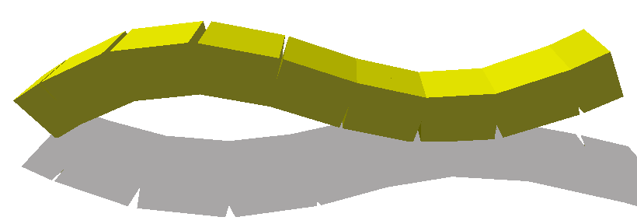
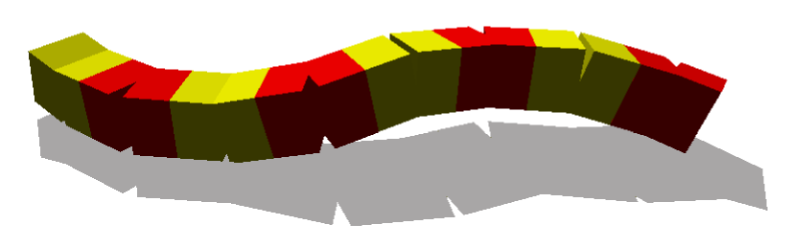
1.- Introduction
Restrictions
Groups of study:
Pitch-pitch connection
Pitch-yaw connection
Steady state
Flat homogeneous surfaces without obstacles
Open loop control
Modules without sensors
Modular Robotics and Locomotion: Application to Limbless Robots
Notes:
but some restrictions have been applied:
* The study is restricted to the pitch-pitch and pitch-yaw connecting modular robots
* The locomotion is analyzed in the steady state, when the robots move on flat homogeneous surfaces without any obstacles
* The control is perform in open loop, so there is no sensors in the modules.

Slide 10
Outline
Outline
Introduction and objectives
Classification
Locomotion in 1D
Locomotion in 2D
Minimal configurations
Experiments
Conclusions and future work
Modular Robotics and Locomotion: Application to Limbless Robots

Slide 11
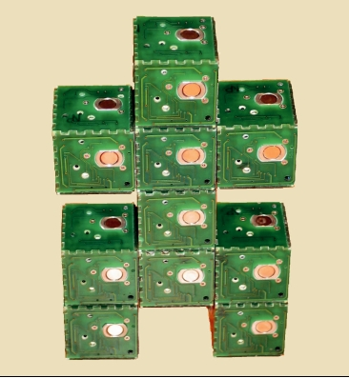

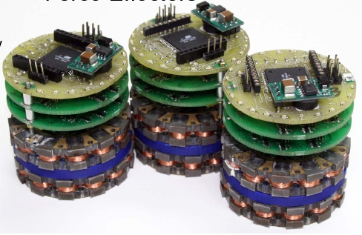
2.- Classification
Modular Robots classification (I)
Modular Robots
(Yim et al.)
Lattice Robots
Chain Robots
Hybrid
2D
3D
(Catom, Goldstein et al., 2005)
(Miche, Rus et al., 2006)
(M-TRAN, Murata et al.,2005 )
Modular Robotics and Locomotion: Application to Limbless Robots
Notes:
First, the modular robots can be divided into three main groups. It was proposed by Yim.
The first group is the lattice robots, which comprises the modular robots that have been designed to build solid objects. The modules acts like athom or molecus that can form solid structures in 2D and 3D.
The second group is the Chain Robot, which contains all the modular robots that are build from the union of chain of modules. Ej. 4 legged robot.
The third group is Hybrid group that comprises those modular robots capables of buildind solid structures (lattice) and Chain robots. One of the most advanced modular robots is M-TRAN

Slide 12
2.- Clasification
Modular Robots classification (II)
Chain Robots
1D Topology
2D Topology
3D Topology
Modular Robotics and Locomotion: Application to Limbless Robots

Slide 13
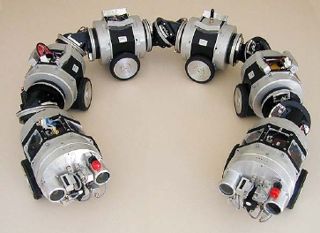
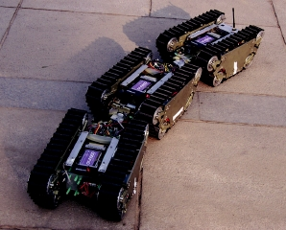
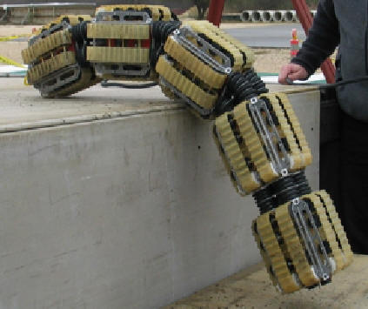
2.- Clasification
Modular Robots classification (III)
1D Topology
(Granosik et al)
Snake Robots
Serpentine Robots
Wheels
Tracks
(Makro, Rome et al,99)
(JL-I, Zhang et al, 06)
(Omnitread,
Granosik et al, 05)
Modular Robotics and Locomotion: Application to Limbless Robots

Slide 14
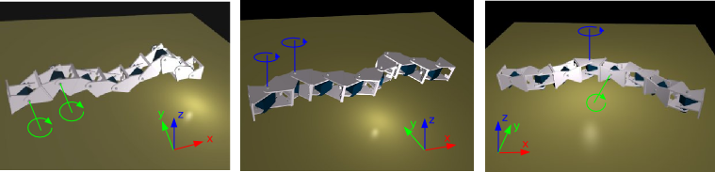
2.- Classification
Modular Robots classification (IV)
Snake Robots
Pitch-Pitch
Yaw-Yaw
Pitch-Yaw
Studied groups in this thesis
(The whole classification map can be found in page 46)
Modular Robotics and Locomotion: Application to Limbless Robots

Slide 15
Outline
Outline
Introduction and objectives
Classification
Locomotion in 1D
Locomotion in 2D
Minimal configurations
Experiments
Conclusions and future work
Modular Robotics and Locomotion: Application to Limbless Robots
Notes:
Now I am going to talk about the locomotion of the pitch-pitch connecting modular robots, which only can move in one dimension

Slide 16
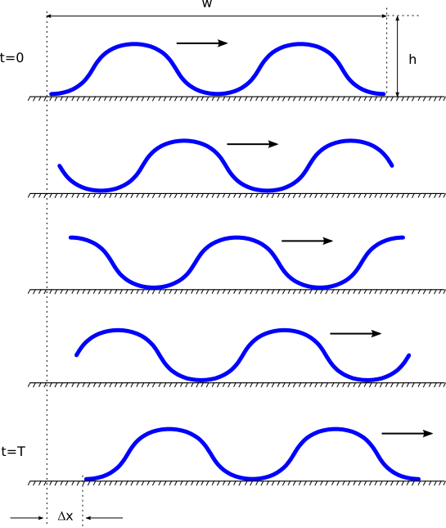
3.- Locomotion in 1D
Locomotion mechanism
Locomotion performed by the body wave propagation
Step:
Mean Speed:
Size: width (w) x heigth (h)
Modular Robotics and Locomotion: Application to Limbless Robots
Notes:
The locomotion of these robots is performed by the propagation of a body wave that goes from the tail to the head of the robot.
After one period, the wave has been propagated and the robot has moved a distance that we call a step.
The velocity of movement depends on the frequency of the oscillations. The mean velocity in one cycle can be calculated by dividing the step between the oscillation period.
The size of the robot while moving are determined by the size of the body wave: width and height.

Slide 17
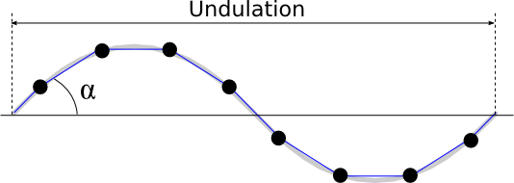
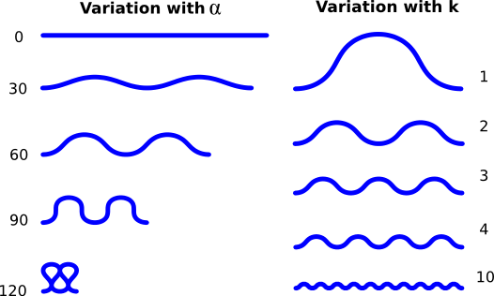
3.- Locomotion in 1D
Shape of the Body wave
Serpenoid curve
  When Sin. oscillations applied
  (Hirose, 1975)
  Snakes: Horizontal serpenoid curve
  Pitch-pitch group: Vertical serpenoid curve
Parameters:
  Winding angle:
  Number of undulations: k
Modular Robotics and Locomotion: Application to Limbless Robots
Notes:
When the sinusoidal oscillators model is used to control the robot, the shape of the body wave is a serpenoid curve.
This curve was discovered by prof. Hirose in 1975 when he was studying the locomotion of the real snakes. They uses a horizontal serpenoid curve for the locomotion. But in the robot we are studying the wave is in a vertical plane. The locomotion principles are different but the waves have the same shape.

Slide 18
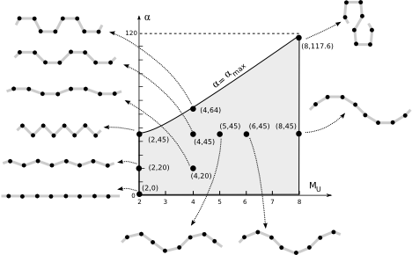
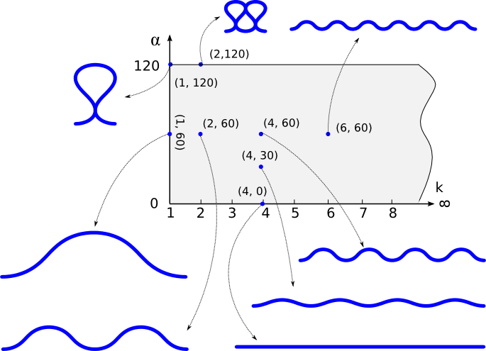
3.- Locomotion in 1D
Shape space
We propose to represent the all the body waves as points in the shape space
Continuous
Discrete
Ej. M=8
Modular Robotics and Locomotion: Application to Limbless Robots
Notes:
We propose to represent all the possible body waves as points in what we call the shape space.
The dimension of the shape space is 2
There are two spaces: for the continuos and discrette robots. The discrette shape space is smaller because there appear mechanical restrictions. The joint's angles have a maximum value.

Slide 19
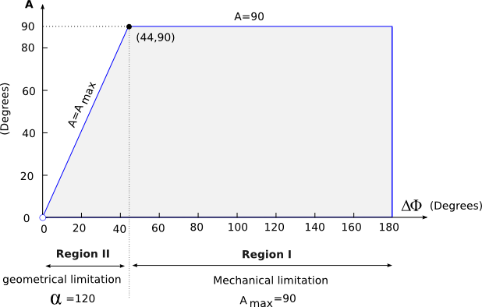
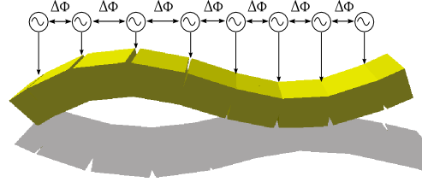
3.- Locomotion in 1D
Control space
Robot are controlled by means of M equal sinusoidal oscillators
The same frequency
The same amplitude A
The same phase difference
Only two parameters are needed:
  Amplitude: A
  Phase difference:
Modular Robotics and Locomotion: Application to Limbless Robots
Notes:
The robots are controlled by means of M equal sinusoidal oscillators. Each one controlling the oscillation of one module. All the generators are the same, with the same parameters.
For studying the coordination, only two parameters are needed: A, DF. The frequency does not affect the coordination, but the velocity.
Again we proposed to represent the oscillations as points in what we call the control space. Each points corresponds to a different joint oscillation.

Slide 20
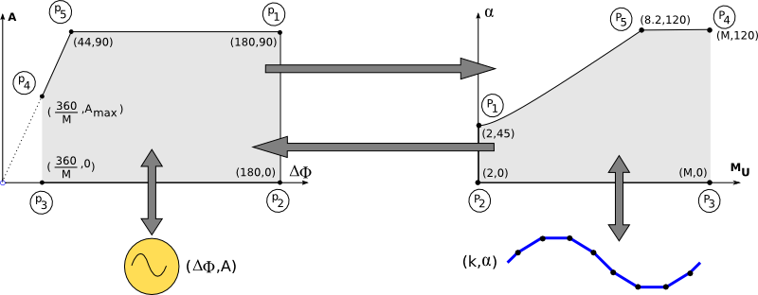
3.- Locomotion in 1D
Kinematics
Direct and Inverse Kinematics problems
Solutions by means of a space transformation
The constraints are set in the shape space (robot dimensions and step)
Control Space
Shape Space
Direct kinematics
Inverse kinematics
Modular Robotics and Locomotion: Application to Limbless Robots
Notes:
For studying the direct and inverse Kinematics we propose to establish relationships between the control spaces and the Shape space. The control space determines the oscillations and the shape space the shape of the robot (size and step).

Slide 21
3.- Locomotion in 1D
Kinematics (II)
Transformations:
Dimensions:
Step:
No analytical solutions
Modular Robotics and Locomotion: Application to Limbless Robots

Slide 22
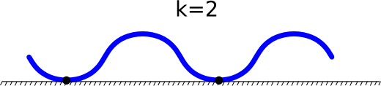
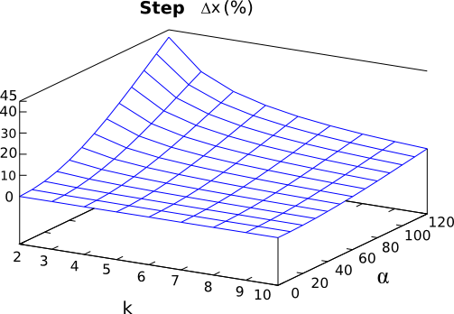
3.- Locomotion in 1D
Step characterization
Stability: k>=2
Step equation:
Deduction from the robot shape
The step increases with
The step decreases with k
Biggest step:
Modular Robotics and Locomotion: Application to Limbless Robots
Notes:
Our goal is to characterize the step of the robot. First the locomotion should be stable. That means that the k parameters should be greater than two. Second we have proposed and equation for the step.
In this picture the step is represented as a function of the points of the shape space. It can be seen that the points in which the step is bigger correspond to 120 and k=2.
Also we can see that the step increases with alfa and decreasea with k.

Slide 23
Outline
Outline
Introduction
Classification
Locomotion in 1D
Locomotion in 2D
Minimal configurations
Experiments
Conclusions and future work
Modular Robotics and Locomotion: Application to Limbless Robots

Slide 24
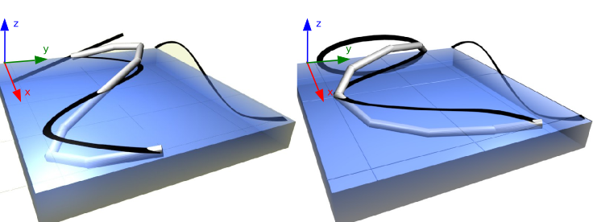
4.- Locomotion in 2D
Locomotion mechanism
3D Body wave propagation
Linear Step:
Angular Step:
Dimensions: width (w) x length (lx) x heigth (h)
Modular Robotics and Locomotion: Application to Limbless Robots

Slide 25
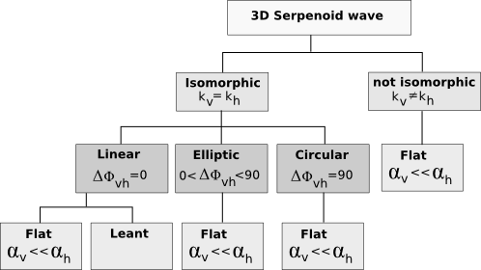
4.- Locomotion in 2D
Shape space
Superposition of two bidimensional waves:
  Vertical wave:
  Horizontal wave:
  Phase difference:
The relationship between the parameters determines the type of wave
TYPE OF WAVES
The Shape space has
5 dimensions
Modular Robotics and Locomotion: Application to Limbless Robots

Slide 26
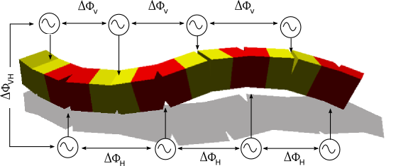
4.- Locomotion in 2D
Control space
Vertical and horizontal oscillators
Equal horizontal oscillators:
Equal vertical oscillators:
Phase difference between vertical and horizontal:
The same period T
The control space has 5 dimensions
Modular Robotics and Locomotion: Application to Limbless Robots

Slide 27
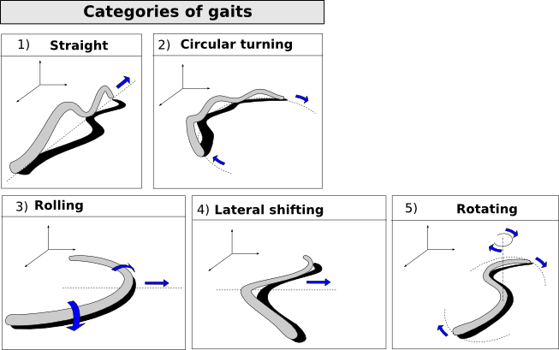
4.- Locomotion in 2D
Locomotion gaits
Searching: Genetic algorithms
5 categories of gaits
Characterized by the 3D body wave
Modular Robotics and Locomotion: Application to Limbless Robots

Slide 28
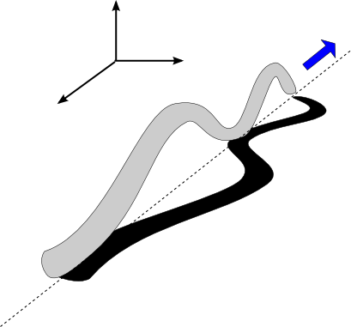
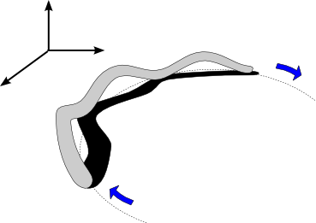
4.- Locomotion in 2D
Locomotion gaits (II)
Straight
Circular turning
Horizontal modules:
Parameters:
Horizontal modules:
Parameters:
Modular Robotics and Locomotion: Application to Limbless Robots

Slide 29
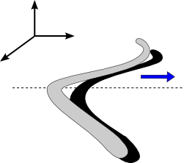
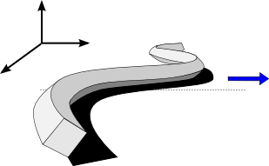
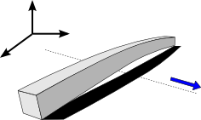
4.- Locomotion in 2D
Locomotion gaits (III): Lateral shifting
Side-winding
Inclined side-winding
Flapping
Characterization:
Characterization:
Characterization:
DOF:
DOF:
DOF:
New
Modular Robotics and Locomotion: Application to Limbless Robots

Slide 30
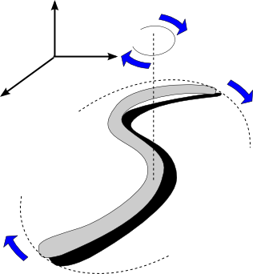
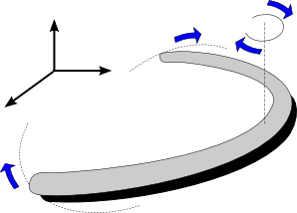
4.- Locomotion in 2D
Locomotion gaits (IV): Rotating
S shaped rotation
U-shaped rotation
Characterization:
Characterization:
DOF:
DOF:
New
New
Modular Robotics and Locomotion: Application to Limbless Robots

Slide 31
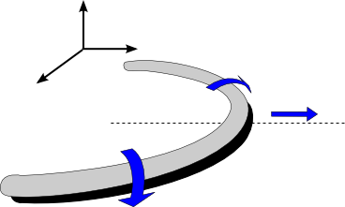
4.- Locomotion in 2D
Locomotion gaits (V)
Rolling
Flapping
Characterization:
If the section is a square, the flapping gaits is achieved when:
DOF:
Modular Robotics and Locomotion: Application to Limbless Robots

Slide 32
Outline
Outline
Introduction and objectives
Classification
Locomotion in 1D
Locomotion in 2D
Minimal configurations
Experiments
Conclusions and future work
Modular Robotics and Locomotion: Application to Limbless Robots

Slide 33
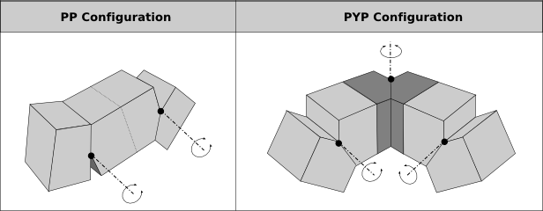
5.- Minimal configurations
Minimal configurations
Configurations with the minimal number of modules that are able to move
Searching the control space using genetic algorithms
Straight line
5 gaits
Modular Robotics and Locomotion: Application to Limbless Robots

Slide 34
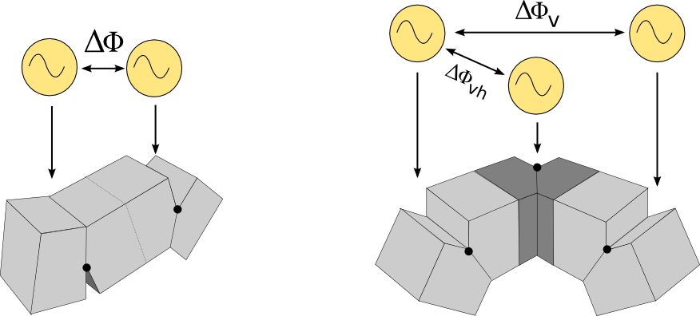
5.- Minimal configurations
Control space
2 dimensions space
4 dimensions space
Modular Robotics and Locomotion: Application to Limbless Robots

Slide 35
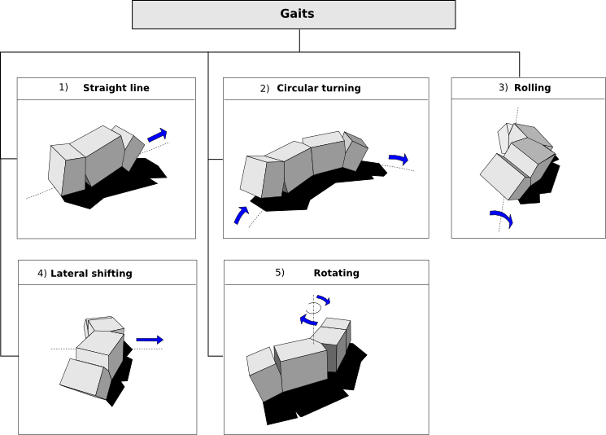
5.- Minimal configurations
Modular Robotics and Locomotion: Application to Limbless Robots

Slide 36
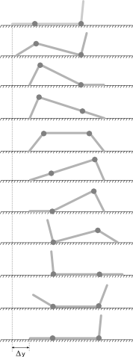
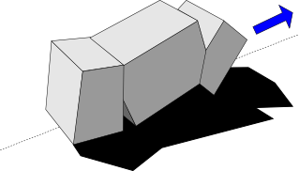
5.- Minimal configurations
Locomotion gaits (II): Straight line
Study of the wired-model
Best coordination:
Maximum step: Best coordination + A=90
Modular Robotics and Locomotion: Application to Limbless Robots

Slide 37
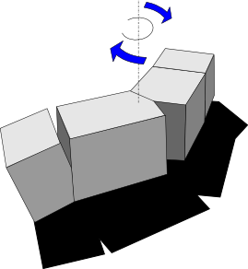
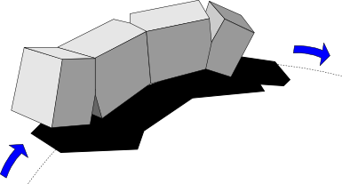
5.- Minimal configurations
Locomotion gaits (III)
Rotating
Circular turning
Characterization:
Characterization:
DOF:
DOF:
Modular Robotics and Locomotion: Application to Limbless Robots

Slide 38
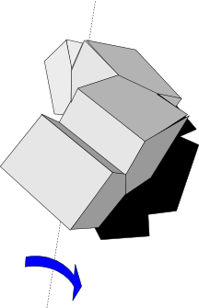
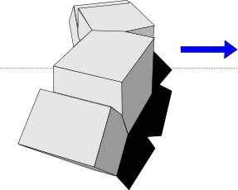
5.- Minimal configurations
Locomotion gaits (VI)
Lateral shifting
Rolling
Characterization:
Characterization:
DOF:
DOF:
Modular Robotics and Locomotion: Application to Limbless Robots

Slide 39
Outline
Outline
Introduction
Classification
Locomotion in 1D
Locomotion in 2D
Minimal configurations
Experiments
Conclusions and future work
Modular Robotics and Locomotion: Application to Limbless Robots

Slide 40
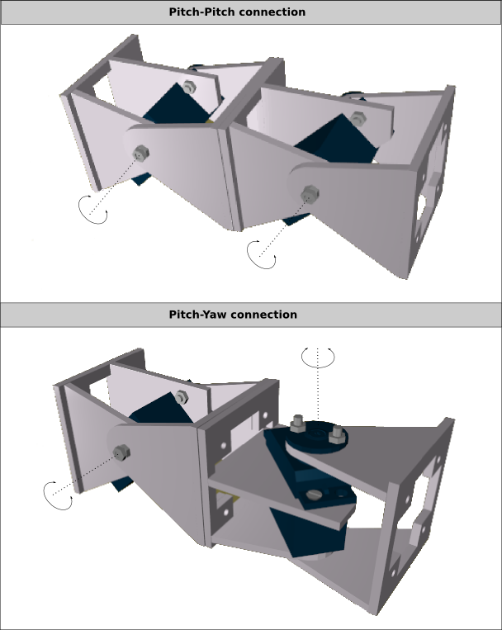
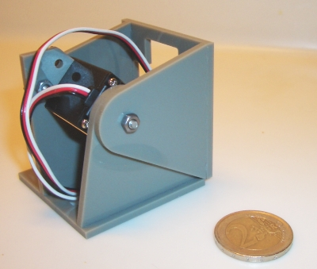

7.- Experiments
Y1 Modules
One degree of freedom
Easy to build
Cheap
Open and “Free”
Modular Robotics and Locomotion: Application to Limbless Robots

Slide 41

7.- Experiments
Modular Robots Prototypes
Modular Robotics and Locomotion: Application to Limbless Robots

Slide 42

7.- Experiments
Robot controlling
Modular Robotics and Locomotion: Application to Limbless Robots

Slide 43


7.- Experiments
Software
1D topology simulator (Based on Open Dynamics Engine [ODE])
Generics algorithms: PGAPack
Mathematical models in Octave/Matlab
Modular Robotics and Locomotion: Application to Limbless Robots

Slide 44

7.- Experiments
Experiments description
Simulation:
  Continuous model locomotion
  Discrete model locomotion
  Minimal configurations
  Data collection
  Comparison with the mathematical model
Real Robots:
  Locomotion validation
  Bad locomotion solutions elimination
Modular Robotics and Locomotion: Application to Limbless Robots

Slide 45
Outline
Outline
Introduction and objectives
Classification
Locomotion in 1D
Locomotion in 2D
Minimal configurations
Experiments
Conclusions and future work
Modular Robotics and Locomotion: Application to Limbless Robots

Slide 46
8.- Conclusion
Summary
State of the art reviewing
Modular robot classification established
Starting hypothesis: Sinusoidal generators
Mathematical models development
Solution searching (genetic algorithms)
Development of a simulator
Model comparison (experimental vs mathematical)
Design of a robotic platform
Experiments on real modular robots
Modular Robotics and Locomotion: Application to Limbless Robots

Slide 47
8.- Conclusions
Main contributions
Viability of the Sinusoidal generator controlling model
At least, 5 different gaits can be achieved
Control space minimal dimensions: 2 y 5
3 new locomotion gaits: U and S shaped rotation and inclined side-winding
Minimal configurations
Relationships between the generators and the kinematics
A new open modular robotic platform (modules, hardware and software)
Knowledge summarized into 27 Key Locomotion principles
Modular Robotics and Locomotion: Application to Limbless Robots

Slide 48




8.- Conclusions
Future work
Dynamics and Energetic models
Sensors feedback
New modules: GZ-I
2D Topologies locomotion
Application to climbing caterpillars
Behaviours implementation (JDE)
Modular Robotics and Locomotion: Application to Limbless Robots

Slide 49
Publications
J. Gonzalez-Gomez, Houxiang Zhang and Eduardo Boemo, Chaper 24: Locomotion Principles of 1D Topology Pitch and Pitch-Yaw-Connecting Modular Robots. Advanced Robotics Systems International and I-Tech Education and Publishing, pp. 403-428, Vienna, Austria. Sep. 2007.
J. Gonzalez-Gomez, I Gonzalez, F. Gomez-Arribas, and E. Boemo. Evaluation of a Locomotion Algorithm for Worm-Like Robots on FPGA-Embedded Processors. In Lecture Notes in Computer Science, vol. 3985, pp. 24-29. Springer Berlin / Heidelberg, March 2006.
J. Gonzalez-Gomez, H. Zhang, E. Boemo, and J. Zhang. Locomotion capabilities of a Modular Robot with Eigth Pitch-Yaw-Connecting Modules. In Proc. of the Int. Conf. on Climbing and Walking machines, pages 150-157, September 2006.
J. Gonzalez-Gomez and E. Boemo. Motion of Minimal Configurations of a Modular Robot: Sinusoidal, Lateral Rolling and Lateral shift. In Proc. of the Int. Conf. on Climbing and Walking Robots, pages 667-674, Springer Berlin / Heidelberg, Sep. 2005.
J. Gonzalez-Gomez, E. Aguayo and E. Boemo. Locomotion of a Modular Worm-like Robot Using a FPGA-based Embedded MicroBlaze Soft-processor. In Proc. of the Int. Conf on Climbing and Walking Robots, pages 869-878, Springer Berlin Heidelberg, September 2004.
H. Zhang, J. Gonzalez-Gomez, Z. Xie, S. Cheng, and J. Zhang. Development of a Low-cost Flexible Modular Robot GZ-I. In Proc. of the IEEE/ASME International Conference on Advanced Intelligent Mechatronlics, pages 223-228, Xian, China, June 2008.
H. Zhang, J. Gonzalez-Gomez, S. Chen, W. Wang, R. Lin, D Li, and J. Zhang. A Novel Modular Climbing Caterpillar Using Low-Frequency Vibrating Passive Suckers. In Proc. of the IEEE/ASME International Conference on Advanced Intelligent Mechatronics, pp. 1-6, ETH Zurich , Switzerland, September 2007

Slide 50
Modular Robotics and Locomotion:
Application to Limbless Robots
Juan González Gómez
Ph.D. Thesis
Supervisor: Dr. Eduardo Boemo Scalvinoni

