Slide 1






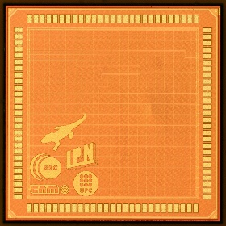

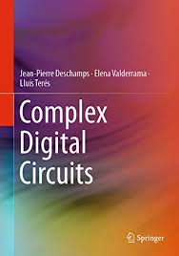


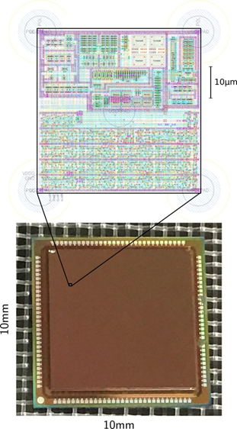
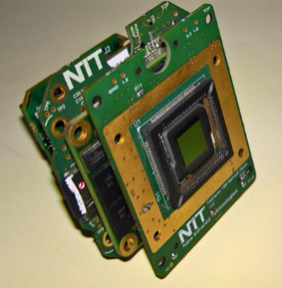
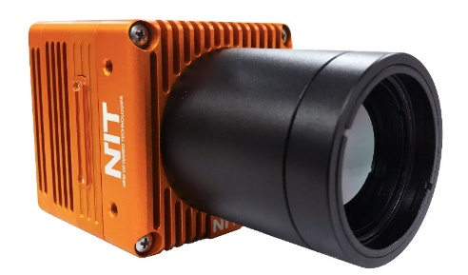
ICAS: Integrated Circuits And Systems
IMB-CNM (CSIC)
RED2018-102384-T
A. Arnal, J. Aymerich, J. Cisneros, M. Dei, R. Escudé, T. Leung, J.M. Margarit, C. Martínez, R. Martínez, J. Puertas, E. Ramon, J. Sacristán, F. Serra-Graells, A. Suanes, Ll. Terés
Mission
Vision
Micro/Nano-Electronic Devices, Circuits and Systems Design, Test and Deploy by means of SoA/new technologies, techniques and architectures to improve the performances of multi-technology integrated solutions.
Improve, connect & exploit the new “micro/nano-devices” from different technologies within the “macro” framework of target applications through interfaces developed including the appropriate degree of intelligence.
Group Profile
Recent / Ongoing Results
Low-Power Analog, Mixed & RF CMOS
  IR/XRay Imagers
  Smart sensor frontends
  IP blocs (DAC/ADC, PLL, …)
  Open hardware based on RISC-V
Printed/Organic-µelectronics
  Inkjet Printed Technologies & Devices
  Organic Thin Film Transistors and Sensors
  Printed Flexible Circuits
LoHiRa ADC (ESA-NPI 553-2017): Low-Power High-Resolution Rad-Hard Analog-to-Digital Converters for Next-Generation Space Image Read-Out ICs
BrainCom (H2020-FETPROACT-Grant 732032): Cortical implants as brain-computer interfaces for cognitive neuroscience applications.
EcoTronic (RTI2018-102070-B-C21): Dispositivos Electronicos Desechables en Papel para Plataformas Eco-Sostenibles.
Red-RISCV (RED2018-102384-T): Investigación, Formación e Innovación en Sistemas RISC-V.
Lagarto-RISC-V (BSC Contract): 1st Spanish RISC-V chip processor.
Research
Digital Design
Microelectronic Design & Test
Introduction to Computer architecture
Informatics, Telecomunication & Electronics engineering degrees
Micro/Nano-Electronics Engineering Master
Mixed teaching courses: on-line (MOOC) & Classroom
Publications:
  An Academic EDA Suite for the Full-Custom Design of Mixed-Mode Integrated Circuits, ISCAS-2017
  Digital Systems: from Logic Gates to Processors. Springer, 2017.
  Complex Digital Circuits. Springer 2019.
UAB Engineering School: Hardware subjects updated & harmonized on RISC-V basis (initial phase)
Training/Teaching
In the past lots of industry-based R&D
Now better balanced “research&Industry”
IR/XRay-ROICs for imagers
IP-blocs/chips for SilTerra, Arquimea/ESA, NIT.
More technology transfer to SMIs on printed-organic electronics
Two IP-cores (Temperature sensor & Charge-pump) for SilTerra Co.
Two ADC IP blocs designed for Arquimea/ESA consortium
Three different IR-ROIC chip imagers (32x32, 80x80 and 128x128 pixels) transferred to NIT S.L.
Innovation
Group positioning & Perspectives in front of Open-Hw & RISC-V
Open Hw/Sw reduces dependency and facilitates collaborative projects and competitive markets.
Freedom for evolution and helpful for training & education of new generations of professionals on Open Hw/Sw.
IP-Blocks design (PLL, ADC, SerDes, Memory Ctrl., …) for RISC-V cores and related application developments.
Low power RISC-V cores for IoT.
Use RISC-V as innovator driver-thread for universities and collaborative training strategies for all education levels.
Just starting an Industrial PhD around RISC-V core for IoT with NVision company
R+D+i+T
Global Remarks
“To consolidate the open hardware/software strategies based on the new RISC-V architectures, the synergies of the prodigious circle “Research-Training-Innovation” are required as an engine for a collaborative and joint evolution of the entire ecosystem that guarantees sustained, sustainable, cooperative and open progress ”
“The new open ISA RISC-V architectures offer an opportunity to improve technological independence, reduce oligopoly risks and facilitate market open competition”
Notes:
Nota: Els logos posats a la part inferior corresponen als logos del departament (esquerra) i empresa o centre de recerca a la dreta, en cas de no haver logos es poden treure.

