Slide 1

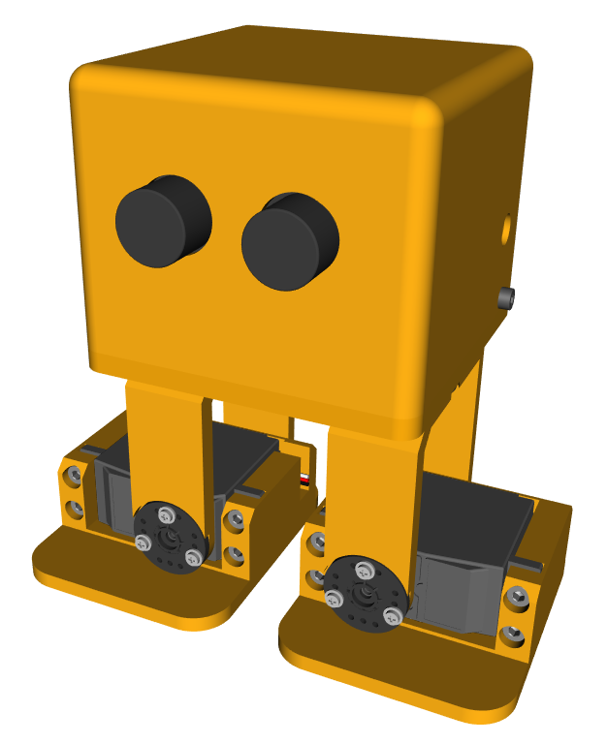
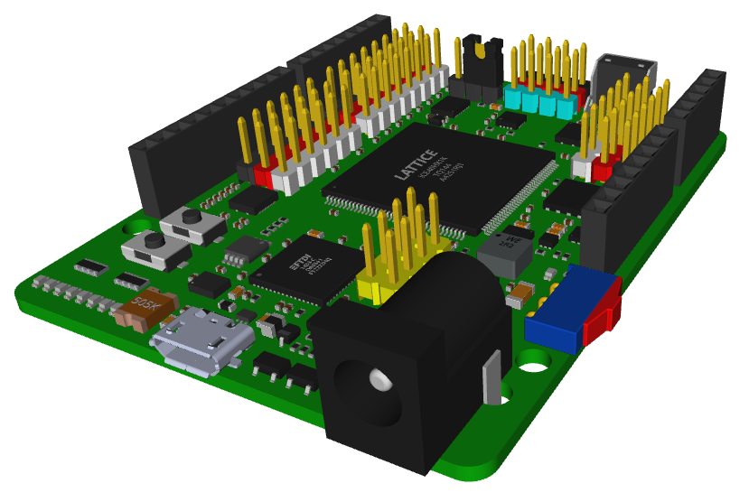







FreeCAD:
Designing in 3D with Open Source Tools
Juan González Gómez
@Obijuan_cube
https://github.com/Obijuan
ICT WORLD
IES Los Cerros
Úbeda (Jaén)
15-Nov-2017
NOVEMBER 2017

Slide 2



Freecad is multiplatform
GNU / Linux
Windows
Mac OS

Slide 3
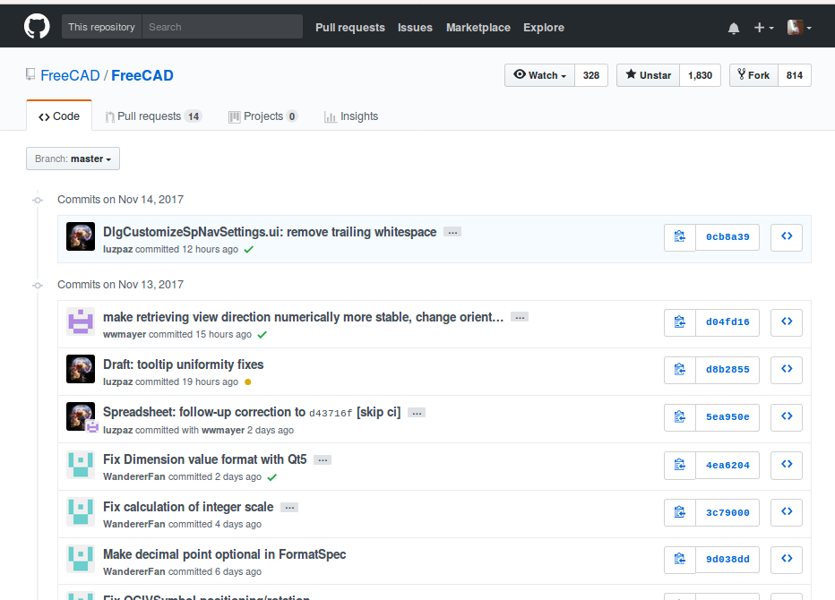
Freecad is Open Source
https://github.com/FreeCAD

Slide 4

Technological Heritage
Libre
Software
Reprap
Libre
Hardware
Open
FPGAs
Printbots

Slide 5
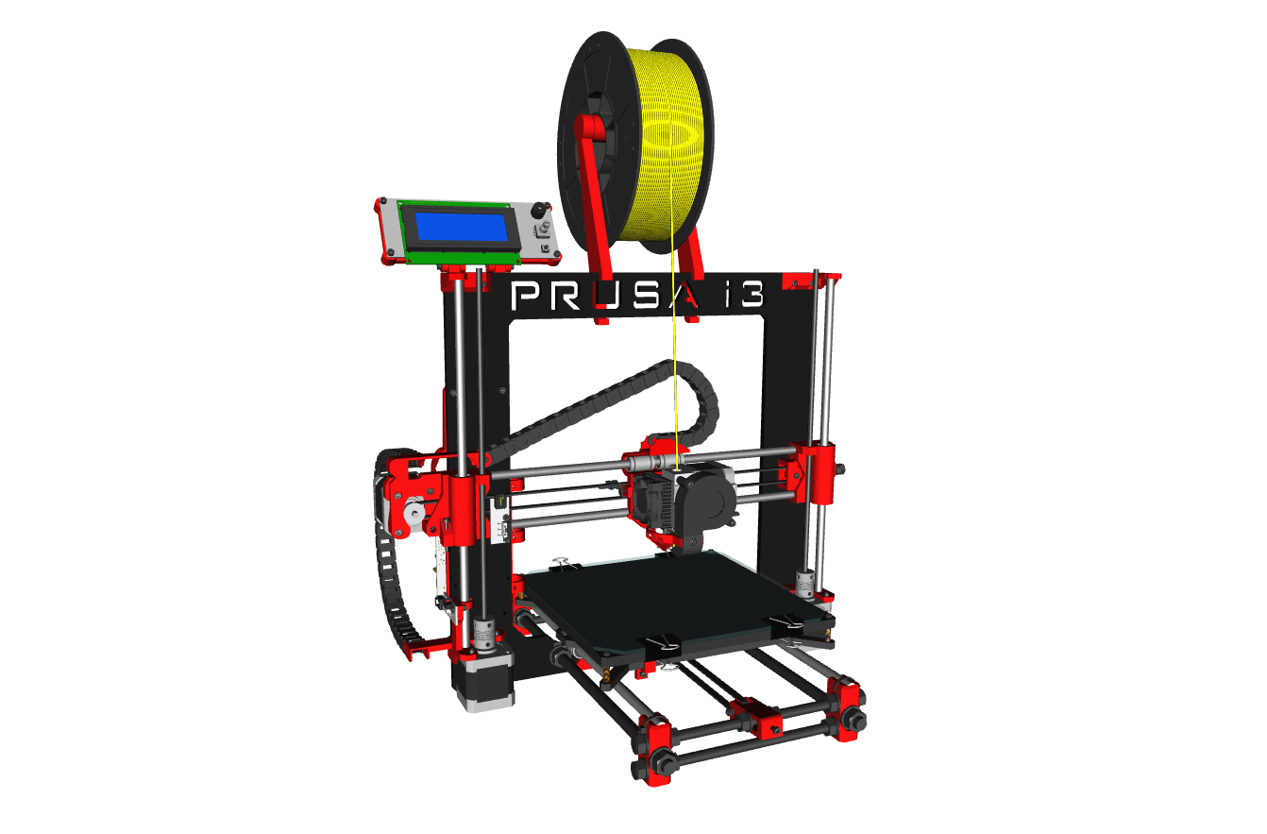
Example design 1: 3D printer

Slide 6
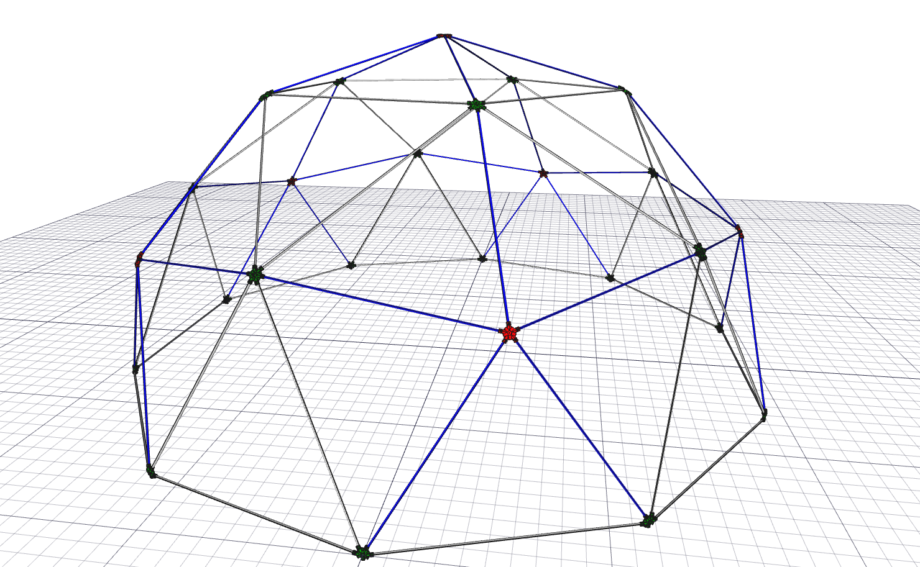
Example design 2: A dome

Slide 7
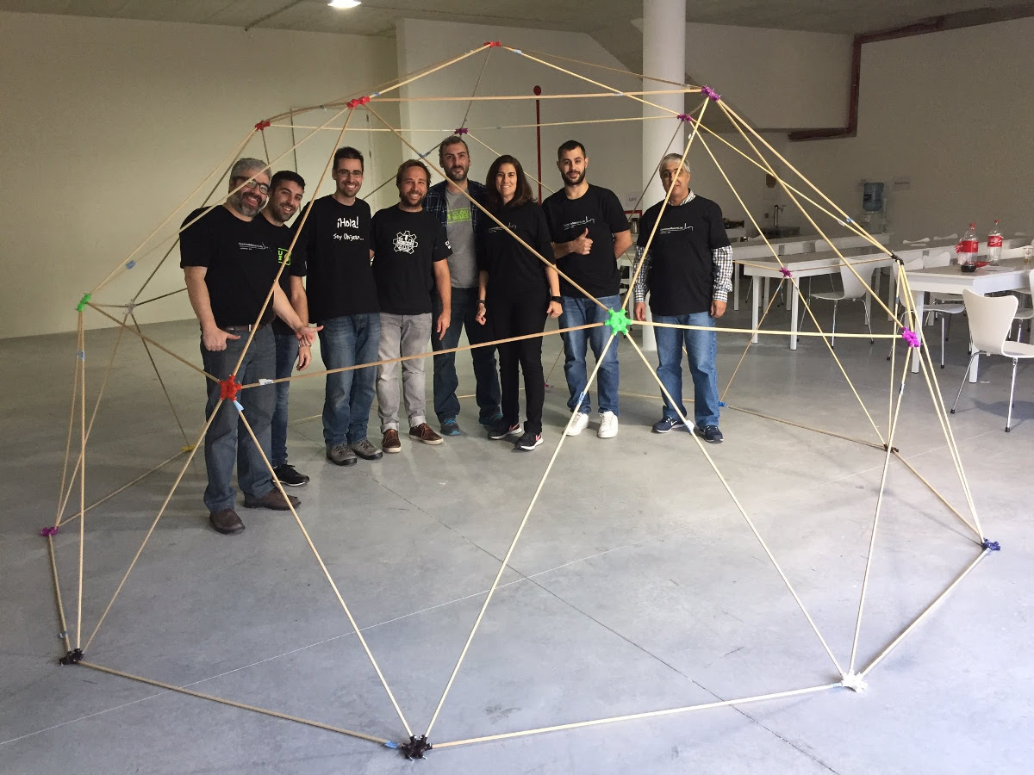
Example design 2: A dome

Slide 8
Example design 3:
Icezum Alhambra board

Slide 9
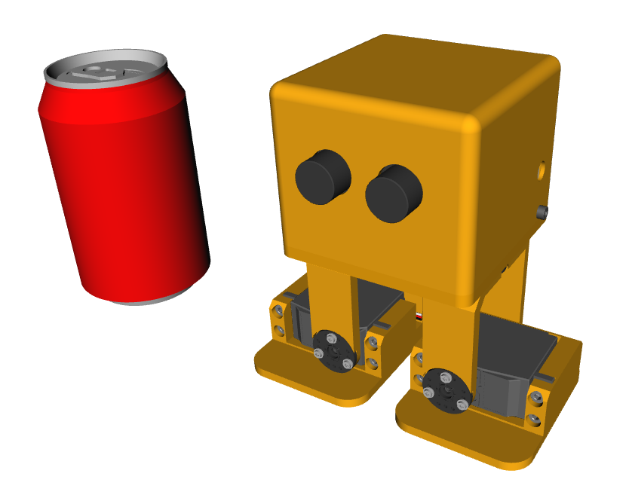
Example design 4: Zowi

Slide 10
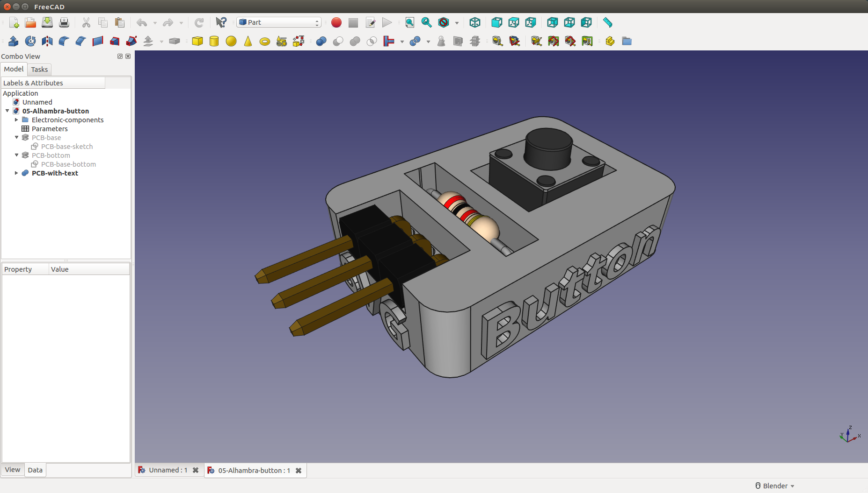
Exaple design 5: PCBprints

Slide 11
Ring with ears
Demo: Constructive solid geometry

Slide 12
Ring with horns
Demo 2: Constructive solid geometry

Slide 13
Standard ring
Demo 3: Working with sketches

Slide 14
Classic ring
Demo 4: Parametric designs

Slide 15
Ring with ears
Demo 5: Drawings

Slide 16
Ring with ears
Demo 5: Drawings

Slide 17
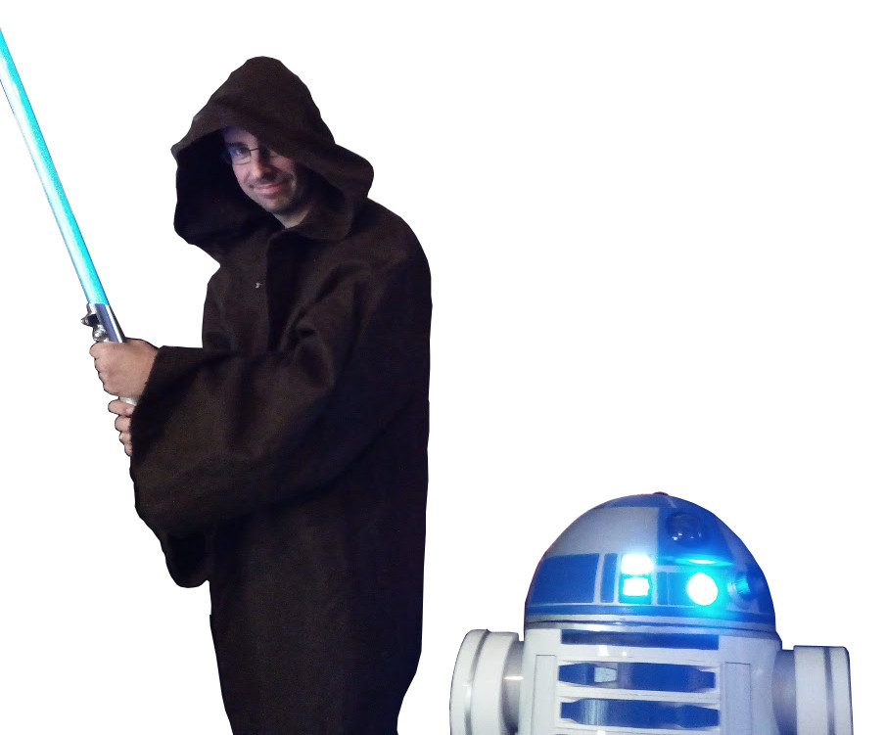
May the FreeCAD be with you!

Slide 18
FreeCAD:
Designing in 3D with Open Source Tools
Juan González Gómez
@Obijuan_cube
https://github.com/Obijuan
ICT WORLD
IES Los Cerros
Úbeda (Jaén)
15-Nov-2017
NOVEMBER 2017

