Slide 1









Funny Digital Electronics with
Open Source FPGAs
http://fpgawars.github.io/
Juan González Gómez
@Obijuan_cube
https://github.com/Obijuan

Slide 2


Obiwan
ObiJuan
Obiwan
Obiwan
I am not a Jedi, but I am trying…
I am an assitant professor at Rey Juan carlos University in Madrid, Spain
I am also a researcher in Robotics at the Robotics Lab in Rey Juan Carlos University

Slide 3

Icestorm project: Thank you very much!
Icestorm project (May, 2015): Clifford Wolf, Mathias Lasser
The first fully open source toolchain in history

Slide 4
Motivation
Is it possible for kids or non-tech people to design digital circuits?
Can we create libre tools for allowing them to learn digital electronics?

Slide 5
Icezum Alhambra v1.1
https://github.com/FPGAwars/icezum/wiki
Author: Eladio Delgado
From en Pinos del Valle (Granada, Spain)
Arduino-like board with and Open source FPGAs
Arduino compatible
Easy connection of sensors / actuators
Really nice for making Educational open-source Robots
Open Source FPGA

Slide 6

Made in Kicad

Slide 7



Icestudio
https://github.com/FPGAwars/icestudio
Author: Jesús Arroyo

Slide 8

Panel example

Slide 9



Peripherals
PCBprints: 3D printed boards

Slide 10
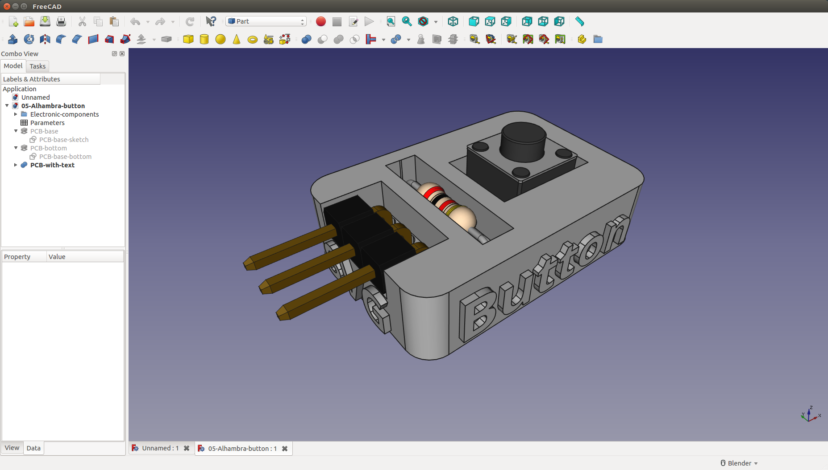
Made in FreeCAD

Slide 11
Demo!

Slide 12

Example 1: Hello world

Slide 13

Hello world: Physical implementation

Slide 14
Live demo...

Slide 15

Modular Robot

Slide 16

May the Open Source FPGAs be with you...
Thanks! :-)

Slide 17
Funny Digital Electronics with
Open Source FPGAs
http://fpgawars.github.io/
Juan González Gómez
@Obijuan_cube
https://github.com/Obijuan

