Slide 1
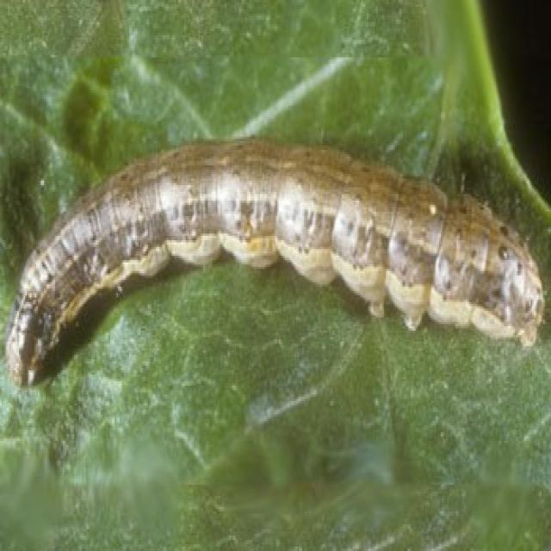
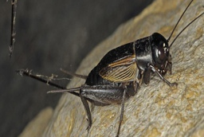
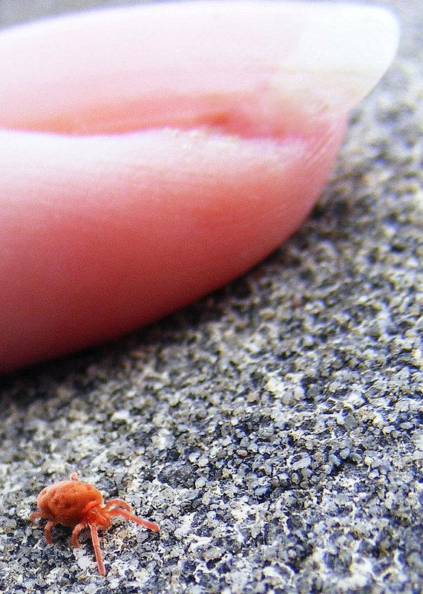
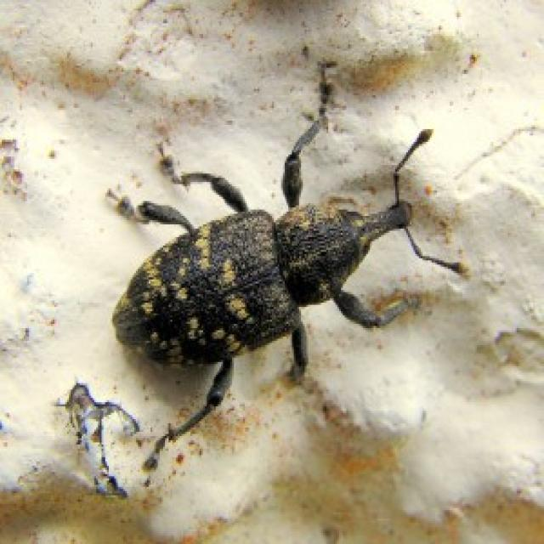
CS 590 PROJECT PROPOSAL
Jute Pest Classification
Without Deep Learning
Beet Armyworm
Field Cricket
Classical machine learning with handcrafted image features
Research question
How accurately can course-based classical ML classify 17 jute pests using shape, color, and texture features instead of neural networks?
Jute Red Mite
Jute Stem Weevil
Obinna Ndubuisi & Luke Laurenzaza
17 pest classes • image classification
Dataset: UCI Machine Learning Repository
Southern Illinois University Edwardsville • Fall 2026
Proposal due Sept. 30, 2026
Sample images © dataset authors, CC BY 4.0
Notes:
We are classifying 17 types of jute pests from images, but unlike the original papers, we are not allowed to use neural networks in this course. Our goal is to build a completely non-neural pipeline using handcrafted image features and classical machine-learning algorithms from class.

Slide 2
MOTIVATION & RELATED WORK
Why this problem and what is different about our project
WHY IT MATTERS
RELATED WORK ON THIS DATASET / PROBLEM
Early pest identification supports faster crop protection decisions.
2023
JutePestDetect
Transfer learning; DenseNet201 reported 99% accuracy.
The dataset contains 17 visually different pest classes.
The task is naturally a multiclass classification problem.
A smaller, interpretable classical pipeline may be useful when deep models are not available or allowed.
2024
UCI introductory paper
Transfer-learning models for the same 17-class task.
2025
Deep features + SVM
DenseNet201/DarkNet53 feature extraction → SVM; 96.779% reported.
OUR GAP
A fully non-neural pipeline: handcrafted visual features + classical ML methods from CS 590.
Application project: real biological image data
Sources: UCI (2024); Talukder et al. (2023); Kiziloluk et al. (2025)
Notes:
Prior work on this jute-pest problem is dominated by transfer learning and deep feature extraction. JutePestDetect reported about 99% accuracy with DenseNet201, and a later paper used DenseNet and DarkNet features before SVM. Our distinction is that neural networks are excluded from the entire pipeline. We will create features ourselves and compare classical classifiers taught in CS 590.

Slide 3
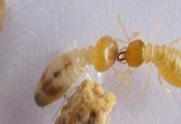
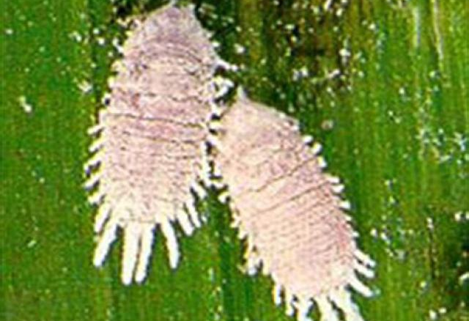
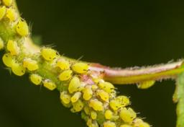
DATASET & INITIAL AUDIT
The data: 17 pest classes with a ready train / validation / test structure
CURRENT ARCHIVE COUNTS
6,444
413
379
Jute Red Mite
Beet Armyworm
Termite
TRAIN
VALIDATION
TEST
7,236 image files in the downloaded archive
UCI page reports 7,235 instances • images are organized into 17 labeled folders
CLASS IMBALANCE
INITIAL LEAKAGE AUDIT
Stem Weevil
Mealybug
Jute Aphid
199 → 676
96 groups
Examples from the downloaded UCI archive
training images / class
exact duplicates cross splits
17 test images overlap train/val
Why it matters: we will report both the original split and a cleaned leakage-free evaluation.
Source: UCI Jute Pest Dataset; archive audited by our group (Sept. 2026)
Notes:
The current download contains 7,236 image files, split into 6,444 train, 413 validation, and 379 test images across 17 classes. The training classes are imbalanced, from 199 to 676 images. During our initial audit we also found 96 exact duplicate groups crossing the supplied splits, including 17 test images that duplicate train or validation images. That motivates a cleaned evaluation in addition to the original split.

Slide 4
METHODS
Proposed pipeline: turn images into numerical shape, color, and texture features
1 IMAGE
2 FEATURE EXTRACTION
3 PREP
4 CLASSIFIERS
5 OUTPUT
Resize + normalize
HOG • HSV histogram • LBP
Standardize
Optional PCA
Logistic • KNN • SVM
Decision Tree • Random Forest
1 of 17 pest classes
WHY THESE HANDCRAFTED FEATURES?
Shape / edges
Color distribution
Texture
NO
NEURAL
NETWORKS
HOG
Captures body outline, wings, legs and orientation.
HSV
Captures color differences while reducing sensitivity to brightness.
LBP
Captures local surface patterns such as hair, shell and wing texture.
Course-aligned classification methods
Course methods include logistic regression, SVM, nearest neighbors and tree-based methods.
Notes:
The key step is feature extraction. Classical classifiers cannot take an image folder directly, so we convert every image into a numerical vector. HOG describes shape and edge direction, HSV histograms describe color, and LBP describes texture. After scaling, and optionally PCA, we compare logistic regression, KNN, SVM, decision trees, and random forests. Neural networks are not used anywhere.

Slide 5
INTENDED EXPERIMENTS & EVALUATION
Experiments: not just “which model wins?” — we test what actually drives performance
PLANNED EXPERIMENTS
PRIMARY METRICS
01
Feature ablation
HOG vs color vs texture vs combined features.
Accuracy
overall correct predictions
Classifier comparison
Logistic Regression, KNN, Linear/RBF SVM, Decision Tree, Random Forest.
Macro-F1
treats each pest class equally
02
Per-class recall
shows which pests are missed
03
Dimensionality reduction
Use PCA to trade feature count / runtime against predictive performance.
Confusion matrix
shows which species are confused
04
Class imbalance
Compare ordinary training with class-weighted methods and minority-class recall.
Runtime / feature size
efficiency tradeoff
05
Leakage sensitivity
Compare supplied split with a cleaned split that removes cross-split duplicates.
Primary success metric: Macro-F1
Evaluation follows course guidance: precision, recall, accuracy, confusion matrix.
Notes:
We want the experiments to answer scientific questions, not just rank algorithms. First, which visual feature family is actually useful? Second, which classifier works best? Third, can PCA reduce the feature vector without losing much performance? Fourth, does class weighting help the smaller classes? Finally, because our audit found duplicates across splits, we will compare the supplied evaluation with a leakage-free evaluation. Macro-F1 will be a key metric because the classes are imbalanced.

Slide 6
EXPECTED CONTRIBUTION & PROJECT PLAN
What we expect to contribute by the final presentation
1 NON-NEURAL BENCHMARK
2 FEATURE INSIGHT
3 TRUSTWORTHY EVALUATION
A reproducible baseline for 17-class jute-pest classification using only classical ML.
Evidence about whether shape, color, texture, or combinations carry the most useful signal.
Quantify how imbalance and duplicate leakage change the measured generalization performance.
WORK PLAN
01
02
03
04
05
Audit & clean
Extract features
Baseline models
Tune & compare
Final analysis
duplicates, class counts, image sizes
HOG, HSV, LBP + scaling
Logistic, KNN, SVM, tree, RF
validation / CV, PCA, class weights
confusion matrix, errors, discussion
End product: the best classical pipeline + an explanation of why it works, where it fails, and how trustworthy the reported score is.
Goal: reproducible code, meaningful experiments, and error analysis.
Notes:
By the end, we want three contributions: a fully classical benchmark, an analysis of which handcrafted features matter most, and a more trustworthy evaluation that accounts for imbalance and duplicate leakage. Our next step is to finish the audit and feature extraction, then run the baseline models, tune them, and finish with error analysis and a confusion matrix.

Slide 7
SELECTED SOURCES
References
UCI Machine Learning Repository. “Jute Pest.” Dataset ID 920, DOI: 10.24432/C5289P. Created 2024. CC BY 4.0.
01
Talukder, S. H., et al. “JutePestDetect: An intelligent approach for jute pest identification using fine-tuned transfer learning.” Smart Agricultural Technology 5 (2023): 100279. DOI: 10.1016/j.atech.2023.100279.
02
Islam, M. T., & Rahman, M. S. “An Efficient Deep Learning Approach for Jute Pest Classification Using Transfer Learning.” 2024 6th ICEEICT, pp. 1473–1478. DOI: 10.1109/ICEEICT62016.2024.10534395.
03
Kiziloluk, S., et al. “A novel feature fusion and mountain gazelle optimizer based framework for the recognition of jute pests in sustainable agriculture.” Scientific Reports 15, 18148 (2025).
04
Gultepe, E. CS 590 Machine Learning Project guidelines, SIUE, Fall 2026.
05
James, G., Witten, D., Hastie, T., & Tibshirani, R. An Introduction to Statistical Learning. Course reference for classical classification and model evaluation.
06
Dataset sample images on slides are from the UCI Jute Pest archive under CC BY 4.0.
Notes:
These are the main sources supporting the dataset description, the deep-learning baseline literature, and the course methodology.

