Slide 1
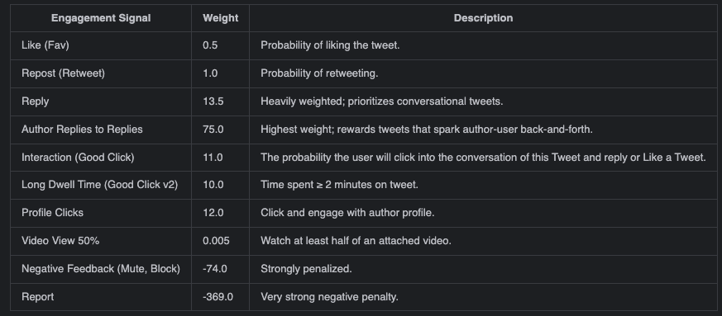
Engagement Signals - Weights
Heavy Ranker weights

Slide 2
Engagement Signals - Risks
Amplification of Harmful Content
Replies are rewarded.
promoting divisive content.
Safeguards are reactive.
Feedback Loops & Echo Chambers
Early engagement snowball
Real-time signals
Repetition, not ideological breadth.
Manipulation Risks
Gaming behaviors
Exposure Bias
Popularity-based filters disadvantage niche or minority views.
Notes:
Amplification of Harmful Content
Tweets that generate replies (even outrage) are rewarded.
High reply weights risk promoting divisive content.
Safeguards (e.g., report penalty) exist but are reactive.
Feedback Loops & Echo Chambers
Early engagement can snowball visibility.
Real-time signals can narrow content diversity.
Diversity heuristics target repetition, not ideological breadth.
Manipulation Risks
Gaming behaviors (e.g., reply-baiting) can exploit high reply weights.
Exposure Bias
Popularity-based filters disadvantage niche or minority views.
RealGraph may reinforce social homogeneity.
Diversity Logic
This code tries to prevent feed domination by a single author or topic. Especially line 45 (candidateSourceDiversityRescorer) CandidateSourceDiversityListwiseRescoringProvider.scala
This is an exponential decay multiplier with a minimum of floor. For index = 0 the multiplier is 1.0, meaning that there is no penalty for the first element, later items are downweighted.

Slide 3
Grok Integration - Risks
Opacity & Accountability:
black-box decision-making
Decisions are now influenced by LLM outputs
Over-Filtering & False Positives:
Grok-based filters may remove legitimate content
Shadowbanning or (un)intentional censorship.
Manipulation Potential:
Game Grok’s content preferences
Suppression of Counter-Speech:
Heavy penalization of “negative” or argumentative replies
Notes:
Opacity & Accountability:
Grok introduces black-box decision-making, making it harder for users or auditors to understand why content is ranked or filtered.
Algorithmic decisions are now influenced by LLM outputs that are not fully open or explainable.
Over-Filtering & False Positives:
Grok-based filters may remove legitimate content (e.g., satire, activism, or art) due to misclassification.
Risk of shadowbanning or unintentional censorship.
Manipulation Potential:
Malicious actors might learn to game Grok’s content preferences (e.g., phrasing, topic hijacking) to push certain narratives or evade moderation.
Suppression of Counter-Speech:
Heavy penalization of “negative” or argumentative replies (e.g., via GrokSlopScoreRescorer.scala) may unintentionally suppress responses to misinformation or abuse, letting harmful content spread unchecked.

Slide 4
Open Questions
While much of the recommender pipeline is open-source, Grok’s underlying model weights, training data, and classification logic are not.

