Slide 2

Overview and way forward for of land use model
«Luisetta»
in JRC.D1
sarah.mubareka@ec.europa.eu

Slide 3
Overview
Brief history
Basic principles
Installation
Components of model
Proposal of way of working (branches, bug reporting, requesting new features, etc)
Legal aspects: licensing / governance etc

Slide 4
Brief history
EU CLUE-Scanner:
1km, Pan-EU
ENV
EUCS100:
100m
JRC
LUISA:
Territorial modelling
LUMP:
Development boom
“Luisetta”
Cleaned and simplified for Dir.D
2018
Land Use Scanner model
2013(ongoing)
CLUE model
2011-2013
2010
02/2010

Slide 5
Basic principles
Definition of land claims
External drivers for land-use changes
Demand settings
Demand Module
Scenarios
Definition and implementation of EU Policy Alternatives
Policy-related rules
Land Claims
Biophysical suitability
Current
land-use
Land-use Change Simulation
Projected Land Use Change
Impact analysis
Land-use based indicators:
Land-use maps
Change hotspots
Regional changes
…
Thematic indicators:
Erosion
Carbon sequestration
Biodiversity
…

Slide 6
Basic principles
Definition of land claims
External drivers for land-use changes
Demand settings
Demand Module
Scenarios
Definition and implementation of EU Policy Alternatives
Policy-related rules
Land Claims
Biophysical suitability
Current
land-use
Land-use Change Simulation
Projected Land Use Change
Impact analysis
LISFLOOD
Water Quantity
POLES
Water & Biomass
GREEN/SWAT
Water Quality
GIS Tools
Spatial indicators
SOC-TOP
Soil OC OM
GUIDOS
Green Infrastructure
CBM
Forestry

Slide 7
Instructions to install everything you need to get Luisetta running on your pc.
Download
1. Tortoise subversion software
2. Notepad ++
3. JrcBox Client* from software centre
4. Latest GeoDMS version from http://wiki.objectvision.nl/index.php/GeoDms_Setups
************************************************************************************
1. Install Tortoise
https://tortoisesvn.net/downloads.html
Set the proxy in the tortoise network settings
http-proxy-host = 10.168.209.72
http-proxy-port = 8012
http-proxy-exceptions = *.jrc.it, *.ies.jrc.it, *.cec.eu.int, *.jrc.org, *.jrc.ec.europa.eu
2. Obtain a username and password from Object vision: Martin van der Beek ‎[mtbeek@objectvision.nl]‎ for http://svn.objectvision.nl/public/Luisetta/trunk
4. Create an empty folder "Luisetta" on your computer. This is where the configuration files sit (61Mb)
Right-click on this new and empty folder, click on "SVN Checkout"
5.Create new folder LocalData. This folder is for cache, leave it empty. It can get pretty big though, so be sure to put it in a place where you have some space (10Gb)
6. Set up the JRC box client.
*********
*JRC BOX*
*********
FOR INTERNAL JRC:
1/ LOGIN TO JRCBOX via web: go to https://jrcbox.jrc.ec.europa.eu and enroll (login once is required for the client to work)
2/ Write an email to sarah.mubareka@ec.europa.eu telling her you have done this so she can share the source data folder with you.
Luisetta data = 18Gb + EUCS_100m data = 5Gb
3/ INSTALL DESKTOP CLIENT: open the software centre on your PC and choose JrcBox.
You can do this by typing "Software Centre" in the lower left hand side of your screen where it says "type here to search".
4/ SYNC CLIENT TO SERVER: Once installed you can run it. Your ECAS credentials will be asked. You will be asked to authorize the JRCbox
desktop client to access your account. Once OK, close the browser window
5/ CHOOSE WHAT TO SYNC: The JRCbox connection wizard will start. In the first step you will be asked to configure “what to sync from server”.
6/ Check that only the “sync” folder is effectively synchronized with your local folder.
->If you are external to JRC:
1/ Obtain ECAS credentials here: https://ecas.ec.europa.eu/cas/eim/external/register.cgi
2/ Login to web based JRC box
3/ Install client via this link: https://owncloud.org/download/#owncloud-desktop-client.
If a password is requested, ask from the support email:JRC-BOX@ec.europa.eu
7. Install Notepad ++
************
*Notepad ++*
************
The Notepad ++ editor can be downloaded from: https://notepad-plus-plus.org.
8. Install and open GeoDMS
File>Open Configuration File> (go to Luisetta folder) select StatusQuo.dms
Tools>Options>General settings> see screenShotTools_Options_inGeoDMS.png in this folder
(adjust paths according to where you have your LocalData and JrcBox client synched - that is the SourceData
After installing the editor, import the language definition files from "GeoDMS/dev/res/\NotePadPlusPlus" (User Name: guest, Password: guest)
with the menu option language > define your language > import.
For working with this editor, the GeoDMSGUI setting for Tools > Options > General Settings > DMS Editor should be:
%ProgramFiles32%\Notepad++\Notepad++.exe "%F" -n%L
If you installed the editor in a different folder as Notepad suggested, you need to adjust the folder.
Installation
Readme file on JRC BOX

Slide 8
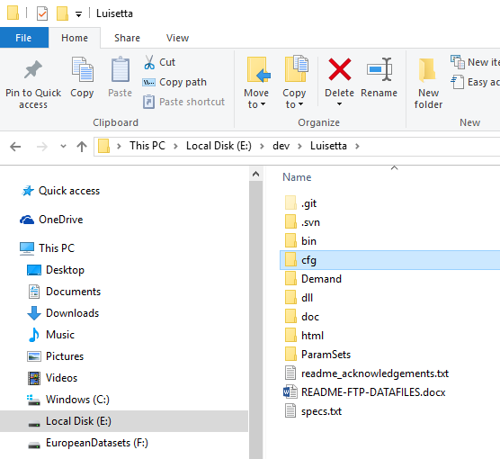
Configuration files (*.dms files)
To be opened with Notepad ++

Slide 9
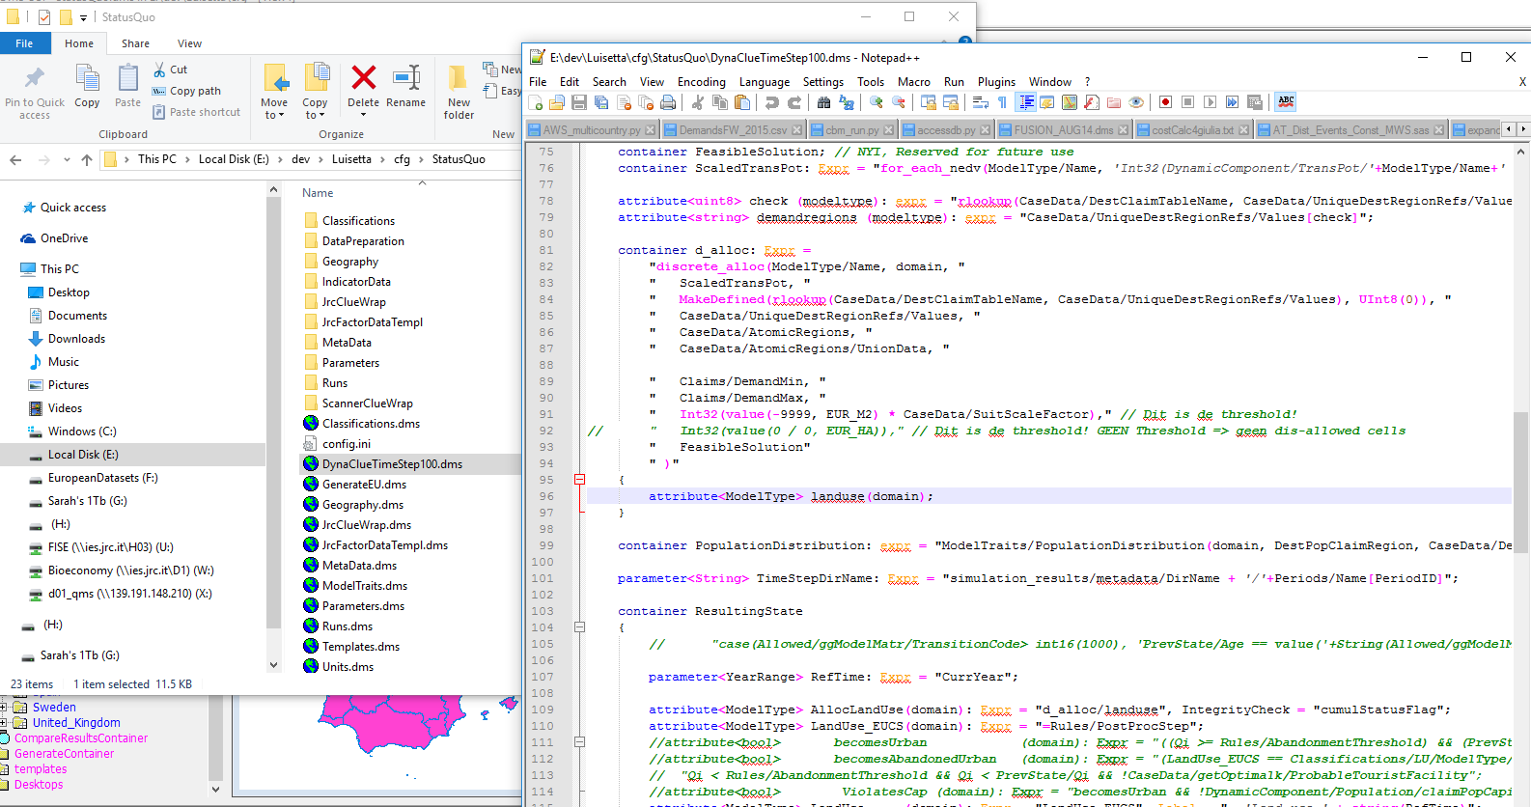
*.dms files

Slide 10
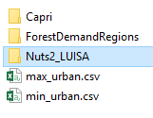
Demand files (*.csv files)

Slide 11
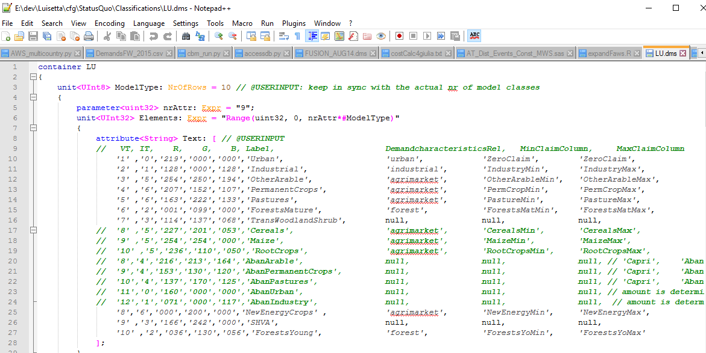
Demand files
Urban land: no demand
Industrial land
(N2)
Agri land: demand from CAPRI (N2)
Forest land: demand for ‘mature’ and
‘young’
(N0)

Slide 12
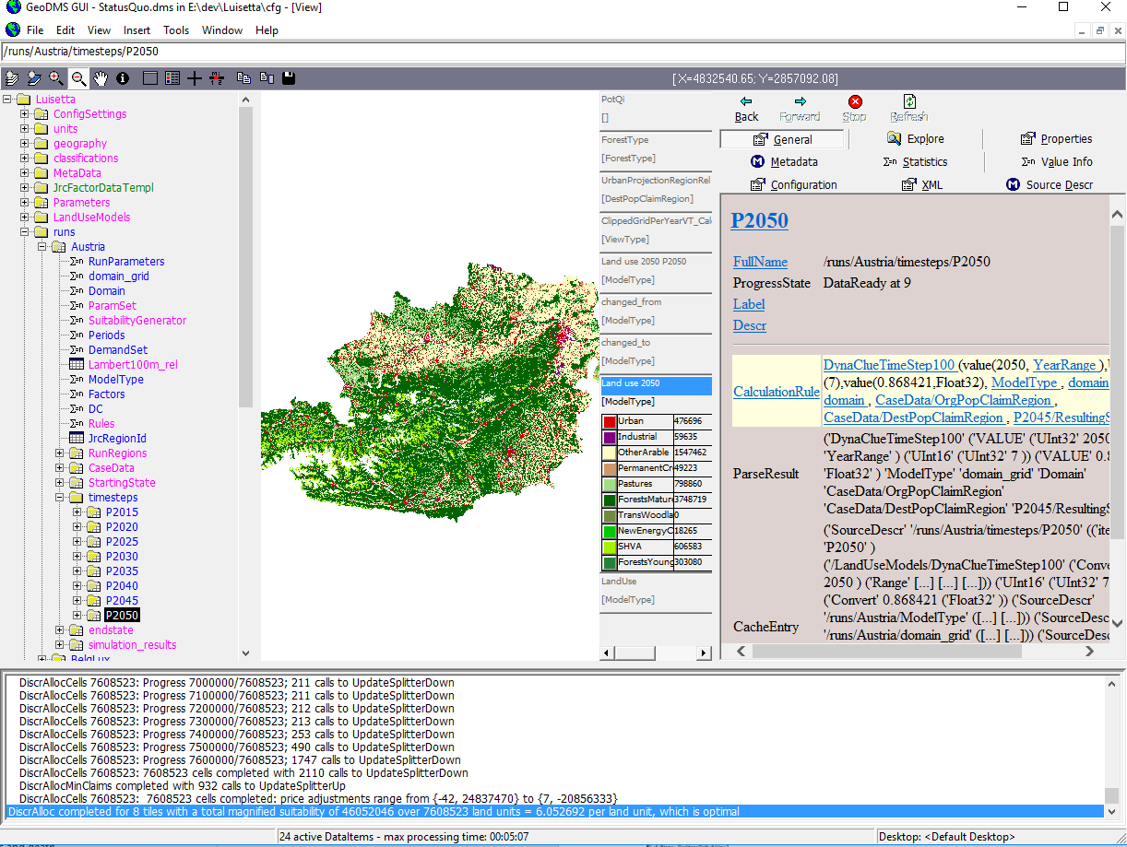
Model interface
2) Data panel
3) Details pages
1) Tree structure
4) Progress messages
Notes:
The Graphical user interface, is divided into four main panels. In the first, the tree structure allows the user to visualize the individual containers of the model. All aspects of the model, from details on the configuration to the containers that are used to execute the run can be visualized in this panel. The second panel is the data panel. When an element in the tree in panel 1 is clicked, this second panel will display either the map or table that is being requested. Similarly, it may also display calculation rules if requested through the third panel. The third panel has several tabs. Each tab displays slightly different information about the tree item that is highlighted in the first panel. The main tab is labelled “General”, and allows the user to read important details about the tree item at a glance. Other tabs include “Explore”, which shows the relative paths of the data in the tree item; “Properties”, which defines the item according to its properties, as intended for the GeoDMS language; Metadata, which can be a pdf uploaded by the user to give further background information on the tree item, such as its history; “Statistics” summarise the raster data by showing basic statistics such as minimum and maximum values of the raster cells for the entire raster, and calculated values such as standard deviation, variance etc; “Configuration” summarises the expression used to obtain the tree item; “XML” summarises the tree item in XML format; and “Source Descr” shows paths of the datasets used to compute the tree item. The fourth panel is analogous to a descriptive progress bar when a tree item that requires computation is selected. Depending on the complexity of the calculation, the tree item may not appear immediately in the second panel (viewer). The user can follow the progress of the calculation through the messages give in this fourth panel.

Slide 13
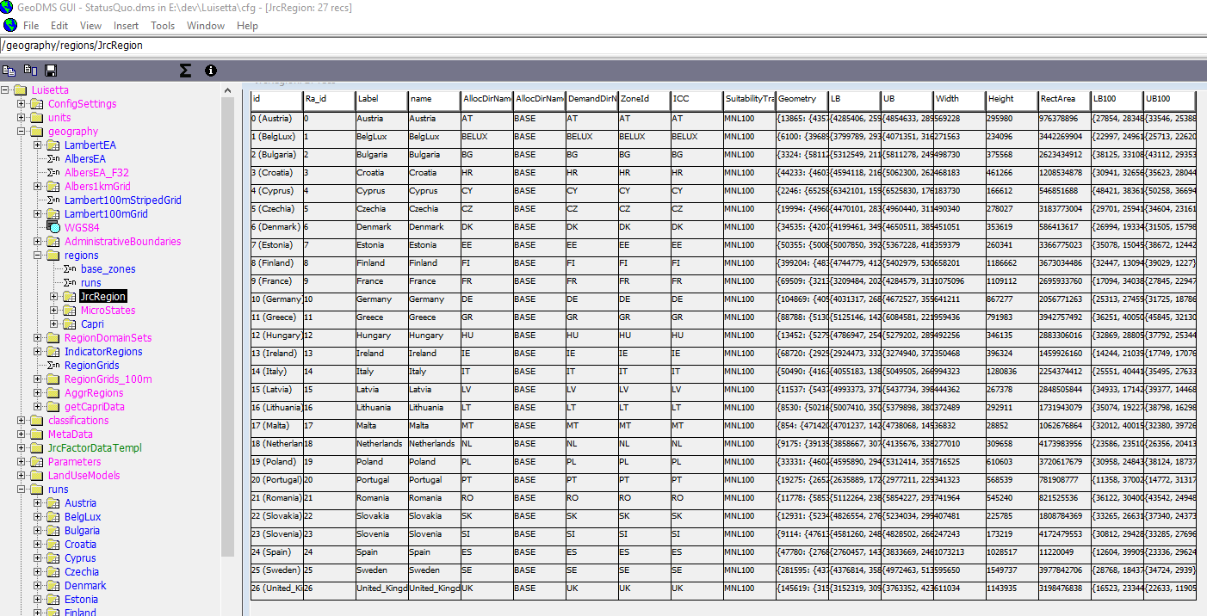

Slide 14
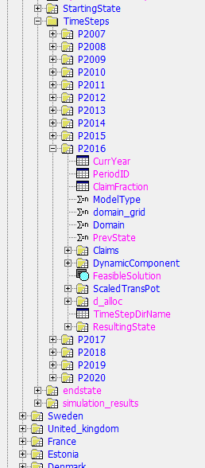
Time steps
& templates
Result of “metascripting”, where each region and each time step has identical set of processing steps (templates).
Furthermore, the templates can be used for thematic classes as well (forest type, species, age or volume class..)

Slide 15
Priorities
Improve forests in the model
allocation: use output from FUSION (CBM/GFTM)
demand: G4M in LTS?
Improve agricultural land in the model
allocation & demand: capdis?
Implement concept of land systems (ecosystem services)
CLUE-MONDO approach (demand for services, not area of land
Full integration with FUSION?

