Slide 1
NETWORKMODEL_EU · SERVICE ACCESS · PHARMACIES
Pharmacy locations across EU regions: how far is today's network from the frontier?
A λ-sweep over a facility-location LP on the road network — what exists today, by how much it could improve at equal cost or equal accessibility, and which of 42 study areas have the most to gain
Lola Dekhuijzen · Maarten Hilferink
Object Vision
Draft for discussion · September 2026 · GeoDMS road-network OD + Julia (JuMP / HiGHS) · NetworkModel_EU / ServiceAccess

Slide 2
AGENDA
Proposed agenda — assessing the current pharmacy distribution
1
The current distribution
What exists today: residents per pharmacy and per 1 km² location, per country and key NUTS1, catchments by road (p3–6).
2
Scope & method
By how much can accessibility improve at equal cost, or cost fall at equal accessibility? A tabula-rasa LP allocation on the road OD, swept over λ, answers that as a frontier of #locations vs travel (p7–14). Cost and accessibility trade off continuously under exogenous demand — there is no trilemma to resolve.
3
Scenario results
S1 (same #, less travel) and S2 (same travel, fewer locations) per area, quantified first in native units — locations and person-minutes, which need no λ — and only then in € (p16–61).
4
Travel-cost function ▸ for discussion / decision
Linear vs the logistic (midpoint 25 / scale 10), its compressed λ-range, and BN's proposal to rescale it (p64).
5
Cap / threshold ladder
A proposed shortcut to the λ-sweep, explored on the Netherlands — catchments vary so widely that realistic min/max bounds cannot be set. Dropped; p15 kept as the record.
6
Choice set, open items & roadmap
Where the 5-nearest choice set binds and why widening it precedes RSSV (p9); exact S1/S2 pinning; what remains, in priority order, and what was dropped (p63).
Decisions sought: travel-cost shape (linear vs logistic, and BN's rescaling) · widen the candidate radius before RSSV · territorial coverage constraints for equity, or keep soft coverage.

Slide 3
BASELINE · RESIDENTS PER PHARMACY
Residents per pharmacy — per country
region | pharm. | residents | resid/ph | #empty | min>0 | p10 | p25 | p50 | p75 | p90 | max
Austria | 1,467 | 8.9M | 6,088 | 3 | 25 | 2,422 | 3,883 | 5,666 | 7,628 | 10,203 | 25,354
Belgium | 4,860 | 11.5M | 2,373 | 11 | 18 | 961 | 1,471 | 2,137 | 3,030 | 4,053 | 10,019
Czechia | 2,668 | 10.5M | 3,932 | 5 | 3 | 1,173 | 2,024 | 3,463 | 5,162 | 7,222 | 18,348
Denmark | 536 | 5.8M | 10,736 | 0 | 2 | 4,892 | 7,363 | 10,014 | 13,242 | 17,801 | 35,188
Estonia | 491 | 1.3M | 2,684 | 0 | 10 | 834 | 1,517 | 2,314 | 3,450 | 4,778 | 20,604
France | 20,698 | 65.3M | 3,155 | 660 | 3 | 1,182 | 1,924 | 2,869 | 4,091 | 5,495 | 17,502
Ireland | 1,652 | 5.0M | 3,025 | 8 | 54 | 857 | 1,461 | 2,420 | 3,990 | 5,817 | 17,055
Italy | 12,991 | 58.7M | 4,520 | 56 | 1 | 1,040 | 1,858 | 3,160 | 5,411 | 9,107 | 85,669
Latvia | 818 | 1.9M | 2,313 | 0 | 30 | 694 | 1,154 | 1,932 | 3,050 | 4,344 | 16,587
Lithuania | 1,253 | 2.8M | 2,240 | 0 | 25 | 671 | 1,046 | 1,782 | 2,866 | 4,507 | 13,754
Luxembourg | 105 | 0.6M | 6,042 | 0 | 600 | 2,954 | 3,672 | 5,610 | 7,822 | 10,139 | 14,020
Netherlands | 1,992 | 17.5M | 8,765 | 4 | 5 | 2,661 | 5,060 | 7,952 | 11,913 | 15,567 | 33,497
Norway | 1,057 | 5.1M | 4,835 | 5 | 27 | 1,661 | 2,755 | 4,300 | 6,236 | 8,548 | 23,011
Poland | 13,791 | 37.1M | 2,688 | 3 | 1 | 878 | 1,439 | 2,280 | 3,488 | 5,017 | 19,078
Portugal | 2,801 | 10.3M | 3,680 | 16 | 28 | 1,262 | 1,950 | 2,941 | 4,439 | 6,497 | 19,709
Slovenia | 355 | 2.1M | 5,918 | 0 | 664 | 2,485 | 3,571 | 5,239 | 7,647 | 10,075 | 20,620
Sweden | 1,448 | 10.2M | 7,078 | 5 | 1 | 2,098 | 3,840 | 6,208 | 9,617 | 12,659 | 37,107
Catchment = residents whose nearest pharmacy BY ROAD-NETWORK travel time is this one (a cell's catchment split evenly among the pharmacies in it); p10..max = percentiles of that per-pharmacy catchment. #empty = pharmacies that are never the road-nearest for any populated cell (fully shadowed / disconnected); min>0 = smallest non-zero catchment. Source: pharmacy_descriptives.csv (road OD; Lewis, 22 May).

Slide 4
BASELINE · RESIDENTS PER PHARMACY
Residents per pharmacy — key NUTS1 regions (FR / IT / SE)
region | pharm. | residents | resid/ph | #empty | min>0 | p10 | p25 | p50 | p75 | p90 | max
Netherlands | 1,992 | 17.5M | 8,765 | 4 | 5 | 2,661 | 5,060 | 7,952 | 11,913 | 15,567 | 33,497
France | 20,698 | 65.3M | 3,155 | 660 | 3 | 1,182 | 1,924 | 2,869 | 4,091 | 5,495 | 17,502
FR1 | 3,488 | 12.3M | 3,530 | 3 | 3 | 1,584 | 2,155 | 3,131 | 4,365 | 6,017 | 17,502
FRB | 763 | 2.6M | 3,375 | 1 | 75 | 1,439 | 2,126 | 3,011 | 4,274 | 5,672 | 12,007
FRC | 921 | 2.8M | 3,039 | 0 | 44 | 1,374 | 1,966 | 2,874 | 3,855 | 4,868 | 12,847
FRD | 917 | 3.3M | 3,596 | 12 | 68 | 1,525 | 2,271 | 3,327 | 4,730 | 5,991 | 13,685
FRE | 1,943 | 6.0M | 3,081 | 7 | 5 | 1,359 | 1,933 | 2,821 | 3,860 | 5,055 | 15,413
FRF | 1,588 | 5.6M | 3,502 | 0 | 97 | 1,332 | 2,157 | 3,248 | 4,415 | 5,900 | 15,870
FRG | 1,069 | 3.8M | 3,589 | 1 | 35 | 1,575 | 2,350 | 3,309 | 4,600 | 5,859 | 12,237
FRH | 1,000 | 3.3M | 3,344 | 7 | 91 | 1,422 | 2,224 | 3,098 | 4,255 | 5,461 | 12,264
FRI | 2,052 | 6.1M | 2,950 | 7 | 46 | 1,174 | 1,832 | 2,680 | 3,768 | 4,973 | 11,655
FRJ | 1,965 | 6.0M | 3,059 | 0 | 45 | 1,207 | 1,890 | 2,724 | 3,847 | 5,369 | 12,011
FRK | 2,420 | 8.1M | 3,353 | 0 | 6 | 1,408 | 2,094 | 3,040 | 4,304 | 5,700 | 12,834
FRL | 1,850 | 5.0M | 2,728 | 46 | 1 | 932 | 1,568 | 2,391 | 3,605 | 4,956 | 14,737
FRM | 131 | 0.3M | 2,541 | 7 | 188 | 855 | 1,401 | 2,304 | 3,228 | 4,762 | 9,333
Italy | 12,991 | 58.7M | 4,520 | 56 | 1 | 1,040 | 1,858 | 3,160 | 5,411 | 9,107 | 85,669
ITC | 4,463 | 15.8M | 3,548 | 2 | 1 | 943 | 1,560 | 2,731 | 4,385 | 7,032 | 42,717
ITF | 1,951 | 13.3M | 6,831 | 20 | 50 | 1,182 | 2,250 | 4,016 | 7,844 | 14,735 | 85,669
ITG | 1,449 | 6.3M | 4,352 | 17 | 1 | 900 | 1,730 | 2,926 | 4,823 | 8,607 | 61,270
ITH | 2,786 | 11.5M | 4,138 | 23 | 6 | 1,058 | 1,880 | 3,204 | 5,354 | 8,068 | 47,393
ITI | 2,342 | 11.7M | 4,996 | 15 | 33 | 1,225 | 2,136 | 3,729 | 6,286 | 10,194 | 51,155
Sweden | 1,448 | 10.2M | 7,078 | 5 | 1 | 2,098 | 3,840 | 6,208 | 9,617 | 12,659 | 37,107
SE1 | 558 | 4.1M | 7,310 | 3 | 1 | 1,882 | 3,734 | 6,197 | 10,009 | 13,365 | 37,107
SE2 | 607 | 4.4M | 7,276 | 3 | 2 | 2,146 | 3,885 | 6,511 | 9,937 | 12,948 | 33,444
SE3 | 284 | 1.7M | 6,121 | 0 | 83 | 2,545 | 3,763 | 5,420 | 7,672 | 10,842 | 16,576
Catchment = residents whose nearest pharmacy BY ROAD-NETWORK travel time is this one (a cell's catchment split evenly among the pharmacies in it); p10..max = percentiles of that per-pharmacy catchment. #empty = pharmacies that are never the road-nearest for any populated cell (fully shadowed / disconnected); min>0 = smallest non-zero catchment. Country rows bold, NUTS1 indented below. Source: pharmacy_descriptives.csv (road OD; Lewis, 22 May).

Slide 5
BASELINE · RESIDENTS PER 1 KM² LOCATION
Residents per 1 km² location — per country
region | locations | residents | resid/loc | #empty | min>0 | p10 | p25 | p50 | p75 | p90 | max
Austria | 1,131 | 8.9M | 7,897 | 2 | 25 | 3,298 | 4,971 | 6,976 | 9,677 | 13,119 | 33,771
Belgium | 2,963 | 11.5M | 3,892 | 5 | 18 | 1,649 | 2,295 | 3,310 | 4,691 | 6,549 | 29,568
Czechia | 1,627 | 10.5M | 6,448 | 3 | 4 | 2,139 | 3,688 | 5,728 | 8,446 | 11,723 | 27,465
Denmark | 466 | 5.8M | 12,349 | 0 | 2 | 5,900 | 8,353 | 11,182 | 15,281 | 20,513 | 40,606
Estonia | 292 | 1.3M | 4,514 | 0 | 19 | 1,242 | 2,373 | 3,711 | 5,421 | 8,262 | 20,604
France | 13,863 | 65.3M | 4,711 | 448 | 3 | 1,578 | 2,638 | 3,991 | 5,863 | 8,412 | 51,246
Ireland | 865 | 5.0M | 5,777 | 3 | 107 | 2,259 | 3,401 | 5,104 | 7,221 | 10,276 | 28,024
Italy | 8,794 | 58.7M | 6,677 | 41 | 1 | 1,296 | 2,546 | 4,919 | 8,616 | 13,684 | 112,620
Latvia | 496 | 1.9M | 3,815 | 0 | 30 | 991 | 1,551 | 2,904 | 5,146 | 8,093 | 16,587
Lithuania | 582 | 2.8M | 4,822 | 0 | 25 | 1,528 | 2,622 | 4,045 | 6,579 | 9,157 | 24,536
Luxembourg | 86 | 0.6M | 7,377 | 0 | 600 | 3,472 | 5,232 | 6,861 | 9,508 | 11,596 | 22,601
Netherlands | 1,617 | 17.5M | 10,797 | 2 | 5 | 4,394 | 6,802 | 10,167 | 13,827 | 17,874 | 34,905
Norway | 758 | 5.1M | 6,737 | 3 | 27 | 2,292 | 3,756 | 5,758 | 8,790 | 12,626 | 26,897
Poland | 7,030 | 37.1M | 5,273 | 3 | 1 | 1,871 | 2,997 | 4,571 | 6,819 | 9,712 | 26,161
Portugal | 1,893 | 10.3M | 5,199 | 11 | 30 | 1,692 | 2,740 | 4,282 | 6,720 | 9,811 | 32,667
Slovenia | 306 | 2.1M | 6,865 | 0 | 664 | 2,928 | 4,294 | 6,106 | 8,708 | 11,475 | 22,559
Sweden | 1,088 | 10.2M | 9,419 | 4 | 2 | 3,080 | 5,220 | 8,541 | 12,284 | 17,268 | 37,107
A location = a unique 1 km² cell with ≥1 pharmacy; catchment = residents whose nearest pharmacy cell BY ROAD is this one; p10..max = percentiles of that per-location catchment. #empty = locations that are never the road-nearest for any populated cell (fully shadowed / disconnected); min>0 = smallest non-zero catchment. Source: pharmacy_descriptives.csv (road OD; Lewis, 22 May).

Slide 6
BASELINE · RESIDENTS PER 1 KM² LOCATION
Residents per 1 km² location — key NUTS1 regions (FR / IT / SE)
region | locations | residents | resid/loc | #empty | min>0 | p10 | p25 | p50 | p75 | p90 | max
Netherlands | 1,617 | 17.5M | 10,797 | 2 | 5 | 4,394 | 6,802 | 10,167 | 13,827 | 17,874 | 34,905
France | 13,863 | 65.3M | 4,711 | 448 | 3 | 1,578 | 2,638 | 3,991 | 5,863 | 8,412 | 51,246
FR1 | 1,452 | 12.3M | 8,480 | 3 | 3 | 2,804 | 4,317 | 6,789 | 10,194 | 15,712 | 51,246
FRB | 614 | 2.6M | 4,194 | 1 | 75 | 1,911 | 2,697 | 3,699 | 5,323 | 6,899 | 12,007
FRC | 723 | 2.8M | 3,871 | 0 | 44 | 1,840 | 2,590 | 3,437 | 4,707 | 6,508 | 15,552
FRD | 683 | 3.3M | 4,824 | 5 | 68 | 2,095 | 3,015 | 4,549 | 6,066 | 7,865 | 15,013
FRE | 1,337 | 6.0M | 4,476 | 4 | 5 | 2,006 | 2,862 | 3,995 | 5,636 | 7,566 | 17,786
FRF | 1,167 | 5.6M | 4,764 | 0 | 97 | 2,068 | 3,035 | 4,213 | 5,963 | 8,069 | 16,534
FRG | 851 | 3.8M | 4,507 | 1 | 35 | 1,963 | 2,816 | 4,106 | 5,647 | 7,539 | 22,395
FRH | 798 | 3.3M | 4,182 | 6 | 166 | 1,728 | 2,643 | 3,849 | 5,140 | 7,199 | 18,734
FRI | 1,590 | 6.1M | 3,804 | 7 | 46 | 1,609 | 2,362 | 3,441 | 4,803 | 6,506 | 18,820
FRJ | 1,424 | 6.0M | 4,221 | 0 | 45 | 1,528 | 2,323 | 3,646 | 5,452 | 7,734 | 17,607
FRK | 1,685 | 8.1M | 4,815 | 0 | 6 | 1,732 | 2,768 | 4,149 | 6,096 | 8,479 | 25,354
FRL | 1,045 | 5.0M | 4,820 | 21 | 1 | 1,326 | 2,520 | 4,132 | 6,229 | 8,837 | 25,437
FRM | 92 | 0.3M | 3,606 | 5 | 188 | 718 | 1,482 | 3,141 | 4,271 | 6,491 | 14,763
Italy | 8,794 | 58.7M | 6,677 | 41 | 1 | 1,296 | 2,546 | 4,919 | 8,616 | 13,684 | 112,620
ITC | 2,892 | 15.8M | 5,470 | 2 | 1 | 1,089 | 2,092 | 4,188 | 7,563 | 11,567 | 42,717
ITF | 1,265 | 13.3M | 10,527 | 12 | 50 | 1,582 | 3,668 | 7,057 | 13,082 | 23,316 | 112,620
ITG | 906 | 6.3M | 6,931 | 15 | 2 | 929 | 2,169 | 4,854 | 9,295 | 15,789 | 61,270
ITH | 2,087 | 11.5M | 5,519 | 9 | 6 | 1,462 | 2,591 | 4,555 | 7,208 | 10,599 | 47,393
ITI | 1,644 | 11.7M | 7,112 | 9 | 33 | 1,599 | 3,196 | 5,533 | 9,382 | 14,373 | 51,155
Sweden | 1,088 | 10.2M | 9,419 | 4 | 2 | 3,080 | 5,220 | 8,541 | 12,284 | 17,268 | 37,107
SE1 | 389 | 4.1M | 10,418 | 2 | 2 | 3,114 | 6,182 | 9,375 | 13,628 | 19,521 | 37,107
SE2 | 454 | 4.4M | 9,668 | 2 | 2 | 3,289 | 5,549 | 8,903 | 12,497 | 16,812 | 35,654
SE3 | 246 | 1.7M | 7,043 | 0 | 168 | 2,572 | 3,926 | 5,939 | 9,425 | 12,971 | 24,673
A location = a unique 1 km² cell with ≥1 pharmacy; catchment = residents whose nearest pharmacy cell BY ROAD is this one; p10..max = percentiles of that per-location catchment. #empty = locations that are never the road-nearest for any populated cell (fully shadowed / disconnected); min>0 = smallest non-zero catchment. Country rows bold, NUTS1 indented below. Source: pharmacy_descriptives.csv (road OD; Lewis, 22 May).

Slide 7
MODEL
The optimization problem — uncapacitated facility location on the road OD
min_{x,y} Σᵢ popᵢ · [ Σⱼ c(tᵢⱼ)·xᵢⱼ + BIG·(1 − Σⱼ xᵢⱼ) ] + λ · Σⱼ yⱼ
c(t) — travel cost, t in minutes
LINEAR c(t)=t; LOGISTIC (adapted logit) c(t)=1/(1+e^−(t−25)/10). The swept LPs run once per function.
travel of the served share + the unserved share, priced at BIG + facility cost
s.t. Σⱼ xᵢⱼ ≤ 1 a client MAY be left unserved
xᵢⱼ ≤ yⱼ only to open pharmacies
yⱼ ∈ {0,1} → relaxed to 0 ≤ yⱼ ≤ 1, xᵢⱼ ≥ 0
λ = w · €100,000 — the price of a location (placeholder)
Linear cost a + b·q reduces to λ·#open: b·q is ~constant while (nearly) all demand is served, so only the fixed cost a matters (approximately, under soft coverage). €100,000 is a placeholder, not an estimate: the frontier, S1/S2 and the rankings are invariant to it — only the € labels move with the true a.
One LP per λ, exact
i = populated 1 km² cells (clients) · j = candidate pharmacy cells · (i,j) only where the road network gives tᵢⱼ ≤ t_max — the exported OD. BIG = price of leaving a client unserved: 120 min (linear) / 1.0 (logistic saturation). Opening a facility only pays off where it saves more travel than λ.
JuMP + HiGHS dual simplex; the model is built once and re-solved along the w-grid from the previous optimal basis (lp_run.jl solve_at_w!) — millions of xᵢⱼ, minutes per point.
⚠ For review: each client's OD holds every candidate out to its 5 nearest EXISTING pharmacies (max_nr_facilities_per_client) — it shrinks the LP but limits reassignment choice, and it can bind at S2-level facility counts. Clients still unreachable within t_max are priced at BIG on BOTH sides — stranded in the baseline, optionally stranded in the LP — so ★ and frontier stay directly comparable. After the scope rules on p8 that is only 0.012% of residents: 34 of 41 areas have none at all, the largest remainder is SE2 with 165 cells / 14,210 residents (0.32%), and these are genuinely remote cells rather than a coverage artefact. Feedback welcome.
Why the relaxation, and what it buys. With yⱼ ∈ {0,1} this is the (NP-hard) uncapacitated facility-location problem, in its strong disaggregated formulation — one xᵢⱼ ≤ yⱼ per OD pair — whose LP relaxation is known to be nearly integral, which the sweeps confirm (frac_y stays small). The LP optimum is a certified lower bound (the grey dashed line); rounding x* to a real set of pharmacies (multistart, p. 12) gives a feasible upper bound — the integer optimum is pinched between the two (+0–18% LINEAR, +0–4.7% LOGISTIC).
Relation to the p-median problem. Imposing the count (Σⱼ yⱼ = p) instead of pricing it gives the p-median problem with costs c(tᵢⱼ) (ReVelle & Swain 1970) — S1 at the baseline count is a p-median instance, in its soft-coverage form: a client may go unserved at BIG rather than be forced onto a far facility (an outside option / p-median with an upper bound on assignment cost). The λ-sweep is its Lagrangian relaxation w.r.t. that constraint (Cornuéjols, Fisher & Nemhauser 1977): it recovers only the p’s on the lower convex envelope of the p-median value function, so p-values in non-convex gaps are unreachable by any λ — there S1/S2 are interpolated between sweep points, or pinned exactly with the cardinality constraint (roadmap: better S1/S2 estimations). The swap polish of p. 12 is the classic p-median vertex-substitution search.
Implementation: lp_run.jl (build_lp_warmstart / solve_at_w!) · weights popᵢ = total residents of cell i (CLIENT_WEIGHT=total_pop) · OD from GeoDMS impedance_matrix_od64, t = seconds/60.

Slide 8
SCOPE
What the model covers — and what it deliberately excludes
Under soft coverage every resident the model cannot route to a pharmacy is priced at BIG (120 min). That is right for someone who is genuinely remote — and wrong when the network or the supply data is simply missing, because it turns a DATA gap into apparent policy headroom. Two rules separate the cases.
1 · Road network — per landbody
2 · Regions the model cannot serve at all
The largest strongly-connected network is kept for EVERY separate landbody, not just the single largest one in the study area.
If more than 50% of a NUTS region's inhabitant locations are absent from the OD matrix, the WHOLE region is excluded — its population AND its candidate locations.
Before, one component survived per study area, so island networks — and the ferry links inside them — were discarded entirely.
Sicilia and Sardegna are two separate landbodies, so at most one of them could ever be kept.
No source data changed: the links were always in the TomTom extract, they were being pruned.
Level: NUTS3 where populated, otherwise NUTS2, otherwise NUTS1.
Judged on the EXISTING network, so the baseline and the λ-sweep always agree on who is in scope.
Excluded today: PT200 Azores (919 cells, 212,855 residents) and PT300 Madeira (419 cells, 244,867 residents) — both 100% absent. They hold population but no pharmacy anywhere in the source data, so no network fix could reach them.
No other area comes near the threshold: it is 100% or far below.
ITG: mean travel 22.3 → 4.9 min · unreachable residents 983,169 → 591
Portugal: baseline travel −62% · mean 8.64 → 3.47 min · figures now cover the MAINLAND ONLY
⚠ Not comparable with the previous deck. Both rules change which residents are counted, so baselines, frontiers and the ranked improvement lists all shift. Absence of a pharmacy record is not evidence of absence of a pharmacy — excluding those regions states what we do not know, rather than asserting the strong version of it.

Slide 9
CHOICE SET
The choice set — where the 5-nearest rule binds, and why widening it comes before RSSV
Each client is connected to every candidate cell within the road distance to its 5th-nearest EXISTING pharmacy (or 120 min). That radius holds ~70–90 candidates on average — so it is not “5 choices”, it is a radius fixed by today’s five. When the optimiser removes facilities, the radius does not grow.
Where it binds — measured at S2
Why widening helps
Why RSSV requires it
SE2 at S2 (309 of 452 open): 1,730 cells / 449,261 residents — 10.2% of the population — have exactly ONE open facility left inside their radius. Closing it would strand them at BIG, so the optimiser must keep it open even where a 6th-nearest pharmacy would serve them.
ITF at S2 (519 of 1,253 open): 9.0% of residents are already stranded and a further 23.9% are one closure away — a third of the population pins the solution.
Even at S1 — same count as today, only relocated — ITF strands 1.84%: relocation moved facilities out of clients’ fixed radii.
More existing and potential locations per client → a wider radius → the optimiser can consolidate further without stranding anyone → S2 reaches the baseline travel cost with fewer facilities.
The gain is concentrated exactly where the lists rank improvement potential: the areas with the most one-option clients.
Keep the EXISTING-side radius at 5 for the baseline, so ★ stays comparable with earlier decks; widen the CANDIDATE side only.
Cost: a wider radius enlarges the full OD (build time, memory) and the exact solve on small areas.
RSSV solves many sub-problems on random CANDIDATE subsets Jᵤ with the FULL client set. Every client must still reach some sampled candidate — otherwise it is stranded at BIG for that sub-problem alone, and those spurious penalties corrupt the spatial votes.
The chance that a random Jᵤ leaves a client with no reachable candidate falls as the radius widens. A thin radius makes voting noisy; a wide one makes it robust.
So the two size-control knobs trade against each other: under RSSV, size control moves from pruning per client to sample → vote → filter → exact solve. Widening the radius is the precondition, not a nicety.
Stratified (not uniform) sampling lets a narrower radius suffice — a lever to trade against OD size.
The frontier is under-estimated wherever the radius, not the geography, decides who can be served.
A cheap experiment: one area, radius 5 → 10, compare S2 facility count and stranding.
Sequence: widen the candidate radius → RSSV → exact MIP on the reduced set.
Also found: S1 and S2 are read off the nearest swept λ grid point. In 5 of 42 areas (FRC, FRH, FRJ, FRK, SE2) both scenarios snap to the SAME point — SE2’s S1 bracket (0.2, 0.5) and S2 bracket (0.5, 1.0) both resolve to w = 0.5, so its delivered S1 has 309 open, not the baseline 452. The interpolated tables on p60–61 are unaffected; the exported S1/S2 location files and the exact-MIP step are where this needs a refinement step rather than a snap.

Slide 10
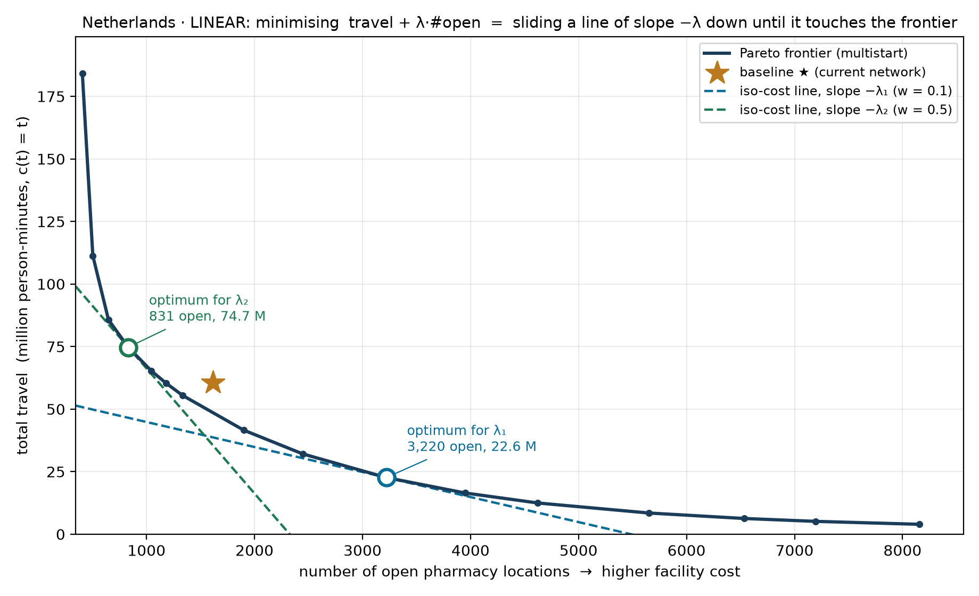
METHOD
How one λ picks one point — and how a sweep over λ traces the frontier
The sweep never fixes a value of λ. Each λ is one slope; the solver returns the point of the feasible set where a line of that slope touches. Netherlands, LINEAR c(t) = t, multistart-rounded solutions; the ★ is today’s network.
1 · The objective is a line
We minimise travel + λ · #open. Every solution with the same objective value C lies on the line travel = C − λ · #open: slope −λ, and the lower the line, the cheaper the solution.
2 · The optimum is a tangency
Slide the line down until it last touches the feasible set. That touching point is the λ-optimum. λ₁ = €10,000 per facility touches at 3,220 open (22.6 M person-minutes); λ₂ = €50,000 touches at 831 open (74.7 M). A steeper slope buys fewer, busier pharmacies.
3 · Many λ → the frontier
Two λ give two tangencies; the 1-2-5 grid gives ~30. Their lower-left envelope is the Pareto frontier of the next slides. The frontier itself needs no λ — λ only says which point on it a decision-maker would pick.
What a tangency cannot reach
A point in a concave dent of the frontier is never a tangency, whatever λ. Such points — and an exact count such as “today’s 1,615” — need a fixed-#open solve, which is the refinement step S1/S2 still lack (p9).

Slide 11
LAMBDA_SWEEP.JL
Scenarios and what the sweep computes
Baseline
Inputs
S1 — fix #facilities
Equal cost
Current pharmacy network
Reduce travel time at sum_x ≈ target_cells
Each client → nearest existing pharmacy.
Reports total travel cost, mean travel time, and the count of grid cells with at least one pharmacy (target_cells).
min Σ wᵢ·c(tᵢⱼ)·yₖ + λ·Σⱼxⱼ
Sweep λ to land sum_x at the baseline cell count.
LP-relaxation of UFLP, strong linking yₖ ≤ x_{j(k)}.
S2 — fix travel cost
Equal access
S3 — reduce both
Pareto sweep
Reduce #facilities at C ≈ baseline cost
Trace the full Pareto frontier
Same objective, different λ target.
Closest point on sweep to the baseline travel cost; trade fewer pharmacies for the same access.
Coarse sweep w ∈ {1e-5 … 1e3}, then fine sweep bracketing the S1 and S2 targets.
Report sum_x and travel cost at each λ.

Slide 12
FROM FRACTIONS TO PHARMACIES
How multistart rounds the LP relaxation — and why it is an upper bound
1
Fix the count
Why this is an upper bound ✓
p = round(Σ yⱼ*) — the integer pharmacy count nearest the LP's fractional total, so every rounded point stays on the same axis as the relaxation.
The rounded set is a feasible point of the same (soft-coverage) problem: exactly p pharmacies actually open (x integer), and every client is either assigned to its nearest open pharmacy or explicitly left unserved at BIG. Feasible ⟹ its objective can only be ≥ the integer optimum, which is ≥ the LP optimum:
LP relax ≤ integer optimum ≤ multistart
Rigorous throughout — no caveat needed. Under soft coverage leaving a client unserved is part of the feasible space, and it is priced at the same BIG in the LP bound, in the rounding and in the baseline. The unserved count is reported next to every figure.
The multi-vs-relax column in the end tables is therefore a certified optimality gap on TOTAL cost: the integer optimum lies inside it. It does NOT bound travel and facility cost separately — the discrete solution may sit with higher travel and lower facility cost than the relaxation, or the reverse. For the logistic variant the bound is on the transformed cost c(t), not on minutes; mean_t is reported alongside and carries no bound. In practice the two bounds are now nearly a line for most areas.
2
Seed 10 candidate sets
top-p by x* and the lazy-greedy set (CELF, Leskovec et al. 2007 — marginal travel gains are submodular), so the result can never be worse than either; plus 8 x*-weighted random draws (Efraimidis–Spirakis 2006 A-Res); must-open pharmacies (x*≈1) are always kept.
3
Polish by swaps
best-improving open↔closed swaps over the fractional pool — the classic p-median vertex-substitution search, in its fast-interchange form (Resende & Werneck 2007). Each swap is accepted only if the exact travel delta improves — cost strictly decreases, ≤ 12 rounds per seed.
4
Score coverage-honestly, keep the best
every client priced at its nearest open pharmacy, c(t); a client left with no open pharmacy in the OD (stranded) is priced at BIG — 120 min (linear) / 1.0 (logistic), the same price as in the LP and the baseline, so abandoning remote clusters is never free. Lowest total wins.
Checked against the implementation (lp_run.jl). An LP-guided matheuristic. The swap profit is the exact per-swap travel change (gain − loss + interaction term — verified case-by-case), so polish is monotone and multistart ≤ min(top-p, greedy) by construction; the final choice re-evaluates every polished set from scratch (travel_of). Deterministic: fixed RNG seed, so decks reproduce. Cost: seconds per point — the LP solve dominates.
lp_run.jl: multistart_round (seeds), swap_round! (fast interchange), travel_of (coverage-honest metric), assign_nearest (final assignment) · MS_RESTARTS=10, MS_ROUNDS=12, MS_SEED fixed.

Slide 13
WHAT THE SWEEP TRACES
The Pareto frontier
Pareto frontier (schematic)
Two competing objectives
Travel cost — total person-c(t), weighted by population.
Facility count — sum_x, the LP-relaxed number of opened pharmacies.
How the sweep works
S2
baseline
Each λ gives one Pareto point (sum_x, travel_c).
Low λ → many cheap facilities, low travel.
High λ → few expensive facilities, high travel.
S1 and S2 are two specific points on the same curve.
The full sweep traces the curve between and beyond them.
travel cost
S1
← fewer facilities sum_x more facilities →
With the strong-linking LP, sum_x is a continuous lower bound on integer facility count.

Slide 14
WHY FRACTIONAL SUM_X IS INFORMATIVE, NOT NOISE
Integrality gap: LP can strictly beat IP
Best integer
Open any one pharmacy: 1 + 1 + 3 + λ = 7
Open any two: 1 + 1 + 1 + 2λ = 7
→ IP optimum = 7 (1 or 2 facilities)
i₃
1
1
LP fractional
j₂
j₃
Set x = (½, ½, ½); each client routes ½ + ½ to its two near pharmacies (cost 1 each).
Travel = 3, facility = 3 · ½ · 2 = 3
→ LP optimum = 6 (sum_x = 1.5, strictly < IP = 7)
1
1
1
1
i₁
j₁
i₂
Takeaway
Fractional sum_x is not a solver artefact. The LP frontier is a true lower bound; geographies that resist clean integer covering show the gap.
3 clients · 3 candidate pharmacies · weight = 1 each · λ = 2

Slide 15
PRELIMINARY · CATCHMENT-CAP LADDER (NO COST FUNCTION)
Netherlands — five rungs, capping catchments instead of a cost function — S1 fix #, ↓travel · S2 ↓#, hold travel
S1 · A
S1 · B
S1 · C
max cap · multiple per cell
max cap · one per cell
urban fixed · model the rest
+13.3% travel vs today
-6.5% travel vs today
full-scale run
pending
1,613 pharmacies · 1,593 cells
1.9% stranded · cap 35,000
1,613 pharmacies · 1,613 cells
0.8% stranded · cap 35,000
S2 · A
S2 · B
S1 keeps today's count, minimises travel under a max catchment cap. S2 minimises the count under a min (viability) + max catchment, holding travel ≈ today. Cost-function rung (S1-D / S2-C) = the λ-sweep that follows.
min + max cap · all facilities
min + max cap · outside urban
full-scale run
pending
full-scale run
pending
PRELIMINARY — INDICATIVE ONLY. Full-scale ladder run incomplete; S1 (fixed-count) figures are sensitive to LP-relaxation rounding and can shift on re-run (robust multistart rounding still to be ported) — read the direction, not the exact %. LINEAR travel cost; max cap = NL observed cell-catchment max (~35k). 'stranded' = demand the cap can't serve within reach, priced at that run's c(t_max) (the λ-sweep now prices stranding at BIG).

Slide 16
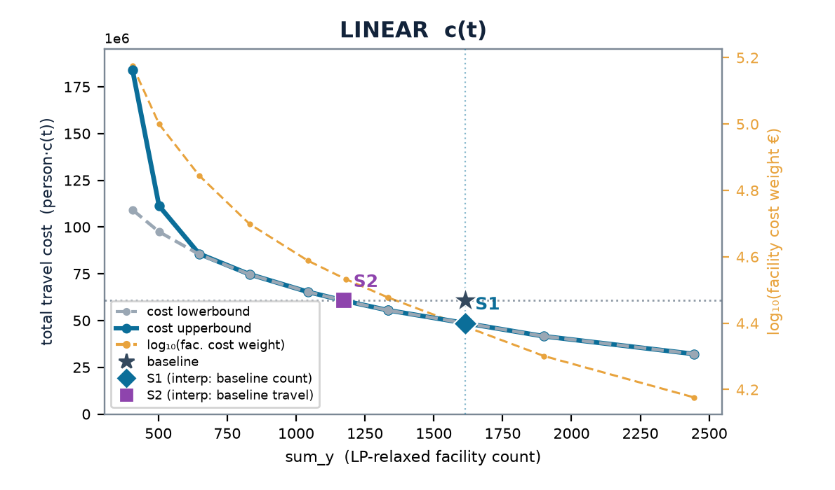
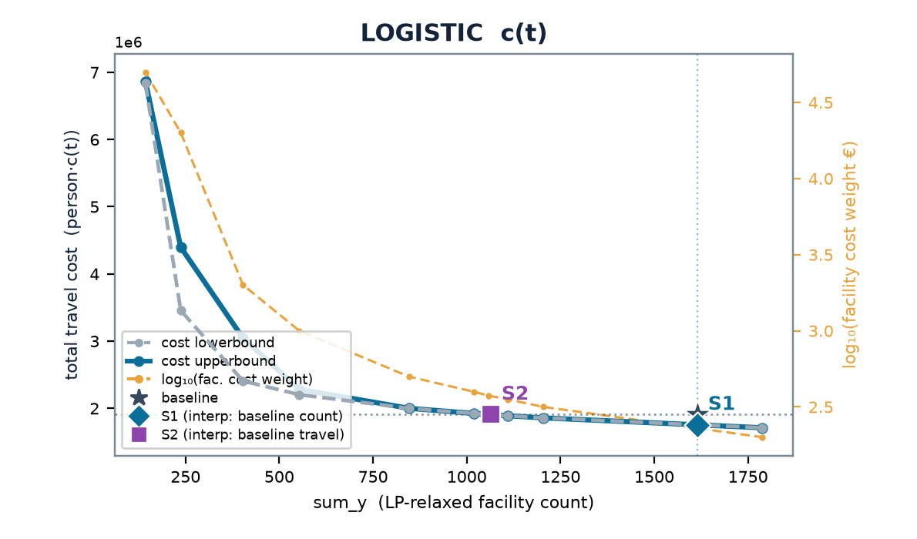
NETHERLANDS
Netherlands — multistart vs the LP-relax frontier
baseline (current) 1,615 cells · 3.48 min mean · travel (stranded at BIG) LIN 60.7M · LOG 1.9M
 | scenario | w | n_open | frac | multi vs relax | stranded (multi)
LINEAR | S1 | 0.300 | 1334 | 63 | +0% | 0
 | S2 | 0.341 | 1180 | 85 | +0% | 1
LOGISTIC | S1 | 0.00200 | 1788 | 104 | +0% | 0
 | S2 | 0.00376 | 1057 | 136 | +0% | 7
Charts: cost lowerbound (LP relaxation, dashed grey — drawn on top) & cost upperbound (multistart integer solution, solid blue) on the left; log₁₀(facility cost weight €) on the right, vs sum_y; ★ baseline, ◆ S1, ■ S2. Lower ≤ integer optimum ≤ upper; stranded clients priced at BIG (120 min linear / 1.0 logistic) — in the baseline too (coverage-consistent).

Slide 17
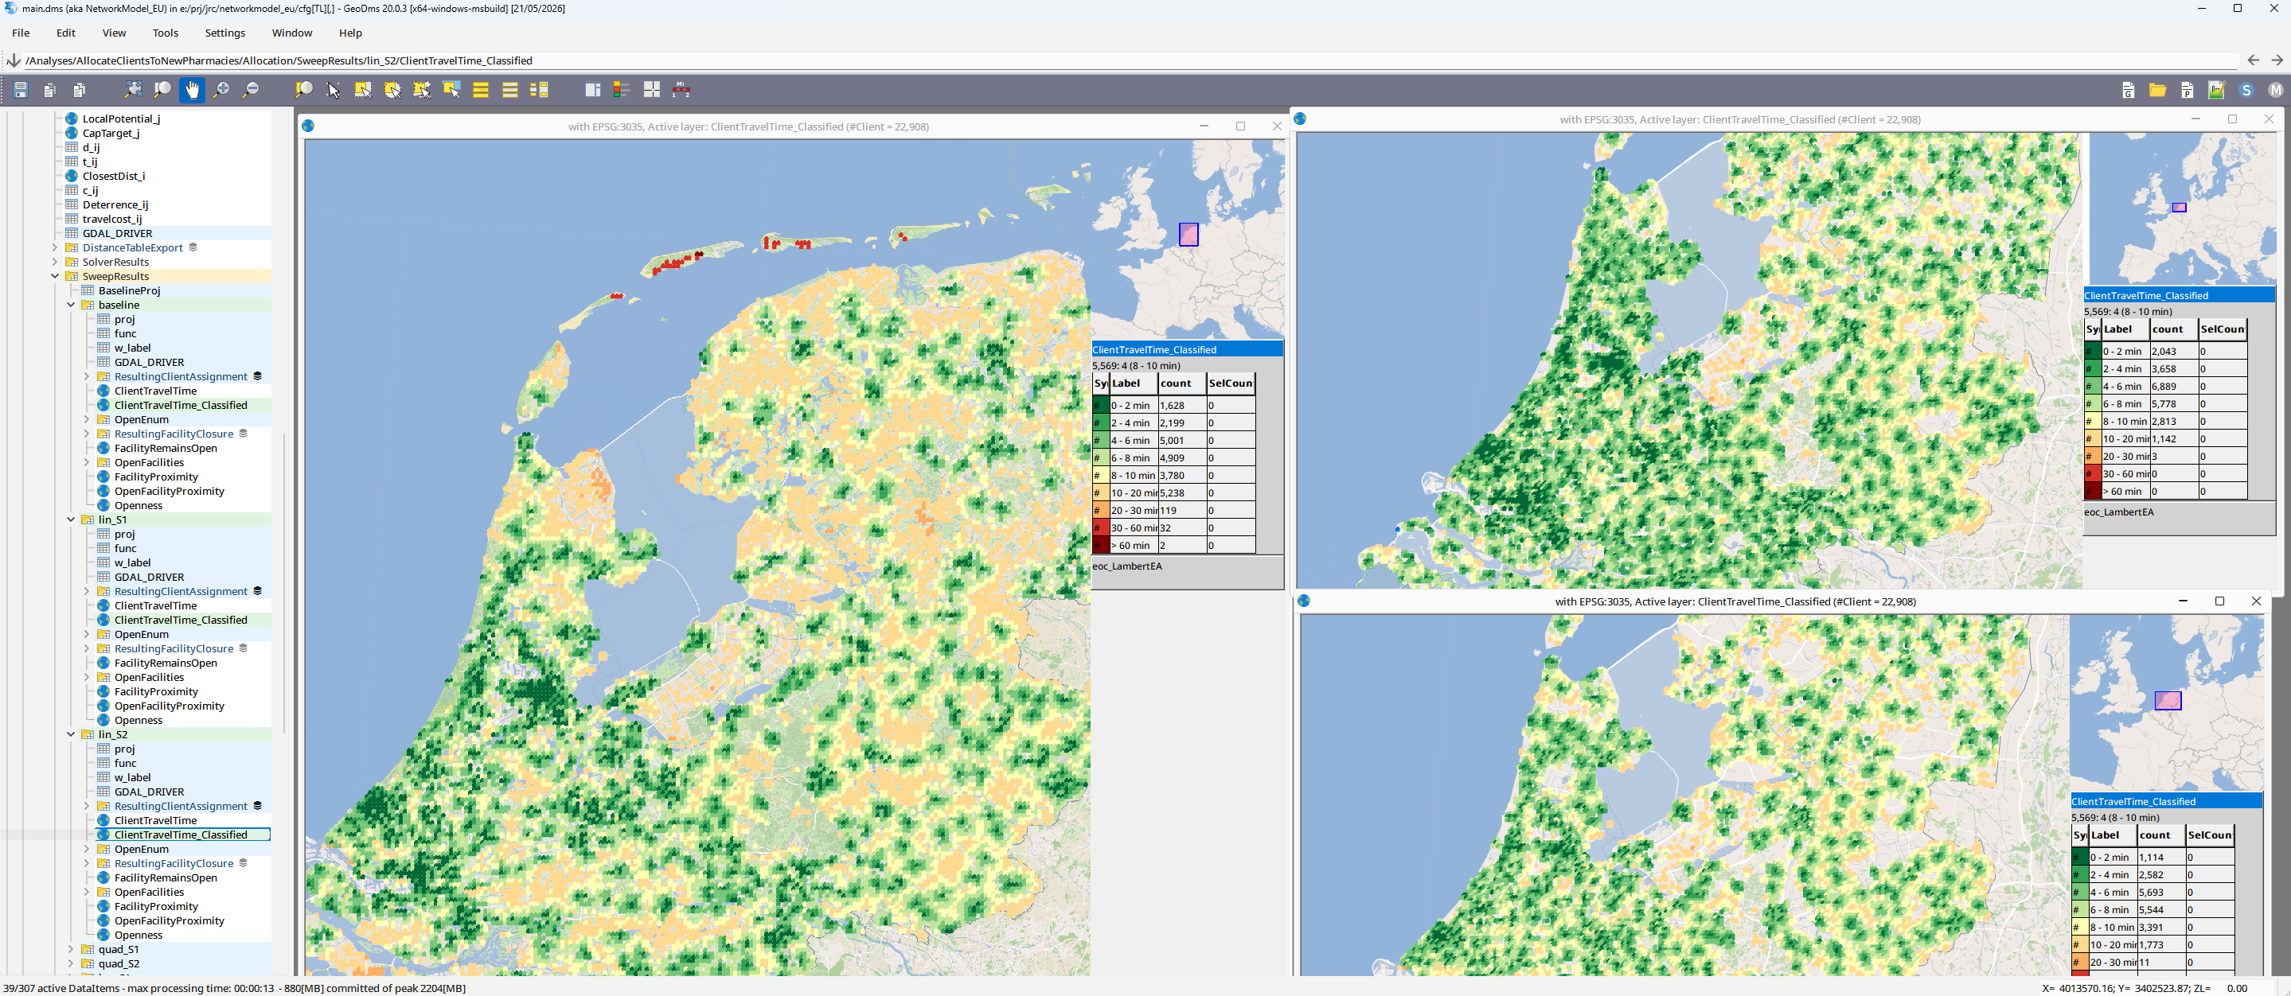

Slide 18
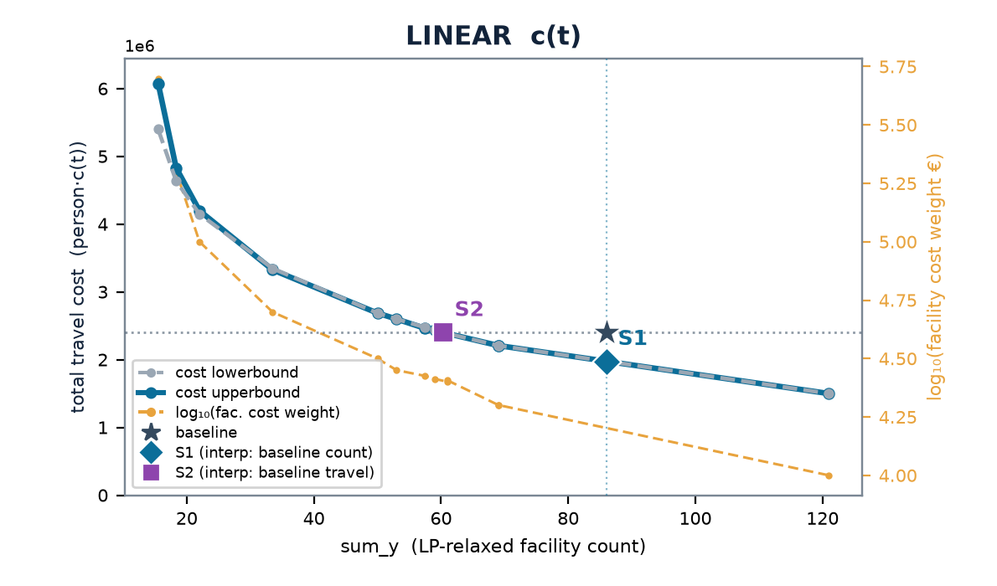
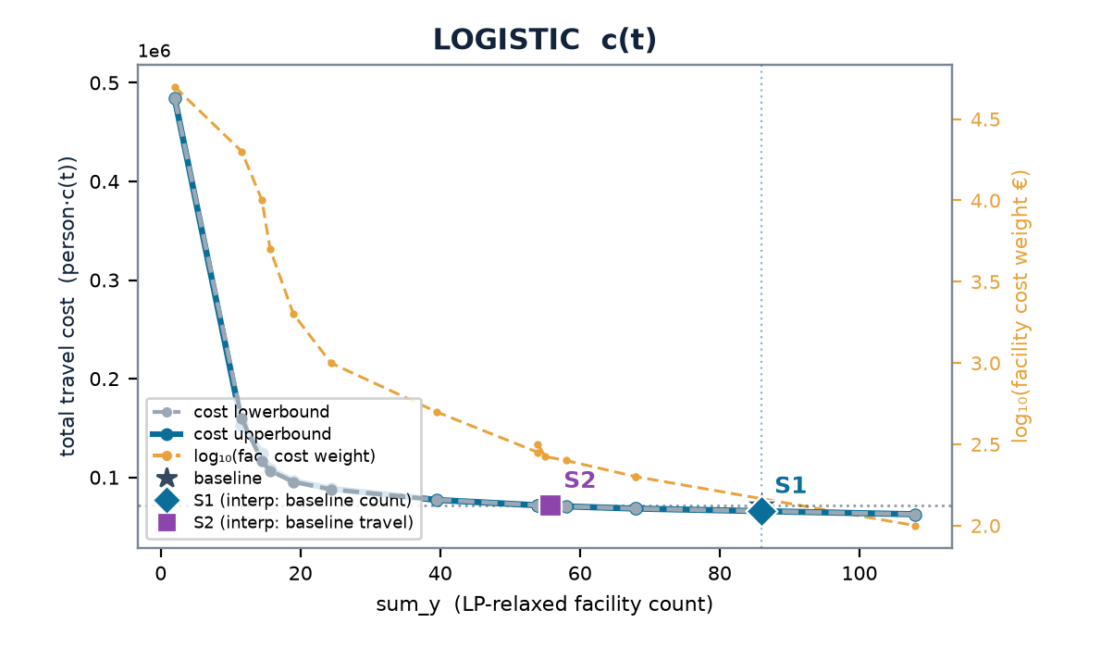
LUXEMBOURG
Luxembourg — multistart vs the LP-relax frontier
baseline (current) 86 cells · 3.79 min mean · travel (stranded at BIG) LIN 2.4M · LOG 71k
 | scenario | w | n_open | frac | multi vs relax | stranded (multi)
LINEAR | S1 | 0.200 | 69 | 0 | +0% | 0
 | S2 | 0.251 | 61 | 6 | +0% | 0
LOGISTIC | S1 | 0.00200 | 68 | 0 | +0% | 0
 | S2 | 0.00266 | 55 | 10 | +0% | 0
Charts: cost lowerbound (LP relaxation, dashed grey — drawn on top) & cost upperbound (multistart integer solution, solid blue) on the left; log₁₀(facility cost weight €) on the right, vs sum_y; ★ baseline, ◆ S1, ■ S2. Lower ≤ integer optimum ≤ upper; stranded clients priced at BIG (120 min linear / 1.0 logistic) — in the baseline too (coverage-consistent).

Slide 19
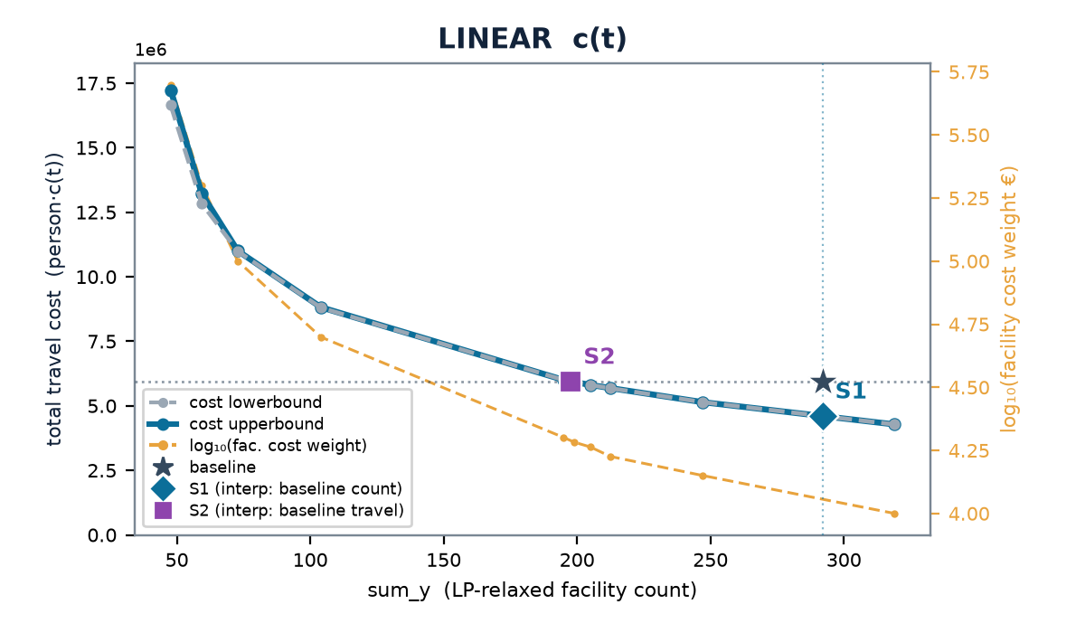
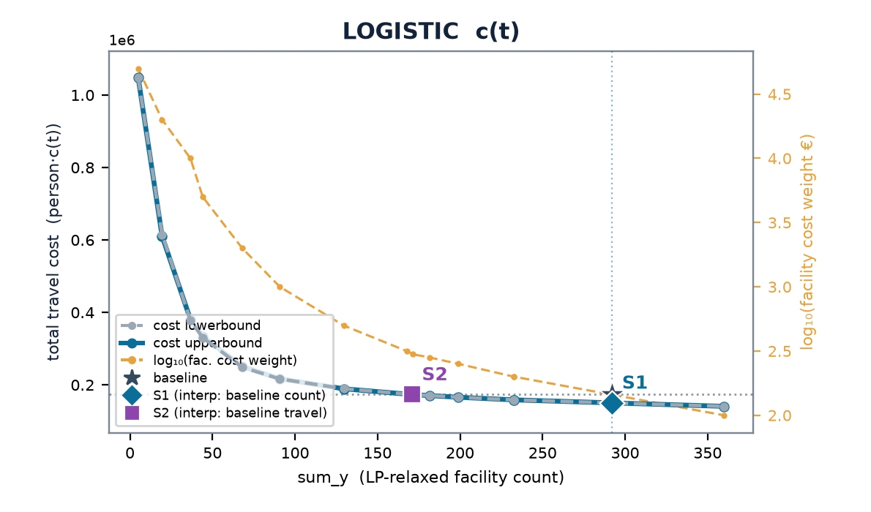
ESTONIA
Estonia — multistart vs the LP-relax frontier
baseline (current) 292 cells · 4.51 min mean · travel (stranded at BIG) LIN 5.9M · LOG 174k
 | scenario | w | n_open | frac | multi vs relax | stranded (multi)
LINEAR | S1 | 0.100 | 319 | 12 | +0% | 0
 | S2 | 0.192 | 199 | 0 | +0% | 1
LOGISTIC | S1 | 0.00200 | 232 | 17 | +0% | 0
 | S2 | 0.00299 | 172 | 19 | -0% | 1
Charts: cost lowerbound (LP relaxation, dashed grey — drawn on top) & cost upperbound (multistart integer solution, solid blue) on the left; log₁₀(facility cost weight €) on the right, vs sum_y; ★ baseline, ◆ S1, ■ S2. Lower ≤ integer optimum ≤ upper; stranded clients priced at BIG (120 min linear / 1.0 logistic) — in the baseline too (coverage-consistent).

Slide 20
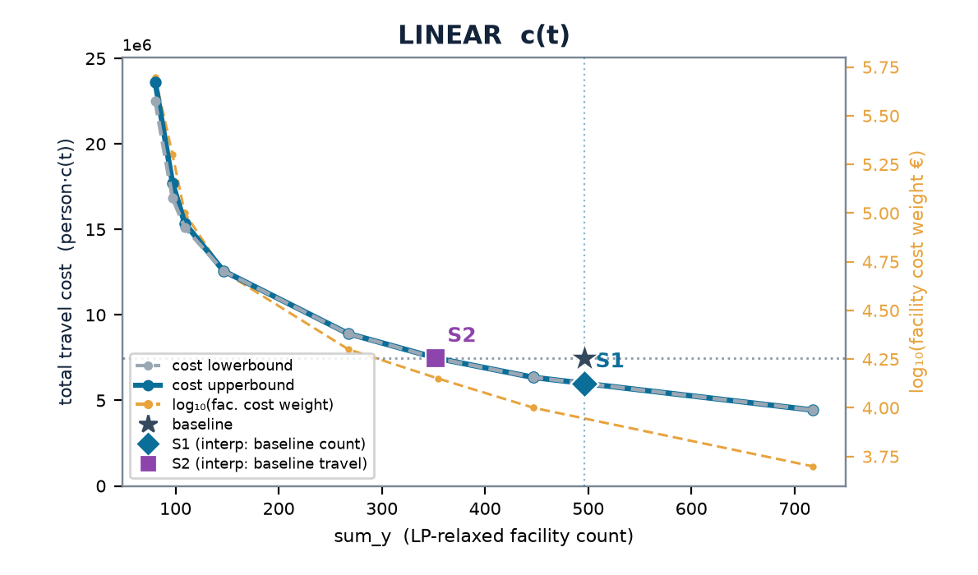
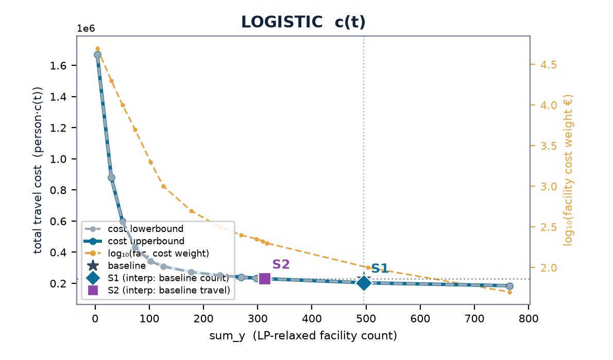
LATVIA
Latvia — multistart vs the LP-relax frontier
baseline (current) 496 cells · 3.96 min mean · travel (stranded at BIG) LIN 7.5M · LOG 230k
 | scenario | w | n_open | frac | multi vs relax | stranded (multi)
LINEAR | S1 | 0.100 | 447 | 0 | +0% | 0
 | S2 | 0.141 | 354 | 15 | +0% | 1
LOGISTIC | S1 | 0.00100 | 504 | 27 | -0% | 0
 | S2 | 0.00200 | 317 | 36 | +0% | 1
Charts: cost lowerbound (LP relaxation, dashed grey — drawn on top) & cost upperbound (multistart integer solution, solid blue) on the left; log₁₀(facility cost weight €) on the right, vs sum_y; ★ baseline, ◆ S1, ■ S2. Lower ≤ integer optimum ≤ upper; stranded clients priced at BIG (120 min linear / 1.0 logistic) — in the baseline too (coverage-consistent).

Slide 21
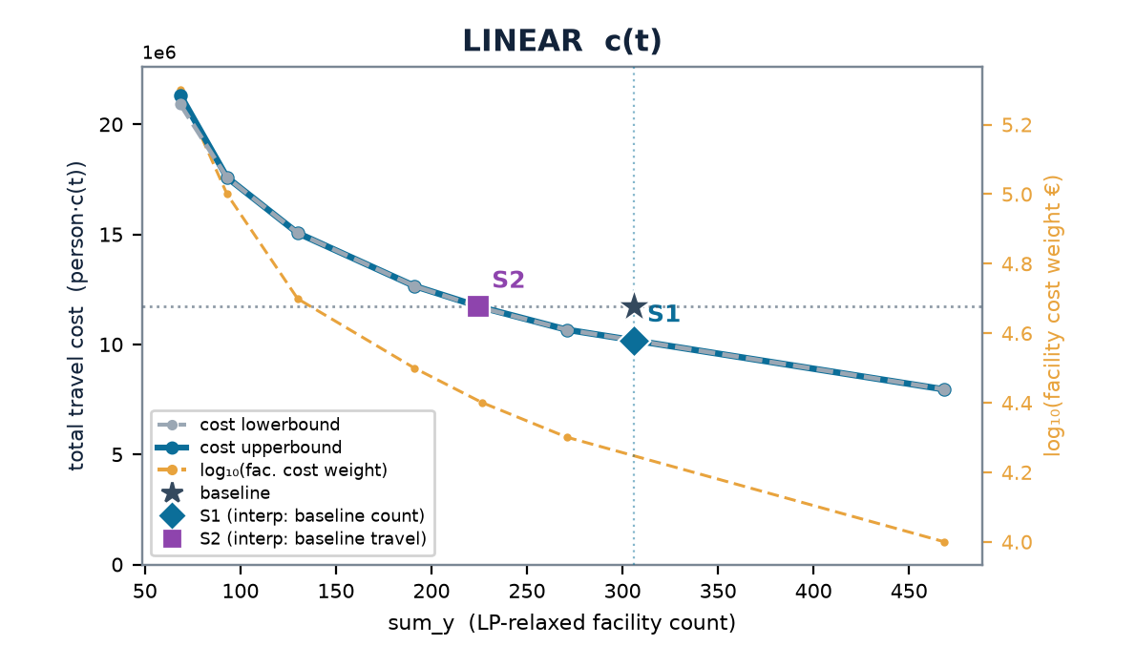
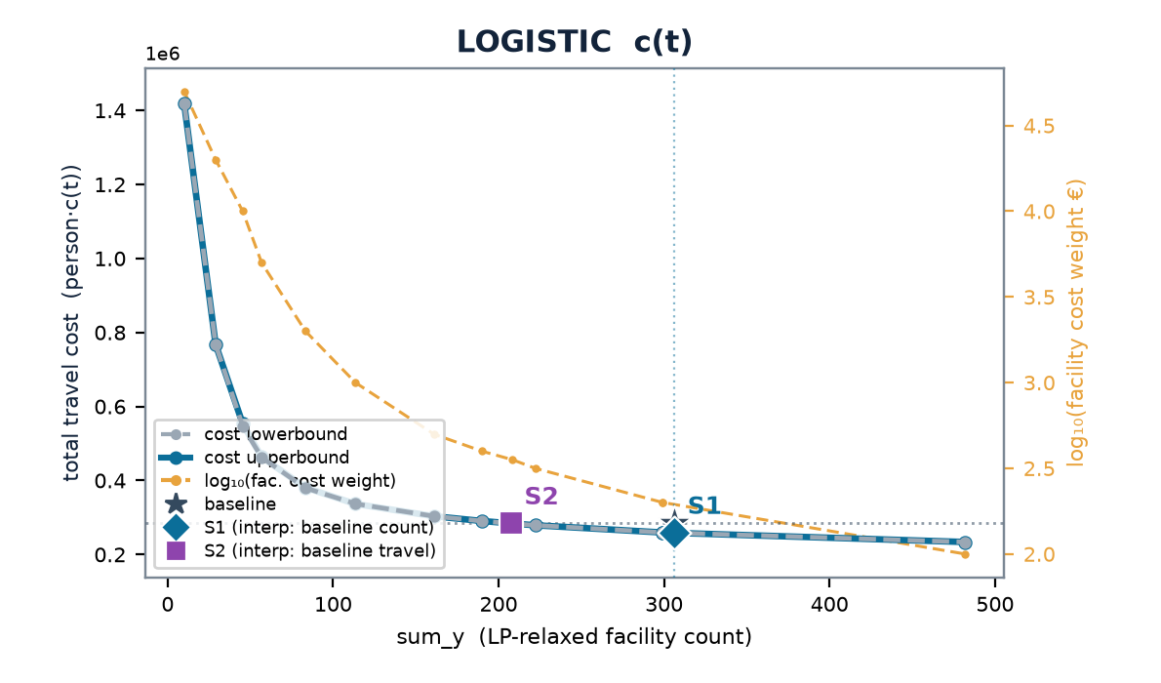
SLOVENIA
Slovenia — multistart vs the LP-relax frontier
baseline (current) 306 cells · 5.58 min mean · travel (stranded at BIG) LIN 11.7M · LOG 284k
 | scenario | w | n_open | frac | multi vs relax | stranded (multi)
LINEAR | S1 | 0.200 | 271 | 59 | +0% | 0
 | S2 | 0.251 | 226 | 27 | +0% | 0
LOGISTIC | S1 | 0.00200 | 299 | 68 | +0% | 0
 | S2 | 0.00355 | 208 | 79 | +0% | 0
Charts: cost lowerbound (LP relaxation, dashed grey — drawn on top) & cost upperbound (multistart integer solution, solid blue) on the left; log₁₀(facility cost weight €) on the right, vs sum_y; ★ baseline, ◆ S1, ■ S2. Lower ≤ integer optimum ≤ upper; stranded clients priced at BIG (120 min linear / 1.0 logistic) — in the baseline too (coverage-consistent).

Slide 22
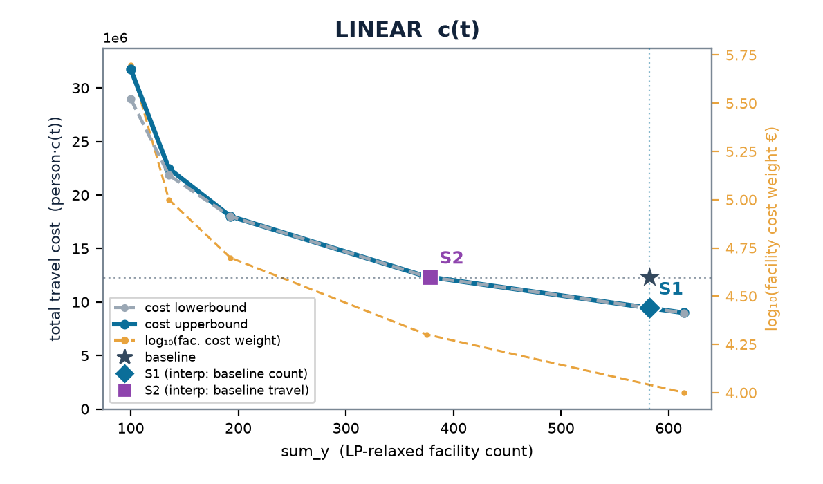
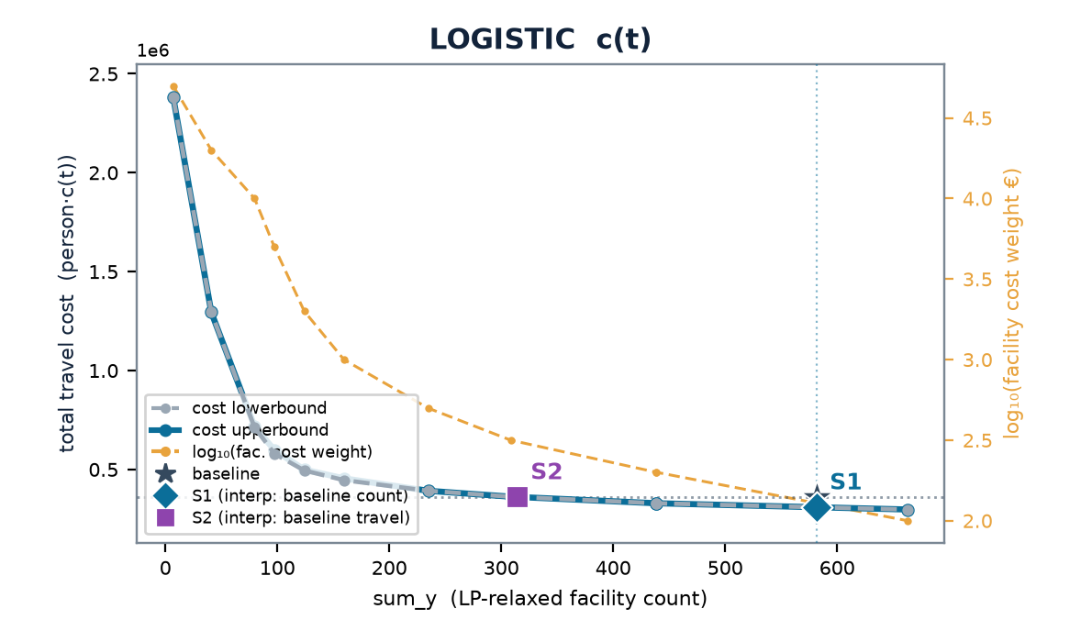
LITHUANIA
Lithuania — multistart vs the LP-relax frontier
baseline (current) 582 cells · 4.39 min mean · travel (stranded at BIG) LIN 12.3M · LOG 361k
 | scenario | w | n_open | frac | multi vs relax | stranded (multi)
LINEAR | S1 | 0.100 | 614 | 13 | +0% | 0
 | S2 | 0.200 | 375 | 9 | +0% | 1
LOGISTIC | S1 | 0.00100 | 663 | 29 | +0% | 0
 | S2 | 0.00316 | 308 | 13 | +0% | 3
Charts: cost lowerbound (LP relaxation, dashed grey — drawn on top) & cost upperbound (multistart integer solution, solid blue) on the left; log₁₀(facility cost weight €) on the right, vs sum_y; ★ baseline, ◆ S1, ■ S2. Lower ≤ integer optimum ≤ upper; stranded clients priced at BIG (120 min linear / 1.0 logistic) — in the baseline too (coverage-consistent).

Slide 23
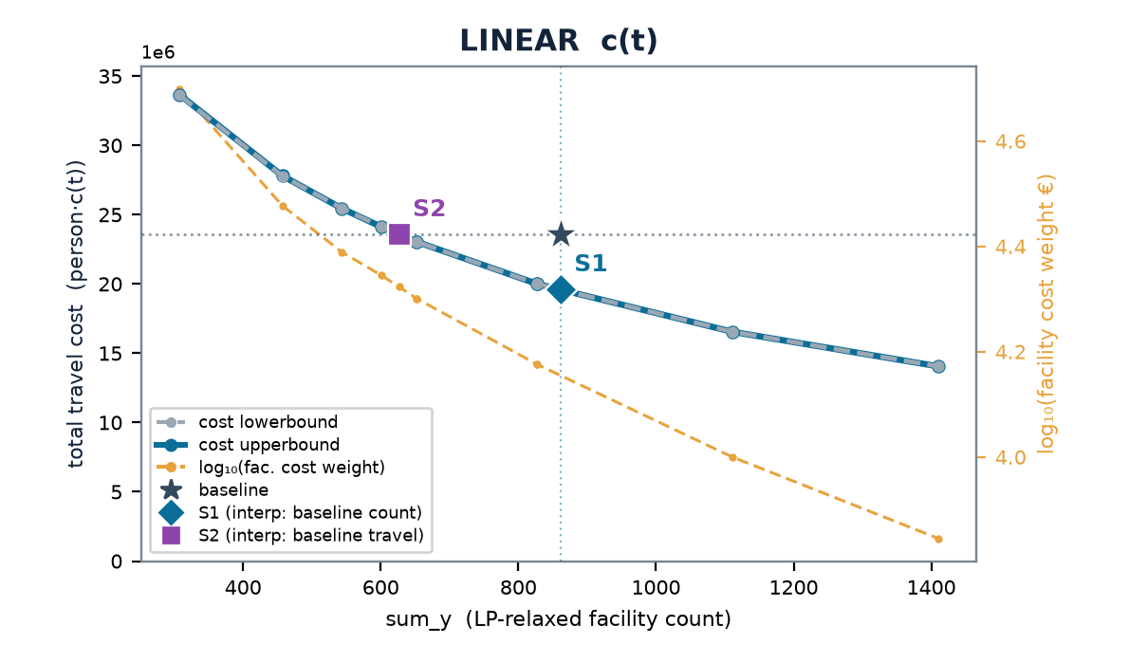
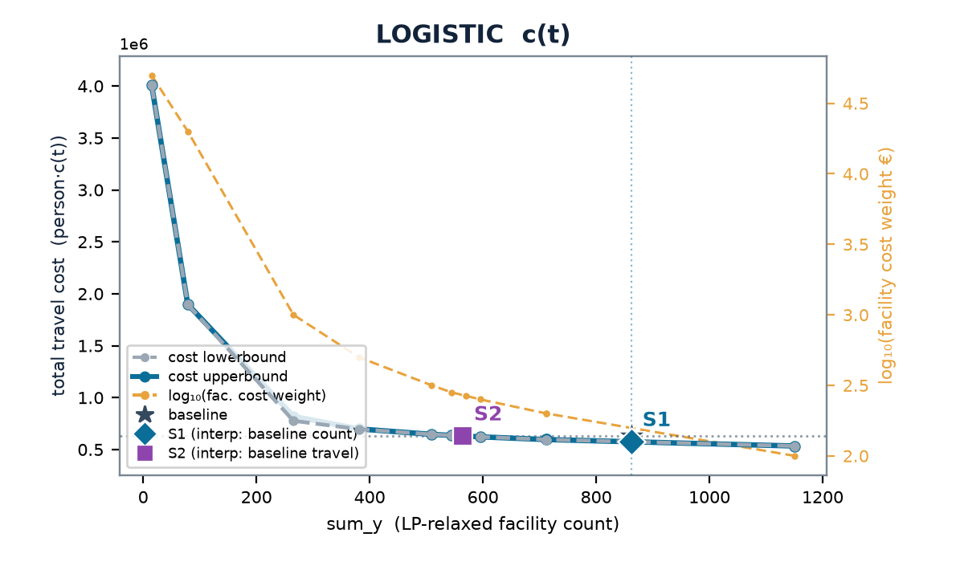
IRELAND
Ireland — multistart vs the LP-relax frontier
baseline (current) 862 cells · 4.71 min mean · travel (stranded at BIG) LIN 23.6M · LOG 630k
 | scenario | w | n_open | frac | multi vs relax | stranded (multi)
LINEAR | S1 | 0.150 | 827 | 40 | +0% | 0
 | S2 | 0.210 | 627 | 79 | +0% | 0
LOGISTIC | S1 | 0.00200 | 712 | 80 | +0% | 0
 | S2 | 0.00266 | 571 | 146 | +0% | 0
Charts: cost lowerbound (LP relaxation, dashed grey — drawn on top) & cost upperbound (multistart integer solution, solid blue) on the left; log₁₀(facility cost weight €) on the right, vs sum_y; ★ baseline, ◆ S1, ■ S2. Lower ≤ integer optimum ≤ upper; stranded clients priced at BIG (120 min linear / 1.0 logistic) — in the baseline too (coverage-consistent).

Slide 24
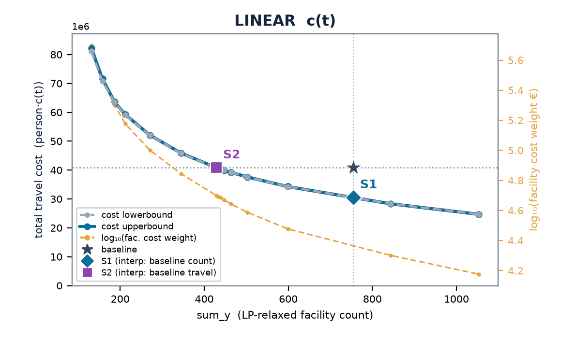
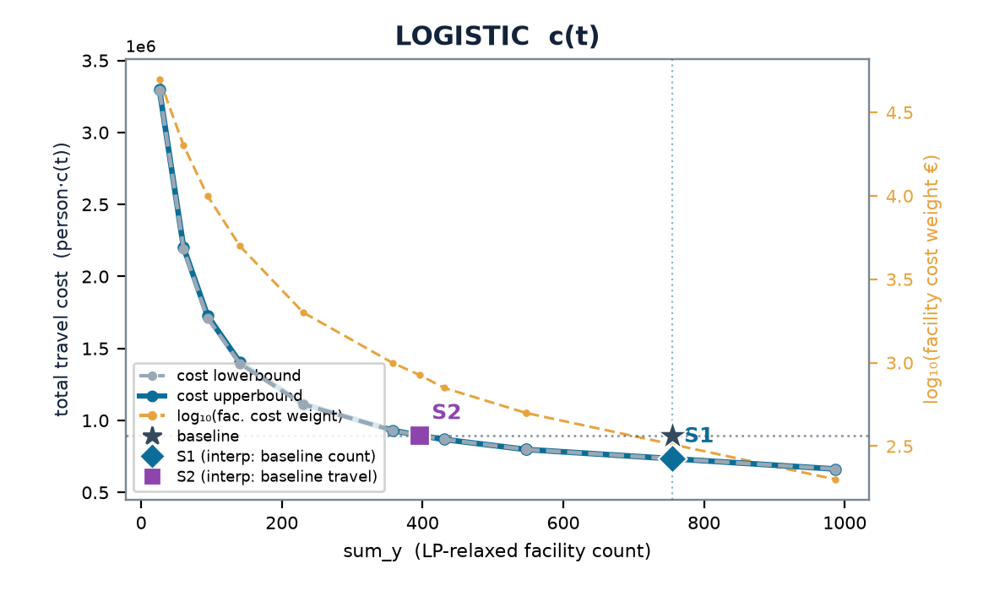
NORWAY
Norway — multistart vs the LP-relax frontier
baseline (current) 755 cells · 7.99 min mean · travel (stranded at BIG) LIN 40.8M · LOG 896k
 | scenario | w | n_open | frac | multi vs relax | stranded (multi)
LINEAR | S1 | 0.200 | 844 | 24 | +0% | 1
 | S2 | 0.500 | 429 | 28 | +0% | 2
LOGISTIC | S1 | 0.00500 | 547 | 58 | +0% | 3
 | S2 | 0.00841 | 396 | 35 | +0% | 54
Charts: cost lowerbound (LP relaxation, dashed grey — drawn on top) & cost upperbound (multistart integer solution, solid blue) on the left; log₁₀(facility cost weight €) on the right, vs sum_y; ★ baseline, ◆ S1, ■ S2. Lower ≤ integer optimum ≤ upper; stranded clients priced at BIG (120 min linear / 1.0 logistic) — in the baseline too (coverage-consistent).

Slide 25
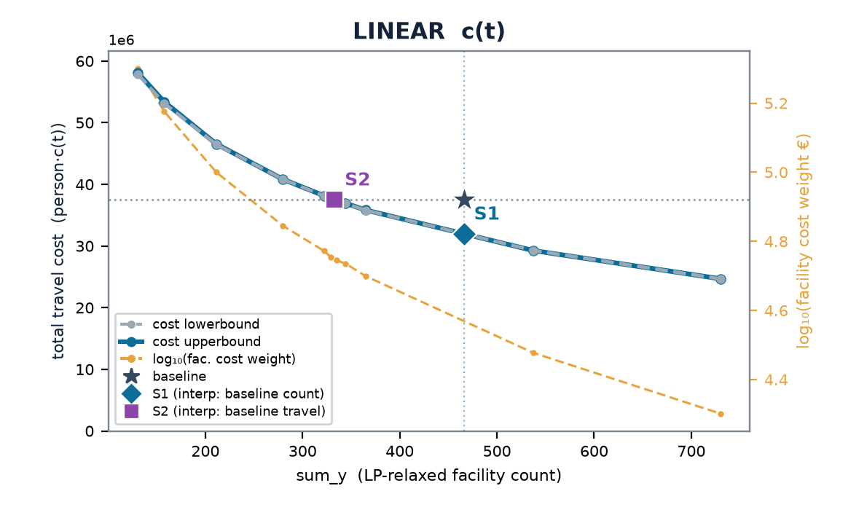
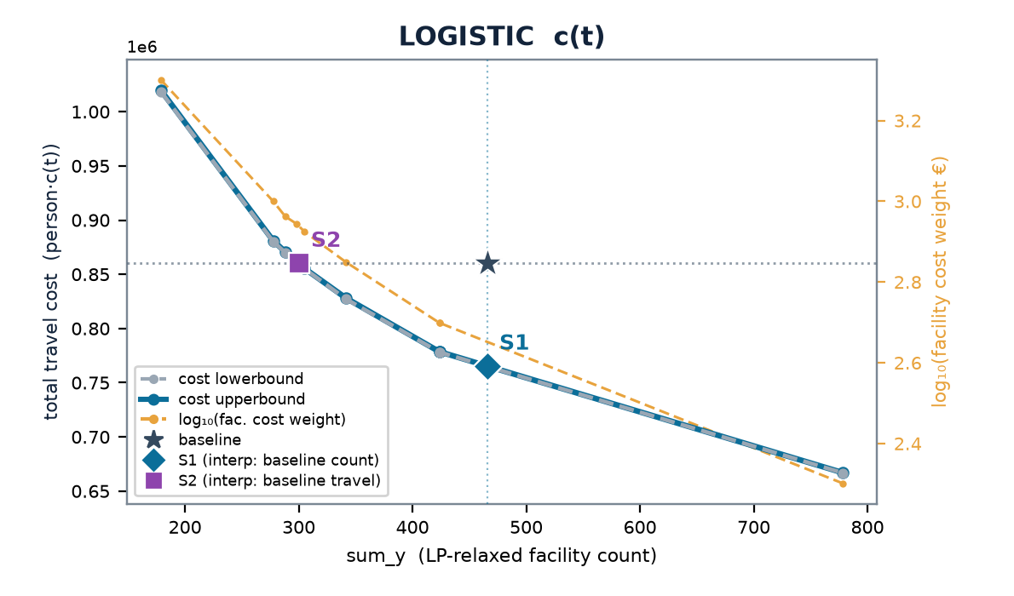
DENMARK
Denmark — multistart vs the LP-relax frontier
baseline (current) 466 cells · 6.52 min mean · travel (stranded at BIG) LIN 37.5M · LOG 860k
 | scenario | w | n_open | frac | multi vs relax | stranded (multi)
LINEAR | S1 | 0.300 | 538 | 31 | -0% | 0
 | S2 | 0.555 | 335 | 52 | +0% | 0
LOGISTIC | S1 | 0.00500 | 424 | 154 | +0% | 0
 | S2 | 0.00878 | 298 | 109 | +0% | 0
Charts: cost lowerbound (LP relaxation, dashed grey — drawn on top) & cost upperbound (multistart integer solution, solid blue) on the left; log₁₀(facility cost weight €) on the right, vs sum_y; ★ baseline, ◆ S1, ■ S2. Lower ≤ integer optimum ≤ upper; stranded clients priced at BIG (120 min linear / 1.0 logistic) — in the baseline too (coverage-consistent).

Slide 26
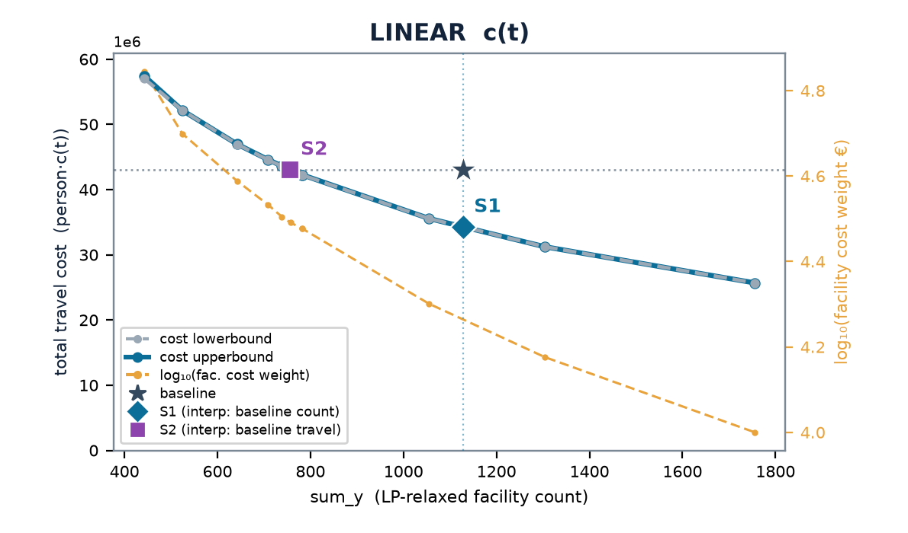
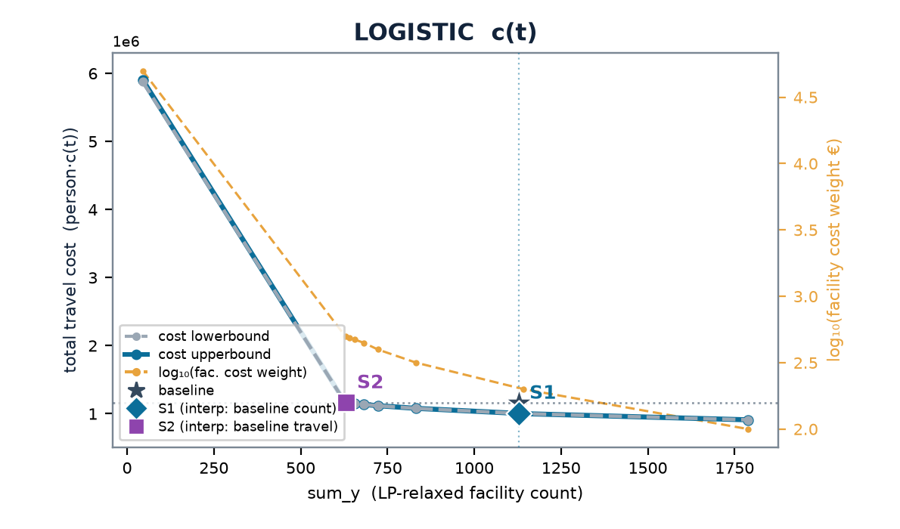
AUSTRIA
Austria — multistart vs the LP-relax frontier
baseline (current) 1,129 cells · 4.82 min mean · travel (stranded at BIG) LIN 43.1M · LOG 1.2M
 | scenario | w | n_open | frac | multi vs relax | stranded (multi)
LINEAR | S1 | 0.200 | 1055 | 100 | +0% | 0
 | S2 | 0.310 | 757 | 181 | +0% | 2
LOGISTIC | S1 | 0.00200 | 1142 | 136 | +0% | 0
 | S2 | 0.00500 | 629 | 181 | +0% | 0
Charts: cost lowerbound (LP relaxation, dashed grey — drawn on top) & cost upperbound (multistart integer solution, solid blue) on the left; log₁₀(facility cost weight €) on the right, vs sum_y; ★ baseline, ◆ S1, ■ S2. Lower ≤ integer optimum ≤ upper; stranded clients priced at BIG (120 min linear / 1.0 logistic) — in the baseline too (coverage-consistent).

Slide 27
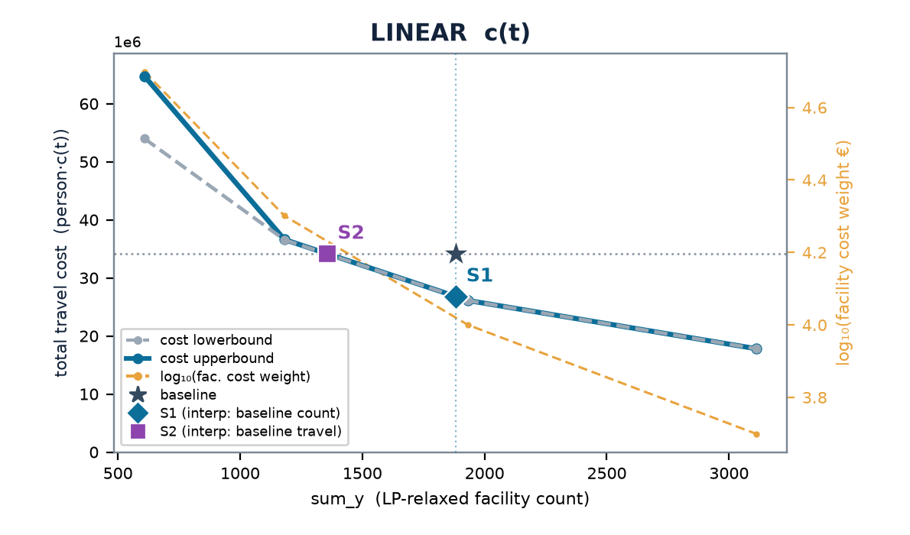
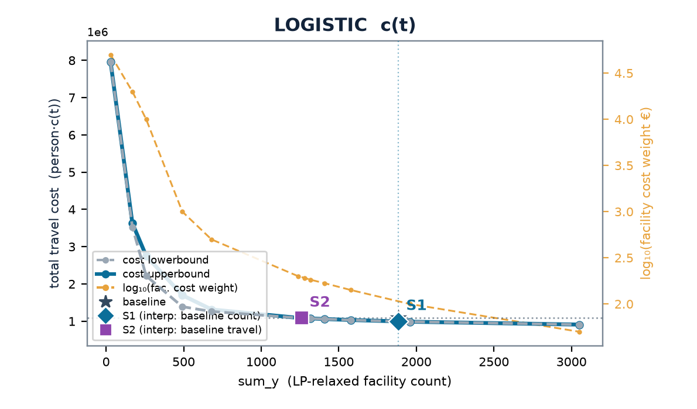
PORTUGAL
Portugal — multistart vs the LP-relax frontier
baseline (current) 1,882 cells · 3.47 min mean · travel (stranded at BIG) LIN 34.2M · LOG 1.1M
 | scenario | w | n_open | frac | multi vs relax | stranded (multi)
LINEAR | S1 | 0.100 | undefined | undefined | +0% | 10
 | S2 | 0.200 | undefined | undefined | +0% | 10
LOGISTIC | S1 | 0.00100 | undefined | undefined | +0% | 10
 | S2 | 0.00192 | undefined | undefined | +0% | 11
Charts: cost lowerbound (LP relaxation, dashed grey — drawn on top) & cost upperbound (multistart integer solution, solid blue) on the left; log₁₀(facility cost weight €) on the right, vs sum_y; ★ baseline, ◆ S1, ■ S2. Lower ≤ integer optimum ≤ upper; stranded clients priced at BIG (120 min linear / 1.0 logistic) — in the baseline too (coverage-consistent).

Slide 28
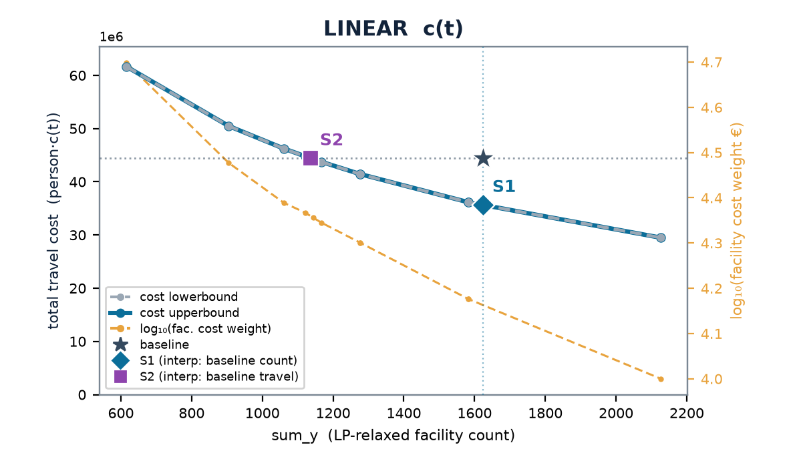

CZECHIA
Czechia — multistart vs the LP-relax frontier
baseline (current) 1,624 cells · 4.23 min mean · travel (stranded at BIG) LIN 44.4M · LOG 1.3M
 | scenario | w | n_open | frac | multi vs relax | stranded (multi)
LINEAR | S1 | 0.150 | 1583 | 58 | +0% | 1
 | S2 | 0.227 | 1144 | 43 | -0% | 0
LOGISTIC | S1 | 0.00200 | 1337 | 141 | +0% | 0
 | S2 | 0.00282 | 1024 | 112 | +0% | 3
Charts: cost lowerbound (LP relaxation, dashed grey — drawn on top) & cost upperbound (multistart integer solution, solid blue) on the left; log₁₀(facility cost weight €) on the right, vs sum_y; ★ baseline, ◆ S1, ■ S2. Lower ≤ integer optimum ≤ upper; stranded clients priced at BIG (120 min linear / 1.0 logistic) — in the baseline too (coverage-consistent).

Slide 29
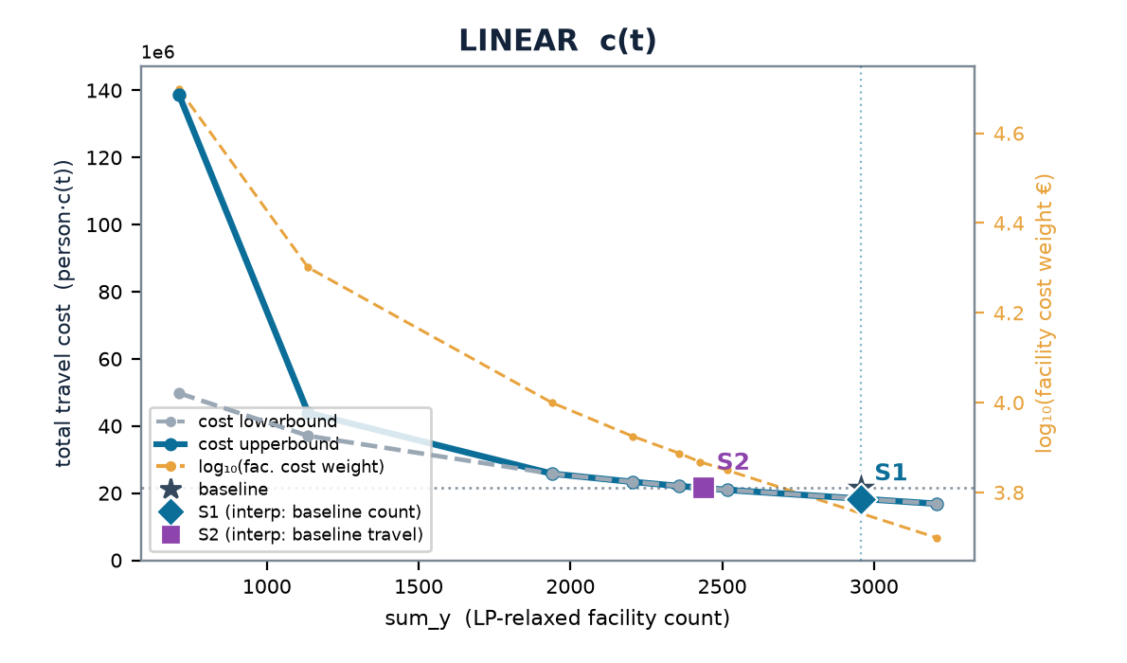
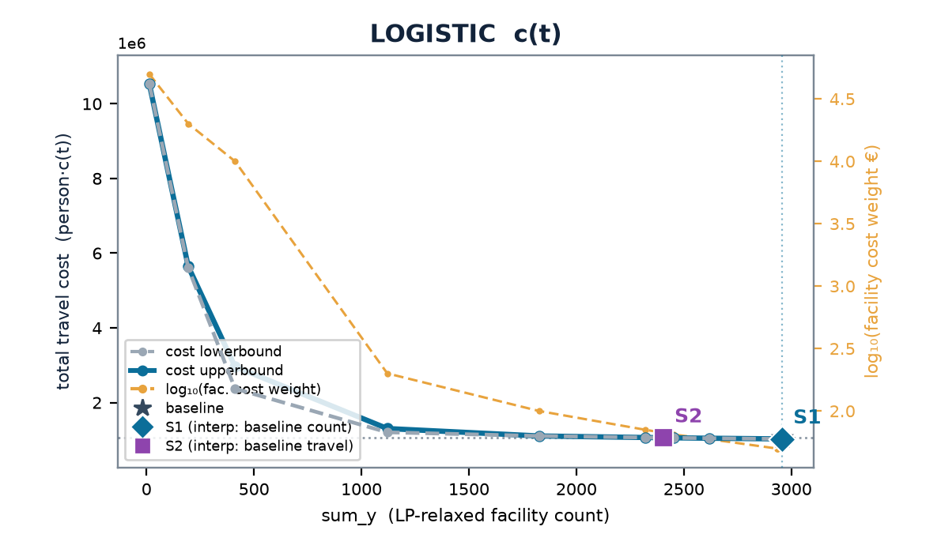
BELGIUM
Belgium — multistart vs the LP-relax frontier
baseline (current) 2,958 cells · 1.87 min mean · travel (stranded at BIG) LIN 21.5M · LOG 1.1M
 | scenario | w | n_open | frac | multi vs relax | stranded (multi)
LINEAR | S1 | 0.0500 | 3208 | 83 | +0% | 0
 | S2 | 0.0738 | 2426 | 150 | +0% | 0
LOGISTIC | S1 | 0.000500 | 2934 | 149 | +0% | 0
 | S2 | 0.000648 | 2453 | 220 | +0% | 0
Charts: cost lowerbound (LP relaxation, dashed grey — drawn on top) & cost upperbound (multistart integer solution, solid blue) on the left; log₁₀(facility cost weight €) on the right, vs sum_y; ★ baseline, ◆ S1, ■ S2. Lower ≤ integer optimum ≤ upper; stranded clients priced at BIG (120 min linear / 1.0 logistic) — in the baseline too (coverage-consistent).

Slide 30
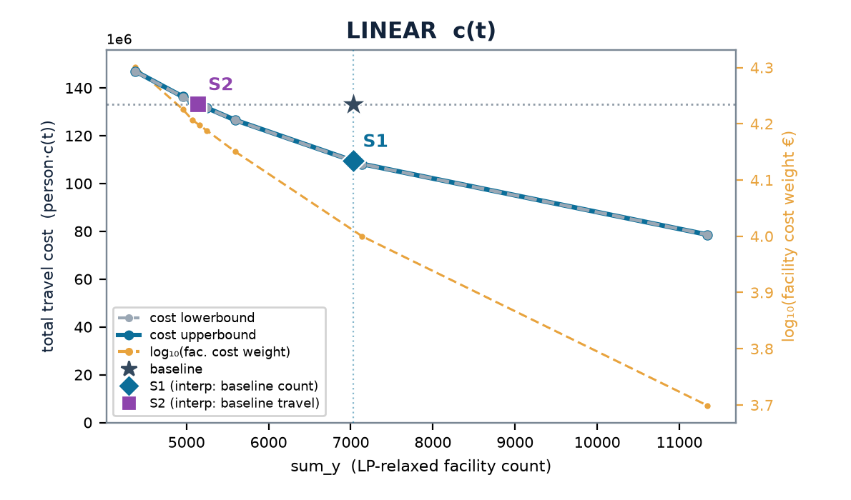
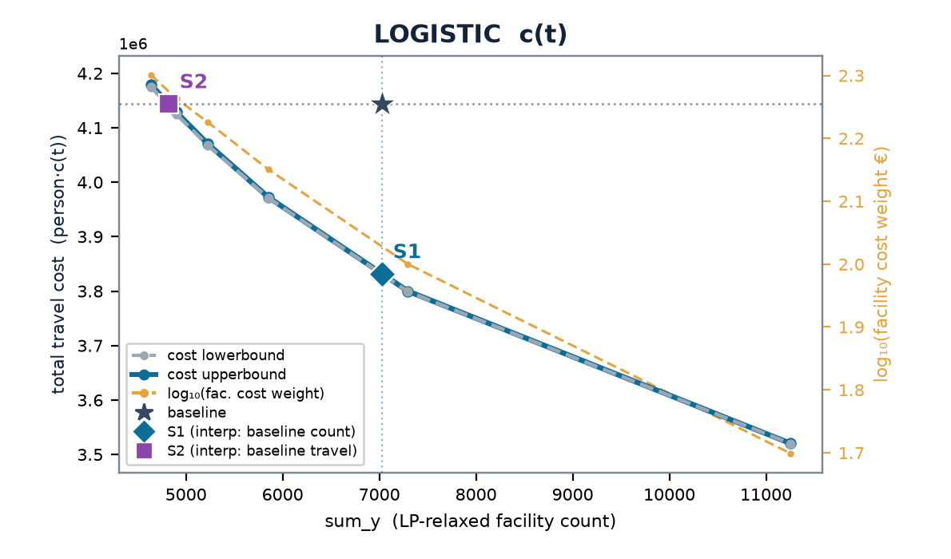
POLAND
Poland — multistart vs the LP-relax frontier
baseline (current) 7,027 cells · 3.59 min mean · travel (stranded at BIG) LIN 133M · LOG 4.1M
 | scenario | w | n_open | frac | multi vs relax | stranded (multi)
LINEAR | S1 | 0.100 | 7139 | 663 | +0% | 0
 | S2 | 0.158 | 5156 | 430 | +0% | 0
LOGISTIC | S1 | 0.00100 | 7297 | 885 | +0% | 0
 | S2 | 0.00183 | 4900 | 1260 | +0% | 0
Charts: cost lowerbound (LP relaxation, dashed grey — drawn on top) & cost upperbound (multistart integer solution, solid blue) on the left; log₁₀(facility cost weight €) on the right, vs sum_y; ★ baseline, ◆ S1, ■ S2. Lower ≤ integer optimum ≤ upper; stranded clients priced at BIG (120 min linear / 1.0 logistic) — in the baseline too (coverage-consistent).

Slide 31
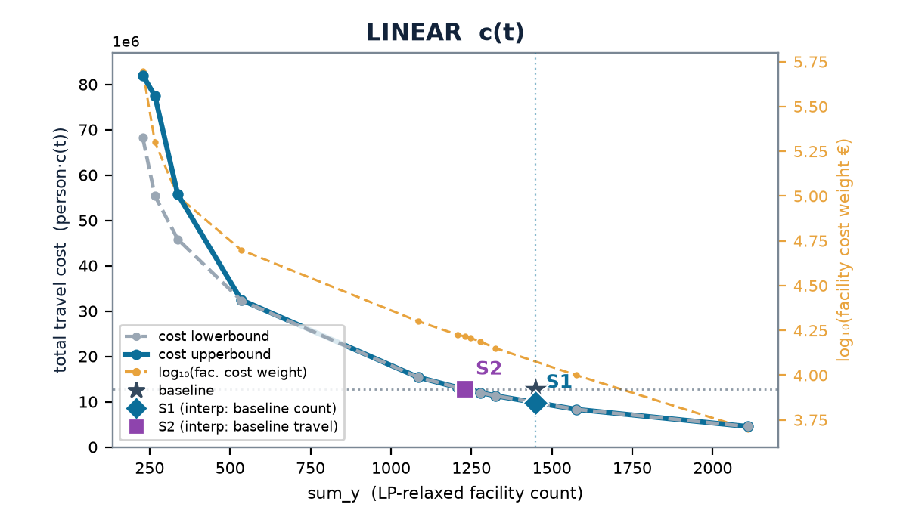
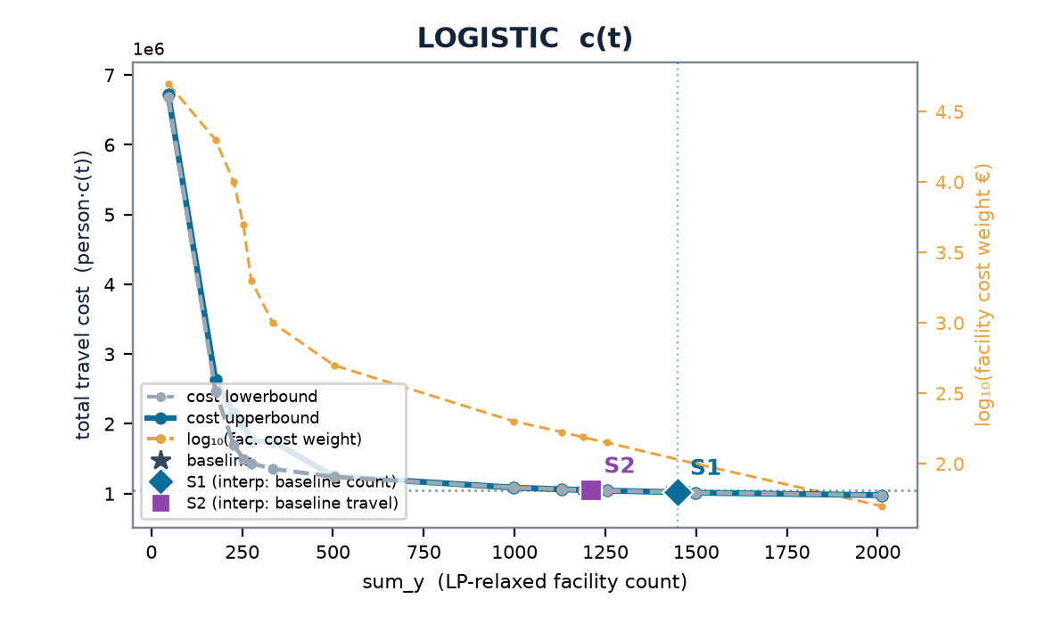
FRANCE · FR1
Île-de-France — multistart vs the LP-relax frontier
baseline (current) 1,449 cells · 1.03 min mean · travel (stranded at BIG) LIN 12.7M · LOG 1.0M
 | scenario | w | n_open | frac | multi vs relax | stranded (multi)
LINEAR | S1 | 0.141 | 1325 | 14 | +0% | 0
 | S2 | 0.165 | 1230 | 12 | +0% | 1
LOGISTIC | S1 | 0.00100 | 1499 | 48 | +0% | 0
 | S2 | 0.00154 | 1188 | 30 | +0% | 1
Charts: cost lowerbound (LP relaxation, dashed grey — drawn on top) & cost upperbound (multistart integer solution, solid blue) on the left; log₁₀(facility cost weight €) on the right, vs sum_y; ★ baseline, ◆ S1, ■ S2. Lower ≤ integer optimum ≤ upper; stranded clients priced at BIG (120 min linear / 1.0 logistic) — in the baseline too (coverage-consistent).

Slide 32
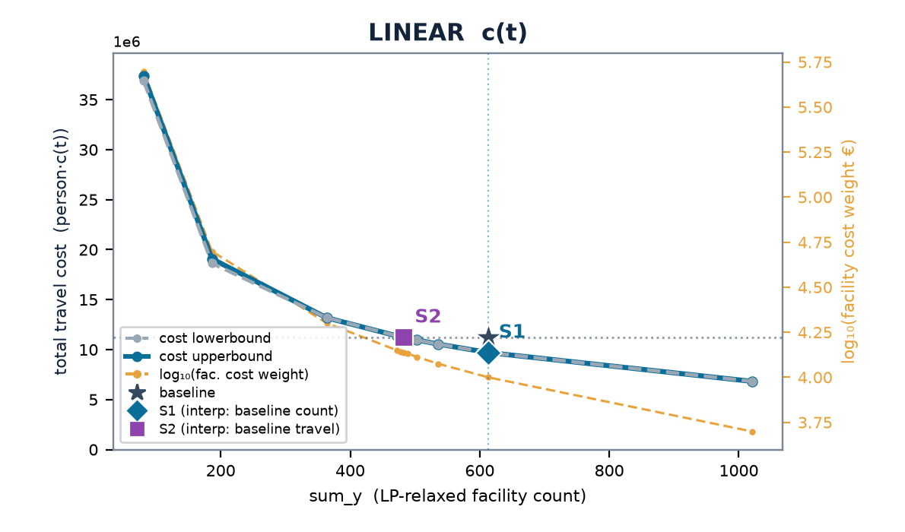
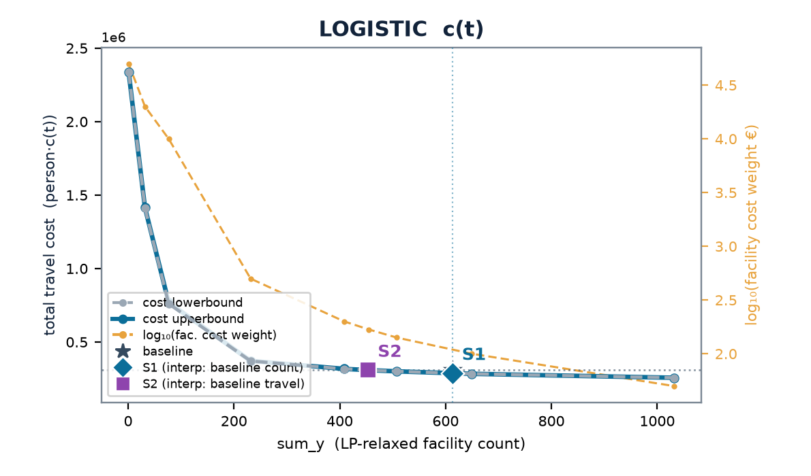
FRANCE · FRB
Centre-Val de Loire — multistart vs the LP-relax frontier
baseline (current) 613 cells · 4.36 min mean · travel (stranded at BIG) LIN 11.2M · LOG 309k
 | scenario | w | n_open | frac | multi vs relax | stranded (multi)
LINEAR | S1 | 0.100 | 613 | 40 | +0% | 0
 | S2 | 0.137 | 482 | 67 | +0% | 1
LOGISTIC | S1 | 0.00100 | 650 | 71 | -0% | 0
 | S2 | 0.00168 | 455 | 102 | +0% | 0
Charts: cost lowerbound (LP relaxation, dashed grey — drawn on top) & cost upperbound (multistart integer solution, solid blue) on the left; log₁₀(facility cost weight €) on the right, vs sum_y; ★ baseline, ◆ S1, ■ S2. Lower ≤ integer optimum ≤ upper; stranded clients priced at BIG (120 min linear / 1.0 logistic) — in the baseline too (coverage-consistent).

Slide 33
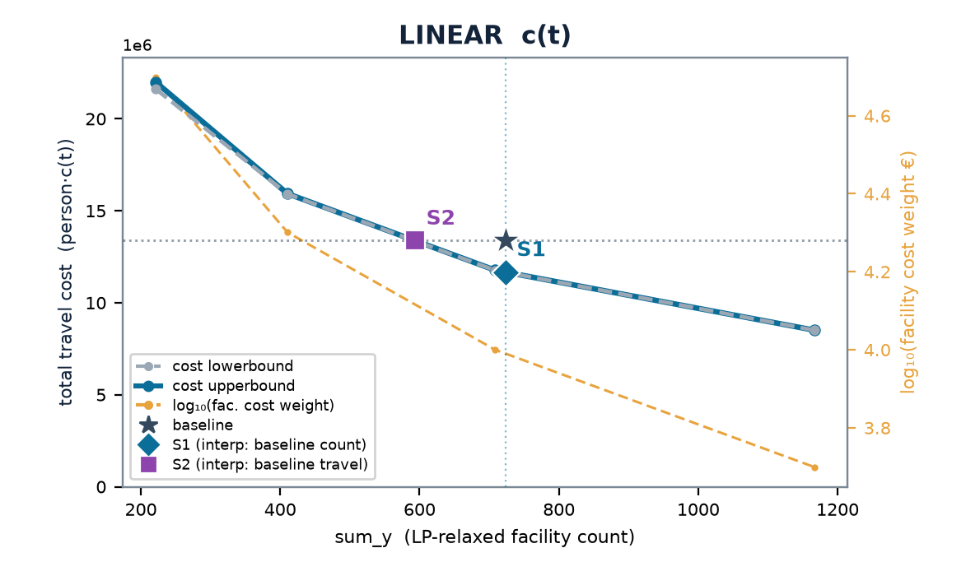
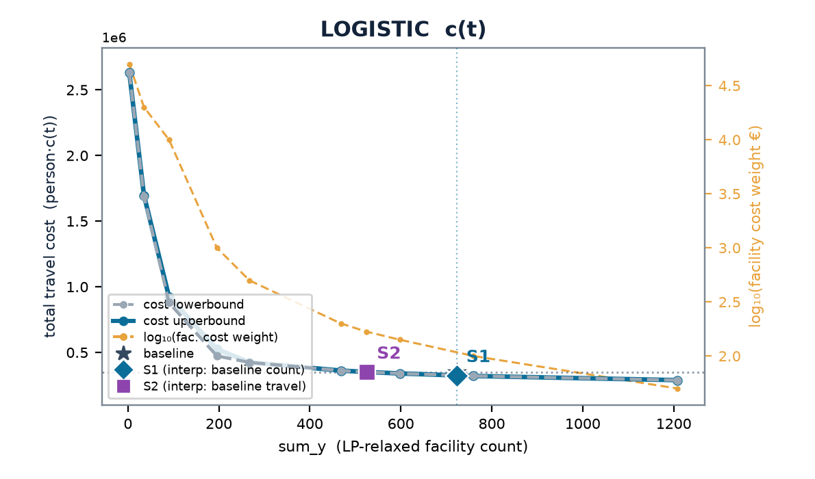
FRANCE · FRC
Bourgogne-Franche-Comté — multistart vs the LP-relax frontier
baseline (current) 723 cells · 4.78 min mean · travel (stranded at BIG) LIN 13.4M · LOG 351k
 | scenario | w | n_open | frac | multi vs relax | stranded (multi)
LINEAR | S1 | 0.100 | 708 | 71 | +0% | 0
 | S2 | 0.100 | 708 | 71 | +0% | 0
LOGISTIC | S1 | 0.00100 | 760 | 99 | +0% | 0
 | S2 | 0.00168 | 524 | 103 | +0% | 1
Charts: cost lowerbound (LP relaxation, dashed grey — drawn on top) & cost upperbound (multistart integer solution, solid blue) on the left; log₁₀(facility cost weight €) on the right, vs sum_y; ★ baseline, ◆ S1, ■ S2. Lower ≤ integer optimum ≤ upper; stranded clients priced at BIG (120 min linear / 1.0 logistic) — in the baseline too (coverage-consistent).

Slide 34
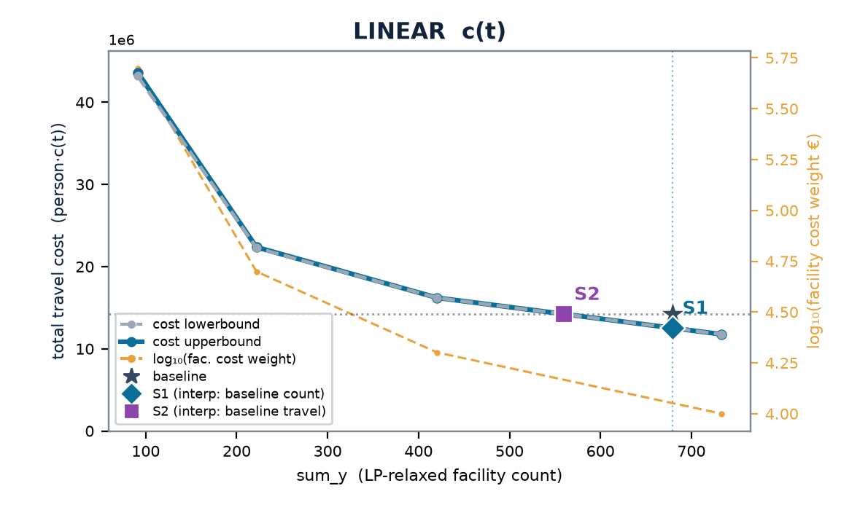
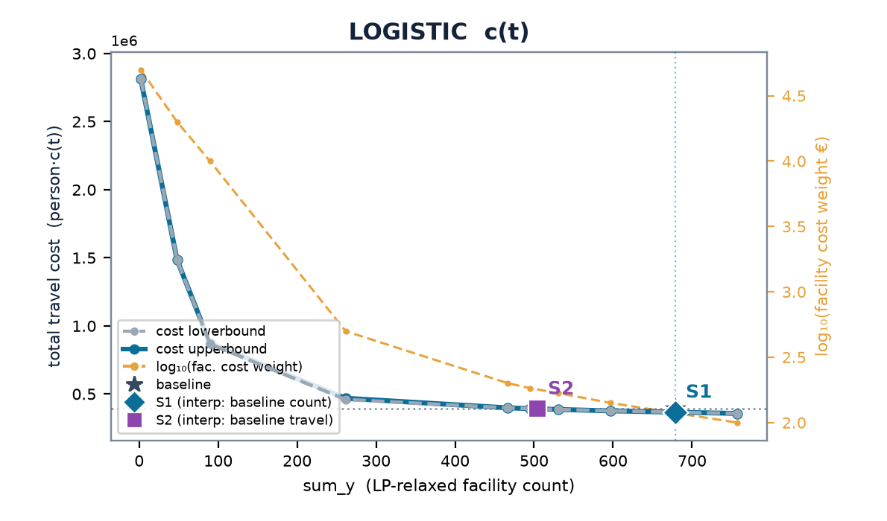
FRANCE · FRD
Normandie — multistart vs the LP-relax frontier
baseline (current) 679 cells · 4.31 min mean · travel (stranded at BIG) LIN 14.2M · LOG 391k
 | scenario | w | n_open | frac | multi vs relax | stranded (multi)
LINEAR | S1 | 0.100 | 733 | 53 | +0% | 0
 | S2 | 0.200 | 420 | 27 | +0% | 4
LOGISTIC | S1 | 0.00100 | 757 | 201 | +0% | 0
 | S2 | 0.00183 | 495 | 197 | +0% | 1
Charts: cost lowerbound (LP relaxation, dashed grey — drawn on top) & cost upperbound (multistart integer solution, solid blue) on the left; log₁₀(facility cost weight €) on the right, vs sum_y; ★ baseline, ◆ S1, ■ S2. Lower ≤ integer optimum ≤ upper; stranded clients priced at BIG (120 min linear / 1.0 logistic) — in the baseline too (coverage-consistent).

Slide 35
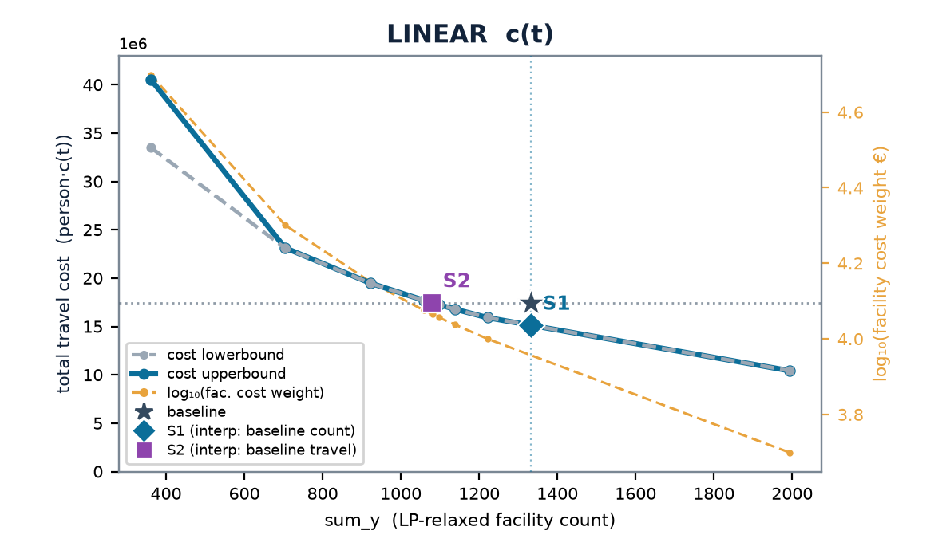
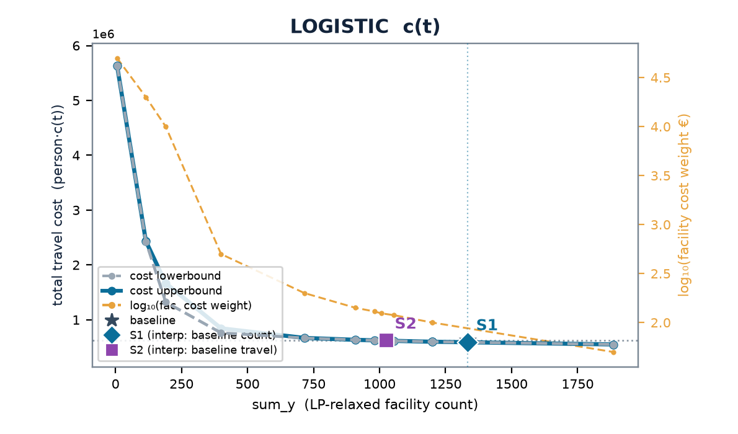
FRANCE · FRE
Hauts-de-France — multistart vs the LP-relax frontier
baseline (current) 1,333 cells · 2.92 min mean · travel (stranded at BIG) LIN 17.5M · LOG 619k
 | scenario | w | n_open | frac | multi vs relax | stranded (multi)
LINEAR | S1 | 0.100 | 1222 | 85 | -0% | 0
 | S2 | 0.116 | 1082 | 186 | +0% | 0
LOGISTIC | S1 | 0.00100 | 1200 | 175 | +0% | 0
 | S2 | 0.00124 | 1007 | 323 | +0% | 0
Charts: cost lowerbound (LP relaxation, dashed grey — drawn on top) & cost upperbound (multistart integer solution, solid blue) on the left; log₁₀(facility cost weight €) on the right, vs sum_y; ★ baseline, ◆ S1, ■ S2. Lower ≤ integer optimum ≤ upper; stranded clients priced at BIG (120 min linear / 1.0 logistic) — in the baseline too (coverage-consistent).

Slide 36
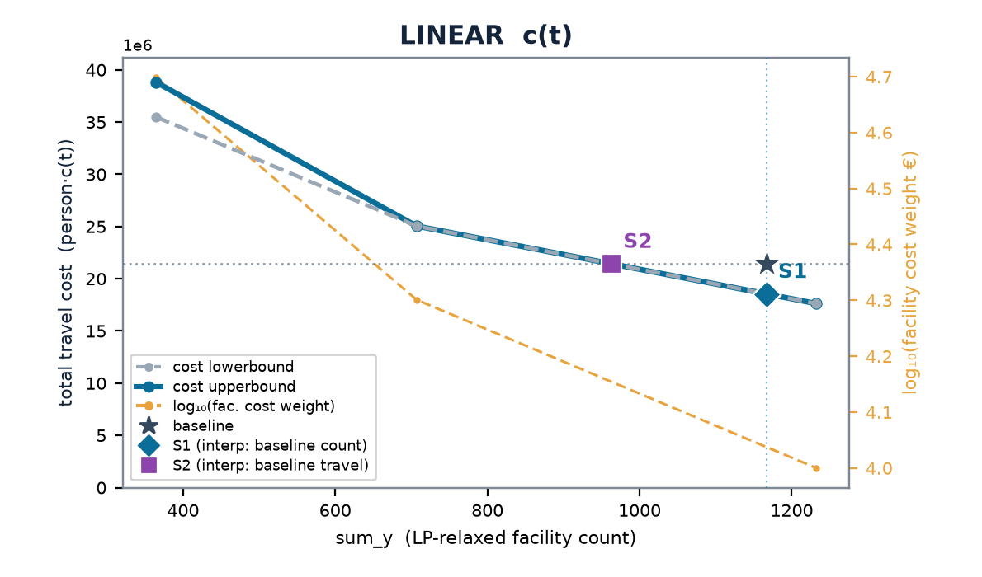
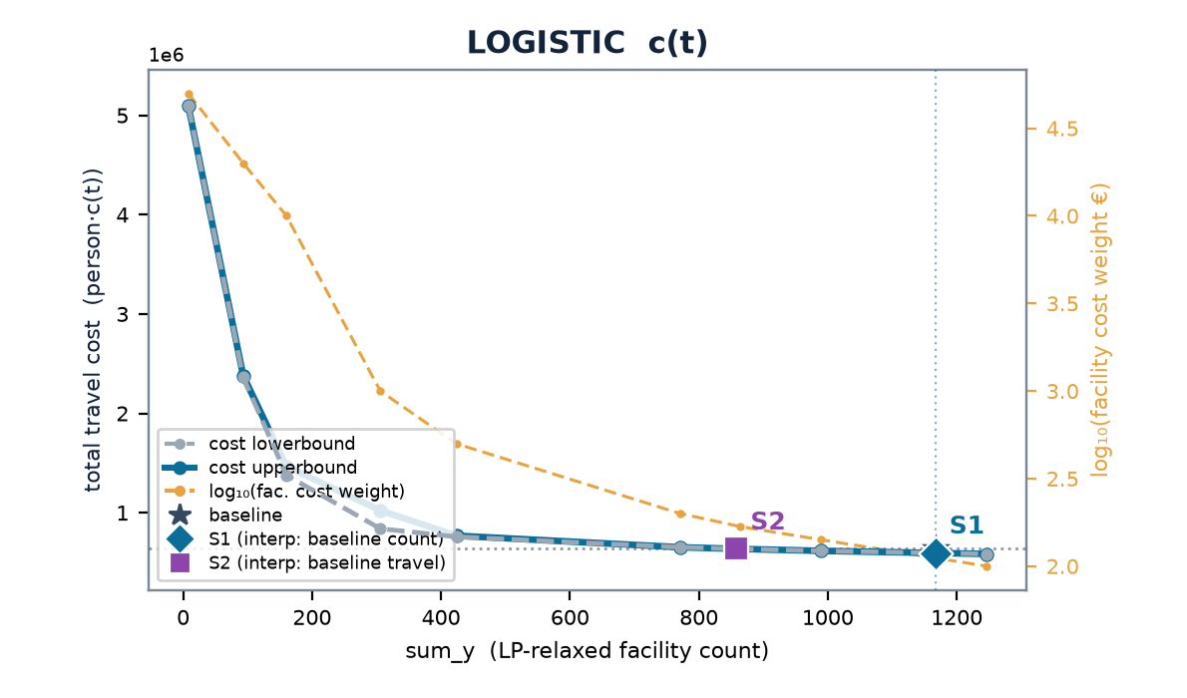
FRANCE · FRF
Grand Est — multistart vs the LP-relax frontier
baseline (current) 1,167 cells · 3.85 min mean · travel (stranded at BIG) LIN 21.4M · LOG 636k
 | scenario | w | n_open | frac | multi vs relax | stranded (multi)
LINEAR | S1 | 0.100 | 1232 | 73 | +0% | 0
 | S2 | 0.200 | 707 | 84 | +0% | 0
LOGISTIC | S1 | 0.00100 | 1247 | 102 | +0% | 0
 | S2 | 0.00168 | 864 | 123 | +0% | 0
Charts: cost lowerbound (LP relaxation, dashed grey — drawn on top) & cost upperbound (multistart integer solution, solid blue) on the left; log₁₀(facility cost weight €) on the right, vs sum_y; ★ baseline, ◆ S1, ■ S2. Lower ≤ integer optimum ≤ upper; stranded clients priced at BIG (120 min linear / 1.0 logistic) — in the baseline too (coverage-consistent).

Slide 37
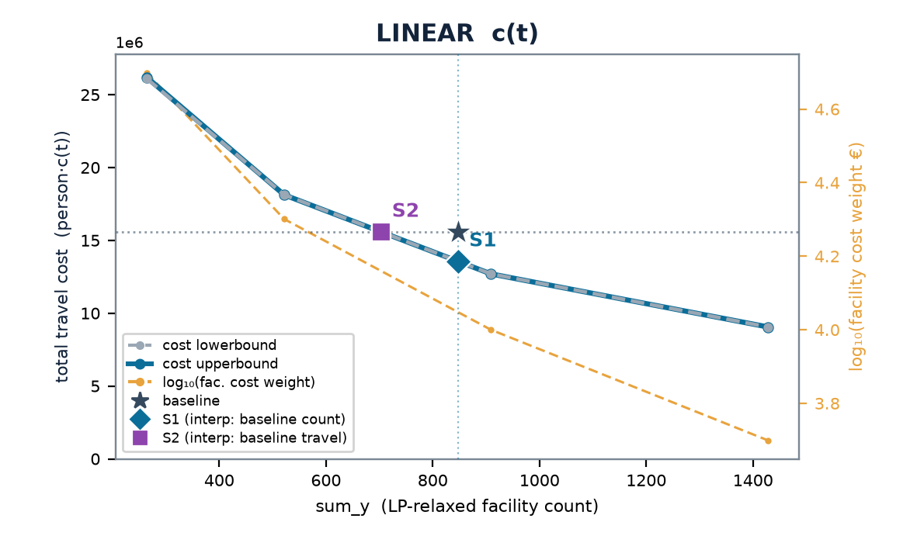

FRANCE · FRG
Pays de la Loire — multistart vs the LP-relax frontier
baseline (current) 848 cells · 4.06 min mean · travel (stranded at BIG) LIN 15.6M · LOG 446k
 | scenario | w | n_open | frac | multi vs relax | stranded (multi)
LINEAR | S1 | 0.100 | 909 | 20 | +0% | 0
 | S2 | 0.200 | 522 | 64 | -0% | 0
LOGISTIC | S1 | 0.00100 | 922 | 52 | -0% | 0
 | S2 | 0.00176 | 622 | 137 | +0% | 0
Charts: cost lowerbound (LP relaxation, dashed grey — drawn on top) & cost upperbound (multistart integer solution, solid blue) on the left; log₁₀(facility cost weight €) on the right, vs sum_y; ★ baseline, ◆ S1, ■ S2. Lower ≤ integer optimum ≤ upper; stranded clients priced at BIG (120 min linear / 1.0 logistic) — in the baseline too (coverage-consistent).

Slide 38
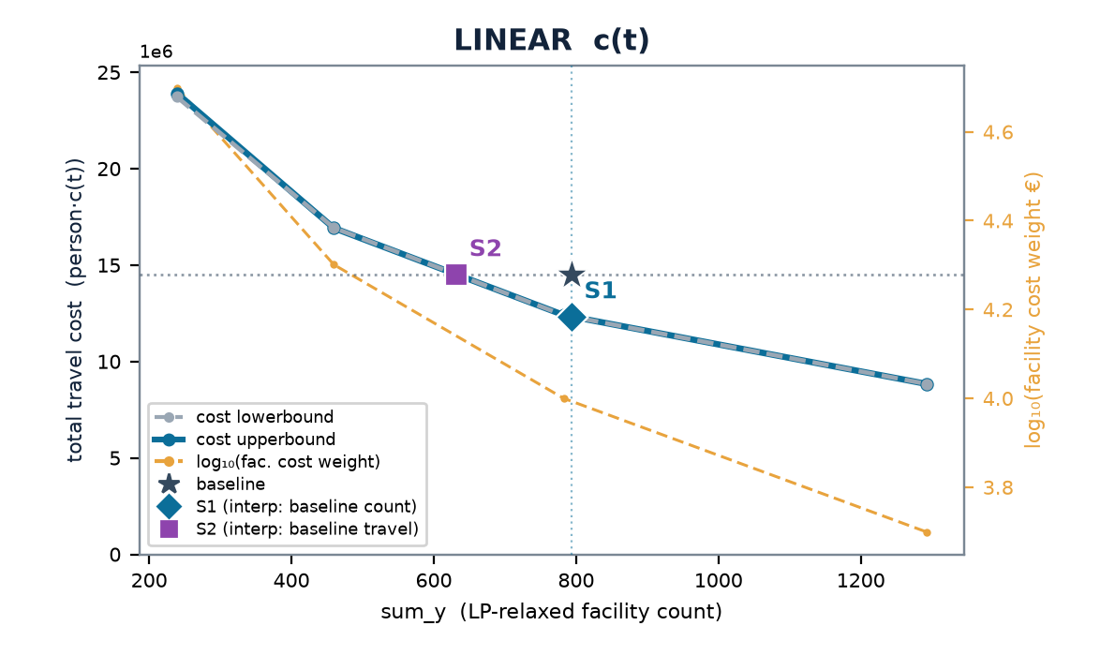
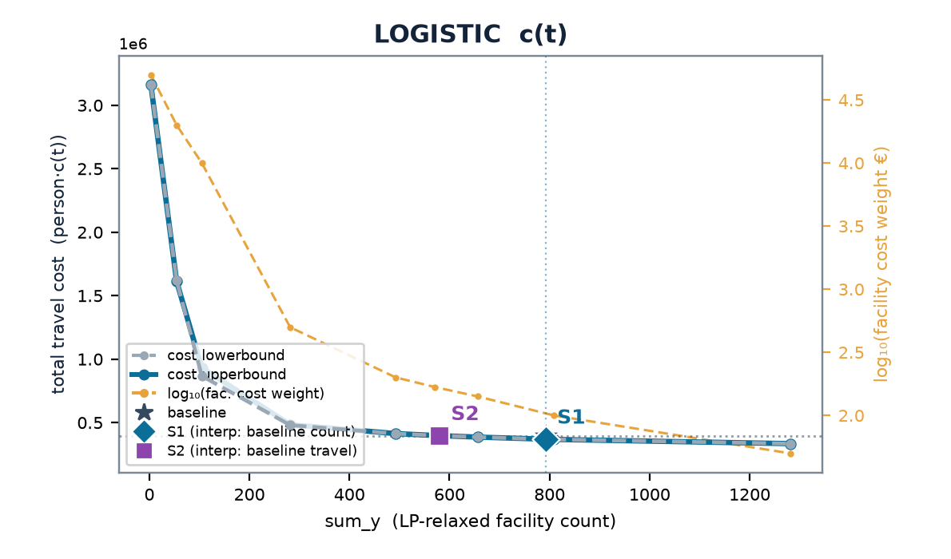
FRANCE · FRH
Bretagne — multistart vs the LP-relax frontier
baseline (current) 793 cells · 4.34 min mean · travel (stranded at BIG) LIN 14.5M · LOG 397k
 | scenario | w | n_open | frac | multi vs relax | stranded (multi)
LINEAR | S1 | 0.100 | 782 | 11 | +0% | 0
 | S2 | 0.100 | 782 | 11 | +0% | 0
LOGISTIC | S1 | 0.00100 | 809 | 106 | +0% | 0
 | S2 | 0.00168 | 570 | 102 | +0% | 0
Charts: cost lowerbound (LP relaxation, dashed grey — drawn on top) & cost upperbound (multistart integer solution, solid blue) on the left; log₁₀(facility cost weight €) on the right, vs sum_y; ★ baseline, ◆ S1, ■ S2. Lower ≤ integer optimum ≤ upper; stranded clients priced at BIG (120 min linear / 1.0 logistic) — in the baseline too (coverage-consistent).

Slide 39
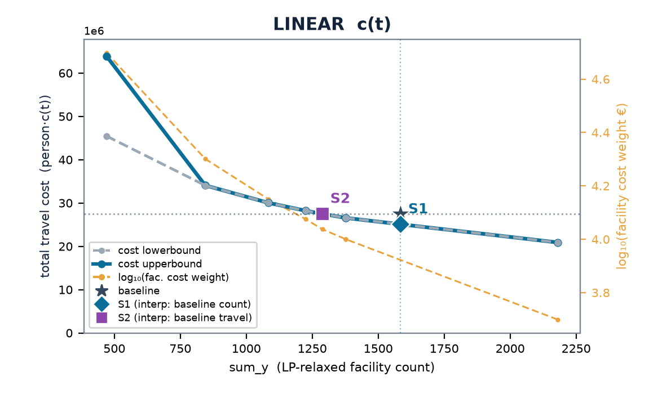

FRANCE · FRI
Nouvelle-Aquitaine — multistart vs the LP-relax frontier
baseline (current) 1,584 cells · 4.54 min mean · travel (stranded at BIG) LIN 27.5M · LOG 741k
 | scenario | w | n_open | frac | multi vs relax | stranded (multi)
LINEAR | S1 | 0.100 | 1378 | 48 | -0% | 0
 | S2 | 0.109 | 1288 | 64 | +0% | 1
LOGISTIC | S1 | 0.00100 | 1559 | 414 | +0% | 0
 | S2 | 0.00154 | 1154 | 355 | +0% | 0
Charts: cost lowerbound (LP relaxation, dashed grey — drawn on top) & cost upperbound (multistart integer solution, solid blue) on the left; log₁₀(facility cost weight €) on the right, vs sum_y; ★ baseline, ◆ S1, ■ S2. Lower ≤ integer optimum ≤ upper; stranded clients priced at BIG (120 min linear / 1.0 logistic) — in the baseline too (coverage-consistent).

Slide 40
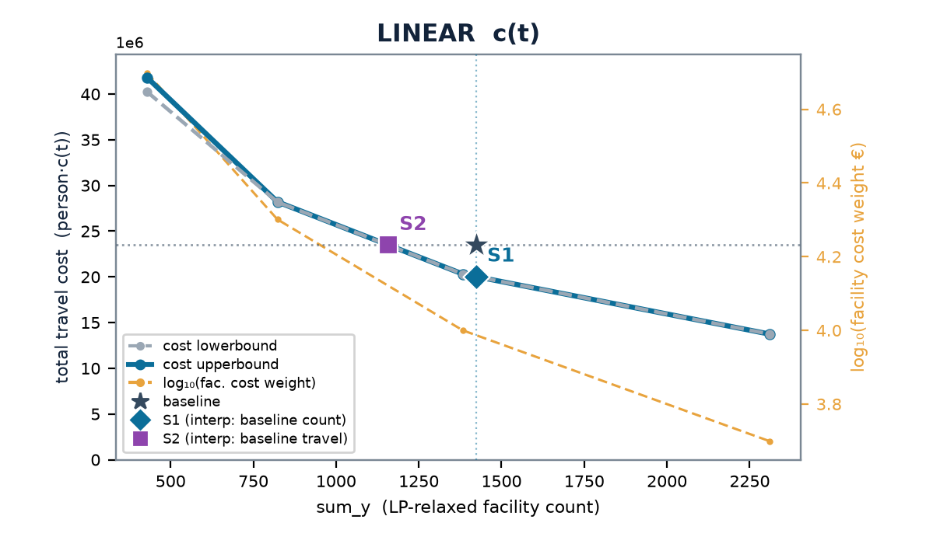
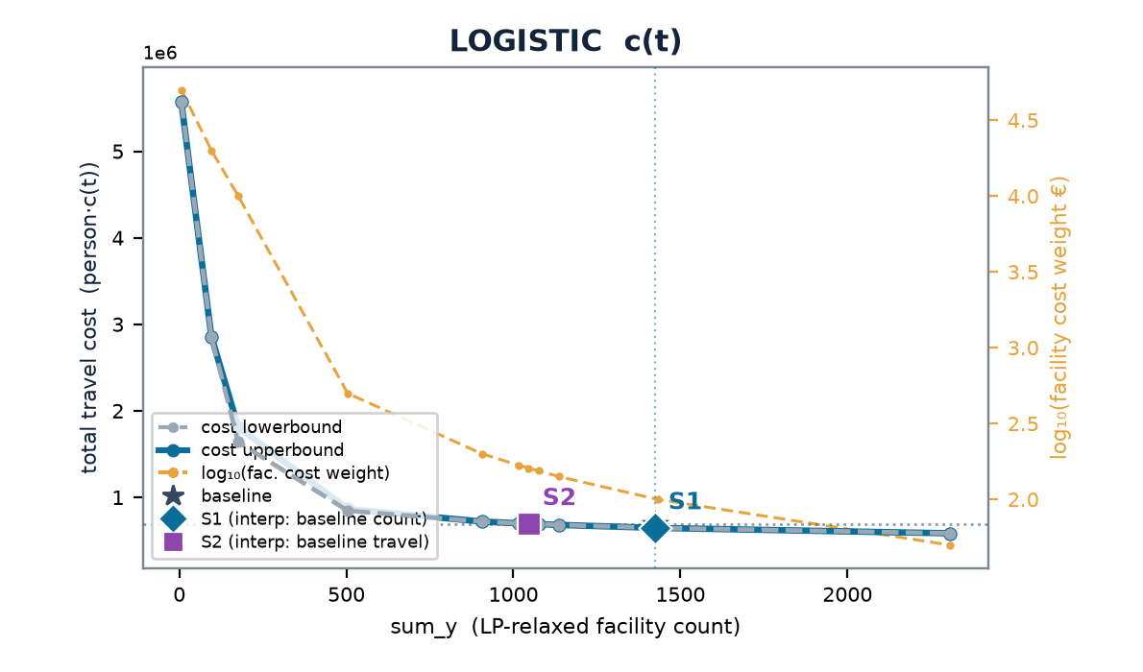
FRANCE · FRJ
Occitanie — multistart vs the LP-relax frontier
baseline (current) 1,424 cells · 3.91 min mean · travel (stranded at BIG) LIN 23.5M · LOG 695k
 | scenario | w | n_open | frac | multi vs relax | stranded (multi)
LINEAR | S1 | 0.100 | 1383 | 56 | +0% | 0
 | S2 | 0.100 | 1383 | 56 | +0% | 0
LOGISTIC | S1 | 0.00100 | 1432 | 235 | +0% | 0
 | S2 | 0.00161 | 1046 | 100 | +0% | 0
Charts: cost lowerbound (LP relaxation, dashed grey — drawn on top) & cost upperbound (multistart integer solution, solid blue) on the left; log₁₀(facility cost weight €) on the right, vs sum_y; ★ baseline, ◆ S1, ■ S2. Lower ≤ integer optimum ≤ upper; stranded clients priced at BIG (120 min linear / 1.0 logistic) — in the baseline too (coverage-consistent).

Slide 41
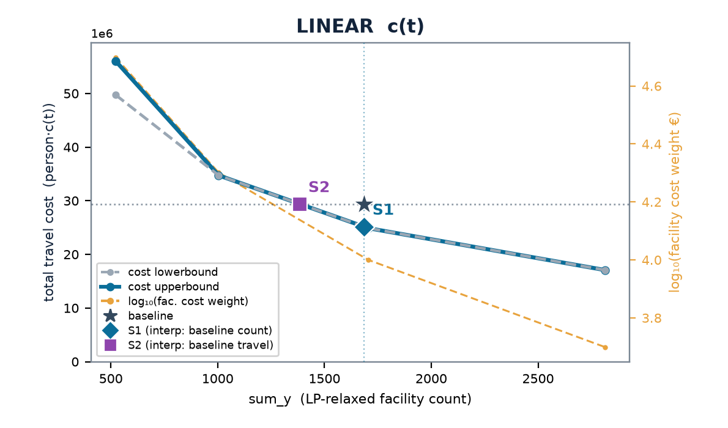
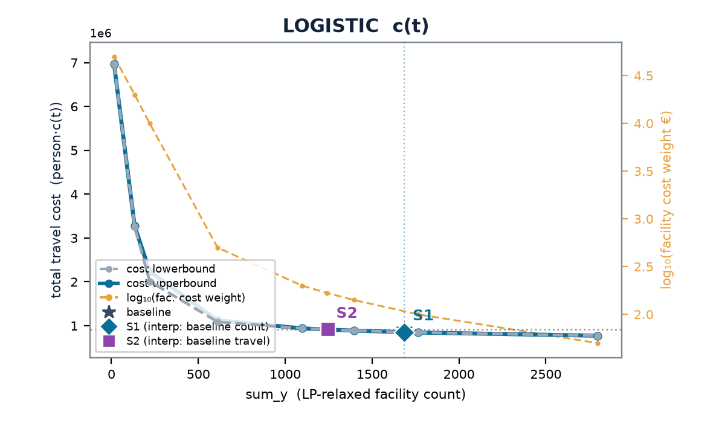
FRANCE · FRK
Auvergne-Rhône-Alpes — multistart vs the LP-relax frontier
baseline (current) 1,685 cells · 3.62 min mean · travel (stranded at BIG) LIN 29.4M · LOG 912k
 | scenario | w | n_open | frac | multi vs relax | stranded (multi)
LINEAR | S1 | 0.100 | 1706 | 67 | -0% | 0
 | S2 | 0.100 | 1706 | 67 | -0% | 0
LOGISTIC | S1 | 0.00100 | 1765 | 138 | +0% | 0
 | S2 | 0.00168 | 1238 | 92 | +0% | 0
Charts: cost lowerbound (LP relaxation, dashed grey — drawn on top) & cost upperbound (multistart integer solution, solid blue) on the left; log₁₀(facility cost weight €) on the right, vs sum_y; ★ baseline, ◆ S1, ■ S2. Lower ≤ integer optimum ≤ upper; stranded clients priced at BIG (120 min linear / 1.0 logistic) — in the baseline too (coverage-consistent).

Slide 42
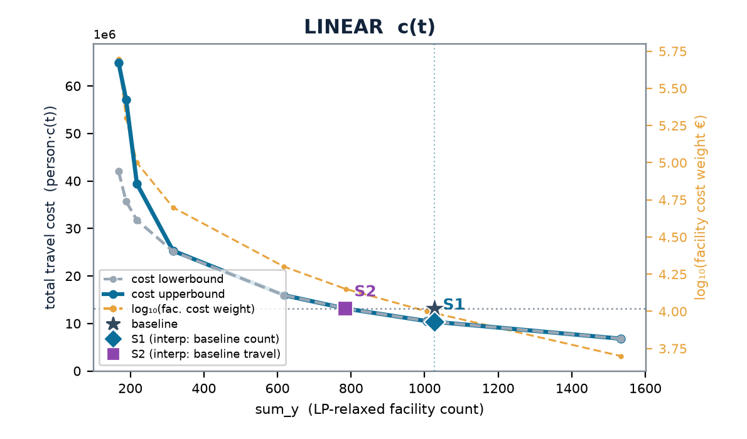

FRANCE · FRL
Provence-Alpes-Côte d'Azur — multistart vs the LP-relax frontier
baseline (current) 1,026 cells · 2.60 min mean · travel (stranded at BIG) LIN 13.1M · LOG 515k
 | scenario | w | n_open | frac | multi vs relax | stranded (multi)
LINEAR | S1 | 0.100 | 1006 | 4 | +0% | 0
 | S2 | 0.141 | 786 | 15 | -0% | 0
LOGISTIC | S1 | 0.00100 | 1006 | 41 | +0% | 0
 | S2 | 0.00154 | 751 | 31 | +0% | 0
Charts: cost lowerbound (LP relaxation, dashed grey — drawn on top) & cost upperbound (multistart integer solution, solid blue) on the left; log₁₀(facility cost weight €) on the right, vs sum_y; ★ baseline, ◆ S1, ■ S2. Lower ≤ integer optimum ≤ upper; stranded clients priced at BIG (120 min linear / 1.0 logistic) — in the baseline too (coverage-consistent).

Slide 43


FRANCE · FRM
Corse — multistart vs the LP-relax frontier
baseline (current) 87 cells · 5.11 min mean · travel (stranded at BIG) LIN 1.7M · LOG 45k
 | scenario | w | n_open | frac | multi vs relax | stranded (multi)
LINEAR | S1 | 0.100 | 89 | 0 | +0% | 0
 | S2 | 0.168 | 62 | 0 | +0% | 0
LOGISTIC | S1 | 0.00100 | 103 | 0 | +0% | 0
 | S2 | 0.00259 | 57 | 10 | +0% | 0
Charts: cost lowerbound (LP relaxation, dashed grey — drawn on top) & cost upperbound (multistart integer solution, solid blue) on the left; log₁₀(facility cost weight €) on the right, vs sum_y; ★ baseline, ◆ S1, ■ S2. Lower ≤ integer optimum ≤ upper; stranded clients priced at BIG (120 min linear / 1.0 logistic) — in the baseline too (coverage-consistent).

Slide 44


ITALY · ITC
Nord-Ovest — multistart vs the LP-relax frontier
baseline (current) 2,890 cells · 2.93 min mean · travel (stranded at BIG) LIN 46.4M · LOG 1.7M
 | scenario | w | n_open | frac | multi vs relax | stranded (multi)
LINEAR | S1 | 0.100 | 2975 | 38 | +0% | 2
 | S2 | 0.200 | 1792 | 83 | +0% | 12
LOGISTIC | S1 | 0.00100 | 2884 | 70 | +0% | 0
 | S2 | 0.00224 | 1661 | 237 | +0% | 10
Charts: cost lowerbound (LP relaxation, dashed grey — drawn on top) & cost upperbound (multistart integer solution, solid blue) on the left; log₁₀(facility cost weight €) on the right, vs sum_y; ★ baseline, ◆ S1, ■ S2. Lower ≤ integer optimum ≤ upper; stranded clients priced at BIG (120 min linear / 1.0 logistic) — in the baseline too (coverage-consistent).

Slide 45


ITALY · ITF
Sud — multistart vs the LP-relax frontier
baseline (current) 1,253 cells · 6.67 min mean · travel (stranded at BIG) LIN 88.9M · LOG 2.1M
 | scenario | w | n_open | frac | multi vs relax | stranded (multi)
LINEAR | S1 | 0.300 | 1258 | 79 | +0% | 6
 | S2 | 1.03 | 519 | 239 | +3% | 208
LOGISTIC | S1 | 0.00500 | 953 | 181 | +0% | 18
 | S2 | 0.0165 | 472 | 403 | +3% | 730
Charts: cost lowerbound (LP relaxation, dashed grey — drawn on top) & cost upperbound (multistart integer solution, solid blue) on the left; log₁₀(facility cost weight €) on the right, vs sum_y; ★ baseline, ◆ S1, ■ S2. Lower ≤ integer optimum ≤ upper; stranded clients priced at BIG (120 min linear / 1.0 logistic) — in the baseline too (coverage-consistent).

Slide 46


ITALY · ITG
Isole — multistart vs the LP-relax frontier
baseline (current) 891 cells · 4.88 min mean · travel (stranded at BIG) LIN 30.6M · LOG 845k
 | scenario | w | n_open | frac | multi vs relax | stranded (multi)
LINEAR | S1 | 0.200 | undefined | undefined | +0% | 6
 | S2 | 0.563 | undefined | undefined | +0% | 44
LOGISTIC | S1 | 0.00200 | undefined | undefined | +0% | 3
 | S2 | 0.00917 | undefined | undefined | +0% | 88
Charts: cost lowerbound (LP relaxation, dashed grey — drawn on top) & cost upperbound (multistart integer solution, solid blue) on the left; log₁₀(facility cost weight €) on the right, vs sum_y; ★ baseline, ◆ S1, ■ S2. Lower ≤ integer optimum ≤ upper; stranded clients priced at BIG (120 min linear / 1.0 logistic) — in the baseline too (coverage-consistent).

Slide 47


ITALY · ITH
Nord-Est — multistart vs the LP-relax frontier
baseline (current) 2,079 cells · 4.20 min mean · travel (stranded at BIG) LIN 48.4M · LOG 1.4M
 | scenario | w | n_open | frac | multi vs relax | stranded (multi)
LINEAR | S1 | 0.150 | 1796 | 62 | -0% | 0
 | S2 | 0.233 | 1257 | 125 | +0% | 6
LOGISTIC | S1 | 0.00100 | 2386 | 127 | +0% | 0
 | S2 | 0.00282 | 1147 | 232 | +0% | 2
Charts: cost lowerbound (LP relaxation, dashed grey — drawn on top) & cost upperbound (multistart integer solution, solid blue) on the left; log₁₀(facility cost weight €) on the right, vs sum_y; ★ baseline, ◆ S1, ■ S2. Lower ≤ integer optimum ≤ upper; stranded clients priced at BIG (120 min linear / 1.0 logistic) — in the baseline too (coverage-consistent).

Slide 48


ITALY · ITI
Centro — multistart vs the LP-relax frontier
baseline (current) 1,631 cells · 4.19 min mean · travel (stranded at BIG) LIN 49.0M · LOG 1.4M
 | scenario | w | n_open | frac | multi vs relax | stranded (multi)
LINEAR | S1 | 0.150 | 1724 | 63 | +0% | 2
 | S2 | 0.330 | 961 | 98 | +0% | 12
LOGISTIC | S1 | 0.00200 | 1417 | 86 | +0% | 2
 | S2 | 0.00421 | 857 | 183 | +0% | 19
Charts: cost lowerbound (LP relaxation, dashed grey — drawn on top) & cost upperbound (multistart integer solution, solid blue) on the left; log₁₀(facility cost weight €) on the right, vs sum_y; ★ baseline, ◆ S1, ■ S2. Lower ≤ integer optimum ≤ upper; stranded clients priced at BIG (120 min linear / 1.0 logistic) — in the baseline too (coverage-consistent).

Slide 49


SWEDEN · SE1
Östra Sverige — multistart vs the LP-relax frontier
baseline (current) 388 cells · 5.41 min mean · travel (stranded at BIG) LIN 22.1M · LOG 573k
 | scenario | w | n_open | frac | multi vs relax | stranded (multi)
LINEAR | S1 | 0.300 | 357 | 14 | +0% | 1
 | S2 | 0.440 | 246 | 13 | +0% | 2
LOGISTIC | S1 | 0.00300 | 387 | 48 | +0% | 2
 | S2 | 0.00700 | 204 | 31 | -0% | 8
Charts: cost lowerbound (LP relaxation, dashed grey — drawn on top) & cost upperbound (multistart integer solution, solid blue) on the left; log₁₀(facility cost weight €) on the right, vs sum_y; ★ baseline, ◆ S1, ■ S2. Lower ≤ integer optimum ≤ upper; stranded clients priced at BIG (120 min linear / 1.0 logistic) — in the baseline too (coverage-consistent).

Slide 50


SWEDEN · SE2
Södra Sverige — multistart vs the LP-relax frontier
baseline (current) 452 cells · 7.36 min mean · travel (stranded at BIG) LIN 32.4M · LOG 716k
 | scenario | w | n_open | frac | multi vs relax | stranded (multi)
LINEAR | S1 | 0.500 | undefined | undefined | +0% | 56
 | S2 | 0.500 | undefined | undefined | +0% | 56
LOGISTIC | S1 | 0.00500 | undefined | undefined | +0% | 110
 | S2 | 0.00958 | undefined | undefined | +0% | 117
Charts: cost lowerbound (LP relaxation, dashed grey — drawn on top) & cost upperbound (multistart integer solution, solid blue) on the left; log₁₀(facility cost weight €) on the right, vs sum_y; ★ baseline, ◆ S1, ■ S2. Lower ≤ integer optimum ≤ upper; stranded clients priced at BIG (120 min linear / 1.0 logistic) — in the baseline too (coverage-consistent).

Slide 51


SWEDEN · SE3
Norra Sverige — multistart vs the LP-relax frontier
baseline (current) 246 cells · 9.48 min mean · travel (stranded at BIG) LIN 16.4M · LOG 349k
 | scenario | w | n_open | frac | multi vs relax | stranded (multi)
LINEAR | S1 | 0.200 | undefined | undefined | +0% | 9
 | S2 | 0.522 | undefined | undefined | +0% | 46
LOGISTIC | S1 | 0.00500 | undefined | undefined | +0% | 130
 | S2 | 0.00917 | undefined | undefined | +0% | 148
Charts: cost lowerbound (LP relaxation, dashed grey — drawn on top) & cost upperbound (multistart integer solution, solid blue) on the left; log₁₀(facility cost weight €) on the right, vs sum_y; ★ baseline, ◆ S1, ■ S2. Lower ≤ integer optimum ≤ upper; stranded clients priced at BIG (120 min linear / 1.0 logistic) — in the baseline too (coverage-consistent).

Slide 52


POLAND · PL2
Południowy — multistart vs the LP-relax frontier
baseline (current) 1,442 cells · 3.21 min mean · travel (stranded at BIG) LIN 24.5M · LOG 811k
 | scenario | w | n_open | frac | multi vs relax | stranded (multi)
LINEAR | S1 | 0.100 | 1402 | 159 | +0% | 0
 | S2 | 0.154 | 1024 | 134 | +0% | 0
LOGISTIC | S1 | 0.00100 | 1387 | 149 | +0% | 0
 | S2 | 0.00168 | 994 | 158 | +0% | 0
Charts: cost lowerbound (LP relaxation, dashed grey — drawn on top) & cost upperbound (multistart integer solution, solid blue) on the left; log₁₀(facility cost weight €) on the right, vs sum_y; ★ baseline, ◆ S1, ■ S2. Lower ≤ integer optimum ≤ upper; stranded clients priced at BIG (120 min linear / 1.0 logistic) — in the baseline too (coverage-consistent).

Slide 53


POLAND · PL4
Północno-Zachodni — multistart vs the LP-relax frontier
baseline (current) 1,200 cells · 3.66 min mean · travel (stranded at BIG) LIN 22.1M · LOG 685k
 | scenario | w | n_open | frac | multi vs relax | stranded (multi)
LINEAR | S1 | 0.100 | 1192 | 59 | +0% | 0
 | S2 | 0.200 | 726 | 42 | +0% | 0
LOGISTIC | S1 | 0.00100 | 1246 | 94 | +0% | 0
 | S2 | 0.00192 | 800 | 93 | +0% | 0
Charts: cost lowerbound (LP relaxation, dashed grey — drawn on top) & cost upperbound (multistart integer solution, solid blue) on the left; log₁₀(facility cost weight €) on the right, vs sum_y; ★ baseline, ◆ S1, ■ S2. Lower ≤ integer optimum ≤ upper; stranded clients priced at BIG (120 min linear / 1.0 logistic) — in the baseline too (coverage-consistent).

Slide 54


POLAND · PL5
Południowo-Zachodni — multistart vs the LP-relax frontier
baseline (current) 688 cells · 3.41 min mean · travel (stranded at BIG) LIN 12.8M · LOG 411k
 | scenario | w | n_open | frac | multi vs relax | stranded (multi)
LINEAR | S1 | 0.100 | 713 | 27 | -0% | 1
 | S2 | 0.156 | 509 | 37 | -0% | 1
LOGISTIC | S1 | 0.00100 | 712 | 6 | +0% | 1
 | S2 | 0.00192 | 465 | 79 | +0% | 1
Charts: cost lowerbound (LP relaxation, dashed grey — drawn on top) & cost upperbound (multistart integer solution, solid blue) on the left; log₁₀(facility cost weight €) on the right, vs sum_y; ★ baseline, ◆ S1, ■ S2. Lower ≤ integer optimum ≤ upper; stranded clients priced at BIG (120 min linear / 1.0 logistic) — in the baseline too (coverage-consistent).

Slide 55


POLAND · PL6
Północny — multistart vs the LP-relax frontier
baseline (current) 1,023 cells · 3.78 min mean · travel (stranded at BIG) LIN 21.1M · LOG 642k
 | scenario | w | n_open | frac | multi vs relax | stranded (multi)
LINEAR | S1 | 0.100 | 1111 | 87 | +0% | 0
 | S2 | 0.200 | 691 | 62 | +0% | 0
LOGISTIC | S1 | 0.00100 | 1150 | 104 | +0% | 0
 | S2 | 0.00224 | 689 | 139 | +0% | 0
Charts: cost lowerbound (LP relaxation, dashed grey — drawn on top) & cost upperbound (multistart integer solution, solid blue) on the left; log₁₀(facility cost weight €) on the right, vs sum_y; ★ baseline, ◆ S1, ■ S2. Lower ≤ integer optimum ≤ upper; stranded clients priced at BIG (120 min linear / 1.0 logistic) — in the baseline too (coverage-consistent).

Slide 56


POLAND · PL7
Centralny — multistart vs the LP-relax frontier
baseline (current) 675 cells · 3.84 min mean · travel (stranded at BIG) LIN 13.6M · LOG 405k
 | scenario | w | n_open | frac | multi vs relax | stranded (multi)
LINEAR | S1 | 0.100 | 675 | 113 | +0% | 0
 | S2 | 0.200 | 417 | 89 | +0% | 1
LOGISTIC | S1 | 0.00100 | 701 | 122 | +0% | 0
 | S2 | 0.00183 | 476 | 179 | +0% | 0
Charts: cost lowerbound (LP relaxation, dashed grey — drawn on top) & cost upperbound (multistart integer solution, solid blue) on the left; log₁₀(facility cost weight €) on the right, vs sum_y; ★ baseline, ◆ S1, ■ S2. Lower ≤ integer optimum ≤ upper; stranded clients priced at BIG (120 min linear / 1.0 logistic) — in the baseline too (coverage-consistent).

Slide 57


POLAND · PL8
Wschodni — multistart vs the LP-relax frontier
baseline (current) 1,065 cells · 4.53 min mean · travel (stranded at BIG) LIN 22.9M · LOG 619k
 | scenario | w | n_open | frac | multi vs relax | stranded (multi)
LINEAR | S1 | 0.100 | undefined | undefined | +0% | 0
 | S2 | 0.200 | undefined | undefined | +0% | 0
LOGISTIC | S1 | 0.00100 | undefined | undefined | +0% | 0
 | S2 | 0.00212 | undefined | undefined | +0% | 0
Charts: cost lowerbound (LP relaxation, dashed grey — drawn on top) & cost upperbound (multistart integer solution, solid blue) on the left; log₁₀(facility cost weight €) on the right, vs sum_y; ★ baseline, ◆ S1, ■ S2. Lower ≤ integer optimum ≤ upper; stranded clients priced at BIG (120 min linear / 1.0 logistic) — in the baseline too (coverage-consistent).

Slide 58


POLAND · PL9
Mazowiecki — multistart vs the LP-relax frontier
baseline (current) 933 cells · 3.20 min mean · travel (stranded at BIG) LIN 17.5M · LOG 591k
 | scenario | w | n_open | frac | multi vs relax | stranded (multi)
LINEAR | S1 | 0.100 | 989 | 96 | +0% | 0
 | S2 | 0.200 | 615 | 73 | +0% | 1
LOGISTIC | S1 | 0.00100 | 994 | 153 | +0% | 0
 | S2 | 0.00200 | 645 | 179 | +0% | 0
Charts: cost lowerbound (LP relaxation, dashed grey — drawn on top) & cost upperbound (multistart integer solution, solid blue) on the left; log₁₀(facility cost weight €) on the right, vs sum_y; ★ baseline, ◆ S1, ■ S2. Lower ≤ integer optimum ≤ upper; stranded clients priced at BIG (120 min linear / 1.0 logistic) — in the baseline too (coverage-consistent).

Slide 59


ALL AREAS COMBINED · 41 DISJOINT AREAS
The aggregated frontier — facilities and travel cost summed per λ
aggregate baseline (current) 43,320 pharmacy cells · travel LIN 1030M · LOG 30.3M
 | point | w | n_open | Δ facilities | multi vs relax | Δ travel (multi)
LINEAR | S1 (same count) | 0.130 | 43,357 | +0% | +0% | -26%
 | S2 (same travel) | 0.227 | 28,609 | -34% | +3% | +0%
 | fewest facilities swept | 0.500 | 15,808 | -64% | +13% | +55%
 | most facilities swept | 0.000100 | 433,828 | +901% | +0% | -93%
LOGISTIC | S1 (same count) | 0.00130 | 44,416 | +3% | +0% | -13%
 | S2 (same travel) | 0.00282 | 26,673 | -38% | +1% | -0%
 | fewest facilities swept | 0.0200 | 10,933 | -75% | +11% | +65%
 | most facilities swept | 0.000100 | 191,428 | +342% | +0% | -31%
Exact-by-separability aggregation over 41 disjoint areas (13 countries + FR/IT/SE/PL NUTS-1; country-level Poland excluded in favour of its 7 NUTS-1): at a common λ the sum of the regional optima IS the combined optimum. Summed at the union of swept w-values inside the range every area covers (68 points; an area without that exact λ is log-interpolated between its adjacent sweep points — the λ-table rule). The Δ columns state the aggregate S1/S2 gain in native units and need no λ; λ only prices them (placeholder €100,000 per location).

Slide 60
SCENARIOS · PER COUNTRY
By how much: S1 and S2 — per country, by travel-cost function
Gains in native units first — person-minutes and locations, read off the frontier and independent of any λ — then the λ at which the sweep reaches each point.
country | today # | S1 · Δ travel (lin) | S2 · Δ # (lin) | S1 · Δ cost · Δ mean t (log) | S2 · Δ # (log) | λ S1 lin | λ S2 lin | λ S1 log | λ S2 log
Netherlands | 1,615 | −12.1 M min · −19.9% | −443 · −27.4% | −8.0% · −0.7 min | −551 · −34.1% | 24,532 | 34,329 | 229 | 373
Luxembourg | 86 | −427 k min · −17.8% | −26 · −29.9% | −7.6% · −0.7 min | −30 · −35.1% | 15,945 | 25,641 | 146 | 262
Estonia | 292 | −1.3 M min · −22.6% | −94 · −32.3% | −13.4% · −0.9 min | −121 · −41.4% | 11,388 | 19,421 | 145 | 302
Latvia | 496 | −1.5 M min · −19.9% | −144 · −29.1% | −11.3% · −0.8 min | −183 · −36.8% | 8,822 | 14,262 | 103 | 205
Slovenia | 306 | −1.5 M min · −13.1% | −82 · −26.7% | −9.0% · −0.8 min | −99 · −32.4% | 17,680 | 25,450 | 195 | 357
Lithuania | 582 | −2.9 M min · −23.5% | −204 · −35.1% | −14.4% · −1.0 min | −268 · −46.0% | 10,987 | 19,834 | 128 | 309
Ireland | 862 | −4.0 M min · −16.9% | −235 · −27.2% | −8.8% · −0.7 min | −297 · −34.5% | 14,269 | 21,020 | 158 | 270
Norway | 755 | −10.3 M min · −25.3% | −326 · −43.2% | −18.0% · −1.8 min | −359 · −47.6% | 23,174 | 49,999 | 324 | 841
Denmark | 466 | −5.5 M min · −14.8% | −133 · −28.6% | −11.0% · −0.9 min | −166 · −35.6% | 37,082 | 55,960 | 448 | 867
Austria | 1,129 | −8.8 M min · −20.4% | −373 · −33.0% | −13.3% · −1.0 min | −497 · −44.0% | 18,361 | 31,027 | 204 | 496
Portugal | 1,882 | −7.4 M min · −21.6% | −527 · −28.0% | −8.3% · −0.7 min | −623 · −33.1% | 10,473 | 17,033 | 107 | 196
Czechia | 1,624 | −8.8 M min · −19.8% | −487 · −30.0% | −8.9% · −0.7 min | −587 · −36.1% | 14,550 | 22,885 | 157 | 278
Belgium | 2,958 | −3.2 M min · −14.9% | −520 · −17.6% | −3.0% · −0.3 min | −552 · −18.7% | 5,666 | 7,340 | 50 | 67
Poland | 7,027 | −23.7 M min · −17.8% | −1,883 · −26.8% | −7.5% · −0.6 min | −2,207 · −31.4% | 10,254 | 15,809 | 107 | 188
S1 = today's number of locations, travel minimised; S2 = today's travel, fewer locations. Δ columns are read off the multistart frontier by interpolation between adjacent sweep points — person-minutes (linear), dimensionless logistic cost with the mean minutes beside it, and locations — and need no λ. λ = w · €100,000 is the price per location at which the sweep reaches that point; the €100,000 is a placeholder, not an estimate — the frontier, the Δs and the ranking of areas do not depend on it, only these € figures do. “—” = the target lies outside the swept λ range.

Slide 61
SCENARIOS · NUTS-1
By how much: S1 and S2 — FR / IT / SE / PL NUTS-1 regions
Gains in native units first — person-minutes and locations, read off the frontier and independent of any λ — then the λ at which the sweep reaches each point.
NUTS-1 region | today # | S1 · Δ travel (lin) | S2 · Δ # (lin) | S1 · Δ cost · Δ mean t (log) | S2 · Δ # (log) | λ S1 lin | λ S2 lin | λ S1 log | λ S2 log
FR1 · Île-de-France | 1,449 | −2.9 M min · −23.0% | −218 · −15.1% | −2.8% · −0.2 min | −237 · −16.4% | 11,918 | 16,444 | 107 | 149
FRB · Centre-Val de Loire | 613 | −1.5 M min · −13.6% | −130 · −21.2% | −6.8% · −0.5 min | −159 · −26.0% | 10,000 | 13,670 | 109 | 169
FRC · Bourgogne-Franche-Comté | 723 | −1.7 M min · −12.8% | −130 · −18.0% | −7.4% · −0.6 min | −197 · −27.2% | 9,783 | 13,075 | 108 | 167
FRD · Normandie | 679 | −1.7 M min · −11.9% | −119 · −17.6% | −6.3% · −0.5 min | −175 · −25.7% | 11,278 | 14,679 | 118 | 179
FRE · Hauts-de-France | 1,333 | −2.3 M min · −13.4% | −254 · −19.1% | −4.7% · −0.4 min | −308 · −23.1% | 9,048 | 11,670 | 87 | 122
FRF · Grand Est | 1,167 | −2.9 M min · −13.5% | −204 · −17.4% | −6.6% · −0.5 min | −309 · −26.5% | 10,901 | 14,257 | 111 | 170
FRG · Pays de la Loire | 848 | −2.0 M min · −13.0% | −144 · −17.0% | −6.7% · −0.5 min | −219 · −25.9% | 11,153 | 14,447 | 114 | 173
FRH · Bretagne | 793 | −2.2 M min · −15.1% | −162 · −20.4% | −7.0% · −0.6 min | −212 · −26.7% | 9,858 | 13,828 | 104 | 165
FRI · Nouvelle-Aquitaine | 1,584 | −2.4 M min · −8.7% | −296 · −18.7% | −7.5% · −0.6 min | −447 · −28.2% | 8,368 | 10,901 | 98 | 158
FRJ · Occitanie | 1,424 | −3.5 M min · −14.7% | −265 · −18.6% | −6.8% · −0.6 min | −377 · −26.5% | 9,698 | 13,202 | 101 | 161
FRK · Auvergne-Rhône-Alpes | 1,685 | −4.2 M min · −14.3% | −300 · −17.8% | −6.3% · −0.5 min | −440 · −26.1% | 10,207 | 13,737 | 108 | 167
FRL · Provence-Alpes-Côte d'Azur | 1,026 | −2.8 M min · −21.2% | −240 · −23.4% | −6.7% · −0.5 min | −286 · −27.9% | 9,741 | 14,155 | 97 | 158
FRM · Corse | 87 | −313 k min · −18.4% | −25 · −29.1% | −10.9% · −0.8 min | −30 · −34.5% | 10,336 | 16,993 | 135 | 259
ITC · Nord-Ovest | 2,890 | −15.6 M min · −33.7% | −1,101 · −38.1% | −10.6% · −1.0 min | −1,196 · −41.4% | 10,511 | 20,047 | 100 | 218
ITF · Sud | 1,253 | −40.7 M min · −45.8% | −732 · −58.5% | −28.3% · −2.8 min | −783 · −62.5% | 30,189 | 101,789 | 350 | 1,655
ITG · Isole | 891 | −15.0 M min · −49.1% | −474 · −53.2% | −26.1% · −2.4 min | −545 · −61.2% | 18,626 | 56,207 | 187 | 917
ITH · Nord-Est | 2,079 | −13.6 M min · −28.0% | −825 · −39.7% | −12.3% · −1.1 min | −945 · −45.4% | 12,529 | 23,350 | 127 | 287
ITI · Centro | 1,631 | −15.3 M min · −31.3% | −675 · −41.4% | −13.8% · −1.2 min | −774 · −47.4% | 16,279 | 33,187 | 169 | 421
SE1 · Östra Sverige | 388 | −4.8 M min · −21.9% | −143 · −36.9% | −14.8% · −1.1 min | −186 · −48.0% | 27,492 | 44,267 | 299 | 711
SE2 · Södra Sverige | 452 | −6.0 M min · −18.5% | −167 · −36.9% | −14.3% · −1.5 min | −192 · −42.4% | 33,567 | 57,265 | 406 | 939
SE3 · Norra Sverige | 246 | −2.5 M min · −15.0% | −78 · −31.8% | −14.3% · −1.6 min | −87 · −35.4% | 30,810 | 52,783 | 439 | 910
PL2 · Południowy | 1,442 | −5.0 M min · −20.3% | −419 · −29.1% | −7.0% · −0.6 min | −462 · −32.1% | 9,666 | 15,455 | 95 | 171
PL4 · Północno-Zachodni | 1,200 | −4.0 M min · −18.1% | −288 · −24.0% | −8.3% · −0.6 min | −404 · −33.7% | 9,925 | 15,169 | 106 | 193
PL5 · Południowo-Zachodni | 688 | −2.3 M min · −17.9% | −180 · −26.2% | −7.5% · −0.6 min | −218 · −31.7% | 10,586 | 15,617 | 106 | 189
PL6 · Północny | 1,023 | −3.5 M min · −16.6% | −247 · −24.2% | −7.7% · −0.6 min | −324 · −31.6% | 11,568 | 17,393 | 125 | 220
PL7 · Centralny | 675 | −2.1 M min · −15.5% | −148 · −21.9% | −7.1% · −0.6 min | −205 · −30.4% | 10,013 | 14,885 | 107 | 188
PL8 · Wschodni | 1,065 | −4.0 M min · −17.3% | −282 · −26.5% | −8.6% · −0.7 min | −363 · −34.1% | 10,273 | 16,347 | 115 | 211
PL9 · Mazowiecki | 933 | −3.0 M min · −17.4% | −217 · −23.2% | −7.0% · −0.6 min | −284 · −30.5% | 11,084 | 16,582 | 112 | 198
S1 = today's number of locations, travel minimised; S2 = today's travel, fewer locations. Δ columns are read off the multistart frontier by interpolation between adjacent sweep points — person-minutes (linear), dimensionless logistic cost with the mean minutes beside it, and locations — and need no λ. λ = w · €100,000 is the price per location at which the sweep reaches that point; the €100,000 is a placeholder, not an estimate — the frontier, the Δs and the ranking of areas do not depend on it, only these € figures do. “—” = the target lies outside the swept λ range.

Slide 62
LINEAR vs LOGISTIC
multistart tracks the LP-relax lower bound — the gap is tightest under LOGISTIC
LINEAR c(t) — unbounded, stranding expensive
LOGISTIC c(t) — saturates ≈1, stranding cheap
multistart sits +0–18% over the LP bound
multistart sits +0–4.7% over the LP bound
integer rounding costs more where stranding is dear
rounding is nearly free; the frontier is almost integral
reg | LIN S1 | LIN S2 | LOG S1 | LOG S2
Netherlands | +0% (0) | +0% (1) | +0% (0) | +0% (7)
Luxembourg | +0% (0) | +0% (0) | +0% (0) | +0% (0)
Estonia | +0% (0) | +0% (1) | +0% (0) | -0% (1)
Latvia | +0% (0) | +0% (1) | -0% (0) | +0% (1)
Slovenia | +0% (0) | +0% (0) | +0% (0) | +0% (0)
Lithuania | +0% (0) | +0% (1) | +0% (0) | +0% (3)
Ireland | +0% (0) | +0% (0) | +0% (0) | +0% (0)
Norway | +0% (1) | +0% (2) | +0% (3) | +0% (54)
Denmark | -0% (0) | +0% (0) | +0% (0) | +0% (0)
Austria | +0% (0) | +0% (2) | +0% (0) | +0% (0)
Portugal | +0% (10) | +0% (10) | +0% (10) | +0% (11)
Czechia | +0% (1) | -0% (0) | +0% (0) | +0% (3)
Belgium | +0% (0) | +0% (0) | +0% (0) | +0% (0)
Poland | +0% (0) | +0% (0) | +0% (0) | +0% (0)
FR1 | +0% (0) | +0% (1) | +0% (0) | +0% (1)
FRB | +0% (0) | +0% (1) | -0% (0) | +0% (0)
FRC | +0% (0) | +0% (0) | +0% (0) | +0% (1)
FRD | +0% (0) | +0% (4) | +0% (0) | +0% (1)
FRE | -0% (0) | +0% (0) | +0% (0) | +0% (0)
FRF | +0% (0) | +0% (0) | +0% (0) | +0% (0)
FRG | +0% (0) | -0% (0) | -0% (0) | +0% (0)
reg | LIN S1 | LIN S2 | LOG S1 | LOG S2
FRH | +0% (0) | +0% (0) | +0% (0) | +0% (0)
FRI | -0% (0) | +0% (1) | +0% (0) | +0% (0)
FRJ | +0% (0) | +0% (0) | +0% (0) | +0% (0)
FRK | -0% (0) | -0% (0) | +0% (0) | +0% (0)
FRL | +0% (0) | -0% (0) | +0% (0) | +0% (0)
FRM | +0% (0) | +0% (0) | +0% (0) | +0% (0)
ITC | +0% (2) | +0% (12) | +0% (0) | +0% (10)
ITF | +0% (6) | +3% (208) | +0% (18) | +3% (730)
ITG | +0% (6) | +0% (44) | +0% (3) | +0% (88)
ITH | -0% (0) | +0% (6) | +0% (0) | +0% (2)
ITI | +0% (2) | +0% (12) | +0% (2) | +0% (19)
SE1 | +0% (1) | +0% (2) | +0% (2) | -0% (8)
SE2 | +0% (56) | +0% (56) | +0% (110) | +0% (117)
SE3 | +0% (9) | +0% (46) | +0% (130) | +0% (148)
PL2 | +0% (0) | +0% (0) | +0% (0) | +0% (0)
PL4 | +0% (0) | +0% (0) | +0% (0) | +0% (0)
PL5 | -0% (1) | -0% (1) | +0% (1) | +0% (1)
PL6 | +0% (0) | +0% (0) | +0% (0) | +0% (0)
PL7 | +0% (0) | +0% (1) | +0% (0) | +0% (0)
PL8 | +0% (0) | +0% (0) | +0% (0) | +0% (0)
PL9 | +0% (0) | +0% (1) | +0% (0) | +0% (0)
cell = multistart travel above the LP-relax bound (multistart clients stranded by rounding, priced at BIG). Sparse Swedish regions keep the largest bound-gaps.

Slide 63
ROADMAP
Status against Lewis's & Bernhard's framing — implemented · remaining · not pursued
The λ-sweep is the working general method. Two method changes since the previous deck — landbody-complete networks and NUTS region exclusion — make these figures NOT comparable with earlier ones. The REGIO review (Moreno Monroy, Brons, Nöbauer) is worked in where it asked for answers and listed below where it asked for work. Status confirmed 4 Sep 2026: nothing is mid-flight, so the list is what is done and what remains, in priority order.
Implemented ✓
Remaining ○ — in priority order (◐ = in progress)
NETWORK per landbody + REGION EXCLUSION (>50% of inhabitant locations unreachable → NUTS region dropped, population AND candidates): ITG mean travel 22.3 → 4.9 min; Azores/Madeira out, Portugal baseline travel −62%. A DATA gap no longer ranks as headroom (p8)
Tabula-rasa LP allocation + λ-sweep → Pareto curve of #locations vs travel (Option D); p-median notation (x = assignment, y = facility)
S1 (same #, ↓travel) · S2 (same travel, ↓#) · S3 full frontier — S1/S2 interpolated onto the frontier, stated in NATIVE units first, € second (p60–61)
Lewis's 6 descriptive indicators per country and key NUTS1, catchments by ROAD travel time — ahead of the model (p3–6)
Candidates = ≥50-pop cells ∪ pharmacy cells · clients = FULL population · adapted logit (25/10) — all 42 areas swept incl. Poland + 7 NUTS-1
Soft coverage (Σx ≤ 1, unserved priced at BIG on BOTH sides): every region brackets S1 & S2; baseline coverage-consistent
Aggregated frontier over 41 disjoint areas (exact by separability), bracketing S1 and S2 for both functions (p59)
Improvement rectangle (raw + relative), diagonal crossing + λ, point-cloud with projections; ranked lists by policy typology, free of coverage artefacts (ITF #1 on an UNCHANGED value)
REGIO review worked in: choice set (p9), λ-tangency (p10), logistic parametrised (p64), bounds on TOTAL cost only (p12), €100,000 a placeholder everywhere
Large-region subsampling keeps EVERY baseline location, so the frontier still dominates the baseline
◐ Communicate λ intuitively (person-minutes per location): the tangency slide (p10) and the native-unit S1/S2 tables (p60–61) are the first steps; the € labels stay placeholders until a is calibrated
Widen the CANDIDATE radius per client (5 → 10 nearest EXISTING), one area first — measured to bind at S2 (SE2: 10.2% of residents one closure from stranding, p9)
RSSV spatial-voting candidate reduction (Avignon CpLP paper, Figueiredo & Genre-Grandpierre) — a principled replacement for the stride subsample on the largest regions; needs the wider radius first
Exact soft-coverage p-median MIP to pin S1/S2 at p = baseline — also replaces the nearest-grid-point snap that makes S1 = S2 in 5 areas (FRC/FRH/FRJ/FRK/SE2, p9)
Territorial coverage constraints (≥1 pharmacy per NUTS unit; multi-scale) as a STRUCTURED equity lever alongside the soft-coverage BIG penalty
DECIDE: rescale the logistic so c(0) and c(60) match the linear (BN, 23 July) — less degeneracy, but it changes the equity weighting the logistic was chosen for (p64)
Calibrate the real pharmacy fixed cost a (schools: 99 699 + 3 277.5x) — only the € labels move, nothing else in the deck
Capacity / max-catchment cap constraint (CpMP; the Avignon strengthened ILP shows how to solve it)
Counterfactuals: −10% pop · replace a known X% · choose which X to close (hard)
Not pursued (decided 4 Sep 2026): the catchment-cap / min-threshold ladder (explored on the Netherlands; p15 kept as the record) · age-weighted demand · candidate cells plus their neighbours · urban/non-urban split and a settlement candidate set · flat-then-linear cost and logit-parameter sensitivity · pharmacist-based and pooled caps, catchment–travel correlation, border cases.
Open questions for the group: widen the choice set before RSSV (p9)? · logistic vs linear, and BN's rescaling (p64)? · territorial coverage constraints for equity, or keep soft coverage?

Slide 64

TRAVEL-COST FUNCTION
Logistic c(t) — the adopted Lewis-tuned curve vs the previous one
previous midpoint 30 · scale 15
adopted midpoint 25 · scale 10
t (min) | previous | adopted
0 | 0.12 | 0.08
5 | 0.16 | 0.12
15 | 0.27 | 0.27
25 | 0.42 | 0.50
30 | 0.50 | 0.62
45 | 0.73 | 0.88
60 | 0.88 | 0.97
Both cross at ≈15 min (0.27). The adopted curve is lower below ~10 min (ignores minor relocations) and saturates by ~45 min (caps remote weight) — Lewis's 22-May ask. Applied in the recalculation (settings.jl defaults; previous variant via LOGISTIC_MIDPOINT=30 LOGISTIC_SCALE=15).
Answers to the review. It is a plain logistic, not a log-logistic: c(t) = 1 / (1 + e^{−(t−25)/10}). It does not start at zero — c(0) = 0.076 — so a relocation within a few minutes is nearly free but not free; c(60) = 0.971, c(120) ≈ 1. The degeneracy: both variants sweep the same 1-2-5/decade λ-grid (1e-4 … 5), but c(t) here spans only 0.08–1 where the linear one spans 0–120, so the travel term is ~100× smaller relative to λ·#open. The aggregate’s useful λ-range is 1e-4 … 0.02 for logistic against 1e-4 … 0.5 for linear — that compression is the degeneracy: many λ values map to one solution. Open (BN, 23 Jul): rescale c(t) so c(0) and c(60) match the linear curve. It would spread the λ-range and reduce degeneracy, but it also changes the equity weighting the group chose the logistic for — a group decision, not a tuning.
c(t) is applied to travel time in minutes (raw OD seconds ÷ 60); LINEAR uses c(t)=t. settings.jl c(): logistic_midpoint=25, logistic_scale=10.

Slide 65

The sweep read along lambda - all 41 areas: travel-cost bounds (left) and facility count (right)
x = lambda, the price per location (log scale). Left axis: LP relaxation (lower bound) and multistart integer solution (upper bound) on travel cost. Right axis: the LP-relaxed count sum_y and the integer count n_open = round(sum_y); they coincide by construction - the certified gap is on TOTAL cost only (p12). Dotted = baseline: S2 is where travel crosses its baseline, S1 where the count does; the guides are interpolated crossings, each labelled with the quantity that defines it - S1 with its facility count (today's) and the facility cost lambda x N at that lambda, S2 with its travel cost (today's) - so S1 reads the same count under LINEAR and LOGISTIC. The count axis is logarithmic and shared by both panels: same height = same count.

Slide 66

The sweep read along lambda - Netherlands: travel-cost bounds (left) and facility count (right)
Same reading as the aggregate. The count falls over two decades of lambda before the travel bounds separate; under LINEAR they open only above ~EUR 50,000 per location, beyond S2, so the S1/S2 figures sit where lower and upper bound agree. S1 is 1,615 facilities under both cost functions by construction; the deck_data scenario rows would have put the guide a whole grid step off (1,334 LINEAR, 1,788 LOGISTIC), which is the S1/S2 snap noted on p9.

Slide 67

Baselines and their frontier projections - LINEAR

Slide 68

Baselines and their frontier projections - LOGISTIC

Slide 69

Lambda at the balanced-improvement crossing, ranked - LINEAR
Lambda is in EUR only through the placeholder EUR 100,000 per location (REGIO review, Brons/BN): the crossing point and this ranking do not depend on it; only the EUR axis rescales with the true fixed cost.

Slide 70

Lambda at the balanced-improvement crossing, ranked - LOGISTIC
Lambda is in EUR only through the placeholder EUR 100,000 per location (REGIO review, Brons/BN): the crossing point and this ranking do not depend on it; only the EUR axis rescales with the true fixed cost.

Slide 71

Improvement-potential rectangle area (raw), ranked - LINEAR

Slide 72

Improvement-potential rectangle area (raw), ranked - LOGISTIC

Slide 73

Improvement potential relative to baseline facility x travel cost - LINEAR

Slide 74

Improvement potential relative to baseline facility x travel cost - LOGISTIC

