Slide 1
NETWORKMODEL_EU · SERVICE ACCESS · PHARMACIES
Pharmacy locations across EU regions: how far is today's network from the frontier?
A λ-sweep over a facility-location LP on the road network — proximity vs efficiency: what exists today, by how much it could improve at equal cost or equal accessibility, and which of 44 study areas have the most to gain
Lola Dekhuijzen · Maarten Hilferink
Object Vision
Draft for discussion · September 2026 · GeoDMS road-network OD + Julia (JuMP / HiGHS) · NetworkModel_EU / ServiceAccess

Slide 2
AGENDA
Proposed agenda — assessing the current pharmacy distribution
1
The current distribution
What exists today: residents per pharmacy and per 1 km² location, per country and key NUTS1, catchments by road (p3–6).
2
Scope & method
By how much can accessibility improve at equal cost, or cost fall at equal accessibility? A tabula-rasa LP allocation on the road OD, swept over λ, answers that as a frontier of #locations vs travel (p7–14): proximity vs efficiency — Lewis's trilemma (travel, operating cost, demand density) with the population distribution taken as given, as his p5 does.
3
Scenario results
S1 (same #, less travel) and S2 (same travel, fewer locations) per area, quantified first in native units — locations and person-minutes, which need no λ — and only then in € (p16–63).
4
Travel-cost function ▸ for discussion / decision
Linear vs the logistic (midpoint 25 / scale 10), its compressed λ-range, and BN's proposal to rescale it (p66).
5
Cap / threshold ladder
A proposed shortcut to the λ-sweep, explored on the Netherlands — catchments vary so widely that realistic min/max bounds cannot be set. Dropped; p15 kept as the record.
6
Choice set, open items & roadmap
Where the 5-nearest choice set binds and why widening it precedes RSSV (p9); exact S1/S2 pinning; what remains, in priority order, and what was dropped (p65). A terminology bridge to Lewis's benchmarking deck and Rosa Figueiredo's La Poste deck closes the deck (p67).
Decisions sought: travel-cost shape (linear vs logistic, and BN's rescaling) · widen the candidate radius before RSSV · territorial coverage constraints (≥1 pharmacy per zone — Rosa's CpMP with territorial coverage) for equity, or keep soft coverage.

Slide 3
BASELINE · RESIDENTS PER PHARMACY
Residents per pharmacy — per country
region | pharm. | residents | resid/ph | #empty | min>0 | p10 | p25 | p50 | p75 | p90 | max
Austria | 1,467 | 8.9M | 6,088 | 3 | 25 | 2,422 | 3,883 | 5,666 | 7,628 | 10,203 | 25,354
Belgium | 4,860 | 11.5M | 2,373 | 11 | 18 | 961 | 1,471 | 2,137 | 3,030 | 4,053 | 10,019
Czechia | 2,668 | 10.5M | 3,932 | 5 | 3 | 1,173 | 2,024 | 3,463 | 5,162 | 7,222 | 18,348
Denmark | 536 | 5.8M | 10,736 | 0 | 2 | 4,892 | 7,363 | 10,014 | 13,242 | 17,801 | 35,188
Estonia | 491 | 1.3M | 2,684 | 0 | 10 | 834 | 1,517 | 2,314 | 3,450 | 4,778 | 20,604
Finland | 797 | 5.5M | 6,876 | 1 | 18 | 1,911 | 3,177 | 5,501 | 9,177 | 13,713 | 36,164
France | 20,698 | 65.3M | 3,155 | 660 | 3 | 1,182 | 1,924 | 2,869 | 4,091 | 5,495 | 17,502
Hungary | 3,094 | 9.6M | 3,119 | 1 | 3 | 934 | 1,548 | 2,591 | 4,311 | 5,874 | 15,016
Ireland | 1,652 | 5.0M | 3,025 | 8 | 54 | 857 | 1,461 | 2,420 | 3,990 | 5,817 | 17,055
Italy | 20,621 | 58.7M | 2,848 | 92 | 1 | 888 | 1,580 | 2,542 | 3,689 | 5,100 | 19,504
Latvia | 818 | 1.9M | 2,313 | 0 | 30 | 694 | 1,154 | 1,932 | 3,050 | 4,344 | 16,587
Lithuania | 1,253 | 2.8M | 2,240 | 0 | 25 | 671 | 1,046 | 1,782 | 2,866 | 4,507 | 13,754
Luxembourg | 105 | 0.6M | 6,042 | 0 | 600 | 2,954 | 3,672 | 5,610 | 7,822 | 10,139 | 14,020
Netherlands | 1,992 | 17.5M | 8,765 | 4 | 5 | 2,661 | 5,060 | 7,952 | 11,913 | 15,567 | 33,497
Norway | 1,057 | 5.1M | 4,835 | 5 | 27 | 1,661 | 2,755 | 4,300 | 6,236 | 8,548 | 23,011
Poland | 13,791 | 37.1M | 2,688 | 3 | 1 | 878 | 1,439 | 2,280 | 3,488 | 5,017 | 19,078
Portugal | 2,801 | 10.3M | 3,680 | 16 | 28 | 1,262 | 1,950 | 2,941 | 4,439 | 6,497 | 19,709
Slovenia | 355 | 2.1M | 5,918 | 0 | 664 | 2,485 | 3,571 | 5,239 | 7,647 | 10,075 | 20,620
Sweden | 1,448 | 10.2M | 7,078 | 5 | 1 | 2,098 | 3,840 | 6,208 | 9,617 | 12,659 | 37,107
Catchment = residents whose nearest pharmacy BY ROAD-NETWORK travel time is this one (a cell's catchment split evenly among the pharmacies in it); p10..max = percentiles of that per-pharmacy catchment. #empty = pharmacies that are never the road-nearest for any populated cell (fully shadowed / disconnected); min>0 = smallest non-zero catchment. Country rows bold, NUTS1 indented below. Source: pharmacy_descriptives.csv (road OD; Lewis, 22 May).

Slide 4
BASELINE · RESIDENTS PER PHARMACY
Residents per pharmacy — key NUTS1 regions (FR / IT / SE)
region | pharm. | residents | resid/ph | #empty | min>0 | p10 | p25 | p50 | p75 | p90 | max
Netherlands | 1,992 | 17.5M | 8,765 | 4 | 5 | 2,661 | 5,060 | 7,952 | 11,913 | 15,567 | 33,497
France | 20,698 | 65.3M | 3,155 | 660 | 3 | 1,182 | 1,924 | 2,869 | 4,091 | 5,495 | 17,502
FR1 | 3,488 | 12.3M | 3,530 | 3 | 3 | 1,584 | 2,155 | 3,131 | 4,365 | 6,017 | 17,502
FRB | 763 | 2.6M | 3,375 | 1 | 75 | 1,439 | 2,126 | 3,011 | 4,274 | 5,672 | 12,007
FRC | 921 | 2.8M | 3,039 | 0 | 44 | 1,374 | 1,966 | 2,874 | 3,855 | 4,868 | 12,847
FRD | 917 | 3.3M | 3,596 | 12 | 68 | 1,525 | 2,271 | 3,327 | 4,730 | 5,991 | 13,685
FRE | 1,943 | 6.0M | 3,081 | 7 | 5 | 1,359 | 1,933 | 2,821 | 3,860 | 5,055 | 15,413
FRF | 1,588 | 5.6M | 3,502 | 0 | 97 | 1,332 | 2,157 | 3,248 | 4,415 | 5,900 | 15,870
FRG | 1,069 | 3.8M | 3,589 | 1 | 35 | 1,575 | 2,350 | 3,309 | 4,600 | 5,859 | 12,237
FRH | 1,000 | 3.3M | 3,344 | 7 | 91 | 1,422 | 2,224 | 3,098 | 4,255 | 5,461 | 12,264
FRI | 2,052 | 6.1M | 2,950 | 7 | 46 | 1,174 | 1,832 | 2,680 | 3,768 | 4,973 | 11,655
FRJ | 1,965 | 6.0M | 3,059 | 0 | 45 | 1,207 | 1,890 | 2,724 | 3,847 | 5,369 | 12,011
FRK | 2,420 | 8.1M | 3,353 | 0 | 6 | 1,408 | 2,094 | 3,040 | 4,304 | 5,700 | 12,834
FRL | 1,850 | 5.0M | 2,728 | 46 | 1 | 932 | 1,568 | 2,391 | 3,605 | 4,956 | 14,737
FRM | 131 | 0.3M | 2,541 | 7 | 188 | 855 | 1,401 | 2,304 | 3,228 | 4,762 | 9,333
Italy | 20,621 | 58.7M | 2,848 | 92 | 1 | 888 | 1,580 | 2,542 | 3,689 | 5,100 | 19,504
ITC | 5,624 | 15.8M | 2,815 | 8 | 6 | 884 | 1,529 | 2,560 | 3,710 | 5,008 | 16,143
ITF | 4,955 | 13.3M | 2,690 | 38 | 34 | 784 | 1,441 | 2,368 | 3,438 | 4,948 | 19,504
ITG | 2,332 | 6.3M | 2,704 | 22 | 1 | 774 | 1,523 | 2,422 | 3,446 | 4,822 | 13,898
ITH | 3,805 | 11.5M | 3,030 | 20 | 6 | 1,096 | 1,720 | 2,736 | 3,954 | 5,227 | 18,442
ITI | 3,919 | 11.7M | 2,986 | 27 | 14 | 943 | 1,673 | 2,632 | 3,844 | 5,259 | 17,207
Sweden | 1,448 | 10.2M | 7,078 | 5 | 1 | 2,098 | 3,840 | 6,208 | 9,617 | 12,659 | 37,107
SE1 | 558 | 4.1M | 7,310 | 3 | 1 | 1,882 | 3,734 | 6,197 | 10,009 | 13,365 | 37,107
SE2 | 607 | 4.4M | 7,276 | 3 | 2 | 2,146 | 3,885 | 6,511 | 9,937 | 12,948 | 33,444
SE3 | 284 | 1.7M | 6,121 | 0 | 83 | 2,545 | 3,763 | 5,420 | 7,672 | 10,842 | 16,576
Catchment = residents whose nearest pharmacy BY ROAD-NETWORK travel time is this one (a cell's catchment split evenly among the pharmacies in it); p10..max = percentiles of that per-pharmacy catchment. #empty = pharmacies that are never the road-nearest for any populated cell (fully shadowed / disconnected); min>0 = smallest non-zero catchment. Country rows bold, NUTS1 indented below. Source: pharmacy_descriptives.csv (road OD; Lewis, 22 May).

Slide 5
BASELINE · RESIDENTS PER 1 KM² LOCATION
Residents per 1 km² location — per country
region | locations | residents | resid/loc | #empty | min>0 | p10 | p25 | p50 | p75 | p90 | max
Austria | 1,131 | 8.9M | 7,897 | 2 | 25 | 3,298 | 4,971 | 6,976 | 9,677 | 13,119 | 33,771
Belgium | 2,963 | 11.5M | 3,892 | 5 | 18 | 1,649 | 2,295 | 3,310 | 4,691 | 6,549 | 29,568
Czechia | 1,627 | 10.5M | 6,448 | 3 | 4 | 2,139 | 3,688 | 5,728 | 8,446 | 11,723 | 27,465
Denmark | 466 | 5.8M | 12,349 | 0 | 2 | 5,900 | 8,353 | 11,182 | 15,281 | 20,513 | 40,606
Estonia | 292 | 1.3M | 4,514 | 0 | 19 | 1,242 | 2,373 | 3,711 | 5,421 | 8,262 | 20,604
Finland | 720 | 5.5M | 7,609 | 1 | 18 | 1,846 | 3,142 | 5,928 | 10,483 | 15,792 | 36,164
France | 13,863 | 65.3M | 4,711 | 448 | 3 | 1,578 | 2,638 | 3,991 | 5,863 | 8,412 | 51,246
Hungary | 1,865 | 9.6M | 5,174 | 1 | 3 | 1,881 | 2,900 | 4,498 | 6,688 | 9,330 | 28,015
Ireland | 865 | 5.0M | 5,777 | 3 | 107 | 2,259 | 3,401 | 5,104 | 7,221 | 10,276 | 28,024
Italy | 14,264 | 58.7M | 4,116 | 71 | 2 | 916 | 1,695 | 3,245 | 5,473 | 8,492 | 33,618
Latvia | 496 | 1.9M | 3,815 | 0 | 30 | 991 | 1,551 | 2,904 | 5,146 | 8,093 | 16,587
Lithuania | 582 | 2.8M | 4,822 | 0 | 25 | 1,528 | 2,622 | 4,045 | 6,579 | 9,157 | 24,536
Luxembourg | 86 | 0.6M | 7,377 | 0 | 600 | 3,472 | 5,232 | 6,861 | 9,508 | 11,596 | 22,601
Netherlands | 1,617 | 17.5M | 10,797 | 2 | 5 | 4,394 | 6,802 | 10,167 | 13,827 | 17,874 | 34,905
Norway | 758 | 5.1M | 6,737 | 3 | 27 | 2,292 | 3,756 | 5,758 | 8,790 | 12,626 | 26,897
Poland | 7,030 | 37.1M | 5,273 | 3 | 1 | 1,871 | 2,997 | 4,571 | 6,819 | 9,712 | 26,161
Portugal | 1,893 | 10.3M | 5,199 | 11 | 30 | 1,692 | 2,740 | 4,282 | 6,720 | 9,811 | 32,667
Slovenia | 306 | 2.1M | 6,865 | 0 | 664 | 2,928 | 4,294 | 6,106 | 8,708 | 11,475 | 22,559
Sweden | 1,088 | 10.2M | 9,419 | 4 | 2 | 3,080 | 5,220 | 8,541 | 12,284 | 17,268 | 37,107
A location = a unique 1 km² cell with ≥1 pharmacy; catchment = residents whose nearest pharmacy cell BY ROAD is this one; p10..max = percentiles of that per-location catchment. #empty = locations that are never the road-nearest for any populated cell (fully shadowed / disconnected); min>0 = smallest non-zero catchment. Country rows bold, NUTS1 indented below. Source: pharmacy_descriptives.csv (road OD; Lewis, 22 May).

Slide 6
BASELINE · RESIDENTS PER 1 KM² LOCATION
Residents per 1 km² location — key NUTS1 regions (FR / IT / SE)
region | locations | residents | resid/loc | #empty | min>0 | p10 | p25 | p50 | p75 | p90 | max
Netherlands | 1,617 | 17.5M | 10,797 | 2 | 5 | 4,394 | 6,802 | 10,167 | 13,827 | 17,874 | 34,905
France | 13,863 | 65.3M | 4,711 | 448 | 3 | 1,578 | 2,638 | 3,991 | 5,863 | 8,412 | 51,246
FR1 | 1,452 | 12.3M | 8,480 | 3 | 3 | 2,804 | 4,317 | 6,789 | 10,194 | 15,712 | 51,246
FRB | 614 | 2.6M | 4,194 | 1 | 75 | 1,911 | 2,697 | 3,699 | 5,323 | 6,899 | 12,007
FRC | 723 | 2.8M | 3,871 | 0 | 44 | 1,840 | 2,590 | 3,437 | 4,707 | 6,508 | 15,552
FRD | 683 | 3.3M | 4,824 | 5 | 68 | 2,095 | 3,015 | 4,549 | 6,066 | 7,865 | 15,013
FRE | 1,337 | 6.0M | 4,476 | 4 | 5 | 2,006 | 2,862 | 3,995 | 5,636 | 7,566 | 17,786
FRF | 1,167 | 5.6M | 4,764 | 0 | 97 | 2,068 | 3,035 | 4,213 | 5,963 | 8,069 | 16,534
FRG | 851 | 3.8M | 4,507 | 1 | 35 | 1,963 | 2,816 | 4,106 | 5,647 | 7,539 | 22,395
FRH | 798 | 3.3M | 4,182 | 6 | 166 | 1,728 | 2,643 | 3,849 | 5,140 | 7,199 | 18,734
FRI | 1,590 | 6.1M | 3,804 | 7 | 46 | 1,609 | 2,362 | 3,441 | 4,803 | 6,506 | 18,820
FRJ | 1,424 | 6.0M | 4,221 | 0 | 45 | 1,528 | 2,323 | 3,646 | 5,452 | 7,734 | 17,607
FRK | 1,685 | 8.1M | 4,815 | 0 | 6 | 1,732 | 2,768 | 4,149 | 6,096 | 8,479 | 25,354
FRL | 1,045 | 5.0M | 4,820 | 21 | 1 | 1,326 | 2,520 | 4,132 | 6,229 | 8,837 | 25,437
FRM | 92 | 0.3M | 3,606 | 5 | 188 | 718 | 1,482 | 3,141 | 4,271 | 6,491 | 14,763
Italy | 14,264 | 58.7M | 4,116 | 71 | 2 | 916 | 1,695 | 3,245 | 5,473 | 8,492 | 33,618
ITC | 3,883 | 15.8M | 4,074 | 8 | 6 | 962 | 1,686 | 3,166 | 5,321 | 8,350 | 27,322
ITF | 3,213 | 13.3M | 4,145 | 26 | 34 | 701 | 1,329 | 3,034 | 5,690 | 9,117 | 31,263
ITG | 1,450 | 6.3M | 4,330 | 19 | 2 | 664 | 1,481 | 3,353 | 6,329 | 9,453 | 22,291
ITH | 3,003 | 11.5M | 3,836 | 10 | 11 | 1,218 | 2,020 | 3,273 | 4,950 | 7,186 | 20,143
ITI | 2,726 | 11.7M | 4,289 | 17 | 14 | 978 | 1,845 | 3,471 | 5,690 | 8,759 | 33,618
Sweden | 1,088 | 10.2M | 9,419 | 4 | 2 | 3,080 | 5,220 | 8,541 | 12,284 | 17,268 | 37,107
SE1 | 389 | 4.1M | 10,418 | 2 | 2 | 3,114 | 6,182 | 9,375 | 13,628 | 19,521 | 37,107
SE2 | 454 | 4.4M | 9,668 | 2 | 2 | 3,289 | 5,549 | 8,903 | 12,497 | 16,812 | 35,654
SE3 | 246 | 1.7M | 7,043 | 0 | 168 | 2,572 | 3,926 | 5,939 | 9,425 | 12,971 | 24,673
A location = a unique 1 km² cell with ≥1 pharmacy; catchment = residents whose nearest pharmacy cell BY ROAD is this one; p10..max = percentiles of that per-location catchment. #empty = locations that are never the road-nearest for any populated cell (fully shadowed / disconnected); min>0 = smallest non-zero catchment. Country rows bold, NUTS1 indented below. Source: pharmacy_descriptives.csv (road OD; Lewis, 22 May).

Slide 7
MODEL
The optimization problem — uncapacitated facility location on the road OD
min_{x,y} Σᵢ popᵢ · [ Σⱼ c(tᵢⱼ)·xᵢⱼ + BIG·(1 − Σⱼ xᵢⱼ) ] + λ · Σⱼ yⱼ
c(t) — travel cost, t in minutes
LINEAR c(t)=t; LOGISTIC (adapted logit) c(t)=1/(1+e^−(t−25)/10). The swept LPs run once per function.
travel of the served share + the unserved share, priced at BIG + facility cost
s.t. Σⱼ xᵢⱼ ≤ 1 a client MAY be left unserved
xᵢⱼ ≤ yⱼ only to open pharmacies
yⱼ ∈ {0,1} → relaxed to 0 ≤ yⱼ ≤ 1, xᵢⱼ ≥ 0
λ = w · €100,000 — the price of a location (placeholder)
Linear cost a + b·q reduces to λ·#open: b·q is ~constant while (nearly) all demand is served, so only the fixed cost a matters (approximately, under soft coverage). €100,000 is a placeholder, not an estimate: the frontier, S1/S2 and the rankings are invariant to it — only the € labels move with the true a.
One LP per λ, exact
i = populated 1 km² cells (clients) · j = candidate pharmacy cells · (i,j) only where the road network gives tᵢⱼ ≤ t_max — the exported OD. BIG = price of leaving a client unserved: 120 min (linear) / 1.0 (logistic saturation). Opening a facility only pays off where it saves more travel than λ.
JuMP + HiGHS dual simplex; the model is built once and re-solved along the w-grid from the previous optimal basis (lp_run.jl solve_at_w!) — millions of xᵢⱼ, minutes per point.
⚠ For review: each client's OD holds every candidate out to its 5 nearest EXISTING pharmacies (max_nr_facilities_per_client) — it shrinks the LP but limits reassignment choice, and it can bind at S2-level facility counts. Clients still unreachable within t_max are priced at BIG on BOTH sides — stranded in the baseline, optionally stranded in the LP — so ★ and frontier stay directly comparable. After the scope rules on p8 that is 0.012% of residents: 36 of 43 areas have none, the largest remainder is SE2 (165 cells, 14,210 residents, 0.32%) — genuinely remote cells, not a coverage artefact. Feedback welcome.
Why the relaxation, and what it buys. With yⱼ ∈ {0,1} this is the (NP-hard) uncapacitated facility-location problem (UFLP), in its strong disaggregated formulation — one xᵢⱼ ≤ yⱼ per OD pair, i.e. the full set of the “disaggregated cuts” that Rosa's La Poste deck (p11) adds only for each customer's closest facility — whose LP relaxation is known to be nearly integral, which the sweeps confirm (frac_y stays small). The LP optimum is a certified lower bound (the grey dashed line); rounding x* to a real set of pharmacies (multistart, p. 12) gives a feasible upper bound — the integer optimum is pinched between the two (+0–18% LINEAR, +0–4.7% LOGISTIC).
Relation to the p-median problem. Imposing the count (Σⱼ yⱼ = p) instead of pricing it gives the p-median problem with costs c(tᵢⱼ) (pMP: Hakimi 1964; ReVelle & Swain 1970) — S1 at the baseline count is a p-median instance, in its soft-coverage form: a client may go unserved at BIG rather than be forced onto a far facility (an outside option / p-median with an upper bound on assignment cost). The λ-sweep is its Lagrangian relaxation w.r.t. that constraint (Cornuéjols, Fisher & Nemhauser 1977): it recovers only the p’s on the lower convex envelope of the p-median value function, so p-values in non-convex gaps are unreachable by any λ — there S1/S2 are interpolated between sweep points, or pinned exactly with the cardinality constraint (roadmap: better S1/S2 estimations). The swap polish of p. 12 is the classic p-median vertex-substitution search. In the family tree of Rosa's deck (her p7): capacities Rⱼ on Σᵢ popᵢ·xᵢⱼ make it the CpMP; a coverage radius in place of c(t) makes it the MCLP — the saturating logistic c(t) is the smooth counterpart of that coverage objective (p66).
Implementation: lp_run.jl (build_lp_warmstart / solve_at_w!) · weights popᵢ = total residents of cell i (CLIENT_WEIGHT=total_pop) · OD from GeoDMS impedance_matrix_od64, t = seconds/60.

Slide 8
SCOPE
What the model covers — and what it deliberately excludes
Under soft coverage every resident the model cannot route to a pharmacy is priced at BIG (120 min). That is right for someone who is genuinely remote — and wrong when the network or the supply data is simply missing, because it turns a DATA gap into apparent policy headroom. Two rules separate the cases.
1 · Road network — per landbody
2 · Regions the model cannot serve at all
The largest strongly-connected network is kept for EVERY separate landbody, not just the single largest one in the study area.
If more than 50% of a NUTS region's inhabitant locations are absent from the OD matrix, the WHOLE region is excluded — its population AND its candidate locations.
Before, one component survived per study area, so island networks — and the ferry links inside them — were discarded entirely.
Sicilia and Sardegna are two separate landbodies, so at most one of them could ever be kept.
No source data changed: the links were always in the TomTom extract, they were being pruned.
Level: NUTS3 where populated, otherwise NUTS2, otherwise NUTS1.
Judged on the EXISTING network, so the baseline and the λ-sweep always agree on who is in scope.
Excluded today: PT200 Azores (919 cells, 212,855 residents) and PT300 Madeira (419 cells, 244,867 residents) — both 100% absent. They hold population but no pharmacy anywhere in the source data, so no network fix could reach them.
No other area comes near the threshold: it is 100% or far below.
ITG: mean travel 22.3 → 4.9 min · unreachable residents 983,169 → 591 (on the ESPON list; 2.0 min and 1,682 on the OECD list, next box)
Portugal: baseline travel −62% · mean 8.64 → 3.47 min · figures now cover the MAINLAND ONLY
⚠ Not comparable with the previous deck, and Italy not with the previous one either. Both rules change which residents are counted, so baselines, frontiers and the ranked lists all shift. And since 7 Sep the Italian pharmacies are the OECD-geolocated Ministry of Health list — 20,635 instead of the ESPON shapefile's 12,991 (ITF 1,951 → 4,955): the “improvement potential” the earlier decks ranked ITF and ITG first on was mostly pharmacies missing from the DATA. Hungary (3,094, OECD-geocoded) and Finland (797) are new areas: 44 swept, 43 disjoint in the aggregate.

Slide 9
CHOICE SET
The choice set — where the 5-nearest rule binds, and why widening it precedes RSSV
Each client is connected to every candidate cell within the road distance to its 5th-nearest EXISTING pharmacy (or 120 min). That radius holds ~70–90 candidates on average — so it is not “5 choices”, it is a radius fixed by today’s five. When the optimiser removes facilities, the radius does not grow.
Where it binds — measured at S2
Why widening helps
Why RSSV requires it
Norway at S2 (429 of 757 open): 2,642 cells / 949,030 residents — 18.6% of the population — have exactly ONE open facility left inside their radius. Closing it would strand them at BIG, so the optimiser must keep it open even where a 6th-nearest pharmacy would serve them.
SE1 at S2 (221 of 388): 12.7% one closure away; SE2 at S2 (278 of 452): 12.0%, 529,700 residents. These are the areas the ranked lists now put on top — the sparse Nordic ones — and exactly where the radius binds hardest.
On the OECD Italian data the pressure is gone from ITF (1.8% at S2, 0% stranded; 28.6 candidates per client): its earlier 9% + 24% was the ESPON list missing three pharmacies in five. Measured on the S1/S2 pinned by bisection (#52).
More existing and potential locations per client → a wider radius → the optimiser can consolidate further without stranding anyone → S2 reaches the baseline travel cost with fewer facilities.
The gain is concentrated exactly where the lists rank improvement potential: the areas with the most one-option clients.
Keep the EXISTING-side radius at 5 for the baseline, so ★ stays comparable with earlier decks; widen the CANDIDATE side only.
Cost: a wider radius enlarges the full OD (build time, memory) and the exact solve on small areas.
RSSV (Albuquerque, Figueiredo & Genre-Grandpierre 2026, arXiv 2607.22666 — Rosa's p12) solves many sub-problems on random CANDIDATE subsets Jᵤ with the FULL client set. Every client must still reach some sampled candidate — otherwise it is stranded at BIG for that sub-problem alone, and those spurious penalties corrupt the spatial votes.
The chance that a random Jᵤ leaves a client with no reachable candidate falls as the radius widens. A thin radius makes voting noisy; a wide one makes it robust.
So the two size-control knobs trade against each other: under RSSV, size control moves from pruning per client to sample → vote → filter → exact solve. Widening the radius is the precondition, not a nicety.
Stratified (not uniform) sampling lets a narrower radius suffice — a lever to trade against OD size.
The frontier is under-estimated wherever the radius, not the geography, decides who can be served.
A cheap experiment: one area, radius 5 → 10, compare S2 facility count and stranding.
Sequence: widen the candidate radius → RSSV (sample → solve → vote → filter) → exact MIP on the reduced set → post-optimisation, as in her flow.
Fixed (#52): S1 and S2 used to be read off the nearest swept λ grid point — a coarse read anywhere (S1 was more than 10% off today’s count in 22 of 74 sweeps) and in 5 areas the same point for both (SE2’s delivered S1 had 309 open, not 452). Both are now pinned by bisection the moment their bracket closes, to within max(1, 0.2%) of today’s count and 0.2% of today’s travel — in 87 of 88 sweeps; the exception is country-level Poland LINEAR (S1 1.6% off), the largest LP, whose solves near S1 take hours each and whose seven NUTS-1 areas are all pinned. The exported S1/S2 location files (#45) and everything measured on them, this slide included, are on the pinned points.

Slide 10
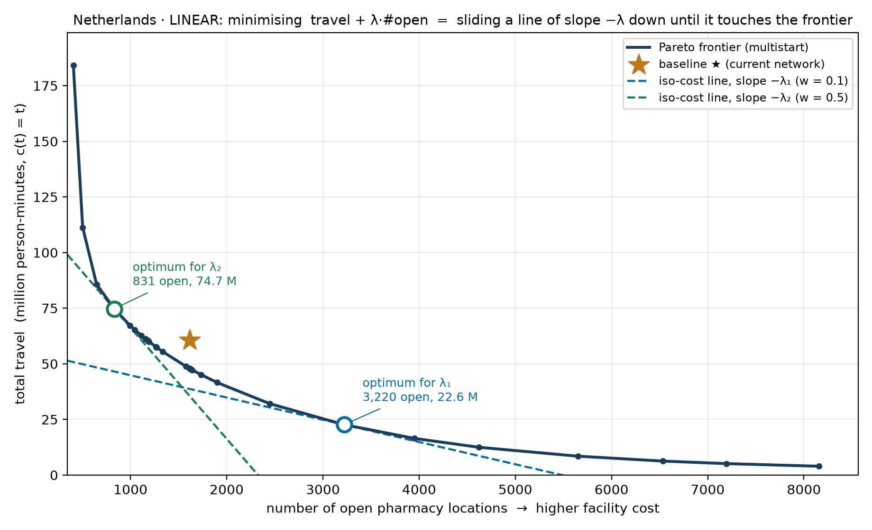
METHOD
How one λ picks one point — and how a sweep over λ traces the frontier
The sweep never fixes a value of λ. Each λ is one slope; the solver returns the point of the feasible set where a line of that slope touches. Netherlands, LINEAR c(t) = t, multistart-rounded solutions; the ★ is today’s network.
1 · The objective is a line
We minimise travel + λ · #open. Every solution with the same objective value C lies on the line travel = C − λ · #open: slope −λ, and the lower the line, the cheaper the solution.
2 · The optimum is a tangency
Slide the line down until it last touches the feasible set. That touching point is the λ-optimum. λ₁ = €10,000 per facility touches at 3,220 open (22.6 M person-minutes); λ₂ = €50,000 touches at 831 open (74.7 M). A steeper slope buys fewer, busier pharmacies.
3 · Many λ → the frontier
Two λ give two tangencies; the 1-2-5 grid gives ~30. Their lower-left envelope is the Pareto frontier of the next slides. The frontier itself needs no λ — λ only says which point on it a decision-maker would pick.
What a tangency cannot reach
A point in a concave dent of the frontier is never a tangency, whatever λ. Such points — and an exact count such as “today’s 1,615” — need a fixed-#open solve — a p-median instance (p7). S1/S2 are now pinned by bisection over λ to within one facility / 0.2% travel (#52, p9); the exact fixed-count solve stays on the roadmap for the integrality gap (p65).

Slide 11
LAMBDA_SWEEP.JL
Scenarios and what the sweep computes
Baseline
Inputs
S1 — fix #facilities
Equal cost
Current pharmacy network
Reduce travel time at sum_y = today's cell count
Each client → nearest existing pharmacy.
Reports total travel cost, mean travel time, and the count of grid cells with at least one pharmacy (target_cells).
min Σᵢ popᵢ·c(tᵢⱼ)·xᵢⱼ + λ·Σⱼ yⱼ (p7)
Bisection over λ pins the count at today's, within max(1, 0.2%) (#52).
LP relaxation of the UFLP, strong linking xᵢⱼ ≤ yⱼ; at fixed p a p-median (pMP).
S2 — fix travel cost
Equal access
S3 — reduce both
Pareto sweep
Reduce #facilities at travel = today's
Trace the full Pareto frontier
Same objective, different λ target.
Bisection over λ pins travel at today's, within 0.2%; fewer pharmacies for the same access.
1-2-5 grid per decade, w ∈ {1e-4 … 5}, extended upward until S1 brackets; then bisection to S1 and S2.
Report sum_y, the travel bounds and the rounded n_open at each λ.

Slide 12
FROM FRACTIONS TO PHARMACIES
How multistart rounds the LP relaxation — and why it is an upper bound
1
Fix the count
Why this is an upper bound ✓
p = round(Σ yⱼ*) — the integer pharmacy count nearest the LP's fractional total, so every rounded point stays on the same axis as the relaxation.
The rounded set is a feasible point of the same (soft-coverage) problem: exactly p pharmacies actually open (x integer), and every client is either assigned to its nearest open pharmacy or explicitly left unserved at BIG. Feasible ⟹ its objective can only be ≥ the integer optimum, which is ≥ the LP optimum:
LP relax ≤ integer optimum ≤ multistart
Rigorous throughout — no caveat needed. Under soft coverage leaving a client unserved is part of the feasible space, and it is priced at the same BIG in the LP bound, in the rounding and in the baseline. The unserved count is reported next to every figure.
The multi-vs-relax column in the end tables is therefore a certified optimality gap on TOTAL cost: the integer optimum lies inside it. It does NOT bound travel and facility cost separately — the discrete solution may sit with higher travel and lower facility cost than the relaxation, or the reverse. For the logistic variant the bound is on the transformed cost c(t), not on minutes; mean_t is reported alongside and carries no bound. In practice the two bounds are now nearly a line for most areas.
2
Seed 10 candidate sets
top-p by x* and the lazy-greedy set (CELF, Leskovec et al. 2007 — marginal travel gains are submodular), so the result can never be worse than either; plus 8 x*-weighted random draws (Efraimidis–Spirakis 2006 A-Res); must-open pharmacies (x*≈1) are always kept.
3
Polish by swaps
best-improving open↔closed swaps over the fractional pool — the classic p-median vertex-substitution search, in its fast-interchange form (Resende & Werneck 2007). Each swap is accepted only if the exact travel delta improves — cost strictly decreases, ≤ 12 rounds per seed.
4
Score coverage-honestly, keep the best
every client priced at its nearest open pharmacy, c(t); a client left with no open pharmacy in the OD (stranded) is priced at BIG — 120 min (linear) / 1.0 (logistic), the same price as in the LP and the baseline, so abandoning remote clusters is never free. Lowest total wins.
Checked against the implementation (lp_run.jl). An LP-guided matheuristic. The swap profit is the exact per-swap travel change (gain − loss + interaction term — verified case-by-case), so polish is monotone and multistart ≤ min(top-p, greedy) by construction; the final choice re-evaluates every polished set from scratch (travel_of). Deterministic: fixed RNG seed, so decks reproduce. Cost: seconds per point — the LP solve dominates.
lp_run.jl: multistart_round (seeds), swap_round! (fast interchange), travel_of (coverage-honest metric), assign_nearest (final assignment) · MS_RESTARTS=10, MS_ROUNDS=12, MS_SEED fixed.

Slide 13
WHAT THE SWEEP TRACES
The Pareto frontier
Pareto frontier (schematic)
Two competing objectives — proximity vs efficiency
Travel cost — total person-c(t), weighted by population.
Facility count — sum_y, the LP-relaxed number of opened pharmacies.
How the sweep works
S2
baseline
Each λ gives one Pareto point (sum_y, travel_c).
Low λ → many cheap facilities, low travel.
High λ → few expensive facilities, high travel.
S1 and S2 are two points on the same curve; the diagonal crossing between them is Lewis's cross-lambda (p72).
The full sweep traces the curve between and beyond them.
travel cost
S1
← fewer facilities sum_y more facilities →
With the strong-linking LP, sum_y is a continuous lower bound on integer facility count.

Slide 14
WHY FRACTIONAL SUM_Y IS INFORMATIVE, NOT NOISE
Integrality gap: LP can strictly beat IP
Best integer
Open any one pharmacy: 1 + 1 + 3 + λ = 7
Open any two: 1 + 1 + 1 + 2λ = 7
→ IP optimum = 7 (1 or 2 facilities)
i₃
1
1
LP fractional
j₂
j₃
Set y = (½, ½, ½); each client routes ½ + ½ to its two near pharmacies (cost 1 each).
Travel = 3, facility = 3 · ½ · 2 = 3
→ LP optimum = 6 (sum_y = 1.5, strictly < IP = 7)
1
1
1
1
i₁
j₁
i₂
Takeaway
Fractional sum_y is not a solver artefact. The LP frontier is a true lower bound; geographies that resist clean integer covering show the gap.
3 clients · 3 candidate pharmacies · weight = 1 each · λ = 2

Slide 15
PRELIMINARY · CATCHMENT-CAP LADDER (NO COST FUNCTION)
Netherlands — five rungs, capping catchments instead of a cost function — S1 fix #, ↓travel · S2 ↓#, hold travel
S1 · A
S1 · B
S1 · C
max cap · multiple per cell
max cap · one per cell
urban fixed · model the rest
+13.3% travel vs today
-6.5% travel vs today
full-scale run
pending
1,613 pharmacies · 1,593 cells
1.9% stranded · cap 35,000
1,613 pharmacies · 1,613 cells
0.8% stranded · cap 35,000
S2 · A
S2 · B
S1 keeps today's count, minimises travel under a max catchment cap. S2 minimises the count under a min (viability) + max catchment, holding travel ≈ today. Cost-function rung (S1-D / S2-C) = the λ-sweep that follows.
min + max cap · all facilities
min + max cap · outside urban
full-scale run
pending
full-scale run
pending
PRELIMINARY — INDICATIVE ONLY. Full-scale ladder run incomplete; S1 (fixed-count) figures are sensitive to LP-relaxation rounding and can shift on re-run (robust multistart rounding still to be ported) — read the direction, not the exact %. LINEAR travel cost; max cap = NL observed cell-catchment max (~35k). 'stranded' = demand the cap can't serve within reach, priced at that run's c(t_max) (the λ-sweep now prices stranding at BIG).

Slide 16
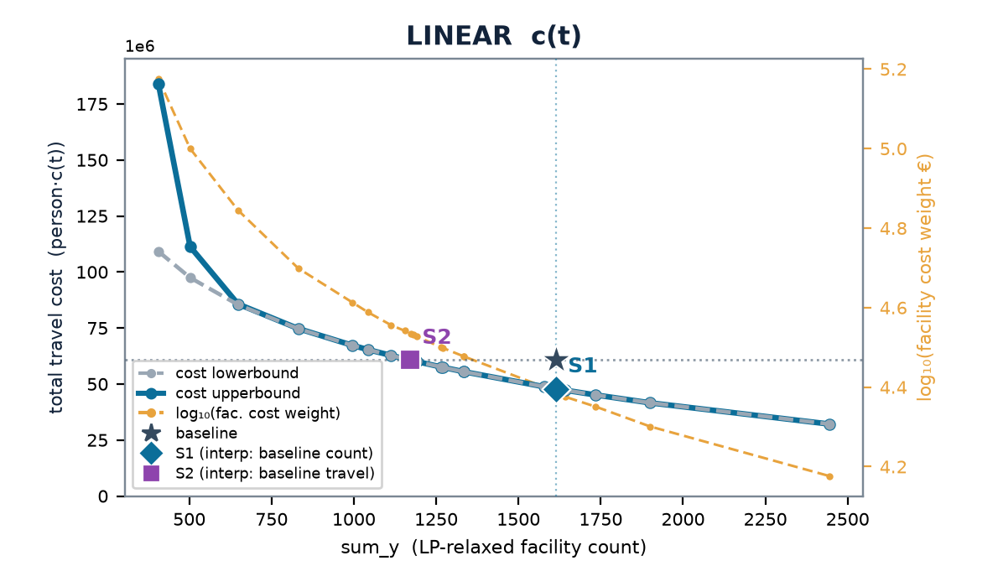
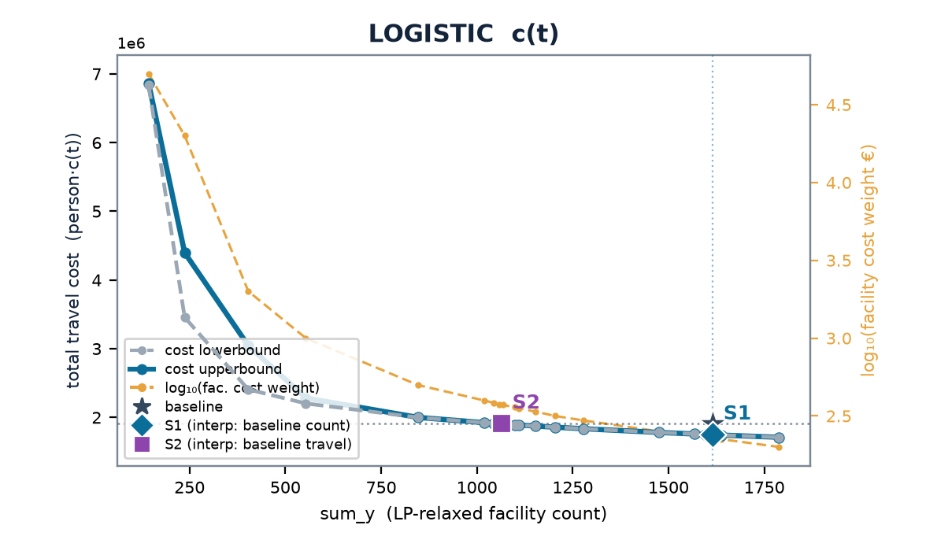
NETHERLANDS
Netherlands — multistart vs the LP-relax frontier
baseline (current) 1,615 cells · 3.48 min mean · travel (stranded at BIG) LIN 60.7M · LOG 1.9M
 | scenario | w | n_open | frac | multi vs relax | stranded (multi)
LINEAR | S1 | 0.243 | 1618 | 57 | +0% | 0
 | S2 | 0.342 | 1174 | 88 | +0% | 1
LOGISTIC | S1 | 0.00228 | 1613 | 86 | +0% | 1
 | S2 | 0.00372 | 1068 | 121 | +0% | 7
Charts: cost lowerbound (LP relaxation, dashed grey — drawn on top) & cost upperbound (multistart integer solution, solid blue) on the left; log₁₀(facility cost weight €) on the right, vs sum_y; ★ baseline, ◆ S1, ■ S2. Lower ≤ integer optimum ≤ upper; stranded clients priced at BIG (120 min linear / 1.0 logistic) — in the baseline too (coverage-consistent).

Slide 17
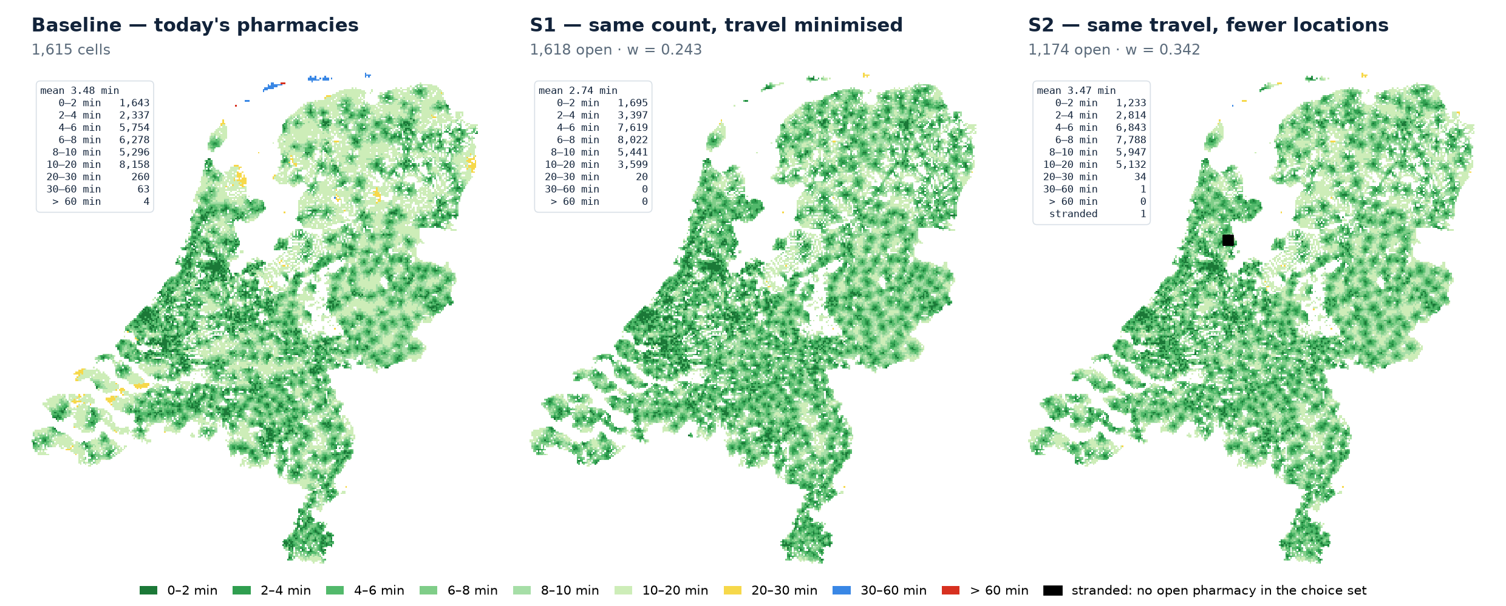
NETHERLANDS
Netherlands — travel time to the nearest open pharmacy: today, S1, S2
LINEAR cost, pinned scenarios (#52). Each 1-km client cell coloured by its road travel time to the nearest OPEN pharmacy, in the classes of the model's own classification (0–2 … 30–60, > 60 min). S1 keeps today's count (1,618 open) and moves pharmacies where they cut travel most; S2 keeps today's travel with 1,174 open. A cell with no open pharmacy among its five nearest candidates is stranded (marked) and priced at BIG in the sweep.
Means are population-weighted, a stranded cell at the 120-min cutoff. From the arrows the sweep writes for the baseline and the pinned S1/S2 (lambda_sweep/LINEAR/{baseline,S1,S2}/traveltime.arrow); doc/nl_maps.jl → doc/nl_maps.py.

Slide 18
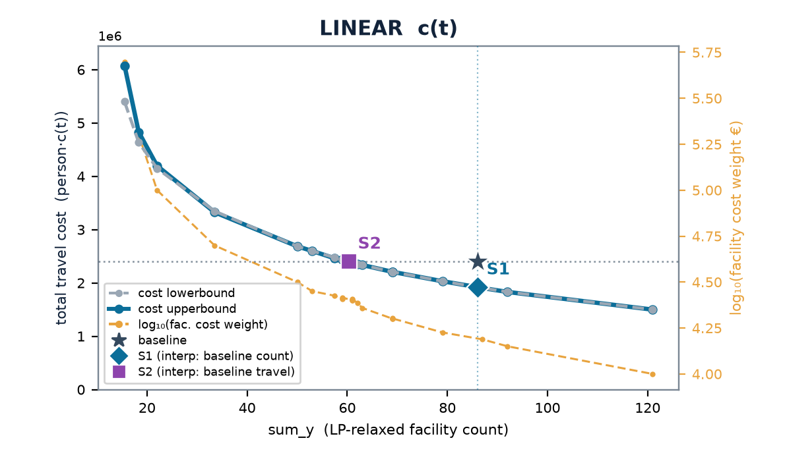
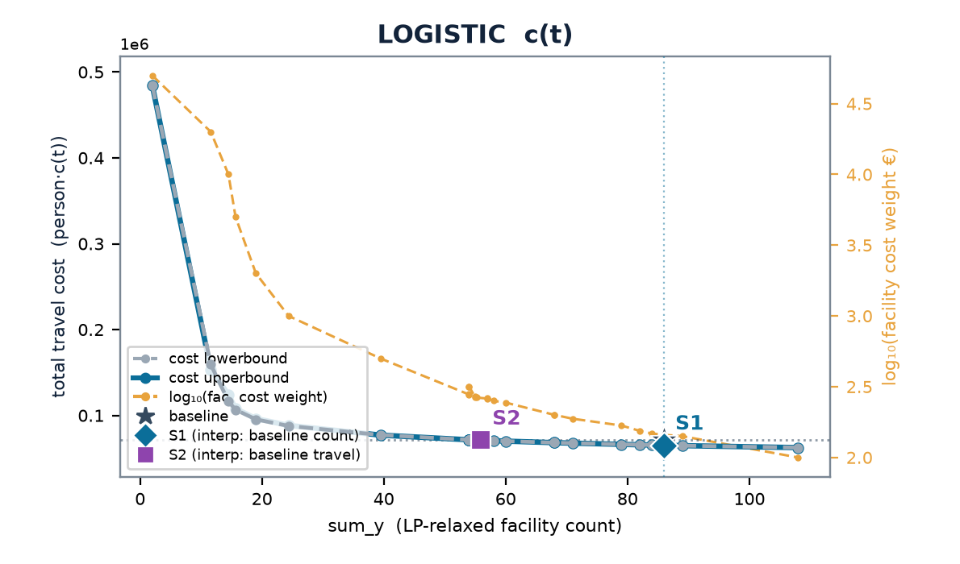
LUXEMBOURG
Luxembourg — multistart vs the LP-relax frontier
baseline (current) 86 cells · 3.79 min mean · travel (stranded at BIG) LIN 2.4M · LOG 71k
 | scenario | w | n_open | frac | multi vs relax | stranded (multi)
LINEAR | S1 | 0.154 | 87 | 0 | +0% | 0
 | S2 | 0.252 | 61 | 6 | +0% | 0
LOGISTIC | S1 | 0.00145 | 86 | 8 | +0% | 0
 | S2 | 0.00265 | 55 | 11 | +0% | 0
Charts: cost lowerbound (LP relaxation, dashed grey — drawn on top) & cost upperbound (multistart integer solution, solid blue) on the left; log₁₀(facility cost weight €) on the right, vs sum_y; ★ baseline, ◆ S1, ■ S2. Lower ≤ integer optimum ≤ upper; stranded clients priced at BIG (120 min linear / 1.0 logistic) — in the baseline too (coverage-consistent).

Slide 19
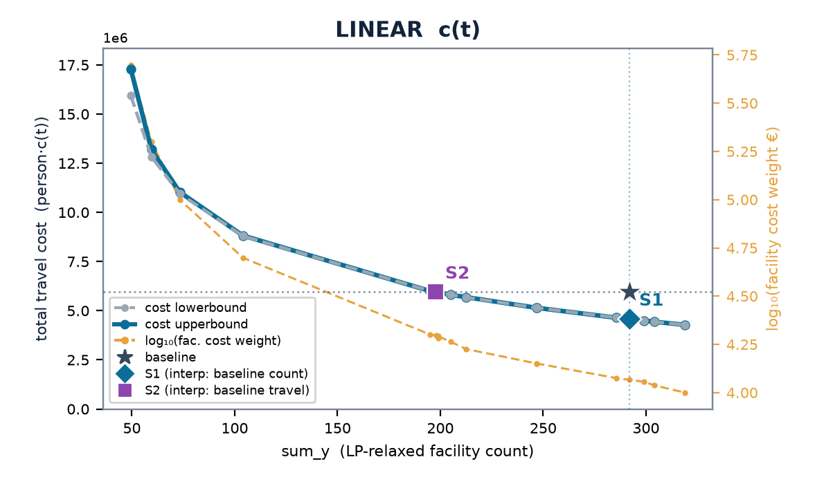
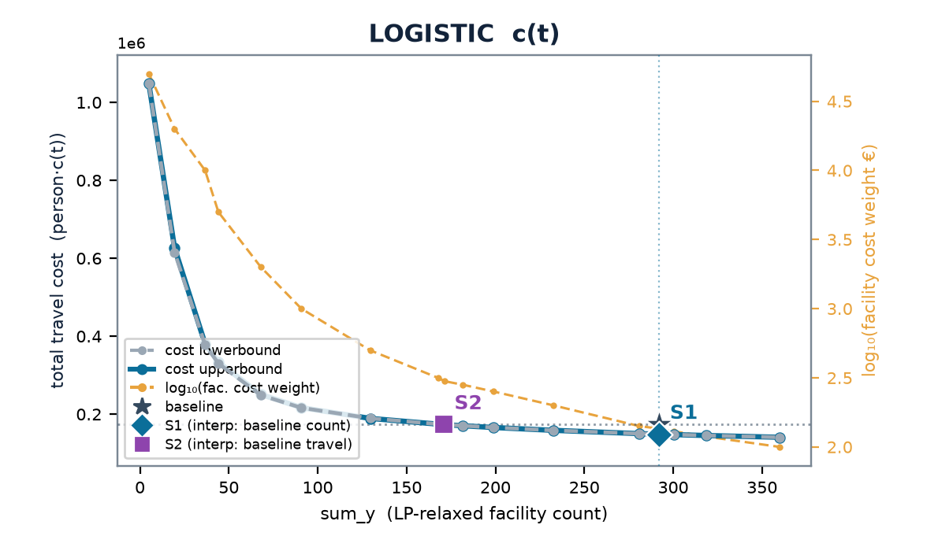
ESTONIA
Estonia — multistart vs the LP-relax frontier
baseline (current) 292 cells · 4.51 min mean · travel (stranded at BIG) LIN 5.9M · LOG 174k
 | scenario | w | n_open | frac | multi vs relax | stranded (multi)
LINEAR | S1 | 0.116 | 292 | 8 | +0% | 0
 | S2 | 0.198 | 198 | 0 | +0% | 1
LOGISTIC | S1 | 0.00135 | 292 | 9 | +0% | 0
 | S2 | 0.00299 | 172 | 19 | -0% | 1
Charts: cost lowerbound (LP relaxation, dashed grey — drawn on top) & cost upperbound (multistart integer solution, solid blue) on the left; log₁₀(facility cost weight €) on the right, vs sum_y; ★ baseline, ◆ S1, ■ S2. Lower ≤ integer optimum ≤ upper; stranded clients priced at BIG (120 min linear / 1.0 logistic) — in the baseline too (coverage-consistent).

Slide 20
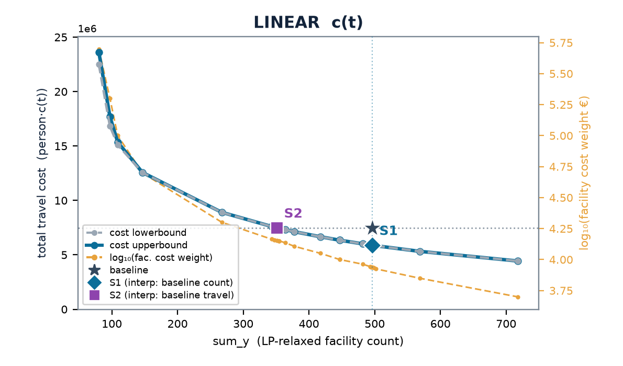
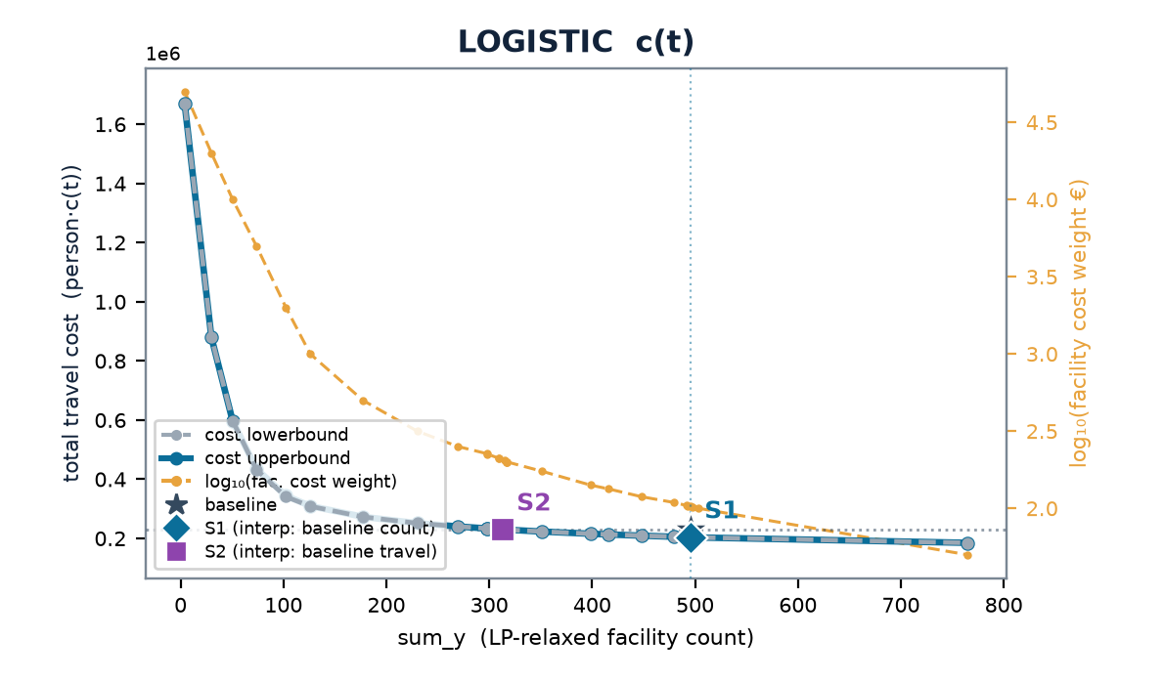
LATVIA
Latvia — multistart vs the LP-relax frontier
baseline (current) 496 cells · 3.96 min mean · travel (stranded at BIG) LIN 7.5M · LOG 230k
 | scenario | w | n_open | frac | multi vs relax | stranded (multi)
LINEAR | S1 | 0.0864 | 496 | 11 | +0% | 0
 | S2 | 0.142 | 352 | 15 | -0% | 1
LOGISTIC | S1 | 0.00103 | 496 | 17 | -0% | 0
 | S2 | 0.00205 | 315 | 38 | +0% | 1
Charts: cost lowerbound (LP relaxation, dashed grey — drawn on top) & cost upperbound (multistart integer solution, solid blue) on the left; log₁₀(facility cost weight €) on the right, vs sum_y; ★ baseline, ◆ S1, ■ S2. Lower ≤ integer optimum ≤ upper; stranded clients priced at BIG (120 min linear / 1.0 logistic) — in the baseline too (coverage-consistent).

Slide 21
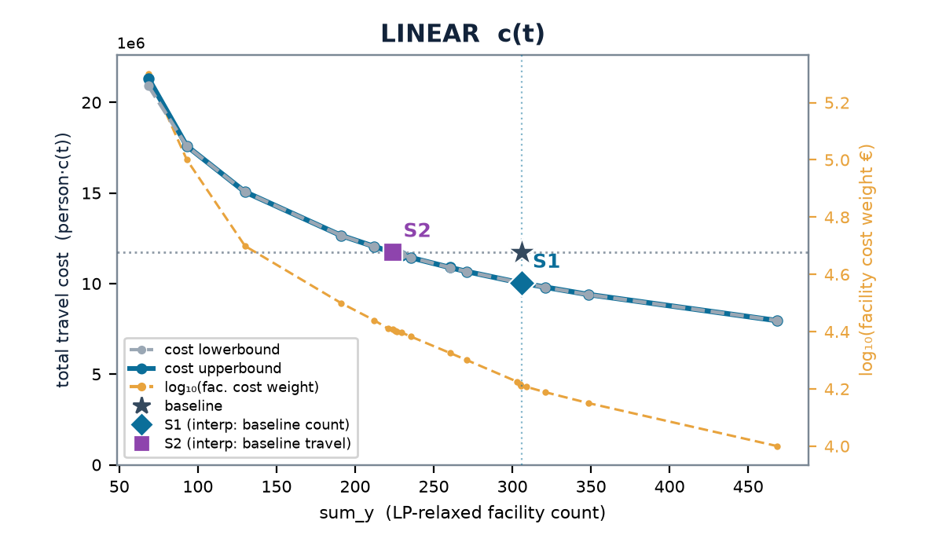
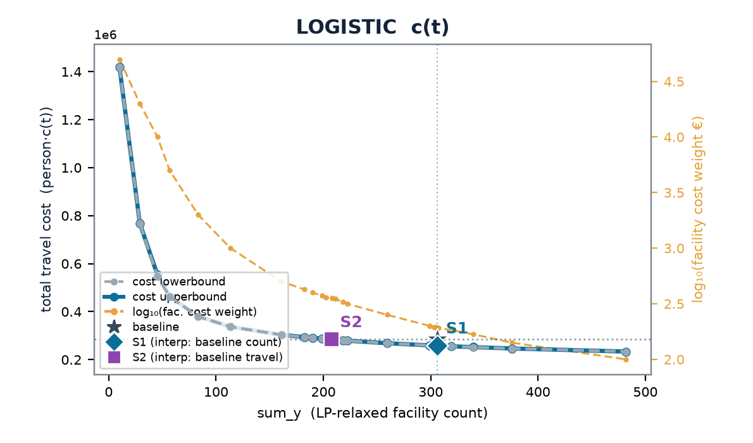
SLOVENIA
Slovenia — multistart vs the LP-relax frontier
baseline (current) 306 cells · 5.58 min mean · travel (stranded at BIG) LIN 11.7M · LOG 284k
 | scenario | w | n_open | frac | multi vs relax | stranded (multi)
LINEAR | S1 | 0.163 | 306 | 84 | -0% | 0
 | S2 | 0.256 | 224 | 34 | +0% | 0
LOGISTIC | S1 | 0.00194 | 305 | 89 | +0% | 0
 | S2 | 0.00355 | 208 | 79 | +0% | 0
Charts: cost lowerbound (LP relaxation, dashed grey — drawn on top) & cost upperbound (multistart integer solution, solid blue) on the left; log₁₀(facility cost weight €) on the right, vs sum_y; ★ baseline, ◆ S1, ■ S2. Lower ≤ integer optimum ≤ upper; stranded clients priced at BIG (120 min linear / 1.0 logistic) — in the baseline too (coverage-consistent).

Slide 22
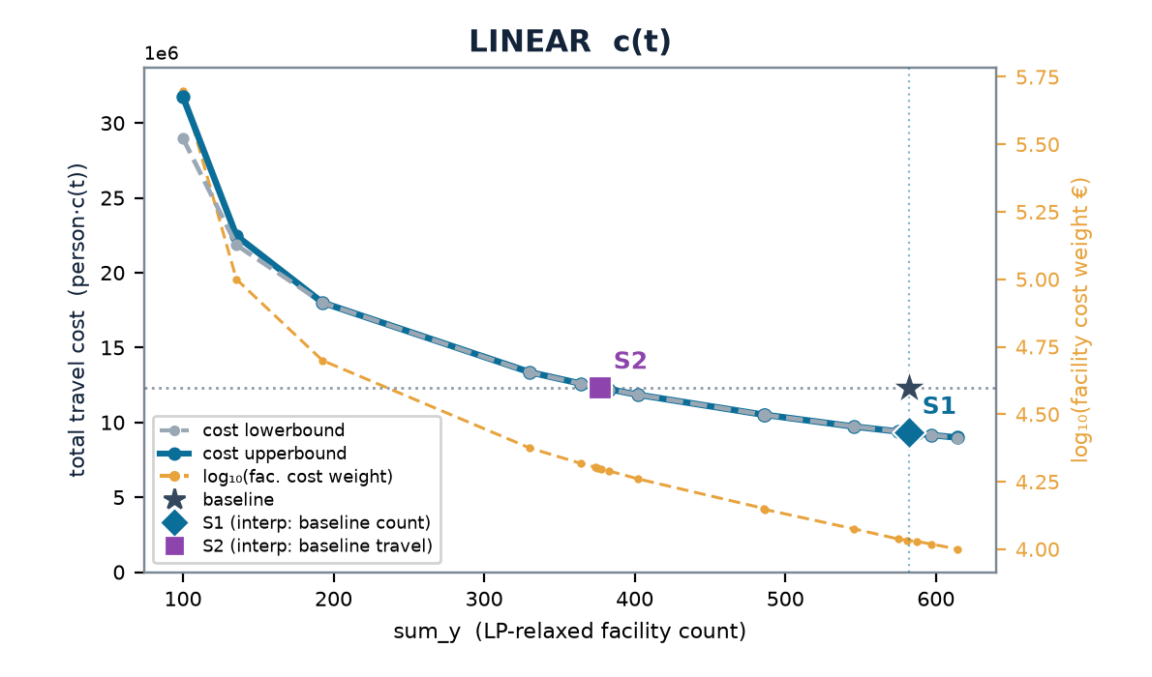
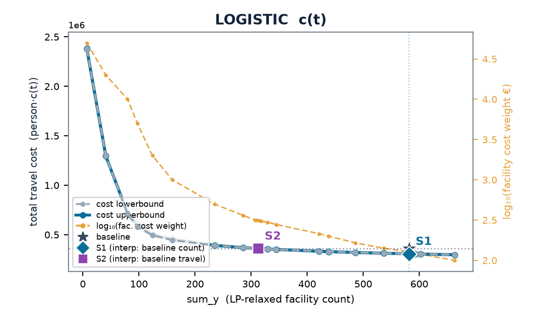
LITHUANIA
Lithuania — multistart vs the LP-relax frontier
baseline (current) 582 cells · 4.39 min mean · travel (stranded at BIG) LIN 12.3M · LOG 361k
 | scenario | w | n_open | frac | multi vs relax | stranded (multi)
LINEAR | S1 | 0.108 | 581 | 6 | +0% | 0
 | S2 | 0.198 | 378 | 10 | -0% | 1
LOGISTIC | S1 | 0.00127 | 582 | 19 | +0% | 0
 | S2 | 0.00313 | 314 | 23 | -0% | 2
Charts: cost lowerbound (LP relaxation, dashed grey — drawn on top) & cost upperbound (multistart integer solution, solid blue) on the left; log₁₀(facility cost weight €) on the right, vs sum_y; ★ baseline, ◆ S1, ■ S2. Lower ≤ integer optimum ≤ upper; stranded clients priced at BIG (120 min linear / 1.0 logistic) — in the baseline too (coverage-consistent).

Slide 23
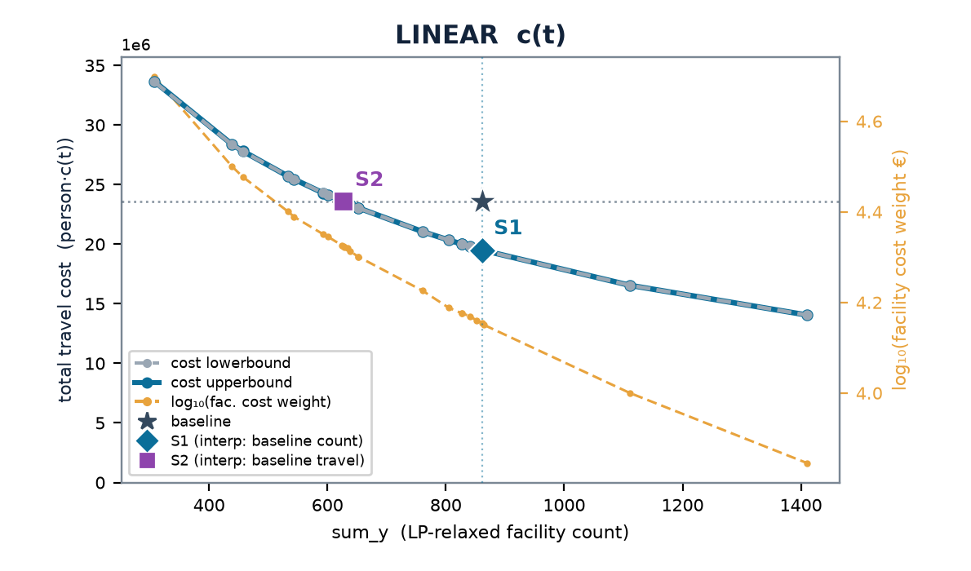

IRELAND
Ireland — multistart vs the LP-relax frontier
baseline (current) 862 cells · 4.71 min mean · travel (stranded at BIG) LIN 23.6M · LOG 630k
 | scenario | w | n_open | frac | multi vs relax | stranded (multi)
LINEAR | S1 | 0.143 | 861 | 46 | +0% | 0
 | S2 | 0.210 | 628 | 79 | +0% | 0
LOGISTIC | S1 | 0.00153 | 861 | 93 | +0% | 0
 | S2 | 0.00270 | 564 | 143 | +0% | 0
Charts: cost lowerbound (LP relaxation, dashed grey — drawn on top) & cost upperbound (multistart integer solution, solid blue) on the left; log₁₀(facility cost weight €) on the right, vs sum_y; ★ baseline, ◆ S1, ■ S2. Lower ≤ integer optimum ≤ upper; stranded clients priced at BIG (120 min linear / 1.0 logistic) — in the baseline too (coverage-consistent).

Slide 24
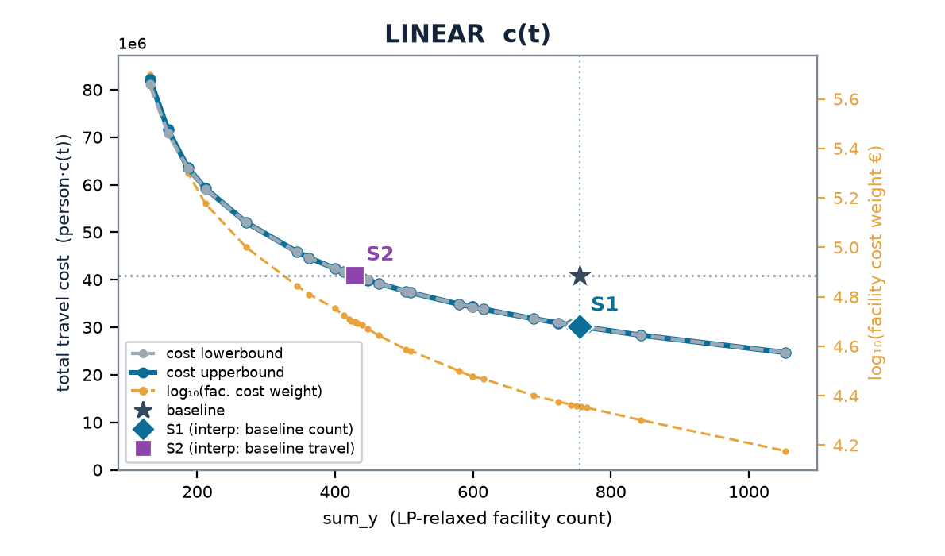
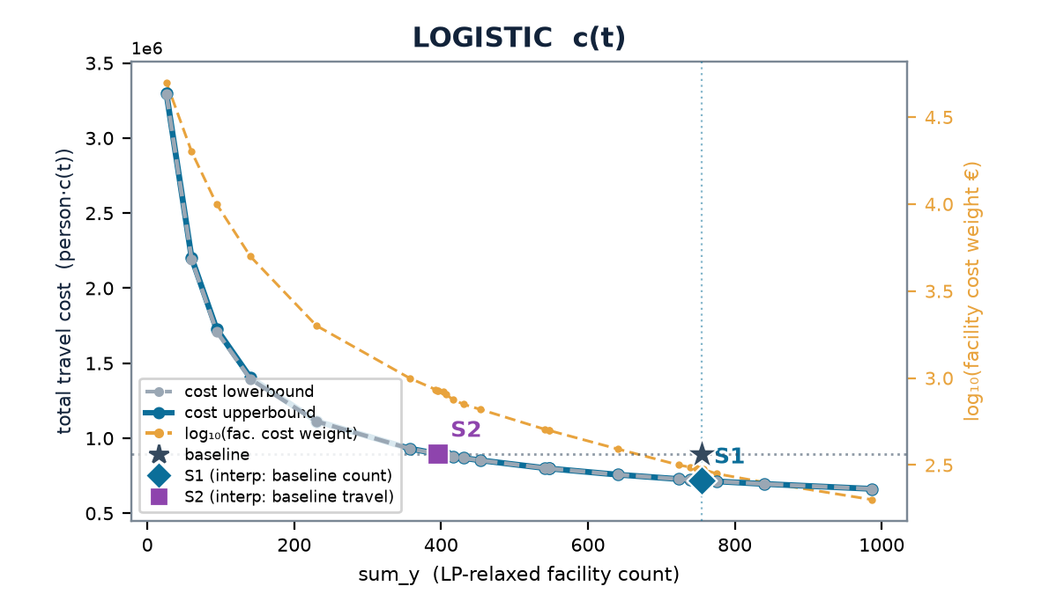
NORWAY
Norway — multistart vs the LP-relax frontier
baseline (current) 755 cells · 7.99 min mean · travel (stranded at BIG) LIN 40.8M · LOG 896k
 | scenario | w | n_open | frac | multi vs relax | stranded (multi)
LINEAR | S1 | 0.226 | 757 | 27 | -0% | 2
 | S2 | 0.500 | 429 | 28 | +0% | 2
LOGISTIC | S1 | 0.00301 | 754 | 39 | -0% | 2
 | S2 | 0.00845 | 394 | 35 | +0% | 54
Charts: cost lowerbound (LP relaxation, dashed grey — drawn on top) & cost upperbound (multistart integer solution, solid blue) on the left; log₁₀(facility cost weight €) on the right, vs sum_y; ★ baseline, ◆ S1, ■ S2. Lower ≤ integer optimum ≤ upper; stranded clients priced at BIG (120 min linear / 1.0 logistic) — in the baseline too (coverage-consistent).

Slide 25
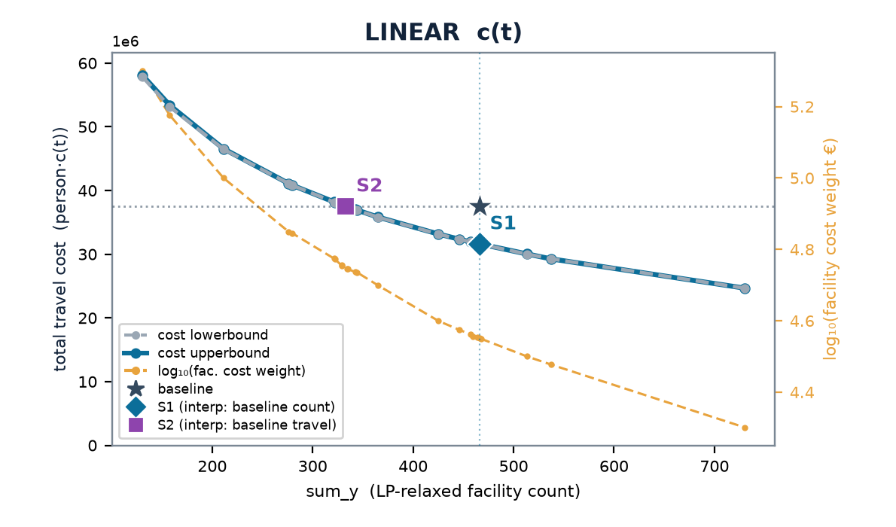
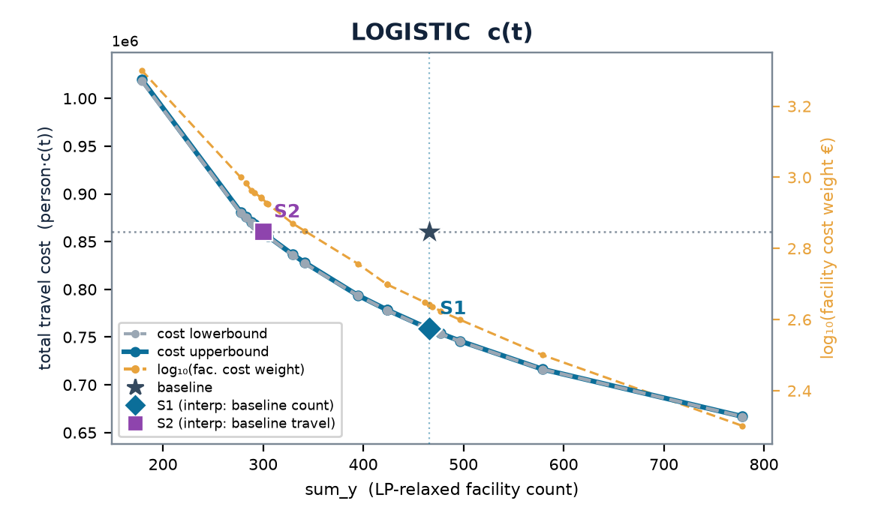
DENMARK
Denmark — multistart vs the LP-relax frontier
baseline (current) 466 cells · 6.52 min mean · travel (stranded at BIG) LIN 37.5M · LOG 860k
 | scenario | w | n_open | frac | multi vs relax | stranded (multi)
LINEAR | S1 | 0.356 | 466 | 61 | +0% | 0
 | S2 | 0.557 | 334 | 52 | +0% | 0
LOGISTIC | S1 | 0.00440 | 466 | 138 | +0% | 0
 | S2 | 0.00875 | 298 | 109 | +0% | 0
Charts: cost lowerbound (LP relaxation, dashed grey — drawn on top) & cost upperbound (multistart integer solution, solid blue) on the left; log₁₀(facility cost weight €) on the right, vs sum_y; ★ baseline, ◆ S1, ■ S2. Lower ≤ integer optimum ≤ upper; stranded clients priced at BIG (120 min linear / 1.0 logistic) — in the baseline too (coverage-consistent).

Slide 26
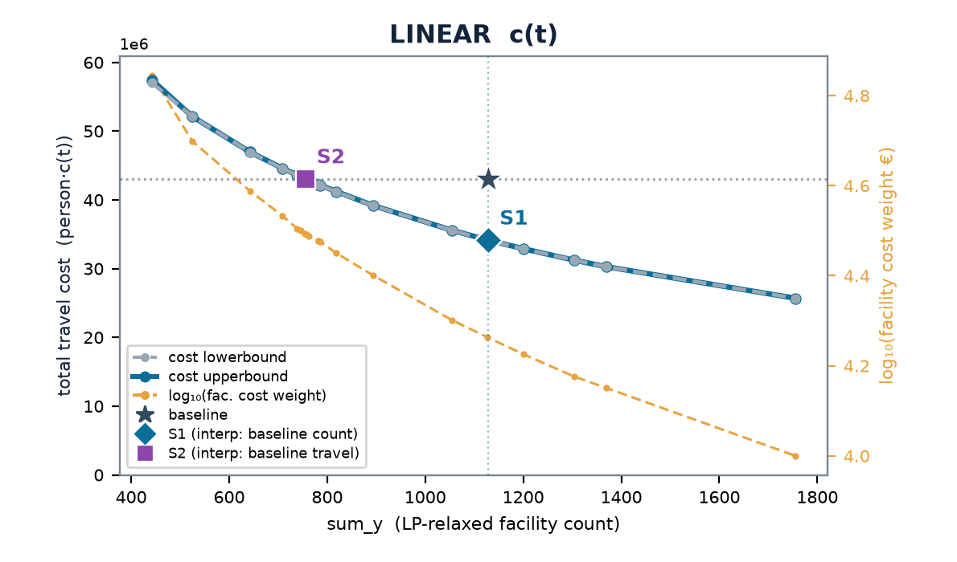
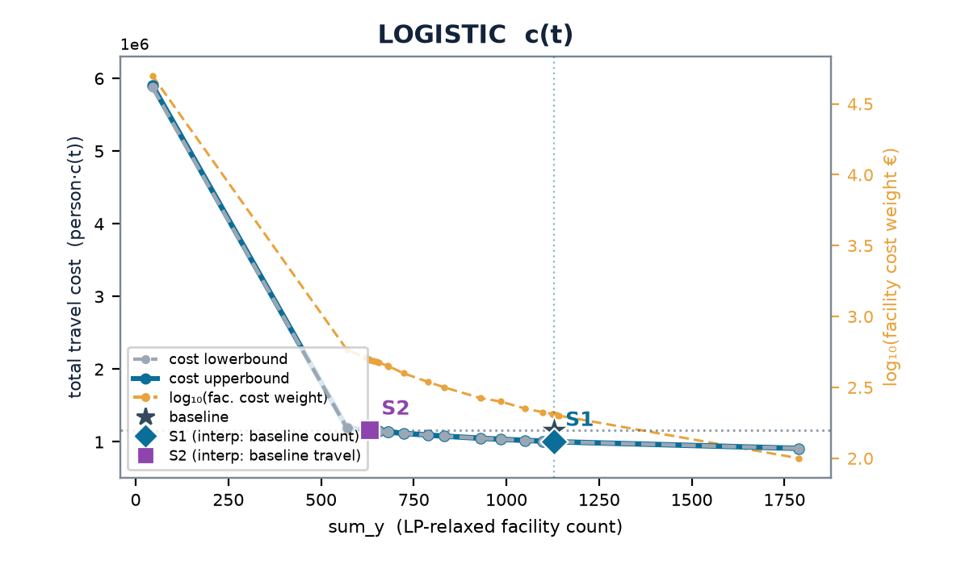
AUSTRIA
Austria — multistart vs the LP-relax frontier
baseline (current) 1,129 cells · 4.82 min mean · travel (stranded at BIG) LIN 43.1M · LOG 1.2M
 | scenario | w | n_open | frac | multi vs relax | stranded (multi)
LINEAR | S1 | 0.183 | 1127 | 138 | +0% | 0
 | S2 | 0.312 | 755 | 183 | +0% | 0
LOGISTIC | S1 | 0.00204 | 1126 | 172 | +0% | 0
 | S2 | 0.00495 | 632 | 165 | +0% | 1
Charts: cost lowerbound (LP relaxation, dashed grey — drawn on top) & cost upperbound (multistart integer solution, solid blue) on the left; log₁₀(facility cost weight €) on the right, vs sum_y; ★ baseline, ◆ S1, ■ S2. Lower ≤ integer optimum ≤ upper; stranded clients priced at BIG (120 min linear / 1.0 logistic) — in the baseline too (coverage-consistent).

Slide 27
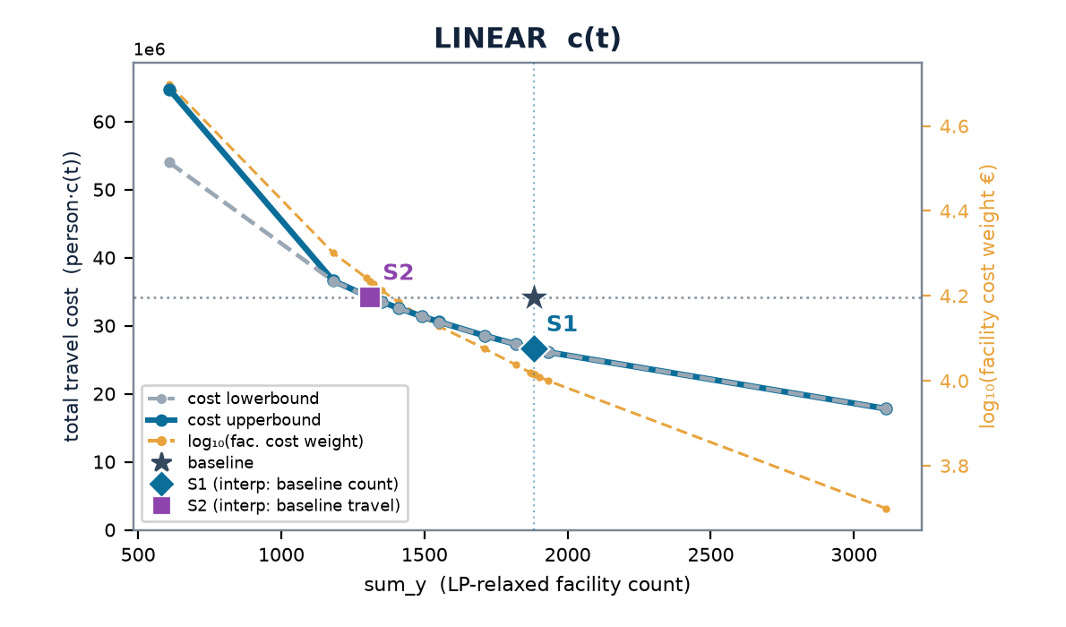
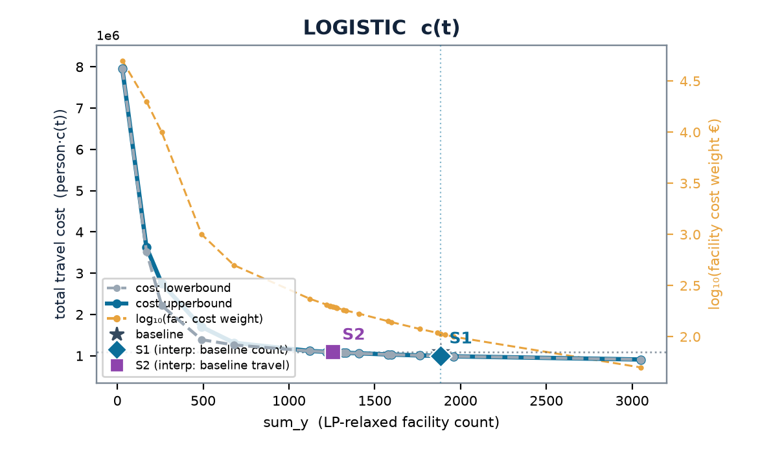
PORTUGAL
Portugal — multistart vs the LP-relax frontier
baseline (current) 1,882 cells · 3.47 min mean · travel (stranded at BIG) LIN 34.2M · LOG 1.1M
 | scenario | w | n_open | frac | multi vs relax | stranded (multi)
LINEAR | S1 | 0.103 | 1886 | 179 | +0% | 10
 | S2 | 0.172 | 1310 | 146 | +0% | 10
LOGISTIC | S1 | 0.00107 | 1885 | 237 | +0% | 10
 | S2 | 0.00196 | 1256 | 291 | +0% | 11
Charts: cost lowerbound (LP relaxation, dashed grey — drawn on top) & cost upperbound (multistart integer solution, solid blue) on the left; log₁₀(facility cost weight €) on the right, vs sum_y; ★ baseline, ◆ S1, ■ S2. Lower ≤ integer optimum ≤ upper; stranded clients priced at BIG (120 min linear / 1.0 logistic) — in the baseline too (coverage-consistent).

Slide 28
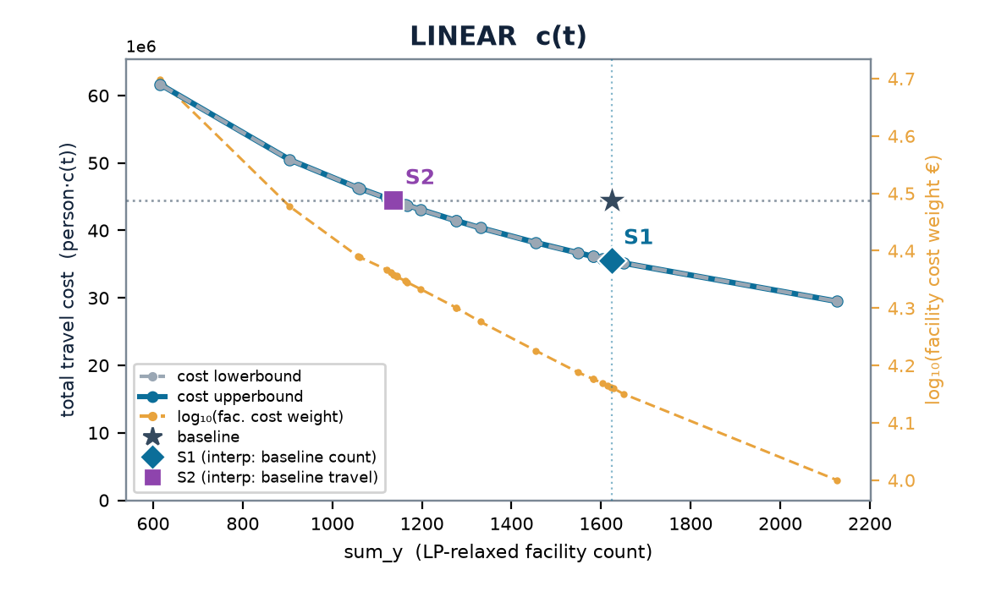

CZECHIA
Czechia — multistart vs the LP-relax frontier
baseline (current) 1,624 cells · 4.23 min mean · travel (stranded at BIG) LIN 44.4M · LOG 1.3M
 | scenario | w | n_open | frac | multi vs relax | stranded (multi)
LINEAR | S1 | 0.145 | 1621 | 67 | +0% | 1
 | S2 | 0.228 | 1137 | 33 | -0% | 2
LOGISTIC | S1 | 0.00149 | 1627 | 122 | +0% | 2
 | S2 | 0.00278 | 1038 | 122 | +0% | 3
Charts: cost lowerbound (LP relaxation, dashed grey — drawn on top) & cost upperbound (multistart integer solution, solid blue) on the left; log₁₀(facility cost weight €) on the right, vs sum_y; ★ baseline, ◆ S1, ■ S2. Lower ≤ integer optimum ≤ upper; stranded clients priced at BIG (120 min linear / 1.0 logistic) — in the baseline too (coverage-consistent).

Slide 29
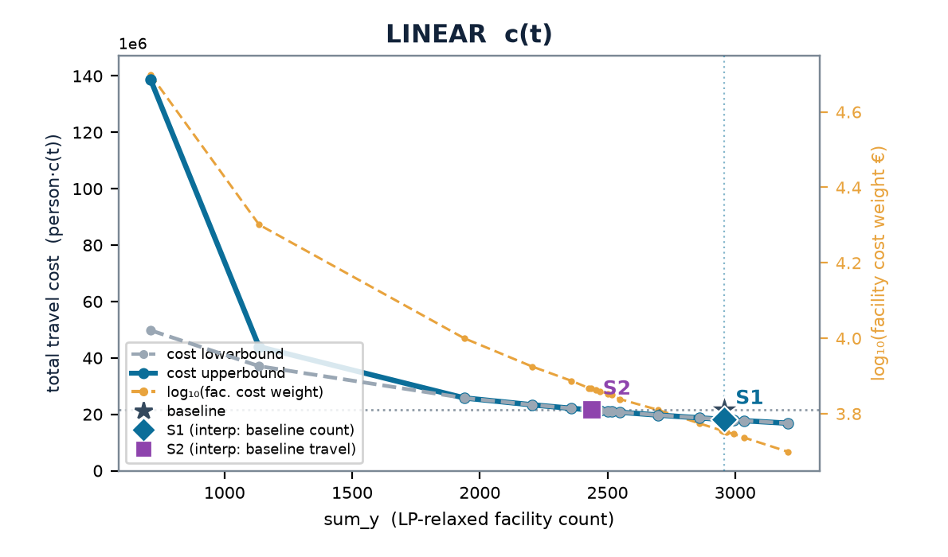
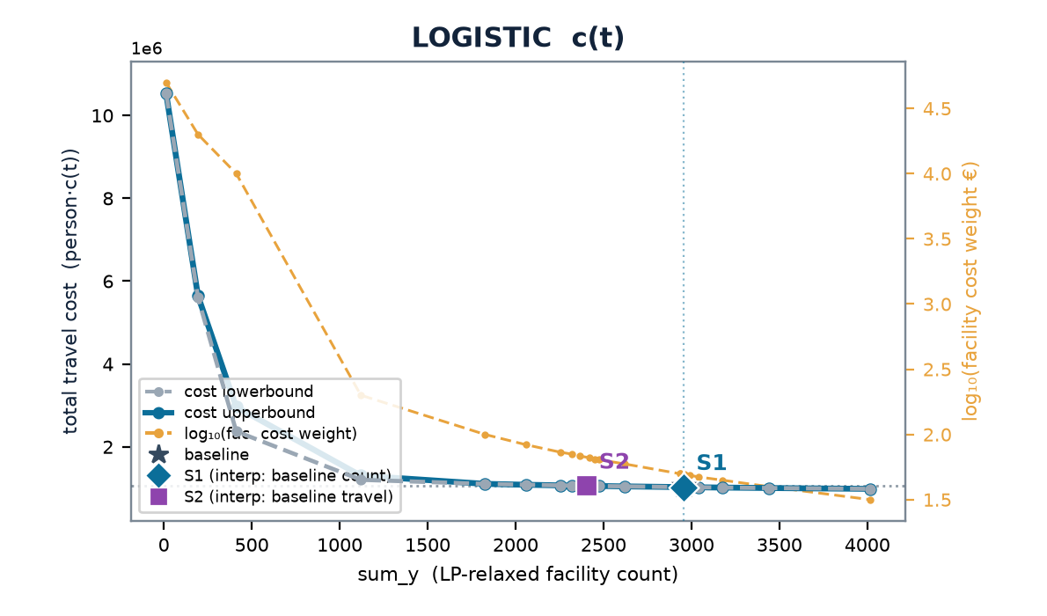
BELGIUM
Belgium — multistart vs the LP-relax frontier
baseline (current) 2,958 cells · 1.87 min mean · travel (stranded at BIG) LIN 21.5M · LOG 1.1M
 | scenario | w | n_open | frac | multi vs relax | stranded (multi)
LINEAR | S1 | 0.0566 | 2953 | 73 | +0% | 0
 | S2 | 0.0736 | 2435 | 159 | +0% | 0
LOGISTIC | S1 | 0.000493 | 2961 | 163 | +0% | 0
 | S2 | 0.000662 | 2422 | 209 | +0% | 0
Charts: cost lowerbound (LP relaxation, dashed grey — drawn on top) & cost upperbound (multistart integer solution, solid blue) on the left; log₁₀(facility cost weight €) on the right, vs sum_y; ★ baseline, ◆ S1, ■ S2. Lower ≤ integer optimum ≤ upper; stranded clients priced at BIG (120 min linear / 1.0 logistic) — in the baseline too (coverage-consistent).

Slide 30
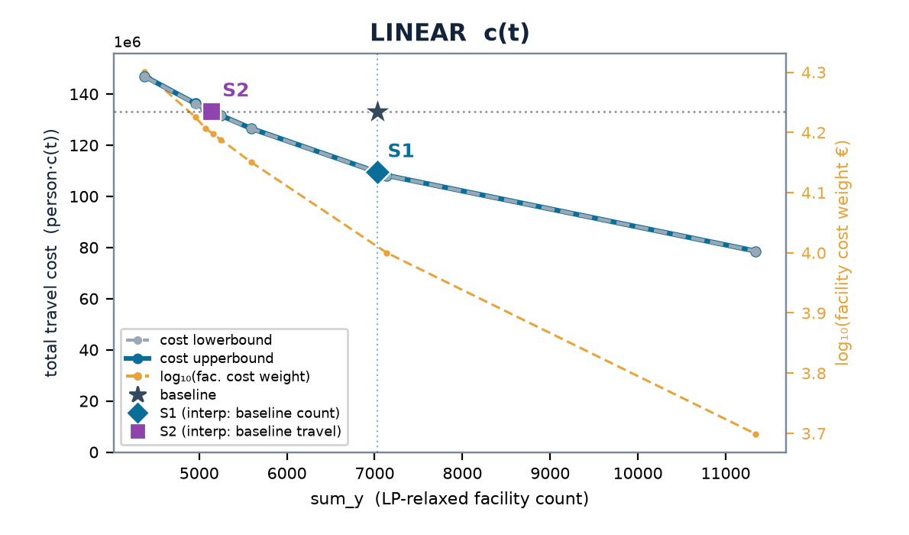
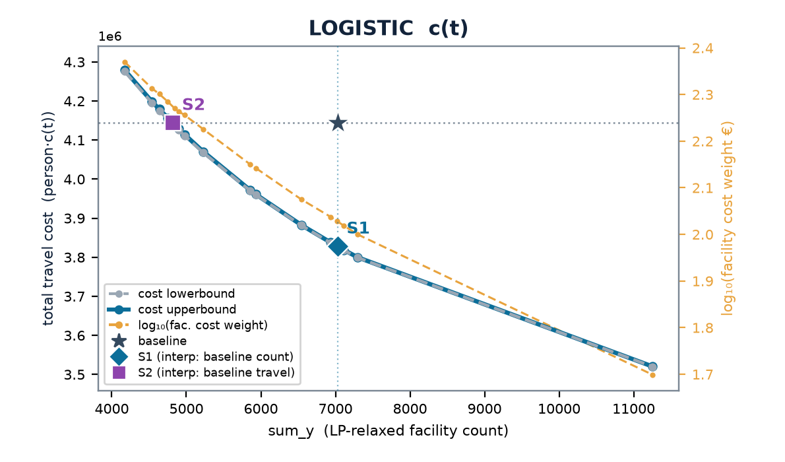
POLAND · DIRECT COUNTRY SWEEP
Poland (country-level sweep) — multistart vs the LP-relax frontier
baseline (current) 7,027 cells · 3.59 min mean · travel (stranded at BIG) LIN 133M · LOG 4.1M
 | scenario | w | n_open | frac | multi vs relax | stranded (multi)
LINEAR | S1 | 0.100 | 7139 | 663 | +0% | 0
 | S2 | 0.158 | 5156 | 430 | +0% | 0
LOGISTIC | S1 | 0.00107 | 7023 | 1043 | +0% | 1
 | S2 | 0.00186 | 4842 | 1211 | +0% | 1
Charts: cost lowerbound (LP relaxation, dashed grey — drawn on top) & cost upperbound (multistart integer solution, solid blue) on the left; log₁₀(facility cost weight €) on the right, vs sum_y; ★ baseline, ◆ S1, ■ S2. Lower ≤ integer optimum ≤ upper; stranded clients priced at BIG (120 min linear / 1.0 logistic) — in the baseline too (coverage-consistent).

Slide 31
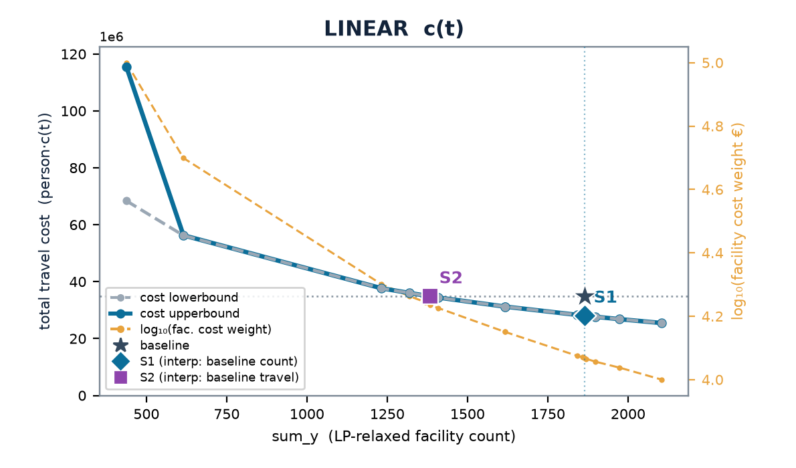
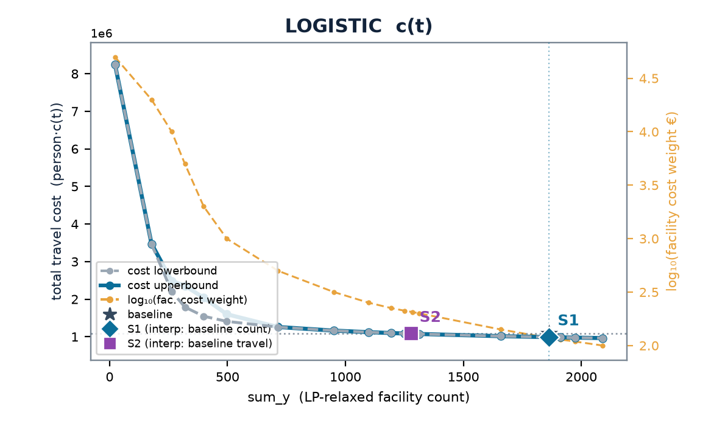
HUNGARY
Hungary — multistart vs the LP-relax frontier
baseline (current) 1,864 cells · 3.61 min mean · travel (stranded at BIG) LIN 34.9M · LOG 1.1M
 | scenario | w | n_open | frac | multi vs relax | stranded (multi)
LINEAR | S1 | 0.117 | 1862 | 20 | +0% | 0
 | S2 | 0.172 | 1384 | 34 | +0% | 0
LOGISTIC | S1 | 0.00118 | 1862 | 66 | +0% | 1
 | S2 | 0.00206 | 1284 | 107 | +0% | 0
Charts: cost lowerbound (LP relaxation, dashed grey — drawn on top) & cost upperbound (multistart integer solution, solid blue) on the left; log₁₀(facility cost weight €) on the right, vs sum_y; ★ baseline, ◆ S1, ■ S2. Lower ≤ integer optimum ≤ upper; stranded clients priced at BIG (120 min linear / 1.0 logistic) — in the baseline too (coverage-consistent).

Slide 32
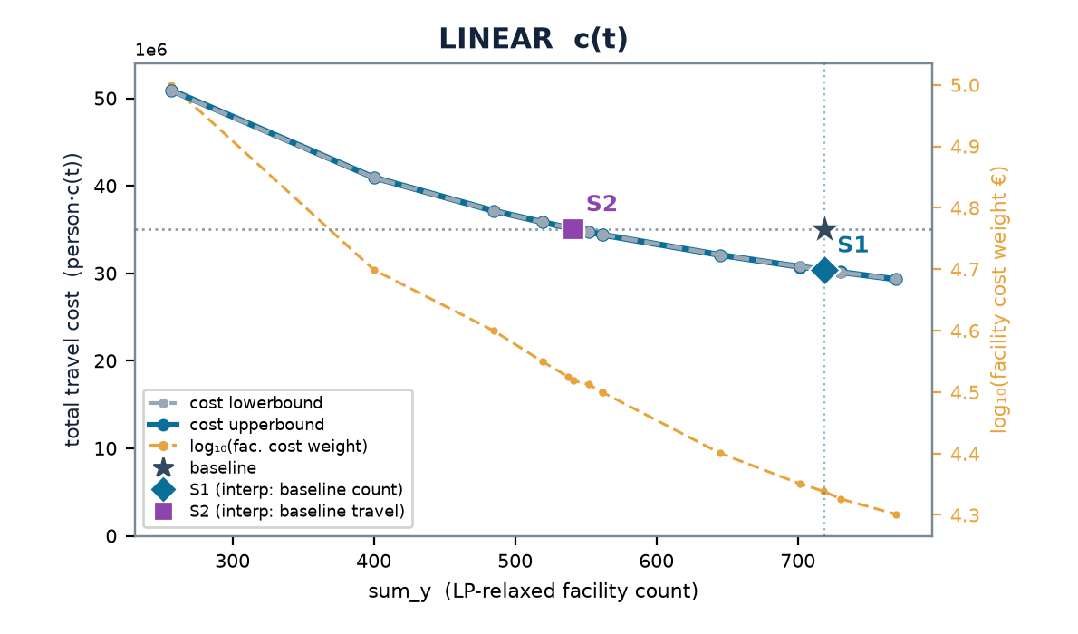
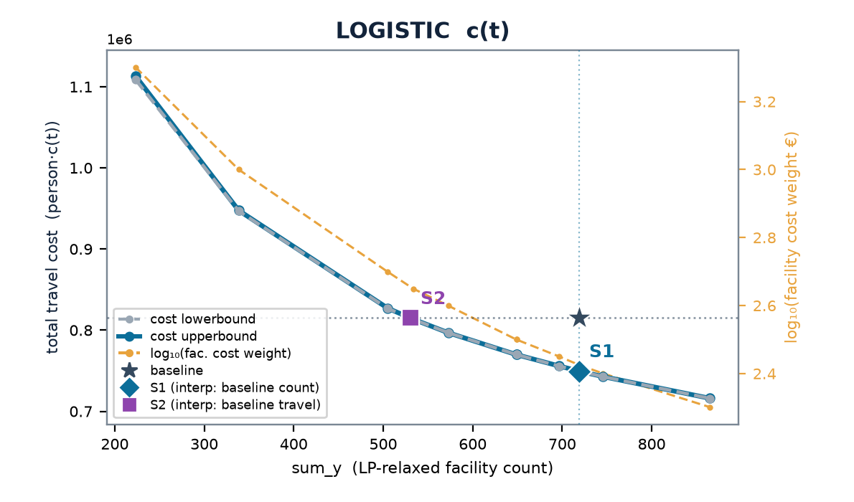
FINLAND
Finland — multistart vs the LP-relax frontier
baseline (current) 719 cells · 6.40 min mean · travel (stranded at BIG) LIN 35.1M · LOG 815k
 | scenario | w | n_open | frac | multi vs relax | stranded (multi)
LINEAR | S1 | 0.218 | 718 | 33 | +0% | 0
 | S2 | 0.330 | 541 | 37 | +0% | 16
LOGISTIC | S1 | 0.00266 | 719 | 28 | -0% | 14
 | S2 | 0.00446 | 534 | 46 | +0% | 15
Charts: cost lowerbound (LP relaxation, dashed grey — drawn on top) & cost upperbound (multistart integer solution, solid blue) on the left; log₁₀(facility cost weight €) on the right, vs sum_y; ★ baseline, ◆ S1, ■ S2. Lower ≤ integer optimum ≤ upper; stranded clients priced at BIG (120 min linear / 1.0 logistic) — in the baseline too (coverage-consistent).

Slide 33
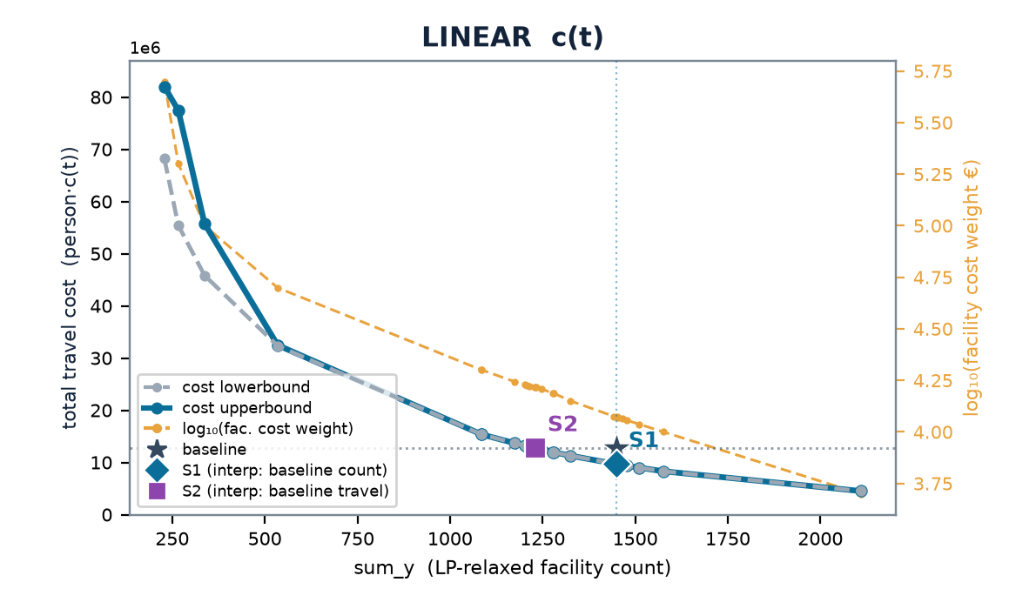
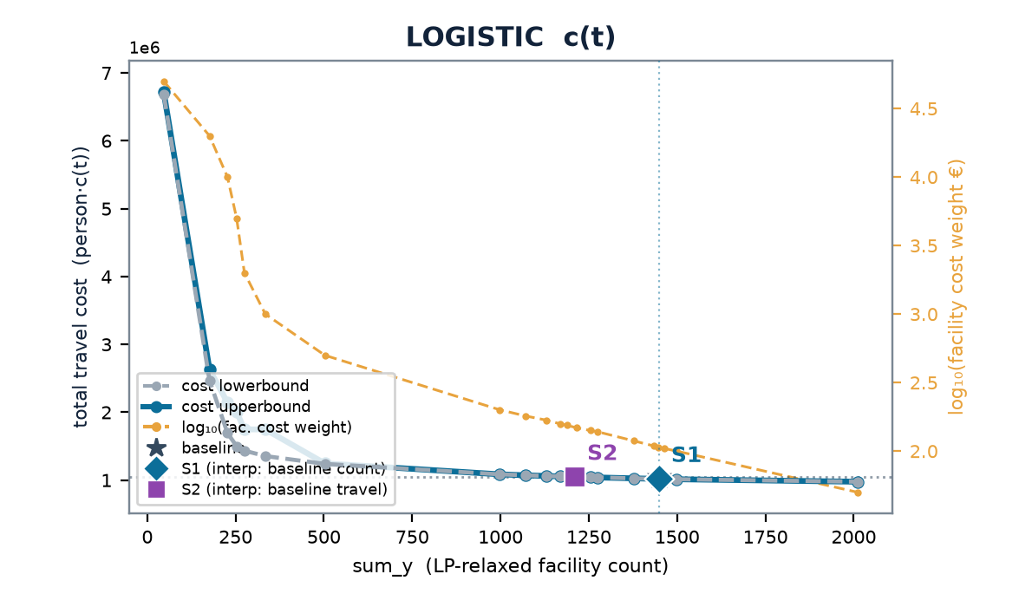
FRANCE · FR1
Île-de-France — multistart vs the LP-relax frontier
baseline (current) 1,449 cells · 1.03 min mean · travel (stranded at BIG) LIN 12.7M · LOG 1.0M
 | scenario | w | n_open | frac | multi vs relax | stranded (multi)
LINEAR | S1 | 0.118 | 1450 | 14 | +0% | 0
 | S2 | 0.164 | 1233 | 15 | -0% | 1
LOGISTIC | S1 | 0.00107 | 1446 | 38 | +0% | 0
 | S2 | 0.00148 | 1215 | 12 | +0% | 1
Charts: cost lowerbound (LP relaxation, dashed grey — drawn on top) & cost upperbound (multistart integer solution, solid blue) on the left; log₁₀(facility cost weight €) on the right, vs sum_y; ★ baseline, ◆ S1, ■ S2. Lower ≤ integer optimum ≤ upper; stranded clients priced at BIG (120 min linear / 1.0 logistic) — in the baseline too (coverage-consistent).

Slide 34
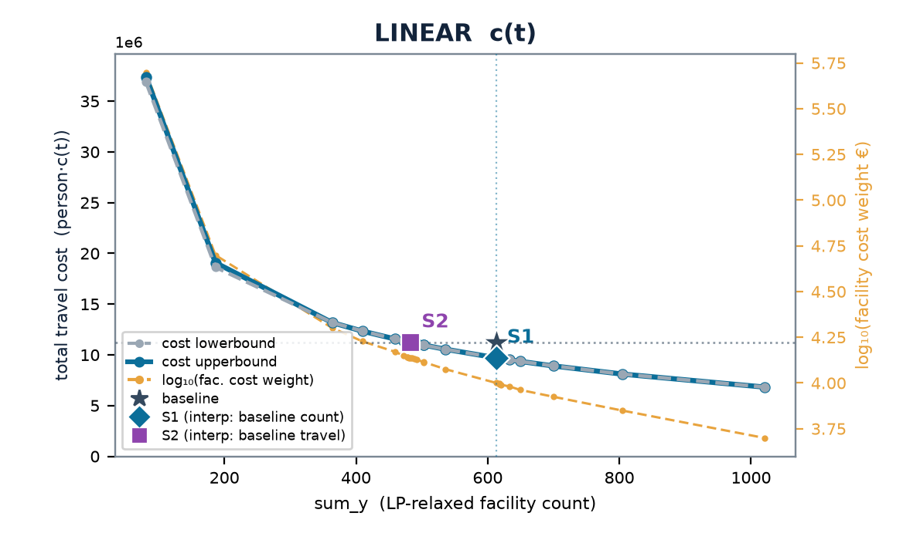
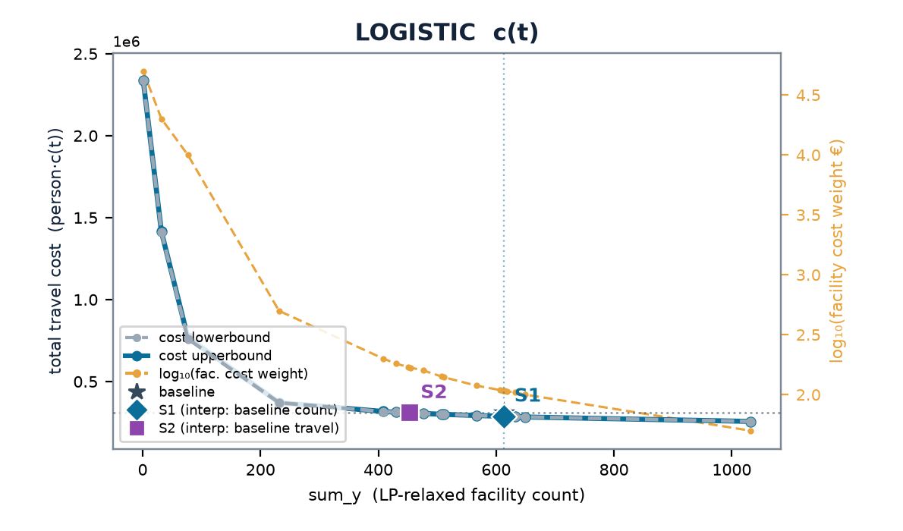
FRANCE · FRB
Centre-Val de Loire — multistart vs the LP-relax frontier
baseline (current) 613 cells · 4.36 min mean · travel (stranded at BIG) LIN 11.2M · LOG 309k
 | scenario | w | n_open | frac | multi vs relax | stranded (multi)
LINEAR | S1 | 0.0995 | 617 | 43 | +0% | 0
 | S2 | 0.137 | 485 | 79 | +0% | 0
LOGISTIC | S1 | 0.00107 | 614 | 66 | +0% | 0
 | S2 | 0.00170 | 451 | 108 | +0% | 1
Charts: cost lowerbound (LP relaxation, dashed grey — drawn on top) & cost upperbound (multistart integer solution, solid blue) on the left; log₁₀(facility cost weight €) on the right, vs sum_y; ★ baseline, ◆ S1, ■ S2. Lower ≤ integer optimum ≤ upper; stranded clients priced at BIG (120 min linear / 1.0 logistic) — in the baseline too (coverage-consistent).

Slide 35
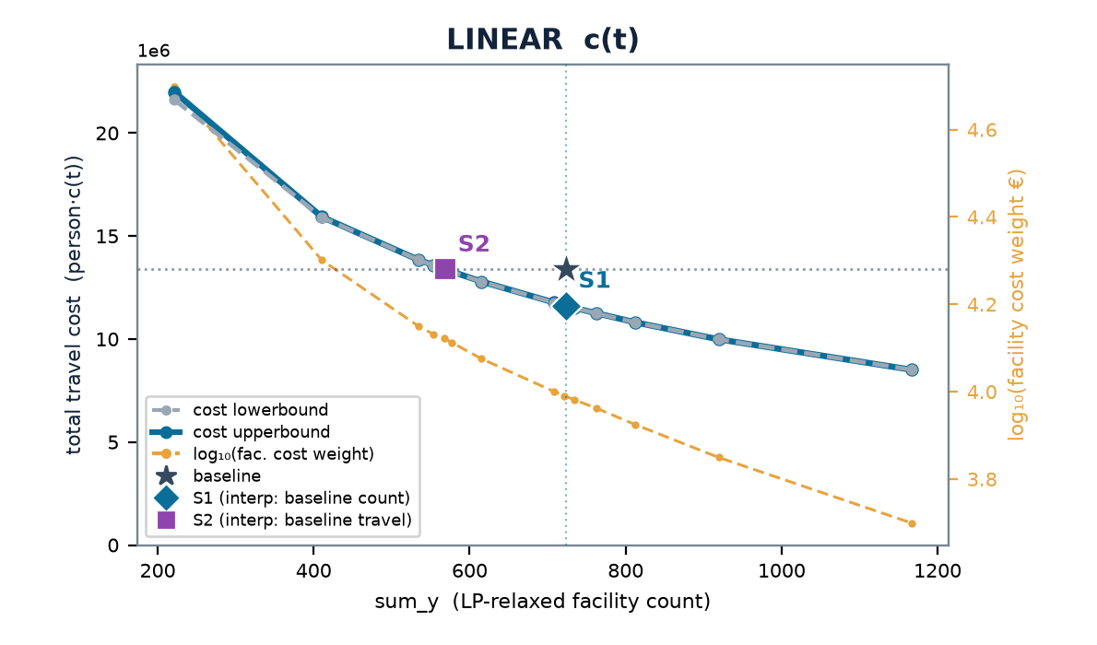
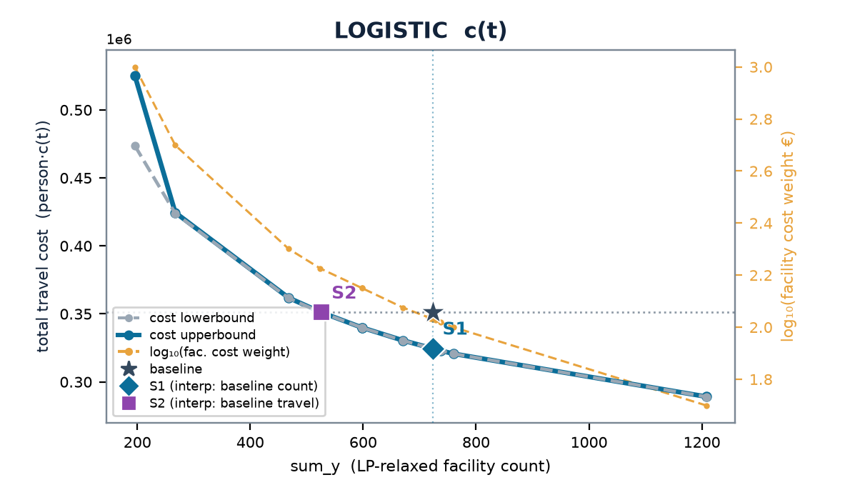
FRANCE · FRC
Bourgogne-Franche-Comté — multistart vs the LP-relax frontier
baseline (current) 723 cells · 4.78 min mean · travel (stranded at BIG) LIN 13.4M · LOG 351k
 | scenario | w | n_open | frac | multi vs relax | stranded (multi)
LINEAR | S1 | 0.0979 | 722 | 85 | +0% | 0
 | S2 | 0.133 | 568 | 105 | +0% | 0
LOGISTIC | S1 | 0.00107 | 724 | 141 | +0% | 0
 | S2 | 0.00168 | 524 | 103 | +0% | 1
Charts: cost lowerbound (LP relaxation, dashed grey — drawn on top) & cost upperbound (multistart integer solution, solid blue) on the left; log₁₀(facility cost weight €) on the right, vs sum_y; ★ baseline, ◆ S1, ■ S2. Lower ≤ integer optimum ≤ upper; stranded clients priced at BIG (120 min linear / 1.0 logistic) — in the baseline too (coverage-consistent).

Slide 36
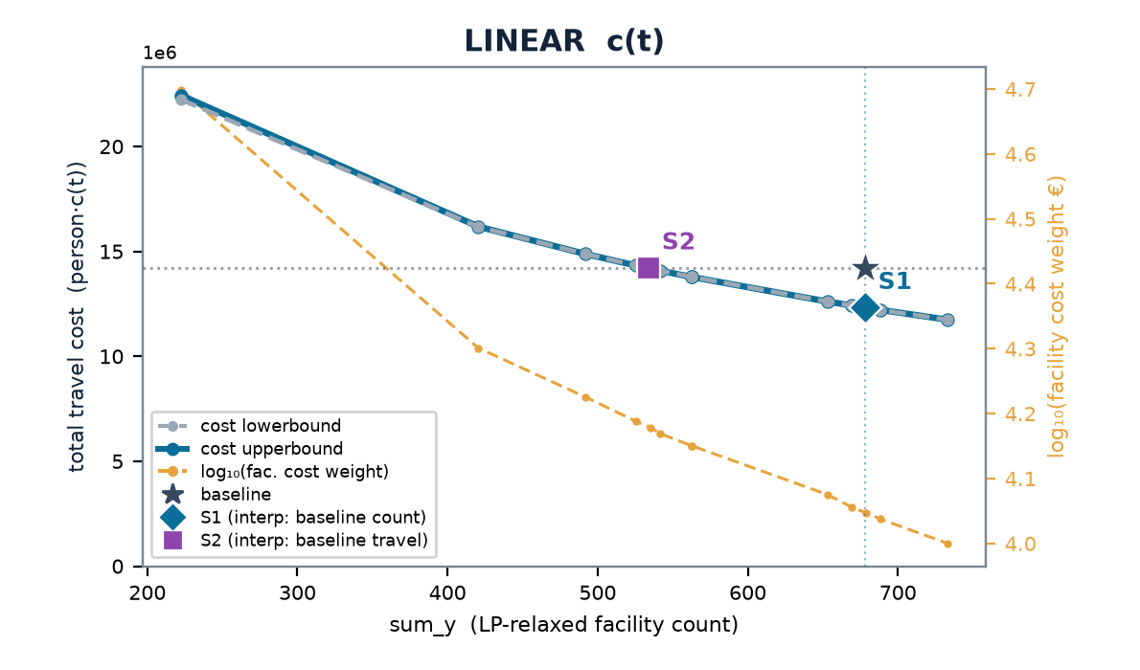
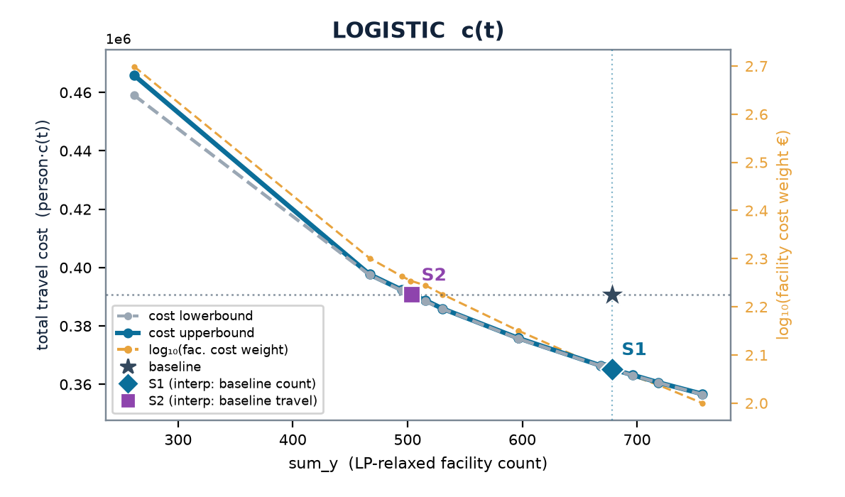
FRANCE · FRD
Normandie — multistart vs the LP-relax frontier
baseline (current) 678 cells · 4.31 min mean · travel (stranded at BIG) LIN 14.2M · LOG 391k
 | scenario | w | n_open | frac | multi vs relax | stranded (multi)
LINEAR | S1 | 0.111 | 679 | 39 | -0% | 0
 | S2 | 0.151 | 535 | 82 | +0% | 1
LOGISTIC | S1 | 0.00116 | 681 | 157 | +0% | 0
 | S2 | 0.00179 | 503 | 203 | +0% | 1
Charts: cost lowerbound (LP relaxation, dashed grey — drawn on top) & cost upperbound (multistart integer solution, solid blue) on the left; log₁₀(facility cost weight €) on the right, vs sum_y; ★ baseline, ◆ S1, ■ S2. Lower ≤ integer optimum ≤ upper; stranded clients priced at BIG (120 min linear / 1.0 logistic) — in the baseline too (coverage-consistent).

Slide 37
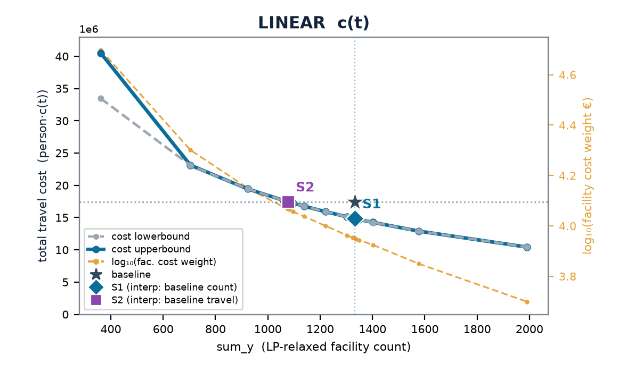
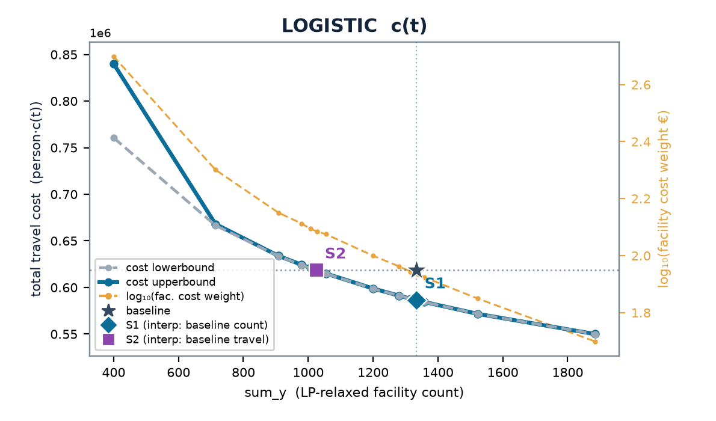
FRANCE · FRE
Hauts-de-France — multistart vs the LP-relax frontier
baseline (current) 1,333 cells · 2.92 min mean · travel (stranded at BIG) LIN 17.4M · LOG 619k
 | scenario | w | n_open | frac | multi vs relax | stranded (multi)
LINEAR | S1 | 0.0893 | 1332 | 136 | +0% | 0
 | S2 | 0.117 | 1077 | 174 | +0% | 0
LOGISTIC | S1 | 0.000859 | 1339 | 126 | +0% | 0
 | S2 | 0.00122 | 1028 | 332 | +0% | 0
Charts: cost lowerbound (LP relaxation, dashed grey — drawn on top) & cost upperbound (multistart integer solution, solid blue) on the left; log₁₀(facility cost weight €) on the right, vs sum_y; ★ baseline, ◆ S1, ■ S2. Lower ≤ integer optimum ≤ upper; stranded clients priced at BIG (120 min linear / 1.0 logistic) — in the baseline too (coverage-consistent).

Slide 38
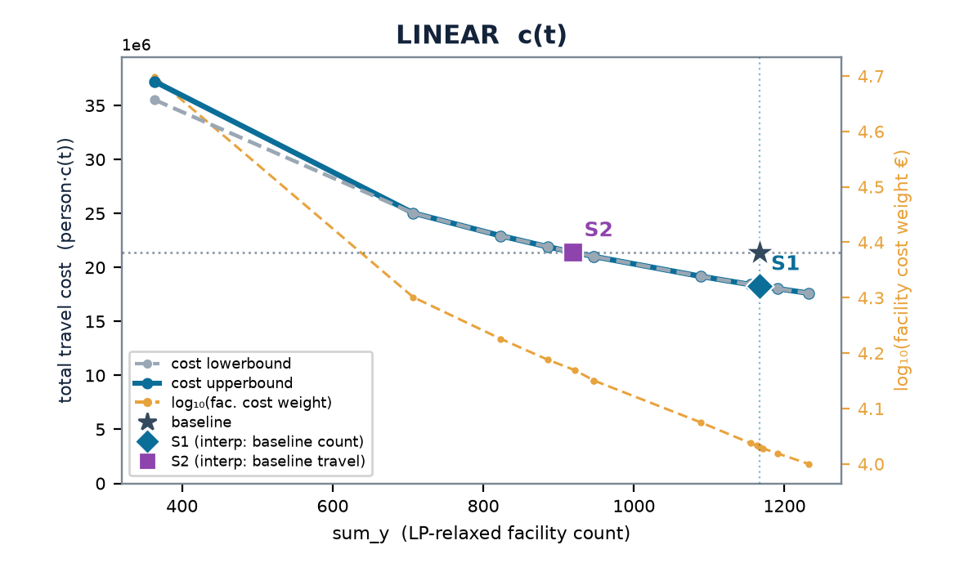
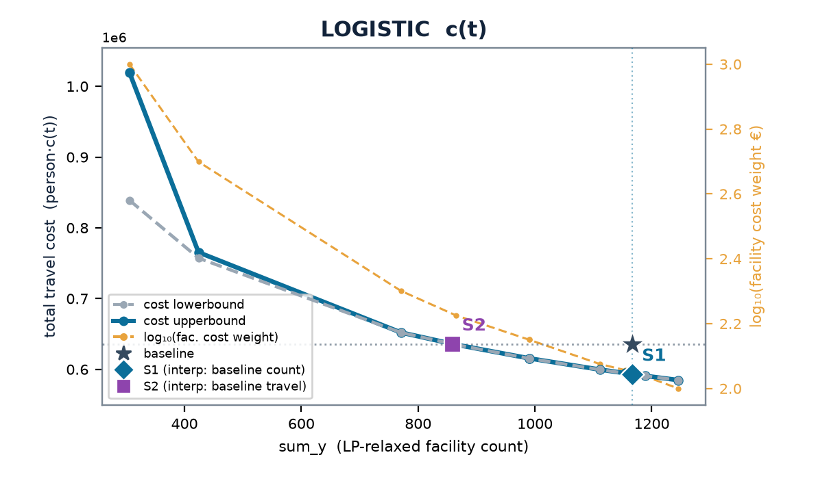
FRANCE · FRF
Grand Est — multistart vs the LP-relax frontier
baseline (current) 1,167 cells · 3.85 min mean · travel (stranded at BIG) LIN 21.4M · LOG 636k
 | scenario | w | n_open | frac | multi vs relax | stranded (multi)
LINEAR | S1 | 0.107 | 1166 | 39 | +0% | 0
 | S2 | 0.148 | 922 | 39 | -0% | 0
LOGISTIC | S1 | 0.00112 | 1168 | 123 | +0% | 0
 | S2 | 0.00168 | 864 | 123 | +0% | 0
Charts: cost lowerbound (LP relaxation, dashed grey — drawn on top) & cost upperbound (multistart integer solution, solid blue) on the left; log₁₀(facility cost weight €) on the right, vs sum_y; ★ baseline, ◆ S1, ■ S2. Lower ≤ integer optimum ≤ upper; stranded clients priced at BIG (120 min linear / 1.0 logistic) — in the baseline too (coverage-consistent).

Slide 39
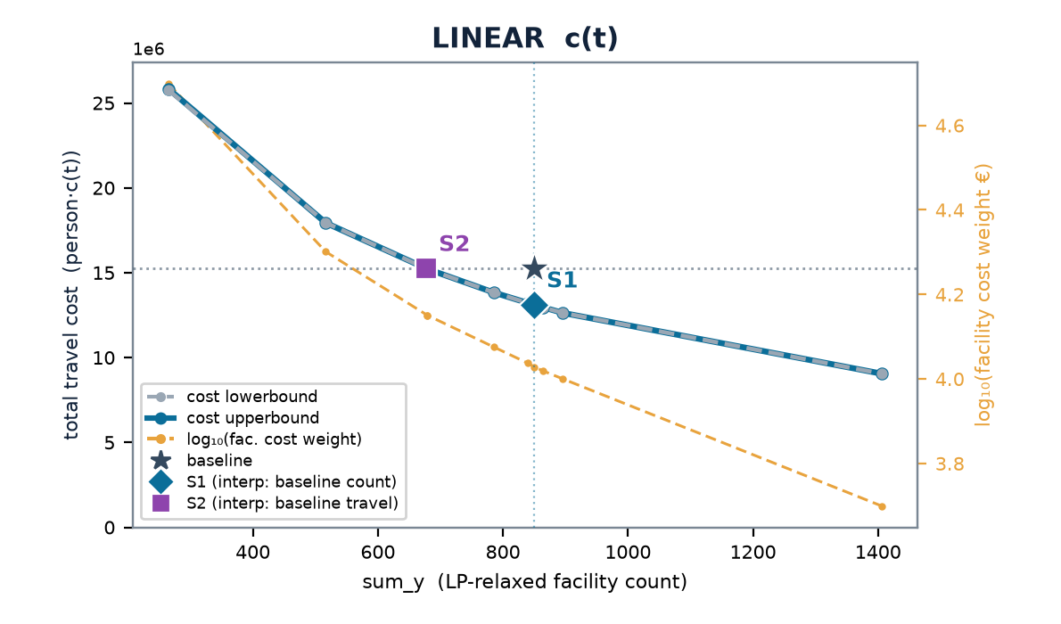
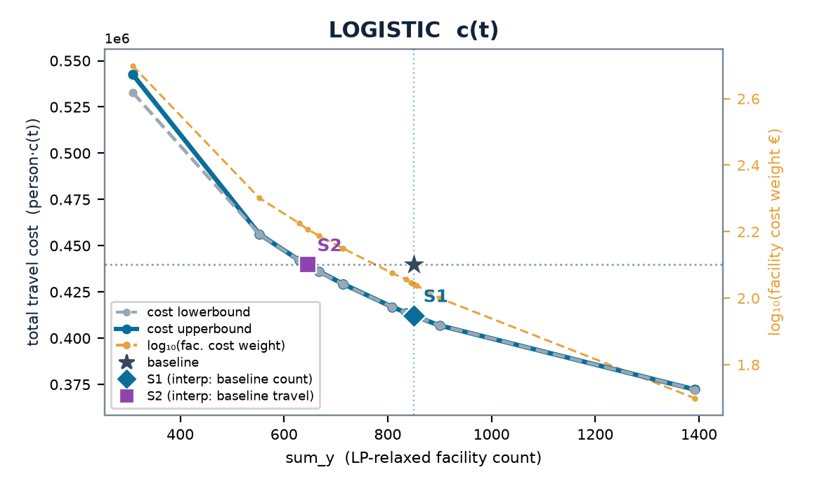
FRANCE · FRG
Pays de la Loire — multistart vs the LP-relax frontier
baseline (current) 850 cells · 3.98 min mean · travel (stranded at BIG) LIN 15.2M · LOG 440k
 | scenario | w | n_open | frac | multi vs relax | stranded (multi)
LINEAR | S1 | 0.107 | 850 | 35 | +0% | 0
 | S2 | 0.141 | 679 | 53 | +0% | 0
LOGISTIC | S1 | 0.00110 | 851 | 41 | -0% | 0
 | S2 | 0.00161 | 645 | 114 | +0% | 0
Charts: cost lowerbound (LP relaxation, dashed grey — drawn on top) & cost upperbound (multistart integer solution, solid blue) on the left; log₁₀(facility cost weight €) on the right, vs sum_y; ★ baseline, ◆ S1, ■ S2. Lower ≤ integer optimum ≤ upper; stranded clients priced at BIG (120 min linear / 1.0 logistic) — in the baseline too (coverage-consistent).

Slide 40
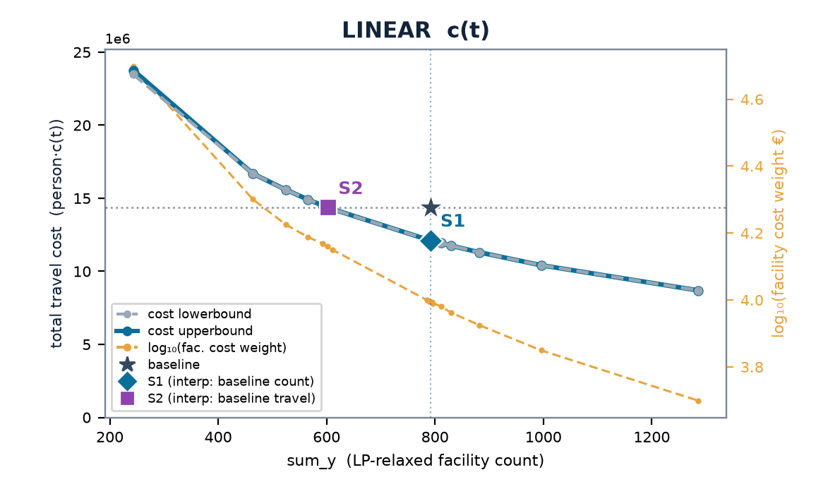
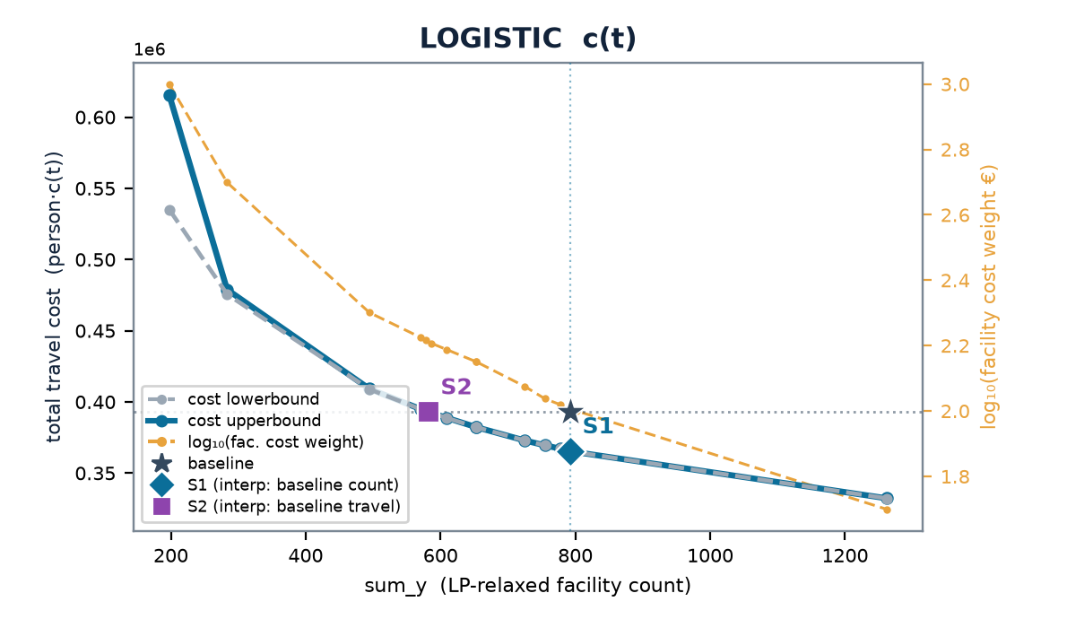
FRANCE · FRH
Bretagne — multistart vs the LP-relax frontier
baseline (current) 792 cells · 4.30 min mean · travel (stranded at BIG) LIN 14.4M · LOG 393k
 | scenario | w | n_open | frac | multi vs relax | stranded (multi)
LINEAR | S1 | 0.0984 | 795 | 20 | +0% | 0
 | S2 | 0.145 | 602 | 18 | -0% | 2
LOGISTIC | S1 | 0.00102 | 792 | 88 | +0% | 0
 | S2 | 0.00165 | 578 | 104 | +0% | 3
Charts: cost lowerbound (LP relaxation, dashed grey — drawn on top) & cost upperbound (multistart integer solution, solid blue) on the left; log₁₀(facility cost weight €) on the right, vs sum_y; ★ baseline, ◆ S1, ■ S2. Lower ≤ integer optimum ≤ upper; stranded clients priced at BIG (120 min linear / 1.0 logistic) — in the baseline too (coverage-consistent).

Slide 41
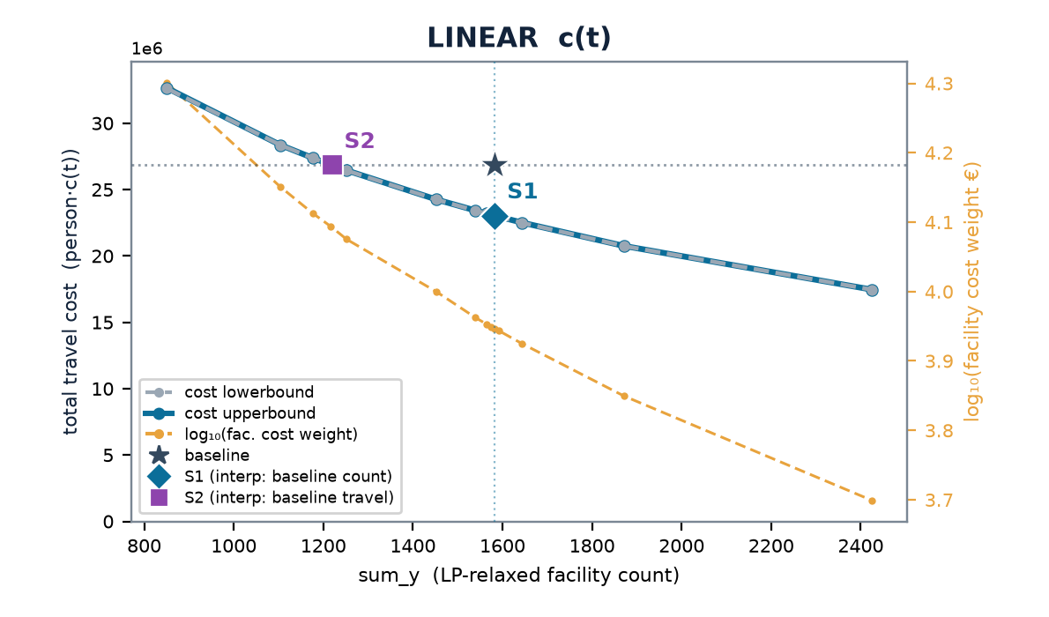
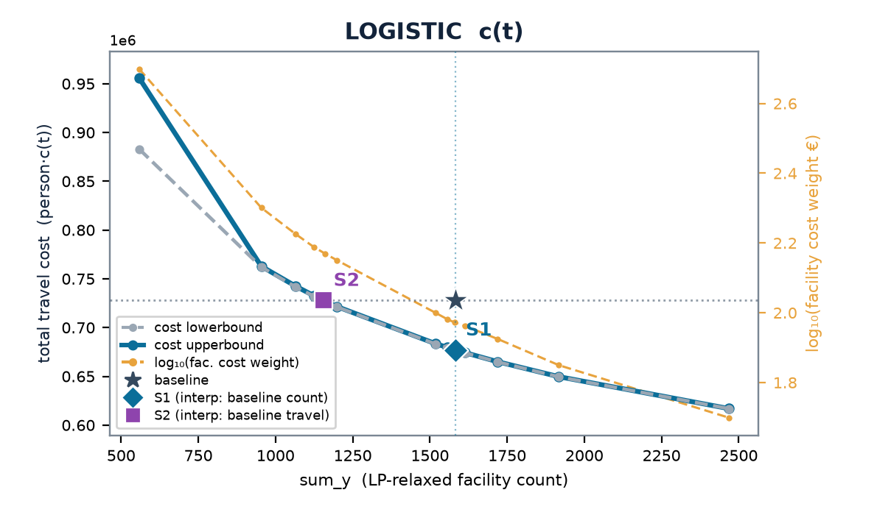
FRANCE · FRI
Nouvelle-Aquitaine — multistart vs the LP-relax frontier
baseline (current) 1,583 cells · 4.44 min mean · travel (stranded at BIG) LIN 26.8M · LOG 728k
 | scenario | w | n_open | frac | multi vs relax | stranded (multi)
LINEAR | S1 | 0.0883 | 1582 | 271 | +0% | 0
 | S2 | 0.124 | 1216 | 147 | +0% | 0
LOGISTIC | S1 | 0.000937 | 1581 | 355 | +0% | 0
 | S2 | 0.00148 | 1161 | 320 | +0% | 0
Charts: cost lowerbound (LP relaxation, dashed grey — drawn on top) & cost upperbound (multistart integer solution, solid blue) on the left; log₁₀(facility cost weight €) on the right, vs sum_y; ★ baseline, ◆ S1, ■ S2. Lower ≤ integer optimum ≤ upper; stranded clients priced at BIG (120 min linear / 1.0 logistic) — in the baseline too (coverage-consistent).

Slide 42


FRANCE · FRJ
Occitanie — multistart vs the LP-relax frontier
baseline (current) 1,424 cells · 3.90 min mean · travel (stranded at BIG) LIN 23.5M · LOG 694k
 | scenario | w | n_open | frac | multi vs relax | stranded (multi)
LINEAR | S1 | 0.0963 | 1424 | 55 | -0% | 0
 | S2 | 0.135 | 1110 | 40 | +0% | 0
LOGISTIC | S1 | 0.00101 | 1425 | 216 | +0% | 0
 | S2 | 0.00161 | 1046 | 100 | +0% | 0
Charts: cost lowerbound (LP relaxation, dashed grey — drawn on top) & cost upperbound (multistart integer solution, solid blue) on the left; log₁₀(facility cost weight €) on the right, vs sum_y; ★ baseline, ◆ S1, ■ S2. Lower ≤ integer optimum ≤ upper; stranded clients priced at BIG (120 min linear / 1.0 logistic) — in the baseline too (coverage-consistent).

Slide 43


FRANCE · FRK
Auvergne-Rhône-Alpes — multistart vs the LP-relax frontier
baseline (current) 1,685 cells · 3.62 min mean · travel (stranded at BIG) LIN 29.4M · LOG 912k
 | scenario | w | n_open | frac | multi vs relax | stranded (multi)
LINEAR | S1 | 0.102 | 1684 | 80 | +0% | 0
 | S2 | 0.140 | 1326 | 88 | +0% | 0
LOGISTIC | S1 | 0.00107 | 1684 | 184 | +0% | 0
 | S2 | 0.00168 | 1238 | 92 | +0% | 0
Charts: cost lowerbound (LP relaxation, dashed grey — drawn on top) & cost upperbound (multistart integer solution, solid blue) on the left; log₁₀(facility cost weight €) on the right, vs sum_y; ★ baseline, ◆ S1, ■ S2. Lower ≤ integer optimum ≤ upper; stranded clients priced at BIG (120 min linear / 1.0 logistic) — in the baseline too (coverage-consistent).

Slide 44


FRANCE · FRL
Provence-Alpes-Côte d'Azur — multistart vs the LP-relax frontier
baseline (current) 1,024 cells · 2.61 min mean · travel (stranded at BIG) LIN 13.1M · LOG 514k
 | scenario | w | n_open | frac | multi vs relax | stranded (multi)
LINEAR | S1 | 0.0979 | 1022 | 4 | +0% | 0
 | S2 | 0.141 | 784 | 15 | +0% | 3
LOGISTIC | S1 | 0.000968 | 1026 | 15 | +0% | 3
 | S2 | 0.00158 | 736 | 33 | +0% | 3
Charts: cost lowerbound (LP relaxation, dashed grey — drawn on top) & cost upperbound (multistart integer solution, solid blue) on the left; log₁₀(facility cost weight €) on the right, vs sum_y; ★ baseline, ◆ S1, ■ S2. Lower ≤ integer optimum ≤ upper; stranded clients priced at BIG (120 min linear / 1.0 logistic) — in the baseline too (coverage-consistent).

Slide 45


FRANCE · FRM
Corse — multistart vs the LP-relax frontier
baseline (current) 87 cells · 5.12 min mean · travel (stranded at BIG) LIN 1.7M · LOG 45k
 | scenario | w | n_open | frac | multi vs relax | stranded (multi)
LINEAR | S1 | 0.100 | 88 | 0 | +0% | 0
 | S2 | 0.165 | 61 | 0 | +0% | 0
LOGISTIC | S1 | 0.00130 | 87 | 0 | +0% | 0
 | S2 | 0.00244 | 57 | 0 | +0% | 0
Charts: cost lowerbound (LP relaxation, dashed grey — drawn on top) & cost upperbound (multistart integer solution, solid blue) on the left; log₁₀(facility cost weight €) on the right, vs sum_y; ★ baseline, ◆ S1, ■ S2. Lower ≤ integer optimum ≤ upper; stranded clients priced at BIG (120 min linear / 1.0 logistic) — in the baseline too (coverage-consistent).

Slide 46


ITALY · ITC
Nord-Ovest — multistart vs the LP-relax frontier
baseline (current) 3,875 cells · 1.89 min mean · travel (stranded at BIG) LIN 29.8M · LOG 1.5M
 | scenario | w | n_open | frac | multi vs relax | stranded (multi)
LINEAR | S1 | 0.0677 | 3875 | 51 | +0% | 1
 | S2 | 0.102 | 2944 | 46 | +0% | 3
LOGISTIC | S1 | 0.000624 | 3880 | 40 | +0% | 1
 | S2 | 0.000958 | 2978 | 91 | +0% | 1
Charts: cost lowerbound (LP relaxation, dashed grey — drawn on top) & cost upperbound (multistart integer solution, solid blue) on the left; log₁₀(facility cost weight €) on the right, vs sum_y; ★ baseline, ◆ S1, ■ S2. Lower ≤ integer optimum ≤ upper; stranded clients priced at BIG (120 min linear / 1.0 logistic) — in the baseline too (coverage-consistent).

Slide 47


ITALY · ITF
Sud — multistart vs the LP-relax frontier
baseline (current) 3,187 cells · 2.02 min mean · travel (stranded at BIG) LIN 26.8M · LOG 1.3M
 | scenario | w | n_open | frac | multi vs relax | stranded (multi)
LINEAR | S1 | 0.0715 | 3191 | 48 | -0% | 0
 | S2 | 0.116 | 2366 | 44 | +0% | 3
LOGISTIC | S1 | 0.000692 | 3192 | 58 | +0% | 0
 | S2 | 0.00116 | 2373 | 67 | +0% | 3
Charts: cost lowerbound (LP relaxation, dashed grey — drawn on top) & cost upperbound (multistart integer solution, solid blue) on the left; log₁₀(facility cost weight €) on the right, vs sum_y; ★ baseline, ◆ S1, ■ S2. Lower ≤ integer optimum ≤ upper; stranded clients priced at BIG (120 min linear / 1.0 logistic) — in the baseline too (coverage-consistent).

Slide 48


ITALY · ITG
Isole — multistart vs the LP-relax frontier
baseline (current) 1,431 cells · 2.01 min mean · travel (stranded at BIG) LIN 12.6M · LOG 595k
 | scenario | w | n_open | frac | multi vs relax | stranded (multi)
LINEAR | S1 | 0.0814 | 1432 | 20 | +0% | 0
 | S2 | 0.131 | 1074 | 0 | +0% | 4
LOGISTIC | S1 | 0.000771 | 1434 | 19 | -0% | 0
 | S2 | 0.00133 | 1065 | 12 | +0% | 3
Charts: cost lowerbound (LP relaxation, dashed grey — drawn on top) & cost upperbound (multistart integer solution, solid blue) on the left; log₁₀(facility cost weight €) on the right, vs sum_y; ★ baseline, ◆ S1, ■ S2. Lower ≤ integer optimum ≤ upper; stranded clients priced at BIG (120 min linear / 1.0 logistic) — in the baseline too (coverage-consistent).

Slide 49


ITALY · ITH
Nord-Est — multistart vs the LP-relax frontier
baseline (current) 2,993 cells · 2.78 min mean · travel (stranded at BIG) LIN 32.0M · LOG 1.2M
 | scenario | w | n_open | frac | multi vs relax | stranded (multi)
LINEAR | S1 | 0.0751 | 2989 | 42 | -0% | 0
 | S2 | 0.108 | 2281 | 105 | +0% | 1
LOGISTIC | S1 | 0.000723 | 2992 | 58 | +0% | 0
 | S2 | 0.00109 | 2259 | 159 | +0% | 0
Charts: cost lowerbound (LP relaxation, dashed grey — drawn on top) & cost upperbound (multistart integer solution, solid blue) on the left; log₁₀(facility cost weight €) on the right, vs sum_y; ★ baseline, ◆ S1, ■ S2. Lower ≤ integer optimum ≤ upper; stranded clients priced at BIG (120 min linear / 1.0 logistic) — in the baseline too (coverage-consistent).

Slide 50


ITALY · ITI
Centro — multistart vs the LP-relax frontier
baseline (current) 2,709 cells · 2.32 min mean · travel (stranded at BIG) LIN 27.1M · LOG 1.1M
 | scenario | w | n_open | frac | multi vs relax | stranded (multi)
LINEAR | S1 | 0.0755 | 2713 | 30 | +0% | 0
 | S2 | 0.115 | 2050 | 89 | +0% | 0
LOGISTIC | S1 | 0.000723 | 2708 | 85 | +0% | 0
 | S2 | 0.00114 | 2049 | 120 | +0% | 4
Charts: cost lowerbound (LP relaxation, dashed grey — drawn on top) & cost upperbound (multistart integer solution, solid blue) on the left; log₁₀(facility cost weight €) on the right, vs sum_y; ★ baseline, ◆ S1, ■ S2. Lower ≤ integer optimum ≤ upper; stranded clients priced at BIG (120 min linear / 1.0 logistic) — in the baseline too (coverage-consistent).

Slide 51


SWEDEN · SE1
Östra Sverige — multistart vs the LP-relax frontier
baseline (current) 387 cells · 5.72 min mean · travel (stranded at BIG) LIN 23.3M · LOG 572k
 | scenario | w | n_open | frac | multi vs relax | stranded (multi)
LINEAR | S1 | 0.278 | 388 | 19 | +0% | 21
 | S2 | 0.539 | 221 | 28 | +0% | 80
LOGISTIC | S1 | 0.00305 | 388 | 64 | -0% | 44
 | S2 | 0.00755 | 199 | 26 | +0% | 225
Charts: cost lowerbound (LP relaxation, dashed grey — drawn on top) & cost upperbound (multistart integer solution, solid blue) on the left; log₁₀(facility cost weight €) on the right, vs sum_y; ★ baseline, ◆ S1, ■ S2. Lower ≤ integer optimum ≤ upper; stranded clients priced at BIG (120 min linear / 1.0 logistic) — in the baseline too (coverage-consistent).

Slide 52


SWEDEN · SE2
Södra Sverige — multistart vs the LP-relax frontier
baseline (current) 452 cells · 7.36 min mean · travel (stranded at BIG) LIN 32.4M · LOG 716k
 | scenario | w | n_open | frac | multi vs relax | stranded (multi)
LINEAR | S1 | 0.303 | 451 | 16 | +0% | 30
 | S2 | 0.556 | 278 | 18 | +0% | 110
LOGISTIC | S1 | 0.00386 | 454 | 21 | -0% | 104
 | S2 | 0.00952 | 259 | 28 | +0% | 117
Charts: cost lowerbound (LP relaxation, dashed grey — drawn on top) & cost upperbound (multistart integer solution, solid blue) on the left; log₁₀(facility cost weight €) on the right, vs sum_y; ★ baseline, ◆ S1, ■ S2. Lower ≤ integer optimum ≤ upper; stranded clients priced at BIG (120 min linear / 1.0 logistic) — in the baseline too (coverage-consistent).

Slide 53


SWEDEN · SE3
Norra Sverige — multistart vs the LP-relax frontier
baseline (current) 246 cells · 9.48 min mean · travel (stranded at BIG) LIN 16.4M · LOG 349k
 | scenario | w | n_open | frac | multi vs relax | stranded (multi)
LINEAR | S1 | 0.278 | 246 | 3 | -0% | 17
 | S2 | 0.527 | 168 | 20 | +0% | 48
LOGISTIC | S1 | 0.00421 | 247 | 0 | +0% | 43
 | S2 | 0.00918 | 158 | 5 | +0% | 148
Charts: cost lowerbound (LP relaxation, dashed grey — drawn on top) & cost upperbound (multistart integer solution, solid blue) on the left; log₁₀(facility cost weight €) on the right, vs sum_y; ★ baseline, ◆ S1, ■ S2. Lower ≤ integer optimum ≤ upper; stranded clients priced at BIG (120 min linear / 1.0 logistic) — in the baseline too (coverage-consistent).

Slide 54


POLAND · PL2
Południowy — multistart vs the LP-relax frontier
baseline (current) 1,442 cells · 3.21 min mean · travel (stranded at BIG) LIN 24.5M · LOG 811k
 | scenario | w | n_open | frac | multi vs relax | stranded (multi)
LINEAR | S1 | 0.0947 | 1443 | 129 | +0% | 0
 | S2 | 0.154 | 1024 | 134 | +0% | 0
LOGISTIC | S1 | 0.000937 | 1441 | 203 | +0% | 0
 | S2 | 0.00172 | 971 | 166 | +0% | 0
Charts: cost lowerbound (LP relaxation, dashed grey — drawn on top) & cost upperbound (multistart integer solution, solid blue) on the left; log₁₀(facility cost weight €) on the right, vs sum_y; ★ baseline, ◆ S1, ■ S2. Lower ≤ integer optimum ≤ upper; stranded clients priced at BIG (120 min linear / 1.0 logistic) — in the baseline too (coverage-consistent).

Slide 55


POLAND · PL4
Północno-Zachodni — multistart vs the LP-relax frontier
baseline (current) 1,200 cells · 3.57 min mean · travel (stranded at BIG) LIN 21.5M · LOG 676k
 | scenario | w | n_open | frac | multi vs relax | stranded (multi)
LINEAR | S1 | 0.0989 | 1200 | 41 | -0% | 0
 | S2 | 0.146 | 907 | 28 | +0% | 0
LOGISTIC | S1 | 0.00104 | 1197 | 80 | +0% | 0
 | S2 | 0.00176 | 837 | 117 | +0% | 0
Charts: cost lowerbound (LP relaxation, dashed grey — drawn on top) & cost upperbound (multistart integer solution, solid blue) on the left; log₁₀(facility cost weight €) on the right, vs sum_y; ★ baseline, ◆ S1, ■ S2. Lower ≤ integer optimum ≤ upper; stranded clients priced at BIG (120 min linear / 1.0 logistic) — in the baseline too (coverage-consistent).

Slide 56


POLAND · PL5
Południowo-Zachodni — multistart vs the LP-relax frontier
baseline (current) 688 cells · 3.41 min mean · travel (stranded at BIG) LIN 12.8M · LOG 411k
 | scenario | w | n_open | frac | multi vs relax | stranded (multi)
LINEAR | S1 | 0.104 | 688 | 14 | +0% | 1
 | S2 | 0.156 | 509 | 37 | -0% | 1
LOGISTIC | S1 | 0.00106 | 688 | 24 | +0% | 1
 | S2 | 0.00189 | 469 | 82 | +0% | 1
Charts: cost lowerbound (LP relaxation, dashed grey — drawn on top) & cost upperbound (multistart integer solution, solid blue) on the left; log₁₀(facility cost weight €) on the right, vs sum_y; ★ baseline, ◆ S1, ■ S2. Lower ≤ integer optimum ≤ upper; stranded clients priced at BIG (120 min linear / 1.0 logistic) — in the baseline too (coverage-consistent).

Slide 57


POLAND · PL6
Północny — multistart vs the LP-relax frontier
baseline (current) 1,023 cells · 3.78 min mean · travel (stranded at BIG) LIN 21.1M · LOG 642k
 | scenario | w | n_open | frac | multi vs relax | stranded (multi)
LINEAR | S1 | 0.113 | 1025 | 76 | +0% | 0
 | S2 | 0.179 | 753 | 70 | +0% | 0
LOGISTIC | S1 | 0.00122 | 1022 | 131 | +0% | 0
 | S2 | 0.00218 | 703 | 160 | +0% | 0
Charts: cost lowerbound (LP relaxation, dashed grey — drawn on top) & cost upperbound (multistart integer solution, solid blue) on the left; log₁₀(facility cost weight €) on the right, vs sum_y; ★ baseline, ◆ S1, ■ S2. Lower ≤ integer optimum ≤ upper; stranded clients priced at BIG (120 min linear / 1.0 logistic) — in the baseline too (coverage-consistent).

Slide 58


POLAND · PL7
Centralny — multistart vs the LP-relax frontier
baseline (current) 675 cells · 3.84 min mean · travel (stranded at BIG) LIN 13.6M · LOG 405k
 | scenario | w | n_open | frac | multi vs relax | stranded (multi)
LINEAR | S1 | 0.101 | 672 | 110 | +0% | 0
 | S2 | 0.151 | 507 | 64 | +0% | 0
LOGISTIC | S1 | 0.00106 | 676 | 143 | +0% | 0
 | S2 | 0.00191 | 468 | 171 | +0% | 1
Charts: cost lowerbound (LP relaxation, dashed grey — drawn on top) & cost upperbound (multistart integer solution, solid blue) on the left; log₁₀(facility cost weight €) on the right, vs sum_y; ★ baseline, ◆ S1, ■ S2. Lower ≤ integer optimum ≤ upper; stranded clients priced at BIG (120 min linear / 1.0 logistic) — in the baseline too (coverage-consistent).

Slide 59


POLAND · PL8
Wschodni — multistart vs the LP-relax frontier
baseline (current) 1,065 cells · 4.53 min mean · travel (stranded at BIG) LIN 22.9M · LOG 619k
 | scenario | w | n_open | frac | multi vs relax | stranded (multi)
LINEAR | S1 | 0.102 | 1067 | 88 | +0% | 0
 | S2 | 0.164 | 755 | 72 | +0% | 0
LOGISTIC | S1 | 0.00114 | 1063 | 170 | +0% | 0
 | S2 | 0.00212 | 697 | 139 | +0% | 0
Charts: cost lowerbound (LP relaxation, dashed grey — drawn on top) & cost upperbound (multistart integer solution, solid blue) on the left; log₁₀(facility cost weight €) on the right, vs sum_y; ★ baseline, ◆ S1, ■ S2. Lower ≤ integer optimum ≤ upper; stranded clients priced at BIG (120 min linear / 1.0 logistic) — in the baseline too (coverage-consistent).

Slide 60


POLAND · PL9
Mazowiecki — multistart vs the LP-relax frontier
baseline (current) 933 cells · 3.20 min mean · travel (stranded at BIG) LIN 17.5M · LOG 591k
 | scenario | w | n_open | frac | multi vs relax | stranded (multi)
LINEAR | S1 | 0.108 | 935 | 67 | -0% | 0
 | S2 | 0.169 | 693 | 70 | +0% | 0
LOGISTIC | S1 | 0.00111 | 935 | 114 | +0% | 0
 | S2 | 0.00200 | 645 | 179 | +0% | 0
Charts: cost lowerbound (LP relaxation, dashed grey — drawn on top) & cost upperbound (multistart integer solution, solid blue) on the left; log₁₀(facility cost weight €) on the right, vs sum_y; ★ baseline, ◆ S1, ■ S2. Lower ≤ integer optimum ≤ upper; stranded clients priced at BIG (120 min linear / 1.0 logistic) — in the baseline too (coverage-consistent).

Slide 61


ALL AREAS COMBINED · 43 DISJOINT AREAS
The aggregated frontier — facilities and travel cost summed per λ
aggregate baseline (current) 51,350 pharmacy cells · travel LIN 965M · LOG 30.4M
 | point | w | n_open | Δ facilities | multi vs relax | Δ travel (multi)
LINEAR | S1 (same count) | 0.109 | 51,640 | +1% | +0% | -24%
 | S2 (same travel) | 0.179 | 35,992 | -30% | +1% | -0%
 | fewest facilities swept | 0.200 | 32,993 | -36% | +1% | +5%
 | most facilities swept | 0.000100 | 469,290 | +814% | +0% | -93%
LOGISTIC | S1 (same count) | 0.00113 | 51,362 | +0% | +0% | -10%
 | S2 (same travel) | 0.00214 | 33,350 | -35% | +1% | +0%
 | fewest facilities swept | 0.00500 | 19,451 | -62% | +4% | +19%
 | most facilities swept | 0.000100 | 204,245 | +298% | +0% | -27%
Exact-by-separability aggregation over 43 disjoint areas (15 countries + FR/IT/SE/PL NUTS-1; country-level Poland excluded in favour of its 7 NUTS-1): at a common λ the sum of the regional optima IS the combined optimum. Summed at the union of swept w-values inside the range every area covers (163 points; an area without that exact λ is log-interpolated between its adjacent sweep points — the λ-table rule). The Δ columns state the aggregate S1/S2 gain in native units and need no λ; λ only prices them (placeholder €100,000 per location).

Slide 62
SCENARIOS · PER COUNTRY
By how much: S1 and S2 — per country, by travel-cost function
Gains in native units first — person-minutes and locations, read off the frontier and independent of any λ — then the λ at which the sweep reaches each point.
country | today # | S1 · Δ travel (lin) | S2 · Δ # (lin) | S1 · Δ cost · Δ mean t (log) | S2 · Δ # (log) | λ S1 lin | λ S2 lin | λ S1 log | λ S2 log
Netherlands | 1,615 | −12.8 M min · −21.1% | −443 · −27.4% | −8.3% · −0.7 min | −551 · −34.1% | 24,319 | 34,297 | 227 | 373
Luxembourg | 86 | −483 k min · −20.1% | −26 · −29.9% | −8.3% · −0.7 min | −30 · −35.1% | 15,590 | 25,556 | 145 | 264
Estonia | 292 | −1.4 M min · −23.1% | −94 · −32.3% | −14.3% · −1.0 min | −121 · −41.4% | 11,637 | 19,806 | 136 | 302
Latvia | 496 | −1.6 M min · −21.4% | −145 · −29.1% | −11.4% · −0.8 min | −183 · −36.8% | 8,652 | 14,258 | 103 | 206
Slovenia | 306 | −1.7 M min · −14.4% | −82 · −26.8% | −9.2% · −0.8 min | −99 · −32.4% | 16,259 | 25,560 | 193 | 356
Lithuania | 582 | −3.0 M min · −24.4% | −205 · −35.2% | −15.0% · −1.0 min | −269 · −46.2% | 10,770 | 19,856 | 127 | 313
Ireland | 862 | −4.1 M min · −17.2% | −235 · −27.2% | −9.6% · −0.8 min | −297 · −34.5% | 14,248 | 21,034 | 153 | 270
Norway | 755 | −10.6 M min · −26.0% | −326 · −43.2% | −19.8% · −2.0 min | −359 · −47.6% | 22,633 | 49,999 | 300 | 841
Denmark | 466 | −5.9 M min · −15.8% | −133 · −28.6% | −11.8% · −1.0 min | −166 · −35.7% | 35,580 | 55,947 | 440 | 865
Austria | 1,129 | −8.9 M min · −20.7% | −373 · −33.1% | −13.4% · −1.0 min | −496 · −43.9% | 18,294 | 31,095 | 204 | 494
Portugal | 1,882 | −7.6 M min · −22.1% | −571 · −30.3% | −8.4% · −0.7 min | −624 · −33.1% | 10,355 | 17,150 | 107 | 195
Czechia | 1,624 | −8.9 M min · −20.0% | −487 · −30.0% | −9.7% · −0.8 min | −588 · −36.2% | 14,499 | 22,819 | 150 | 279
Belgium | 2,958 | −3.4 M min · −15.6% | −520 · −17.6% | −3.0% · −0.3 min | −553 · −18.7% | 5,652 | 7,353 | 49 | 67
Hungary | 1,864 | −6.8 M min · −19.5% | −481 · −25.8% | −8.5% · −0.7 min | −585 · −31.4% | 11,682 | 17,208 | 118 | 207
Finland | 719 | −4.7 M min · −13.5% | −178 · −24.7% | −8.0% · −0.8 min | −188 · −26.2% | 21,768 | 33,003 | 266 | 452
France | 13,408 | −33.5 M min · −15.6% | −2,839 · −21.2% | −6.1% · −0.5 min | −3,382 · −25.2% | 9,991 | 13,844 | 103 | 158
Italy | 14,195 | −31.4 M min · −24.4% | −3,491 · −24.6% | −5.5% · −0.5 min | −3,480 · −24.5% | 7,280 | 11,188 | 69 | 110
Sweden | 1,085 | −16.4 M min · −22.8% | −418 · −38.5% | −15.6% · −1.5 min | −469 · −43.2% | 28,776 | 54,229 | 361 | 870
Poland | 7,026 | −24.1 M min · −18.0% | −1,888 · −26.9% | −7.7% · −0.6 min | −2,235 · −31.8% | 10,280 | 15,956 | 107 | 192
S1 = today's number of locations, travel minimised; S2 = today's travel, fewer locations. Δ columns are read off the multistart frontier by interpolation between adjacent sweep points — person-minutes (linear), dimensionless logistic cost with the mean minutes beside it, and locations — and need no λ. λ = w · €100,000 is the price per location at which the sweep reaches that point; the €100,000 is a placeholder, not an estimate — the frontier, the Δs and the ranking of areas do not depend on it, only these € figures do. “—” = the target lies outside the swept λ range. France, Italy, Sweden and Poland are the sums of their NUTS-1 regions at common λ (exact by separability, as the aggregate slide); Poland's direct country sweep has its own slide and is not in this table.

Slide 63
SCENARIOS · NUTS-1
By how much: S1 and S2 — FR / IT / SE / PL NUTS-1 regions
Gains in native units first — person-minutes and locations, read off the frontier and independent of any λ — then the λ at which the sweep reaches each point.
NUTS-1 region | today # | S1 · Δ travel (lin) | S2 · Δ # (lin) | S1 · Δ cost · Δ mean t (log) | S2 · Δ # (log) | λ S1 lin | λ S2 lin | λ S1 log | λ S2 log
FR1 · Île-de-France | 1,449 | −3.1 M min · −24.0% | −218 · −15.1% | −2.9% · −0.2 min | −238 · −16.4% | 11,841 | 16,449 | 106 | 149
FRB · Centre-Val de Loire | 613 | −1.5 M min · −13.6% | −130 · −21.2% | −6.9% · −0.6 min | −159 · −26.0% | 10,000 | 13,679 | 108 | 169
FRC · Bourgogne-Franche-Comté | 723 | −1.8 M min · −13.1% | −154 · −21.4% | −7.5% · −0.6 min | −197 · −27.2% | 9,764 | 13,230 | 107 | 167
FRD · Normandie | 678 | −1.9 M min · −13.3% | −144 · −21.3% | −6.5% · −0.5 min | −174 · −25.7% | 11,163 | 15,139 | 117 | 179
FRE · Hauts-de-France | 1,333 | −2.6 M min · −14.9% | −254 · −19.1% | −5.2% · −0.4 min | −307 · −23.1% | 8,915 | 11,678 | 86 | 122
FRF · Grand Est | 1,167 | −3.1 M min · −14.6% | −248 · −21.2% | −6.7% · −0.5 min | −309 · −26.5% | 10,723 | 14,813 | 112 | 170
FRG · Pays de la Loire | 850 | −2.1 M min · −14.1% | −173 · −20.3% | −6.3% · −0.5 min | −205 · −24.1% | 10,681 | 14,197 | 110 | 161
FRH · Bretagne | 792 | −2.2 M min · −15.6% | −188 · −23.8% | −7.0% · −0.6 min | −210 · −26.5% | 9,866 | 14,390 | 102 | 163
FRI · Nouvelle-Aquitaine | 1,583 | −3.8 M min · −14.2% | −364 · −23.0% | −7.0% · −0.6 min | −428 · −27.0% | 8,824 | 12,369 | 94 | 149
FRJ · Occitanie | 1,424 | −3.6 M min · −15.2% | −315 · −22.1% | −6.9% · −0.6 min | −376 · −26.4% | 9,624 | 13,552 | 101 | 161
FRK · Auvergne-Rhône-Alpes | 1,685 | −4.3 M min · −14.6% | −362 · −21.5% | −6.4% · −0.5 min | −440 · −26.1% | 10,154 | 14,042 | 107 | 167
FRL · Provence-Alpes-Côte d'Azur | 1,024 | −2.8 M min · −21.6% | −240 · −23.5% | −6.8% · −0.5 min | −286 · −27.9% | 9,759 | 14,151 | 97 | 157
FRM · Corse | 87 | −321 k min · −18.9% | −26 · −29.6% | −12.0% · −0.9 min | −30 · −34.8% | 10,054 | 16,435 | 130 | 247
ITC · Nord-Ovest | 3,875 | −7.7 M min · −25.7% | −929 · −24.0% | −4.8% · −0.5 min | −911 · −23.5% | 6,771 | 10,207 | 63 | 96
ITF · Sud | 3,187 | −7.5 M min · −27.8% | −818 · −25.7% | −5.8% · −0.5 min | −810 · −25.4% | 7,159 | 11,618 | 69 | 116
ITG · Isole | 1,431 | −3.7 M min · −29.3% | −359 · −25.1% | −6.3% · −0.6 min | −367 · −25.6% | 8,157 | 13,131 | 77 | 133
ITH · Nord-Est | 2,993 | −6.4 M min · −20.0% | −711 · −23.8% | −5.6% · −0.5 min | −742 · −24.8% | 7,491 | 10,784 | 72 | 110
ITI · Centro | 2,709 | −6.1 M min · −22.6% | −660 · −24.3% | −5.4% · −0.5 min | −670 · −24.7% | 7,561 | 11,516 | 72 | 115
SE1 · Östra Sverige | 387 | −6.3 M min · −27.2% | −166 · −43.0% | −15.6% · −1.5 min | −189 · −48.8% | 27,899 | 53,985 | 306 | 759
SE2 · Södra Sverige | 452 | −7.1 M min · −22.0% | −174 · −38.4% | −15.6% · −1.5 min | −192 · −42.5% | 30,197 | 55,447 | 390 | 946
SE3 · Norra Sverige | 246 | −2.9 M min · −17.8% | −78 · −31.8% | −15.4% · −1.6 min | −87 · −35.4% | 27,700 | 52,816 | 426 | 914
PL2 · Południowy | 1,442 | −5.1 M min · −20.7% | −419 · −29.1% | −7.2% · −0.7 min | −463 · −32.1% | 9,488 | 15,456 | 94 | 171
PL4 · Północno-Zachodni | 1,200 | −3.5 M min · −16.4% | −294 · −24.5% | −7.4% · −0.6 min | −366 · −30.5% | 9,888 | 14,638 | 104 | 177
PL5 · Południowo-Zachodni | 688 | −2.3 M min · −18.2% | −180 · −26.1% | −7.6% · −0.6 min | −218 · −31.7% | 10,443 | 15,613 | 106 | 189
PL6 · Północny | 1,023 | −3.8 M min · −18.1% | −268 · −26.2% | −8.4% · −0.7 min | −324 · −31.7% | 11,285 | 17,906 | 121 | 220
PL7 · Centralny | 675 | −2.1 M min · −15.5% | −169 · −25.0% | −7.2% · −0.6 min | −205 · −30.4% | 10,008 | 15,114 | 106 | 189
PL8 · Wschodni | 1,065 | −4.0 M min · −17.6% | −310 · −29.1% | −9.1% · −0.8 min | −364 · −34.1% | 10,239 | 16,432 | 114 | 211
PL9 · Mazowiecki | 933 | −3.2 M min · −18.5% | −242 · −25.9% | −7.2% · −0.6 min | −284 · −30.5% | 10,858 | 16,947 | 112 | 198
S1 = today's number of locations, travel minimised; S2 = today's travel, fewer locations. Δ columns are read off the multistart frontier by interpolation between adjacent sweep points — person-minutes (linear), dimensionless logistic cost with the mean minutes beside it, and locations — and need no λ. λ = w · €100,000 is the price per location at which the sweep reaches that point; the €100,000 is a placeholder, not an estimate — the frontier, the Δs and the ranking of areas do not depend on it, only these € figures do. “—” = the target lies outside the swept λ range. France, Italy, Sweden and Poland are the sums of their NUTS-1 regions at common λ (exact by separability, as the aggregate slide); Poland's direct country sweep has its own slide and is not in this table.

Slide 64
LINEAR vs LOGISTIC
multistart tracks the LP-relax lower bound — the gap is tightest under LOGISTIC
LINEAR c(t) — unbounded, stranding expensive
LOGISTIC c(t) — saturates ≈1, stranding cheap
multistart sits +0–18% over the LP bound
multistart sits +0–4.7% over the LP bound
integer rounding costs more where stranding is dear
rounding is nearly free; the frontier is almost integral
reg | LIN S1 | LIN S2 | LOG S1 | LOG S2
Netherlands | +0% (0) | +0% (1) | +0% (1) | +0% (7)
Luxembourg | +0% (0) | +0% (0) | +0% (0) | +0% (0)
Estonia | +0% (0) | +0% (1) | +0% (0) | -0% (1)
Latvia | +0% (0) | -0% (1) | -0% (0) | +0% (1)
Slovenia | -0% (0) | +0% (0) | +0% (0) | +0% (0)
Lithuania | +0% (0) | -0% (1) | +0% (0) | -0% (2)
Ireland | +0% (0) | +0% (0) | +0% (0) | +0% (0)
Norway | -0% (2) | +0% (2) | -0% (2) | +0% (54)
Denmark | +0% (0) | +0% (0) | +0% (0) | +0% (0)
Austria | +0% (0) | +0% (0) | +0% (0) | +0% (1)
Portugal | +0% (10) | +0% (10) | +0% (10) | +0% (11)
Czechia | +0% (1) | -0% (2) | +0% (2) | +0% (3)
Belgium | +0% (0) | +0% (0) | +0% (0) | +0% (0)
Poland_sweep | +0% (0) | +0% (0) | +0% (1) | +0% (1)
Hungary | +0% (0) | +0% (0) | +0% (1) | +0% (0)
Finland | +0% (0) | +0% (16) | -0% (14) | +0% (15)
FR1 | +0% (0) | -0% (1) | +0% (0) | +0% (1)
FRB | +0% (0) | +0% (0) | +0% (0) | +0% (1)
FRC | +0% (0) | +0% (0) | +0% (0) | +0% (1)
FRD | -0% (0) | +0% (1) | +0% (0) | +0% (1)
FRE | +0% (0) | +0% (0) | +0% (0) | +0% (0)
FRF | +0% (0) | -0% (0) | +0% (0) | +0% (0)
FRG | +0% (0) | +0% (0) | -0% (0) | +0% (0)
FRH | +0% (0) | -0% (2) | +0% (0) | +0% (3)
reg | LIN S1 | LIN S2 | LOG S1 | LOG S2
FRI | +0% (0) | +0% (0) | +0% (0) | +0% (0)
FRJ | -0% (0) | +0% (0) | +0% (0) | +0% (0)
FRK | +0% (0) | +0% (0) | +0% (0) | +0% (0)
FRL | +0% (0) | +0% (3) | +0% (3) | +0% (3)
FRM | +0% (0) | +0% (0) | +0% (0) | +0% (0)
ITC | +0% (1) | +0% (3) | +0% (1) | +0% (1)
ITF | -0% (0) | +0% (3) | +0% (0) | +0% (3)
ITG | +0% (0) | +0% (4) | -0% (0) | +0% (3)
ITH | -0% (0) | +0% (1) | +0% (0) | +0% (0)
ITI | +0% (0) | +0% (0) | +0% (0) | +0% (4)
SE1 | +0% (21) | +0% (80) | -0% (44) | +0% (225)
SE2 | +0% (30) | +0% (110) | -0% (104) | +0% (117)
SE3 | -0% (17) | +0% (48) | +0% (43) | +0% (148)
PL2 | +0% (0) | +0% (0) | +0% (0) | +0% (0)
PL4 | -0% (0) | +0% (0) | +0% (0) | +0% (0)
PL5 | +0% (1) | -0% (1) | +0% (1) | +0% (1)
PL6 | +0% (0) | +0% (0) | +0% (0) | +0% (0)
PL7 | +0% (0) | +0% (0) | +0% (0) | +0% (1)
PL8 | +0% (0) | +0% (0) | +0% (0) | +0% (0)
PL9 | -0% (0) | +0% (0) | +0% (0) | +0% (0)
France | +0% (0) | +0% (7) | +0% (3) | +0% (10)
Italy | +0% (1) | +0% (11) | +0% (1) | +0% (11)
Sweden | +0% (68) | +0% (238) | +0% (191) | +0% (490)
Poland | +0% (1) | +0% (1) | +0% (1) | +0% (2)
cell = multistart travel above the LP-relax bound (multistart clients stranded by rounding, priced at BIG). Sparse Swedish regions keep the largest bound-gaps.

Slide 65
ROADMAP
Status against Lewis's & Bernhard's framing — implemented · remaining · not pursued
The λ-sweep is the working general method. Landbody-complete networks and NUTS region exclusion make these figures NOT comparable with earlier decks. The REGIO review (Moreno Monroy, Brons, Nöbauer) is worked in where it asked for answers and listed below where it asked for work. Status confirmed 4 Sep 2026, in priority order; items marked ▸ came from the seminar decks of Lewis and Rosa (16 Sep 2026) as proposals, not results.
Implemented ✓
Remaining ○ — in priority order (◐ = in progress)
NETWORK per landbody + REGION EXCLUSION (>50% of inhabitant locations unreachable → NUTS region dropped, population AND candidates): ITG mean travel 22.3 → 4.9 min; Azores/Madeira out, Portugal baseline travel −62%. A DATA gap no longer ranks as headroom (p8)
OECD-checked pharmacy lists (7 Sep): Italy 20,635 geolocated (was ESPON 12,991; ITF 1,951 → 4,955), Hungary new (3,094), Finland back in (797; the June reader issue is gone on GeoDMS 20.19) — 44 areas swept, Italy's five rebuilt from the network up
S1/S2 pinned by bisection (#52): within max(1, 0.2%) of today's count / 0.2% of today's travel in 87 of 88 sweeps (country-level Poland LINEAR, the largest LP, keeps its 1.6%-off grid point); the snap that put S1 up to 32% off and S1 = S2 in 5 areas is gone, and the sweep no longer burns hours on time-outs beyond S2
Tabula-rasa LP allocation + λ-sweep → Pareto curve of #locations vs travel (Option D), p-median notation; S1 (same #, ↓travel) · S2 (same travel, ↓#) · S3 full frontier, in NATIVE units first, € second (p62–63)
Lewis's 6 descriptive indicators per country and key NUTS1, catchments by ROAD travel time — ahead of the model (p3–6)
Candidates = ≥50-pop cells ∪ pharmacy cells, the FULL set in every area (the stride subsample of the July FRI/PL8 sweeps is retired, #54) · clients = FULL population · adapted logit (25/10) · soft coverage (Σx ≤ 1, unserved at BIG on BOTH sides): every area brackets S1 & S2
Aggregated frontier over 43 disjoint areas (exact by separability), bracketing S1 and S2 for both functions (p61)
Improvement rectangle (raw + relative), diagonal crossing + λ — Lewis's “cross-lambda” (his p21) —, point-cloud with projections; ranked lists by policy typology — on the OECD data the sparse Nordic and Baltic areas lead (SE1, Norway, Lithuania, SE2, Estonia); the Italian lead of earlier decks was missing data
REGIO review worked in: choice set (p9), λ-tangency (p10), logistic parametrised (p66), bounds on TOTAL cost only (p12), €100,000 a placeholder everywhere
◐ Communicate λ intuitively (person-minutes per location): the tangency slide (p10) and the native-unit S1/S2 tables (p62–63) are the first steps; the € labels stay placeholders until a is calibrated
Widen the CANDIDATE radius per client (5 → 10 nearest EXISTING), one area first — measured to bind at S2 (Norway: 18.6% of residents one closure from stranding, SE1 12.7%, SE2 12.0%; p9)
RSSV random-sampling spatial-voting matheuristic (Albuquerque, Figueiredo & Genre-Grandpierre 2026, arXiv 2607.22666; Rosa's p12) — the principled way to make the largest LPs tractable (country-level Poland) now that the stride subsample is retired; needs the wider radius first
Exact soft-coverage p-median MIP at p = baseline — S1 is now pinned to ±1 facility by bisection (#52), so this is about the integrality gap, no longer about the snap
Territorial coverage constraints (≥1 pharmacy per NUTS unit; multi-scale nested — Rosa's CpMP with territorial coverage, her p8–9) as a STRUCTURED equity lever alongside the soft-coverage BIG penalty. Her PACA case prices the levels: +0.9% travel at the canton level, +111% at the commune level, +51% nested (her p19; RIC = travel above the p-median optimum at equal p)
DECIDE: rescale the logistic so c(0) and c(60) match the linear (BN, 23 July) — less degeneracy, but it changes the equity weighting the logistic was chosen for (p66)
Calibrate the real pharmacy fixed cost a (schools: 99 699 + 3 277.5x) — only the € labels move, nothing else in the deck
Capacity / max-catchment cap constraint (Rosa's CpMP; her lifted p-cover and location-bound cuts, p11, solve it exactly; her capacities are synthetic — Voronoi cells → demand bins → sampled, her p21)
▸ Counterfactuals anchored at today's network, as the La Poste curves (Rosa's p17–18): closure-only and addition-only frontiers next to the tabula-rasa one, a relocation budget, and the share of today's sites an optimum keeps (her “Actual %”). Lewis's two questions (his p4: subsidy to bring everybody nearby; extra travel if small facilities go) read off these. Closure-only = the sweep on the Existing OD; addition-only = today's cells fixed open. Still listed: −10% pop · replace a known X%
▸ Lewis's next steps (his p25): the S1/S2 gains by degree of urbanisation (his p6/p8; the DEGURBA 2021 grid is already in Locations.dms), a policy-vs-geography split of today's travel on the frontier (common-λ frontier · today's count · gap to the frontier), and cross-lambda against distance-to-frontier by OECD archetype — post-processing on existing sweep output, no new solves
Not pursued (decided 4 Sep 2026): the catchment-cap / min-threshold ladder (explored on the Netherlands; p15 kept as the record) · age-weighted demand · candidate cells plus their neighbours · urban/non-urban split and a settlement candidate set · flat-then-linear cost and logit-parameter sensitivity · pharmacist-based and pooled caps, catchment–travel correlation, border cases.
Open questions for the group: widen the choice set before RSSV (p9)? · logistic vs linear, and BN's rescaling (p66)? · territorial coverage constraints (≥1 per zone; Rosa's p19 prices the levels) for equity, or keep soft coverage?

Slide 66

TRAVEL-COST FUNCTION
Logistic c(t) — the adopted Lewis-tuned curve vs the previous one
previous midpoint 30 · scale 15
adopted midpoint 25 · scale 10
t (min) | previous | adopted
0 | 0.12 | 0.08
5 | 0.16 | 0.12
15 | 0.27 | 0.27
25 | 0.42 | 0.50
30 | 0.50 | 0.62
45 | 0.73 | 0.88
60 | 0.88 | 0.97
Both cross at ≈15 min (0.27). The adopted curve is lower below ~10 min (ignores minor relocations) and saturates by ~45 min (caps remote weight) — Lewis's 22-May ask; his benchmarking deck (p14) reads it as: short-trip differences matter little, 10–60 min is critical, beyond 60 min equally disliked. Applied in the recalculation (settings.jl defaults; previous variant via LOGISTIC_MIDPOINT=30 LOGISTIC_SCALE=15).
Answers to the review. It is a plain logistic, not a log-logistic: c(t) = 1 / (1 + e^{−(t−25)/10}). It does not start at zero — c(0) = 0.076 — so a relocation within a few minutes is nearly free but not free; c(60) = 0.971, c(120) ≈ 1. The degeneracy: both variants sweep the same 1-2-5/decade λ-grid (1e-4 … 5), but c(t) here spans only 0.08–1 where the linear one spans 0–120, so the travel term is ~100× smaller relative to λ·#open. The aggregate’s useful λ-range is 1e-4 … 0.02 for logistic against 1e-4 … 0.5 for linear — that compression is the degeneracy: many λ values map to one solution. Open (BN, 23 Jul): rescale c(t) so c(0) and c(60) match the linear curve. It would spread the λ-range and reduce degeneracy, but it also changes the equity weighting the group chose the logistic for — a group decision, not a tuning. In Rosa's terms: LINEAR c(t) = t is the p-median (pMP) objective; the saturating logistic is a smooth counterpart of maximal covering (MCLP) with a ~25-min radius, so linear-vs-logistic is the soft version of her pMP-vs-MCLP-5km comparison (her p16).
c(t) is applied to travel time in minutes (raw OD seconds ÷ 60); LINEAR uses c(t)=t. settings.jl c(): logistic_midpoint=25, logistic_scale=10.

Slide 67
TERMINOLOGY
Terminology bridge — this deck · Lewis's benchmarking deck · Rosa's La Poste deck
Same objects, three vocabularies. Where a name differs, this deck now carries the other deck's term next to its own; where a concept exists in one deck only, the cell says so. Page numbers are each deck's own.
 | this deck | Lewis — Benchmarking access to pharmacies | Rosa — Balancing equity and efficiency (La Poste, PACA)
today's network | ★ baseline (current); catchments by road (p3–6) | current situation (p15, p21) | Current; “Actual %” = share of today's sites an optimum keeps (p16)
the trade-off | #locations vs travel cost — the Pareto frontier (p13) | proximity vs efficiency; the trilemma collapses once the population distribution is given (p3–5, p15) | efficiency vs equity: pMP vs MCLP; objective value against p (p16–17)
λ | price per location, w · €100,000 placeholder; the slope of the tangent (p7, p10) | lambda = preference for efficiency over proximity (p11) | not swept — p is fixed per instance; λ is the multiplier of Σⱼ yⱼ = p (p7 here)
fixed-count problem | p-median at Σⱼ yⱼ = p (p7); S1 is one instance | S1 — fix the number of facilities (p16) | pMP (Hakimi 1964); with capacities Rⱼ the CpMP (p5, p7)
coverage | soft coverage: an unserved client is priced at BIG; the logistic c(t) saturates (p7, p66) | logistic: beyond 60 min equally disliked (p14) | MCLP within radius r (5 km); territorial coverage ≥1 / ≤1 per zone, multi-scale nested (p8–9)
gap to the frontier | S1 Δ travel and S2 Δ # in native units; the improvement rectangle (p62–63, p76–79) | distance between cross-lambda and the current situation (p21) | RIC = (Sol_X − Sol_pMP) / Sol_pMP × 100 at equal p (p16); knee points (p17)
position on the frontier | λ at the balanced-improvement crossing (p72–73); against today's density (p74–75) | cross-lambda — a revealed network preference, by OECD archetype (p21–24) | knee point of the objective-vs-p curve (p17, p23)
lower bound | LP relaxation of the UFLP, strong disaggregated formulation (p7) | “LP … a plausible lower band” (p26) | pMP + disaggregated cuts for the closest facility, lifted p-cover, location upper bound (p11)
integer solution | multistart: top-p, CELF greedy, weighted draws, swap polish (p12) | “multipart heuristic … upper band” (p26) | post-optimisation after the final solve (p12)
scale | full candidate set; radius = 5 nearest existing pharmacies (p9) | small countries and NUTS1 regions (p15) | RSSV: random sampling → sub-problems → spatial voting → filtering → final solve (p12)
from today's network | roadmap item (p65) | subsidy to bring everybody nearby; extra travel if small facilities go (p4) | optimal removal / optimal addition from the current network; relocations allowed (p17–18)
distribution | stranded count; catchment percentiles (p3–6) | distance to the nearest pharmacy by degree of urbanisation (p6, p8) | Gini, % within 5 km, max / avg distance, communes served (p16, p24)
capacity | catchment-cap ladder, explored and dropped (p15) | — | CpMP with synthetic capacities: Voronoi cells → demand bins → sampled (p21)
Sources. Lewis Dijkstra, Chris Jacobs-Crisioni, Maarten Hilferink & Jip Claassens, “Benchmarking access to pharmacies” (JRC draft, 15 Sep 2026; its p15, p16 and p27 share this deck's p13, p11 and p10). Rosa Figueiredo, Felipe Albuquerque & Cyrille Genre-Grandpierre, “Balancing equity and efficiency — the case of La Poste in France”, OECD/EC knowledge-sharing seminar, Ispra, 18 Sep 2026; the method is arXiv 2607.22666. Caution on cross-lambda: for one and the same geography it is lower the more pharmacies there are today, so across areas it moves with residents per pharmacy (p3) as well as with policy — read it next to that table.

Slide 68

The sweep read along lambda - all 43 areas: travel-cost bounds (left) and facility count (right)
x = lambda, the price per location (log scale). Left axis: LP relaxation (lower bound) and multistart integer solution (upper bound) on travel cost. Right axis: the LP-relaxed count sum_y and the integer count n_open = round(sum_y); they coincide by construction - the certified gap is on TOTAL cost only (p12). Dotted = baseline: S2 is where travel crosses its baseline, S1 where the count does; the guides are interpolated crossings, each labelled with the quantity that defines it - S1 with its facility count (today's) and the facility cost lambda x N at that lambda, S2 with its travel cost (today's) - so S1 reads the same count under LINEAR and LOGISTIC. The count axis is logarithmic and shared by both panels: same height = same count.

Slide 69

The sweep read along lambda - Netherlands: travel-cost bounds (left) and facility count (right)
Same reading as the aggregate. The count falls over two decades of lambda before the travel bounds separate; under LINEAR they open only above ~EUR 50,000 per location, beyond S2, so the S1/S2 figures sit where lower and upper bound agree. S1 is 1,615 facilities under both cost functions by construction; the deck_data scenario rows would have put the guide a whole grid step off (1,334 LINEAR, 1,788 LOGISTIC), which is the S1/S2 snap noted on p9.

Slide 70

Baselines and their frontier projections - LINEAR

Slide 71

Baselines and their frontier projections - LOGISTIC

Slide 72

Cross-lambda: lambda at the balanced-improvement crossing, ranked - LINEAR
Cross-lambda (Lewis's p21) = the lambda at the balanced-improvement crossing, read there as a revealed network preference. For one geography it falls as today's pharmacy count rises, so across areas it moves with residents per pharmacy (p3) as well as with policy. EUR only via the placeholder EUR 100,000 per location (REGIO review, Brons/BN): the ranking does not depend on it.

Slide 73

Cross-lambda: lambda at the balanced-improvement crossing, ranked - LOGISTIC
Cross-lambda (Lewis's p21) = the lambda at the balanced-improvement crossing, read there as a revealed network preference. For one geography it falls as today's pharmacy count rises, so across areas it moves with residents per pharmacy (p3) as well as with policy. EUR only via the placeholder EUR 100,000 per location (REGIO review, Brons/BN): the ranking does not depend on it.

Slide 74

Cross-lambda against residents per location, by OECD archetype - LINEAR
x = residents per 1 km2 pharmacy location today (the count the frontier uses), y = cross-lambda, both on log scales. The dotted line is the log-log least-squares fit over all areas - the part of cross-lambda that today's density predicts; the distance to it is what is left for geography and policy. Archetype colours as on the map of Lewis's benchmarking deck (p22-23). Residuals per area: doc\cross_lambda_residuals_<FN>.csv (doc\cross_lambda_scatter.py).

Slide 75

Cross-lambda against residents per location, by OECD archetype - LOGISTIC
x = residents per 1 km2 pharmacy location today (the count the frontier uses), y = cross-lambda, both on log scales. The dotted line is the log-log least-squares fit over all areas - the part of cross-lambda that today's density predicts; the distance to it is what is left for geography and policy. Archetype colours as on the map of Lewis's benchmarking deck (p22-23). Residuals per area: doc\cross_lambda_residuals_<FN>.csv (doc\cross_lambda_scatter.py).

Slide 76

Improvement-potential rectangle area (raw), ranked - LINEAR

Slide 77

Improvement-potential rectangle area (raw), ranked - LOGISTIC

Slide 78

Improvement potential relative to baseline facility x travel cost - LINEAR

Slide 79

Improvement potential relative to baseline facility x travel cost - LOGISTIC

