Slide 1

NodeJS training
KMITL – 04 DEC 2021

Slide 2



About Instructor
Name : Krit Ratchawong (50050098)
Position : Senior Cloud Consultant
Department : Research and Development
Email : krit.ratchawong@gmail.com
Experience : Hybrid mobile app, Salesforce, Web Application, SAP, SAP on Cloud, AWS Cloud.

Slide 3
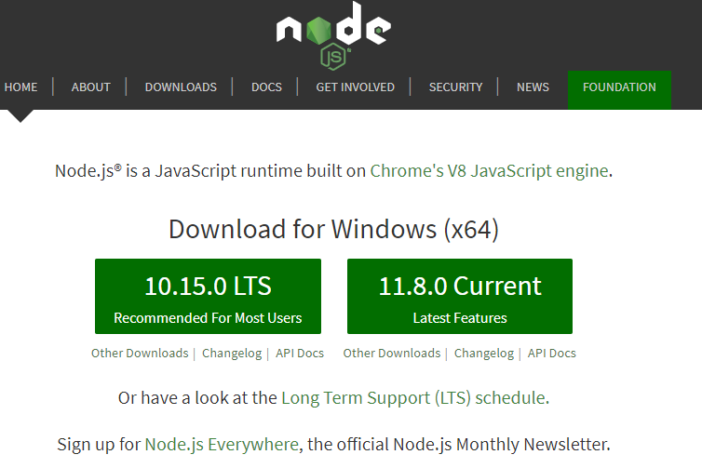
Installing NodeJS

Slide 4
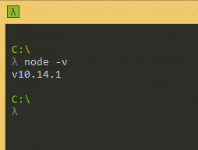
Test NodeJS on your machine

Slide 5
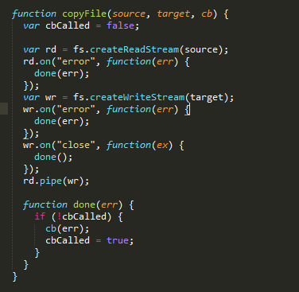
NodeJS fundamental
JavaScript
Event Driven programming
Function variable

Slide 6
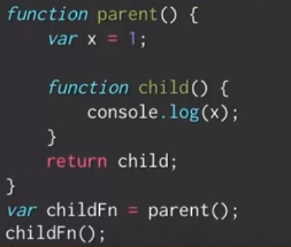
NodeJS Closure (Scope of variable) #c1
Try following code

Slide 7
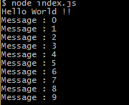
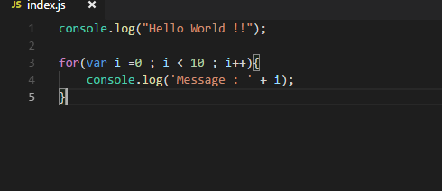
Hello World !! #c2

Slide 8
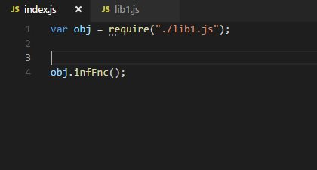
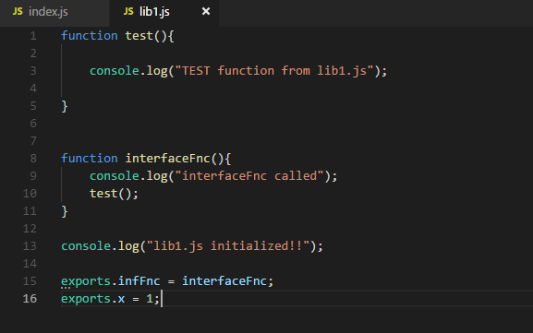
Module Export #c3

Slide 9
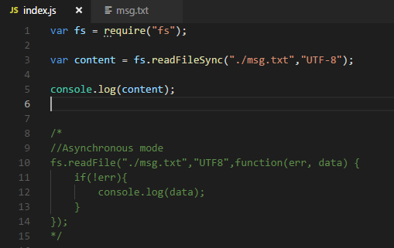
File System – Read file #c4

Slide 10
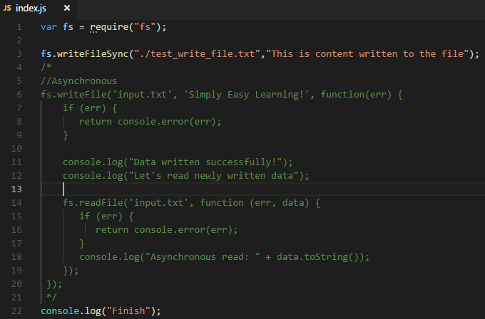
File System – Write file #c5

Slide 11
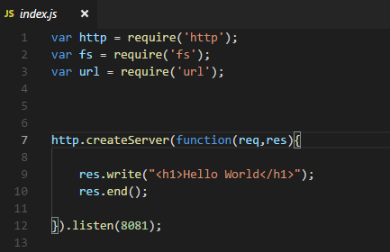
Create Server (#c6)

Slide 12
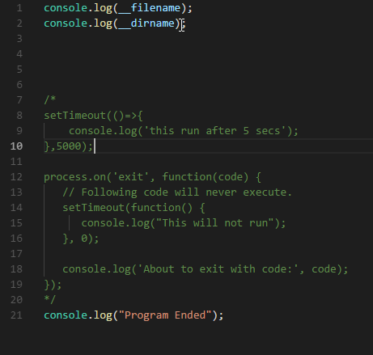
Global Object (#c7)
__dirname
__filename

Slide 13
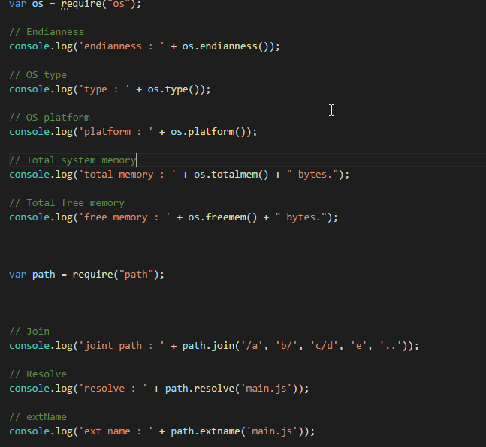
Utility Module (#c8)
- OS
- Path

Slide 14

Express Framework
Installation

Slide 15
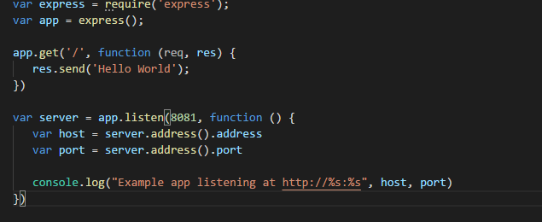
Express App (#c9)

Slide 16
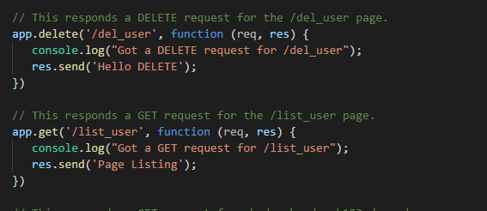
Routing (#c9 routing.js)

Slide 17
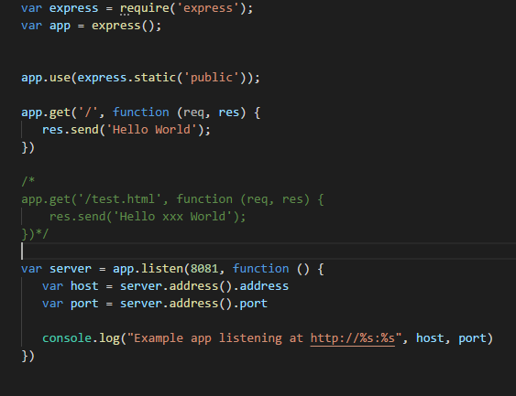
Serving Static File #c9 (static_file.js)

Slide 18
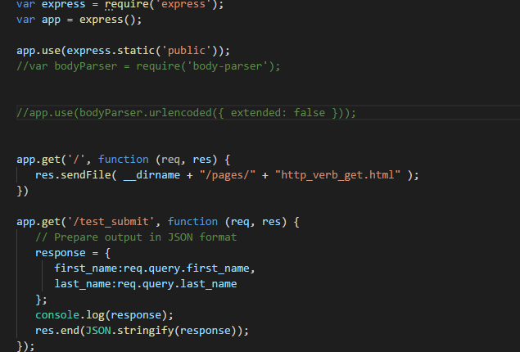
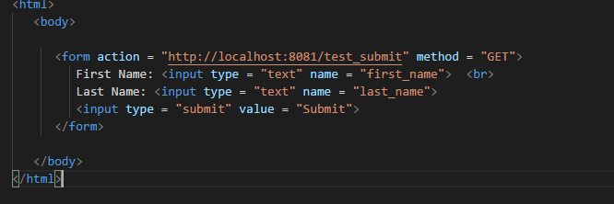
HTTP Verb #c9 (http_verb.js)

Slide 19
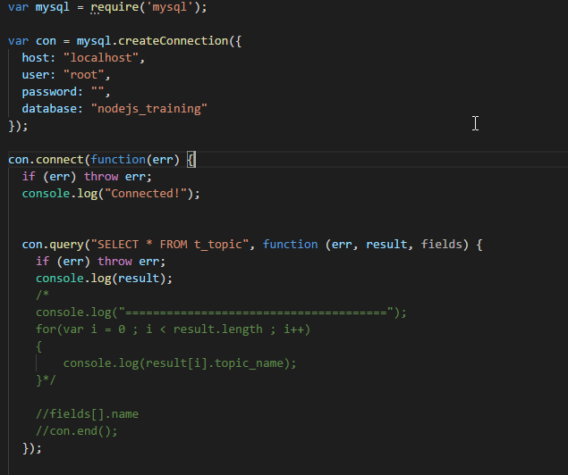
Database MySQL #c10 (mysql_test.js)
npm install mysql

Slide 20
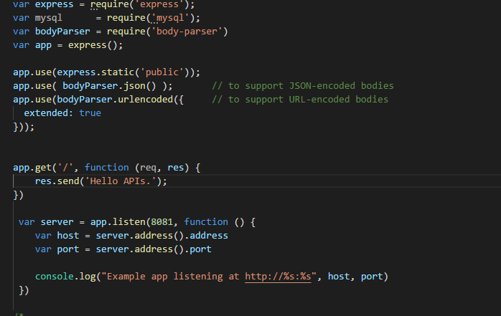
RestFul APIs. (c10)

Slide 21
Workshop
Create RestFul Service base on JSON

Slide 22
Thanks

