Slide 1
Coursera Capstone Project
Predicting Severe Accidents

Slide 2
Introduction
1.3 million people die in car accidents worldwide
Average of 3,287 deaths per day
50 million injuries globally each year
Increase in use of smart cars, and IoT
Systems that can predict accidents and warn drivers

Slide 3
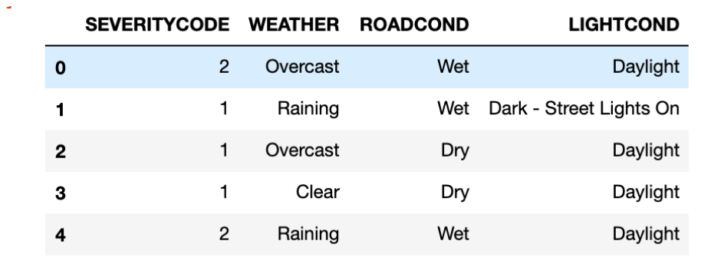
Dataset – Seattle City

Slide 4
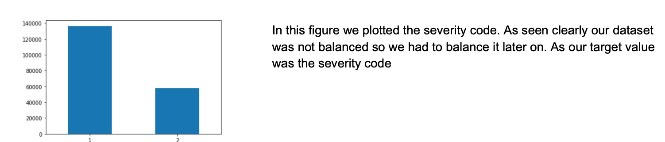
Visualizing our Data

Slide 5
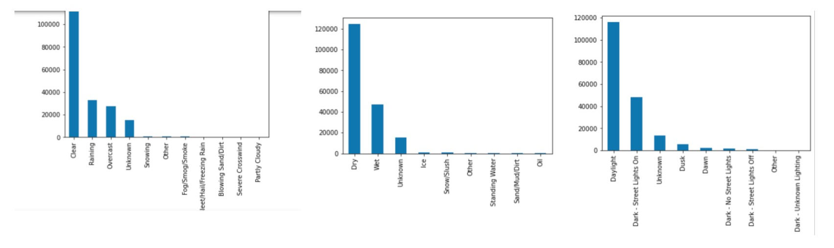
Visualization – Independent Variables
Most Accidents on Ideal Conditions

Slide 6
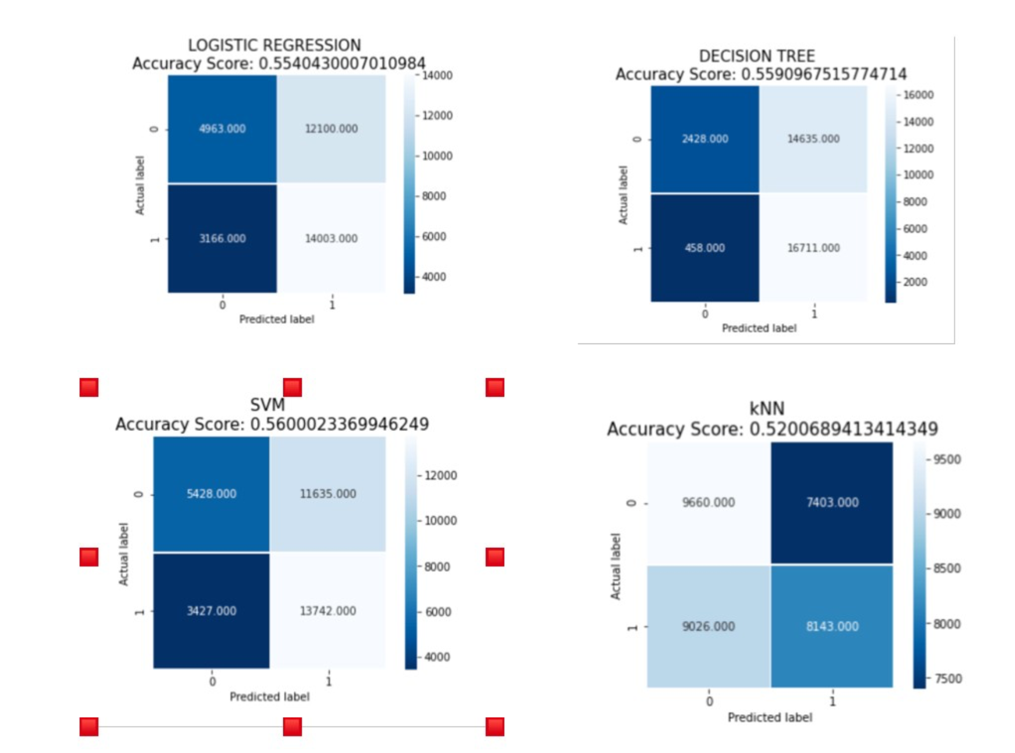
Models

Slide 7
Conclusion
Most accident happen on “ideal” conditions
Our models accuracies are not satisfying
Improvement has to be made.
Better data preprocessing and feature engineering has to be done

