Slide 1
WELLCOME to our presentation
Presenting by
HM Mahmudul Hasan - 011 152 041
Sukesh Nandan Saha - 011 152 149

Slide 2
PASSWORD PROTECTED DIARY
-features
-Header File
-Functions
-Conclusion

Slide 3
Features
-Add note[With Time & Date]
-View Note[With search by Date & Time]
-Edit Note[With search by Date & Time]
-Password[Changeable]
-Delete Records.

Slide 4
Header File
#include<stdio.h>
#include<stdlib.h>
#include<conio.h>
#include<string.h>

Slide 5
Functions
void addrecord();
void viewrecord();
void editrecord();
void editpassword();
void deleterecord();

Slide 6
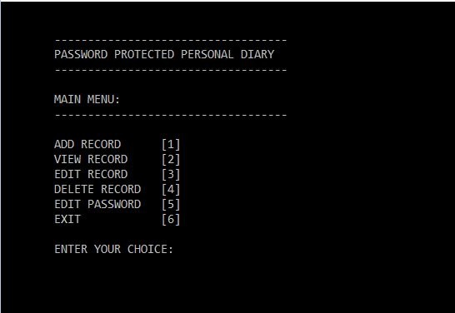
Screenshot

Slide 7
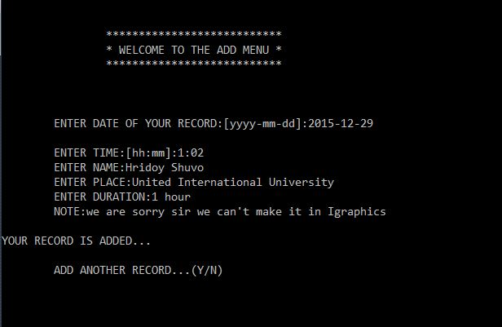
Screenshot

Slide 8
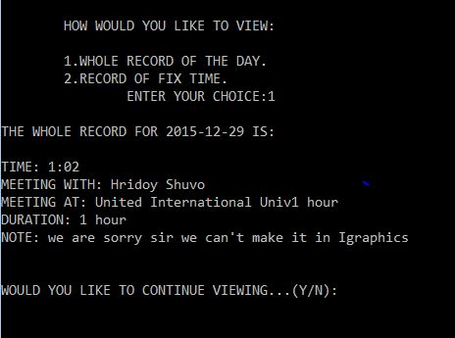
Screenshot

Slide 9
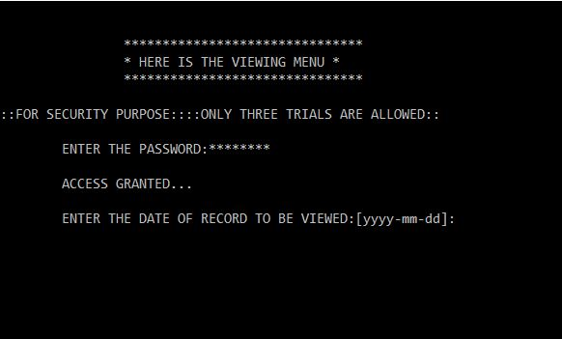
Screenshot

Slide 10
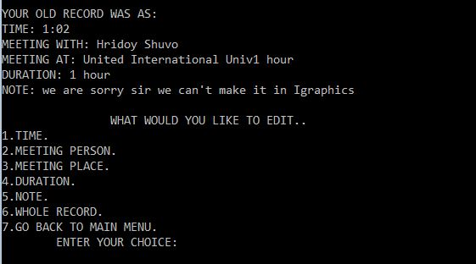
Screenshot

Slide 11
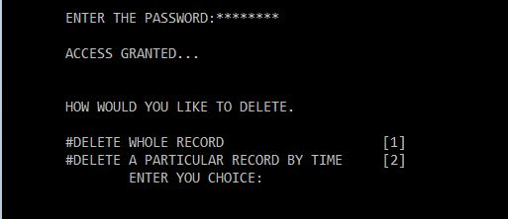
Screenshot

Slide 12
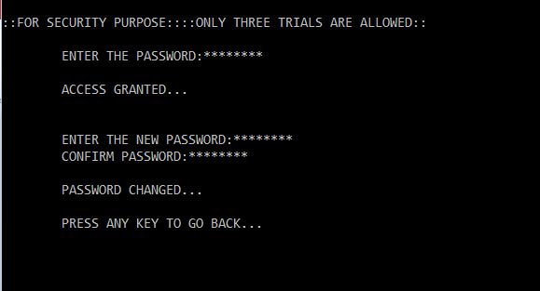
Screenshot

Slide 13
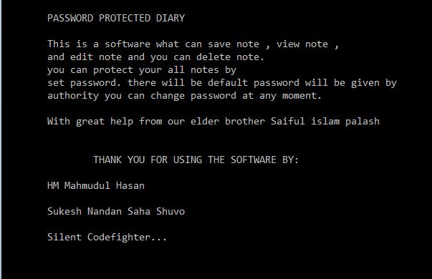
Screenshot

Slide 14
THANK YOU ☺
We will try our best to make this concept and software as full and complete software

