Slide 1
liteBark
A deep look into the performance of the Raspberry Pi for parallel processing of speech recognition and object detection
Derin Ozturk | Victor Barr

Slide 2
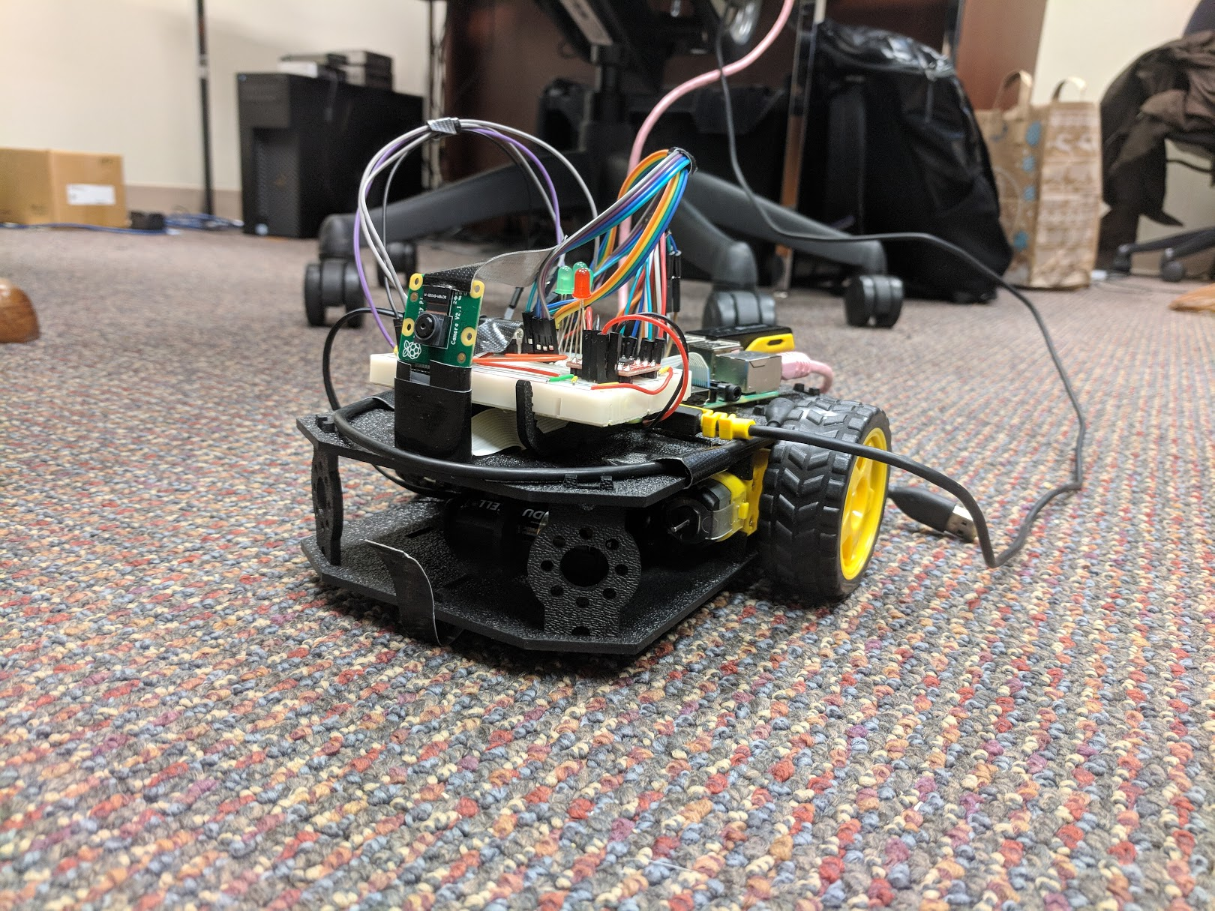
Background
Main goals:
Human Tracking – Detect the location of humans and follow/turn towards them
Speech Enabled – Voice enabled commands to turn, go forward, and stop
Light Tracking – Follow highest intensity of light
Purpose:
Understand the performance capabilities of the Raspberry Pi for machine learning applications
Can it train models? Build Tensorflow? Run multiple threads?
Power Consumption? Overheating?

Slide 3
Hierarchy of Design
Hardware
Software

Slide 4
Software Used and Parts List
Software Used
Tensorflow
60,000+ .wav file model
“Go”, “Stop”, “Left”, “Right”, “Yes”, “No”, “Up”, “Down”
OpenCV
Python-based Code
Hardware Used
Raspberry Pi 3b+
Pi Camera v2
Motor Bridge
Robot Frame

Slide 5
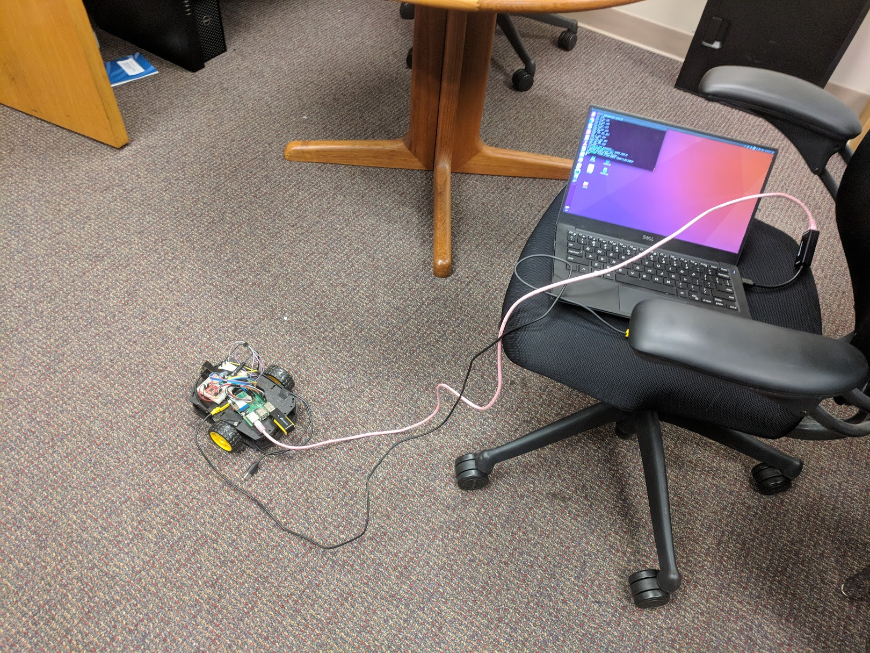
Results
Speech Recognition:
Detects speech of multiple keywords
Can rotate, and actuate motors based on these keywords
Object Detection
Can detect intensities of light from camera
Detect human objects and actuate motors for robot to follow human object
Problems
Power surge problems with current output of battery
Multithread to combine speech recognition and object detection is too performance heavy

Slide 6
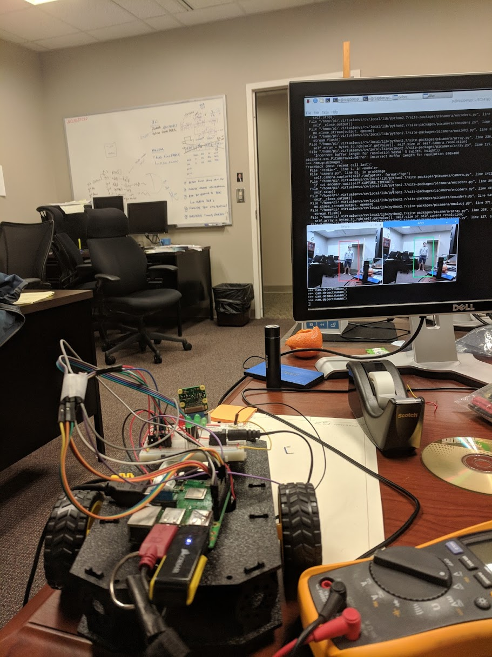
Future Work
Improvements
Manipulate threads to improve voice recognition and object detection in combined interface
Look into better power options for the Raspberry Pi
Add additional wheel to front of the robot
3D print pi mount, more solid wires
No Ethernet Cable (fully headset)

